Slide 1
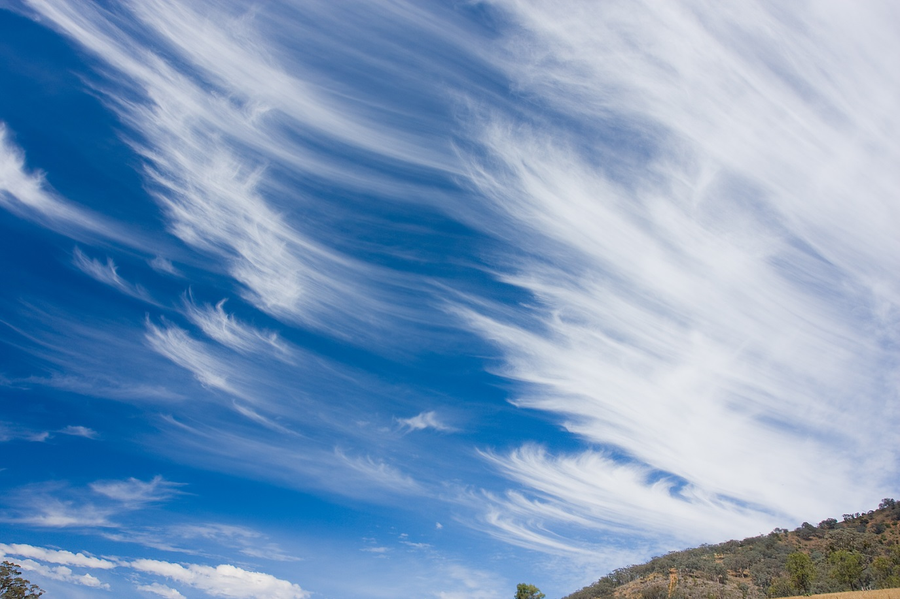
Cloud-Scale Information Retrieval
Ken Birman, CS5412 Cloud Computing

Slide 2
Styles of cloud computing
Think about Facebook…
  We normally see it in terms of pages that are image-heavy
  But the tags and comments and likes create “relationships” between objects within the system
  And FB itself tries to be very smart about what it shows you in terms of notifications, stuff on your wall, timeline, etc…
How do they actually get data to users with such impressive real-time properties? (often << 100ms!)

Slide 3
Facebook image “stack”
Role is to serve images (photos, videos) for FB’s hundreds of millions of active users
  About 80B large binary objects (“blob”) / day
  FB has a huge number of big and small data centers
    “Point of presense” or PoP: some FB owned equipment normally near the user
    Akamai: A company FB contracts with that caches images
    FB resizer service: caches but also resizes images
    Haystack: inside data centers, has the actual pictures (a massive file system)

Slide 4
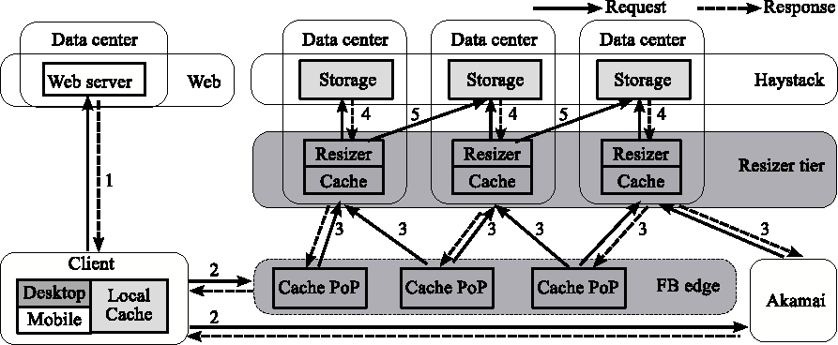
Facebook “architecture”
Think of Facebook as a giant distributed HashMap
  Key: photo URL (id, size, hints about where to find it...)
  Value: the blob itself

Slide 5
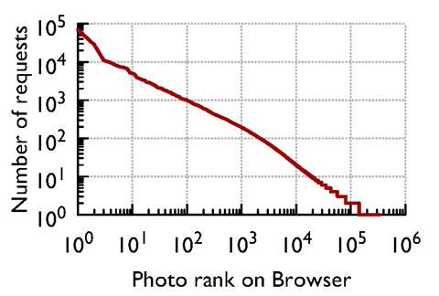
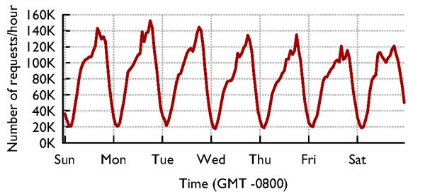
Facebook traffic for a week
Client activity varies daily....
... and different photos have very different popularity statistics

Slide 6
Observations
There are huge daily, weekly, seasonal and regional variations in load, but on the other hand the peak loads turn out to be “similar” over reasonably long periods like a year or two
  Whew! FB only needs to reinvent itself every few years
  Can plan for the worst-case peak loads…
And during any short period, some images are way more popular than others: Caching should help

Slide 7
Facebook’s goals?
Get those photos to you rapidly
Do it cheaply
Build an easily scalable infrastructure
  With more users, just build more data centers
... they do this using ideas we’ve seen in cs5412!

Slide 8
Best ways to cache this data?
Core idea: Build a distributed photo cache (like a HashMap, indexed by photo URL)
Core issue: We could cache data at various places
  On the client computer itself, near the browser
  In the PoP
  In the Resizer layer
  In front of Haystack
Where’s the best place to cache images?
  Answer depends on image popularity...

Slide 9
Distributed Hash Tables
It is easy for a program on biscuit.cs.cornell.edu to send a message to a program on “jam.cs.cornell.edu”
  Each program sets up a “network socket
  Each machine has an IP address, you can look them up and programs can do that too via a simple Java utility
  Pick a “port number” (this part is a bit of a hack)
  Build the message (must be in binary format)
  Java utils has a request

Slide 10
Distributed Hash Tables
It is easy for a program on biscuit.cs.cornell.edu to send a message to a program on “jam.cs.cornell.edu”
... so, given a key and a value
  Hash the key
  Find the server that “owns” the hashed value
  Store the key,value pair in a “local” HashMap there
To get a value, ask the right server to look up key

Slide 11
Distributed Hash Tables
hashmap kept by 123.45.66.782
dht.Put(“ken”,2110)
(“ken”, 2110)
123.45.66.781 123.45.66.782 123.45.66.783 123.45.66.784
“ken”.hashcode()%N=77
IP.hashcode()%N=13
IP.hashcode()%N=77
IP.hashcode()%N=98
IP.hashcode()%N=175
dht.Get(“ken”)
“ken”.hashcode()%N=77

Slide 12
How should we build this DHT?
DHTs and related solutions seen so far in CS5412
  Chord, Pastry, CAN, Kelips
  MemCached, BitTorrent
They differ in terms of the underlying assumptions
  Can we safely assume we know which machines will run the DHT?
    For a P2P situation, applications come and go at will
    For FB, DHT would run “inside” FB owned data centers, so they can just keep a table listing the active machines…

Slide 13
FB DHT approach
DHT is actually split into many DHT subsystems
  Each subsystem lives in some FB data center, and there are plenty of those (think of perhaps 50 in the USA)
  In fact these are really side by side clusters: when FB builds a data center they usually have several nearby buildings each with a data center in it, combined into a kind of regional data center
  They do this to give “containment” (floods, fires) and also so that they can do service and upgrades without shutting things down (e.g. they shut down 1 of 5…)

Slide 14
Facebook “architecture”
Think of Facebook as a giant distributed HashMap
  Key: photo URL (id, size, hints about where to find it...)
  Value: the blob itself

Slide 15
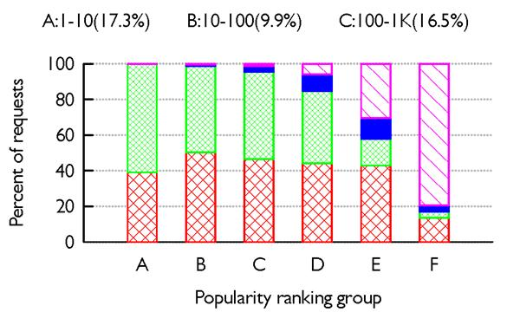
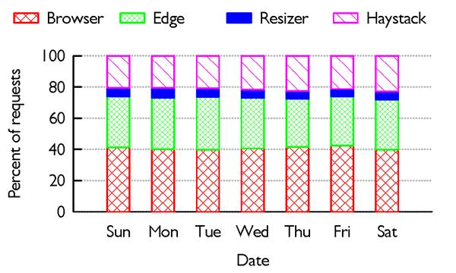
Facebook cache effectiveness
Existing caches are very effective...
... but different layers are more effective for images with different popularity ranks

Slide 16
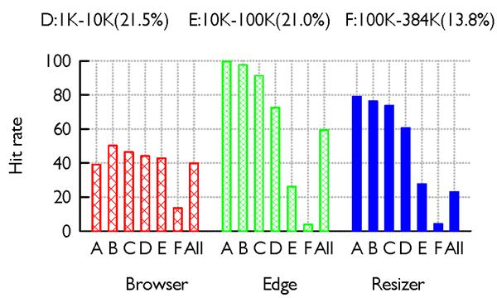
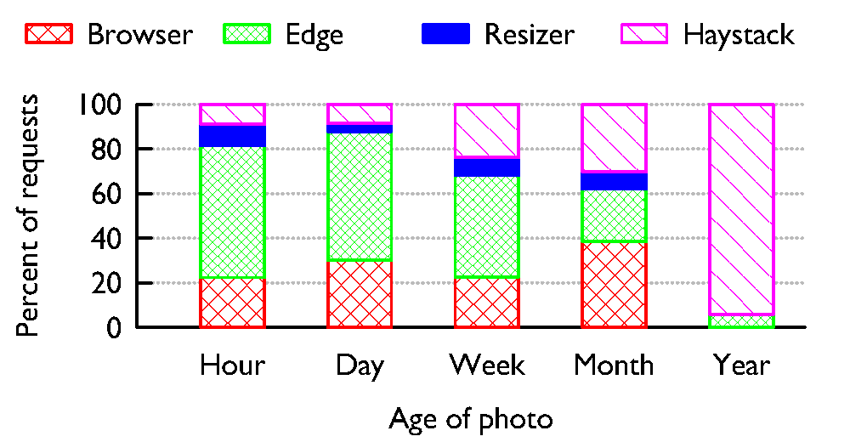
Facebook cache effectiveness
Each layer should “specialize” in different content.
Photo age strongly predicts effectiveness of caching

Slide 17
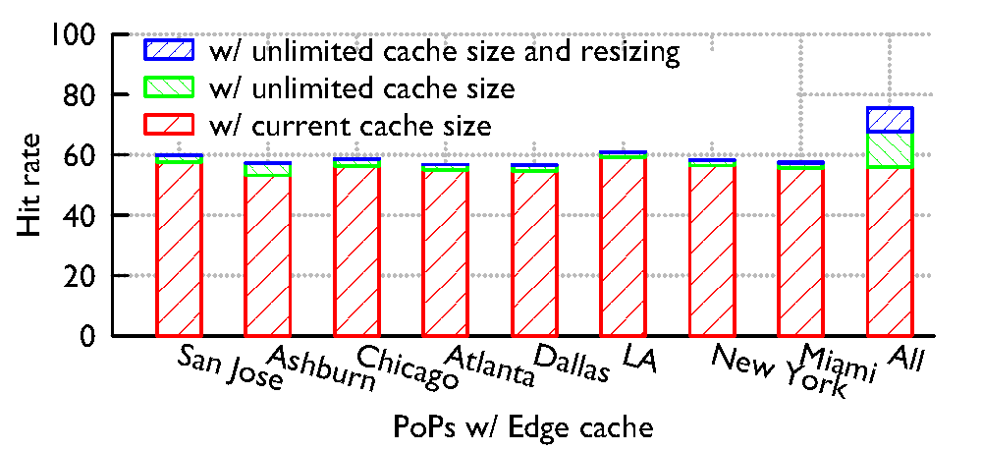
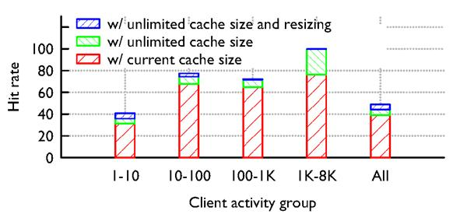
Hypothetical changes to caching?
We looked at the idea
of having Facebook
caches collaborate at national scale…
… and also at how to
vary caching based on the “busyness” of the client

Slide 18
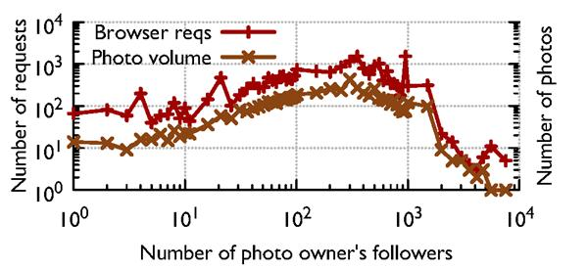
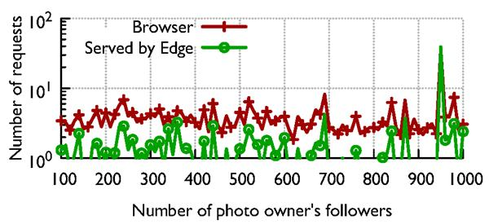
Social networking effect?
Hypothesis: caching will work best for photos posted by famous people with zillions of followers
Actual finding: not really

Slide 19
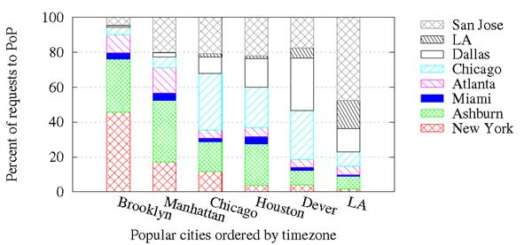
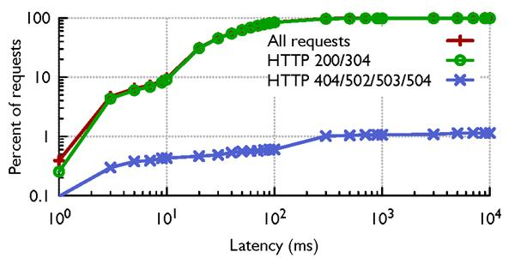
Locality?
Hypothesis: FB probably serves photos from close to where you are sitting
Finding: Not really...
… just the same, if
the photo exists, it
finds it quickly

Slide 20
Can one conclude anything?
Learning what patterns of access arise, and how effective it is to cache given kinds of data at various layers, we can customize cache strategies
Each layer can look at an image and ask “should I keep a cached copy of this, or not?”
Smart decisions ⇒ Facebook is more effective!

Slide 21
Strategy varies by layer
Browser should cache less popular content but not bother to cache the very popular stuff
Akamai/PoP layer should cache the most popular images, etc...
We also discovered that some layers should “cooperatively” cache even over huge distances
  Our study discovered that if this were done in the resizer layer, cache hit rates could rise 35%!

Slide 22
Overall picture in cloud computing
Facebook example illustrates a style of working
  Identify high-value problems that matter to the community because of the popularity of the service, the cost of operating it, the speed achieved, etc
  Ask how best to solve those problems, ideally using experiments to gain insight
  Then build better solutions
Let’s look at another example of this pattern

Slide 23



Caching for TAO
Facebook recently introduced a new kind of database that they use to track groups
  Your friends
  The photos in which a user is tagged
  People who like Sarah Palin
  People who like Selina Gomez
  People who like Justin Beiber
  People who think Selina and Justin were a great couple
  People who think Sarah Palin and Justin should be a couple

Slide 24
How is TAO used?
All sorts of FB operations require the system to
  Pull up some form of data
  Then search TAO for a group of things somehow related to that data
  Then pull up fingernails from that group of things, etc
So TAO works hard, and needs to deal with all sorts of heavy loads
  Can one cache TAO data? Actually an open question

Slide 25
How FB does it now
They create a bank of maybe 1000 TAO servers in each data center
Incoming queries always of the form “get group associated with this key”
They use consistent hashing to hash key to some server, and then the server looks it up and returns the data. For big groups they use indirection and return a pointer to the data plus a few items

Slide 26
Challenges
TAO has very high update rates
  Millions of events per second
  They use it internally too, to track items you looked at, that you clicked on, sequences of clicks, whether you returned to the prior page or continued deeper…
  So TAO sees updates at a rate even higher than the total click rate for all of FBs users (billions, but only hundreds of millions are online at a time, and only some of them do rapid clicks… and of course people playing games and so forth don’t get tracked this way)

Slide 27
Goals for TAO [Slides from a FB talk given at Upenn in 2012]
Provide a data store with a graph abstraction (vertexes and edges), not keys+values
Optimize heavily for reads
  More than 2 orders of magnitude more reads than writes!
Explicitly favor efficiency and availability over consistency
  Slightly stale data is often okay (for Facebook)
  Communication between data centers in different regions is expensive

Slide 28



Thinking about related objects
Images by Jojo Mendoza, Creative Commons licensed
Facebook
fan-of
fan-of
fan-of
Mikhail
fan-of
Magna Carta
friend-of
friend-of
fan-of
Alice
Sunita
Jose
We can represent related objects as a labeled, directed graph
Entities are typically represented as nodes; relationships are typically edges
  Nodes all have IDs, and possibly other properties
  Edges typically have values, possibly IDs and other properties

Slide 29
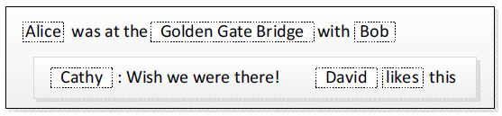
TAO's data model
Facebook's data model is exactly like that!
  Focuses on people, actions, and relationships
  These are represented as vertexes and edges in a graph
Example: Alice visits a landmark with Bob
  Alice 'checks in' with her mobile phone
  Alice 'tags' Bob to indicate that he is with her
  Cathy added a comment
  David 'liked' the comment
vertexes and
edges in the
graph

Slide 30
TAO's data model and API
TAO "objects" (vertexes)
  64-bit integer ID (id)
  Object type (otype)
  Data, in the form of key-value pairs
Object API: allocate, retrieve, update, delete
TAO "associations" (edges)
  Source object ID (id1)
  Association type (atype)
  Destination object ID (id2)
  32-bit timestamp
  Data, in the form of key-value pairs
Association API: add, delete, change type
Associations are unidirectional
  But edges often come in pairs (each edge type has an 'inverse type' for the reverse edge)

Slide 31
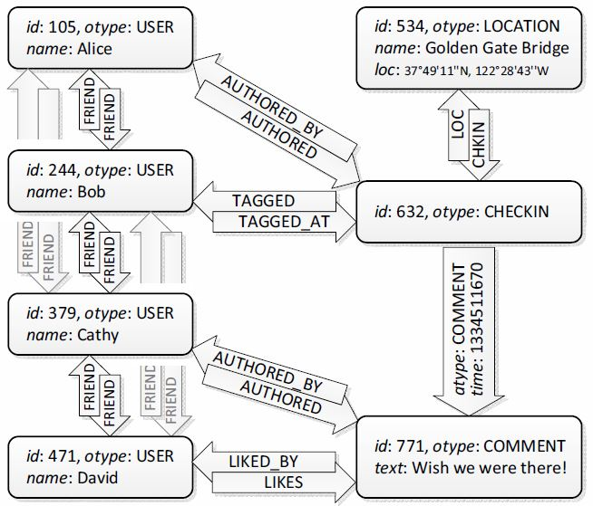
Example: Encoding in TAO
Data (KV pairs)
Inverse
edge types

Slide 32
Association queries in TAO
TAO is not a general graph database
  Has a few specific (Facebook-relevant) queries 'baked into it'
  Common query: Given object and association type, return an association list (all the outgoing edges of that type)
    Example: Find all the comments for a given checkin
  Optimized based on knowledge of Facebook's workload
    Example: Most queries focus on the newest items (posts, etc.)
    There is creation-time locality → can optimize for that!
Queries on association lists:
  assoc_get(id1, atype, id2set, t_low, t_high)
  assoc_count(id1, atype)
  assoc_range(id1, atype, pos, limit) ← "cursor"
  assoc_time_range(id1, atype, high, low, limit)

Slide 33
TAO's storage layer
Objects and associations are stored in mySQL
But what about scalability?
  Facebook's graph is far too large for any single mySQL DB!!
Solution: Data is divided into logical shards
  Each object ID contains a shard ID
  Associations are stored in the shard of their source object
  Shards are small enough to fit into a single mySQL instance!
  A common trick for achieving scalability
  What is the 'price to pay' for sharding?

Slide 34
Caching in TAO (1/2)
Problem: Hitting mySQL is very expensive
  But most of the requests are read requests anyway!
  Let's try to serve these from a cache
TAO's cache is organized into tiers
  A tier consists of multiple cache servers (number can vary)
  Sharding is used again here → each server in a tier is responsible for a certain subset of the objects+associations
  Together, the servers in a tier can serve any request!
  Clients directly talk to the appropriate cache server
    Avoids bottlenecks!
  In-memory cache for objects, associations, and association counts (!)

Slide 35
Caching in TAO (2/2)
How does the cache work?
  New entries filled on demand
  When cache is full, least recently used (LRU) object is evicted
  Cache is "smart": If it knows that an object had zero associ-ations of some type, it knows how to answer a range query
    Could this have been done in Memcached? If so, how? If not, why not?
What about write requests?
  Need to go to the database (write-through)
  But what if we're writing a bidirectonal edge?
    This may be stored in a different shard → need to contact that shard!
  What if a failure happens while we're writing such an edge?
    You might think that there are transactions and atomicity...
    ... but in fact, they simply leave the 'hanging edges' in place (why?)
    Asynchronous repair job takes care of them eventually

Slide 36
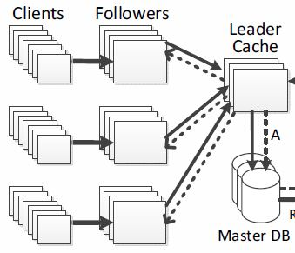
Leaders and followers
How many machines
should be in a tier?
  Too many is problematic:
  More prone to hot spots, etc.
Solution: Add another
level of hierarchy
  Each shard can have multiple
  cache tiers: one leader, and multiple followers
  The leader talks directly to the mySQL database
  Followers talk to the leader
  Clients can only interact with followers
  Leader can protect the database from 'thundering herds'

Slide 37
Leaders/followers and consistency
What happens now when a client writes?
  Follower sends write to the leader, who forwards to the DB
  Does this ensure consistency?
Need to tell the other followers about it!
  Write to an object → Leader tells followers to invalidate any cached copies they might have of that object
  Write to an association → Don't want to invalidate. Why?
    Followers might have to throw away long association lists!
  Solution: Leader sends a 'refill message' to followers
    If follower had cached that association, it asks the leader for an update
  What kind of consistency does this provide?
No!

Slide 38
Scaling geographically
Facebook is a global service. Does this work?
No - laws of physics are in the way!
  Long propagation delays, e.g., between Asia and U.S.
  What tricks do we know that could help with this?

Slide 39
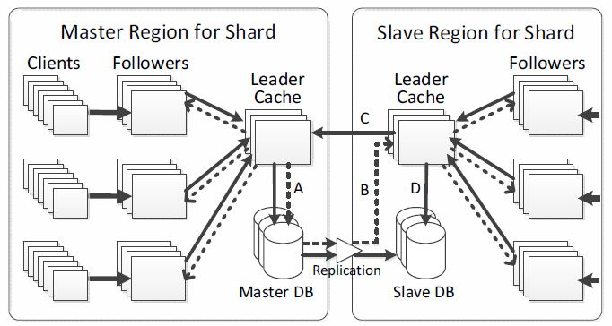
Scaling geographically
Idea: Divide data
centers into
regions; have one
full replica of the
data in each region
  What could be a problem with this approach?
  Again, consistency!
  Solution: One region has the 'master' database; other regions forward their writes to the master
  Database replication makes sure that the 'slave' databases eventually learn of all writes; plus invalidation messages, just like with the leaders and followers

Slide 40
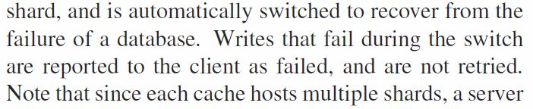
Handling failures
What if the master database fails?
  Can promote another region's database to be the master
  But what about writes that were in progress during switch?
  What would be the 'database answer' to this?
  TAO's approach:
  Why is (or isn't) this okay in general / for Facebook?

Slide 41
Consistency in more detail
What is the overall level of consistency?
  During normal operation: Eventual consistency (why?)
  Refills and invalidations are delivered 'eventually' (typical delay is less than one second)
  Within a tier: Read-after-write (why?)
When faults occur, consistency can degrade
  In some situations, clients can even observe values
  'go back in time'!
  How bad is this (for Facebook specifically / in general)?
Is eventual consistency always 'good enough'?
  No - there are a few operations on Facebook that need stronger consistency (which ones?)
  TAO reads can be marked 'critical' ; such reads are handled directly by the master.

Slide 42
Fault handling in more detail
General principle: Best-effort recovery
  Preserve availability and performance, not consistency!
Database failures: Choose a new master
  Might happen during maintenance, after crashes, repl. lag
Leader failures: Replacement leader
  Route around the faulty leader if possible (e.g., go to DB)
Refill/invalidation failures: Queue messages
  If leader fails permanently, need to invalidate cache for the entire shard
Follower failures: Failover to other followers
  The other followers jointly assume responsibility for handling the failed follower's requests

Slide 43
Production deployment at Facebook
Impressive performance
  Handles 1 billion reads/sec and 1 million writes/sec!
Reads dominate massively
  Only 0.2% of requests involve a write
Most edge queries have zero results
  45% of assoc_count calls return 0...
  but there is a heavy tail: 1% return >500,000! (why?)
Cache hit rate is very high
  Overall, 96.4%!

Slide 44
TAO Summary
The data model really does matter!
  KV pairs are nice and generic, but you sometimes can get better performance by telling the storage system more about the kind of data you are storing in it (→ optimizations!)
Several useful scaling techniques
  "Sharding" of databases and cache tiers (not invented at Facebook, but put to great use)
  Primary-backup replication to scale geographically
Interesting perspective on consistency
  On the one hand, quite a bit of complexity & hard work to do well in the common case (truly "best effort")
  But also, a willingness to accept eventual consistency
  (or worse!) during failures, or when the cost would be high

Slide 45
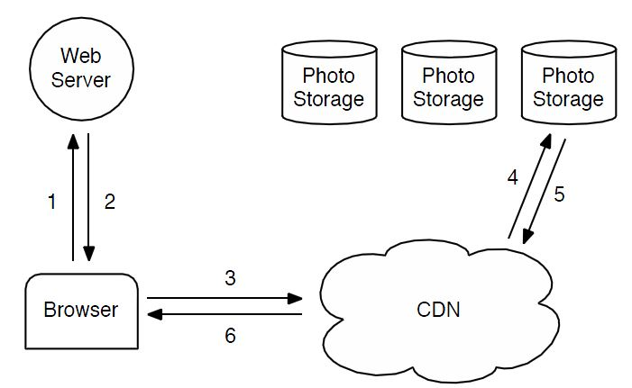
HayStack Storage Layer
Facebook stores a huge number of images
  In 2010, over 260 billion (~20PB of data)
  One billion (~60TB) new uploads each week
How to serve requests for these images?
  Typical approach: Use a CDN (and Facebook does do that)

Slide 46
Haystack challenges
Very long tail: People often click around and access very rarely seen photos
Disk I/O is costly
  Haystack goal: one seek and one read per photo
Standard file systems are way too costly and inefficient
  Haystack response: Store images and data in long “strips” (actually called “volumes”)
  Photo isn’t a file; it is in a strip at off=xxxx len=yyyy

Slide 47
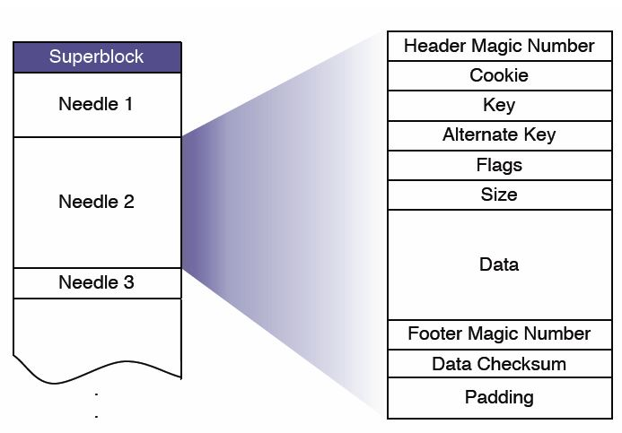
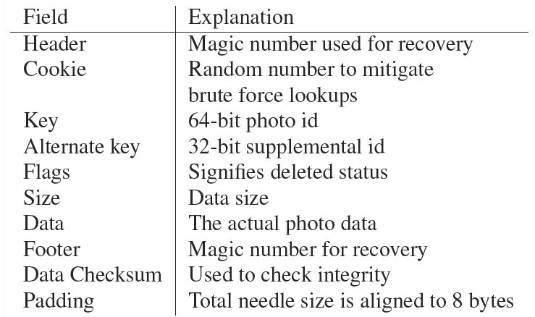
Haystack: The Store (1/2)
Volumes are simply very large files (~100GB)
  Few of them needed → In-memory data structures small
Structure of each file:
  A header, followed by a number of 'needles' (images)
  Cookies included to prevent guessing attacks
  Writes simply append to the file; deletes simply set a flag

Slide 48
Haystack: The Store (2/2)
Store machines have an in-memory index
  Maps photo IDs to offsets in the large files
What to do when the machine is rebooted?
  Option #1: Rebuild from reading the files front-to-back
    Is this a good idea?
  Option #2: Periodically write the index to disk
What if the index on disk is stale?
  File remembers where the last needle was appended
  Server can start reading from there
  Might still have missed some deletions - but the server can 'lazily' update that when someone requests the deleted img

Slide 49
Recovery from failures
Lots of failures to worry about
  Faulty hard disks, defective controllers, bad motherboards...
Pitchfork service scans for faulty machines
  Periodically tests connection to each machine
  Tries to read some data, etc.
  If any of this fails, logical (!) volumes are marked read-only
    Admins need to look into, and fix, the underlying cause
Bulk sync service can restore the full state
  ... by copying it from another replica
  Rarely needed

Slide 50
How well does it work?
How much metadata does it use?
  Only about 12 bytes per image (in memory)
  Comparison: XFS inode alone is 536 bytes!
  More performance data in the paper
Cache hit rates: Approx. 80%

Slide 51
Summary
Different perspective from TAO's
  Presence of "long tail" → caching won't help as much
Interesting (and unexpected) bottleneck
  To get really good scalability, you need to understand your system at all levels!
In theory, constants don't matter - but in practice, they do!
  Shrinking the metadata made a big difference to them,
  even though it is 'just' a 'constant factor'
  Don't (exclusively) think about systems in terms of big-O notations!

