Slide 1

Unshackle the Cloud: Commoditization of the Cloud
Hakim Weatherspoon
Assistant Professor, Dept of Computer Science
CS 5412, Guest Lecture, Cornell University
January 24, 2012
Notes:
s

Slide 2





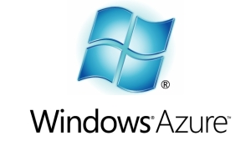



Context
The promise of the Cloud
  A computer utility; a commodity
  Catalyst for technology economy
  Revolutionizing for health care, financial systems,
  scientific research, and society
Notes:
The cloud completes the commoditization process and makes storage and computation a commodity.

Slide 3
Context
The promise of the Cloud
  ubiquitous, convenient, on-demand network access to a shared pool of configurable computing resources (e.g., networks, servers, storage, applications, and services) that can be rapidly provisioned and released with minimal management effort or service provider interaction.
NIST Cloud Definition
Notes:
The cloud completes the commoditization process and makes storage and computation a commodity.
Public vs private
IaaS, PaaS, SaaS
On demand (self service), network access, resource pooling, rapid elasticity, measured service

Slide 4
Context
The promise of the Cloud
  ubiquitous, convenient, on-demand network access to a shared pool of configurable computing resources (e.g., networks, servers, storage, applications, and services) that can be rapidly provisioned and released with minimal management effort or service provider interaction.
NIST Cloud Definition
Notes:
The cloud completes the commoditization process and makes storage and computation a commodity.
Public vs private
IaaS, PaaS, SaaS
On demand (self service), network access, resource pooling, rapid elasticity, measured service

Slide 5
Context
The promise of the Cloud
  ubiquitous, convenient, on-demand network access to a shared pool of configurable computing resources (e.g., networks, servers, storage, applications, and services) that can be rapidly provisioned and released with minimal management effort or service provider interaction.
However, cloud platforms entail significant risk
  Vendor Lock-in
  Storage Lock-in
  Computation Lock-in
Notes:
The cloud completes the commoditization process and makes storage and computation a commodity.
Public vs private
IaaS, PaaS, SaaS
On demand (self service), network access, resource pooling, rapid elasticity, measured service

Slide 6
Challenge
How to use the cloud?
  Storage
  Computation
  Network
Without being locked into a single cloud provider?

Slide 7
Outline
Breaking Cloud Storage Lock-in
Breaking Cloud Computation Lock-in
  (Nested) Virtualization

Slide 8
Vendor Lock-in: Cloud Storage
Large organizations considering using the cloud
  New York Times
  Netflix
  Nintendo
  Cornell
  Library of Congress
The more data you have, the harder it is to move
  Switching providers entails paying for bandwidth twice
  Inhibits opportunistic migration

Slide 9

Vendor Lock-in: Cloud Storage
How hard is it to move a PetaByte?
Titan tech boom, randy katz, 2008

Slide 10
Vendor Lock-in: Cloud Storage
All my valuable data/computation is in the cloud
Am I locked in to one provider forever?
  The more data you have, the harder it is to move
RACS: Redundant Array of Cloud Storage
  Collaboration with the Internet Archive and IBM
k=3
n=4
RACS(3,4)
Notes:
RACS: Redundant Array of Cloud Storage
Stripe data over n cloud storage repositories
Any k-subset contains a complete copy of data
Tolerate up to (n-k) failures
Written RACS(k,n)

Slide 11

Vendor Lock-in: Cloud Storage
All my valuable data/computation is in the cloud Am I locked in to one provider forever?
  The more data you have, the harder it is to move
RACS: Redundant Array of Cloud Storage
  Collaboration with the Internet Archive and IBM
RACS(3,4)
33KB
Object
100 KB
33KB
Object
100 KB
33KB
33KB
k=3
n=4
Relative Storage | n/k
Relative Upload Bandwidth | n/k
Relative Download Bandwidth | 1
RACS(3,4)
Notes:
RACS: Redundant Array of Cloud Storage
Stripe data over n cloud storage repositories
Any k-subset contains a complete copy of data
Tolerate up to (n-k) failures
Written RACS(k,n)

Slide 12
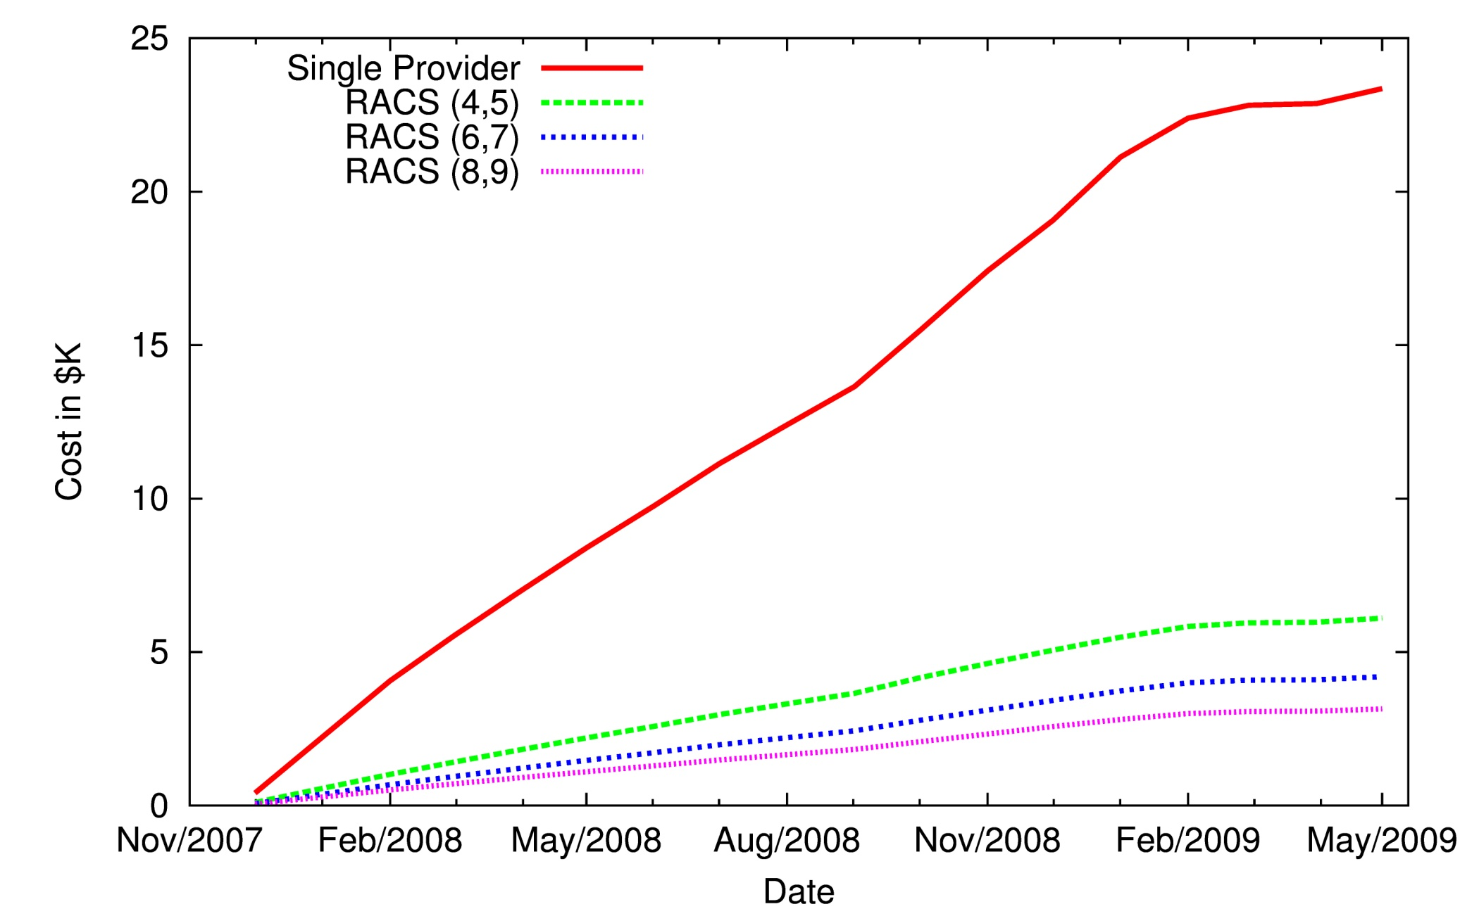
Vendor Lock-in: Cloud Storage
Estimated Cost of Switching Cloud Providers
33KB
RACS(3,4)
Object
100 KB
33KB
33KB
Relative Storage | n/k
Relative Upload Bandwidth | n/k
Relative Download Bandwidth | 1
33KB

Slide 13
Vendor Lock-in: Cloud Storage
Graduate Students
  Hussam Abu-Libdeh
  Lonnie Princehouse
  Ji Yong Shin
Collaborators
  Sandra Payette (Fedora Commons)
Website:
  http://racs.cs.cornell.edu

Slide 14
Vendor Lock-in: Cloud Computation
Cloud storage is only a half third of the story
  What about computation?
How can I move my computation between clouds?
Notes:
Networking is another third of the story
New York Times
Netflix
Nintendo
Cornell
Library of Congress

Slide 15
Vendor Lock-in: Cloud Computation
Move computation via Virtualization
  Virtualize processor Instruction Set Architecture
  Full Virtualization vs Paravirtualization (of hardware)
  VMWare vs (Original) Xen
Xen
  Separation of policy and mechanism
  DomU hosts guest operating system in virtual machine
  Dom0 manages devices and guests
  Control Transfer: Hypercalls and Events
  (like syscalls and device interrupts)
Notes:
Full Virtualization
Virtualizing the entire instruction set
Virtual hardware is functionally identical to underlying machine
Previously Problematic for certain privileged instructions
Problematic for certain privileged instructions
Failed silently rather than trapping
Shadow structures
Vmware traps every update page table event
No real time available
Paravirtalization
rtualization
Virtual hardware is similar, not identical to the underlying hardware
Partial view of the underlying hardware
No modification of applications
VMs handle paging
No shadow tables required
Real, virtual and clock time provided
Need modifications to the OS
porting to Xen for every version of every OS

Slide 16
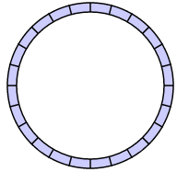
Vendor Lock-in: Cloud Computation
Linux Dom0
Linux DomU: VM
Shared Memory
Device: Ring
Backend
Frontend
PCI-Driver
Xen
Baremetal
Notes:
Original Management Layer
Xen is popular for this
One VMM for controlling VMs: Xen3.x
One Special VM(Dom0) for controlling devices: Linux2.6.18.x
Original Virtual Machine
On top of Xen
Under the assistance of hardware
No need to modify OS
Uses shared memory devices

Slide 17
Vendor Lock-in: Cloud Computation
Can I compute in the cloud if some of my data is in a vault at
home or on another provider
App
33KB
Guest OS
VMM
App
Object
100 KB
Guest OS
33KB
App
VMM
Guest OS
VMM
33KB
VMM
33KB
VMM

Slide 18
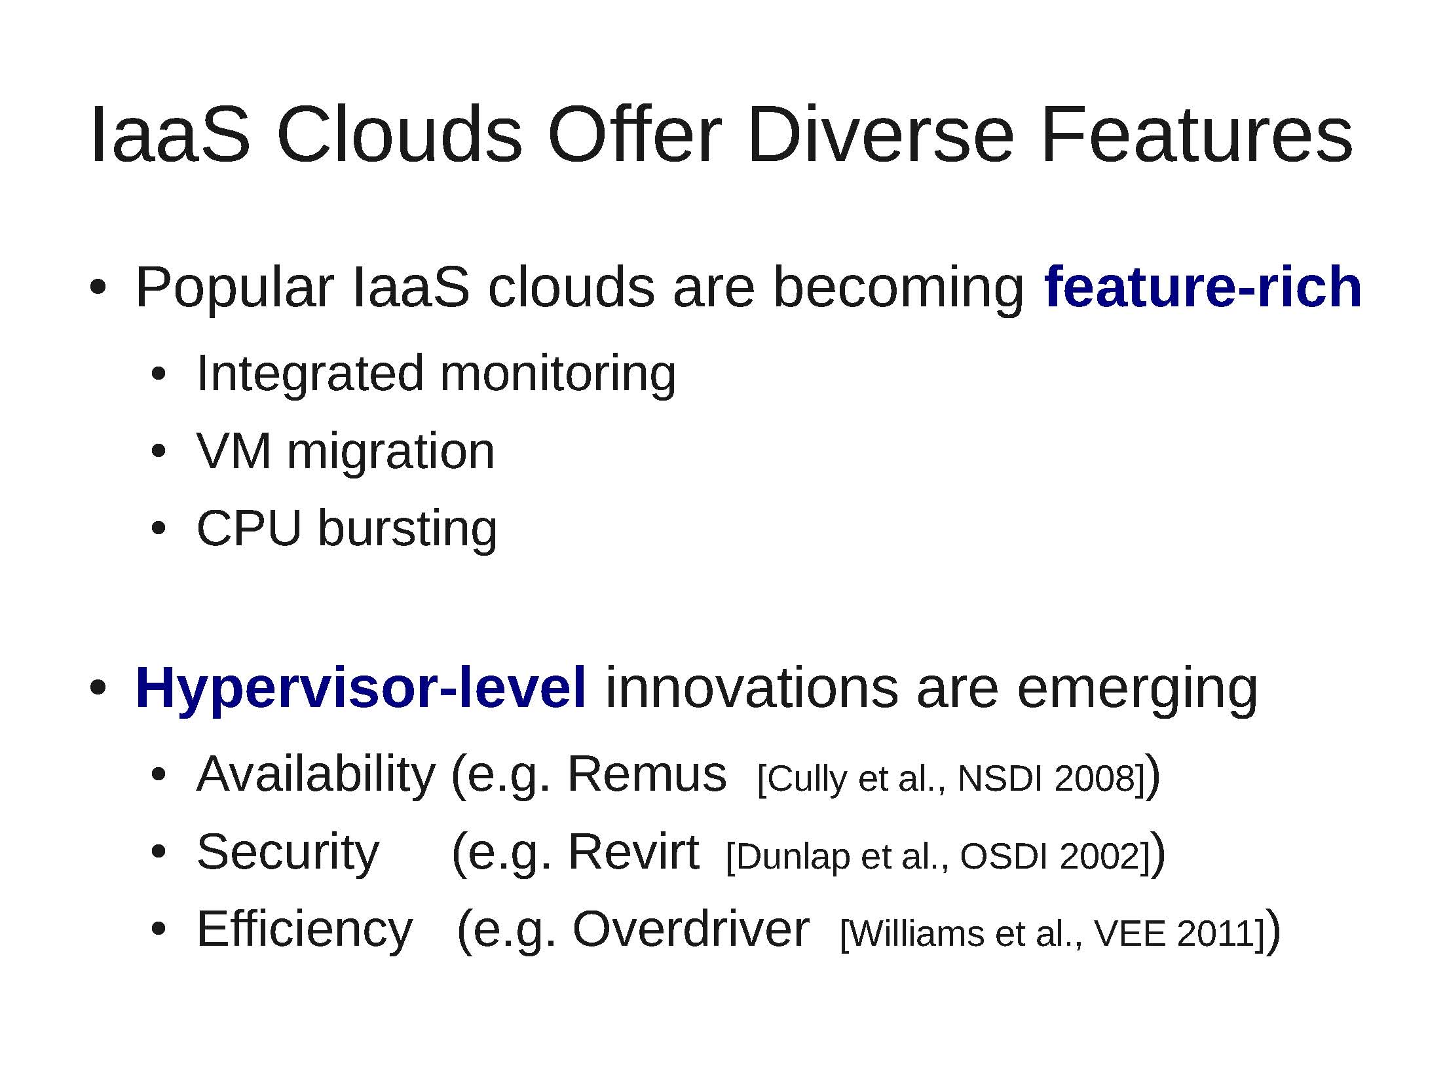
Vendor Lock-in: Cloud Computation
App
Guest OS
VMM
Notes:
Iaas Clouds Offer Diverse Features

Slide 19
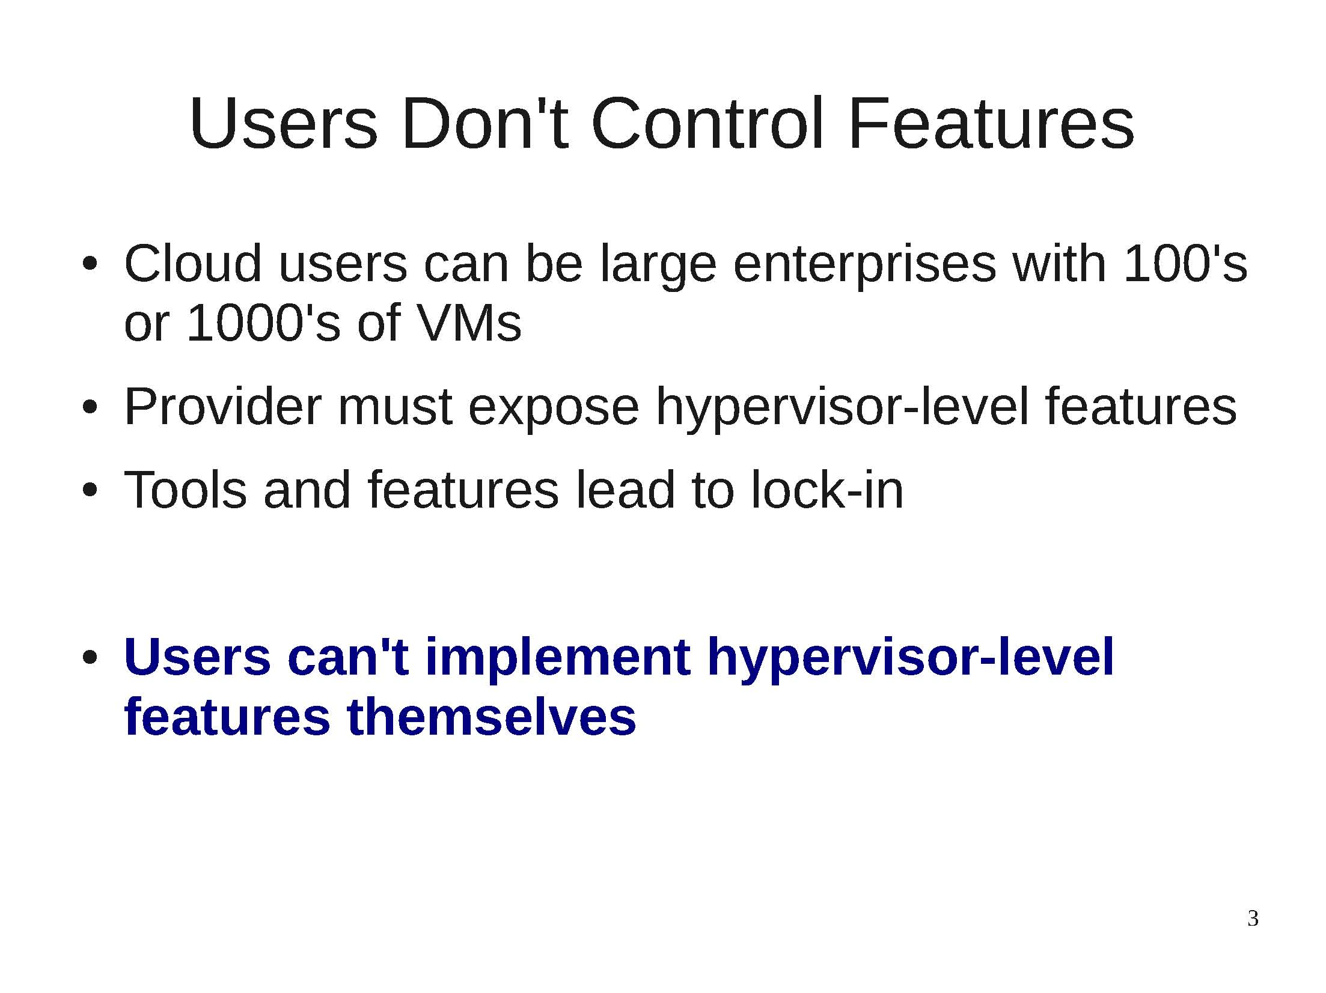
Vendor Lock-in: Cloud Computation
App
Guest OS
VMM
Notes:
User’s Don’t Control Features

Slide 20
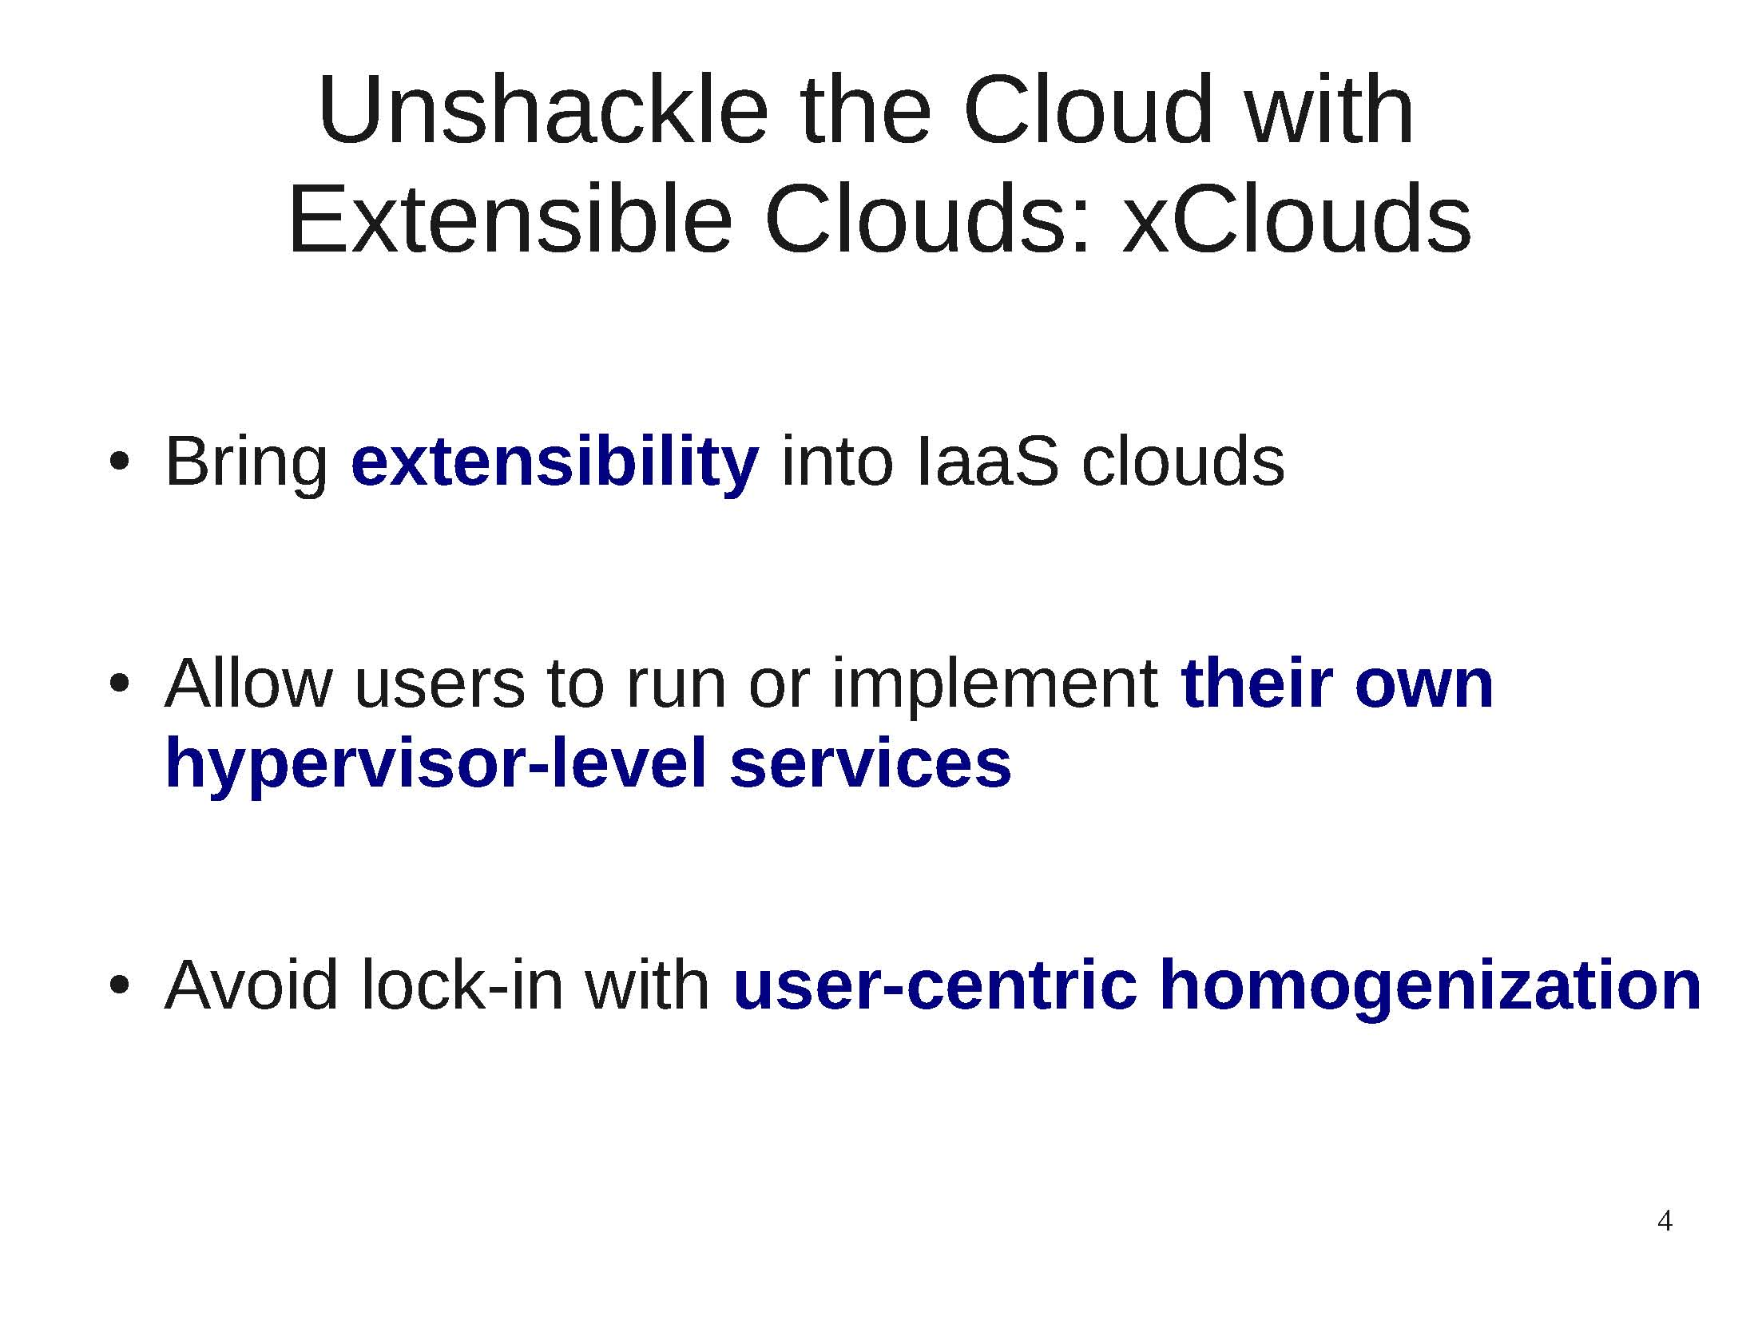
Unshackle the Cloud: xClouds

Slide 21
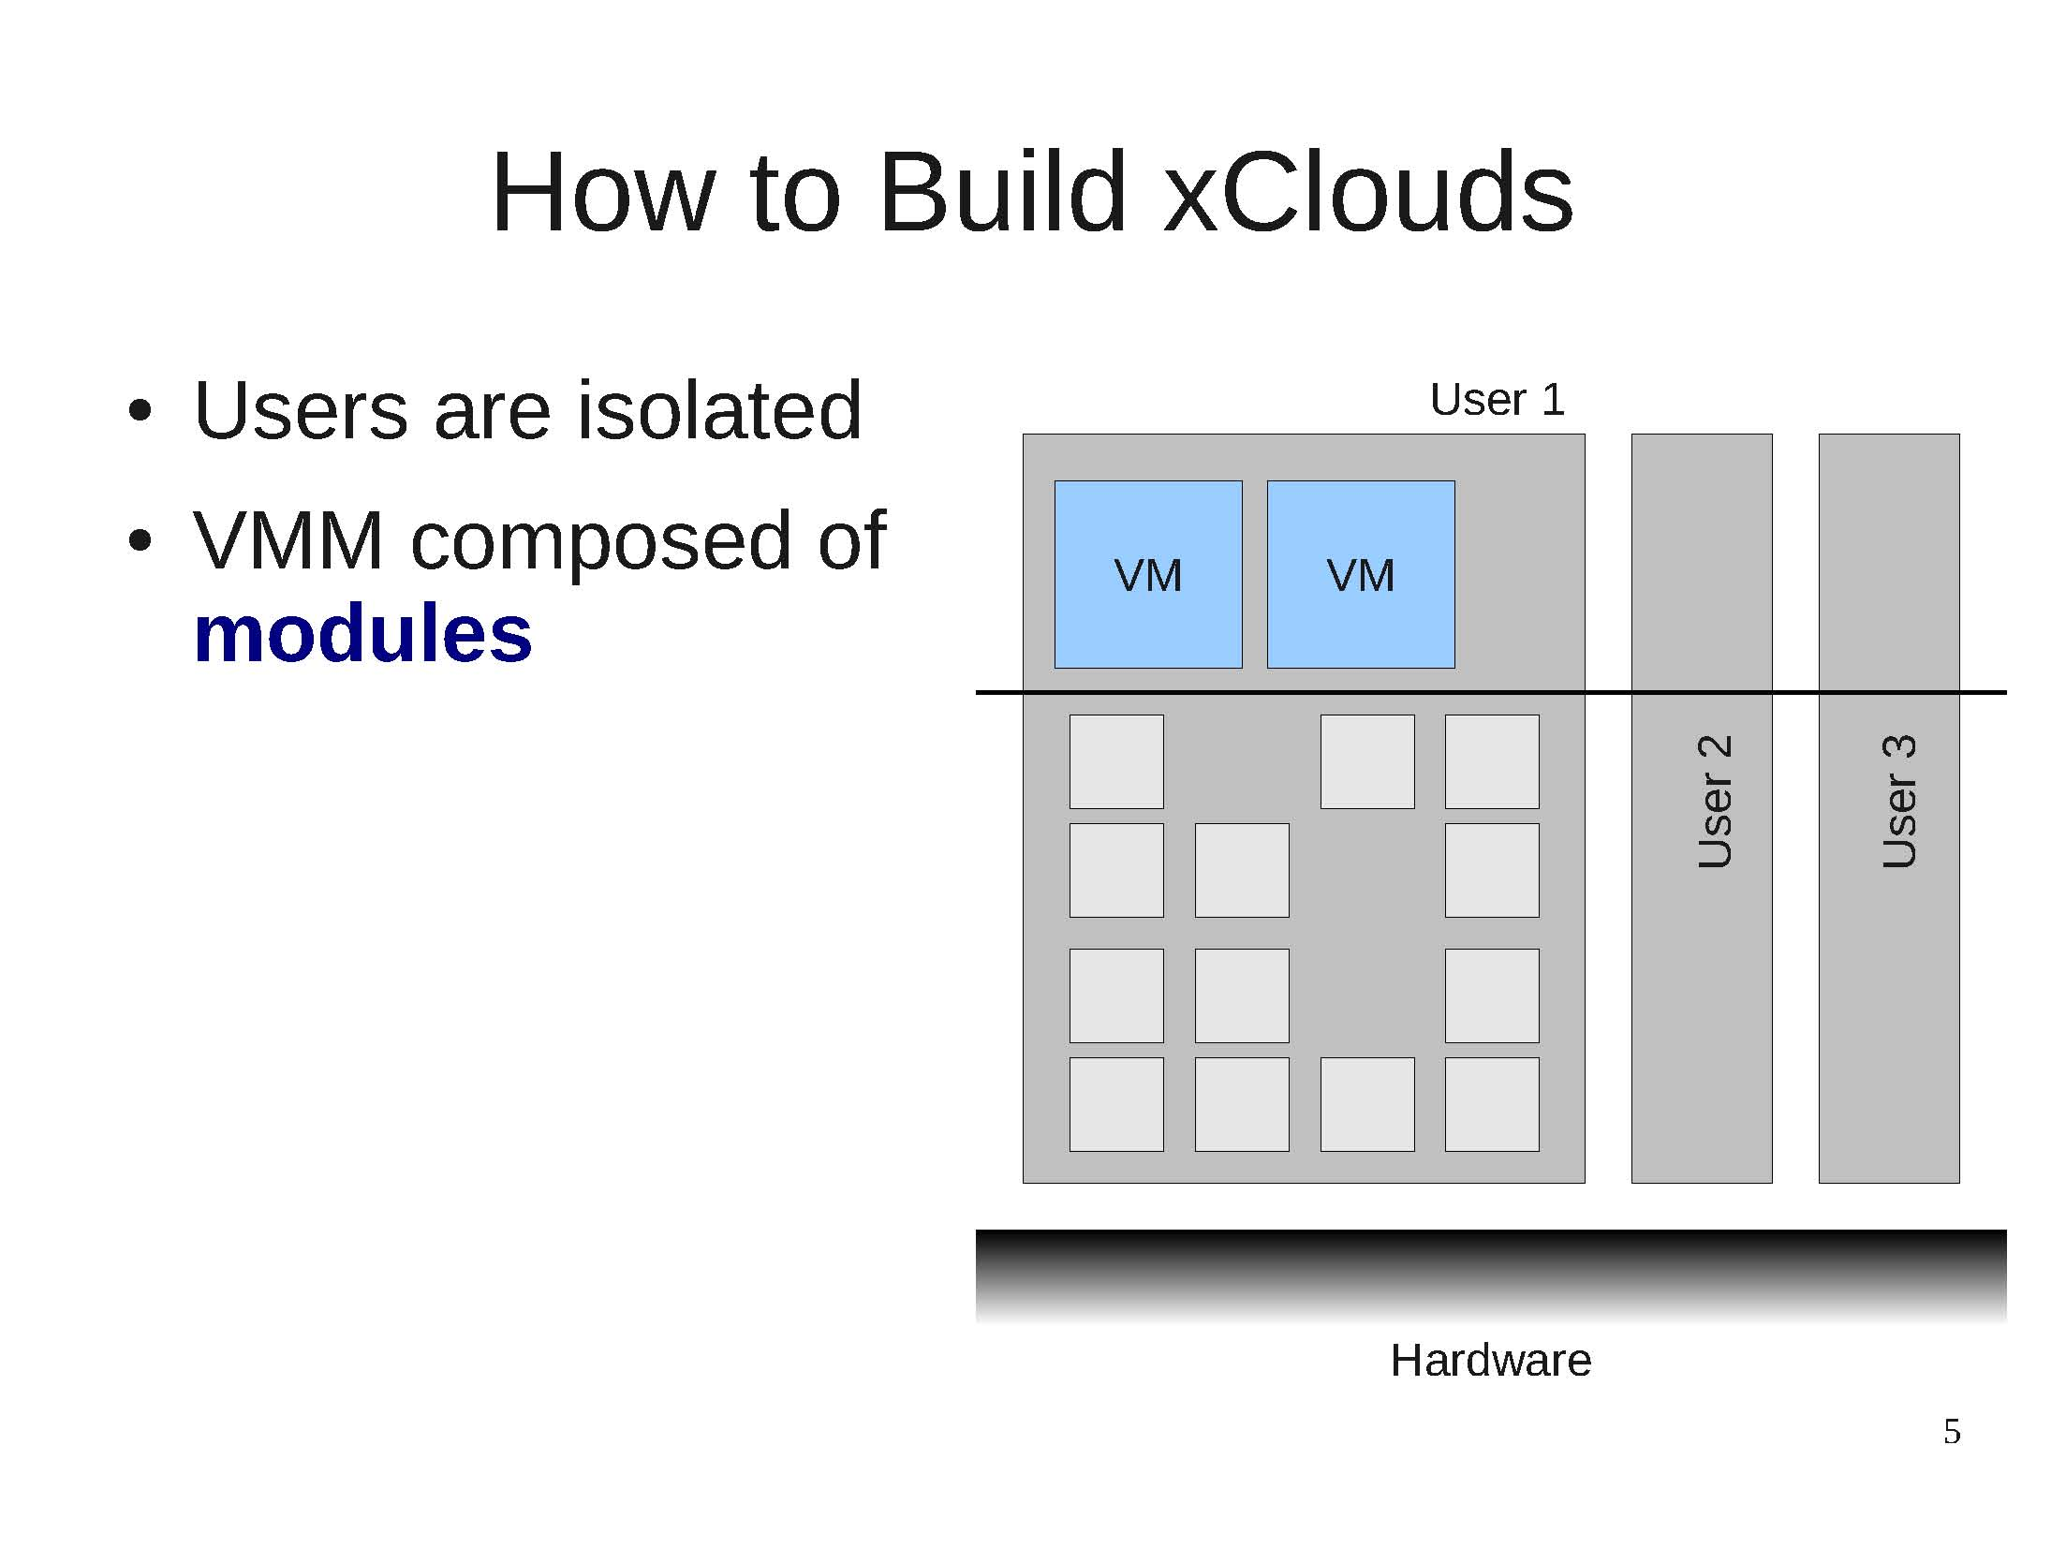
How to Build xClouds

Slide 22
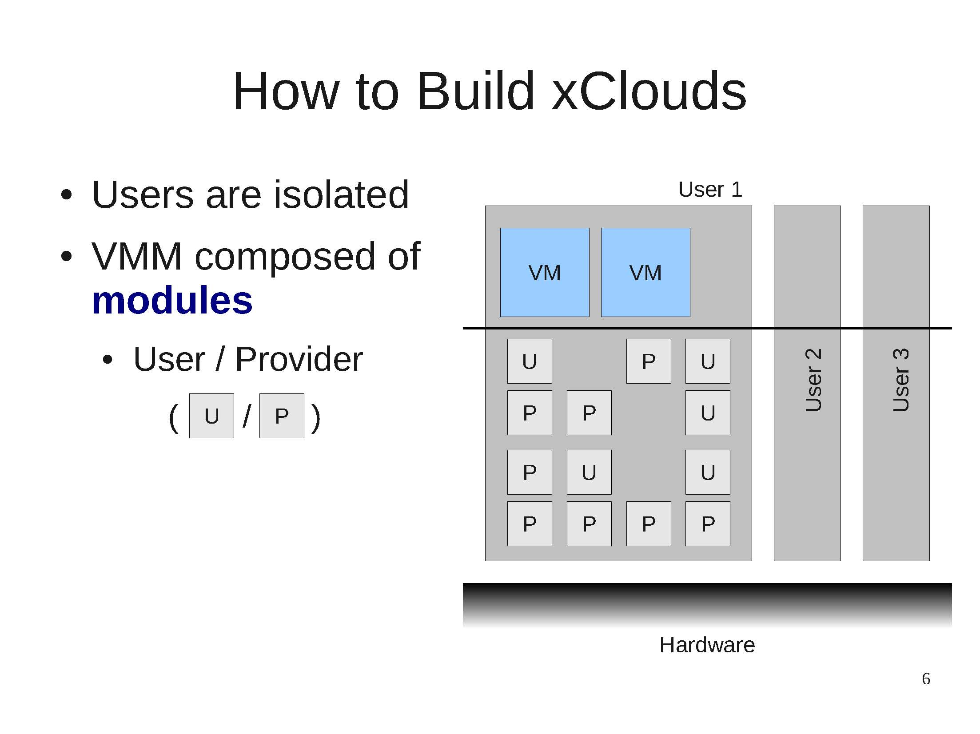
How to Build xClouds

Slide 23
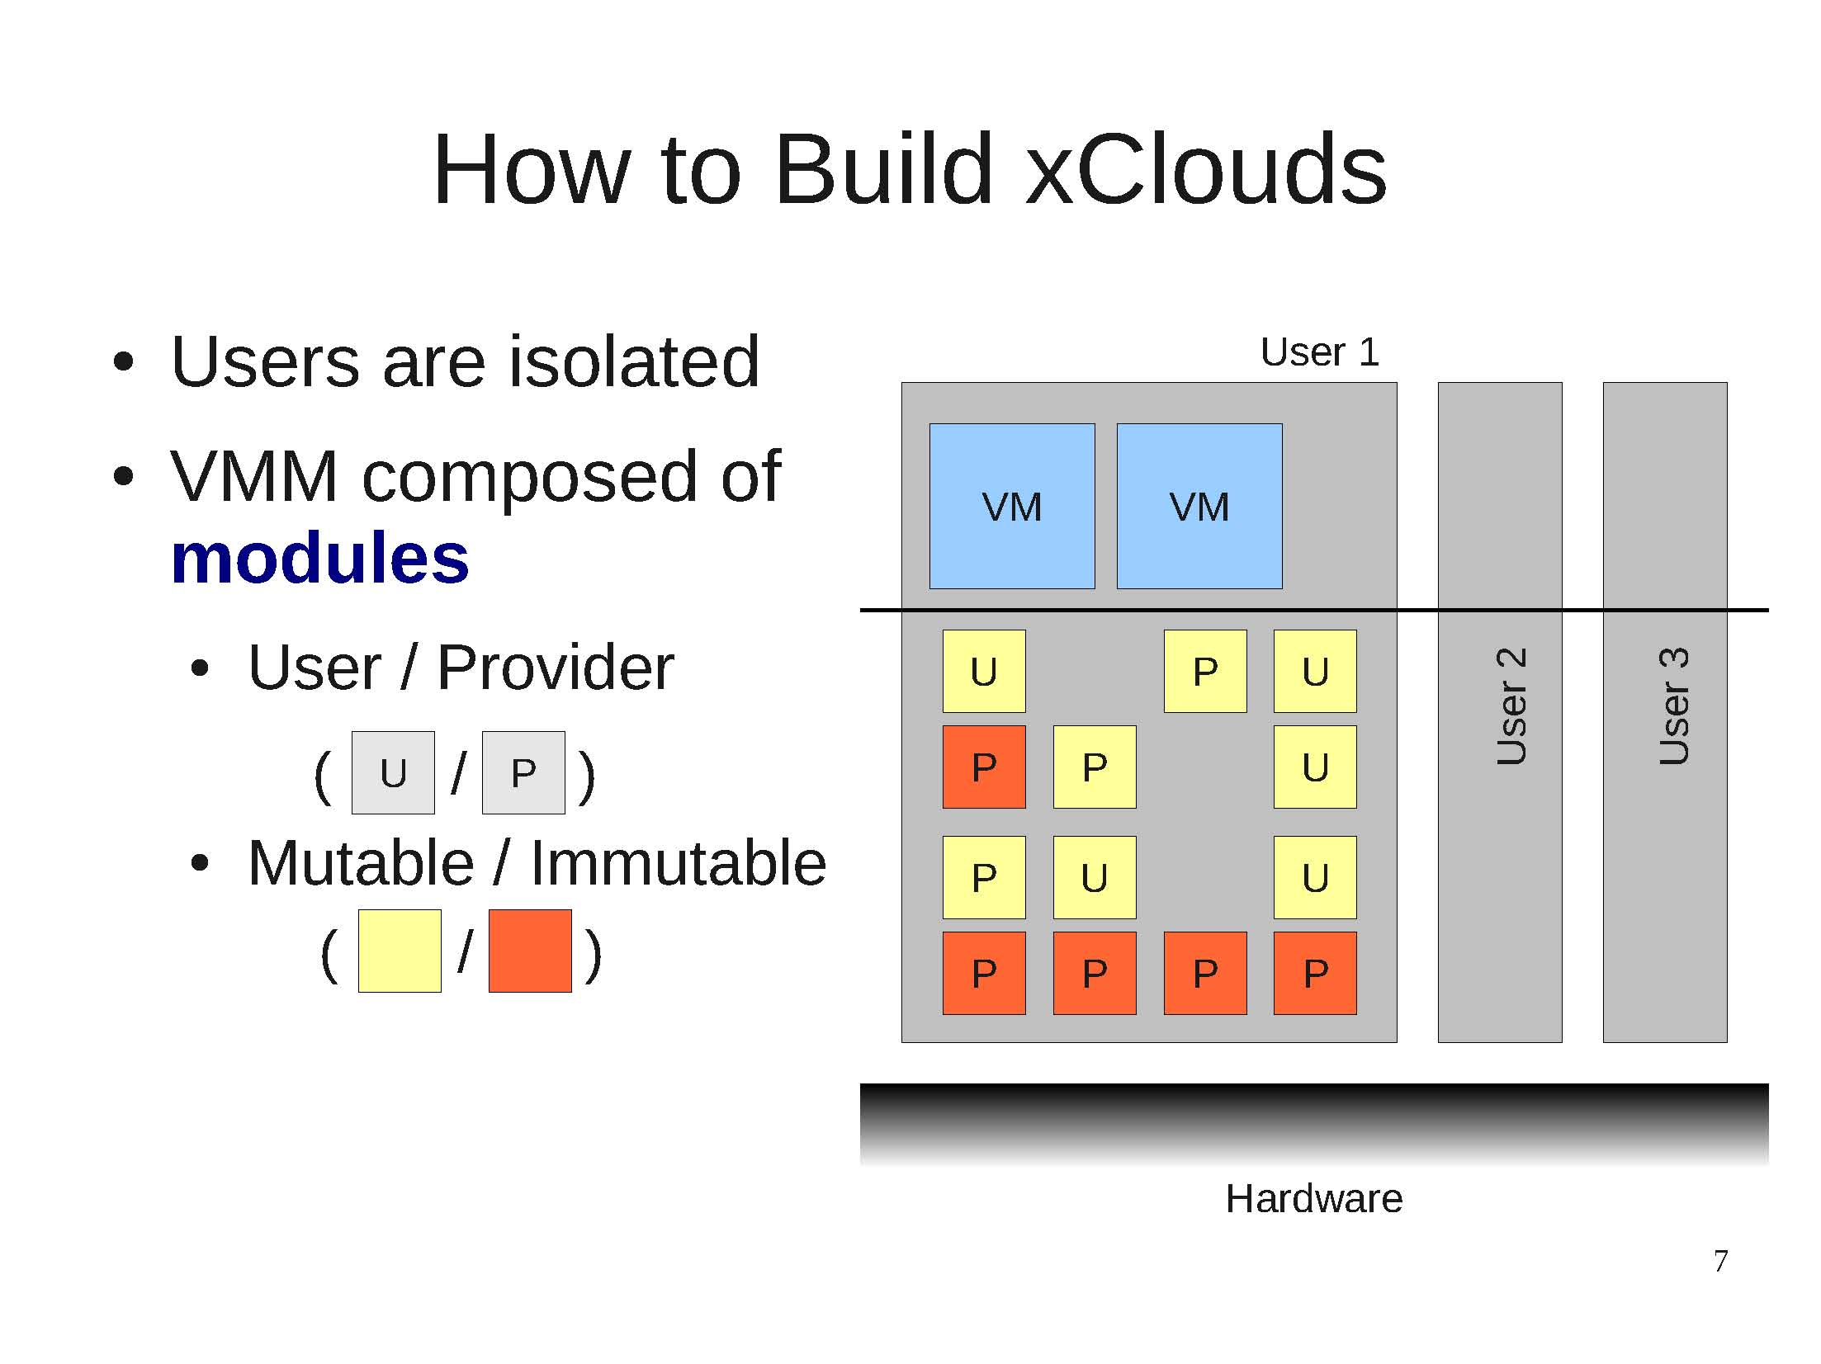
How to Build xClouds

Slide 24
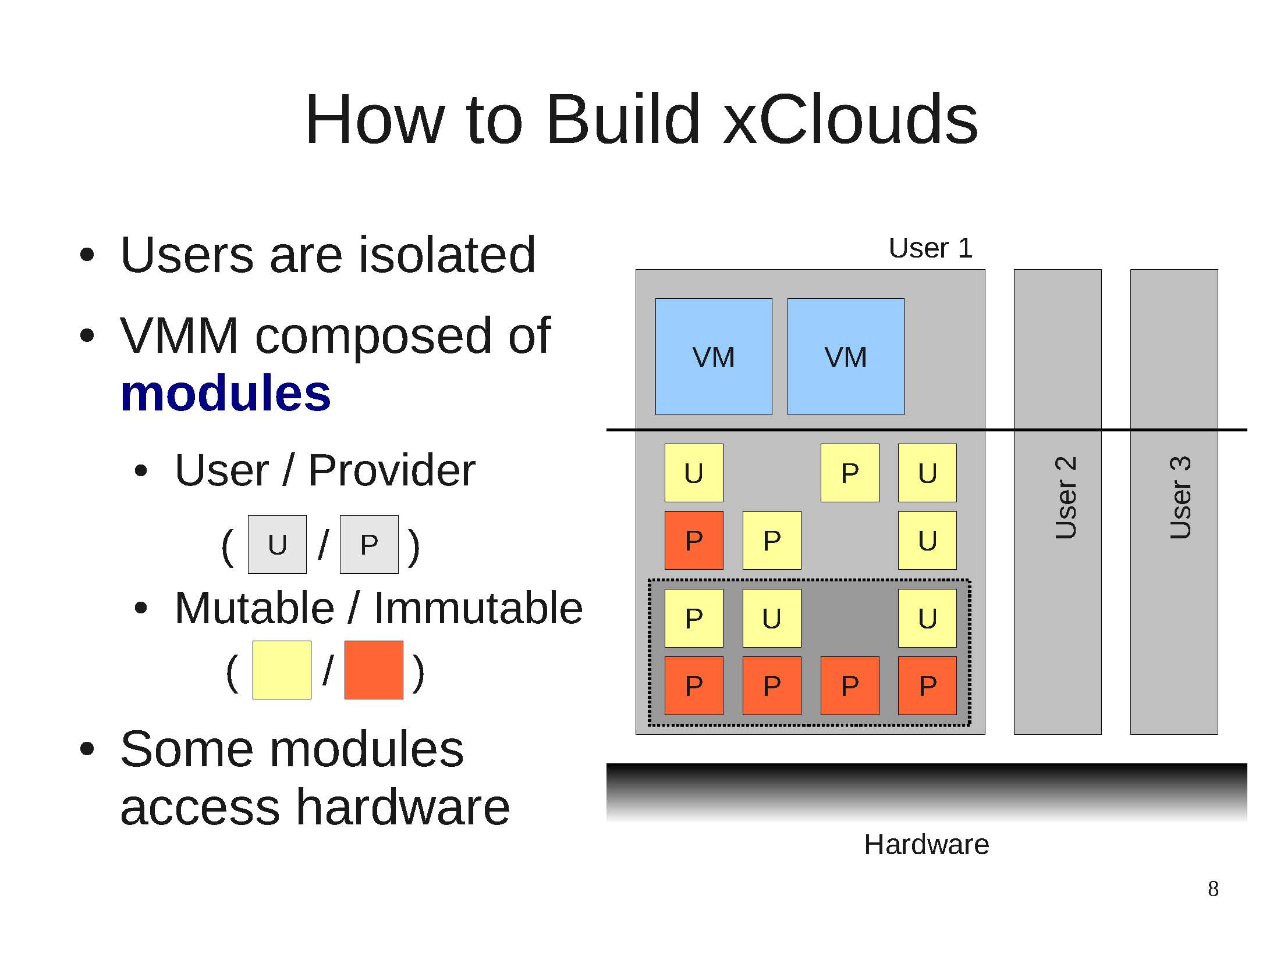
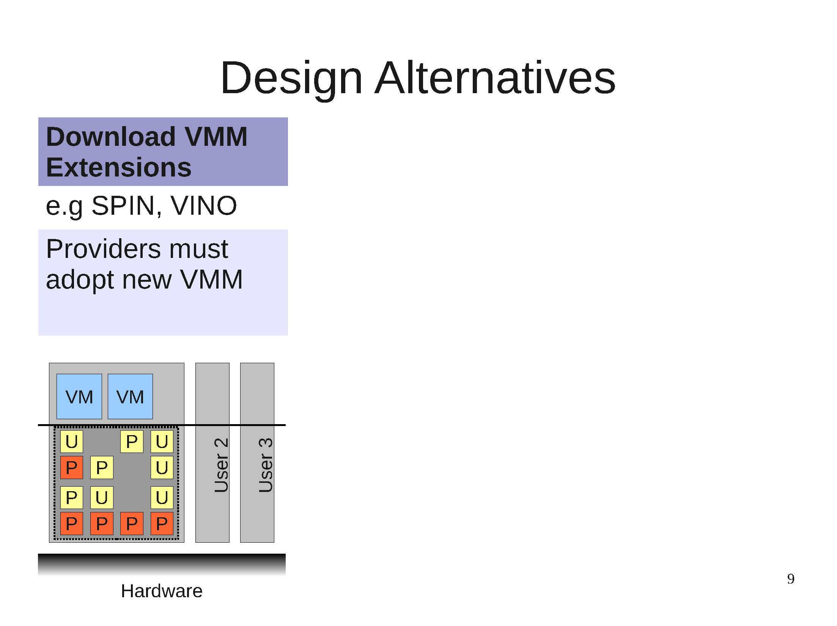
How to Build xClouds: Alternatives

Slide 25
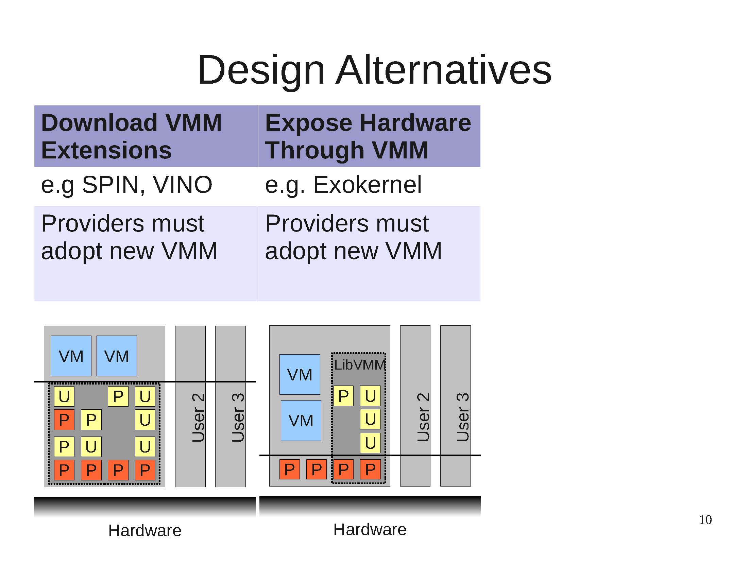
How to Build xClouds: Alternatives

Slide 26
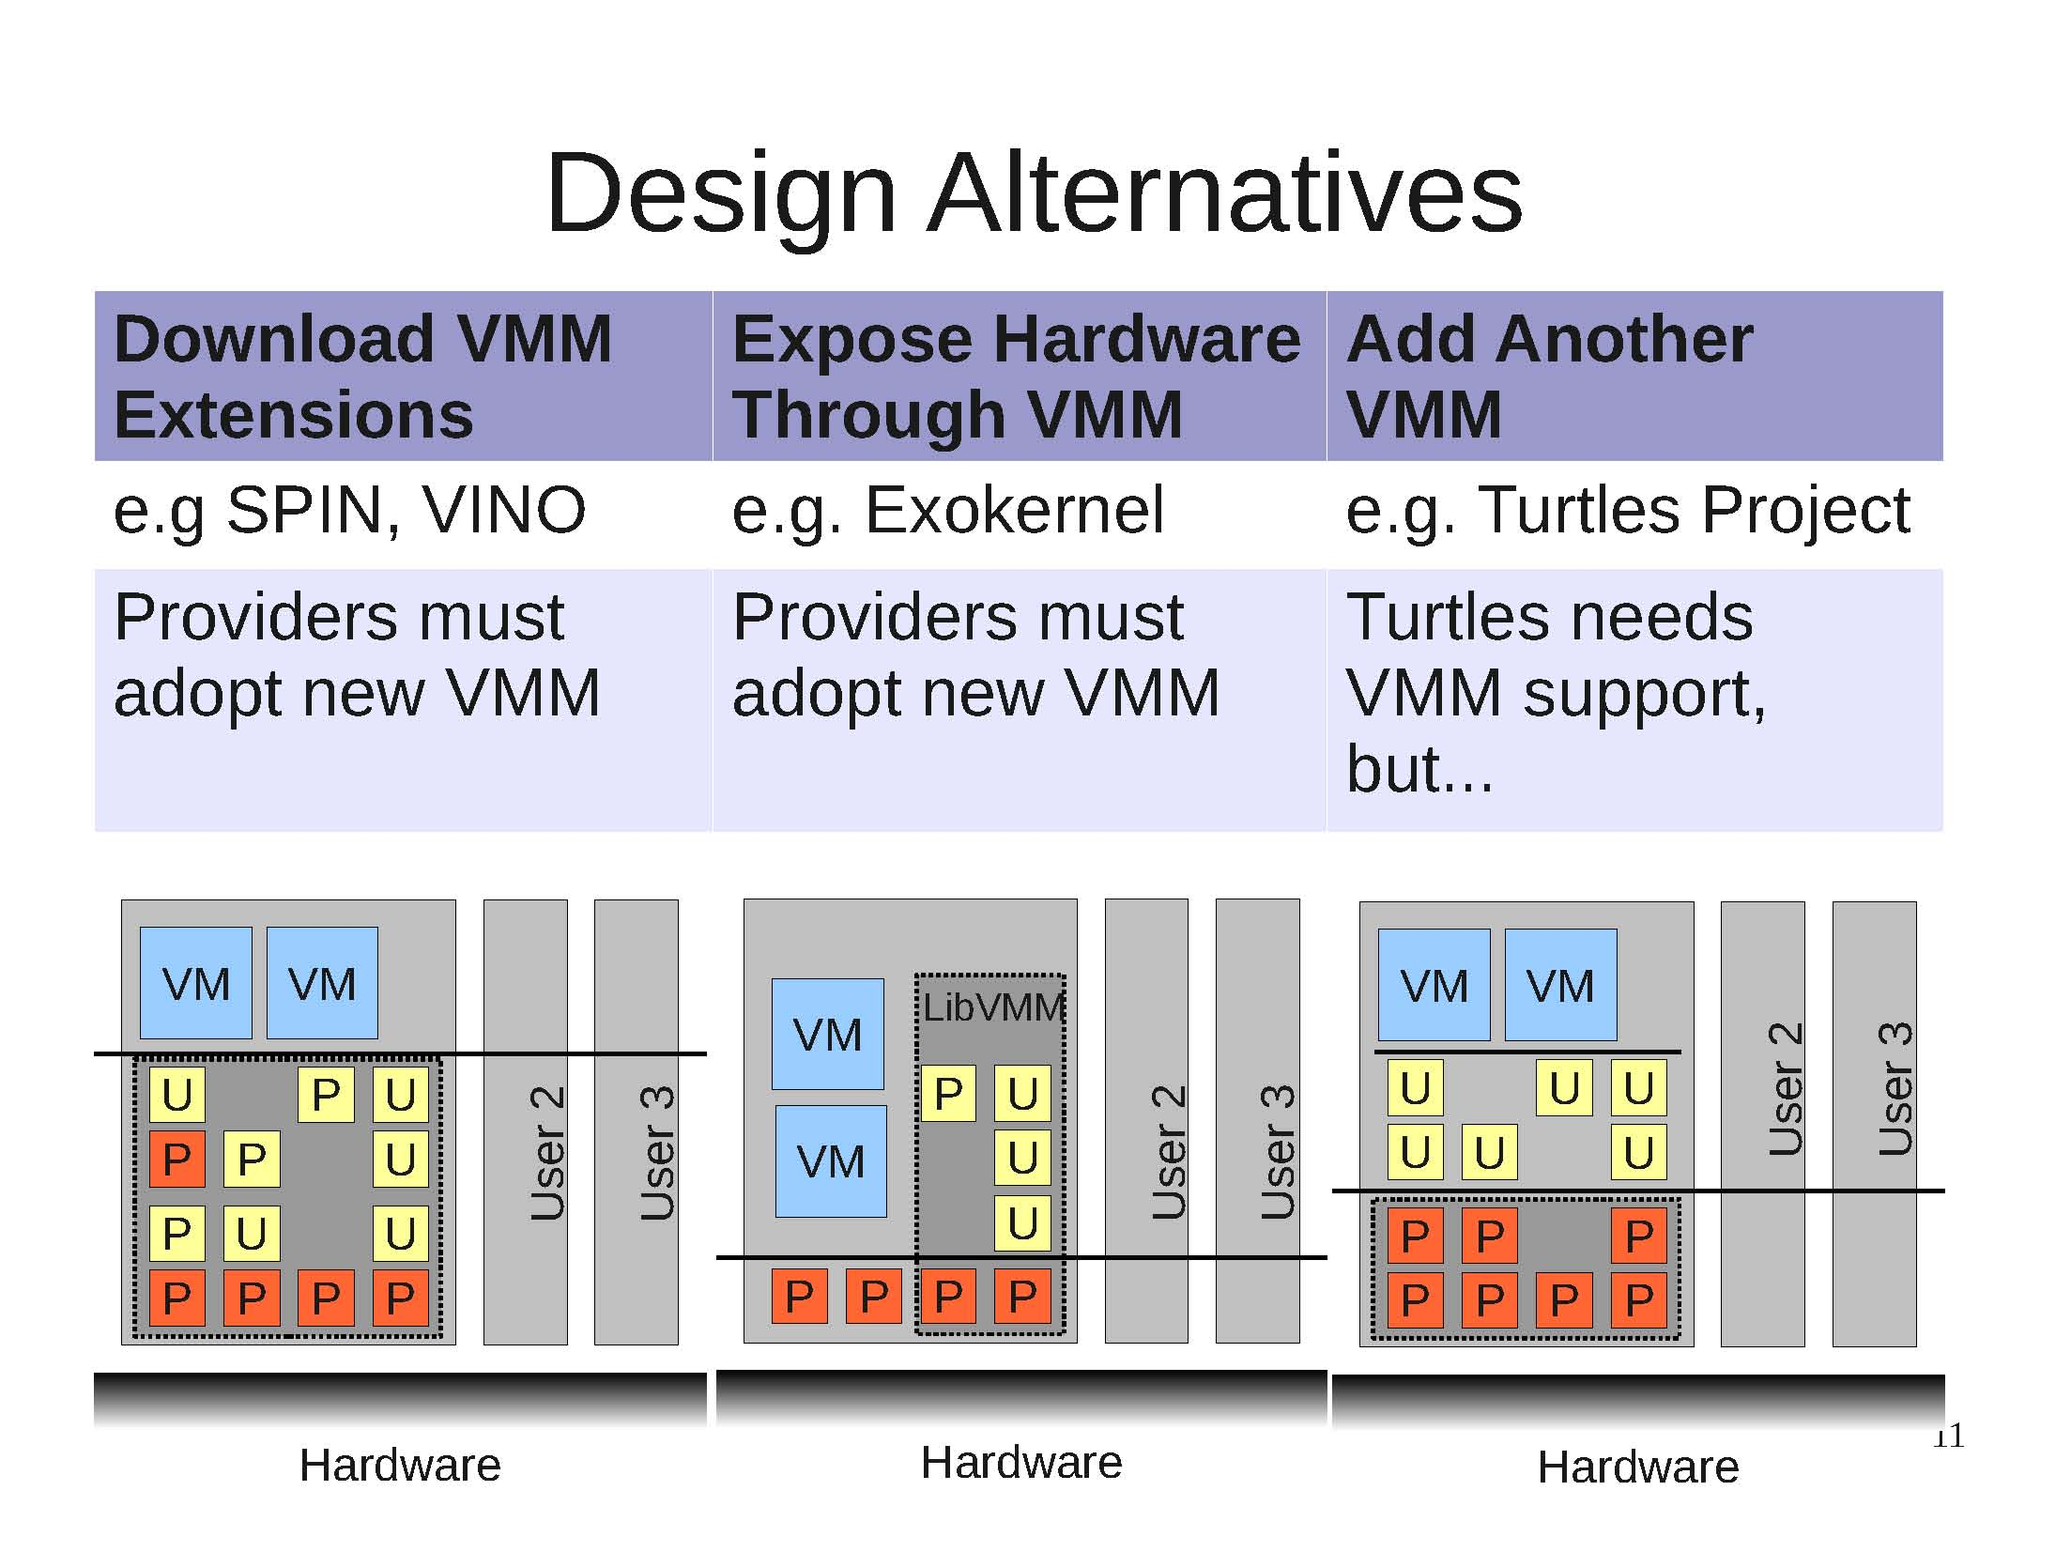
How to Build xClouds: Alternatives

Slide 27
How to Build xClouds: Another Layer
Linux Dom0
Linux DomU: VM
Shared Memory
Device: Ring
Backend
Frontend
PCI-Driver
Xen
Baremetal

Slide 28
How to Build xClouds: Another Layer
Linux Dom0
Dom0 for
Xenblanket
PV-
DomU
PV-
DomU
Backend
Frontend
Frontend
Frontend
Backend
Xen - 4.1.1 Blanket
PCI-Driver
1st-Layer Xen
Hypercalls
Baremetal
Device
Notes:
The Dom0 lacks the driver for shared memory devices
nested Xen: helps nested Dom0 to access shared memory devices
nested Dom0: drives and multiplexes shared memory devices
nested DomU: modified Linux3.x, transparent to User Apps

Slide 29
How to Build xClouds: Another Layer
Event-Channel Drivers for virtual interrupts
  One for Receive Event from 1st-Layer Xen: virtual interrupts
  One for multiplexing to nested DomU
Grant Page Table Drivers for shared memory
  One for Shared Ring buffer with 1st-Layer Dom0
  One for sharing memory with/or between nested DomUs
Two Xenbus drivers
  One for connect to 1st-Layer shared memory devices
  One for nested DomUs to connect to nested shared memory devices
Block and Net Frontend Drivers
  - For virtual disk and network devices of nested Dom0

Slide 30
Hypercall Passthrough
Need Hypercall Passthrough
  Nested Dom0 must be able to get information about shared memory devices from 1st Layer-Xen
  Nested Dom0 can only issue hypercall to Nested Xen
    So, nested Xen should help passthrough related hypercalls

Slide 31
Time calibration
No timer, no progress
Timer supported by Xen
  HPET (High precision event timer)
    x because no HPET devices for VM
  APIC (Local timer on SMP systems)
    x Malfunctions
  ACPI PM (Power management timer)
    x Same as above
  PIT (oldest, but works!): Send IPI to notify other AP ()
    Simulate the effect of APIC timer
    100Hz, 1000Hz or 250Hz

Slide 32
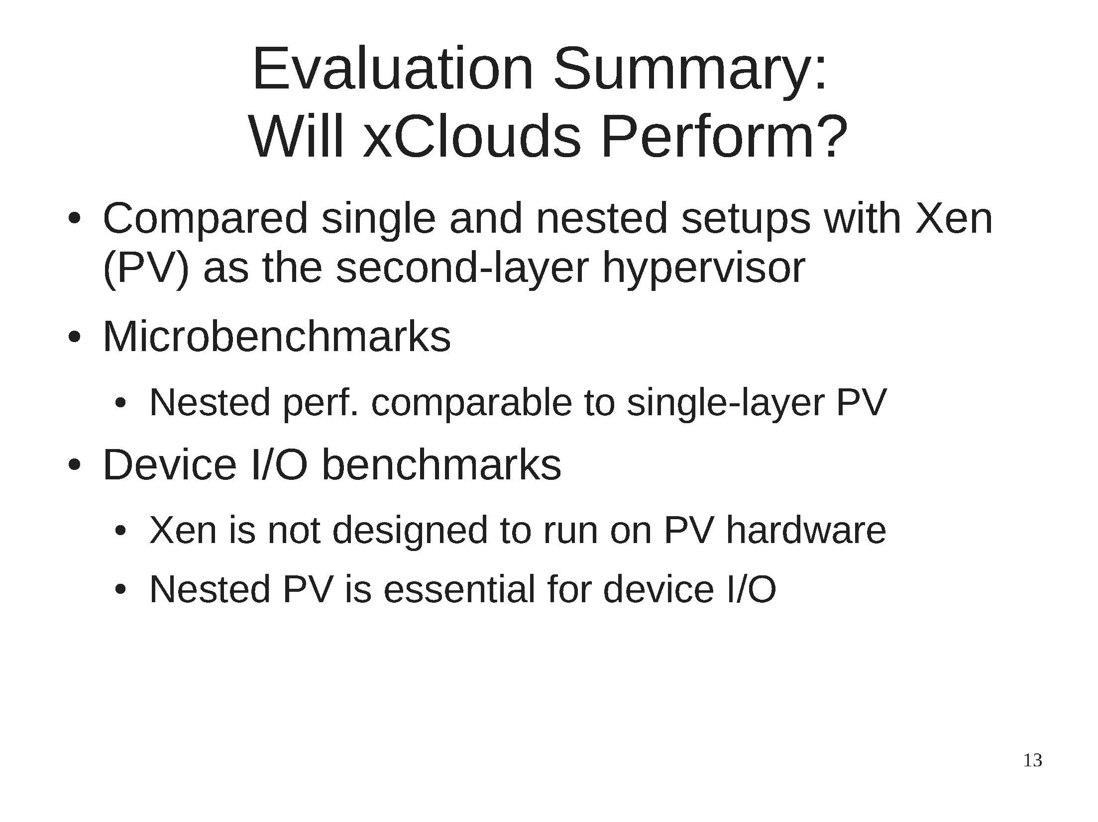
Will xClouds Perform?

Slide 33
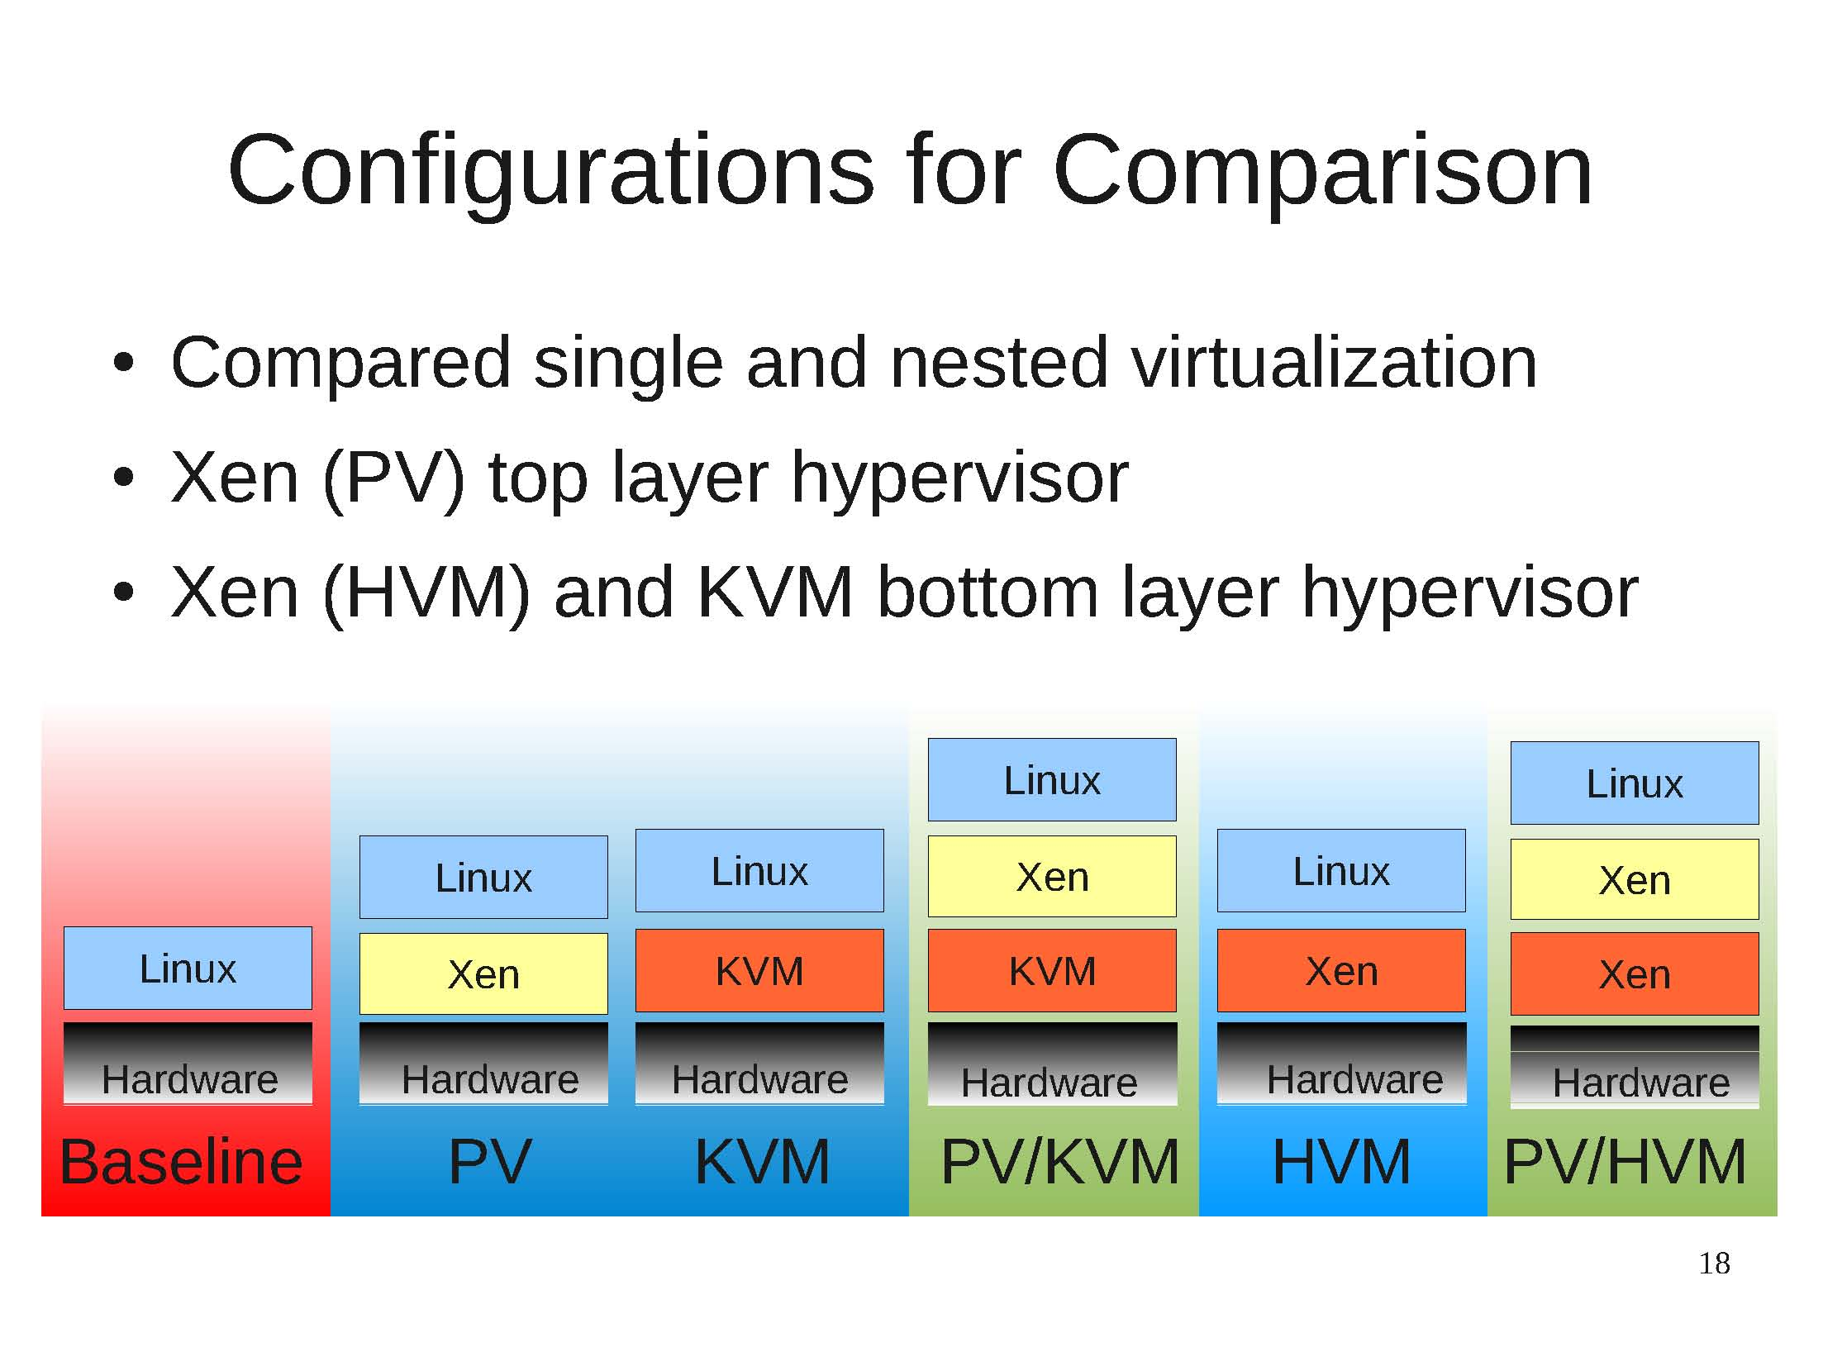
Configuration for Comparison

Slide 34
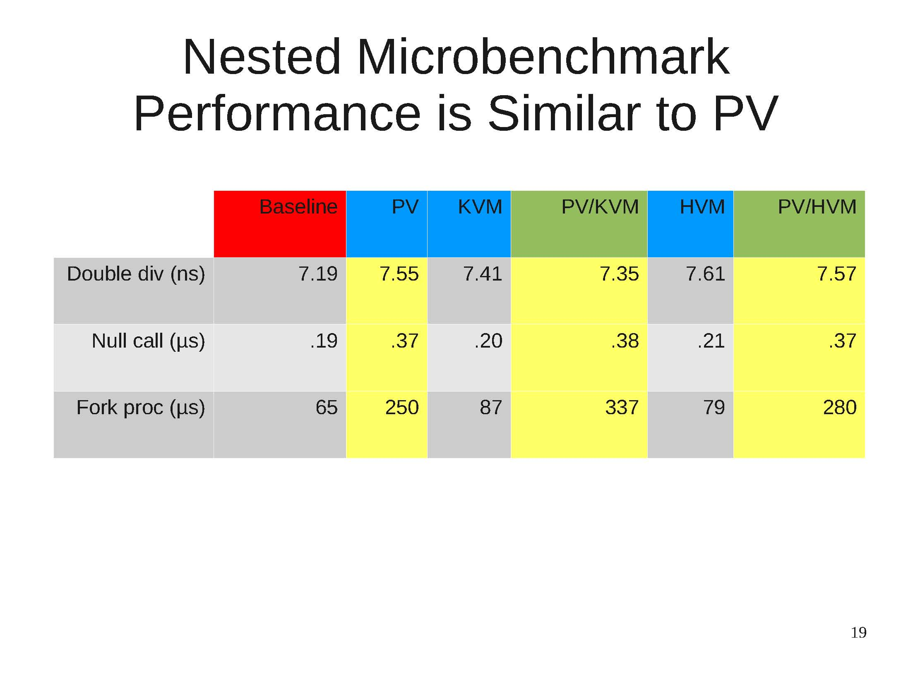
Nested Microbenchmark

Slide 35
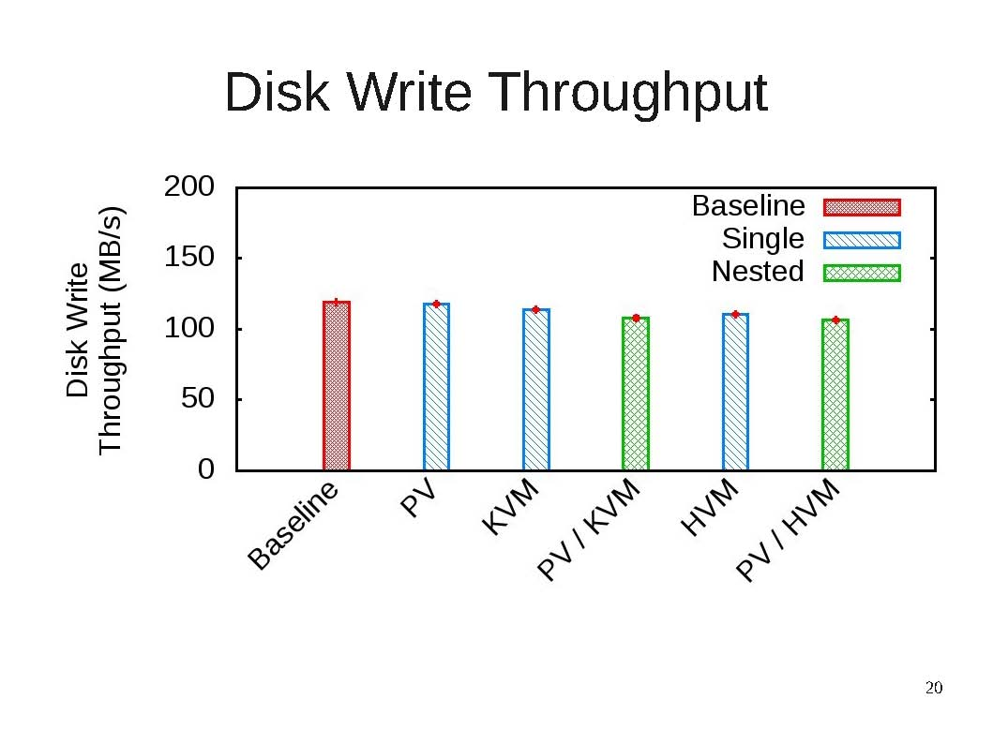
Disk Write Throughput

Slide 36
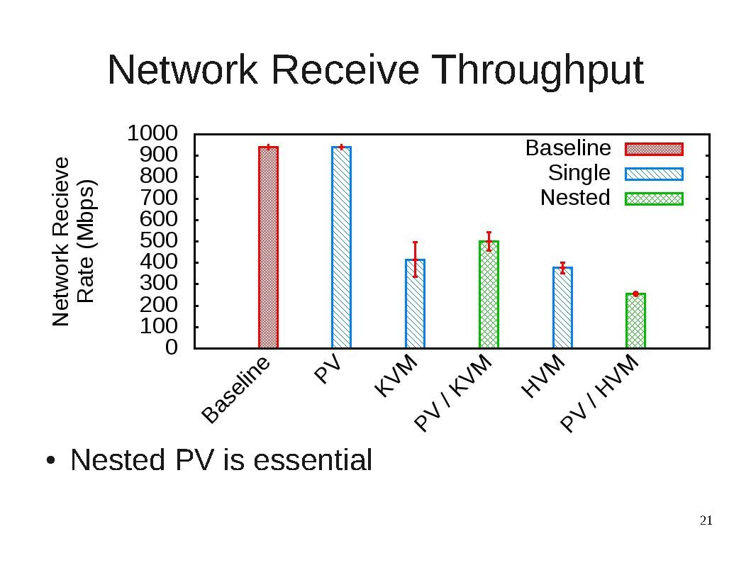
Network Receive Throughput

Slide 37
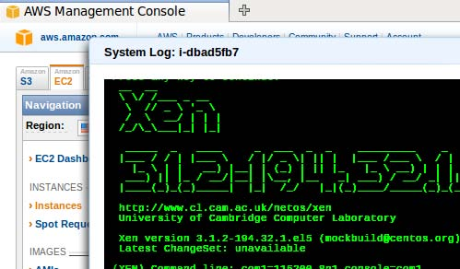
xClouds works Today!
Nested paravirtual device drivers
Xen on EC2

Slide 38
xClouds works Today!
Nested paravirtual device drivers
Xen on EC2
Can create your own
Cloud-within-a-Cloud
App
33KB
Guest OS
VMM
VMM
App
Object
100 KB
Guest OS
33KB
App
VMM
Guest OS
VMM
VMM
33KB
VMM
VMM
VMM
33KB
VMM
VMM

Slide 39
xClouds works Today!
Graduate Students
  Dan Williams
  Zhefu Jiang
  Ji Yong Shin
External Collaborators
  Hani Jamjoom (IBM)

Slide 40
Summary
“With great power comes great responsibility”
  Cloud technology can be used to address economic concerns
Treating the cloud as a commodity
  Users need to be able to trade-off overhead and vendor mobility
  Providers need to be accountable to users and environment
Lots more research to do to achieve the promise of the Cloud

Slide 41
“Nature is a mutable cloud which is always and never the same”
– Ralph Waldo Emerson
Paper Trail Theme: Cloud & Vendor Lock-in
  xCloud/Xen-Blanket in EuroSys-2012
  xCloud in HotCloud-2011
  Overdriver in VEE-2011
  RACS in SOCC-2010
More at http://fireless.cs.cornell.edu
and also http://xcloud.cs.cornell.edu
Email: hweather@cs.cornell.edu

Slide 42
Backup

