Slide 1
CS5412: The cloud Under Attack!
Lecture XXIV
Ken Birman

Slide 2
For all its virtues, the cloud is risky!
Categories of concerns
Client platform inadequacies, code download, browser insecurities
Internet outages, routing problems, vulnerability to DDoS
Cloud platform might be operated by an untrustworthy third party, could shift resources without warning, could abruptly change pricing or go out of business
Provider might develop its own scalability problems
Consolidation creates monoculture threats
Cloud security model is very narrow and might not cover important usage cases

Slide 3
But the cloud is also good in some ways
With a private server, DDoS attacks often succeed
In contrast, it can be hard to DDoS a cloud
The DDoS operator spends real money and won’t want to waste the cash
Thus because cloud is hard to DDoS, cloud emerges as a very good response to DDoS worries

Slide 4
More good news
Diversity can compensate for monoculture worries
Elasticity is a unique capability not seen in other settings
Ability to host and compute on massive data sets is very valuable
Obviously, only of value if task is suited this style of massive parallism, but many do fit the model
... the list goes on

Slide 5
So the cloud is tempting
And cheaper, too!
What’s not to love?
Imagine that you work for a large company that is healthy and has managed its own story in its own way
Now the cloud suddenly offers absolutely unique opportunities that we can’t access in any other way
Should you recommend that your boss drink the potion?

Slide 6
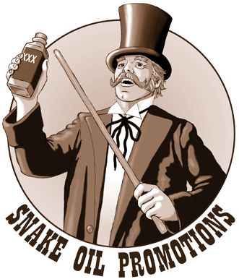
But how can anyone trust the cloud?
The cloud seems so risky that it makes no sense at all to trust it in any way!
Yet we seem to trust it in many ways
This puts the fate of your company in the hands of third parties!

Slide 7
The concept of “good enough”
We’ve seen that there really isn’t any foolproof way to build a computer, put a large, complex program on it, and then run it with confidence
We also know that with effort, many kinds of systems really start to work very well
When is a “pretty good” solution good enough?

Slide 8
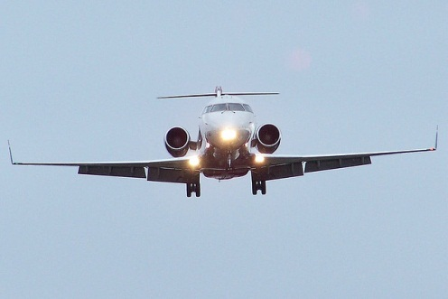
How they do it in avionics
FAA and NASA have a process that is used for things like fly-by-wire control software
Requires very stringent proofs
The program must be certified on particular hardware, even specific versions of chips
Any change of any kind triggers a recertification task
Very costly: a controller 100 lines long may generate 1000 pages of documentation!

Slide 9
How most production software is built
Generally, company develops good specification
Code is created in teams with code review frequent and much unit testing
Then code is passed to a “red team” that uses the code, attacks it, tries to find issues
Cycle continues until adequate assurance is reached and the initial release can take place
Subsequently must track and fix bugs, repeat Q/A, do periodic patch releases
Wise to rebuild entire solution every 5 years or so

Slide 10
How cloud software is built
Not enough time for proper Q/A
So much of the cloud was built in a huge hurry
Even today, race for features often doesn’t leave time for proper testing
Early versions have been rough, insecure, fault-prone
Over time, slow improvement
Seems to shift a lot of emphasis to patches and upgrades
Many cloud systems auto-upgrade frequently

Slide 11
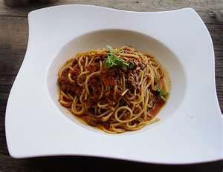
Legacy code
Not all code fits the “rebuilt periodically” model
Many major technologies were important in their day but now live on in isolated settings
They work… do something important for some organization… and so nobody touches them
These legacy systems are often minimally maintained but over time the amount of legacy code can become substantial: a tangle of vital, rarely touched code and systems

Slide 12
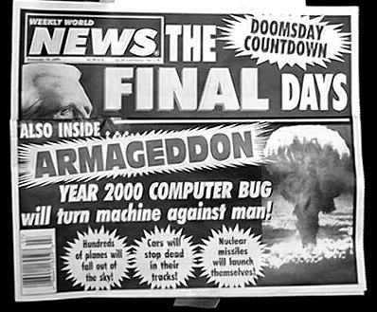
The parable of Y2K
Once upon a time many, many depended on 2-digit clocks
They only kept 2 digits for the years, like a credit card that expires 05/13
Thus when we reached 01/00 it looked like time travel 100 years into the past
Experiments made it clear that many systems crashed when this happened… and nobody had any idea how to find the “bad apples” in the barrel

Slide 13
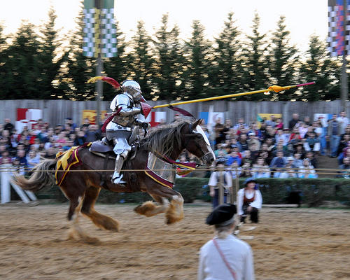
So how did things work out?
Initial cost estimates were terrifying
Tens or hundreds of billions of dollars to scan the hundreds of millions of lines of code that do important things
Lack of people do even do the work
Code in baffling, ancient languages like COBOL
Disaster loomed…
Infosys rode to the rescue!

Slide 14
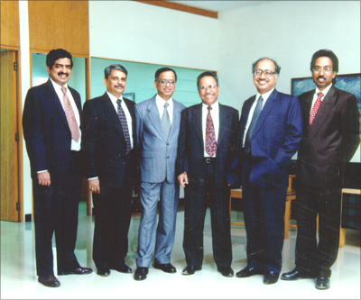
Infosys in the pre-Y2K period
A small Indian software company that was known mostly for its work on the Paris Airport luggage transportation system
A very complex system, which Infosys was successful building at a fraction the standard cost and with far fewer bugs or delays than France had ever seen
Company had a few hundred employees
Founded in 1981 with $600!

Slide 15
Infosys was an unusual company
Founders were all very socially pro-active and very concerned about the situation of India’s poor
Extremely high ethical standard: A decision to never pay bribes or in any way rig the outcome of business decisions
When many company executives were paying themselves big bonuses, the founders reinvested

Slide 16
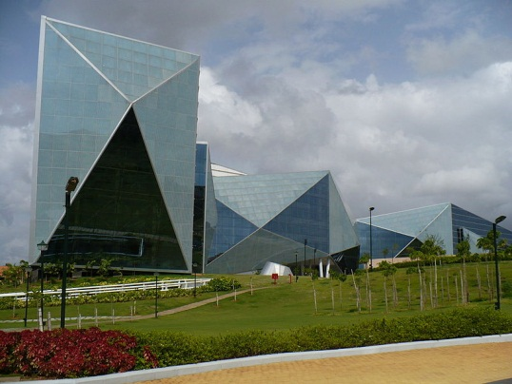
1987: A big event
Infosys got a toehold in the United States when it landed its first US corporate client
A company named Data Basics Corporation
The Infosys “angle”?
Hire smart kids from all over India
Offer them additional training at a corporate campus in Mysore
Form them into a highly qualified workforce

Slide 17
Financial angle?
In the early days, Infosys was paying highly qualified employees $5,000/year
In the US highly qualified technology workers were earning $125,000/year in that time period
Skill sets weren’t so different…
Today the gap is a little smaller, but not hugely so

Slide 18
How Y2K helped
Companies like Infosys tackled the Y2K challenge for “pennies on the dollar” relative to estimates
A company facing a $50M bill to review all the corporate code base saw it shrink to perhaps $1M
And Infosys often finished these tasks early
…. January 1, 2000 arrived and the world didn’t end. Instead the world of outsourcing began!
A few minor issues occurred, but nothing horrible

Slide 19
Lessons one learns
Cheaper isn’t necessarily inferior!
In fact over time, cheaper but “good enough” wins
This is a very important lesson that old companies miss
Earlier adopters often accept risks
... risks that can be managed
And those good-enough solutions sometimes catch up later
Bad stuff (lots of it) lurks deep within the cool new stuff that we all love

Slide 20
Fast forward to 2012
Today cloud computing has a similar look and feel
It works really well for the things we use it to do today
How often does an iPhone service malfunction?
Pretty often, actually, but not often enough to bother anyone
The cloud is fast, scalable, has amazing capabilities, and yes, it has a wide variety of issues
Is the cloud really worse than what came before it?
Given that the cloud evolved from what came earlier, is this even a sensible question?
When has any technology ever been “assured”?

Slide 21
Life with technology is about tradeoffs
Clearly, we err if we use a technology in a dangerous or inappropriate way
Liability laws need to be improved: they let software companies escape pretty much all responsibility
Yet gross negligence is still a threat to those who build things that will play critical roles and yet fail to take adequate steps to achieve assurance

Slide 22
Another parable: Real-time multicast
The community that builds real-time systems favors proofs that the system is guaranteed to satisfy its timing bounds and objectives
The community that does things like data replication in the cloud tends to favor speed
We want the system to be fast
Guarantees are great unless they slow the system down

Slide 23
Can a guarantee slow a system down?
Suppose we want to implement broadcast protocols that make direct use of temporal information
Examples:
Broadcast that is delivered at same time by all correct processes (plus or minus the clock skew)
Distributed shared memory that is updated within a known maximum delay
Group of processes that can perform periodic actions

Slide 24
A real-time broadcast
t+a
t+b
t
p₀
*
p₁
p₂
*
p₃
*
p₄
*
p₅
*
Message is sent at time t by p₀. Later both p₀ and p₁ fail. But message is still delivered atomically, after a bounded delay, and within a bounded interval of time (at non-faulty processes)

Slide 25
A real-time distributed shared memory
t+a
t+b
t
p₀
set x=3
p₁
p₂
x=3
p₃
p₄
p₅
At time t p₀ updates a variable in a distributed shared memory. All correct processes observe the new value after a bounded delay, and within a bounded interval of time.

Slide 26
Periodic process group: Marzullo
p₀
p₁
p₂
p₃
p₄
p₅
Periodically, all members of a group take some action. Idea is to accomplish this with minimal communication

Slide 27
The CASD protocols
Also known as the “Δ -T” protocols
Developed by Cristian and others at IBM, was intended for use in the (ultimately, failed) FAA project
Goal is to implement a timed atomic broadcast tolerant of Byzantine failures

Slide 28
Basic idea of the CASD protocols
Assumes use of clock synchronization
Sender timestamps message
Recipients forward the message using a flooding technique (each echos the message to others)
Wait until all correct processors have a copy, then deliver in unison (up to limits of the clock skew)

Slide 29
CASD picture
t+a
t+b
t
p₀
*
p₁
p₂
*
p₃
*
p₄
*
p₅
*
p₀, p₁ fail. Messages are lost when echoed by p₂, p₃

Slide 30
Idea of CASD
Assume known limits on number of processes that fail during protocol, number of messages lost
Using these and the temporal assumptions, deduce worst-case scenario
Now now that if we wait long enough, all (or no) correct process will have the message
Then schedule delivery using original time plus a delay computed from the worst-case assumptions

Slide 31
The problems with CASD
In the usual case, nothing goes wrong, hence the delay can be very conservative
Even if things do go wrong, is it right to assume that if a message needs between 0 and δms to make one hope, it needs [0,n* δ ] to make n hops?
How realistic is it to bound the number of failures expected during a run?

Slide 32
CASD in a more typical run
t+a
t+b
t
p₀
*
p₁
*
p₂
*
p₃
*
p₄
*
p₅
*

Slide 33
... leading developers to employ more aggressive parameter settings
t+a
t+b
t
p₀
*
p₁
*
p₂
*
*
p₃
*
p₄
p₅
*

Slide 34
CASD with over-aggressive paramter settings starts to “malfunction”
t+a
t+b
t
p₀
*
p₁
*
p₂
*
p₃
p₄
p₅
*
all processes look “incorrect” (red) from time to time

Slide 35
CASD “mile high”
When run “slowly” protocol is like a real-time version of abcast
When run “quickly” protocol starts to give probabilistic behavior:
If I am correct (and there is no way to know!) then I am guaranteed the properties of the protocol, but if not, I may deliver the wrong messages

Slide 36
How to repair CASD in this case?
Gopal and Toueg developed an extension, but it slows the basic CASD protocol down, so it wouldn’t be useful in the case where we want speed and also real-time guarantees
Can argue that the best we can hope to do is to superimpose a process group mechanism over CASD (Verissimo and Almeida are looking at this).

Slide 37
Why worry?
CASD can be used to implement a distributed shared memory (“delta-common storage”)
But when this is done, the memory consistency properties will be those of the CASD protocol itself
If CASD protocol delivers different sets of messages to different processes, memory will become inconsistent

Slide 38
Why worry?
In fact, we have seen that CASD can do just this, if the parameters are set aggressively
Moreover, the problem is not detectable either by “technically faulty” processes or “correct” ones
Thus, DSM can become inconsistent and we lack any obvious way to get it back into a consistent state

Slide 39
Using CASD in real environments
Once we build the CASD mechanism how would we use it?
Could implement a shared memory
Or could use it to implement a real-time state machine replication scheme for processes
US air traffic project adopted latter approach
But stumbled on many complexities…

Slide 40
Using CASD in real environments
Pipelined computation
Transformed computation

Slide 41
Issues?
Could be quite slow if we use conservative parameter settings
But with aggressive settings, either process could be deemed “faulty” by the protocol
If so, it might become inconsistent
Protocol guarantees don’t apply
No obvious mechanism to reconcile states within the pair
Method was used by IBM in a failed effort to build a new US Air Traffic Control system

Slide 42
A comparison
Virtually synchronous Send is fault-tolerant and very robust, and very fast, but doesn’t guarantee realtime delivery of messages
CASD is fault-tolerant and very robust, but rather slow. But it does guarantee real-time delivery
CASD is “better” if our application requires absolute confidence that real-time deadlines will be achieved... but only if those deadlines are “slow”

Slide 43
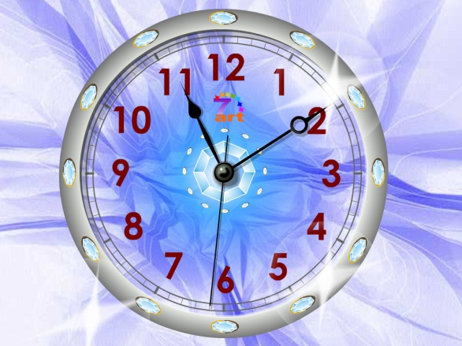
Which is better for real-time uses?
Virtually synchronous Send or CASD?
CASD may need seconds before it can deliver, but comes with a very strong proof that it will do so correctly
Send will deliver within milliseconds unless strange scheduling delays impact a node
But actually delay limit is probably ~45 seconds
Beyond this, node will be declared to have crashed

Slide 44
Generalizing to the whole cloud
Massive scale
And most of the thing gives incredibly fast responses: sub 100ms is a typical goal
But sometimes we experience a long delay or a failure

Slide 45
Traditional view of real-time control favored CASD view of assurances
In this strongly assured model, the assumption was that we need to prove our claims and guarantee that the system will meet goals
And like CASD this leads to slow systems
And to CAP and similar concerns

Slide 46
Back to our puzzle
So can the cloud do high assurance?
Presumably not if we want CASD kinds of proofs
But if we are willing to “overwhelm” delays with redundancy, why shouldn’t we be able to do well?
Suppose that we connect our user to two cloud nodes and they perform read-only tasks in parallel
Client takes first answer, but either would be fine
We get snappier response but no real “guarantee”

Slide 47
A vision: “Good enough assurance”
Build applications to protect themselves against rare but extreme problems (e.g. a medical device might warn that it has lost connectivity)
This is needed anyhow: hardware can fail…
So: start with “fail safe” technology
Now make our cloud solution as reliable as we can without worrying about proofs
We want speed and consistency but are ok with rare crashes that might be noticed by the user

Slide 48
Will this do?
Probably not for some purposes… but some things just don’t belong under computer control
For most purposes, this sort of solution might balance the benefits of the cloud with the kinds of guarantees we know how to provide
Use redundancy to compensate for delays, insecurity, failures of individual nodes

Slide 49
How the cloud is like Infosys
The cloud brings huge advantages
Lower cost… much better scalability
And it also brings problems
Today’s cloud is inconsistent by design, not very secure…
But why should we assume tomorrow’s cloud won’t be better? The cloud seems to be winning!
Our job: find ways to make the cloud safely do more
This task seems completely feasible!

Slide 50
Summary: Should we trust the cloud?
We’ve identified a tension centering on priorities
If your top priority is assurance properties you may be forced to sacrifice scalability and performance in ways that leave you with a useless solution
If your top priorities center on scale and performance and then you layer in other characteristics it may be feasible to keep the cloud properties and get a good enough version of the assurance properties
These tradeoffs are central to cloud computing!
But like the other examples, cloud could win even if in some ways, it isn’t the “best” or “most perfect” solution

