Slide 1
CS5412:
How Durable Should it Be?
Lecture XV
Ken Birman

Slide 2
Durability
When a system accepts an update and won’t lose it, we say that event has become durable
Everyone jokes that the cloud has a permanent memory and this of course is true
  Once data enters a cloud system, they rarely discard it
  More common to make lots of copies, index it…
But loss of data due to a failure is an issue

Slide 3
Should Consistency “require” Durability?
The Paxos protocol guarantees durability to the extent that its command lists are durable
Normally we run Paxos with the command list on disk, and hence Paxos can survive any crash
  In Isis², this is g.SafeSend with the “DiskLogger” active
  But costly

Slide 4
Consider the first tier of the cloud
Recall that applications in the first tier are limited to what Brewer calls “Soft State”
  They are basically prepositioned virtual machines that the cloud can launch or shutdown very elastically
  But when they shut down, lose their “state” including any temporary files
  Always restart in the initial state that was wrapped up in the VM when it was built: no durable disk files

Slide 5
Examples of soft state?
Anything that was cached but “really” lives in a database or file server elsewhere in the cloud
  If you wake up with a cold cache, you just need to reload it with fresh data
Monitoring parameters, control data that you need to get “fresh” in any case
  Includes data like “The current state of the air traffic control system” – for many applications, your old state is just not used when you resume after being offline
  Getting fresh, current information guarantees that you’ll be in sync with the other cloud components
Information that gets reloaded in any case, e.g. sensor values

Slide 6
Would it make sense to use Paxos?
We do maintain sharded data in the first tier and some requests certainly trigger updates
So that argues in favor of a consistency mechanism
In fact consistency can be important even in the first tier, for some cloud computing uses

Slide 7
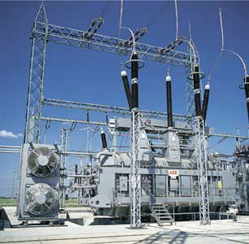
Control of the smart power grid
Suppose that a cloud control system speaks with “two voices”
In physical infrastructure settings, consequences can be very costly
“Canadian 50KV bus going offline”
Bang!
“Switch on the 50KV Canadian bus”

Slide 8
So… would we use Paxos here?
In discussion of the CAP conjecture and their papers on the BASE methodology, authors generally assume that “C” in CAP is about ACID guarantees or Paxos
Then argue that these bring too much delay to be used in settings where fast response is critical
Hence they argue against Paxos

Slide 9
By now we’ve seen a second option
Virtual synchrony Send is “like” Paxos yet different
Paxos has a very strong form of durability
Send has consistency but weak durability unless you use the “Flush” primitive. Send+Flush is amnesia-free
Further complicating the issue, in Isis² Paxos is called SafeSend, and has several options
  Can set the number of acceptors
  Can also configure to run in-memory or with disk logging

Slide 10
How would we pick?
The application code looks nearly identical!
  g.Send(GRIDCONTROL, action to take)
  g.SafeSend(GRIDCONTROL, action to take)
Yet the behavior is very different!
  SafeSend is slower
  … and has stronger durability properties. Or does it?

Slide 11
SafeSend in the first tier
Observation: like it or not we just don’t have a durable place for disk files in the first tier
The only forms of durability are
  In-memory replication within a shard
  Inner-tier storage subsystems like databases or files
Moreover, the first tier is expect to be rapidly responsive and to talk to inner tiers asynchronously

Slide 12
So our choice is simplified
No matter what anyone might tell you, in fact the only real choices are between two options
  Send + Flush: Before replying to the external customer, we know that the data is replicated in the shard
  In-memory SafeSend: On an update by update basis, before each update is taken, we know that the update will be done at every replica in the shard

Slide 13
Consistency model: Virtual synchrony meets Paxos (and they live happily ever after…)
A=3
B=7
B = B-A
A=A+1
Non-replicated reference execution
Synchronous execution
Virtually synchronous execution
Virtual synchrony is a “consistency” model:
  Synchronous runs: indistinguishable from non-replicated object that saw the same updates (like Paxos)
  Virtually synchronous runs are indistinguishable from synchronous runs

Slide 14
SafeSend versus Send
Send can have different delivery orders if there are different senders
  In fact Isis² offers other options, we’ll discuss them next time.
SafeSend can’t have the strange amnesia problem see in the top right corner on the timeline picture
But these guarantees are pretty costly!

Slide 15
Looking closely at that “oddity”
Virtually synchronous execution “amnesia” example (Send but without calling Flush)

Slide 16
What made it odd?
In this example a network partition occurred and, before anyone noticed, some messages were sent and delivered
  “Flush” would have blocked the caller, and SafeSend would not have delivered those messages
  Then the failure erases the events in question: no evidence remains at all
  So was this bad? OK? A kind of transient internal inconsistency that repaired itself?

Slide 17
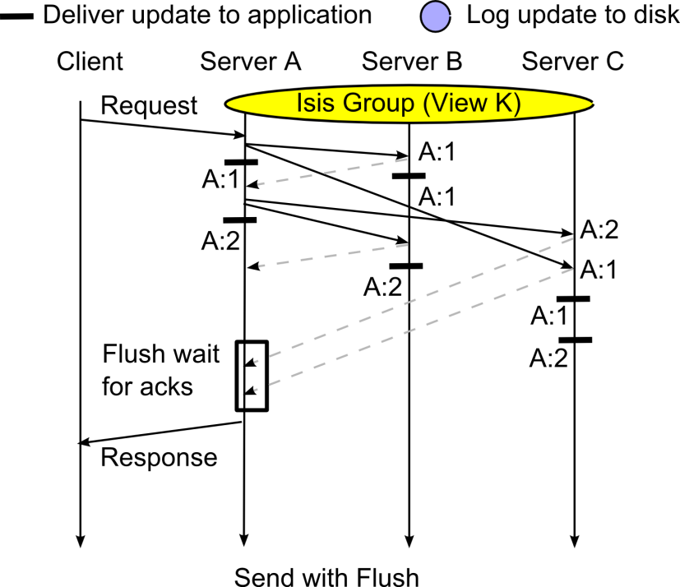
Looking closely at that “oddity”

Slide 18
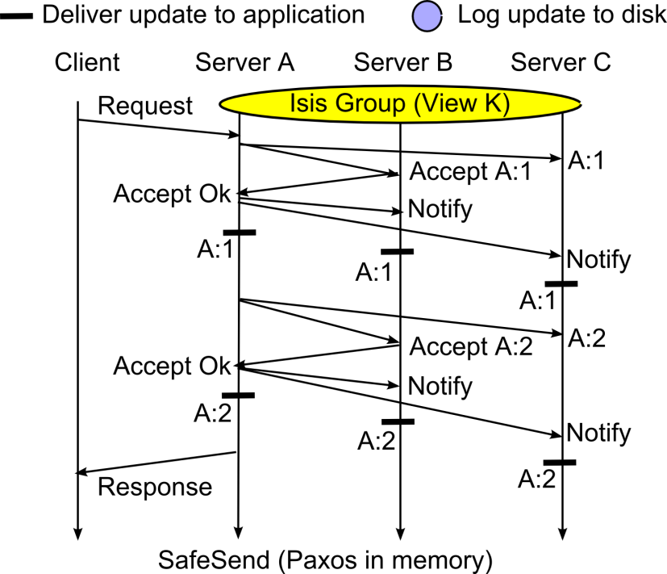
Looking closely at that “oddity”

Slide 19
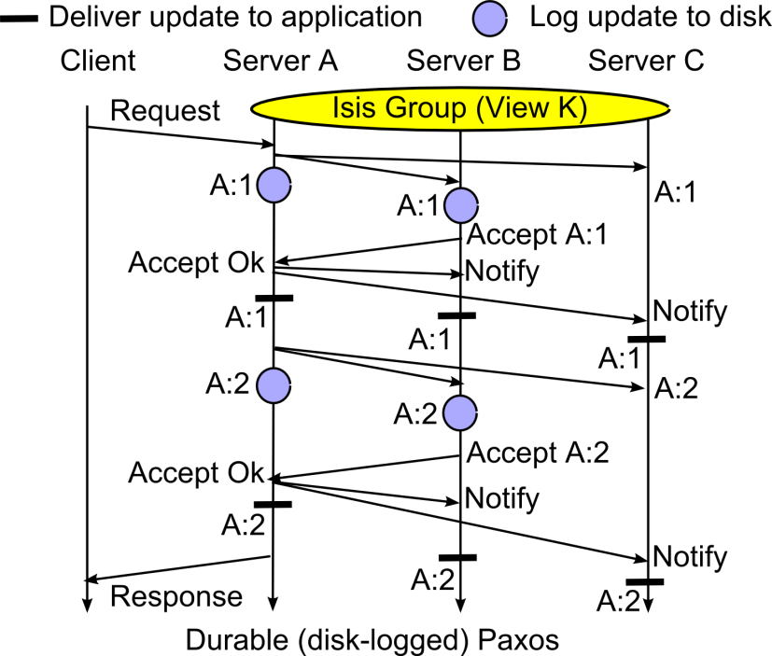
Looking closely at that “oddity”

Slide 20
Paxos avoided the issue… at a price
SafeSend, Paxos and other multi-phase protocols don’t deliver in the first round/phase
This gives them stronger safety on a message by message basis, but also makes them slower and less scalable
Is this a price we should pay for better speed?

Slide 21
Revisiting our medical scenario
Update the monitoring and alarms criteria for Mrs. Marsh as follows…
Execution timeline for an individual first-tier replica
A B C D
Soft-state first-tier service
Response delay seen by end-user would also include Internet latencies
Send
Send
Local response delay
Send
Confirmed
flush
An online monitoring system might focus on real-time response and be less concerned with data durability

Slide 22
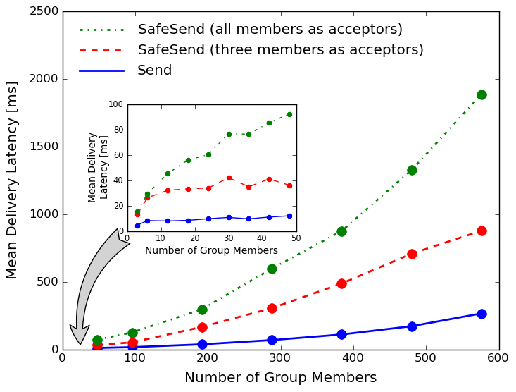
Isis²: Send v.s. in-memory SafeSend
Send scales best, but SafeSend with
in-memory (rather than disk) logging and small
numbers of acceptors isn’t terrible.

Slide 23
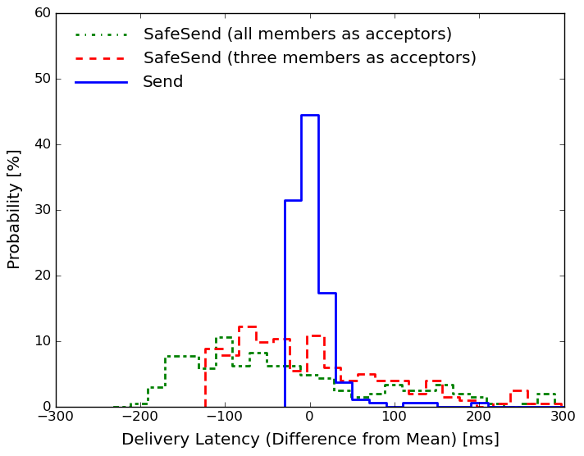
Jitter: how “steady” are latencies?
The “spread” of latencies is much
better (tighter) with Send: the 2-phase
SafeSend protocol is sensitive to
scheduling delays

Slide 24
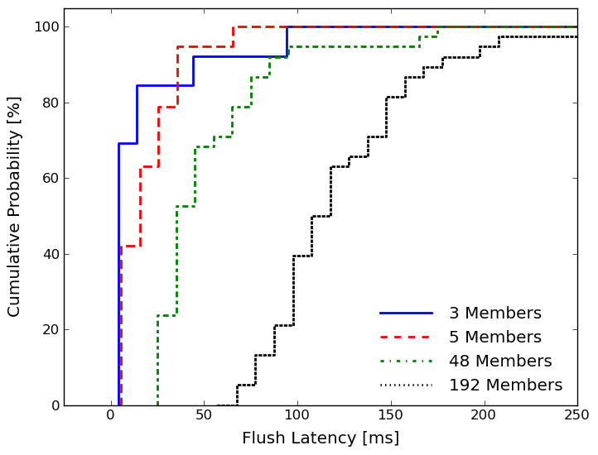
Flush delay as function of shard size
Flush is fairly fast if we only wait for
acks from 3-5 members, but is slow
if we wait for acks from all members.
After we saw this graph, we changed
Isis² to let users set the threshold.

Slide 25
First-tier “mindset” for tolerant f faults
Suppose we do this:
  Receive request
  Compute locally using consistent data and perform updates on sharded replicated data, consistently
  Asynchronously forward updates to services deeper in cloud but don’t wait for them to be performed
  Use the “flush” to make sure we have f+1replicas
Call this an “amnesia free” solution. Will it be fast enough? Durable enough?

Slide 26
Which replicas?
One worry is this
  If the first tier is totally under control of a cloud management infrastructure, elasticity could cause our shard to be entirely shut down “abruptly”
Fortunately, most cloud platforms do have some ways to notify management system of shard membership
  This allows the membership system to shut down members of multiple shards without ever depopulating any single shard
  Now the odds of a sudden amnesia event become low

Slide 27
Advantage: Send+Flush?
It seems that way, but there is a counter-argument
The problem centers on the Flush delay
  We pay it both on writes and on some reads
  If a replica has been updated by an unstable multicast, it can’t safely be read until a Flush occurs
  Thus need to call Flush prior to replying to client even in a read-only procedure
    Delay will occur only if there are pending unstable multicasts

Slide 28
We don’t need this with SafeSend
In effect, it does the work of Flush prior to the delivery (“learn”) event
So we have slower delivery, but now any replica is always safe to read and we can reply to the client instantly
In effect the updater sees delay on his critical path, but the reader has no delays, ever

Slide 29
Advantage: SafeSend?
Argument would be that with both protocols, there is a delay on the critical path where the update was initiated
But only Send+Flush ever delays in a pure reader
So SafeSend is faster!
  But this argument is flawed…

Slide 30
Flaws in that argument
The delays aren’t of the same length (in fact the pure reader calls Flush but would rarely be delayed)
Moreover, if a request does multiple updates, we delay on each of them for SafeSend, but delay just once if we do Send…Send…Send…Flush
How to resolve?

Slide 31
Only real option is to experiment
In the cloud we often see questions that arise at
  Large scale,
  High event rates,
  … and where millisecond timings matter
Best to use tools to help visualize performance
Let’s see how one was used in developing Isis²

Slide 32
Something was… strangely slow
We weren’t sure why or where
Only saw it at high data rates in big shards
So we ended up creating a visualization tool just to see how long the system needed from when a message was sent until it was delivered
Here’s what we saw

Slide 33
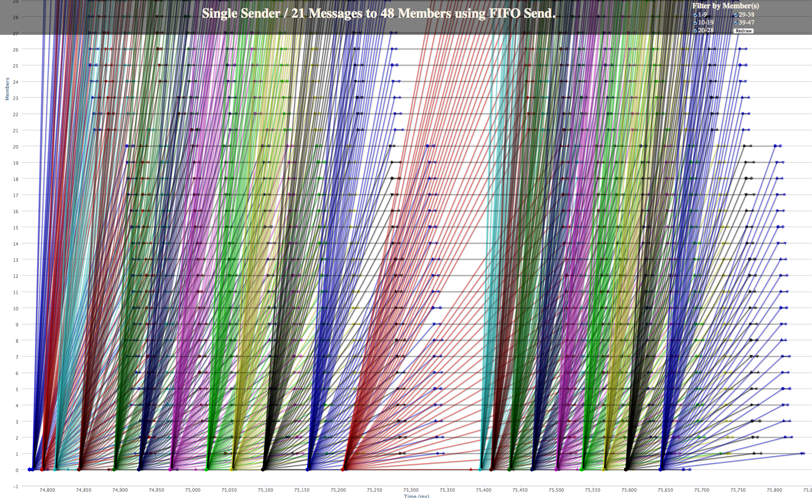
Debugging: Stabilization bug
At first Isis² is running very fast (as we later learned, too fast to sustain)
Eventually it pauses. The delay is similar to a Flush delay. A backlog was forming

Slide 34
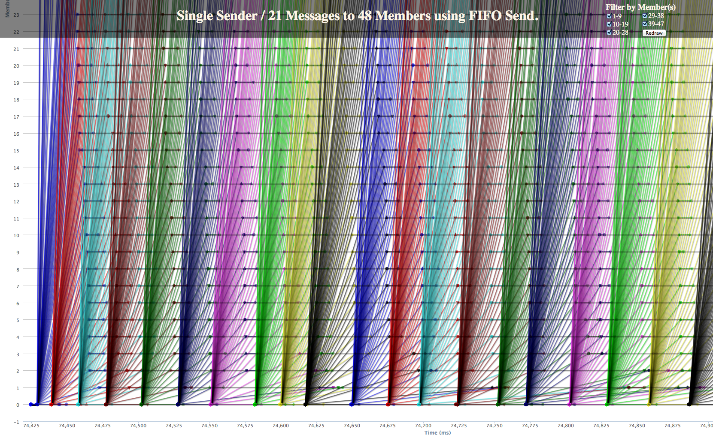
Debugging : Stabilization bug fixed
The revised protocol is actually a tiny bit slower, but now we can sustain the rate

Slide 35
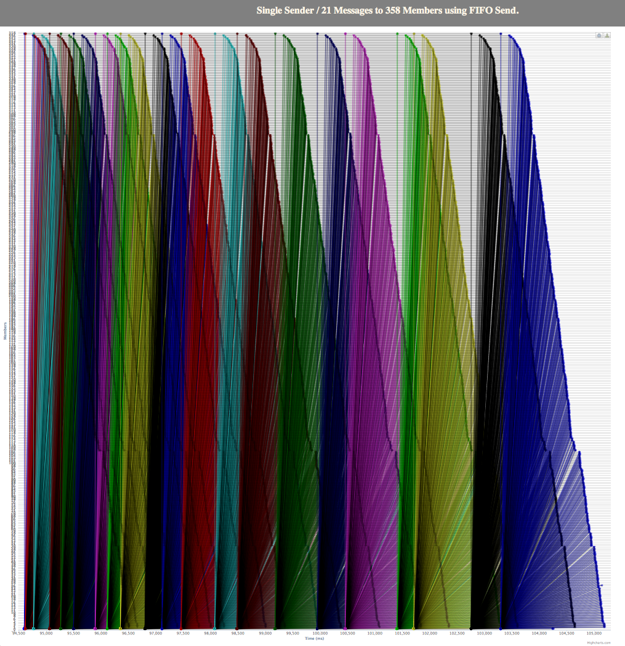
Debugging : 358-node run slowdown
Original problem but at an even larger scale

Slide 36
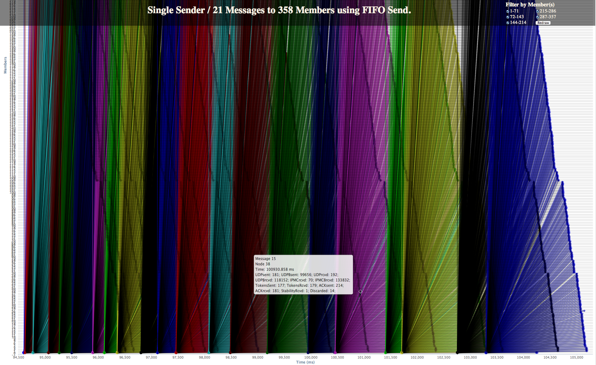
358-node run slowdown: Zoom in
Hard to make sense of the situation: Too much data!

Slide 37
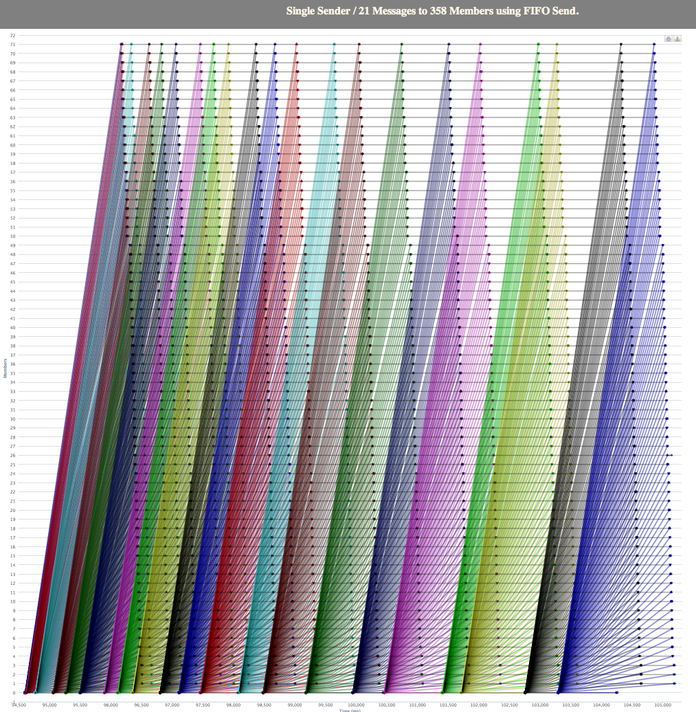
358-node run slowdown: Filter
Filtering is a necessary part of this kind of experimental performance debugging!

Slide 38
Conclusions?
A question like “how much durability do I need in the first tier of the cloud” is easy to ask…
  … much harder to answer!
Study of the choices reveals that there are really two options
  Send + Flush
  SafeSend, in-memory
They actually are similar but SafeSend has an internal “flush” before any delivery occurs, on each request
  SafeSend seems more costly
  But must do experiments to really answer such questions

