Slide 1
Sybil Attacks and Reputation Tracking
Ken Birman
Cornell University. CS5410 Fall 2008.

Slide 2
Background for today
Consider a system like Astrolabe. Node p announces:
  I’ve computed the aggregates for the set of leaf nodes to which I belong
  It turns out that under the rules, I’m one regional contact to use, and my friend node q is the second contact
  Nobody in our region has seen any signs of intrusion attempts.
Should we trust any of this?
Similar issues arise in many kinds of P2P and gossip-based systems

Slide 3
What could go wrong?
Nodes p and q could be compromised
  Perhaps they are lying about values other leaf nodes reported to them…
  … and they could also have miscomputed the aggregates
  … and they could have deliberately ignored values that they were sent, but felt were “inconvenient” (“oops, I thought that r had failed…”)
  Indeed, could assemble a “fake” snapshot of the region using a mixture of old and new values, and then computed a completely correct aggregate using this distorted and inaccurate raw data

Slide 4
Astrolabe can’t tell
… Even if we wanted to check, we have no easy way to fix Astrolabe to tolerate such attacks
  We could assume a public key infrastructure and have nodes sign values, but doing so only secures raw data
  Doesn’t address the issue of who is up, who is down, or whether p was using correct, current data
  And even if p says “the mean was 6.7” and signs this, how can we know if the computation was correct?
Points to a basic security weakness in P2P settings

Slide 5
Today’s topic
We are given a system that uses a P2P or gossip protocol and does something important. Ask:
Is there a way to strengthen it so that it will tolerate attackers (and tolerate faults, too)?
  Ideally, we want our solution to also be a symmetric, P2P or gossip solution
  We certainly don’t want it to cost a fortune
    For example, in Astrolabe, one could imagine sending raw data instead of aggregates: yes, this would work… but it would be far too costly and in fact would “break the gossip model”
  And it needs to scale well

Slide 6

… leading to
Concept of a Sybil attack
Broadly:
  Attacker has finite resources
  Uses a technical trick to amplify them into a huge (virtual) army of zombies
  These join the P2P system and then subvert it

Slide 7

Who was Sybil?
Actual woman with a psychiatric problem
  Termed “multiple personality disorder”
  Unclear how real this is
Sybil Attack: using small number of machines to mimic much larger set

Slide 8
Relevance to us?
Early IPTPS paper suggested that P2P and gossip systems are particularly fragile in face of Sybil attacks
  Researchers found that if one machine mimics many (successfully), the attackers can isolate healthy ones
  Particularly serious if a machine has a way to pick its own hashed ID (as occurs in systems where one node inserts itself multiple times into a DHT)
Having isolated healthy nodes, can create a “virtual” environment in which we manipulate outcome of queries and other actions

Slide 9

Real world scenarios
Recording Industry of America (RIA) rumored to have used Sybil attacks to disrupt illegal file sharing
So-called “Internet Honeypots” lure virus,
worms, other malware (like insects to a
pot of honey)
Organizations like the NSA might use Sybil approach to evade onion-routing and other information hiding methods

Slide 10
Elements of a Sybil attack
In a traditional attack, the intruder takes over some machines, perhaps by gaining root privilages
  Once on board, intruder can access files and other data managed by the P2P system, maybe even modify them
  Hence the node runs correct protocol but is controlled by the attacker
In a Sybil attack, the intruder has similar goals, but seeks a numerical advantage.

Slide 11
Chord scenario
Once search reaches a compromised node attacker can “hijack” it
N5
N10
N110
K19
N20
N99
N32
Lookup(K19)
N80
N60
Notes:
Maybe note that fingers point to the first relevant node.

Slide 12
Challenge is numerical…
In most P2P settings, there are LOTS of healthy clients
Attack won’t work unless the attacker has a huge number of machines at his disposal
  Even a rich attacker is unlikely to have so much money
Solution?
  Attacker amplies his finite number of attack nodes by clever use of a kind of VMM

Slide 13
VMM technology
Virtual machine technology dates to IBM in 1970’s
  Idea then was to host a clone of an outmoded machine or operating system on a more modern one
  Very popular… reduced costs of migration
Died back but then resurfaced during the OS wars between Unix-variants (Linux, FreeBSD, Mac-OS…) and the Windows platforms
  Goal was to make Linux the obvious choice
  Want Windows? Just run it in a VMM partition

Slide 14
Example: IBM VM/370
Adapted from Dietel, pp. 606–607

Slide 15
VMM technology took off
Today VMWare is a huge company
  Ironically, the actual VMM in widest use is Xen, from XenSource in Cambridge
  Uses paravirtualization
Main application areas?
  Some “Windows on Linux”
  But migration of VMM images has been very popular
  Leads big corporations to think of thin clients that talk to VMs hosted on cloud computing platforms
  Term is “consolidation”

Slide 16
Paravirtualization vs. Full Virtualization
User Applications
Ring 3
Control
Plane
User
Apps
Ring 2
Guest OS
Ring 1
Binary Translation
Guest OS
Dom0
VMM
Xen
Ring 0
Full Virtualization
Paravirtualization

Slide 17
VMMs and Sybil
If one machine can host multiple VM images… then we have an ideal technology for Sybil attacks
  Use one powerful machine, or a rack of them
  Amplify them to look like thousands or hundreds of thousands of machines
  Each of those machines offers to join, say, eMule
Similar for honeypots
  Our system tries to look like thousands of tempting, not very protected Internet nodes

Slide 18
Research issues
If we plan to run huge numbers of instances of some OS on our VM, there will be a great deal of replication of pages
  All are running identical code, configurations (or nearly identical)
Hence want VMM to have a smart memory manager that has just one copy of any given page
  Research on this has yielded some reasonable solutions
  Copy-on-write quite successful as a quick hack and by itself gives a dramatic level of scalability

Slide 19
Other kinds of challenges
One issue relates to IP addresses
  Traditionally, most organizations have just one or two primary IP domain addresses
  For example, Cornell has two “homes” that function as NAT boxes. All our machines have the same IP prefix
This is an issue for the Sybil attacker
  Systems like eMule have black lists
  If they realize that one machine is compromised, it would be trivial to exclude others with the same prefix
  But there may be a solution….

Slide 20
Attacker is the “good guy”
In our examples, the attacker is doing something legal
And has a lot of money
Hence helping him is a legitimate line of business for ISPs
So ISPs might offer the attacker a way to purchase lots and lots of seemingly random IP addresses
  They just tunnel the traffic to the attack site

Slide 21
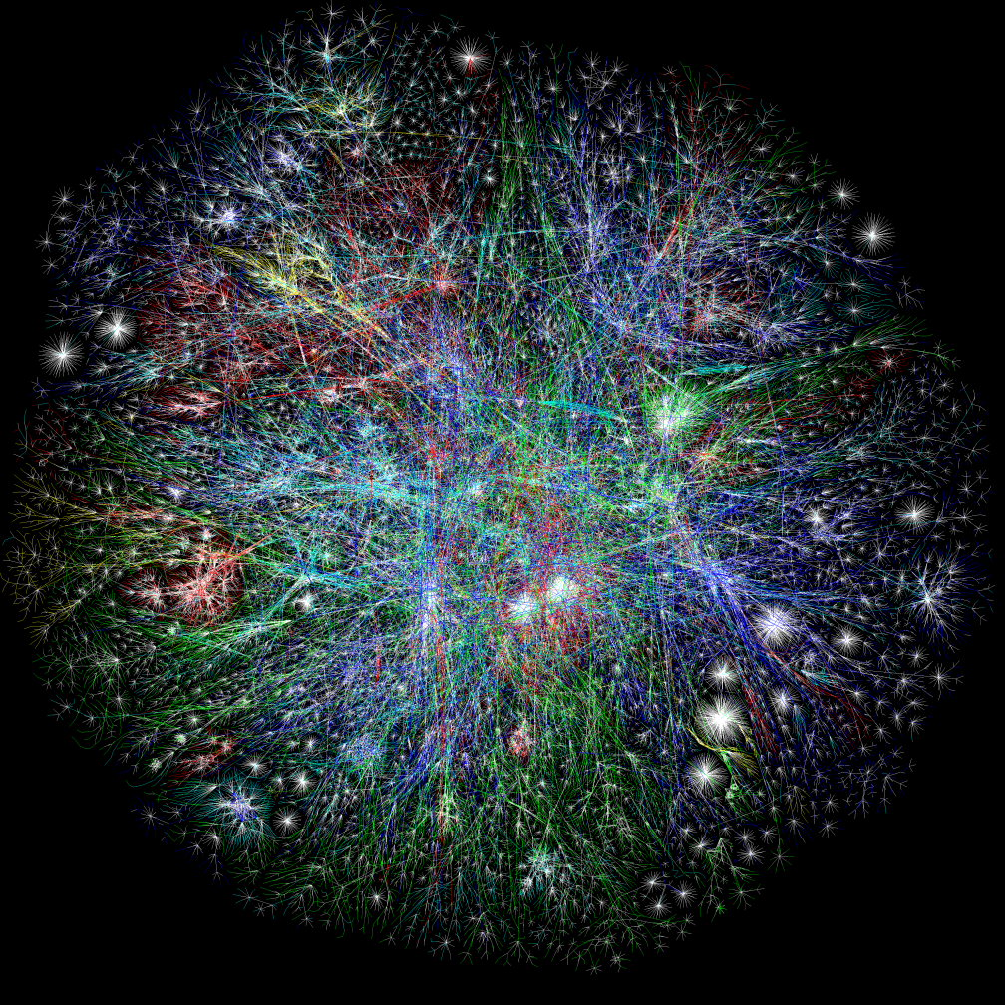
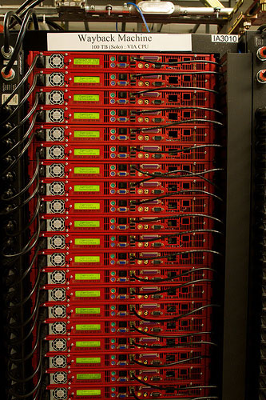
A very multi-homed Sybil attacker

Slide 22
Implications?
Without “too much” expense, attacker is able to
  Create a potentially huge number of attack points
  Situate them all over the network (with a little help from AT&T or Verizon or some other widely diversified ISP)
  Run whatever he would like on the nodes rather efficiently, gaining a 50x or even 100’sx scale-up factor!
And this really works…
  See, for example, the Honeypot work at UCSD
  U. Michigan (Brian Ford, Peter Chen) another example

Slide 23
Defending against Sybil attacks
Often system maintains a black list
  If nodes misbehave, add to black list
  Need a robust way to share it around
  Then can exclude the faulty nodes from the application
  Issues? Attacker may try to hijack the black list itself
    So black list is usually maintained by central service
Check joining nodes
  Make someone solve a puzzle (proof of human user)
  Perhaps require a voucher “from a friend”
Finally, some systems continuously track “reputation”

Slide 24
Reputation
Basic idea:
  Nodes track behavior of other nodes
  Goal is to
    Detect misbehavior
    Be in a position to prove that it happened
  Two versions of reputation tracking
    Some systems assume that the healthy nodes outnumber the misbehaving ones (by a large margin)
      In these, a majority can agree to shun a minority
    Other systems want proof of misbehavior

Slide 25
Proof?
Suppose that we model a system as a time-space diagram, with processes, events, messages
e₀ e₁ e₃
p
e₄ e₅ e₆
q
e₇ e₈
r
e₉ e₁₀ e₁₁
s

Slide 26
Options
Node A to all:
  Node B said “X” and I can prove it
  Node B said “X” in state S and I can prove it
  Node B said “X” when it was in state S after I reached state S’ and before I reached state S’’
First two are definitely achievable. Last one is trickier and comes down to cost we will pay
Collusion attacks are also tricky

Slide 27
Collusion
Occurs when the attack compromises multiple nodes
With collusion they can talk over their joint story and invent a plausible and mutually consistent one
They can also share their private keys, gang up on a defenseless honest node, etc

Slide 28
An irrefutable log
Look at an event sequence: e₀ e₁ e₂
Suppose that we keep a log of these events
If I’m shown a log, should I trust it?
  Are the events legitimate?
  We can assume public-key cryptography (“PKI”)
  Have the process that performed
  each event sign for it
e₀
[e₀ ]_{p}

Slide 29
Use of a log?
It lets a node prove that it was able to reach state S
Once an honest third party has a copy of the node, the creator can’t back out of the state it claimed to reach
But until a third party looks at the log, logs are local and a dishonest node could have more than one…

Slide 30
An irrefutable log
But can I trust the sequence of events?
  Each record can include a hash of the
  prior record
Doesn’t prevent a malicious process from maintaining multiple versions of the local log (“cooked books”)
But any given log has a robust record sequence now
[MD5(e₀ ): e₁ ]_{p}

Slide 31
An irrefutable log
What if p talks to q?
  p tells q the hash of its last log entry (and signs for it)
  q appends to log and sends log record back to p
e₀ e₁
p
[MD5_{p} (e₀ ): e₁ ]_{p}
[[e₂ ]_{q} [[e₁ ]_{p} : m]_{p} ]_{q}
[[e₁ ]_{p} : m]_{p}
e₂
q
[ e₂ ]_{q}
Generates e₃ as incoming msg. New log record is [[e₂ ]_{q} [[e₁ ]_{p} : m]_{p} ]_{q}

Slide 32
What does this let us prove?
Node p can prove now that
  When it was in state S
  It sent message M to q
  And node q received M in state S’
Obviously, until p has that receipt in hand, though, it can’t know (much less prove) that M was received

Slide 33
An irrefutable log
q has freedom to decide when to receive the message from p… but once it accepts the message is compelled to add to its log and send proof back to p
p can decide when to receive the proof, but then must log it
Rule: must always log the outcome of the previous exchange before starting the next one

Slide 34
Logs can be audited
Any third party can
  Confirm that p’s log is a well-formed log for p
  Compare two logs and, if any disagreement is present, can see who lied
Thus, given a system, we can (in general) create a consistent snapshot, examine the whole set of logs, and identify all the misbehaving nodes within the set
Idea used in NightWatch (Haridisan, Van Renesse 07)

Slide 35
Costs?
Runtime overhead is tolerable
  Basically, must send extra signed hashes
  These objects are probably 128 bits long
Computing them is slow, however
  Not extreme, but encrypting an MD5 hash isn’t cheap
Auditing a set of logs could be very costly
  Study them to see if they embody a contradiction
  Could even check that computation was done correctly

Slide 36
Methods of reducing costs
One idea: don’t audit in real-time
  Run auditor as a background activity
  Periodically, it collects some logs, verifies them individually, and verifies the cross-linked records too
Might only check “now and then”
For fairness: have everyone do some auditing work
If a problem is discovered, broadcast the bad news with a proof (use gossip: very robust). Everyone checks the proof, then shuns the evil-doer

Slide 37
Limits of auditability
Underlying assumption?
  Event information captures everything needed to verify the log contents
But is this assumption valid?
  What if event says “process p detected a failure of process q”
    Could be an excuse used by p for ignoring a message!
  And we also saw that our message exchange protocol still left p and q some wiggle room (“it showed up late…”)

Slide 38
Apparent need?
Synchronous network
Accurate failure detection
In effect: auditing is as hard as solving consensus
But if so, FLP tells us that we can never guarantee that auditing will successfully reveal truth

Slide 39
How systems deal with this?
Many don’t: Most P2P systems can be disabled by Sybil attacks
Some use human-in-the-loop solutions
  Must prove human is using the system
  And perhaps central control decides who to allow in
Auditing is useful, but no panacea

Slide 40
Other similar scenarios
Think of Astrolabe
  If “bad data” is relayed, can contaminate the whole system (Amazon had such an issue in August 08)
Seems like we could address this for leaf data with signature scheme… but what about aggregates
  If node A tells B that “In region R, least loaded machine at time 10:21.376 was node C with load 5.1”
  Was A using valid inputs? And was this correct at that specific time?
  An evil-doer could delay data or detect failures to manipulate the values of aggregates!

Slide 41
Auditable time?
Only way out of temporal issue is to move towards a state machine execution
  Every event…
  … eventually visible to every healthy node
  … in identical order
  … even if nodes fail during protocol, or act maliciously
With this model, a faulty node is still forced to accept events in the agreed upon order

Slide 42
Summary?
Sybil attacks: remarkably hard to stop
  With small numbers of nodes: feasible
  With large numbers: becomes very hard
Range of options
  Simple schemes like blacklists
  Simple forms of reputation (“Jeff said that if I mentioned his name, I might be able to join…”)
  Fancy forms of state tracking and audit

