Slide 1
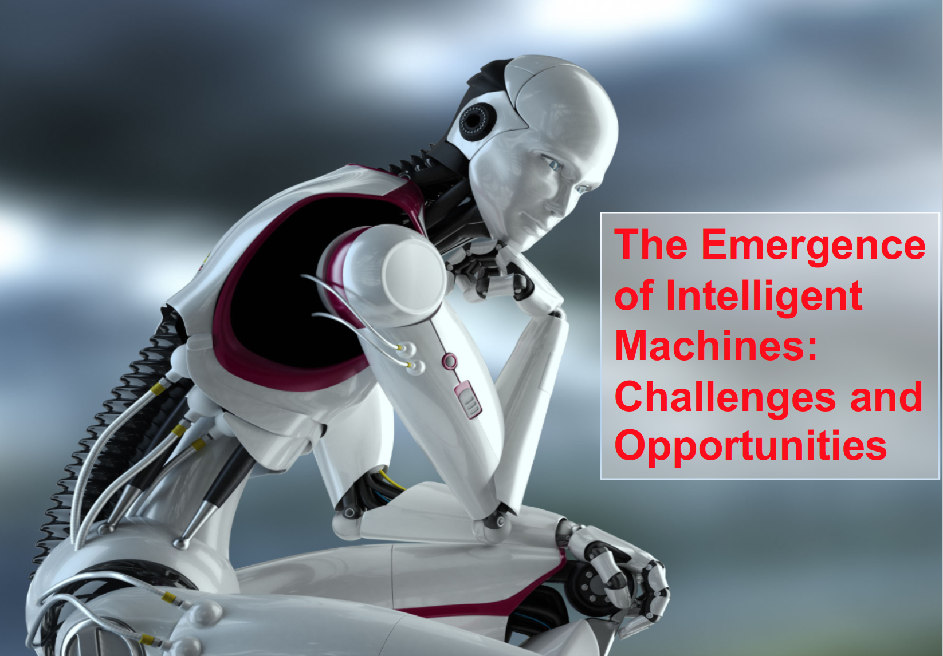
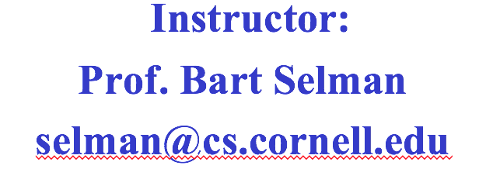


Slide 2
The Emergence of Artificial Intelligence Introduction
I Emergence of (semi-)intelligent autonomous systems in society
--- Self-driving cars and trucks. Autonomous drones.
Virtual assistants. Fully autonomous trading systems.
Assistive robotics.
II Shift of AI research from academic to real-world
--- Enabled by qualitative change in the field,
driven in part by “Deep Learning” & Big Data.

Slide 3
Reasons for Dramatic Progress
--- series of events
--- main one: machine perception is starting to work (finally!)
systems are starting to “hear” and “see”
after “only” 50+ yrs of research…
--- dramatic change: lots of AI techniques (reasoning, search,
reinforcement learning, planning, decision theoretic
methods) were developed assuming perceptual inputs were
“somehow” provided to the system. But, e.g., robots could
not really see or hear anything…
(e.g. 2005 Stanley car drove around blind; developers were
told “don’t bother putting in a camera” --- Thrun, Stanford)
Now, we can use output from a perceptual system and
leverage a broad range of existing AI techniques.
Our systems are finally becoming “grounded in (our) world.”
Already: super-human face recognition (Facebook)
super-human traffic sign recognition (Nvidia)

Slide 4
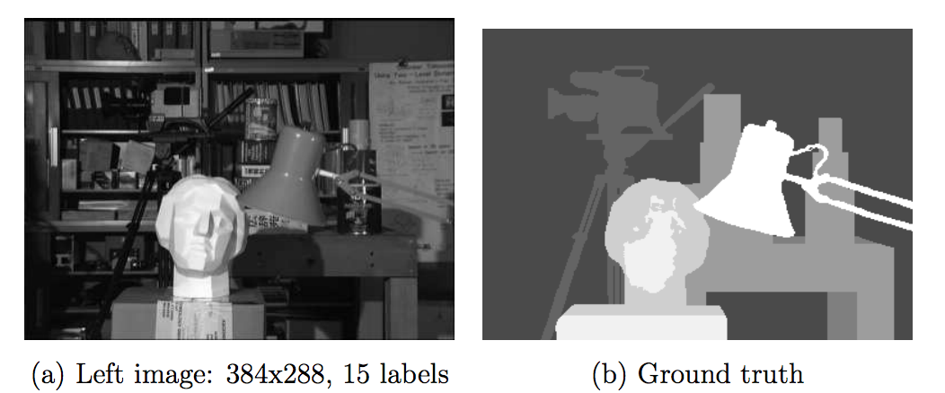
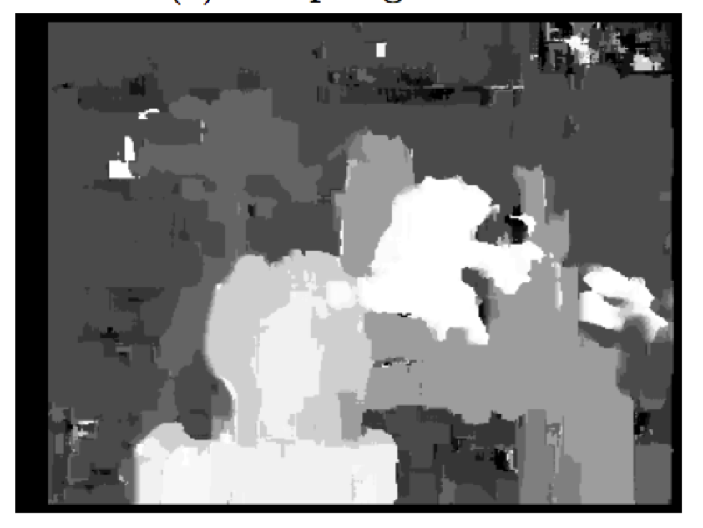
Computer vision / Image Processing ca. 2005
(human labeled)
(machine labeled)
2005 --- sigh ☹
(c) Processed image

Slide 5
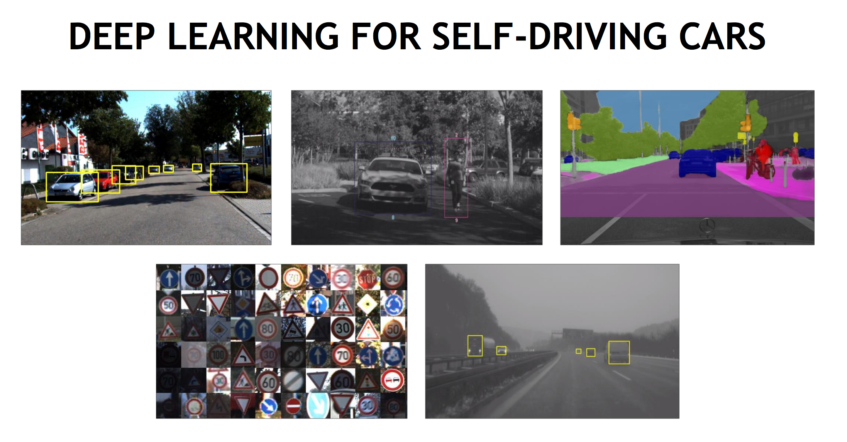
Note
labeling!
Statistical model (neural net) trained on >1M images;
Models with > 500K parameters
Requires GPU power
(Mobileye 2016;
Nvidia 2016)

Slide 6
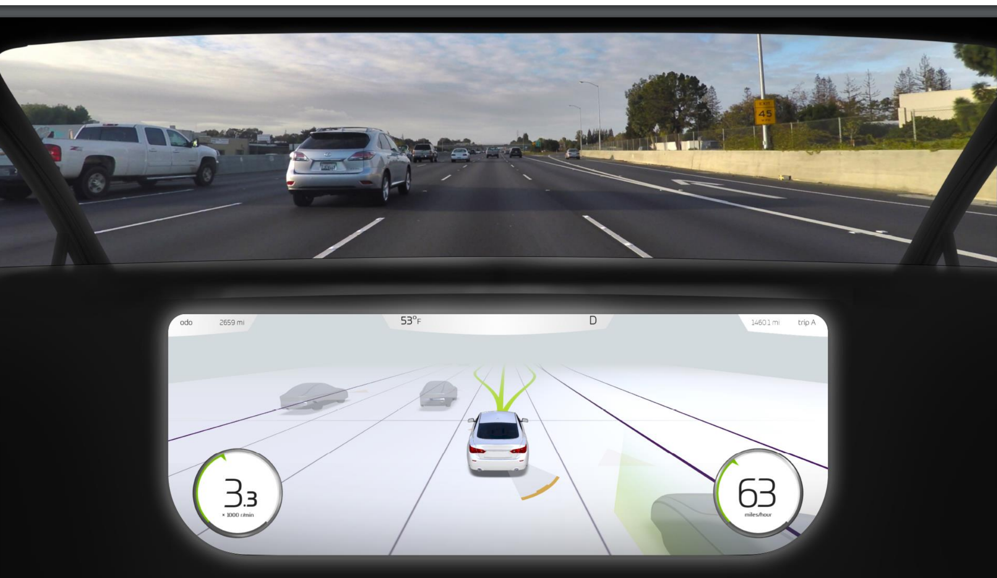
Real-time tracking of environment (360 degrees/ 50+m) and decision making.

Slide 7
Factors in accelerated progress, cont.
--- deep learning / deep neural nets
success is evidence in support of the “hardware hypothesis”
(need to get near brain compute power; Moravec)
core neural net ideas from mid 1980s
needed: several orders of magnitude increase
in computational power and data
Aside:
(1) This advance was not anticipated/predicted at all.
by 2000, almost all AI/ML researchers had moved away from
neural nets… changed around 2011/12.
(2) Algorithmic advances still provided larger part of
speedups than hardware. Core algorithmic concept from 1980s
but key additional advances since.
+ BIG DATA!

Slide 8
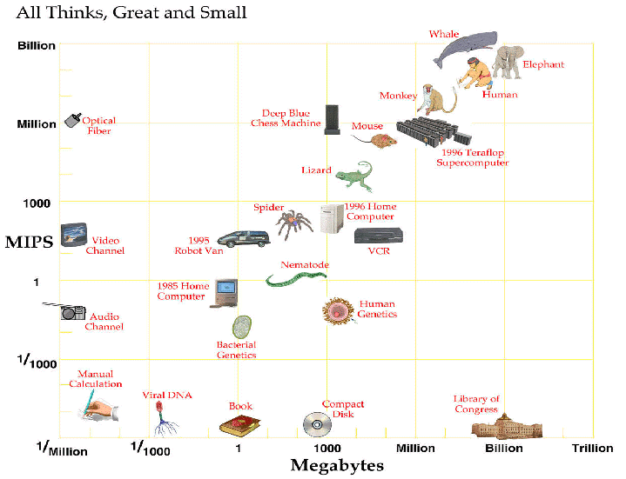
Computer vs. Brain
approx. 2030
$1K compute
resources will
match
human brain
compute and storage
capacity
Processing Speed
Memory

Slide 9
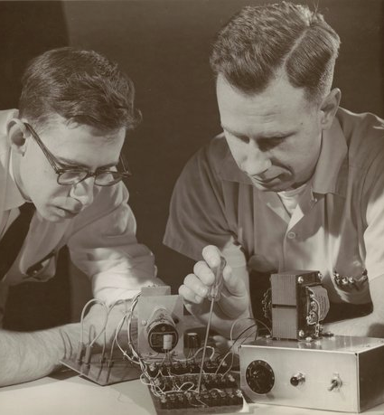
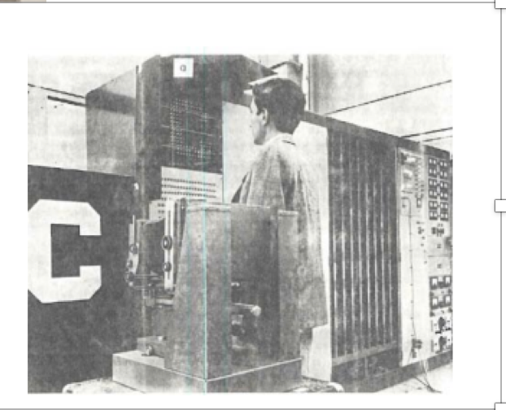
Historical Aside: The first learning Artificial Neural Net was developed at Cornell.
Rosenblatt (left), 1958.
(unfortunately,
patent long expired…)

Slide 10
Progress, cont.
--- crowd-sourced human data --- machines need to understand
our conceptualization of the world. E.g. vision for self driving
cars trained on 100,000+ images of labeled road data.
--- engineering teams (e.g. IBM’s Watson)
strong commercial interests
at a scale never seen before in our field
--- Investments in AI systems are being scaled-up by an order
of magnitude (to billions).
Google, Facebook, Baidu, IBM, Microsoft, Tesla etc. ($2B+)
+ military ($19B proposed)
An AI arms race

Slide 11
AI milestones starting in the late 90s
1997 IBM’s Deep Blue defeats Kasparov
2005 Stanley --- self-driving car (controlled environment)
IBM’s Watson wins Jeopardy! (question answering)
Speech recognition via “deep learning” (Geoff Hinton)
2014 Computer vision is starting to work (deep learning)
2015 Microsoft demos real-time translation (speech to speech)
Google’s AlphaGo defeats Lee Sedol
Google’s WaveNet --- human level speech synthesis
Watson technology automates 30 mid-level office insurance claim workers, Japan (IBM).
Automated dermatologists, human expert accuracy (Stanford)
Poker, Heads-up, No-Limit Texas Hold’em, CMU program beats top human players

Slide 12
AI milestones starting in the late 90s
Lecture topic
1997 IBM’s Deep Blue defeats Kasparov
2005 Stanley --- self-driving car (controlled environment)
IBM’s Watson wins Jeopardy! (question answering)
Speech recognition via “deep learning” (Geoff Hinton)
2014 Computer vision is starting to work (deep learning)
2015 Microsoft demos real-time translation (speech to speech)
Google’s AlphaGo defeats Lee Sedol
Google’s WaveNet --- human level speech synthesis
Watson technology automates 30 mid-level office insurance claim workers, Japan (IBM).
Automated dermatologists, human expert accuracy (Stanford)
Poker, Heads-up, No-Limit Texas Hold’em, CMU program beats top human players
Alpha-beta search
A* search
K&R / agents
Neural nets
Deep learning
Monte-Carlo search
Reinforcement
learning
Multi-Agent
Systems

Slide 13
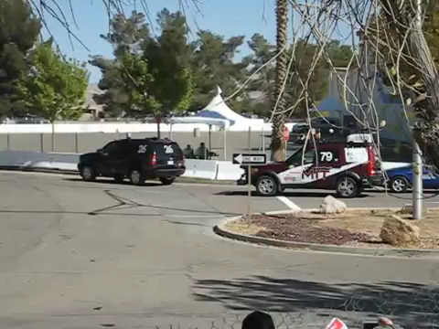
Historical aside:
World’s first collision between fully autonomous cars (2007)
CORNELL
MIT

Slide 14

Next Phase
Further integration of techniques --- perception, (deep) learning, inference, planning --- will be a game changer for AI systems.
Example: AlphaGo:
Deep Learning
+
Reasoning
(Google/Deepmind 2016, 2017)

Slide 15
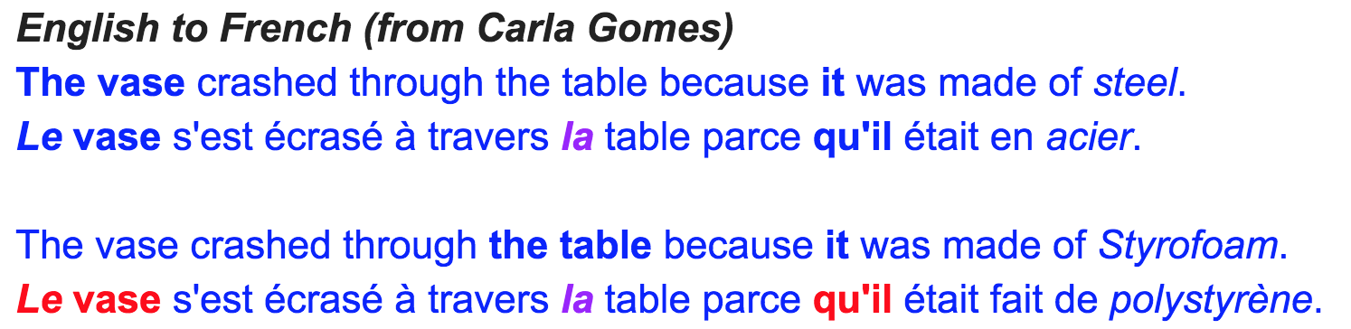
What We Can’t Do Yet [Detailed]
Aside:
Google translation is
really done without
any understanding
of the text!
(very unexpected)
Need deeper semantics of natural language
Requires commonsense knowledge and reasoning
Example:
“The large ball crashed through the table because it was made of Styrofoam.”
What was made of Styrofoam? The large ball or the table?
“The large ball crashed through the table because it was made of steel.”
Hmm… Can’t Google figure this out? No! (Carla Gomes)
Reference Resolution, Winograd Schemas, Oren Etzioni, Allen AI Institute

Slide 16
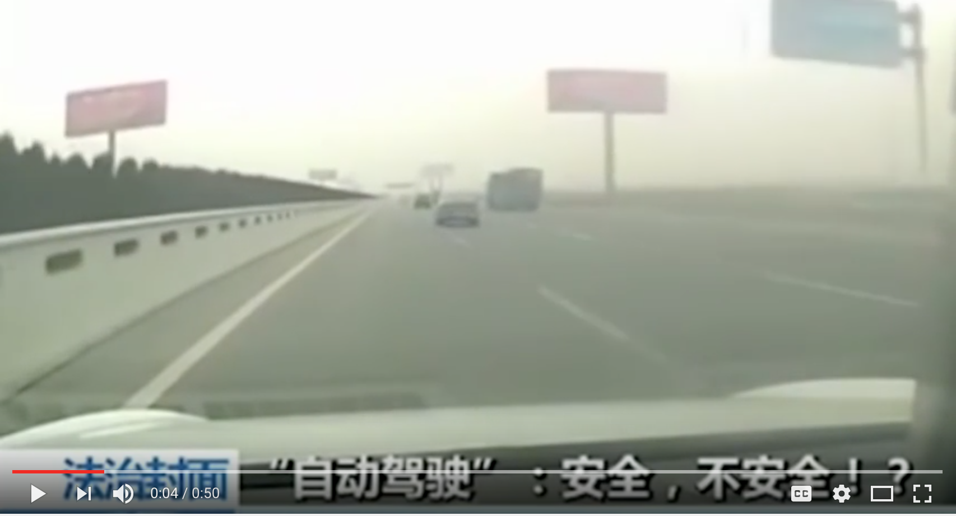
What We Can’t Do Yet
Need deeper semantics of natural language
Commonsense knowledge and reasoning
Example: “The large ball crashed right through the table because it was made of Styrofoam.”
What does “it” refer to? The large ball or the table?
vs: “The large ball crashed right through the table because it was made of steel.”
(Oren Etzioni, Allen AI Institute)
Commonsense is
needed to deal with
unforeseen cases.
(i.e., cases not in training
data)
China Tesla crash --- consider how human driver handles this!
You Tube: Tesla crashes into an orange streetsweeper on Autopilot –Chinese Media

Slide 17
The emergence of intelligent autonomous machines among us is expected to have a major impact on society.
“Preparing for the Future of Artificial Intelligence”
White House Report,
Executive Office of the President, Oct. 2016
Societal issues:
1) Economics (wealth inequality) & Employment
2) AI Safety & Ethics
3) Military Impact (Smart autonomous weapon systems)
4) The Future: Super-Intelligence? Living with smart machines.
Elon Musk: Future of Life Institute (Max Tegmark, MIT)
AI Safety research program
In detail in “AI, Society, and Ethics” seminar course.

Slide 18
1) Economic Impact: Technological Unemployment
Example 1: self-driving vehicles (5 - 10 yrs).
90+% accident reduction BUT
Transportation covers about 1 in 10 US jobs!
Not so easy to replace… Also hospital emergency
room reduction…
Retrain? But for what?
Knowledge worker? (see next)
STEM field? (too small)
Example 2: IBM Watson style automation of
30 insurance admin jobs (2017, Japan).
Expensive to create system but easy to duplicate…
Places mid-level knowledge-based jobs at risk.

Slide 19
Most jobs with a significant routine component will be affected.
Significant economic incentive for companies to pursue automation.
40+% of jobs at risk.
It appears inevitable that advanced AI (systems that can hear, see, reason, plan, and learn) will have a significant impact on employment and our society in general.
Human society will need to prepare itself.
Universal basic income?
Without work, how do we feel useful?
Amplification of wealth inequality?

Slide 20
2) AI Safety & Ethics
Area 1: Issues with Machine Learning (ML)
Data-Driven Approaches
Data-driven ML approaches are starting to provide
decision support at all levels of society.
Examples:
Financial loan approvals
Hiring / interview decisions
Google search order rankings
College applicant selection
Medical diagnosis
What’s in your news feed…
Your year-end raise
Etc.

Slide 21
What about hidden biases in these decisions? & Are data-driven decisions fair?
ML approaches include hidden biases from data (e.g. past hiring / performance data) and from algorithms (e.g., what types of unfair bias cannot be eliminated?)
EU on the forefront: Working on laws to require explainable machine learning results. Also, statistical models need to be shown to adhere to non-discrimination laws.
Problem: not so easy to do!
But, at least, Google can longer just say “Results are fair because they are decided by an algorithm and data. And, algorithms and data are always fair.” That worked great for a while… :-)

Slide 22
2) AI Safety & Ethics, cont.
Area 2: Autonomous Goal-Driven Systems that Plan and Reason
Autonomous AI systems (eg robots or virtual assistants) no longer follow the traditional programming paradigm with detailed hand-coded sequence of instructions.
[See AI Planning in R&N.]
Instead: only high-level goals or instructions are given, and the system synthesizes a sequence of actions to perform given the current sensory inputs.
How do we ensure that these decision making systems do what we want them to do and do so in a responsible matter benefiting humans?
“The Value Alignment Problem.” Stuart Russell, UC Berkeley.

Slide 23
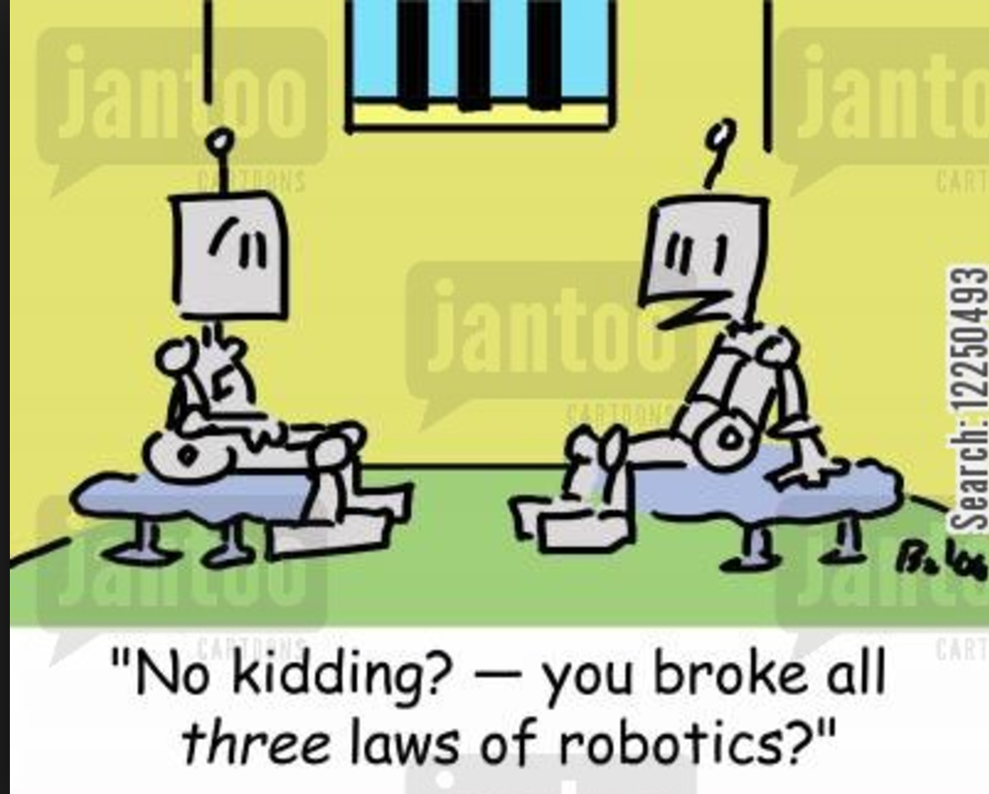
AAAI 1994 --- Etzioni and Weld revisited Asimov’s laws of robotics (including “do no harm to humans”). Paper showed many difficulties in implementing such laws.
Example: just ask your robot to take your car to the carwash!
[Weld anecdote]
Ethical issues are often framed in extreme terms. E.g. should a self-driving car risk the lives of pedestrians to save its passenger?
However, issue is much more practical:
Ask your self-driving car to pass the slow car in front of you to get to your meeting on time.
Slightly increases your own safety risk but also for people in other cars. Should your car obey? (scenarios will occur thousands of times per day) Who’s responsible for accidents?
Ethics is back!

Slide 24
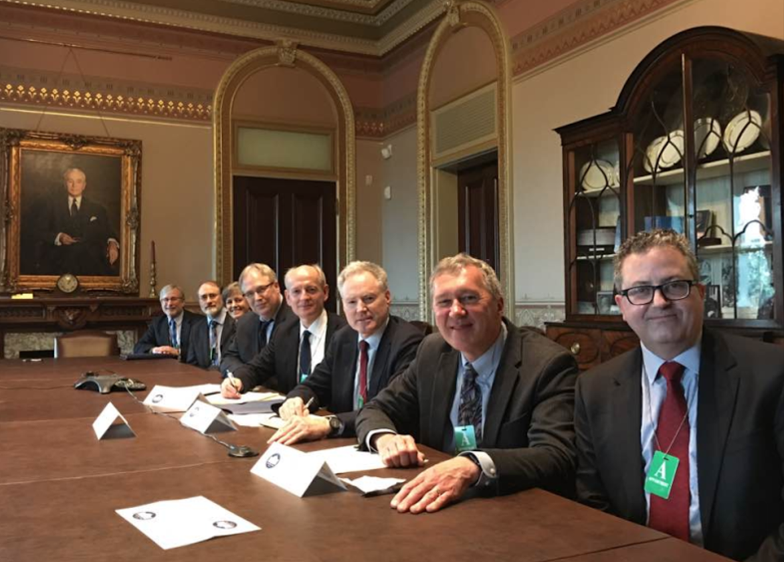
3) War & Peace
AI scientists and others have recently raised significant concerns about the risks of an smart, AI-based Autonomous Weapons race.
Lots of pressure to take the human out of the loop in weapon systems because of the need for ever-faster time-critical decisions.
Also part of cyber-security and cyber-defense discussions, with countries working on AI-based autonomous software.
Issue far from resolved. Discussions at all levels, both national and international (UN). Various non-proliferation arms treaties are being considered. Call for Autonomous AI Weapon Ban. August 2017.
AI researchers discussing the risk of an AI Arms Race
at the White House, 2016.

Slide 25

4) Future: Super-Human Intelligence?
Super-human AI often gets the most press.
Will we be “superseded” by smart machines?
May work out much better than some have argued. Push for AI Safety Research (funded by Elon Musk and others) will quite likely ensure a tight coupling between human and machine interests.
Also, even if machines outperform us on a range of intellectual tasks, that does necessarily mean we won’t be able to understand the systems. Humans can understand complex solutions even if we do not discover them ourselves!
We’re on an exciting intellectual journey in the history of humanity!

