Slide 1
CS 4700:
Foundations of Artificial Intelligence
Prof. Bart Selman
selman@cs.cornell.edu
Machine Learning:
Decision Trees
R&N 18.3

Slide 2
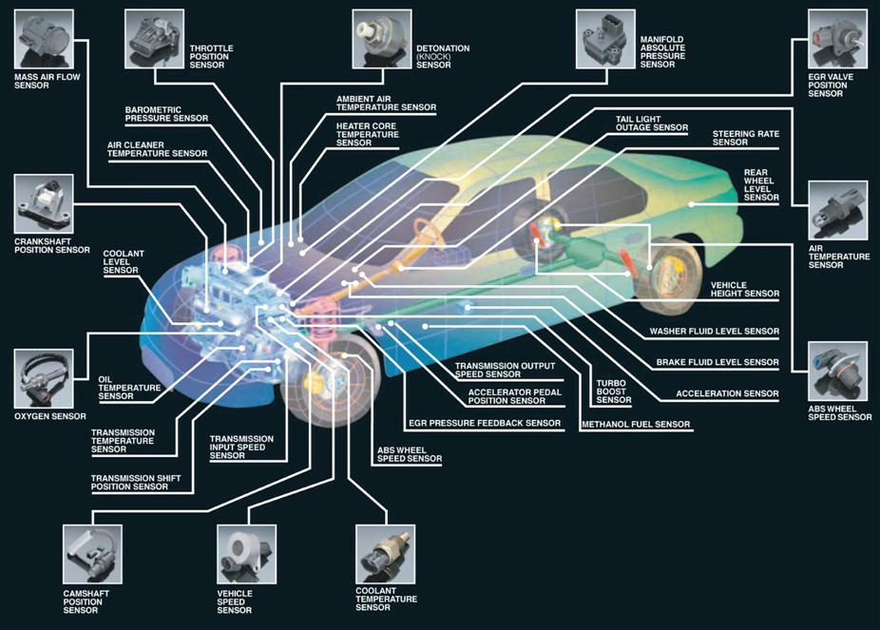
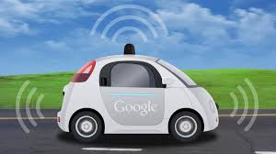
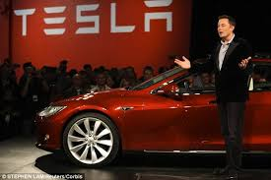
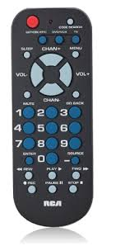
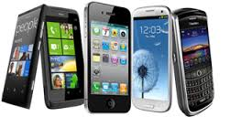
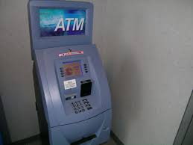
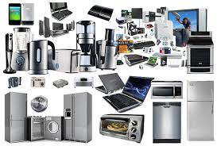
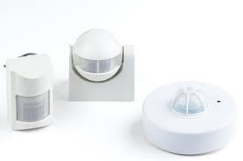

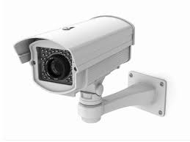
Big Data:
Sensors Everywhere
Data collected and stored at
enormous speeds (GB/hour)
Cars
Cellphones
Remote Controls
Traffic lights,
ATM machines
Appliances
Motion sensors
Surveillance cameras
etc etc

Slide 3
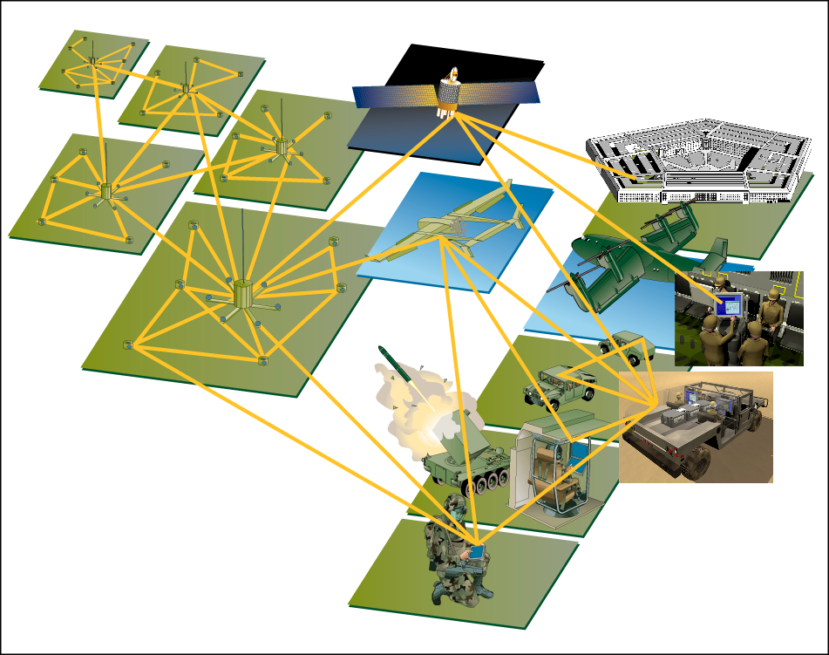
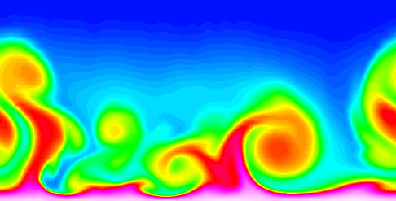
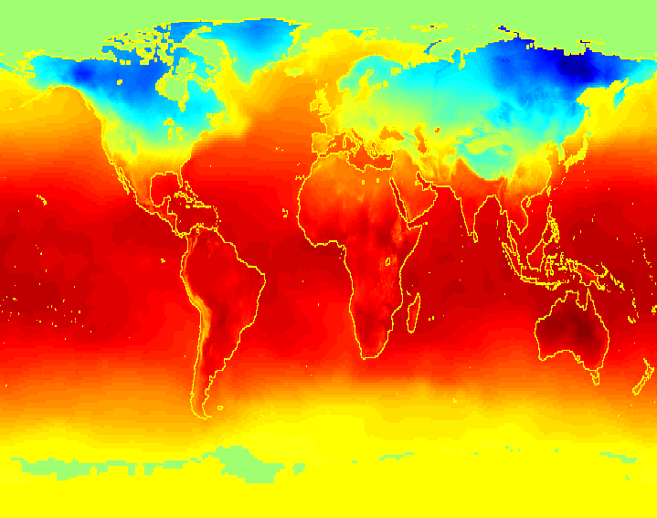
Big Data:
Scientific Domains
Data collected and stored at
enormous speeds (GB/hour)
  remote sensors on a satellite
  telescopes scanning the skies
  microarrays generating gene
  expression data
  scientific simulations
  generating terabytes of data
Traditional statistical techniques infeasible to deal with the data TUSNAMI – they don’t scale up!!!
→ Machine Learning Techniques
(adapted from Vipin Kumar)

Slide 4
Machine Learning Tasks
Prediction Methods
  Use some variables to predict unknown or future values of other variables.
Description Methods
  Find human-interpretable patterns that describe the data.

Slide 5
Machine Learning Tasks
Supervised learning:
We are given a set of examples with the correct answer - classification and regression
Unsupervised learning: “just make sense of the data”

Slide 6
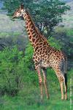
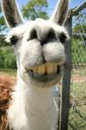

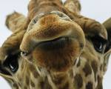
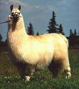

Example: Supervised Learning object recognition
Classification
x
f(x)
Target
Function
giraffe
giraffe
giraffe
llama
llama
llama

Slide 7
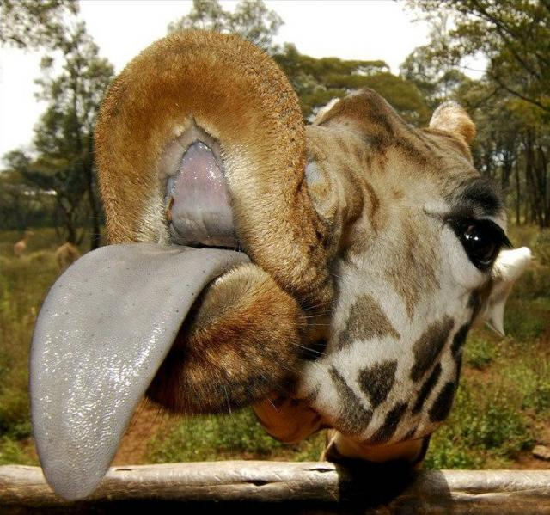
Example: Supervised Learning object recognition
Classification
x
f(x)
Target
Function
giraffe
giraffe
giraffe
llama
llama
llama
X=
f(x)=?

Slide 8
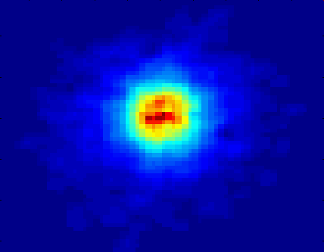
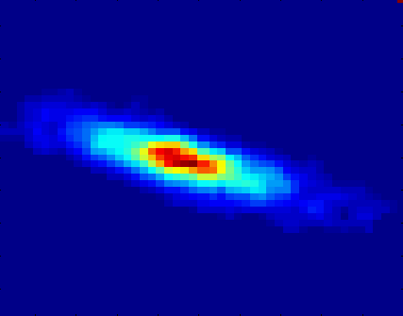
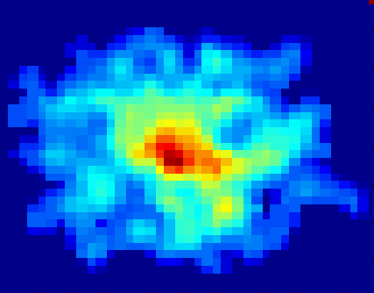
Classifying Galaxies
Courtesy: http://aps.umn.edu
Early
Class:
Stages of Formation
Attributes:
Image features,
Characteristics of light waves received, etc.
Intermediate
Late
Data Size:
72 million stars, 20 million galaxies
Object Catalog: 9 GB
Image Database: 150 GB

Slide 9
Supervised learning: curve fitting
Regression

Slide 10
Supervised learning: curve fitting
Regression

Slide 11
Supervised learning: curve fitting
Regression

Slide 12
Supervised learning: curve fitting
Regression

Slide 13
Supervised learning: curve fitting
Regression

Slide 14
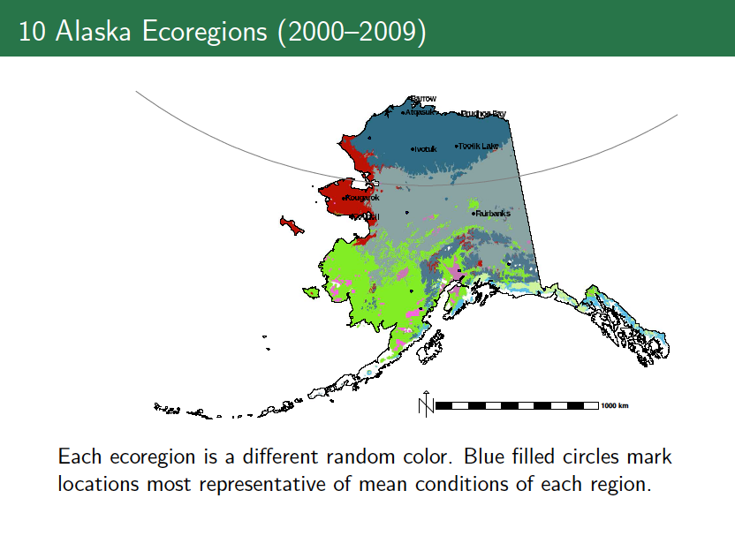
Unsupervised Learning:
Clustering
Ecoregion Analysis of Alaska using clustering
“Representativeness-based Sampling Network Design for the State of Alaska.” Hoffman, Forrest M., Jitendra Kumar, Richard T. Mills, and William W. Hargrove. 2013. Landscape Ecology

Slide 15
Machine Learning
In classification – inputs belong two or more classes.
Goal: the learner must produce a model that assigns unseen inputs to one (or multi-label classification) or more of these classes. Typically supervised learning.
  Example –
  Spam filtering is an example of classification, where the inputs are email (or other) messages and the classes are "spam" and "not spam".
In regression, also typically supervised, the outputs are continuous rather than discrete.
In clustering, a set of inputs is to be divided into groups. Typically done in an unsupervised way (i.e., no labels, the groups are not known beforehand).

Slide 16
Supervised learning: Big Picture
Goal: To learn an unknown target function f
Input: a training set of labeled examples (x_{j},y_{j}) where y_{j} = f(x_{j})
    E.g., x_{j} is an image, f(x_{j}) is the label “giraffe”
    E.g., x_{j} is a seismic signal, f(x_{j}) is the label “explosion”
Output: hypothesis h that is “close” to f, i.e., predicts well on unseen examples (“test set”)
Many possible hypothesis families for h
  Linear models, logistic regression, neural networks, support vector machines, decision trees, examples (nearest-neighbor), grammars, kernelized separators, etc etc

Slide 17
Big Picture of Supervised Learning
Today: Decision Trees!
Learning can be seen as fitting a function to the data. We can consider
different target functions and therefore different hypothesis spaces.
Examples:
Propositional if-then rules
Decision Trees
First-order if-then rules
First-order logic theory
Linear functions
Polynomials of degree at most k
Neural networks
Java programs
Turing machine
Etc
A learning problem
is realizable if its hypothesis space contains the true function.
Tradeoff between expressiveness of
a hypothesis space and the
complexity of finding simple, consistent hypotheses
within the space.

Slide 18
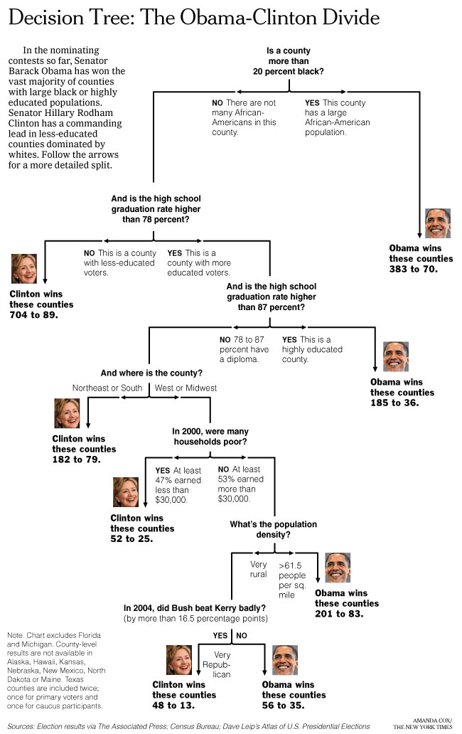
Can we learn
how counties vote?
New York Times
April 16, 2008
Decision Trees:
a sequence of tests.
Representation very natural for humans.
Style of many “How to” manuals and trouble-shooting
procedures.

Slide 19
Note: order of tests
matters (in general)!

Slide 20
Decision tree
learning approach
can construct tree
(with test thresholds)
from example counties.

Slide 21
Decision Tree Learning

Slide 22
Decision Tree Learning
Task:
  Given: collection of examples (x, f(x))
  Return: a function h (hypothesis) that approximates f
  h is a decision tree
Input: an object or situation described by a set of attributes (or features)
Output: a “decision” – the predicts output value for the input.
The input attributes and the outputs can be discrete or continuous.
We will focus on decision trees for Boolean classification:
each example is classified as positive or negative.

Slide 23
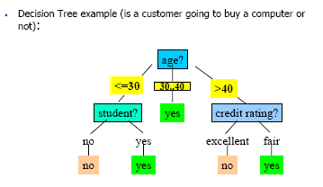
Decision Tree
What is a decision tree?
A tree with two types of nodes:
Decision nodes
Leaf nodes
Decision node: Specifies a choice or test of some attribute with 2 or more alternatives;
→ every decision node is part of a path to a leaf node
Leaf node: Indicates classification of an example

Slide 24
Big Tip Example
Etc.
Instance Space X: Set of all possible objects described by attributes (often called features).
Target Function f: Mapping from Attributes to Target Feature
(often called label) (f is unknown)
Hypothesis Space H: Set of all classification rules h_{i} we allow.
Training Data D: Set of instances labeled with Target Feature

Slide 25
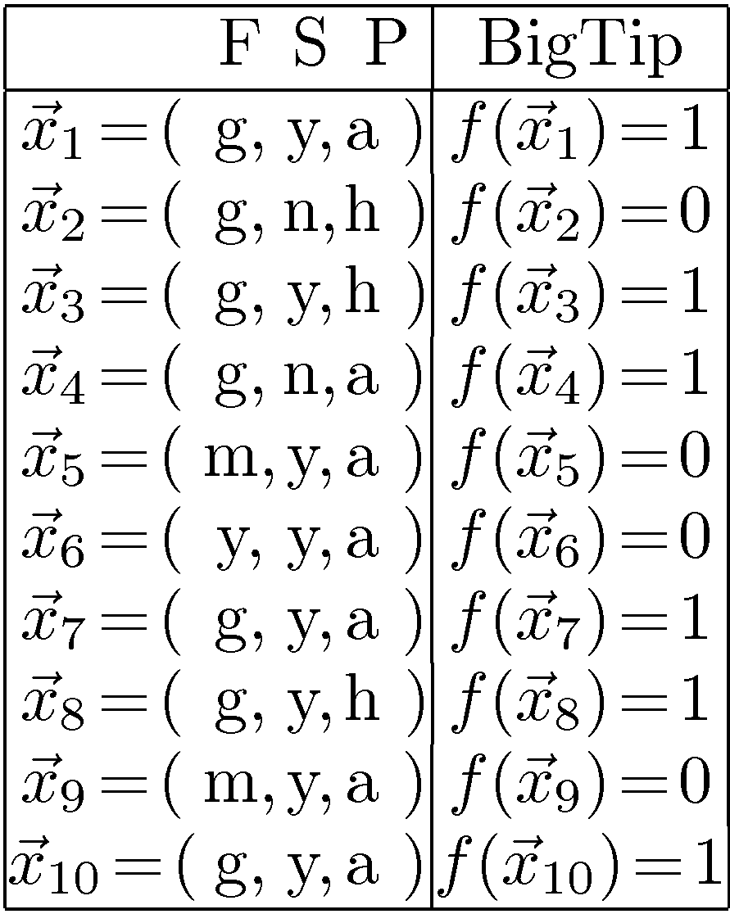
Decision Tree Example: “BigTip”
great
Food
yuck
mediocre
Speedy
no
no
no
yes
Our data
yes
Price
high
adequate
yes
no
Is the decision tree we learned consistent?
Yes, it agrees with all the examples!
Data: Not all 2x2x3 = 12 tuples
Also, some repeats! These are
literally “observations.”
Notes:
Definition of components
Internal nodes: tests on attributes
Branches: attribute value (one branch for each value)
Leaves: assign classification
Understanding example tree
Classify Example 1: yes
Classify Example 2: yes
Classify Example 3: no
Classify Example 4: yes
Classify: $x_2=(Food=great, Chat=no, Fast=no, Price=adequate, Bar=no)$ $\rightarrow$ yes
Example represents function: (Food=great) AND ((Fast=yes) OR ((Fast=no) AND (Price=adequate)))
→ Simplify to: (Food=great) AND ((Fast=yes) OR (Price=adequate))
How would you represent:
A AND B
A OR B
A XOR B

Slide 26
Learning decision trees:
Another example (waiting at a restaurant)
Problem: decide whether to wait for a table at a restaurant. What attributes would you use?
Attributes used by R&N
  Alternate: is there an alternative restaurant nearby?
  Bar: is there a comfortable bar area to wait in?
  Fri/Sat: is today Friday or Saturday?
  Hungry: are we hungry?
  Patrons: number of people in the restaurant (None, Some, Full)
  Price: price range ($, $$, $$$)
  Raining: is it raining outside?
  Reservation: have we made a reservation?
  Type: kind of restaurant (French, Italian, Thai, Burger)
  WaitEstimate: estimated waiting time (0-10, 10-30, 30-60, >60)
Aside:
What about using
restaurant name?
It could be great for
generating a small
tree …
But it doesn’t
generalize!
Goal predicate: WillWait?

Slide 27
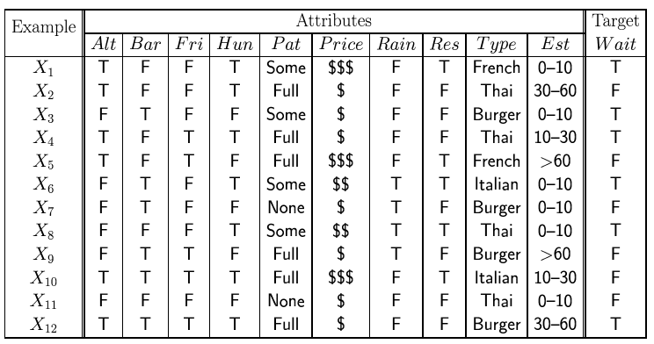
Attribute-based representations
Examples described by attribute values (Boolean, discrete, continuous)
E.g., situations where I will/won't wait for a table:
Classification of examples is positive (T) or negative (F)
12 examples
6 +
6 -

Slide 28
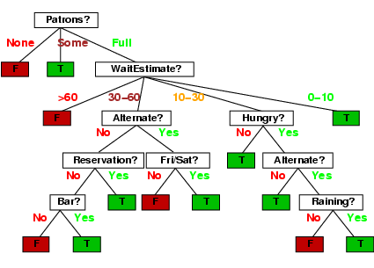
Decision trees
One possible representation for hypotheses
E.g., here is a tree for deciding whether to wait:

Slide 29
Decision tree learning Algorithm
Decision trees can express any Boolean function.
Goal: Finding a decision tree that agrees with training set.
We could construct a decision tree that has one path to a leaf for each example, where the path tests sets each attribute value to the value of the example.
Overall Goal: get a good classification with a small number of tests.
What is the problem with this from a learning point of view?
Problem: This approach would just memorize example. How to deal with new examples? It doesn’t generalize!
(But sometimes hard to avoid --- e.g. parity function, 1, if an even number of inputs, or majority function, 1, if more than half of the inputs are 1).
We want a compact/smallest tree.
But finding the smallest tree consistent with the examples is NP-hard!

Slide 30
Basic DT Learning Algorithm
“most significant”
In what sense?
Goal: find a small tree consistent with the training examples
Idea: (recursively) choose "most significant" attribute as root of (sub)tree;
Use a top-down greedy search through the space of possible decision trees.
Greedy because there is no backtracking. It picks highest values first.
Variations of known algorithms ID3, C4.5 (Quinlan -86, -93)
Top-down greedy construction
  Which attribute should be tested?
    Heuristics and Statistical testing with current data
  Repeat for descendants
(ID3 Iterative Dichotomiser 3)

Slide 31
Big Tip Example
10 examples:
6+
1
3
4
7
8
10
4-
2
5
6
9
Attributes:
Food with values g,m,y
Speedy? with values y,n
Price, with values a, h
Let’s build our decision tree
starting with the attribute Food,
(3 possible values: g, m, y).
Notes:
Definition of components
Internal nodes: tests on attributes
Branches: attribute value (one branch for each value)
Leaves: assign classification
Understanding example tree
Classify Example 1: yes
Classify Example 2: yes
Classify Example 3: no
Classify Example 4: yes
Classify: $x_2=(Food=great, Chat=no, Fast=no, Price=adequate, Bar=no)$ $\rightarrow$ yes
Example represents function: (Food=great) AND ((Fast=yes) OR ((Fast=no) AND (Price=adequate)))
→ Simplify to: (Food=great) AND ((Fast=yes) OR (Price=adequate))
How would you represent:
A AND B
A OR B
A XOR B

Slide 32
Top-Down Induction of Decision Tree:
Big Tip Example
Node “done” when uniform label, “no
further
Uncertainty,” or no features left
1
3
4
7
8
10
2
5
6
9
10 examples:
6+
Food
4-
y
1
3
4
7
8
10
m
g
2
No
No
Speedy
6
5
9
n
4
y
Yes
Price
2
a
h
1
3
7
8
10
Yes
No
4
2
How many + and - examples
per subclass, starting with y?
Let’s consider next
the attribute Speedy
Notes:
Definition of components
Internal nodes: tests on attributes
Branches: attribute value (one branch for each value)
Leaves: assign classification
Understanding example tree
Classify Example 1: yes
Classify Example 2: yes
Classify Example 3: no
Classify Example 4: yes
Classify: $x_2=(Food=great, Chat=no, Fast=no, Price=adequate, Bar=no)$ $\rightarrow$ yes
Example represents function: (Food=great) AND ((Fast=yes) OR ((Fast=no) AND (Price=adequate)))
→ Simplify to: (Food=great) AND ((Fast=yes) OR (Price=adequate))
How would you represent:
A AND B
A OR B
A XOR B

Slide 33
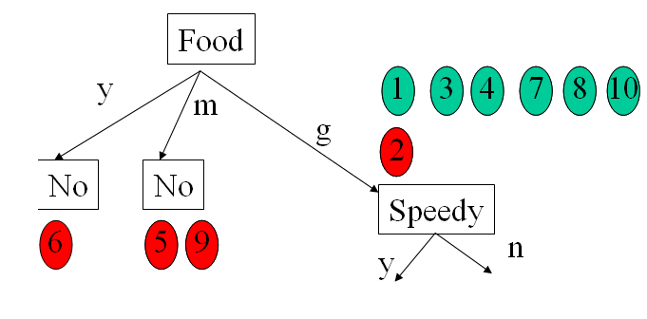
Top-Down Induction of DT (simplified)
Yes
TDIDF(D,c_{def})
IF(all examples in D have same class c)
  Return leaf with class c (or class c_{def}, if D is empty)
ELSE IF(no attributes left to test)
  Return leaf with class c of majority in D
ELSE
  Pick A as the “best” decision attribute for next node
  FOR each value v_{i} of A create a new descendent of node
    Subtree t_{i} for v_{i} is TDIDT(D_{i},c_{def})
  RETURN tree with A as root and t_{i} as subtrees
Training Data:

Slide 34
Picking the Best Attribute to Split
Ockham’s Razor:
  All other things being equal, choose the simplest explanation
Decision Tree Induction:
  Find the smallest tree that classifies the training data correctly
Problem
  Finding the smallest tree is computationally hard ☹!
Approach
  Use heuristic search (greedy search)
Key Heuristics:
  Pick attribute that maximizes information (Information Gain)
  i.e. “most informative”
  Other statistical tests
Notes:
Trivial Tree: Full tree with full depth, just label the nodes.

Slide 35
Attribute-based representations
Examples described by attribute values (Boolean, discrete, continuous)
E.g., situations where I will/won't wait for a table:
Classification of examples is positive (T) or negative (F)
12 examples
6 +
6 -

Slide 36
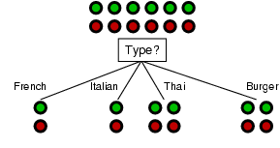
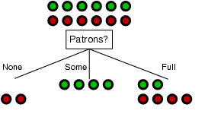
Choosing an attribute:
Information Gain
Goal: trees with short paths to leaf nodes
Is this a good attribute
to split on?
Which one should we pick?
A perfect attribute would ideally divide the
examples into sub-sets that are all positive or all negative…
i.e. maximum information gain.

Slide 37
Information Gain
Most useful in classification
  how to measure the ‘worth’ of an attribute information gain
  how well attribute separates examples according to their classification
Next
  precise definition for gain
  → measure from Information Theory
Shannon and Weaver 49
One of the most successful and impactful
mathematical theories known.

Slide 38
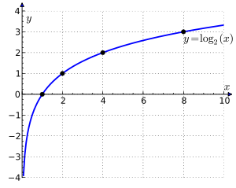
Information
“Information” answers questions. Entropy is a measure of unpredictability of information content.
The more clueless I am about a question, the more information
the answer to the question contains.
Example – fair coin → prior <0.5,0.5>
By definition Information of the prior (or entropy of the prior):
I(P1,P2) = - P1 log₂(P1) –P2 log₂(P2) =
I(0.5,0.5) = -0.5 log₂(0.5) – 0.5 log₂(0.5) = 1
We need 1 bit to convey the outcome of the flip of a fair coin.
Does a biased coin have more or less information? Why?
E[-log₂(P(x))]
log₂
Scale: 1 bit = answer to Boolean question with prior <0.5, 0.5>

Slide 39
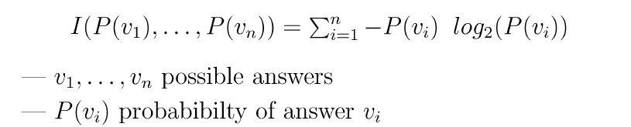
Information
(or Entropy)
Information in an answer given possible answers v₁, v₂, … v_{n}:
(Also called entropy of the prior.)
Example – biased coin → prior <1/100,99/100>
I(1/100,99/100) = -1/100 log₂(1/100) –99/100 log₂(99/100)
= 0.08 bits (so not much information gained from “answer.”)
Example – fully biased coin → prior <1,0>
I(1,0) = -1 log₂(1) – 0 log₂(0) = 0 bits
0 log₂(0) =0
i.e., no uncertainty left in source!

Slide 40
Shape of Entropy Function
Roll of an unbiased die
1
0
0
1/2
1
p
The more uniform the probability distribution,
the greater is its entropy.

Slide 41


Information or
Entropy
Information or Entropy measures the “randomness” of an arbitrary collection of examples.
We don’t have exact probabilities but our training data provides an estimate of the probabilities of positive vs. negative examples given a set of values for the attributes.
For a collection S, entropy is given as:
For a collection S having positive and negative examples
p - # positive examples;
n - # negative examples

Slide 42
Attribute-based representations
Examples described by attribute values (Boolean, discrete, continuous)
E.g., situations where I will/won't wait for a table:
Classification of examples is positive (T) or negative (F)
12 examples
6 +
6 -
What’s the entropy
of this collection of
examples?
p = n = 6; I(0.5,0.5) = -0.5 log2(0.5) –0.5 log2(0.5) = 1
So, we need 1 bit of info to classify a randomly picked example,
assuming no other information is given about the example. (Makes sense!)

Slide 43

Choosing an attribute:
Information Gain
Intuition: Pick the attribute that reduces the entropy (the uncertainty) the
most.
So we measure the information gain after testing a given attribute A:
Remainder(A) → gives us the remaining uncertainty after getting info on attribute A.

Slide 44

Choosing an attribute:
Information Gain
Remainder(A)
→ gives us the amount information we still need after testing on A.
Assume A divides the training set E into E₁, E₂, … E_{v}, corresponding to the different v distinct values of A.
Each subset E_{i} has p_{i} positive examples and n_{i} negative examples.
So for total information content, we need to weigh the contributions of the different subclasses induced by A
Weight (relative size) of each subclass

Slide 45

Choosing an attribute:
Information Gain
Measures the expected reduction in entropy. The higher the Information Gain (IG), or just Gain, with respect to an attribute A , the more is the expected reduction in entropy.
where Values(A) is the set of all possible values for attribute A,
S_{v} is the subset of S for which attribute A has value v.
Weight of each subclass

Slide 46
Interpretations of gain
Gain(S,A)
  expected reduction in entropy caused by knowing A
  information provided about the target function value given the value of A
  number of bits saved in the coding a member of S knowing the value of A
Used in ID3 (Iterative Dichotomiser 3) Ross Quinlan

Slide 47

Information gain
For the training set, p = n = 6, I(6/12, 6/12) = 1 bit
Consider the attributes Type and Patrons:
Patrons has the highest IG of all attributes and so is chosen by the DTL algorithm as the root.
Info gain?
0.541 bits

Slide 48
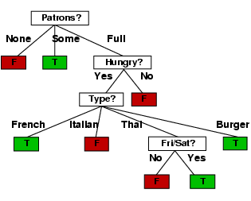
Example contd.
Decision tree learned from the 12 examples:
“personal R&N Tree”
Substantially simpler than “true” tree ---
but a more complex hypothesis isn’t justified
from just the data.

Slide 49

Expressiveness of Decision Trees
Any particular decision tree hypothesis for WillWait goal predicate can be
seen as a disjunction of a conjunction of tests, i.e., an assertion of the form:
∀s WillWait(s) ↔ (P1(s) ∨ P2(s) ∨ … ∨ Pn(s))
Where each condition Pi(s) is a conjunction of tests corresponding
to the path from the root of the tree to a leaf with a positive outcome.

Slide 50
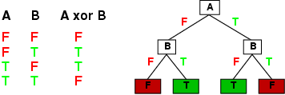
Expressiveness
Decision trees can express any Boolean function of the input attributes.
E.g., for Boolean functions, truth table row → path to leaf:

Slide 51
Expressiveness:
Boolean Function with 2 attributes → DTs
2²²
AND
OR
A
XOR
A
A
A
A
T
F
T
F
T
F
T
F
B
B
B
B
B
B
B
B
T
F
T
F
T
F
T
F
T
F
T
F
T
F
T
F
T
F
F
F
T
T
T
F
F
T
T
F
T
T
F
F
NAND
NOR
A
XNOR
NOT A
A
A
A
T
F
T
F
T
F
T
F
B
B
B
B
B
B
B
B
T
F
T
F
T
F
T
F
T
F
T
F
T
F
T
F
F
T
T
T
F
F
F
T
F
T
F
T
F
F
T
T

Slide 52
Expressiveness:
2 attribute → DTs
2²²
AND
OR
A
XOR
A
A
A
A
T
F
T
F
T
F
T
F
B
T
B
B
B
T
F
F
T
F
T
F
T
F
T
F
T
F
T
F
F
T
T
F
NAND
NOR
A
XNOR
NOT A
A
A
A
T
F
T
F
T
F
T
F
B
T
F
B
B
B
F
T
T
F
T
F
T
F
T
F
F
T
F
T
F
T
F
T

Slide 53
Expressiveness:
2 attribute → DTs
2²²
A AND-NOT B
NOT A AND B
B
TRUE
A
A
A
A
T
F
T
F
T
F
T
F
B
B
B
B
B
B
B
B
T
F
T
F
T
F
T
F
T
F
T
F
T
F
T
F
F
T
F
F
F
F
T
F
T
F
T
F
T
T
T
T
A OR NOT B
NOR A OR B
NOT B
A
FALSE
A
A
A
T
T
F
T
F
T
F
F
B
B
B
B
B
B
B
B
T
F
T
F
T
F
T
F
T
F
T
F
T
F
T
F
T
F
T
T
T
T
F
T
F
T
F
T
F
F
F
F

Slide 54
Expressiveness:
2 attribute → DTs
2²²
A AND-NOT B
NOT A AND B
B
TRUE
A
A
B
T
T
F
T
F
T
F
B
F
F
B
T
F
T
F
T
F
F
T
T
F
A OR NOT B
NOR A OR B
NOT B
FALSE
F
A
A
B
T
F
T
F
T
F
B
T
T
B
T
F
T
F
T
F
T
F
F
T

Slide 55
Number of Distinct Decision Trees
How many distinct decision trees with 10 Boolean attributes?
= number of Boolean functions with 10 propositional symbols
Input features Output
0 0 0 0 0 0 0 0 0 0 0/1
0 0 0 0 0 0 0 0 0 1 0/1
0 0 0 0 0 0 0 0 1 0 0/1
0 0 0 0 0 0 0 1 0 0 0/1
…
1 1 1 1 1 1 1 1 1 1 0/1
How many entries does this table have?
2¹⁰
So how many Boolean functions
with 10 Boolean attributes are there,
given that each entry can be 0/1?
= 2²¹⁰

Slide 56
Hypothesis spaces
How many distinct decision trees with n Boolean attributes?
= number of Boolean functions
= number of distinct truth tables with 2^{n} rows
With 6 Boolean attributes, there are 18,446,744,073,709,551,616 possible trees!
= 2^{2n}
E.g. how many Boolean functions on 6 attributes? A lot…
Googles calculator could not handle 10 attributes ☺!

Slide 57
Evaluation Methodology
General for Machine Learning

Slide 58
Evaluation Methodology
How to evaluate the quality of a learning algorithm, i.e.,:
How good are the hypotheses produce by the learning algorithm?
How good are they at classifying unseen examples?
Standard methodology (“Holdout Cross-Validation”):
  1. Collect a large set of examples.
  2. Randomly divide collection into two disjoint sets: training set and test set.
  3. Apply learning algorithm to training set generating hypothesis h
  4. Measure performance of h w.r.t. test set (a form of cross-validation)
  → measures generalization to unseen data
Important: keep the training and test sets disjoint! “No peeking”!
Note: The first two questions about any learning result: Can you describe
your training and your test set? What’s your error on the test set?
Notes:
Peeking – example of peeking:
We generate four different hypothesis – for example by using different criteria to pick the next attribute to branch on.
We test them on the test set and we select the best hypothesis – voila’ – there was picking since the hypothesis was selcted on the basis of its performance on the test set, so information about the test set has leaked into the learning algorithm.

Slide 59
Test/Training Split
Real-world Process
drawn randomly
split randomly
Data D
split randomly
Training Data D_{train}
Test Data D_{test}
(x₁,y₁), …, (x_{n},y_{n})
D_{train}
h
(x₁,y₁),…(x_{k},y_{k})
Learner
Also validation set for meta-parametres.
Notes:
Goal: Decouple algorithm testing from real-world process time constraints
Example: Drug effectiveness prediction (some problems with non iid for spam and stock)

Slide 60
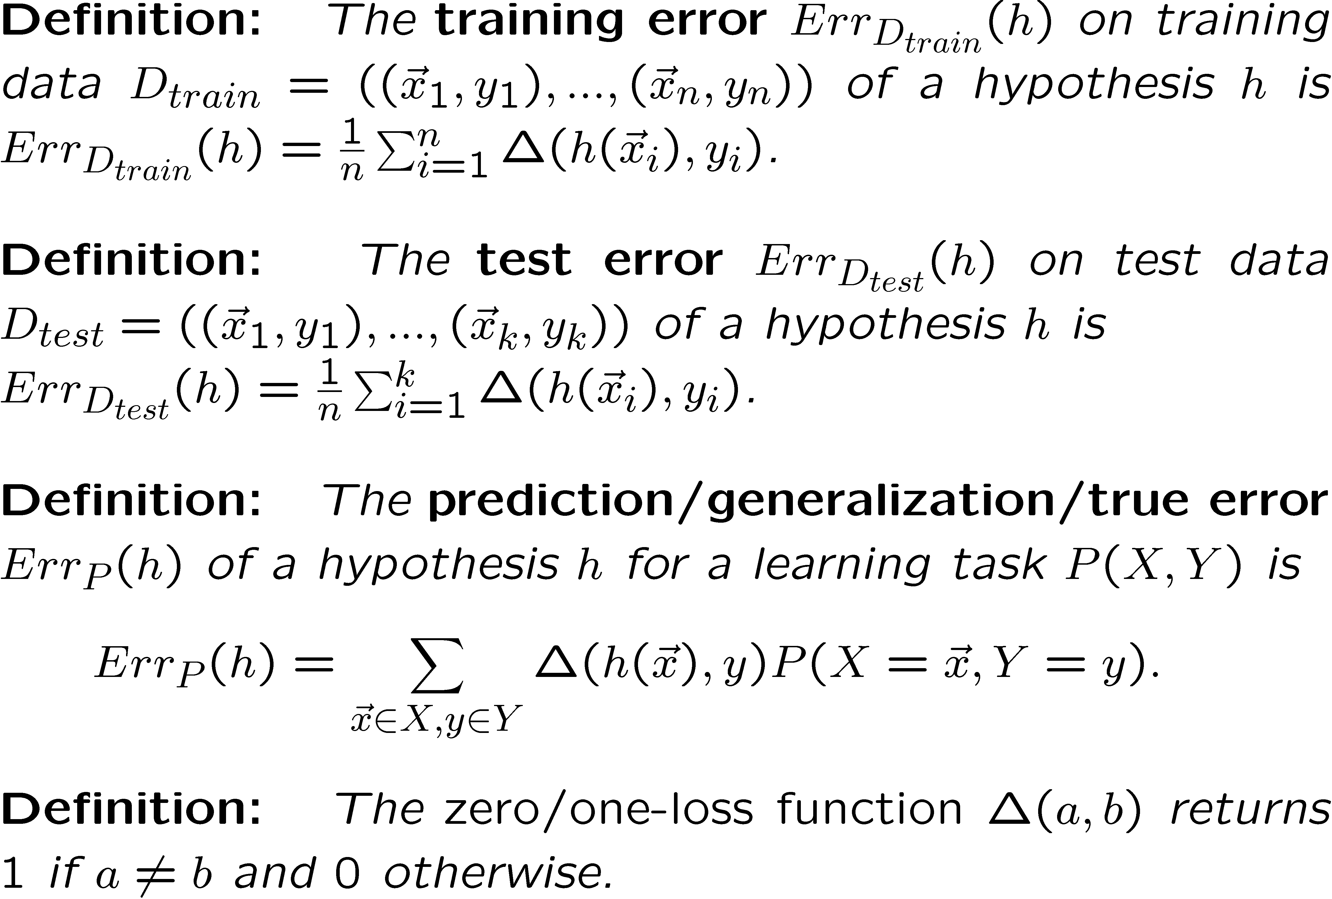
Measuring Prediction Performance

Slide 61
Performance Measures
Error Rate
  Fraction (or percentage) of false predictions
Accuracy
  Fraction (or percentage) of correct predictions
Precision/Recall
  Example: binary classification problems (classes pos/neg)
  Precision: Fraction (or percentage) of correct predictions among all examples predicted to be positive
  Recall: Fraction (or percentage) of correct predictions among all real positive examples
  (Can be generalized to multi-class case.)

Slide 62
Extensions of the
Decision Tree Learning Algorithm
Noisy data
Overfitting and Model Selection
Cross Validation
Missing Data (R&N, Section 18.3.6)
Using gain ratios (R&N, Section 18.3.6)
Real-valued data (R&N, Section 18.3.6)
Generation of rules and pruning
DT Ensembles
Regression DT

Slide 63
How well does it work?
Many case studies have shown that decision trees are at least as accurate as human experts.
  A study for diagnosing breast cancer had humans correctly classifying the examples 65% of the time, and the decision tree classified 72% correct.
  British Petroleum designed a decision tree for gas-oil separation for offshore oil platforms that replaced an earlier rule-based expert system.
  Cessna designed an airplane flight controller using 90,000 examples and 20 attributes per example.

Slide 64



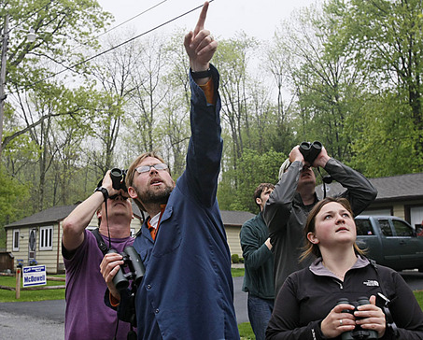

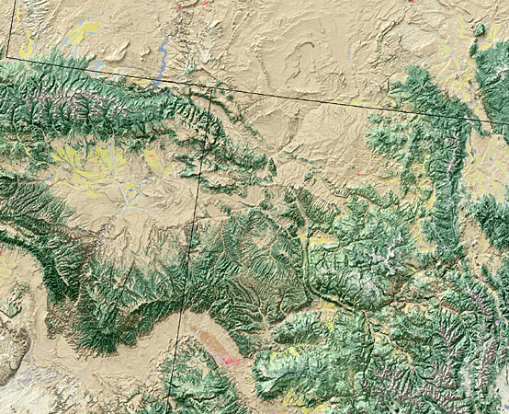
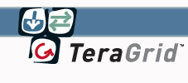
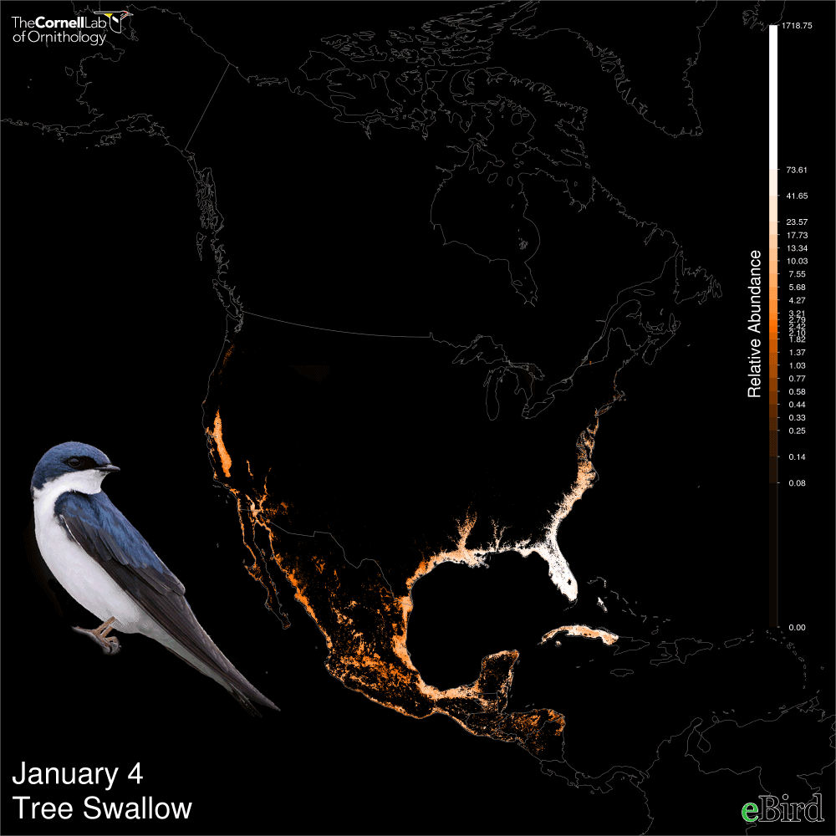
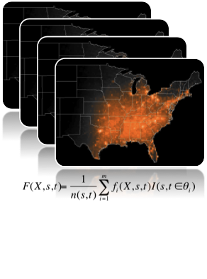

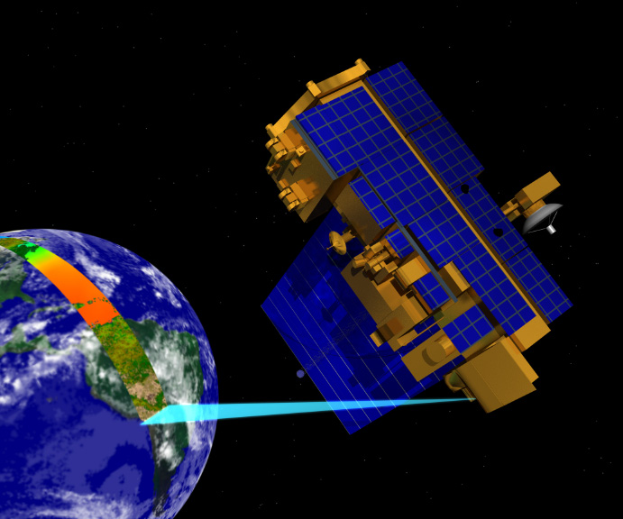
Bird Distributions
Machine Learning and Citizen Science
Bird Observations
State of the Birds Report
(officially released by Secretary of Interior)
300K+
volunteer birders
300M+
bird observations
22M+
hours of field work (2500+years)
Novel Approaches
To Conservation
Based on eBird Models
Distribution Models for
400+ species with
weekly estimates
at fine spatial resolution
(3km²)
Land Cover
80,000+
CPU Hours
(~ 10 Years!!!)
Weather
Environmental Data
Adaptive Spatio-Temporal
Machine Learning
Models and Algorithms
(STEM Models)
Relate environmental predictors to observed patterns of occurrences and absences
Remote Sensing
Boosted Regression DT Ensemble
Patterns of occurrence of the Tree Swallow for different months of the year Source : Daniel Fink
Bird Distribution Models, Revealing, at a fine resolution, Species’ Habitat Preferences
Notes:
Citizen science plays a key role in conservation.
eBird is a citizen science program of Cornell Lab of Ornithology with over 150 thousand volunteer birds who have submitted over 2M bird observations

Slide 65
Summary:
When to use Decision Trees
Instances presented as attribute-value pairs
Method of approximating discrete-valued functions
Target function has discrete values: classification problems
Robust to noisy data:
Training data may contain
  errors
  missing attribute values
Typical bias: prefer smaller trees (Ockham's razor )
Widely used, practical and easy to interpret results

Slide 66
Inducing decision trees is one of the most widely used learning methods in practice
Can outperform human experts in many problems
Strengths include
  Fast
  simple to implement
  human readable
  can convert result to a set of easily interpretable rules
  empirically valid in many commercial products
  handles noisy data
Weaknesses include:
  "Univariate" splits/partitioning using only one attribute at a time so limits types of possible trees
  large decision trees may be hard to understand
  requires fixed-length feature vectors
  non-incremental (i.e., batch method)
Can be a legal requirement! Why?

