Slide 1
CS 4700: Foundations of Artificial Intelligence
Bart Selman
selman@cs.cornell.edu
Module: Knowledge, Reasoning, and Planning
Logical Agents
Model Theoretic Semantics
Entailment and Proof Theory
R&N: Chapter 7

Slide 2
Logical agents:
Agents with some representation of the
complex knowledge about the world / its environment,
and uses inference to derive new information from that
knowledge combined with new inputs (e.g. via perception).
Key issues:
1- Representation of knowledge
What form? Meaning / semantics?
2- Reasoning and inference processes
Efficiency.

Slide 3
Knowledge-base Agents
Key issues:
Representation of knowledge → knowledge base
Reasoning processes → inference/reasoning
Knowledge base = set of sentences in a formal language representing facts about the world (*)
(*) called Knowledge Representation (KR) language

Slide 4

Knowledge bases
Key aspects:
How to add sentences to the knowledge base
How to query the knowledge base
Both tasks may involve inference – i.e. how to derive new sentences from old sentences
Logical agents – inference must obey the fundamental requirement that when one asks a question to the knowledge base, the answer should follow from what has been told to the knowledge base previously. (In other words the inference process should not “make things” up…)

Slide 5
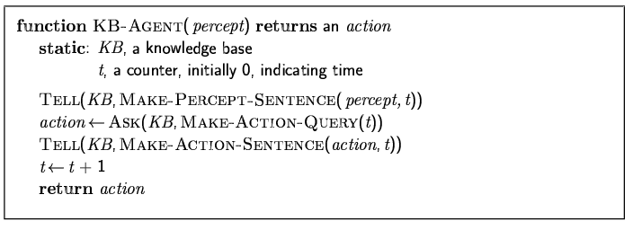
A simple knowledge-based agent
The agent must be able to:
Represent states, actions, etc.
Incorporate new percepts
Update internal representations of the world
Deduce hidden properties of the world
Deduce appropriate actions

Slide 6
KR language candidate:
logical language (propositional / first-order) combined
with a logical inference mechanism
How close to human thought? (mental-models / Johnson-Laird).
What is “the language of thought”?
Why not use natural language (e.g. English)?
Greeks / Boole / Frege --- Rational thought: Logic?
We want clear syntax & semantics (well-defined
meaning), and, mechanism to infer new information.
Soln.: Use a formal language.

Slide 7
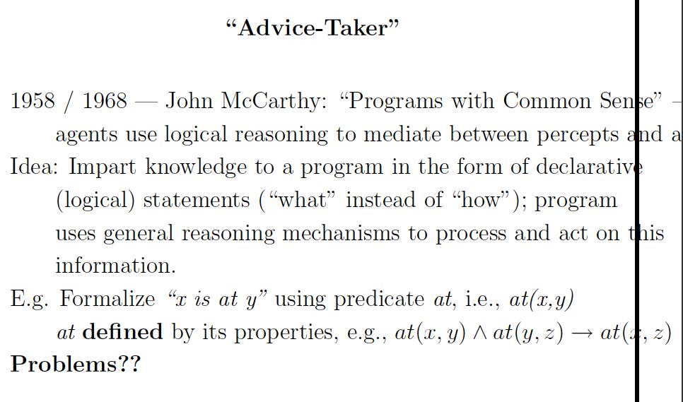
Consider: to-the-right-of(x,y)

Slide 8
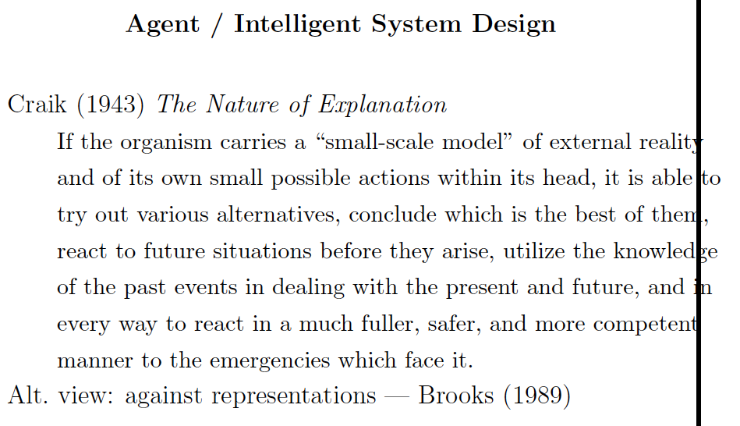

Slide 9
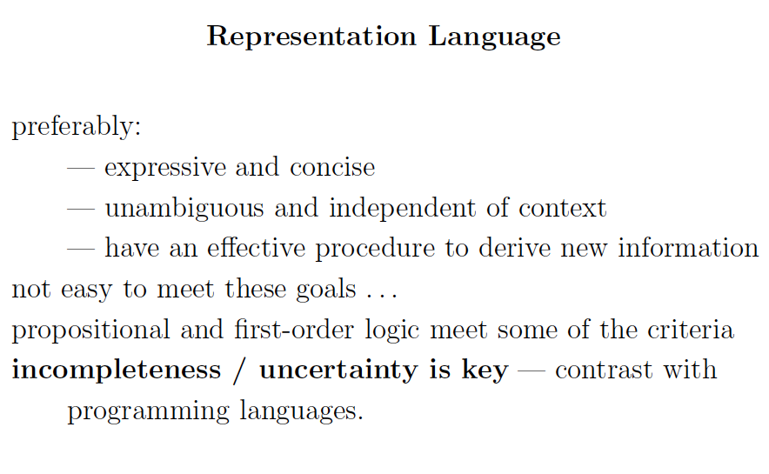

Slide 10
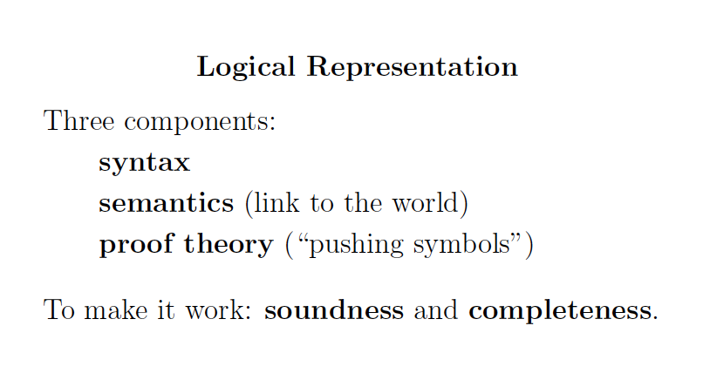

Slide 11
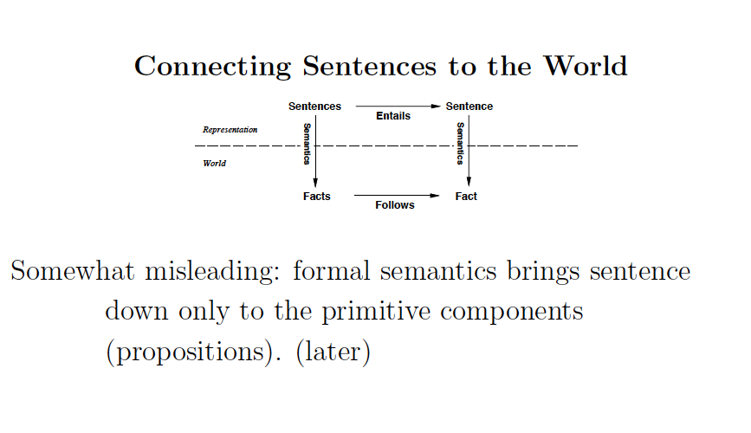

Slide 12
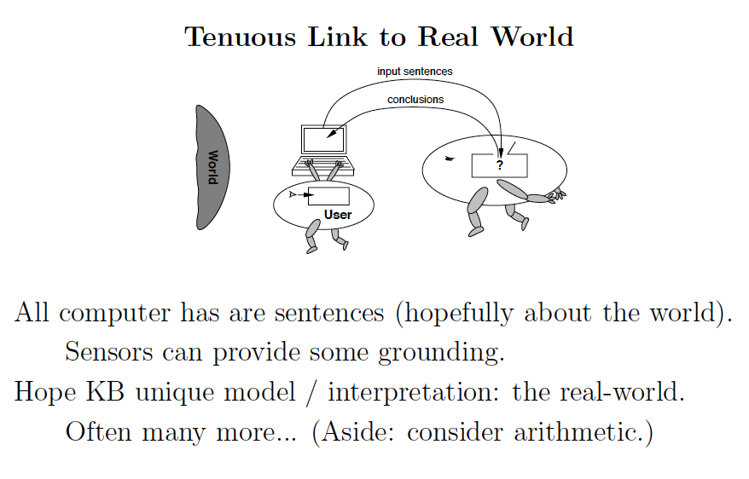
The “symbol grounding problem.”

Slide 13
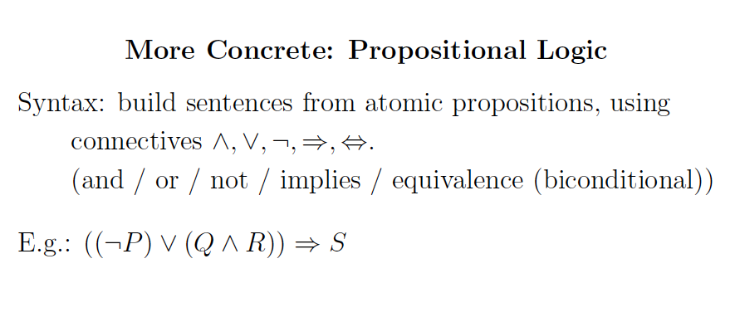

Slide 14
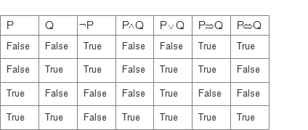
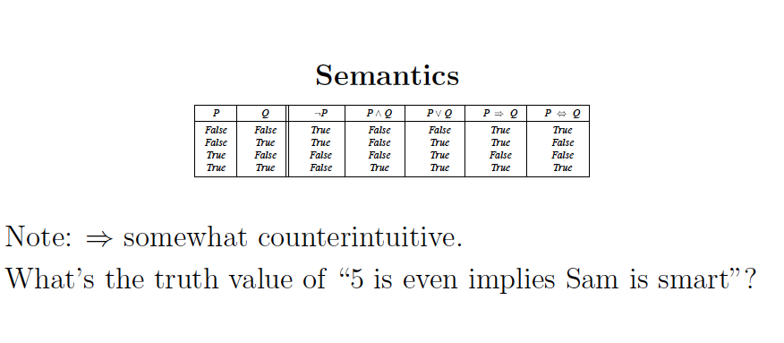
Semantics (as before)
True!

Slide 15
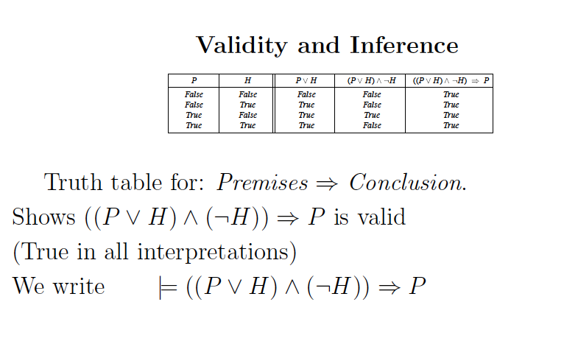
Logical validity / tautology.
Compositional semantics

Slide 16
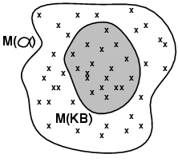
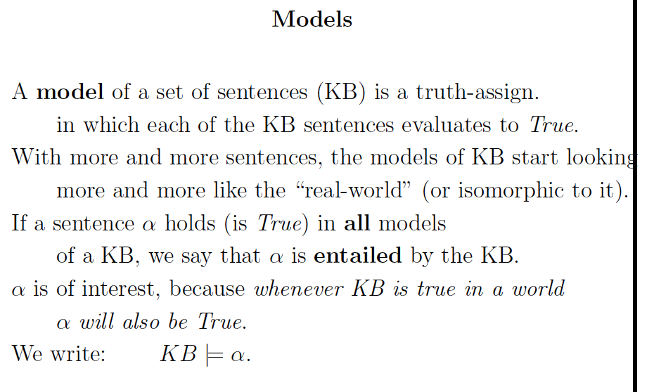
Note: KB defines exactly the set of worlds we are interested in.
I.e., our current knowledge about the world.
“KB entails \alpha”
I.e.: Models(KB) Models( )

Slide 17
Observation about “language”
Possibly the key property of a language (both formal and natural) is that relatively short statements can capture exponentially large sets of possible situations (“worlds”).
This allows intelligent entities to communicate and think about the exponential set of possible future world trajectories and exponential sets of possible world states when we only have partial information.

Slide 18
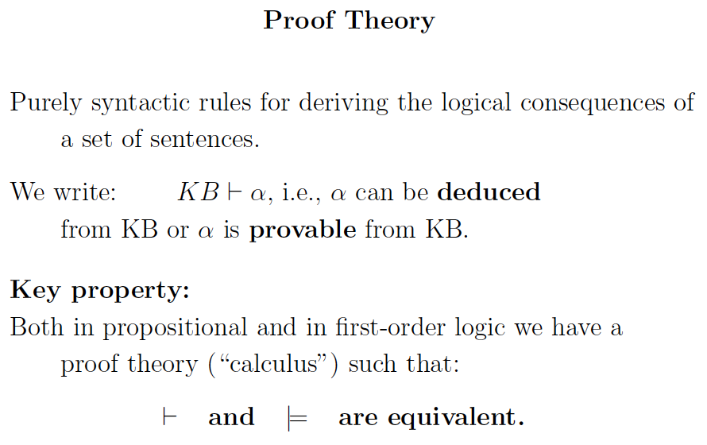
Example soon.

Slide 19
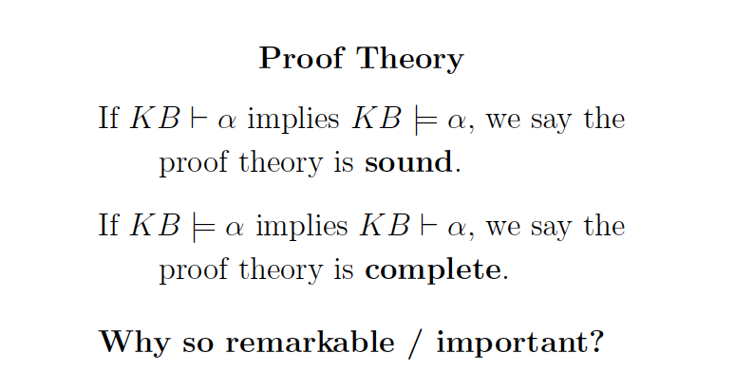

Slide 20
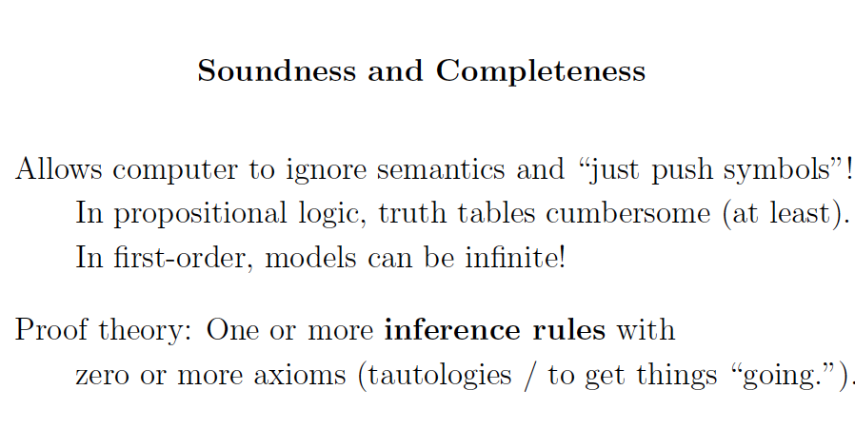
Note: (1) This was Aristotle’s original goal ---
Construct infallible arguments based purely
on the form of statements --- not on the “meaning”
of individual propositions.
(2) Sets of models can be exponential size or worse,
compared to symbolic inference (deduction). I.e., we
manipulate short descriptions of exponential size sets.

Slide 21
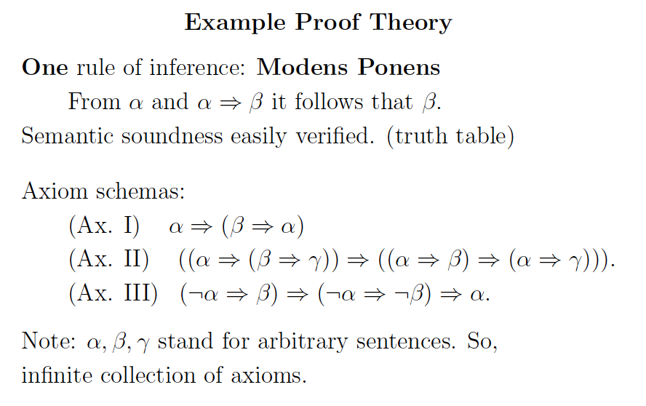
Modus Ponens

Slide 22
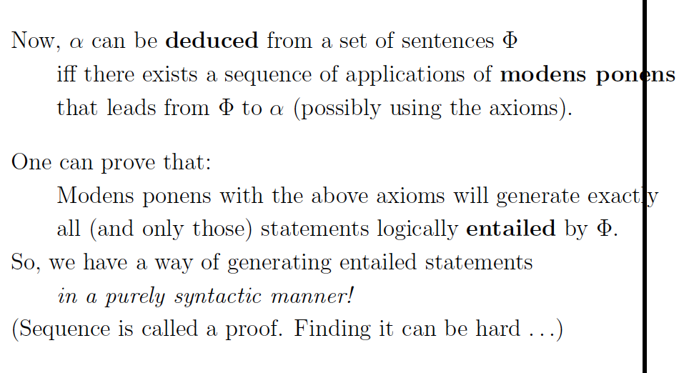
Modus Ponens

Slide 23
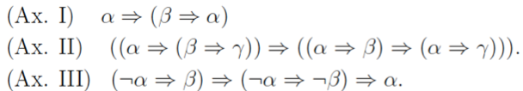
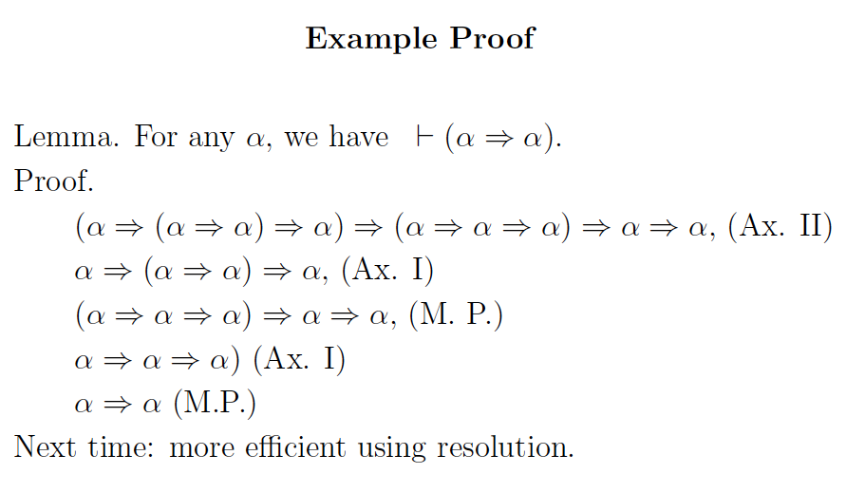
(

Slide 24
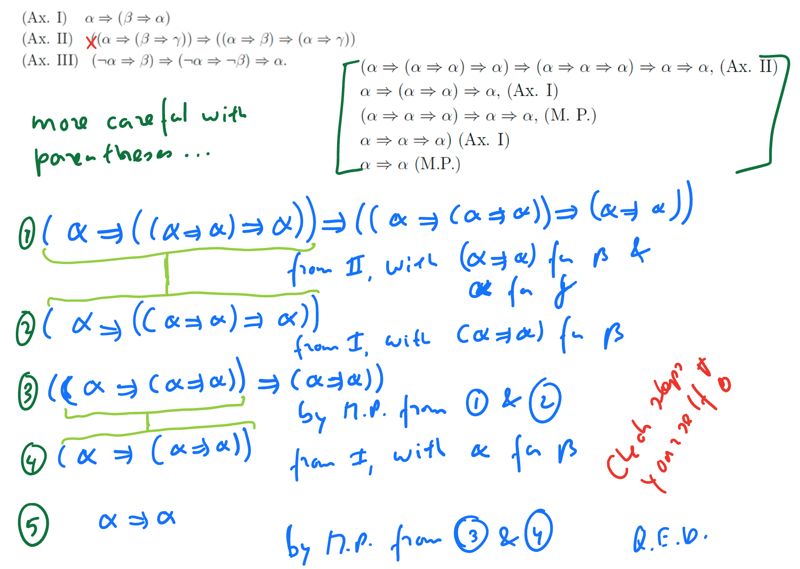

Slide 25
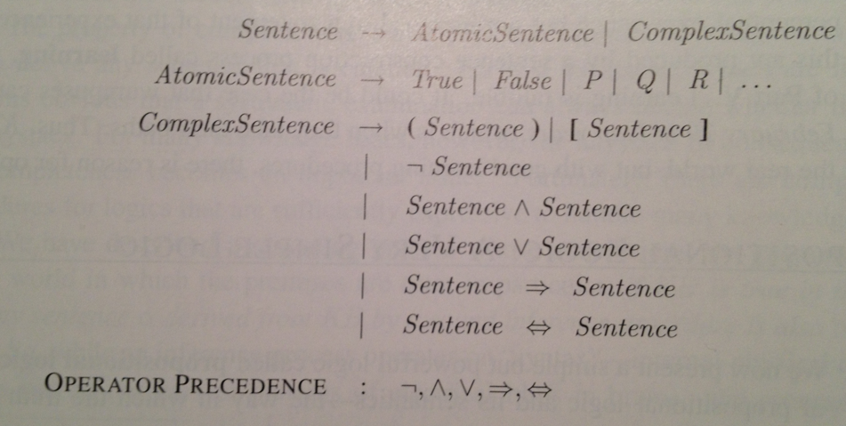
Addendum
Standard syntax and semantics for propositional
logic. (CS-2800; see 7.4.1 and 7.4.2.)
Syntax:

Slide 26
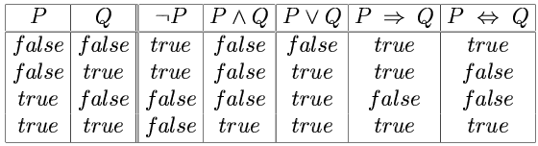
Semantics
Note: Truth value of a sentence is built from its parts “compositional semantics”

Slide 27
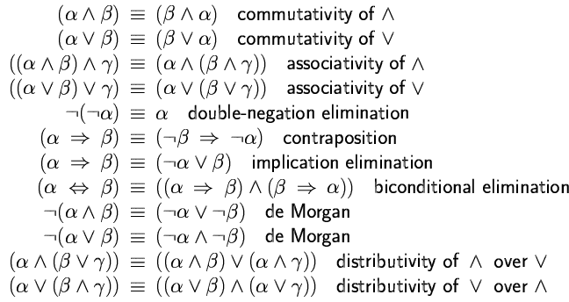
Logical equivalences
(*)
(*) key to go to clausal (Conjunctive Normal Form)
Implication for “humans”; clauses for machines.
de Morgan laws also very useful in going to clausal form.

