Slide 1
CS 4700: Foundations of Artificial Intelligence
Bart Selman
selman@cs.cornell.edu
Logical Agents ---
Intro Knowledge Representation
& Boolean Satisfiability (SAT) encodings
R&N: Chapter 7

Slide 2
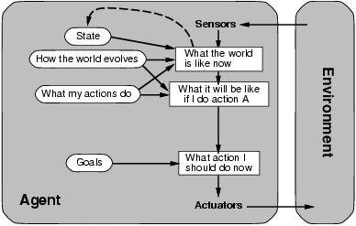
A Model-Based Agent
Requires: Knowledge and Reasoning

Slide 3
Knowledge and Reasoning
Knowledge and Reasoning:
humans are very good at acquiring new information by
combining raw knowledge, experience with reasoning.
AI-slogan: “Knowledge is power” (or “Data is power”?)
Examples:
Medical diagnosis --- physician diagnosing a patient
infers what disease, based on the knowledge he/she
acquired as a student, textbooks, prior cases
Common sense knowledge / reasoning ---
common everyday assumptions / inferences. e.g.,
(1) “lecture starts at four” infer pm not am;
(2) when traveling, I assume there is some way to get
from the airport to the hotel.

Slide 4
Logical agents:
Agents with some representation of the
complex knowledge about the world / its environment,
and uses inference to derive new information from that
knowledge combined with new inputs (e.g. via perception).
Key issues:
1- Representation of knowledge
What form? Meaning / semantics?
2- Reasoning and inference processes
Efficiency.

Slide 5
Knowledge-base Agents
Key issues:
Representation of knowledge → knowledge base
Reasoning processes → inference/reasoning
Knowledge base = set of sentences in a formal language representing facts about the world (*)
(*) called Knowledge Representation (KR) language

Slide 6
Knowledge Representation language candidate:
logical language (propositional / first-order)
combined with a logical inference mechanism
Why not use natural language (e.g. English)?
We want clear syntax & semantics (well-defined
meaning), and, mechanism to infer new information.
Soln.: Use a formal language.

Slide 7
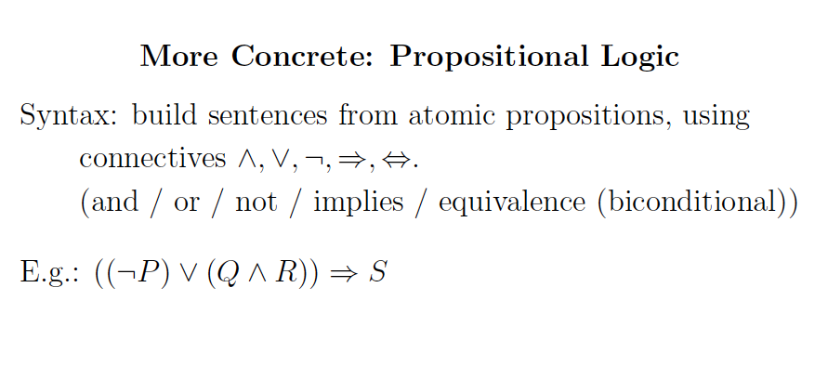
Note: You have seen propositional logic in other courses.
Make sure you review!

Slide 8
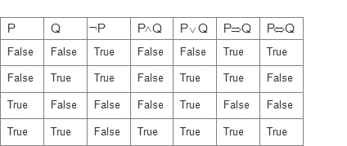
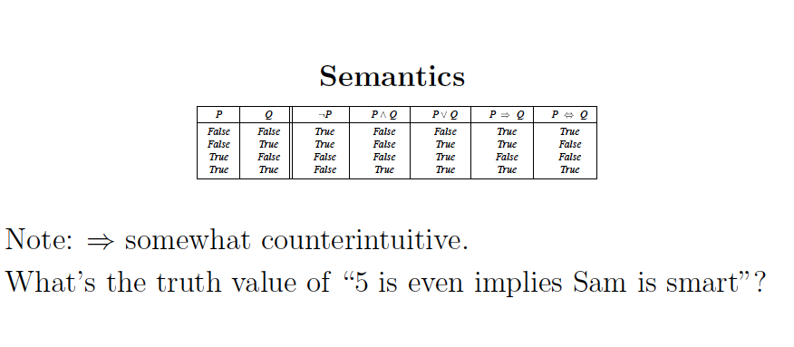
Semantics
P V Q
True
True
False
True
True!

Slide 9
Boolean Satisfiability (SAT

Slide 10
Propositional Satisfiability problem
Satifiability (SAT): Given a formula in propositional calculus, is there a model
(i.e., a satisfying interpretation, an assignment to its variables) making it true?
We consider clausal form, e.g.:
( a ∨ ¬b ∨ ¬ c ) AND ( b ∨ ¬ c) AND ( a ∨ c)
possible assignments
Note: Any propositional logic expression can be
rewritten in clausal form.
SAT: prototypical hard combinatorial search and reasoning problem. Problem is NP-Complete. (Cook 1971)
Surprising “power” of SAT for encoding computational problems
Modern SAT Solvers use this language.

Slide 11
SAT Encodings
We’ll use clausal form to encode our task specific knowledge in such way that a satisfying assignment to the Boolean variables represents a solution the the task under consideration.
A broad range of (AI) reasoning tasks can be encoded
this way. E.g., planning, scheduling, diagnosis, and verification.

Slide 12
SAT Solvers
Modern Satisfiability (SAT) solvers operating on the clausal form
are surprisingly *much* more efficient than other logic-based approaches
(e.g., pure resolution that will be discussed later)
The SAT solvers treat the set of clauses as a set of constraints (disjunctions) on Boolean variables. Current solvers are very powerful. Can handle 1 Million+ variables and several millions of clauses.
Systematic: Davis Putnam (DPLL) + series of improvements
Stochastic local search: WalkSAT (issue?)

Slide 13
Satisfiability as an Encoding Language

Slide 14
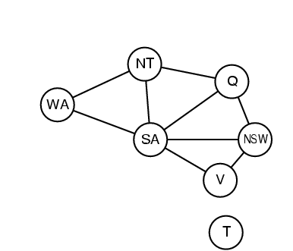
SAT Translation of Graph Coloring
Variables
NxK vars
C_{i,k} node i has color k
Total # colors: K. Total # nodes: N.
At least one of K colors per node i :
(C_{i,1} v C_{i,2} v C_{i,3} v ... V C_{i,K})
At most one color per node i :
(~C_{i,k} v ~C_{i,k’} ) for all k =/= k’
If node i and node j (=/= i) share an edge,
need to have different colors:
(~C_{i,l} v ~C_{j,l}) for all 1 <= I <= K
Note: Translation from
“problem” into SAT.
Reverse of usual
translation to show
NP-completeness.
Works also for (easy)
polytime problems!

Slide 15
SAT Solvers in the Real World

Slide 16
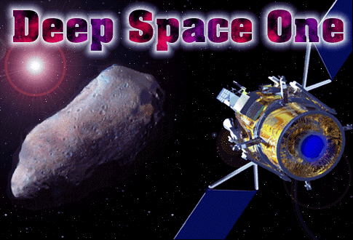
NASA Deep Space One Spacecraft: Remote Agent
Remote Agent (remote intelligent self-repair software) (RAX), developed at NASA and JPL, was the first artificial-intelligence control system to control a spacecraft without human supervision.
Remote Agent successfully demonstrated the ability to plan onboard activities and correctly diagnose and respond to faults in spacecraft components through its built-in REPL environment

Slide 17
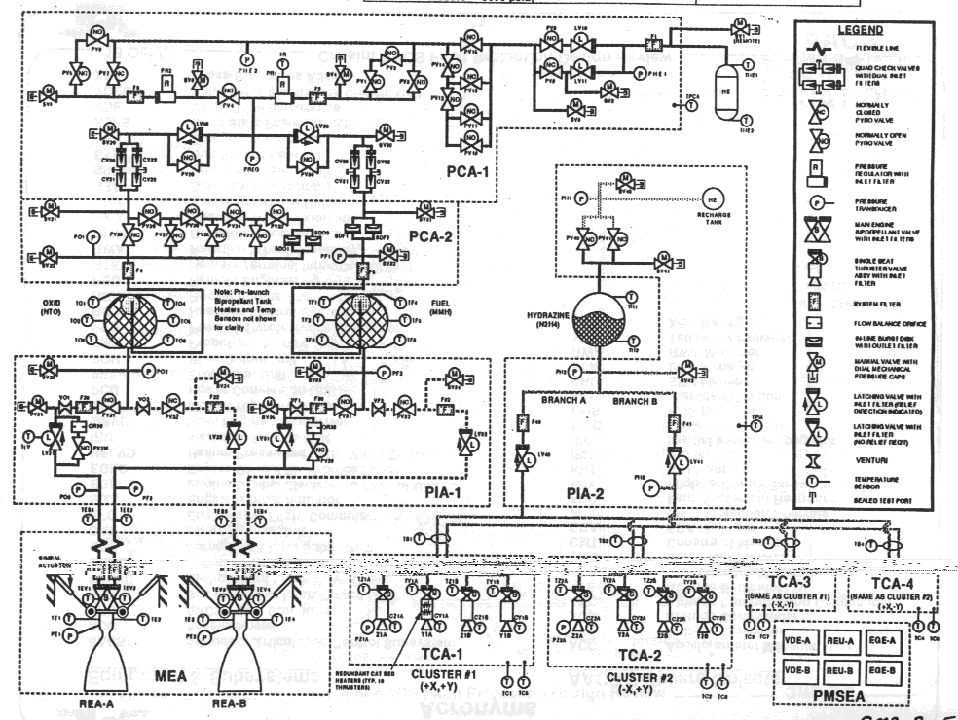
NASA Deep Space One: Remote Agent
Autonomous diagnosis & repair “Remote Agent”
Compiled systems schematic to 7,000 var SAT problem
Started: January 1996
Launch: October 15th, 1998
Experiment: May 17-21

Slide 18
Deep Space One
a failed electronics unit
Remote Agent fixed by reactivating the unit.
a failed sensor providing false information
Remote Agent recognized as unreliable and therefore correctly ignored.
an altitude control thruster (a small engine for controlling the spacecraft's orientation) stuck in the "off" position
Remote Agent detected and compensated for by switching to a mode that did not rely on that thruster.

Slide 19
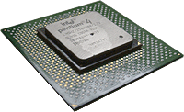
Significant progress in Satisfiability Methods
Software and hardware verification – complete methods are critical - e.g. for verifying the correctness of chip design, using SAT encodings
Applications:
Hardware and
Software Verification
Planning,
Protocol Design, etc.
Going from 50 variable in, 200 constraints
to 1,000,000+ variables and 5,000,000+ constraints
in the last 20 years

Slide 20
Progress in Last 25 years
Significant progress since the 1990’s. How much?
Problem size: We went from 100 variables, 200 constraints (early 90’s)
to 1,000,000+ variables and 5,000,000+ constraints in 20 years
Search space: from 10^30 to 10^300,000.
[Aside: “one can encode quite a bit in 1M variables.”]
Is this just Moore’s Law? It helped, but not much…
– 2x faster computers does not mean can solve 2x larger instances
– search difficulty does *not* scale linearly with problem size!
In fact, for O(2^n), 2x faster, how many more vars?
handles 1 more variable!!
Mainly algorithmic progress. Memory growth also key.
Tools: 50+ competitive SAT solvers available (e.g. Minisat solver)
See http://www.satcompetition.org/

Slide 21
Model Checking

Slide 22
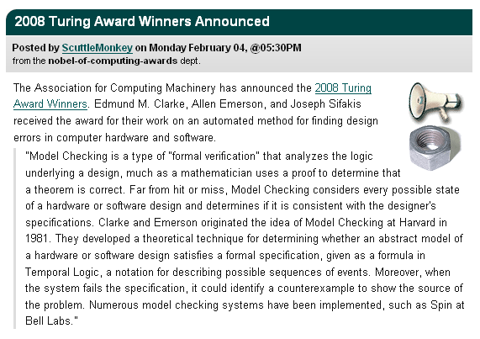
Turing Award
Source: Slashdot

Slide 23
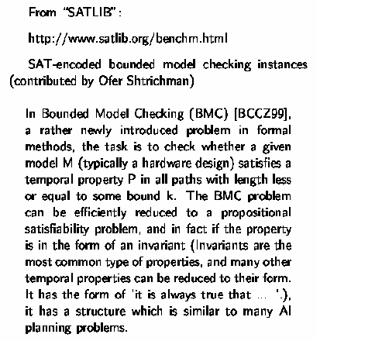
A “real world” example

Slide 24
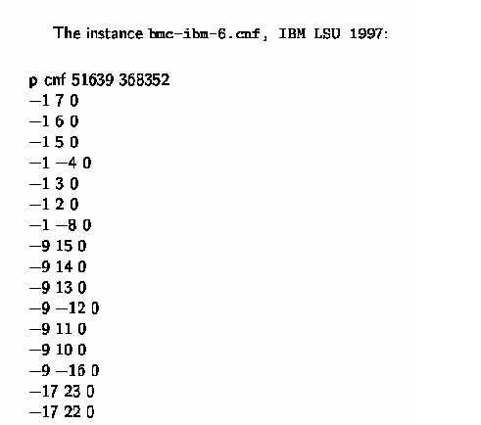
Bounded Model Checking instance:
i.e. ((not x₁) or x₇)
and ((not x₁) or x₆)
and … etc.

Slide 25
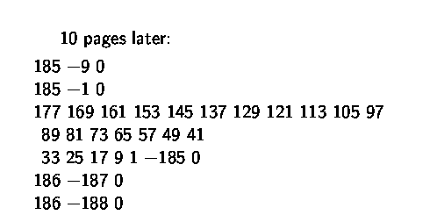
10 pages later:
…
(x₁₇₇ or x₁₆₉ or x₁₆₁ or x₁₅₃ …
or x₁₇ or x₉ or x₁ or (not x₁₈₅))
clauses / constraints are getting more interesting…

Slide 26
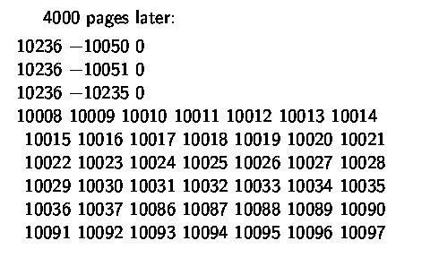
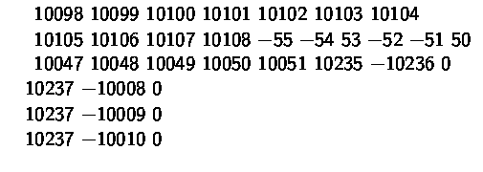
4000 pages later:
!!!
a 59-cnf clause…
…

Slide 27
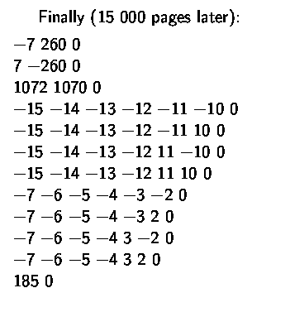

Finally, 15,000 pages later:
Note that:
… !!!
MiniSAT solver solves
this instance in less than one minute.

