Slide 1

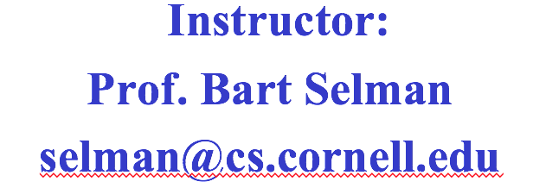
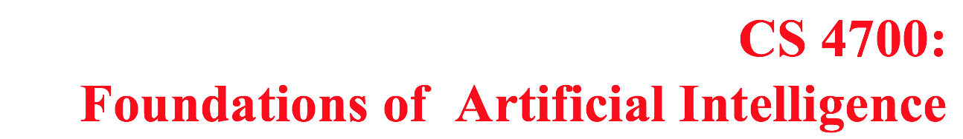

Slide 2
CS 4700: Foundations of Artificial Intelligence
Instructor:
Prof. Selman
selman@cs.cornell.edu
Admin

Slide 3

Course Administration
Office hours and web page next week
Text book: Russell & Norvig --- Artificial Intelligence: A Modern Approach (AIMA)

Slide 4
Grading
Homework (20%)
Prelim/Midterm (30%)
Final (45%)
Class participation (5%)
Late policy: 5 one-day extensions to be used (almost) however you want during the term. (Count weekend as 1 day.) Max of 3 days per assignment.
Prelim/exam date & time: See university schedule.
(Google: “exam roster Cornell”
Out mid Sept. or before.)
(Why? Yes, some students tried to use 5 days for their first hwk! Not a good idea!)

Slide 5
In-class participation credit (max 5%)
Required minimum to get credit:
5 in-class participation events
(in-class question/comment/remark,
answer to in-class question, hwk suggestion,
help with progr. assign. prep., topic
suggestion, news item suggestion,
piazza participation)
Reporting: Honor system. Keep track yourself (use google doc). I will ask for an interim report during the term and a final report.
I will announce in class (and via email) how to submit reports.

Slide 6
Admin details
This is a large course. Sadly, that’s why there is much less flexibility than in a small or mid-size course.
Before signing up, make sure that
--- you can attend the midterm and final (don’t schedule interview travel for that date!). There is no make-up.
--- you can attend the final exam (don’t travel home before
the final.) There is no make-up.
--- late days on homework are there to give you the needed
Flexibility in your schedule. Use them wisely!
If you cannot attend midterm or exam, do not sign up for the
course! (Otherwise need to withdraw later.)
Exams date & time: See University schedule on web. (Google
“Cornell exam calendar”.)

Slide 7
Admin details continued
Grading and re-grades check with TAs!
Check office hours.
Use email / piazza for urgent questions and/or office hours. Can contact TAs directly via email.

Slide 8
Other remarks
Class is over-subscribed with many folks on a waiting list. So, if you intend to drop the course (or have signed up by mistake ☺ ), please de-enroll asap. Thanks!!
CS-4701 is a project course. We will have brief organizational meeting next week. TBA
All announcements for CS-4701 made in
CS4700 class, web page, and via CMS email.

Slide 9
Homework
Homework is very important. It is the best way for you to learn the material. You are encouraged to discuss the problems with your classmates, but all work handed in should be original, and written by you in your own words.

