Slide 1
CS 4700:
Foundations of Artificial Intelligence
Bart Selman
selman@cs.cornell.edu
Module: Knowledge, Reasoning, and Planning
First-Order Logic and Inference
R&N: Chapters 8 and 9

Slide 2
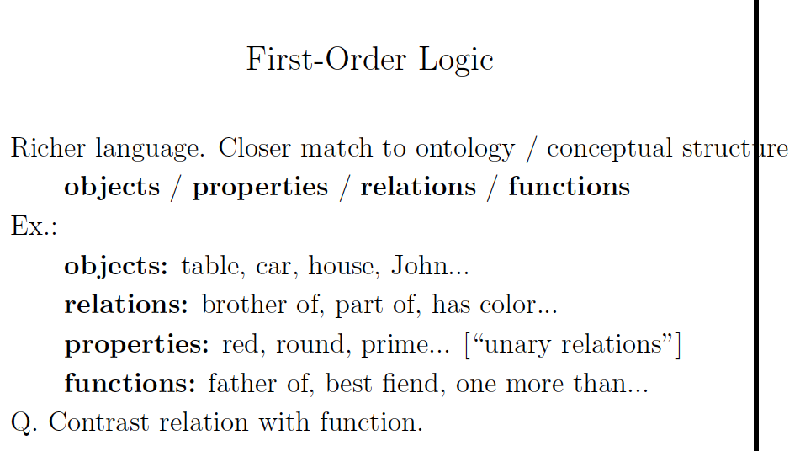

Slide 3
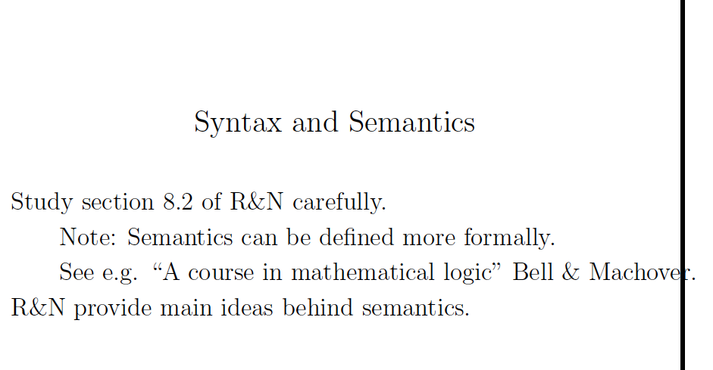

Slide 4
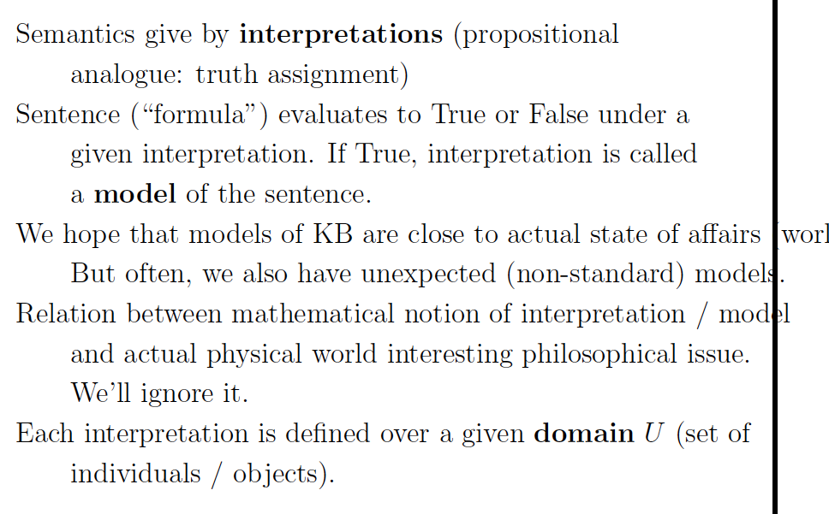

Slide 5
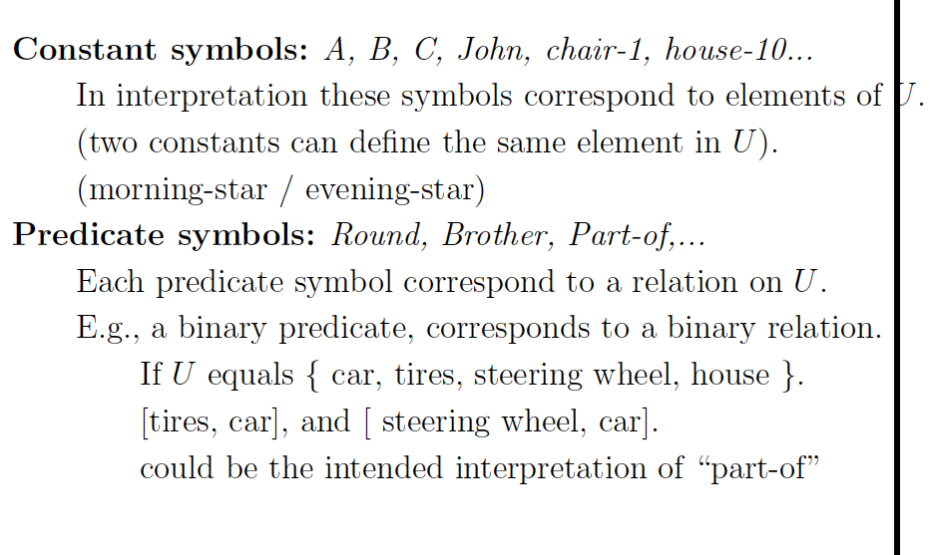

Slide 6
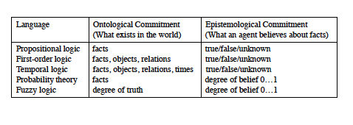

Slide 7
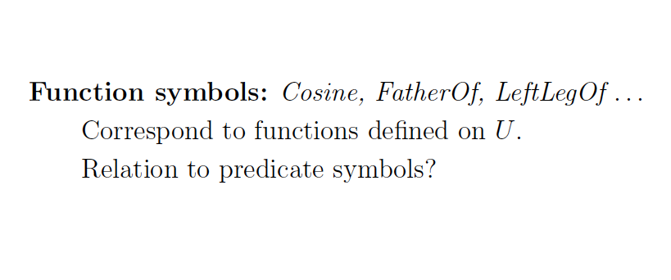

Slide 8
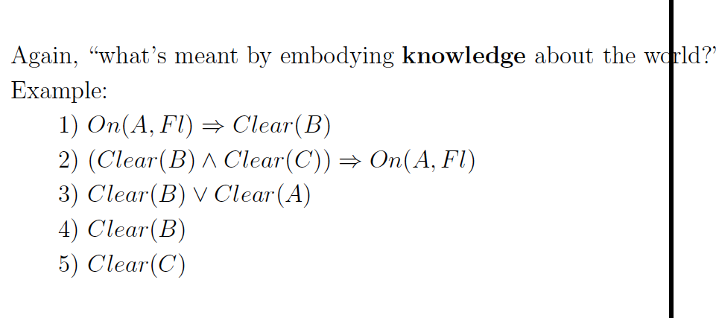

Slide 9
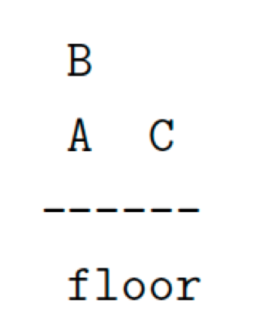
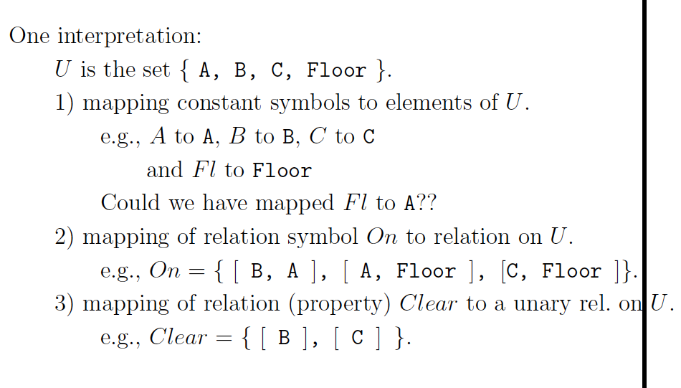

Slide 10
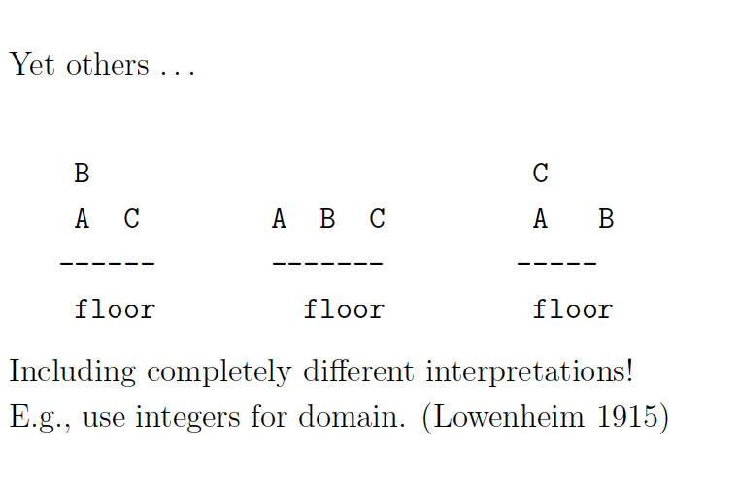
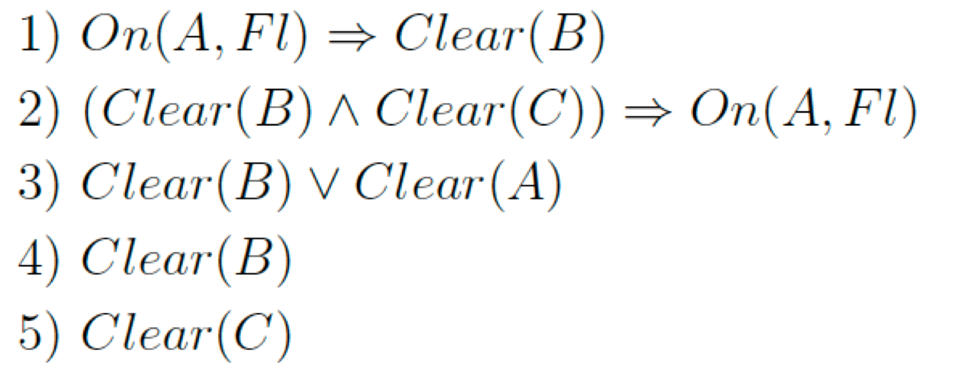

Slide 11
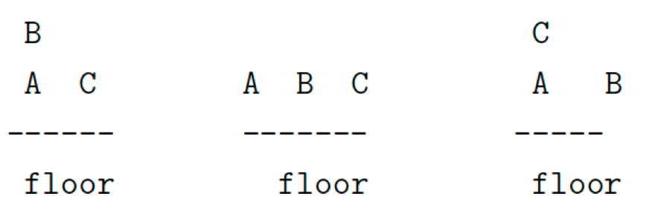
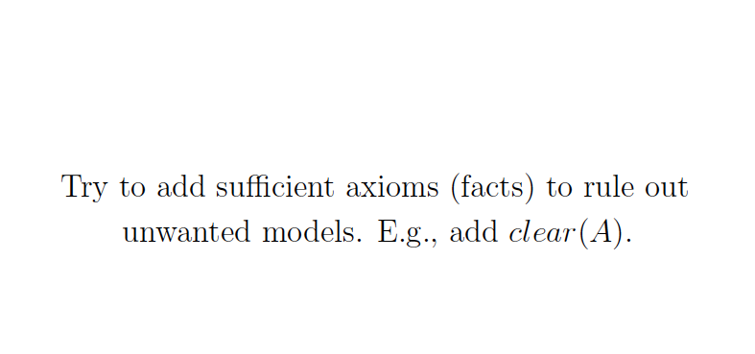


Slide 12
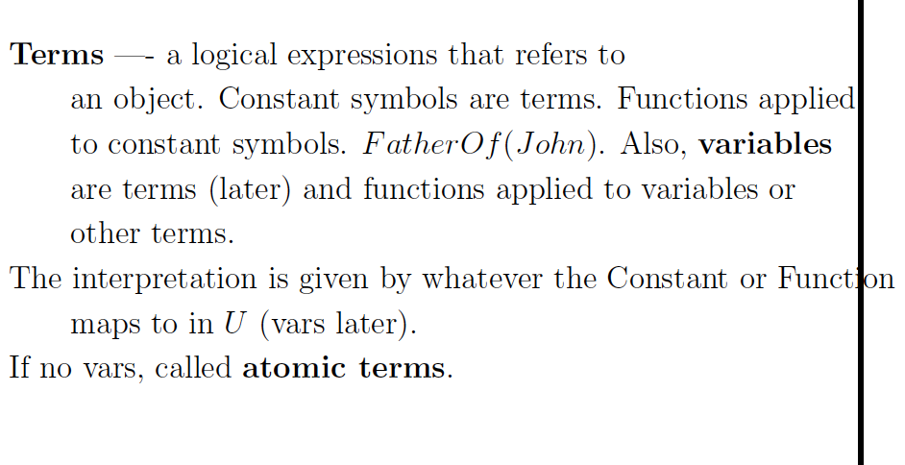

Slide 13
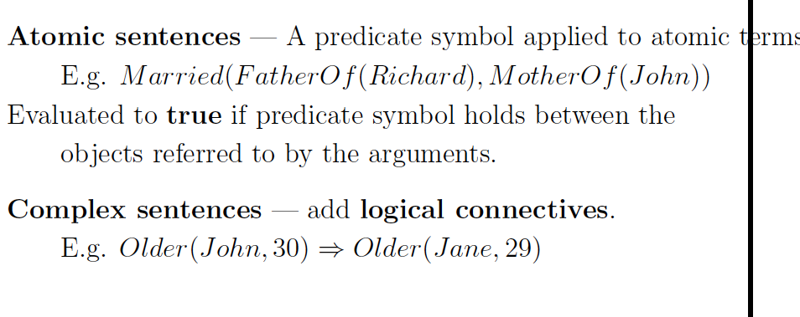

Slide 14
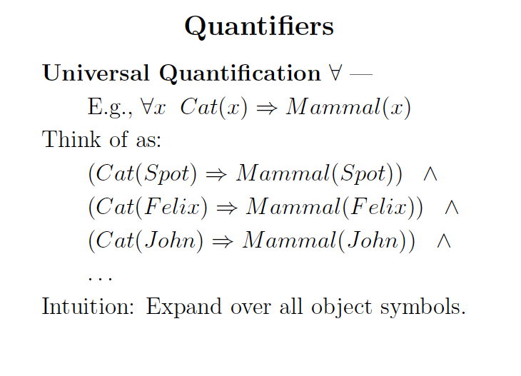

Slide 15
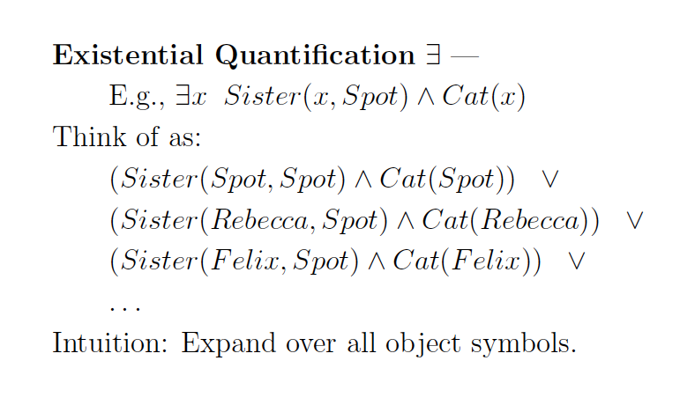

Slide 16
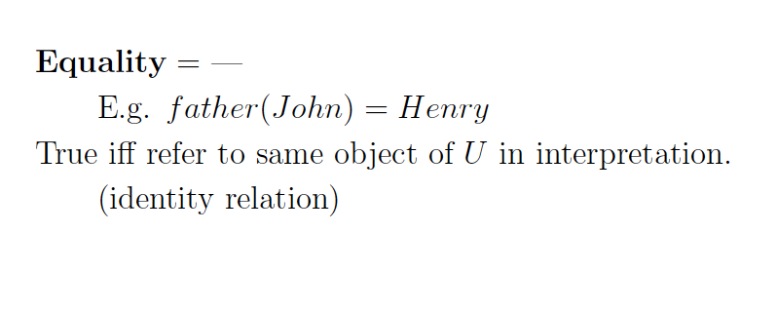

Slide 17
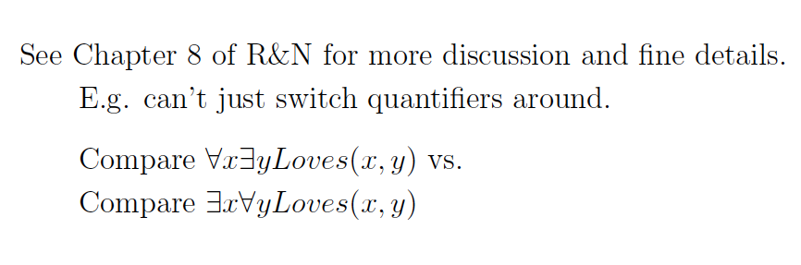

Slide 18
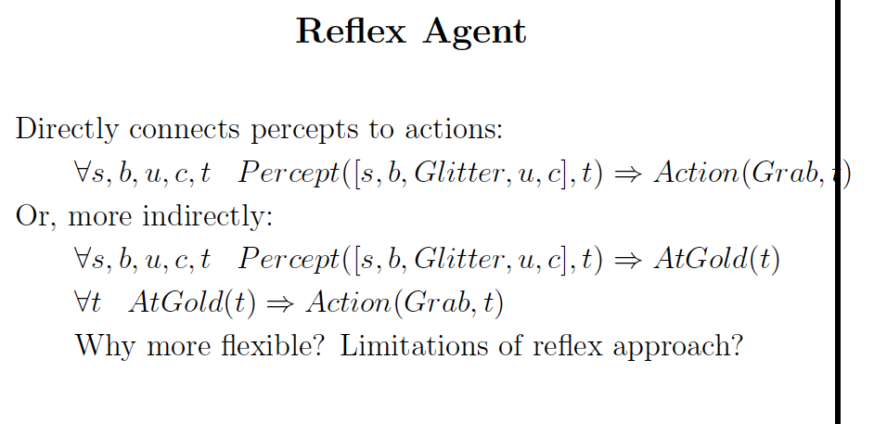
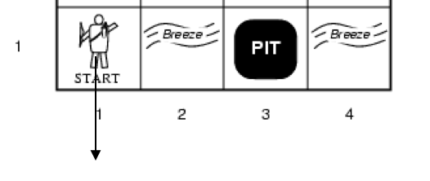
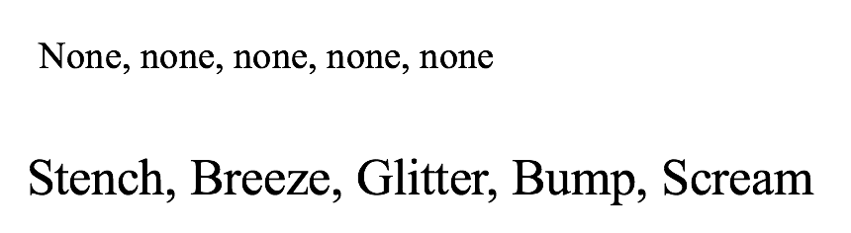

Slide 19
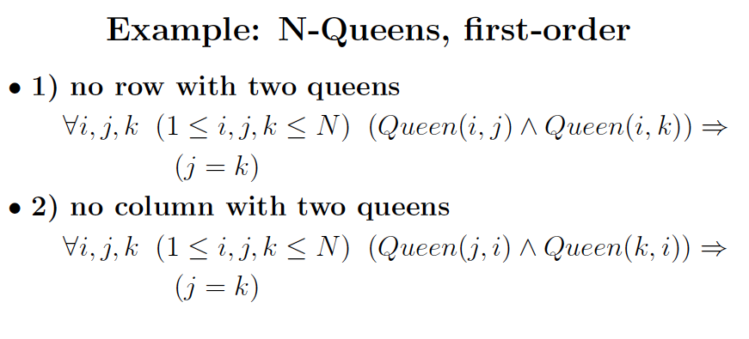
Finite domains === “essentially propositional.” Also called:
Propositional schema.

Slide 20
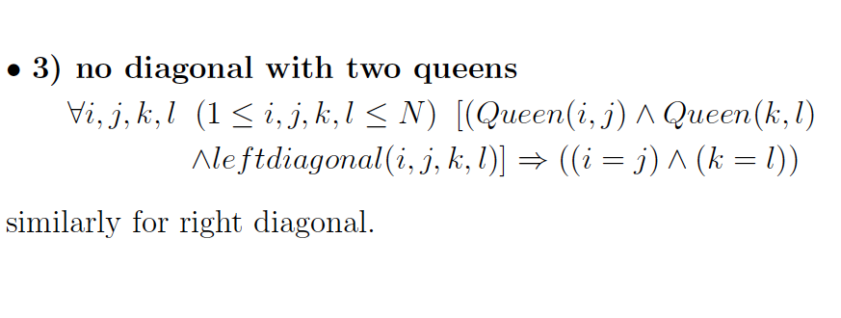

Slide 21
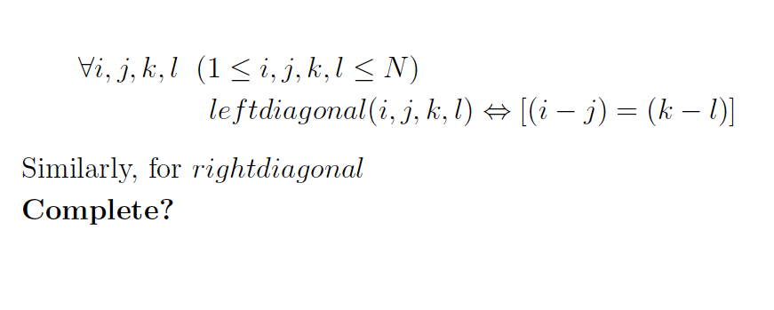

Slide 22
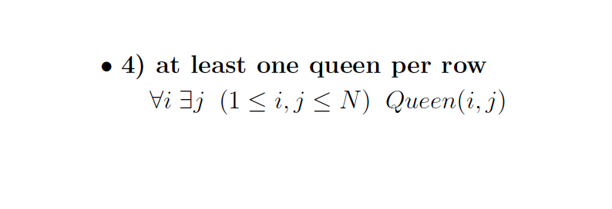

Slide 23
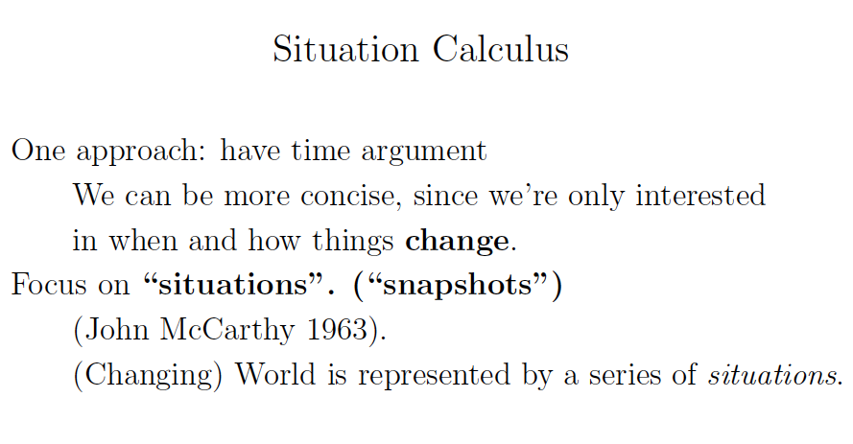
Also discussed earlier. Here some additional axiom details. R&N Section 10.4.2.

Slide 24
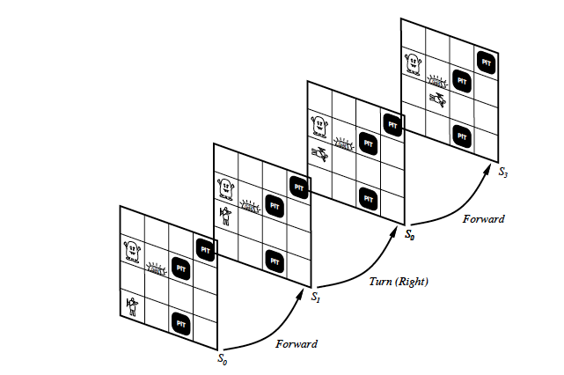

Slide 25
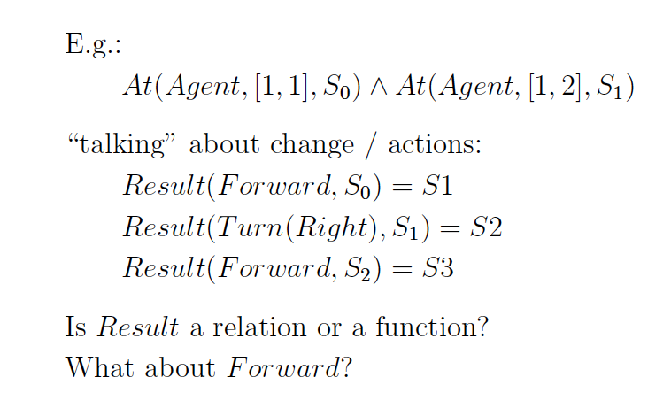
Result(action, situation) → situation (unique outcome)

Slide 26
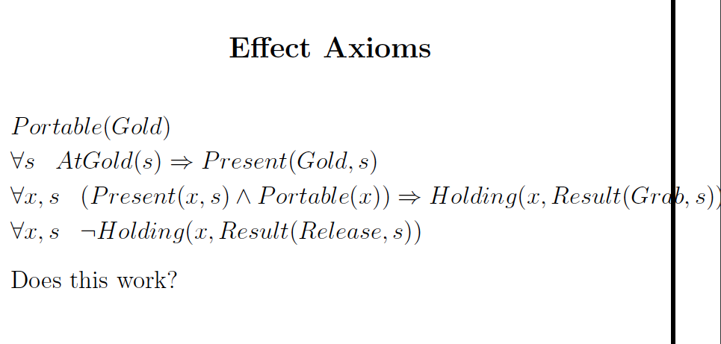

Slide 27
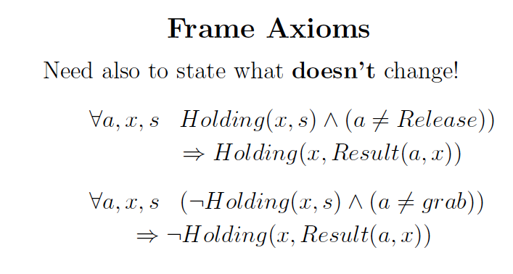
Again, as discussed in propositional case.

Slide 28
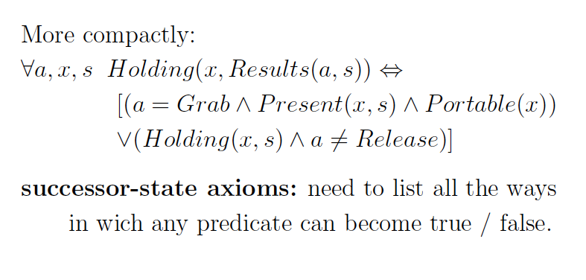

Slide 29
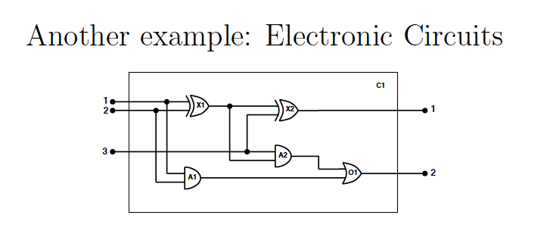
R&N 8.4.2.
Further illustration of FOL formulation.
A bit “tedious.” Check details at home.

Slide 30
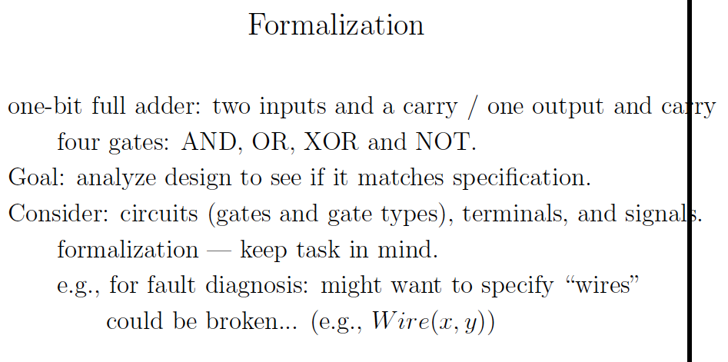

Slide 31
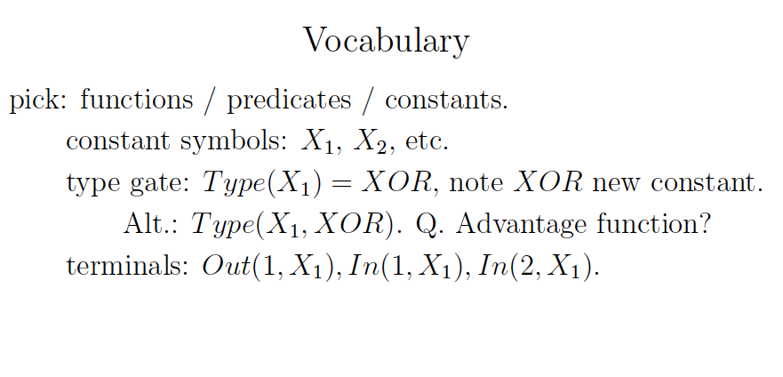
Always define first and
carefully.

Slide 32
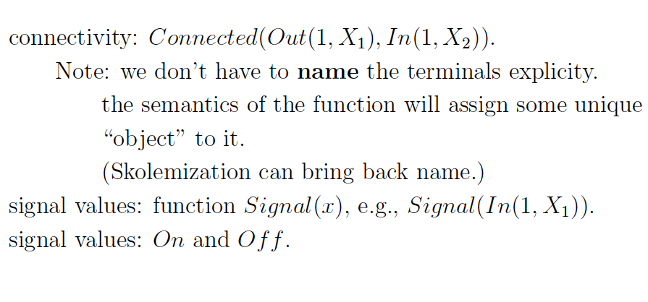

Slide 33
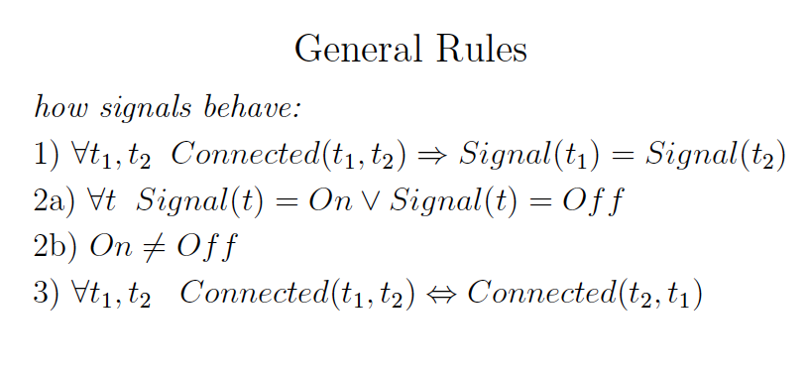

Slide 34
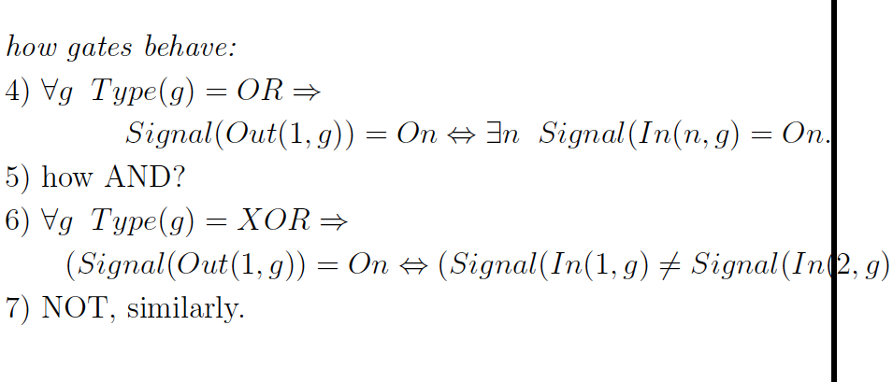

Slide 35
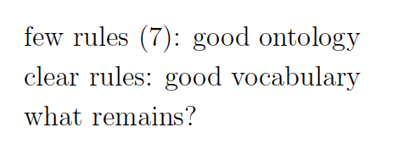

Slide 36
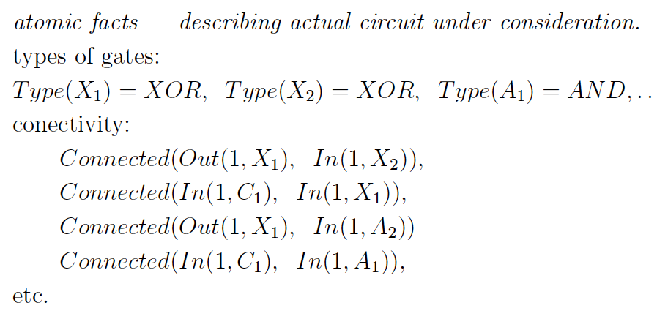
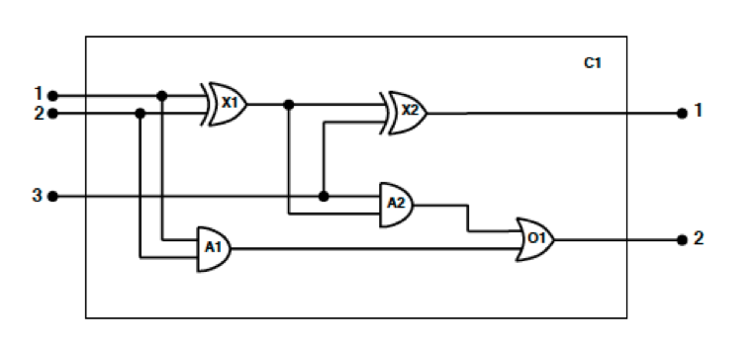

Slide 37
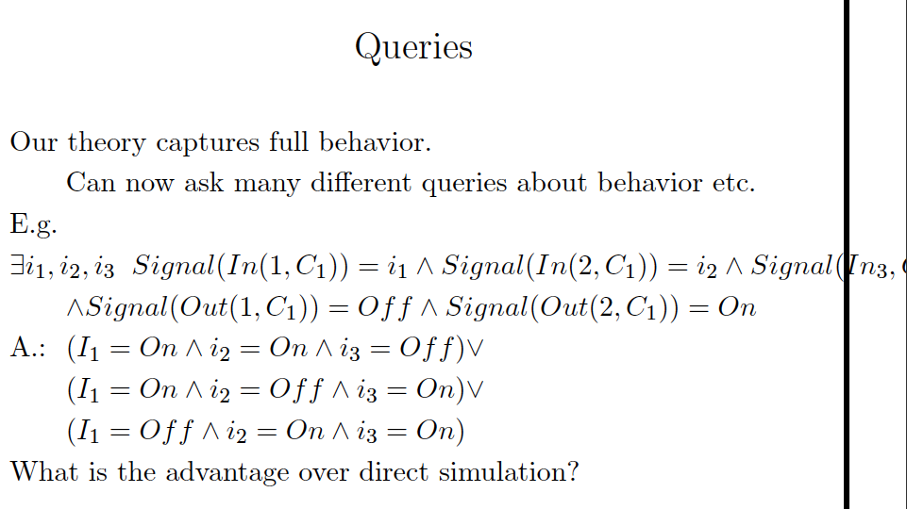

Aside: previously The same here but we want a bit more “detailed answer”. Inference will also give us variable bindings if existential query is entailed.

Slide 38
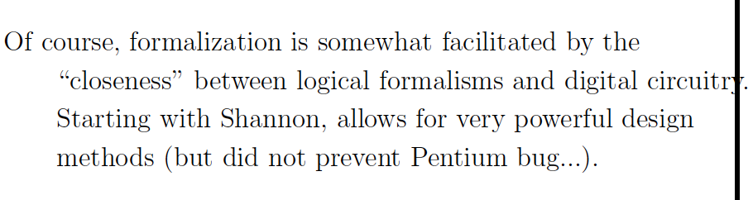

Slide 39
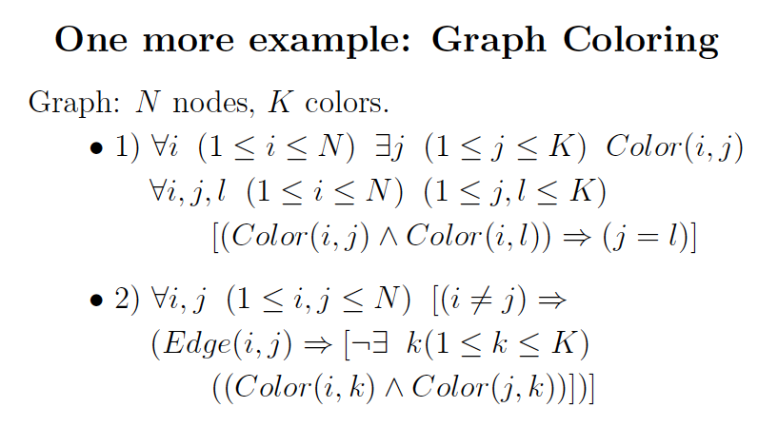
Done with prop. logic. Just check for syntax and FOL form.

Slide 40
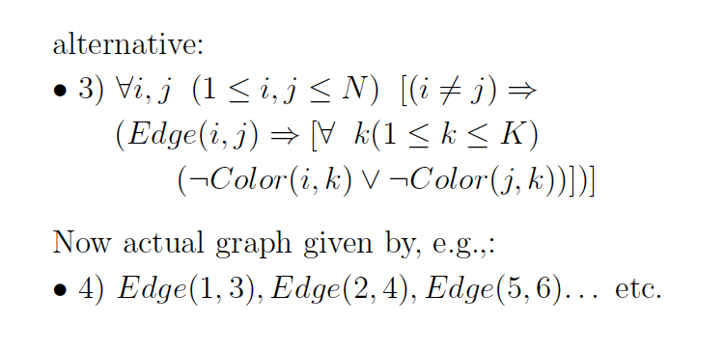

Slide 41
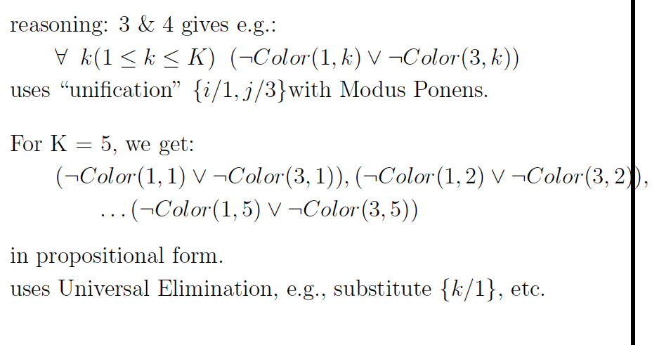

Slide 42
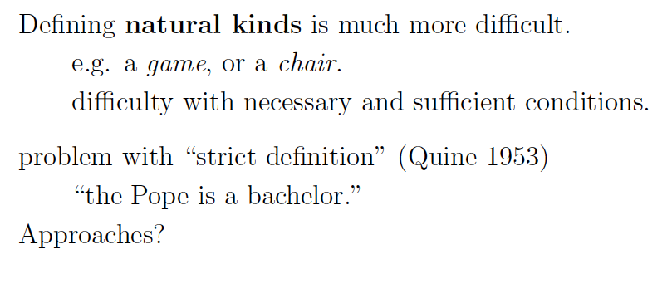
See R&N p. 443
FOL formalizations can be challenging
for “everyday” concepts.
Probabilistic representations (extending prop. logic /
FOL) can help!

Slide 43
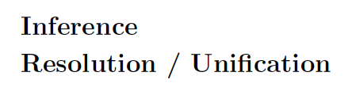
Chapter 9 R&N.
NOTE: for finite domains that are not too large,
better to “ground to” propositional and use
SAT solver.
In hardware/software verification:
Use small numbers (eg int up to 10) OR
“bit blasting”, represent 64 bit int by 64 Boolean vars.

Slide 44
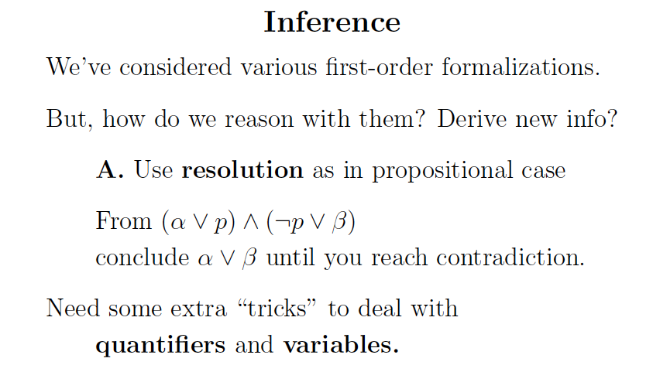

Slide 45
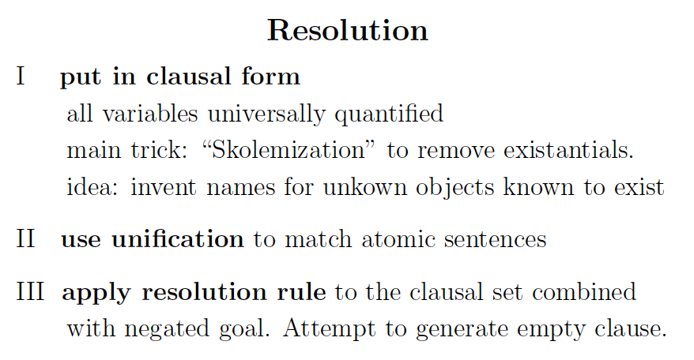

Slide 46


Slide 47


Slide 48


Find the “right” substitution for
a universal quantified variable.

Slide 49


Slide 50

Can substitute in because original clause universally quantified.

Slide 51


Slide 52


Slide 53


Slide 54


Slide 55


Slide 56


Slide 57

Natural language
input.
(From dog to more general.)
(General statement.)
The query
YES!
What “hidden” background knowledge is being used?

Slide 58



(
)
Cats are animals.
Not stated explicitly! This is
an example of background
knowledge key to Natural
Language Understanding.
Query: KB |== Kills(Curiosity, Tuna) ??
NLU needs to resolve “the cat” to Tuna!

Slide 59




D is a “fake name” for the dog.
Negation of query!
Proof by contradiction
for resolution.
Missing?
8. ¬ Kills(Curiosity, Tuna)
Translation to clausal form automatic.

Slide 60


i.e.
: Kills(Curiosity,Tuna)
Warning: Non-standard notation!!

Slide 61



First-order resolution proof (more carefully)
9. ¬ Owns(x, D)∨ AnimalLover(x) using S(x)/D
10. AnimalLover(Jack) using x/Jack
11. Animal (Tuna) using z/Tuna

Slide 62
11. Animal (Tuna)
12. ¬ AnimalLover(w) ∨ ¬ Kills(w, Tuna) using y/Tuna
10. AnimalLover(Jack)
13. ¬ Kills(Jack, Tuna) using w/Jack
14. Kills(Curiosity, Tuna)
15 lines; trivial with
modern solvers.
Can do 1+ billion lines!
8. ¬ Kills(Curiosity, Tuna)
15 ⧠ (contradiction reached)
So, KB |== Kills(Curiosity, Tuna)

Slide 63

So, we answered a natural language query using
Natural language parsing (almost there)
Background knowledge (much work remaining)
Reasoning (works fine now)
We will see much progress in this kind of natural
language question answering in next decade.
Eg executable semantic parsing.
Persi Liang, Stanford.

Slide 64


Slide 65


Slide 66


Slide 67


Slide 68


Slide 69

Certain sets of first-order statements can overwhelm general resolution solvers, e.g. about infinite sets (natural numbers).
Or, better yet, for finite domains, fall back to SAT solvers.

Slide 70
Concludes propositional and first-order
logic for knowledge representation and reasoning.
Next “Big Picture Slide”

