Slide 1
CS 4700:
Foundations of Artificial Intelligence
Bart Selman
selman@cs.cornell.edu
Module: Knowledge, Reasoning, and Planning
Part 1
Logical Agents
R&N: Chapter 7

Slide 2
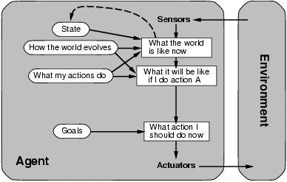
A Model-Based Agent
Requires: Knowledge and Reasoning

Slide 3
Knowledge and Reasoning
  Knowledge and Reasoning:
  humans are very good at acquiring new information by
  combining raw knowledge, experience with reasoning.
  AI-slogan: “Knowledge is power” (or “Data is power”?)
  Examples:
  Medical diagnosis --- physician diagnosing a patient
  infers what disease, based on the knowledge he/she
  acquired as a student, textbooks, prior cases
  Common sense knowledge / reasoning ---
  common everyday assumptions / inferences
  e.g., “lecture starts at four” infer pm not am;
  when traveling, I assume there is some way to get from the
  airport to the hotel.

Slide 4
  Logical agents:
  Agents with some representation of the
  complex knowledge about the world / its environment,
  and uses inference to derive new information from that
  knowledge combined with new inputs (e.g. via perception).
Key issues:
  1- Representation of knowledge
  What form? Meaning / semantics?
  2- Reasoning and inference processes
  Efficiency.

Slide 5
Knowledge-base Agents
Key issues:
  Representation of knowledge → knowledge base
  Reasoning processes → inference/reasoning
Knowledge base = set of sentences in a formal language representing facts about the world(*)
(*) called Knowledge Representation (KR) language

Slide 6

Knowledge bases
Key aspects:
  How to add sentences to the knowledge base
  How to query the knowledge base
  Both tasks may involve inference – i.e. how to derive new sentences from old sentences
  Logical agents – inference must obey the fundamental requirement that when one asks a question to the knowledge base, the answer should follow from what has been told to the knowledge base previously. (In other words the inference process should not “make things” up…)

Slide 7
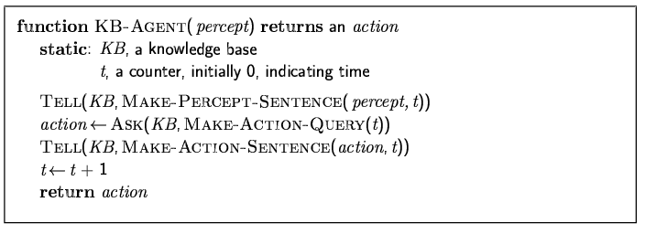
A simple knowledge-based agent
The agent must be able to:
  Represent states, actions, etc.
  Incorporate new percepts
  Update internal representations of the world
  Deduce hidden properties of the world
  Deduce appropriate actions

Slide 8
KR language candidate:
logical language (propositional / first-order) combined
with a logical inference mechanism
How close to human thought? (mental-models / Johnson-Laird).
What is “the language of thought”?
Why not use natural language (e.g. English)?
Greeks / Boole / Frege --- Rational thought: Logic?
We want clear syntax & semantics (well-defined
meaning), and, mechanism to infer new information.
Soln.: Use a formal language.

Slide 9
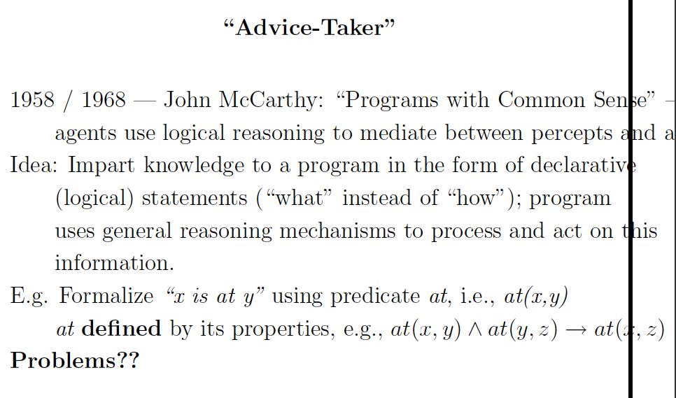
Consider: to-the-right-of(x,y)

Slide 10
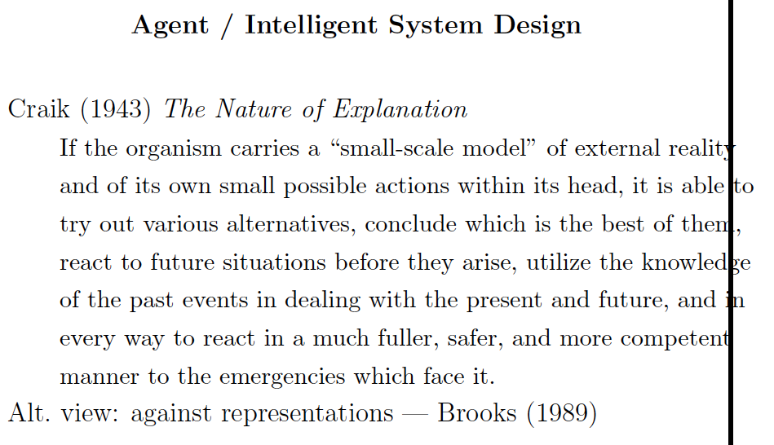

Slide 11
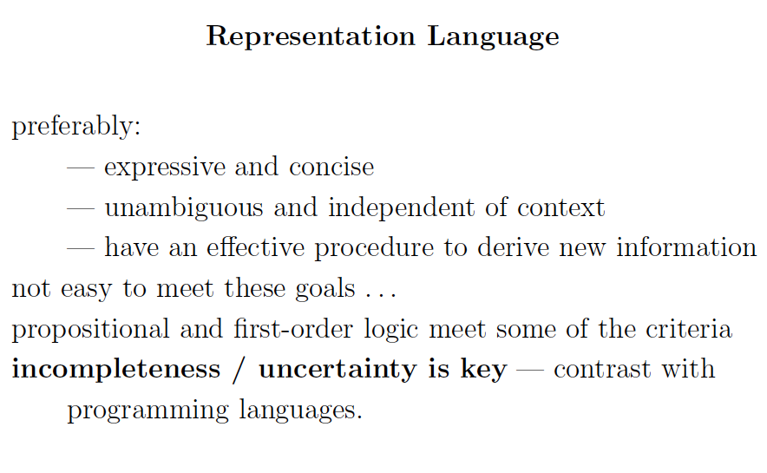

Slide 12
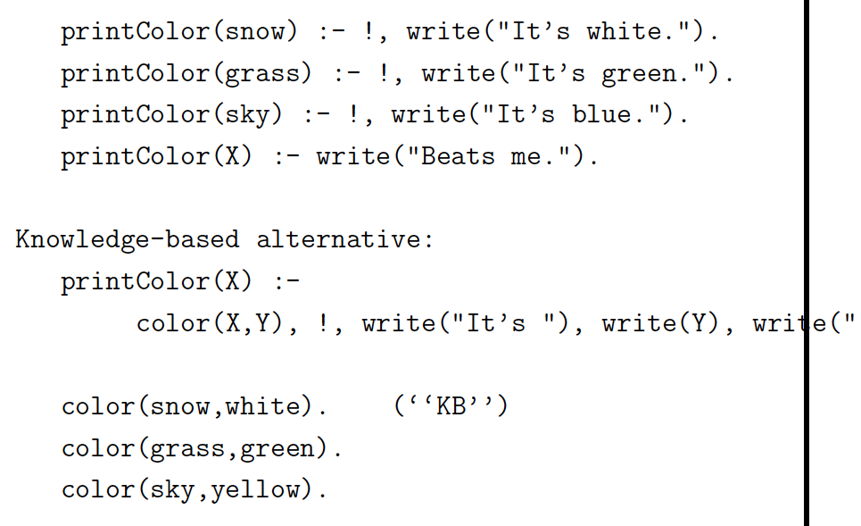
Procedural style:
Knowledge-based alternative:
Modular.
Change KB without
changing program.

Slide 13
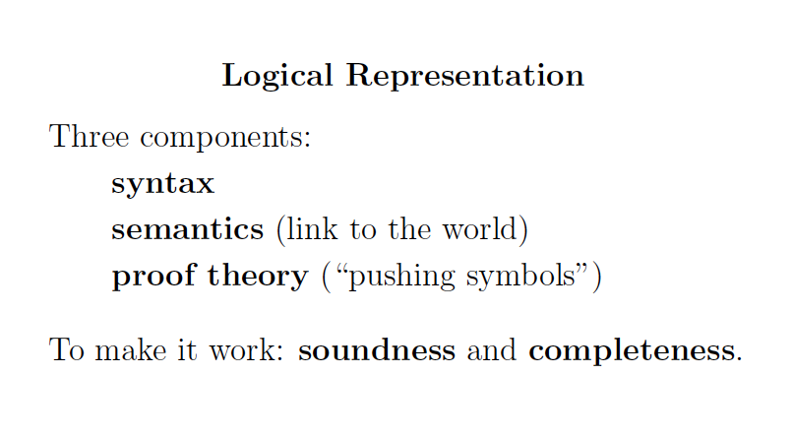

Slide 14
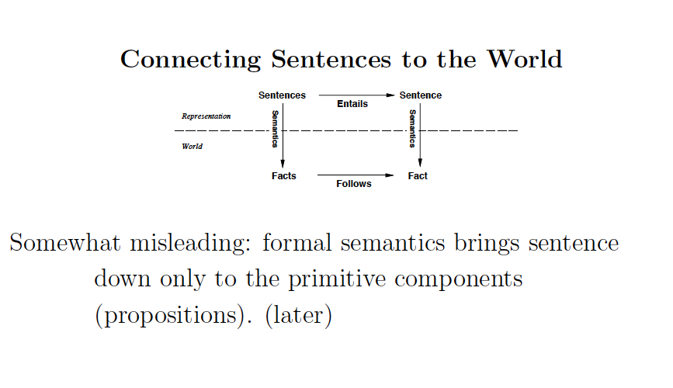

Slide 15
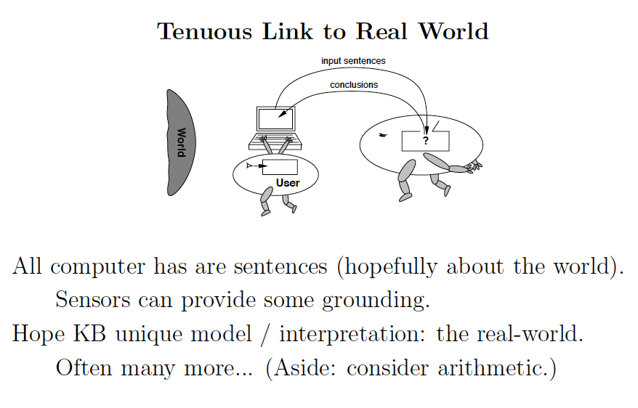
The “symbol grounding problem.”

Slide 16
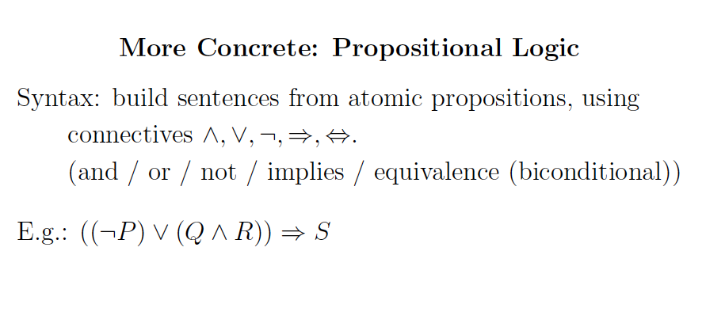

Slide 17
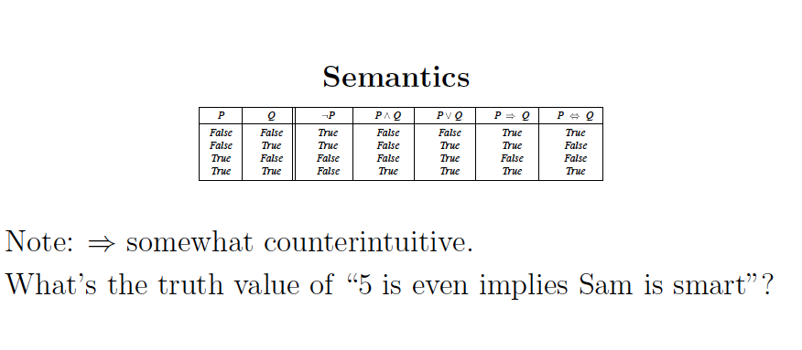
True!

Slide 18
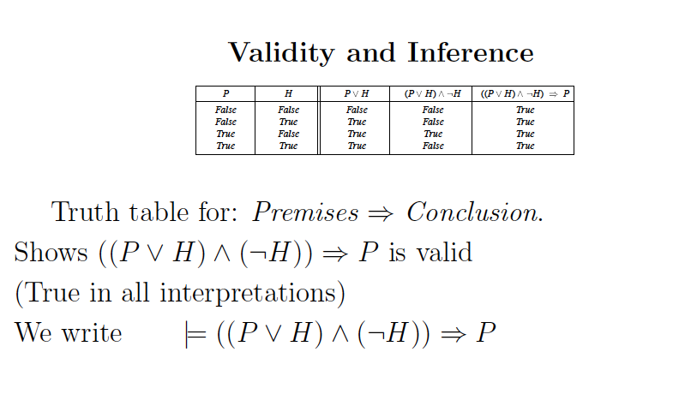
Compositional semantics

Slide 19
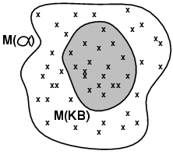
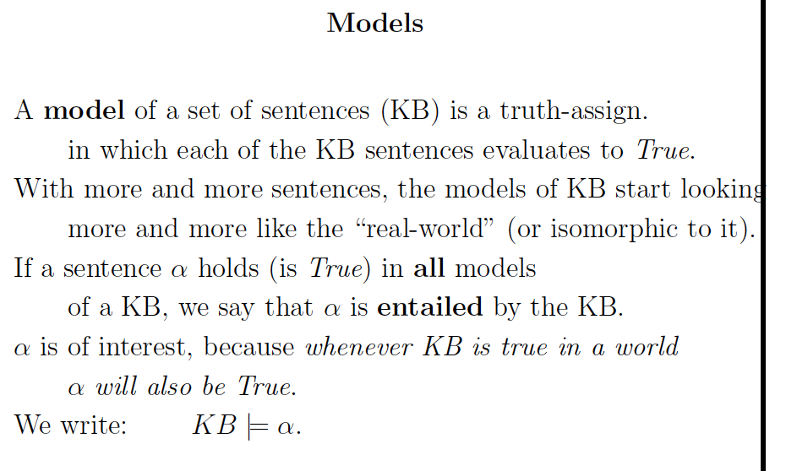
Note: KB defines exactly the set of worlds we are interested in.
I.e.: Models(KB) Models( )

Slide 20
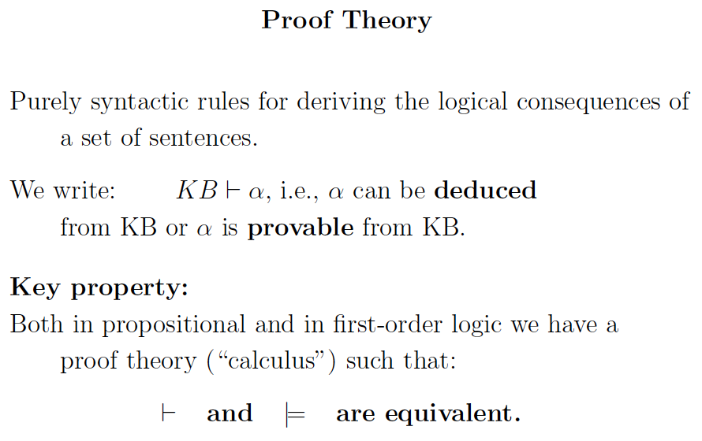

Slide 21
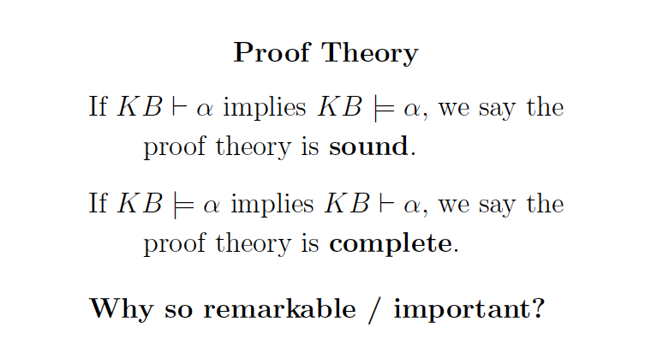

Slide 22
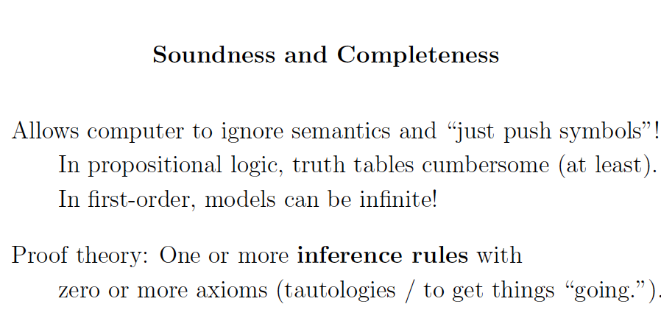
Note: (1) This was Aristotle’s original goal ---
Construct infallible arguments based purely
on the form of statements --- not on the “meaning”
of individual propositions.
(2) Sets of models can be exponential size or worse,
compared to symbolic inference (deduction).

Slide 23
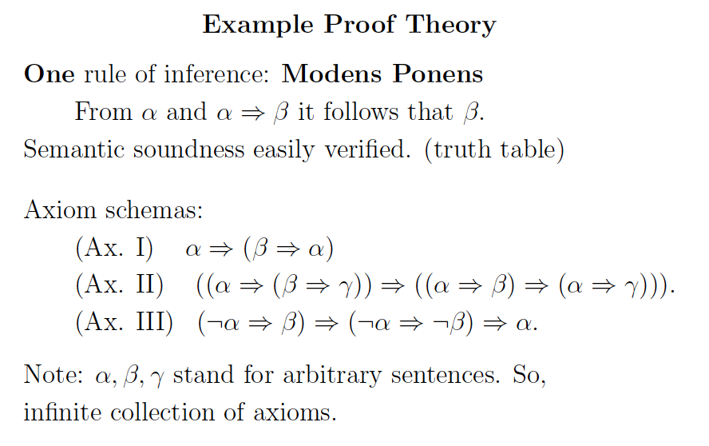

Slide 24
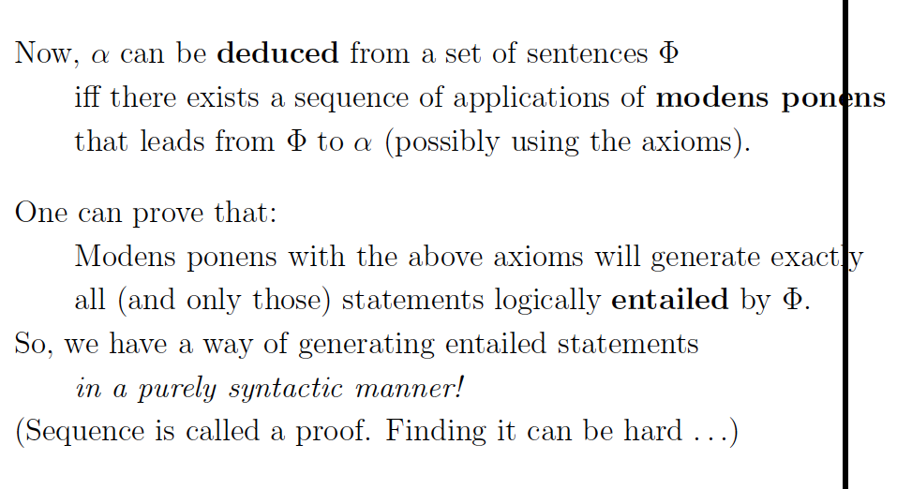

Slide 25
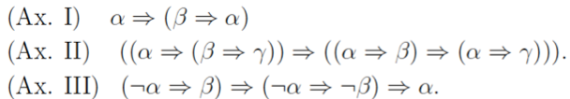
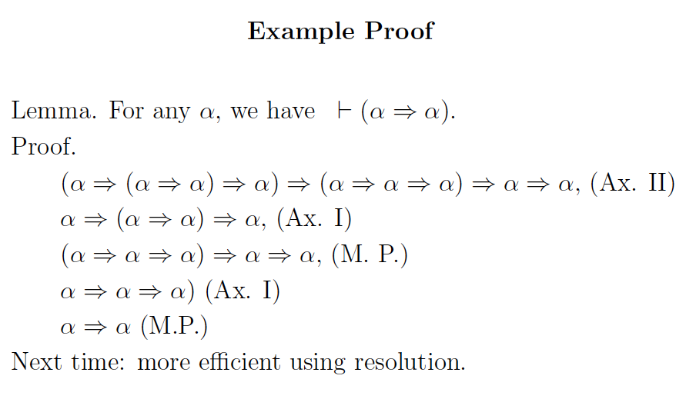

Slide 26
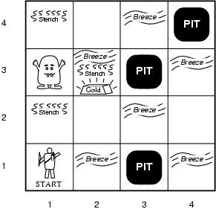
Illustrative example: Wumpus World
(Somewhat whimsical!)
Performance measure
  gold +1000,
  death -1000
  (falling into a pit or being eaten by the wumpus)
  -1 per step, -10 for using the arrow
Environment
  Rooms / squares connected by doors.
  Squares adjacent to wumpus are smelly
  Squares adjacent to pit are breezy
  Glitter iff gold is in the same square
  Shooting kills wumpus if you are facing it
  Shooting uses up the only arrow
  Grabbing picks up gold if in same square
  Releasing drops the gold in same square
  Randomly generated at start of game. Wumpus only senses current room.
Sensors: Stench, Breeze, Glitter, Bump, Scream [perceptual inputs]
Actuators: Left turn, Right turn, Forward, Grab, Release, Shoot
Notes:
A cave consisting of rooms connected by passageways:
lurking somewhere in the cave is the wumpus, a beast that eats anyone who enters its room;
the wumpus can be shot by an agent, but the agent has only one arrow;
Some rooms contain bottomless pits that will trp anyone who wanders into these rooms – except the wumpus which is too big to fall;
Mitigating feature of living in this environment: finding gold (Michael Genesereth);
Agent always starts in square (1,1) facing to the right; locations of gold and the wumpus are chosen randomly, with uniform distribution, from the squares other than the start square; each square other than the start can be a pit with probability 0.2

Slide 27
Wumpus world characterization
Fully Observable No – only local perception
Deterministic Yes – outcomes exactly specified
Static Yes – Wumpus and Pits do not move
Discrete Yes
Single-agent? Yes – Wumpus is essentially a “natural feature.”

Slide 28
Exploring a wumpus world
The knowledge base of the agent
consists of the rules of the
Wumpus world plus the percept
“nothing” in [1,1]
Boolean percept
feature values:
<0, 0, 0, 0, 0>
None, none, none, none, none
Stench, Breeze, Glitter, Bump, Scream

Slide 29
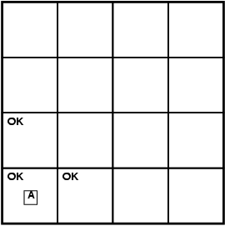
World “known” to agent
at time = 0.
T=0 The KB of the agent consists of
the rules of the Wumpus world plus
the percept “nothing” in [1,1].
By inference, the agent’s knowledge
base also has the information that
[2,1] and [1,2] are okay.
Added as propositions.
None, none, none, none, none
Stench, Breeze, Glitter, Bump, Scream

Slide 30
Further exploration
T = 0
T = 1
P?
A/B
P?
V
None, breeze, none, none, none
None, none, none, none, none
A – agent
V – visited
B - breeze
Stench, Breeze, Glitter, Bump, Scream
@ T = 1 What follows?
Pit(2,2) or Pit(3,1)
Where next?

Slide 31
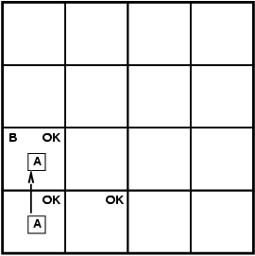
T=3
4
3
W
S
P?
S
2
P
1
P?
P
1 2 3 4
Stench, none, none, none, none
Stench, Breeze, Glitter, Bump, Scream
Where is Wumpus?
Wumpus cannot be in (1,1) or in (2,2) (Why?)➔ Wumpus in (1,3)
Not breeze in (1,2) ➔ no pit in (2,2); but we know there is
pit in (2,2) or (3,1) ➔ pit in (3,1)

Slide 32
We reasoned about the possible states the Wumpus world can be in, given our percepts and our knowledge of the rules of the Wumpus world.
I.e., the content of KB at T=3.
W
P
P
What follows is what holds true in all those worlds that satisfy what is known at that time T=3 about the particular Wumpus world we are in.
Example property: P_in_(3,1)
Models(KB) Models(P_in_(3,1))
Essence of logical reasoning:
Given all we know, Pit_in_(3,1) holds.
(“The world cannot be different.”)

Slide 33
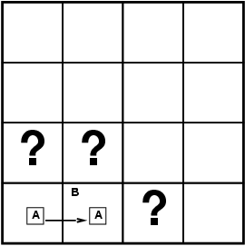
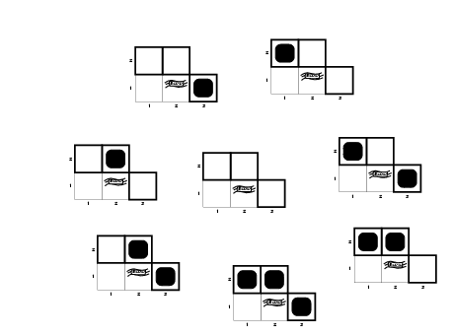
Formally: Entailment
Knowledge Base (KB) in the Wumpus World →
Rules of the wumpus world + new percepts
Situation after detecting nothing in [1,1], moving right, breeze in [2,1]. I.e. T=1.
Consider possible models for KB with respect to the cells (1,2), (2,2) and (3,1), with respect to the existence or non existence of pits
3 Boolean choices ⇒
8 possible interpretations
(enumerate all the models or
“possible worlds” wrt Pitt location)
T = 1

Slide 34
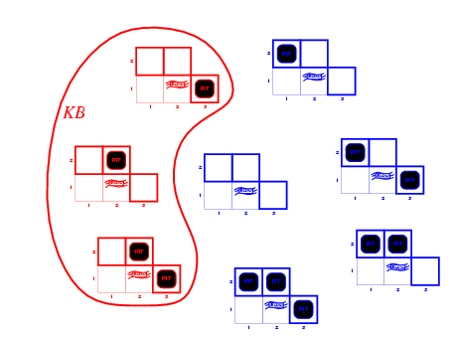

Is KB consistent with all
8 possible worlds?
Worlds
that violate KB
(are inconsistent
with what we
know)
KB = Wumpus-world rules + observations (T=1)
Q: Why does world violate KB?

Slide 35
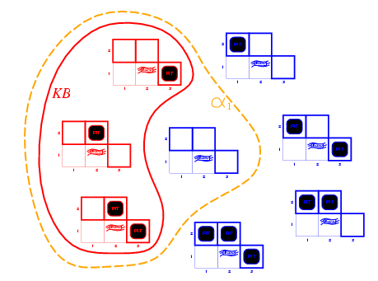
Entailment in Wumpus World
So, KB defines
all worlds that
we hold possible.
Queries: we want to know the properties of those worlds.
That’s how the semantics of logical entailment is defined.
Models of the KB and α1
Note: \alpha_1
holds in more
models than KB.
That’s OK, but we
don’t care about
those worlds.
KB = Wumpus-world rules + observations
α₁ = "[1,2] has no pit", KB ╞ α₁
  In every model in which KB is true, α₁ is True (proved by “model checking”)

Slide 36
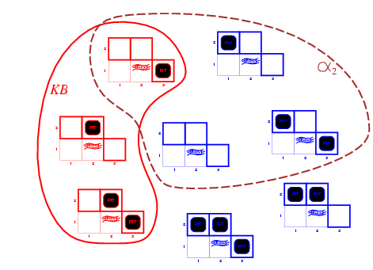
Wumpus models
KB = wumpus-world rules + observations
α2 = "[2,2] has no pit", this is only True in some
of the models for which KB is True, therefore KB ╞ α2
Model Checking
Models of α2
A model of KB where does NOT hold!
α2

Slide 37
Entailment via
“Model Checking”
Inference by Model checking –
We enumerate all the KB models and check if α₁ and α₂ are
True in all the models (which implies that we can only use it
when we have a finite number of models).
I.e. using semantics directly.
Models(KB) Models( )

Slide 38
Example redux: More formal
P?
A/B
P?
V
None, none, none, none, none
None, breeze, none, none, none
Stench, Breeze, Glitter, Bump, Scream
A – agent
V – visited
B - breeze
How do we actually encode background
knowledge and percepts in formal language?

Slide 39
Wumpus World KB
Define propositions:
Let P_{i,j} be true if there is a pit in [i, j].
Let B_{i,j} be true if there is a breeze in [i, j].
  Sentence 1 (R1): ¬ P_{1,1}
  Sentence 2 (R2): ¬ B_{1,1}
  Sentence 3 (R3): B_{2,1}
"Pits cause breezes in adjacent squares”
  Sentence 4 (R4): B_{1,1} ⇔ (P_{1,2} ∨ P_{2,1})
  Sentence 5 (R5): B_{2,1} ⇔ (P_{1,1} ∨ P_{2,2} ∨ P_{3,1})
  etc.
Notes: (1) one such statement about Breeze for each square.
(2) similar statements about Wumpus, and stench
  and Gold and glitter. (Need more propositional
  letters.)
[Given.]
[Observation T = 0.]
[Observation T = 1.]

Slide 40
What about Time? What about Actions?
Is Time represented?
No!
Can include time in propositions:
  Explicit time P_{i,j,t} B_{i,j,t} L_{i,j,t} etc.
  Many more props: O(TN²) (L_{i,j,t} for agent at (i,j) at time t)
Now, we can also model actions, use props: Move(i ,j ,k ,l ,t)
E.g. Move(1, 1, 2, 1, 0)
What knowledge axiom(s) capture(s) the effect of an Agent move?
Move(i, j, k, l ,t) (: L(i, j, t+1) Æ L(k, l, t+1))
Is this it?
What about i, j, k, and l?
What about Agent location at time t?
)

Slide 41
Move implies a change in the world state;
a change in the world state, implies a move occurred!
Improved:
Move(i, j, k, l ,t) , (L(i, j, t) Æ : L(i, j, t+1) Æ L(k, l, t+1))
For all tuples (i, j, k, l) that represent legitimate possible moves.
E.g. (1, 1, 2, 1) or (1, 1, 1, 2)
Still, some remaining subtleties when representing time and
actions. What happens to propositions at time t+1 compared to at
time t, that are *not* involved in any action?
E.g. P(1, 3, 3) is derived at some point.
What about P(1, 3, 4), True or False?
R&N suggests having P as an “atemporal var” since it cannot change over
time. Nevertheless, we have many other vars that can change over time,
called “fluents”.
Values of propositions not involved in any action should not change! “The Frame Problem” / Frame Axioms R&N 7.7.1

Slide 42
Successor-State Axioms
Axiom schema:
F is a fluent (prop. that can change over time)
For example:
i.e. L_1,1 was “as before” with [no movement action or bump into wall]
or resulted from some action (movement into L_1,1).

Slide 43
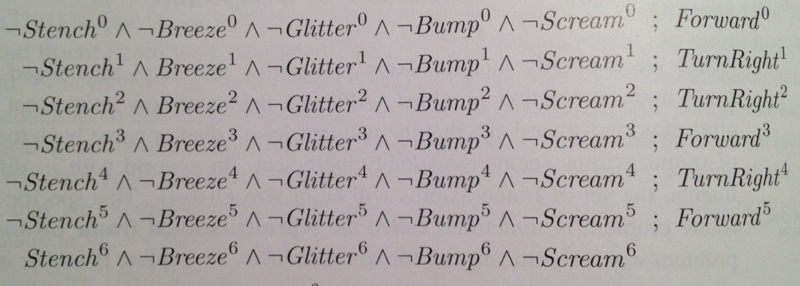



Some example inferences
Section 7.7.1 R&N
Actions and inputs up to time 6
Note: includes turns!
Define “OK”:
In milliseconds, with modern SAT solver.

Slide 44
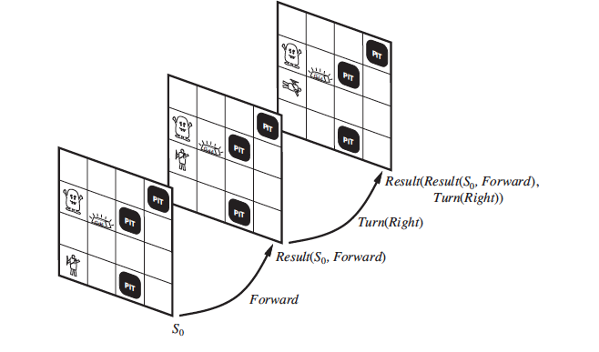
Alternative formulation: Situation Calculus
R&N 10.4.2
No explicit time. Actions are what changes the world
from “situation” to “situation”. More elegant, but
still need frame axioms to capture what stays the same.
Inherent with many representation formalisms: “physical”
persistance does not come for free! (and probably shouldn’t)

Slide 45
Inference by enumeration / “model checking”
Style I
The goal of logical inference is to decide whether KB╞ α, for some α.
For example, given the rules of the Wumpus World, is P₂₂ entailed? Relevant propositional symbols:
  R1: ¬ P_{1,1}
  R2: ¬B_{1,1}
  R3: B_{2,1}
"Pits cause breezes in adjacent squares"
  R4: B_{1,1} ⇔ (P_{1,2} ∨ P_{2,1})
  R5: B_{2,1} ⇔ (P_{1,1} ∨ P_{2,2} ∨ P_{3,1})
?
Models(KB) Models( P22 )
Inference by enumeration. We have 7 relevant symbols
Therefore 2⁷ = 128 interpretations.
Need to check if P22 is true in all of the KB models
(interpretations that satisfy KB sentences).
Q.: KB has many more symbols. Why can we restrict ourselves
to these symbols here?
But, be careful, typically we can’t!!

Slide 46
All equivalent
Prop. / FO Logic
1) KB ² ®
entailment
2) M(KB) µ M(®)
by defn. / semantic proofs / truth tables
“model checking” /enumeration
(style I, R&N 7.4.4)
3) ² (KB ) ®)
deduction thm. R&N 7.5
soundness and completeness
logical deduction / symbol pushing
proof by inference rules (style II)
e.g. modus ponens (R&N 7.5.1)
4) KB ` ®
5) (KB Æ : ®) is inconsistent
Proof by contradiction
use CNF / clausal form
Resolution (style III, R&N 7.5)
SAT solvers (style IV, R&N 7.6)
most effective

Slide 47
Proof techniques
M(KB) µ M(®)
by defn. / semantic proofs / truth tables
“model checking”
(style I, R&N 7.4.4) Done.
soundness and completeness
logical deduction / symbol pushing
proof by inference rules (style II)
e.g. modus ponens (R&N 7.5.1)
KB ` ®
(KB Æ : ®) is inconsistent
Proof by contradiction
use CNF / clausal form
Resolution (style III, R&N 7.5)
SAT solvers (style IV, R&N 7.6)
most effective

Slide 48
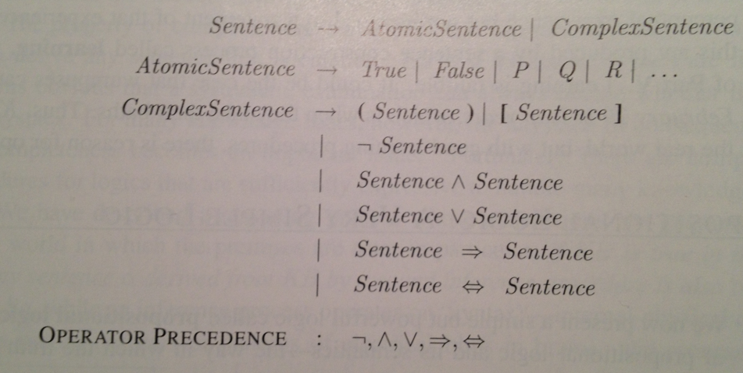
Aside
Standard syntax and semantics for propositional
logic. (CS-2800; see 7.4.1 and 7.4.2.)
Syntax:

Slide 49
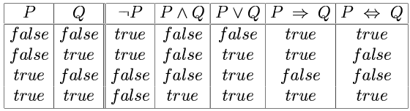
Semantics
Note: Truth value of a sentence is built from its parts “compositional semantics”

Slide 50
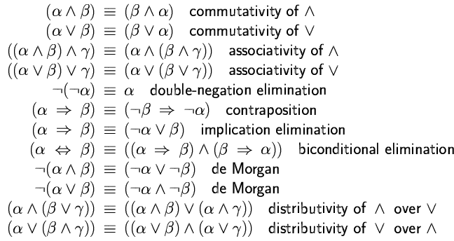
Logical equivalences
(*)
(*) key to go to clausal (Conjunctive Normal Form)
Implication for “humans”; clauses for machines.
de Morgan laws also very useful in going to clausal form.

Slide 51
Style II: Proof by inference rules
Modus Ponens (MP)
KB at T = 1:
  R1: ¬P_{1,1}
  R2: ¬B_{1,1}
  R3: B_{2,1}
  R4: B_{1,1} ⇔ (P_{1,2} ∨ P_{2,1})
  R5: B_{2,1} ⇔ (P_{1,1} ∨ P_{2,2} ∨ P_{3,1})
How can we show that KR ² : P_{1,2} ?
P?
R4: B_{1,1} ⇔ (P_{1,2} ∨ P_{2,1})
It follows (bicond elim)
B_{1,1} ) (P_{1,2} ∨ P_{2,1}) Æ (P_{1,2} ∨ P_{2,1}) ) B_{1,1}
And-elimination (7.5.1 R&N):
(P_{1,2} ∨ P_{2,1}) ) B_{1,1}
By contrapositive:
: B_{1,1} ) (: (P_{1,2} Ç P_{2,1}))
Thus (de Morgan):
: B_{1,1} ) (:P_{1,2} Æ : P_{2,1})
By Modus Ponens using R2, we get
(:P_{1,2} Æ : P_{2,1})
Finally, by And-elimination, we get:
: P_{1,2}
A/B
P?
V
Wumpus world
at T = 1
Note: In formal proof,
every step needs to be
justified.

Slide 52
Length of Proofs
Why bother with inference rules? We could always use a truth table
to check the validity of a conclusion from a set of premises.
But, resulting proof can be much shorter than truth table method.
Consider KB:
p_1, p_1 → p_2, p_2 → p_3, …, p_(n-1) → p_n
To prove conclusion: p_n
Inference rules: Truth table:
n-1 MP steps
2^{n}
Key open question: Is there always a short proof for any valid
conclusion? Probably not. The NP vs. co-NP question.
(The closely related: P vs. NP question carries a $1M prize.)

Slide 53
Style III: Resolution
First, we need a conversion to Conjunctive
Normal Form (CNF) or Clausal Form.
Let’s consider converting R4 in clausal form:
R4: B_{1,1} ⇔ (P_{1,2} ∨ P_{2,1})
We have:
B_{1,1} ) (P_{1,2} Ç P_{2,1})
which gives (implication elimination):
(: B_{1,1} Ç P_{1,2} Ç P_{2,1})
Also
(P_{1,2} ∨ P_{2,1}) ) B_{1,1}
which gives:
(: (P_{1,2} Ç P_{2,1}) Ç B_{1,1})
Thus,
(: P_{1,2} Æ : P_{2,1}) Ç B_{1,1}
leaving,
(: P_{1,2} Ç B_{1,1} )
(: P_{2,1} Ç B_{1,1} )
(note: clauses in red)
P?
A/B
P?
V
Wumpus world
at T = 1

Slide 54
KB at T = 1:
  R1: ¬P_{1,1}
  R2: ¬B_{1,1}
  R3: B_{2,1}
  R4: B_{1,1} ⇔ (P_{1,2} ∨ P_{2,1})
  R5: B_{2,1} ⇔ (P_{1,1} ∨ P_{2,2} ∨ P_{3,1})
P?
KB at T=1 in clausal form:
  R1: ¬P_{1,1}
  R2: ¬B_{1,1}
  R3: B_{2,1}
R4a: : B_{1,1} Ç P_{1,2} Ç P_{2,1}
R4b: : P_{1,2} Ç B_{1,1}
R4c: : P_{2,1} Ç B_{1,1}
R5a: : B_{2,1} Ç P_{1,1} Ç P_{2,2} Ç P_{3,1}
R5b: : P_{1,1} Ç B_{2,1}
R5c: : P_{2,2} Ç B_{2,1}
R5d: : P_{3,1} Ç B_{2,1}
A/B
P?
V
Wumpus world
at T = 1

Slide 55
How can we show that KR ² : P_{1,2} ?
Proof by contradiction:
Need to show that (KB Æ P_{1,2}) is
inconsistent (unsatisfiable).
Resolution rule:
(® Ç p) and (¯ Ç : p)
gives resolvent (logically valid conclusion):
(® Ç ¯)
If we can reach the empty clause, then KB
is inconsistent. (And, vice versa.)

Slide 56
KB at T=1 in clausal form:
  R1: ¬P_{1,1}
  R2: ¬B_{1,1}
  R3: B_{2,1}
R4a: : B_{1,1} Ç P_{1,2} Ç P_{2,1}
R4b: : P_{1,2} Ç B_{1,1}
R4c: : P_{2,1} Ç B_{1,1}
R5a: : B_{2,1} Ç P_{1,1} Ç P_{2,2} Ç P_{3,1}
R5b: : P_{1,1} Ç B_{2,1}
R5c: : P_{2,2} Ç B_{2,1}
R5d: : P_{3,1} Ç B_{2,1}
P?
A/B
P?
V
Wumpus world
at T = 1
Show that (KB Æ P_{1,2}) is inconsistent. (unsatisfiable)
R4b with P_{1,2} resolves to B_{1,1},
which with R2, resolves to the empty clause, .
So, we can conclude KB ² : P_{1,2}.
(make sure you use “what you want to prove.”)

Slide 57
KB at T=1 in clausal form:
  R1: ¬P_{1,1}
  R2: ¬B_{1,1}
  R3: B_{2,1}
R4a: : B_{1,1} Ç P_{1,2} Ç P_{2,1}
R4b: : P_{1,2} Ç B_{1,1}
R4c: : P_{2,1} Ç B_{1,1}
R5a: : B_{2,1} Ç P_{1,1} Ç P_{2,2} Ç P_{3,1}
R5b: : P_{1,1} Ç B_{2,1}
R5c: : P_{2,2} Ç B_{2,1}
R5d: : P_{3,1} Ç B_{2,1}
P?
A/B
P?
V
Wumpus world
at T = 1
Note that R5a resolved with R1, and
then resolved with R3, gives (P_{2,2} Ç P_{3,1}).
Almost there… to show KB ² (P_{2,2} Ç P_{3,1}) , we need to show KB Æ (: (P_{2,2} Ç P_{3,1})) is inconsistent. (Why? Semantically?)
So, show KB Æ : P_{2,2} Æ : P_{3,1} is inconsistent.
This follows from (P_{2,2} Ç P_{3,1}); because in two more resolution steps, we get the empty clause (a contradiction).

Slide 58
Length of Proofs
What is hard for resolution?
Consider:
Given a fixed pos. int. N
(P(i,1) Ç P(i,2) Ç … P(i,N)) for i = 1, … N+1
(: P(i,j) Ç : P(i’,j)) for j= 1, … N;
i = 1, … N+1;
i’ = 1, …N+1; i =/= i’
What does this encode?
Think of: P(i,j) for “object i in location j”
Pigeon hole problem…
Provable requires exponential number of resolution
steps to reach empty clause (Haken 1985). Method “can’t count.”

Slide 59
Style IV: SAT Solvers
Instead of using resolution to show that
KB Æ : ®
is inconsistent,
modern Satisfiability (SAT) solvers operating on the clausal form
are *much* more efficient.
The SAT solvers treat the set of clauses as a set of constraints (disjunctions) on Boolean variables, i.e., a CSP problem! Current solvers are very powerful. Can handle 1 Million+ variables and several millions of clauses.
Systematic: Davis Putnam (DPLL) + series of improvements
Stochastic local search: WalkSAT (issue?)
See R&N 7.6. “Ironically,” we are back to semantic model checking, but way more clever than basic truth assignment enumeration (exponentially faster)!

Slide 60
DPLL improvements
Backtracking + …
Component analysis (disjoint sets of constraints? Problem decomposition?)
Clever variable and value ordering (e.g. degree heuristics)
Intelligent backtracking and clause learning (conflict learning)
Random restarts (heavy tails in search spaces…)
Clever data structures
1+ Million Boolean vars & 10+ Million clause/constraints
are feasible nowadays. (e.g. Minisat solver)
Has changed the world of verification (hardware/software)
over the last decade (incl. Turing award for Clarke).
Widely used in industry, Intel, Microsoft, IBM etc.

Slide 61
Satisfiability (SAT/CSP) or Inference?
Really solving the same problem but SAT/CSP view appears more effective.
KB ² ®
iff M(KB) µ M(®) iff (KB Æ :®) is unsat
Assume KB and ® is in CNF (clausal form).
Note that: KB ² (¯ Æ °) iff
(KB ² ¯) and (KB ² °)
(consider defn. in terms of models)
So, can break conjunction in several queries, one for
each disjunction (clause). Each a call to a SAT solver to check
KB Æ : (l1 Ç l2 … ) for consist. or equivalently
check KB Æ : l1 Æ : l2 … (i.e. CNF form) for consistency.

Slide 62
KB ² (l1 Ç l2 …) iff KB Æ : l1 Æ : l2 …
The SAT solvers essentially views the KB as a set of constraints that
defines a subset of the set of all 2^{N} possible worlds (N prop. vars.).
The query ® also defines a subset of the 2^{N} possible worlds. (Above
we used a single clause (l1 Ç l2 …) where l_{i} is a var or its negation.)
The SAT/CSP solvers figures out whether there are any worlds
consistent with the KB constraints that do not satisfy the constraints
of the query. If so, than the query does not follow from the KB.
Aside: In verification, such a world exposes a bug.
If such worlds do not exist, then the query must be entailed by the KB.
(M(KB) µ M(®) Search starts from query!)
Viewing logical reasoning as reasoning about constraints on the
way the “world can be” is quite actually quite natural! It’s definitely
a computationally effective strategy.

Slide 63
Addendum: Reflections on Inference, Knowledge, and Data ca. 2012
In the logical agent perspective, we take the “knowledge-based” approach.
We’ll have a knowledge base, capturing our world knowledge in a formal language. We’ll use an inference procedure to derive new information.
Representation has well-defined syntax and semantics / meaning.
How far are actual AI systems in the knowledge / reasoning paradigm?
Specifically, where do Deep Blue, Watson, and Siri fit?
What about IR, Google Translate, and Google’s Knowledge Graph?
And, “shallow semantics” / Semantic Web?

Slide 64
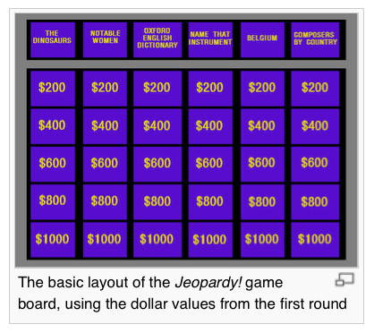
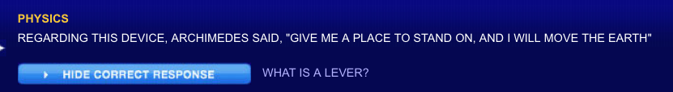
Watson
IBM’s Jeopardy! playing system.

Slide 65

Chris Welty from IBM on Watson and “understanding”
http://spectrum.ieee.org/podcast/at-work/innovation/what-is-toronto
See 4 min mark for discussion on “understanding.”
Till around min 11.

Slide 66
Watson
Key aspects:
Limited number of categories of types of questions
Well-defined knowledge sources (Wikipedia; Encyclopedias;
Dictionaries etc.) Not: WWW (Contrast: Google Knowl. Graph)
Around 70 “expert” modules that handle different aspects of the possible question and answers. 1000+ hypotheses
Final result based on a confidence vote.
Limited language parsing. Lot based on individual words (like IR).
Form of IR “+” (parsing; limited knowledge graph: “books have authors” “movie has actors and director” “verb represents an action” etc. )
Some game theory to reason about whether to answer
To some extent: Watson “understands”!
(It’s actually a bit of a problem for IBM… Clients expect too much!)

Slide 67
AI Knowledge-
Data-
Inference
Triangle
2012
Knowledge
Intensive
Common Sense
NLU
Computer Vision
20+yr GAP!
Google’s Knowl. Graph
Semantic Web
Watson
Verification
Google Transl.
Object recognition
Siri
Robbin’s Conj.
4-color thm.
Sentiment analysis
Google Search (IR)
Deep Blue
Speech understanding
Reasoning/Search
Intensive
Data
Intensive

Slide 68

Interesting readings: Appendix on AI in Paul Allen’s autobiography.
Discusses the remaining challenges: mostly focused on
commonsense reasoning and knowledge representation.
New: Vulcan Ventures AI Institute.

Slide 69
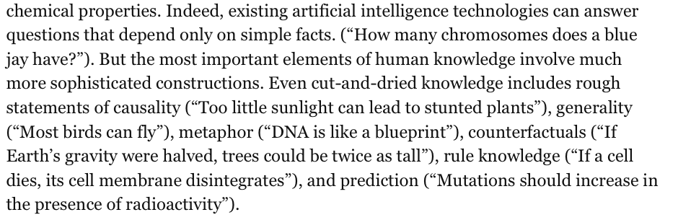
Project Halo: Read biology textbook to be able to pass AP
Biology exam. Very challenging! At least, 5 to 10 more years.

Slide 70
Additional Slides
Some examples of SAT solving
I.e. Propositional Reasoning Engines

Slide 71
Application: I --- Diagnosis
Problem: diagnosis a malfunctioning device
  Car
  Computer system
  Spacecraft
where
  Design of the device is known
  We can observe the state of only certain parts of the device – much is hidden

Slide 72
Model-Based, Consistency-Based Diagnosis
Idea: create a logical formula that describes how the device should work
  Associated with each “breakable” component C is a proposition that states “C is okay”
  Sub-formulas about component C are all conditioned on C being okay
A diagnosis is a smallest of “not okay” assumptions that are consistent with what is actually observed

Slide 73
Consistency-Based Diagnosis
Make some Observations O.
Initialize the Assumption Set A to assert that all components are working properly.
Check if the KB, A, O together are inconsistent (can deduce false).
If so, delete propositions from A until consistency is restored (cannot deduce false). The deleted propositions are a diagnosis.
    There may be many possible diagnoses

Slide 74
Example: Automobile Diagnosis
Observable Propositions:
  EngineRuns, GasInTank, ClockRuns
Assumable Propositions:
  FuelLineOK, BatteryOK, CablesOK, ClockOK
Hidden (non-Assumable) Propositions:
  GasInEngine, PowerToPlugs
Device Description F:
  (GasInTank ∧ FuelLineOK) → GasInEngine
  (GasInEngine ∧ PowerToPlugs) → EngineRuns
  (BatteryOK ∧ CablesOK) → PowerToPlugs
  (BatteryOK ∧ ClockOK) → ClockRuns
Observations:
  ¬ EngineRuns, GasInTank, ClockRuns
Note: of course a highly simplified set of axioms.

Slide 75
Example
  (GasInTank ∧ FuelLineOK) → GasInEngine
  (GasInEngine ∧ PowerToPlugs) → EngineRuns
Is F ∪ Observations ∪ Assumptions consistent?
F ∪ {¬EngineRuns, GasInTank, ClockRuns}
∪ { FuelLineOK, BatteryOK, CablesOK, ClockOK } → false
  Must restore consistency!
F ∪ {¬EngineRuns, GasInTank, ClockRuns}
∪ { BatteryOK, CablesOK, ClockOK } → satisfiable
  ¬ FuelLineOK is a diagnosis
F ∪ {¬EngineRuns, GasInTank, ClockRuns}
∪ {FuelLineOK, CablesOK, ClockOK } → false
  ¬ BatteryOK is not a diagnosis

Slide 76

Complexity of Diagnosis
If F is Horn, then each consistency test takes linear O(n) time – unit propagation is complete for Horn clauses.
Complexity = ways to delete propositions from Assumption Set that are considered.
  Single fault diagnosis – O(n²)
  Double fault diagnosis – O(n³)
  Triple fault diagnosis – O(n⁴)
  In practice, for non-Horn use SAT solver
for consistency check.
Horn clause: at most one positive literal. Also, consider )

Slide 77
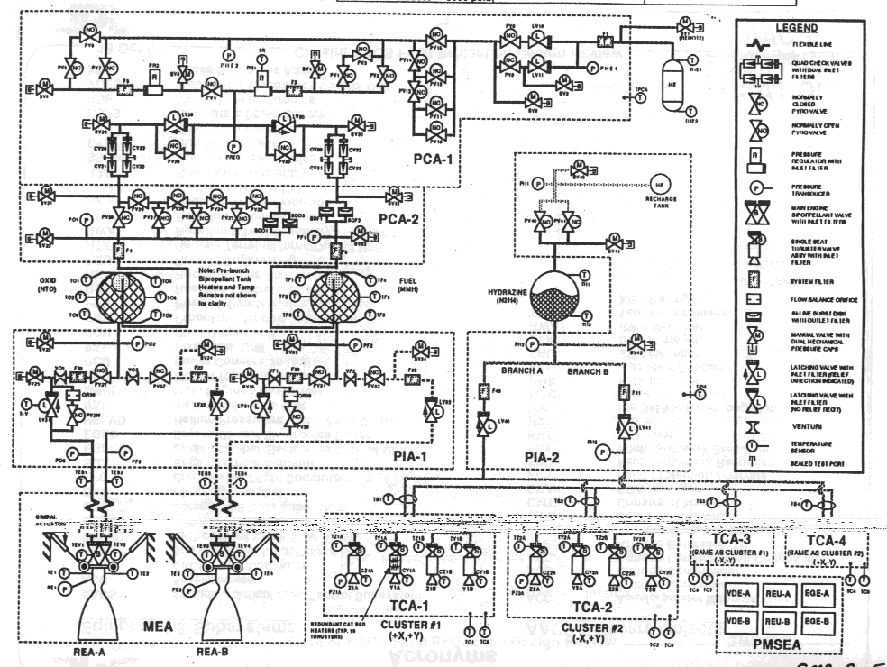

NASA Deep Space One
Autonomous diagnosis & repair “Remote Agent”
Compiled systems schematic to 7,000 var SAT problem
Started: January 1996
Launch: October 15th, 1998
Experiment: May 17-21

Slide 78
Deep Space One
a failed electronics unit
  Remote Agent fixed by reactivating the unit.
a failed sensor providing false information
  Remote Agent recognized as unreliable and therefore correctly ignored.
an altitude control thruster (a small engine for controlling the spacecraft's orientation) stuck in the "off" position
  Remote Agent detected and compensated for by switching to a mode that did not rely on that thruster.

Slide 79
II --- Testing Circuit Equivalence
Do two circuits compute the same function?
Circuit optimization
Is there input for which the two circuits compute different values?
(Satisfying assignment
will tell us. Reveals bug!)
C
C’
nand
A
B
A
B
Possible implementation
using hardware gates (invertor & nand)
Formal spec. OR

Slide 80
Note: if consitent,
model reveals “bug”
in hardware design.
Descr. of OR
C
C’
Descr. of
Hardware.
nand
Our query:
Does this hold?
Yes iff negation with
KB is inconsistent.
D
E
What happens if you add
instead of ? Still OK?
A
B
A
B
Informally: Given the same inputs values for A and B,
logic specifies outputs (C and C’). Are there inputs for which
C and C’ differ?

Slide 81
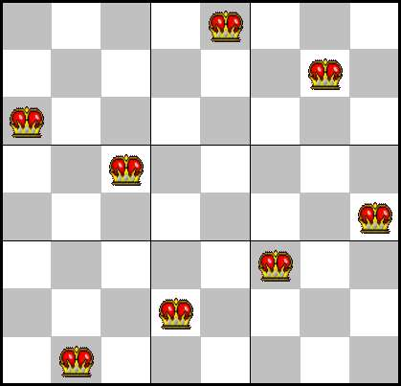
III --- SAT Translation of
N-Queens
At least one queen each row:
  (Q11 v Q12 v Q13 v ... v Q18)
  (Q21 v Q22 v Q23 v ... v Q28)
  ...
No attacks (columns):
  (~Q11 v ~Q21)
  (~Q11 v ~Q31)
  (~Q11 v ~Q41)
  ...
No attacks (diag; need left and right):
  (~Q11 v ~Q22)
  (~Q11 v ~Q33)
  (~Q11 v ~Q44)
  ...
How about: No attacks (rows)
  (~Q11 v ~Q12)
  (~Q11 v ~Q13)
  (~Q11 v ~Q14)
  …
Redundant! Why? Sometimes slows solver.

Slide 82
More compactly
At least one queen each row:
  (Qi1 v Qi2 ... v QiN) for 1 <= i <= N
No attacks (columns; “look in i^{th} column”):
  (~Qji v ~Qj’i) for 1 <= i,j,j’ <= N and j =/= j’
No attacks (diag; need left and right):
  (~Qij v ~Qi’j’) for 1 <= i, i’, j, j’ s.t. |i – i’| = |j – j’| & i =/= i’ & j =/= j’
Or: in first order logic syntax, e.g., second constraint set:
8 i 8 j 8 j’ (j =/= j’ ) (: Q_{j,i} Ç : Q_{j’,i}))
with bounded type quantifier 1 <= i, j, j’ <= N
Really a compact “propositional schema.”
First-order logic for finite domains is equiv. to prop. logic.
For SAT solver, always “ground to propositional.”

Slide 83
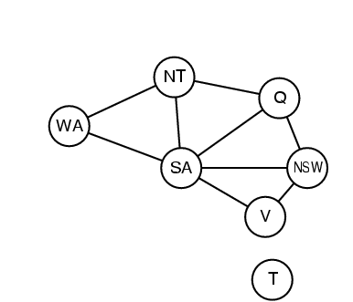
IV --- SAT Translation of
Graph Coloring
At least one color per node i :
  (C_i1 v Q_i2 v Q_i3 v ... v Q_iK)
At most one color per node i :
  (~C_ik v ~Q_ik’) for all k =/= k’
If node i and node j (=/= i) share an edge,
need to have different colors:
  (~C_il v ~Q_jl) for all 1 <= I <= K
Note: Translation from
“problem” into SAT.
Reverse of usual
translation to show
NP-completeness.
Works also for (easy)
polytime problems!
C_ik for node i has color k
Total # colors: K. Total # nodes: N.

Slide 84
V --- Symbolic Model Checking
Any finite state machine is characterized by a transition function
  CPU
  Networking protocol
Wish to prove some invariant holds for any possible inputs
Bounded model checking: formula is sat iff invariant fails k steps in the future
1) Can go to CNF.
2) Equivalent to planning as propositional inference
SATPLAN
(Kautz & Selman 1996)
7.7.4 R&N
The k-step plan
is satisfying assignment.
Note: ½ is just like our “move” earlier.
Axioms says what happens “next.”

Slide 85
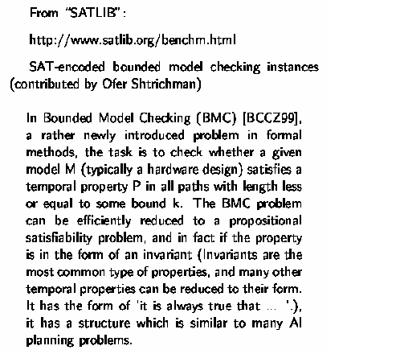
A real-world example

Slide 86
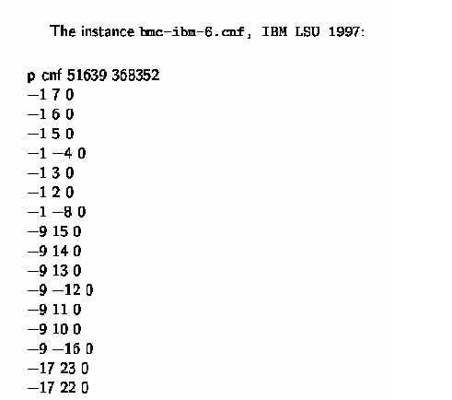
Bounded Model Checking instance
i.e. ((not x₁) or x₇)
and ((not x₁) or x₆)
and … etc.

Slide 87
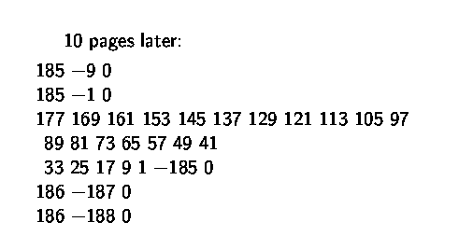
10 pages later:
…
(x₁₇₇ or x₁₆₉ or x₁₆₁ or x₁₅₃ …
or x₁₇ or x₉ or x₁ or (not x₁₈₅))
clauses / constraints are getting more interesting…

Slide 88
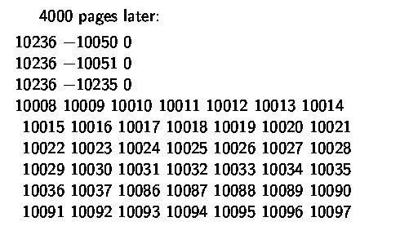
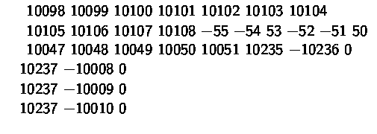
4000 pages later:
!!!
a 59-cnf clause…
…

Slide 89
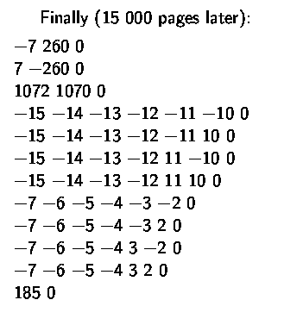

Finally, 15,000 pages later:
What makes this possible?
Note that:
… !!!
The Chaff SAT solver (Princeton) solves
this instance in less than one minute.

Slide 90
Progress in Last 20 years
Significant progress since the 1990’s. How much?
Problem size: We went from 100 variables, 200 constraints (early 90’s)
to 1,000,000+ variables and 5,000,000+ constraints in 20 years
Search space: from 10^30 to 10^300,000.
[Aside: “one can encode quite a bit in 1M variables.”]
Is this just Moore’s Law? It helped, but not much…
– 2x faster computers does not mean can solve 2x larger instances
– search difficulty does *not* scale linearly with problem size!
In fact, for O(2^n), 2x faster, how many more vars?
handles 1 more variable!!
Mainly algorithmic progress. Memory growth also key.
Tools: 50+ competitive SAT solvers available (e.g. Minisat solver)
See http://www.satcompetition.org/

Slide 91
Forces Driving Faster, Better SAT Solvers
Inference engines
From academically interesting to practically relevant “Real” benchmarks, with real interest in solving them
Regular SAT Solver Competitions (Germany-89, Dimacs-93, China-96, SAT-02, SAT-03, …, SAT-07, SAT-09, SAT-2011)
  “Industrial-instances-only” SAT Races (2008, 2010)
  A tremendous resource! E.g., SAT Competition 2006 (Seattle):
    35+ solvers submitted, downloadable, mostly open source
    500+ industrial benchmarks, 1000+ other benchmarks
    50,000+ benchmark instances available on the Internet
Constant improvement in SAT solvers is the key to the success of, e.g., SAT-based planning, verification, and KB inference.

