Slide 1
CS 4700:
Foundations of Artificial Intelligence
Prof. Bart Selman
selman@cs.cornell.edu
Machine Learning:
Neural Networks
R&N 18.7

Slide 2
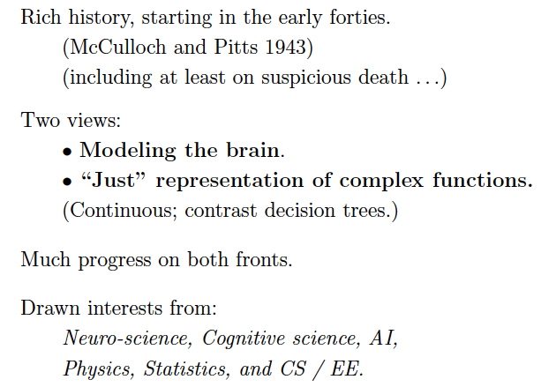

Slide 3
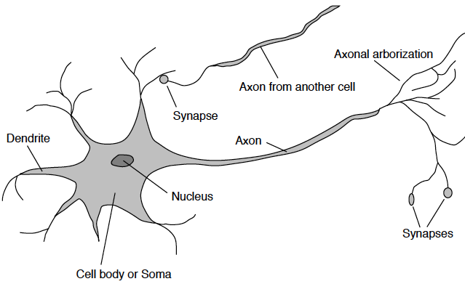

Slide 4
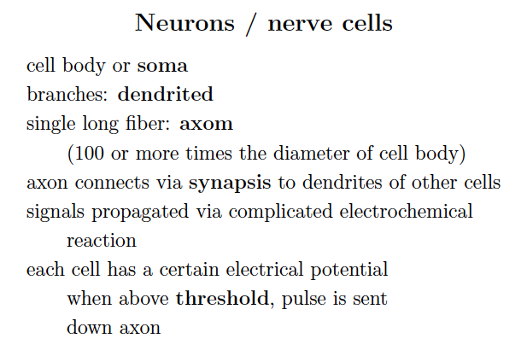

Slide 5
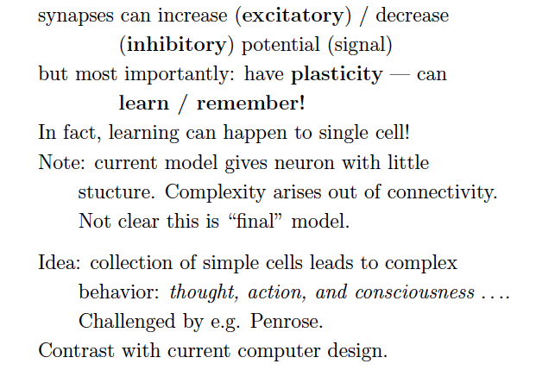

Slide 6
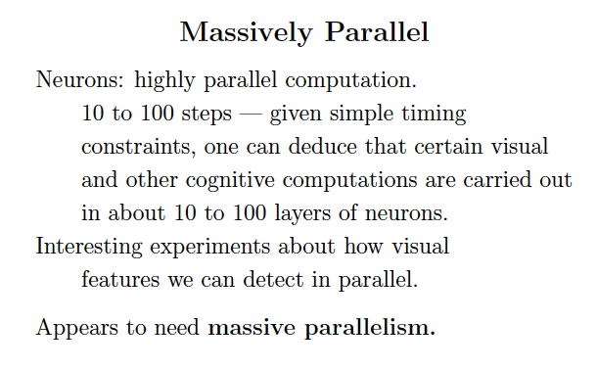

Slide 7
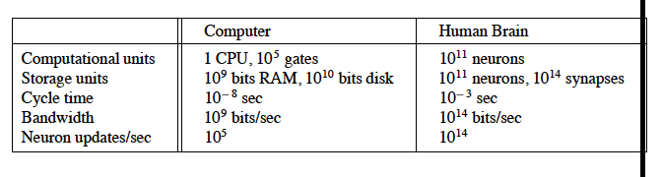

Slide 8
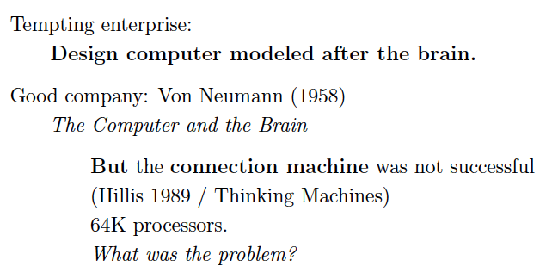

Slide 9
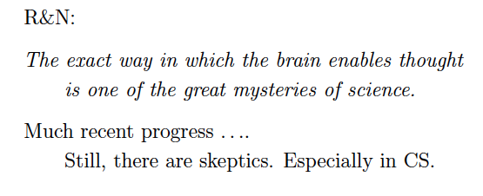

Slide 10
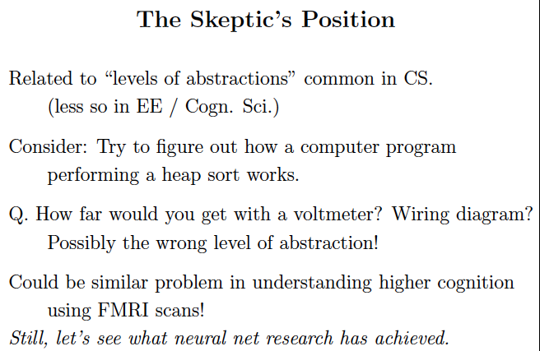

Slide 11
New York Times: “Scientists See Promise in Deep-Learning
Programs,” Saturday, Nov. 24, front page.
http://www.nytimes.com/2012/11/24/science/scientists-see-advances-in-deep-learning-a-part-of-artificial-intelligence.html?hpw
Multi-layer neural networks, a resurgence!
Winner one of the most recent learning competitions
Automatic (unsupervised) learning of “cat” and “human face” from 10 million of Google images; 16,000 cores 3 days; multi-layer neural network (Stanford & Google).
Speech recognition and real-time translation (Microsoft Research, China).
Aside: see web site for great survey article
“A Few Useful Things to Know About
Machine Learning” by Domingos, CACM, 2012.

Slide 12
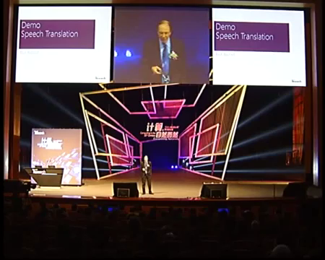
Start at min. 3:00. Deep Neural Nets in speech recognition.

Slide 13
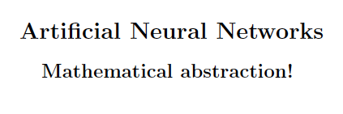

Slide 14
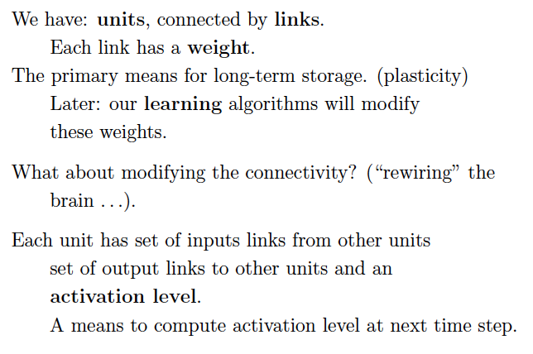

Slide 15
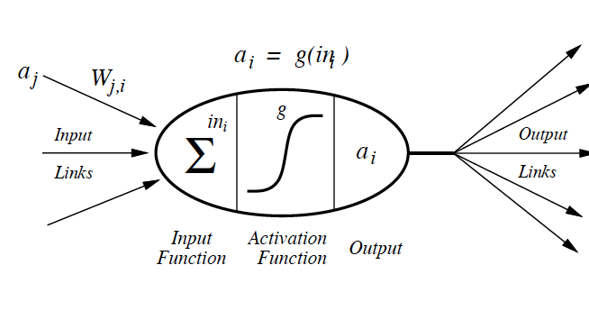

Slide 16
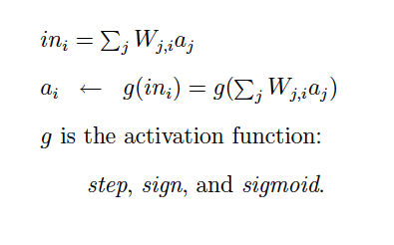

Slide 17
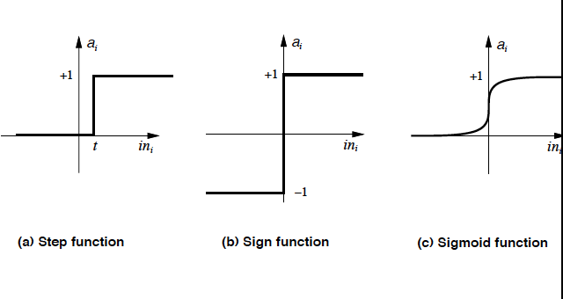

Slide 18
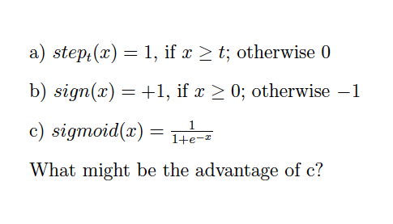

Slide 19
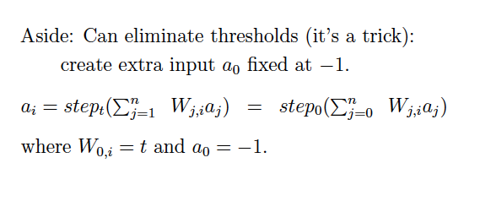

Slide 20
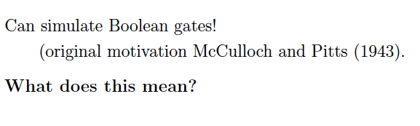

Slide 21
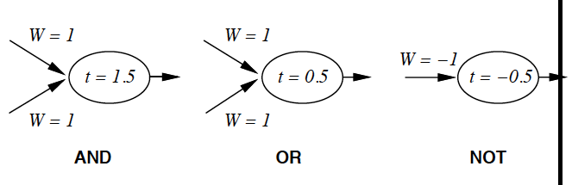

Slide 22
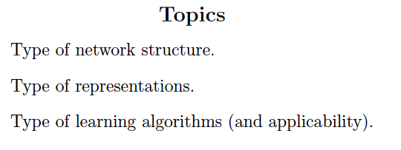

Slide 23
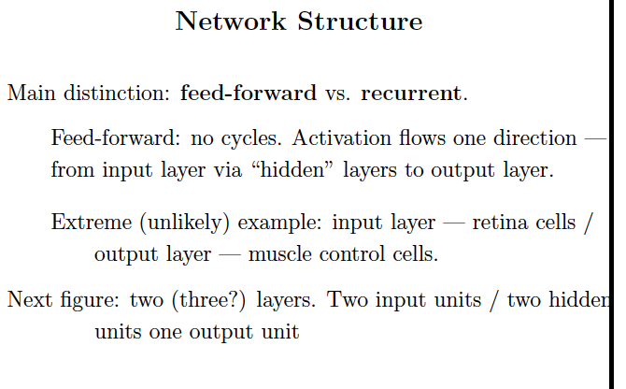

Slide 24
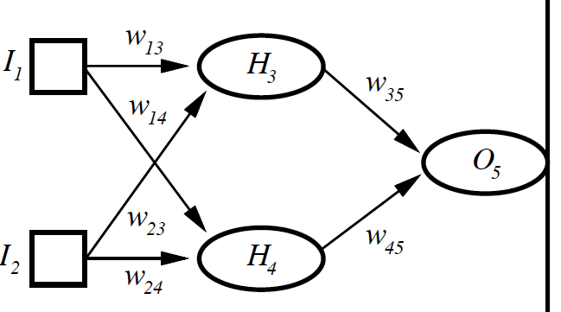

Slide 25
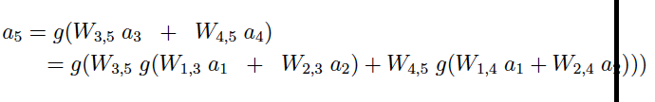

Slide 26
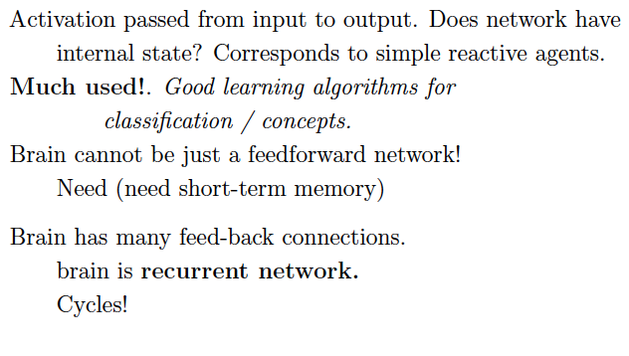

Slide 27
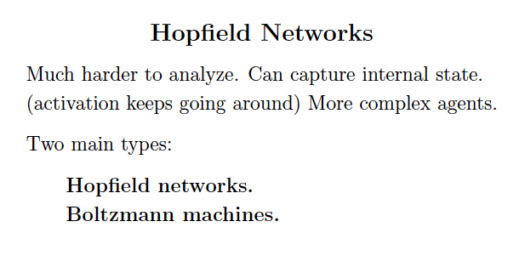

Slide 28
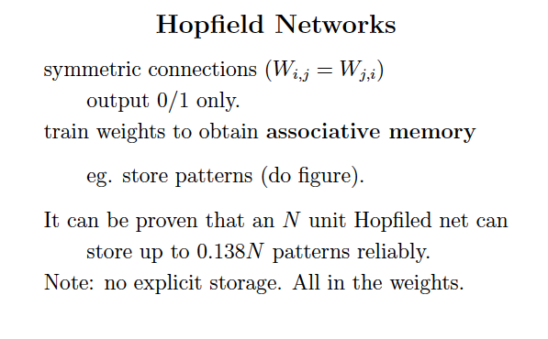

Slide 29
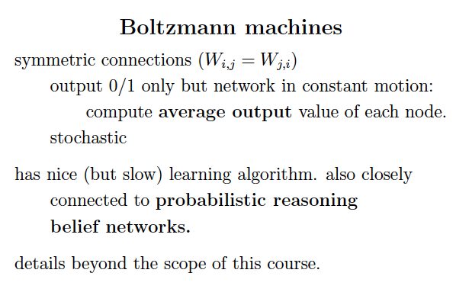

Slide 30
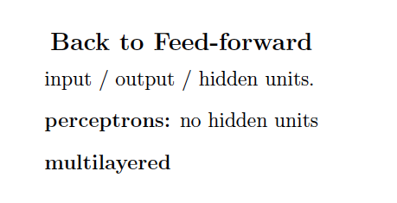

Slide 31
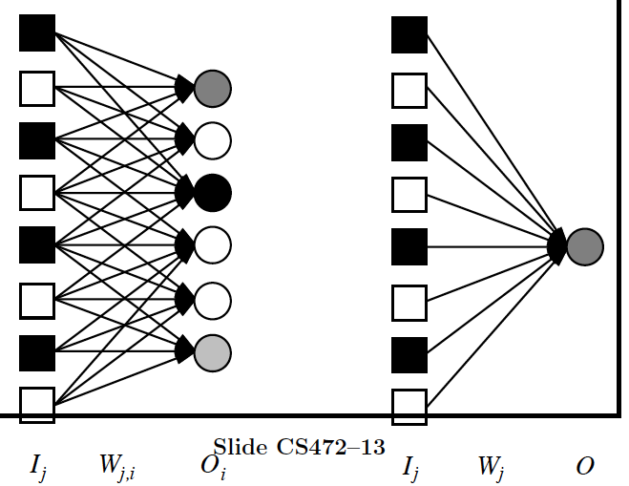

Slide 32
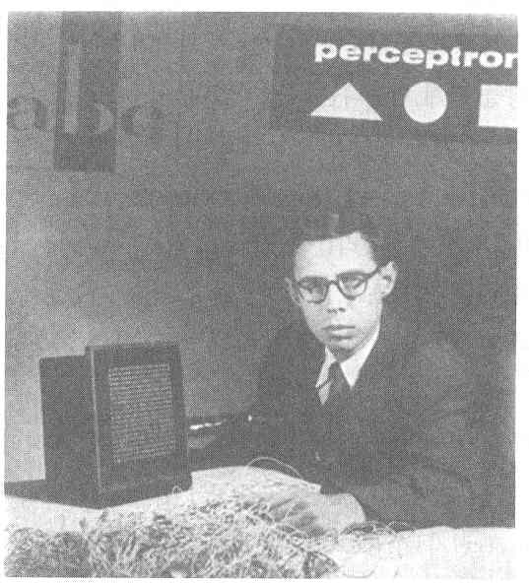
Perceptron
Perceptron
  Invented by Frank Rosenblatt in 1957 in an attempt to understand human memory, learning, and cognitive processes.
  The first neural network model by computation, with a remarkable learning algorithm:
    If function can be represented by perceptron, the learning algorithm is guaranteed to quickly converge to the hidden function!
  Became the foundation of pattern recognition research
Cornell Aeronautical Laboratory
One of the earliest and most influential neural networks:
An important milestone in AI.
Rosenblatt &
Mark I Perceptron:
the first machine that could "learn" to recognize and identify optical patterns.
Notes:
Perceptron invented by Frank Rosenblatt in 1957.
When perceptron was first introduced, this issue created considerable sensation.
Perceptron was the first neural network modeled by correct computation and affected many fields.
Perceptron also became the foundation of pattern recognition research.
<사진>
This guy is Frank Rosenblatt inventor of perceptron.
And this one is Mark ⅠPerceptron image sensor that is the first neural network equipment.

Slide 33
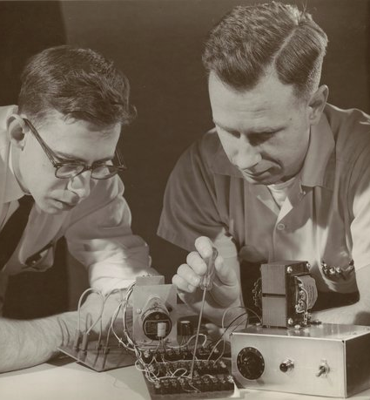
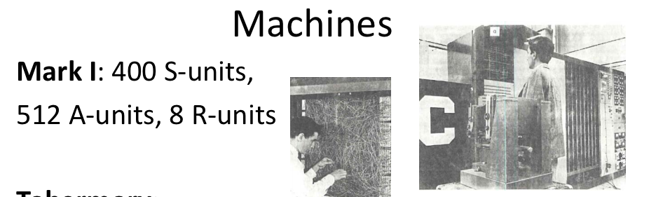

Slide 34
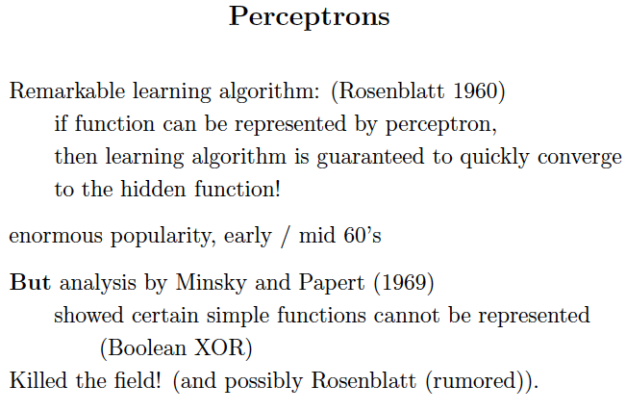
But Minsky appears to have used a simplified model. Single layer.

Slide 35
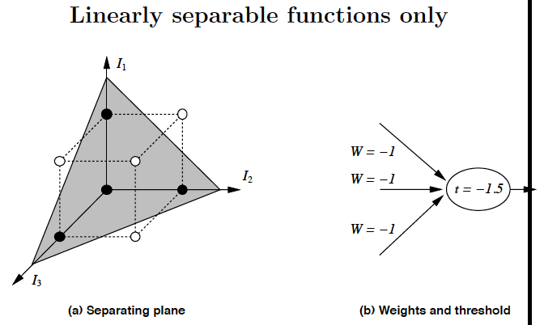

Slide 36
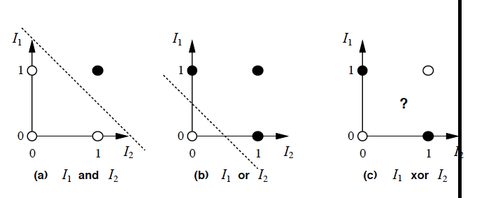

Slide 37
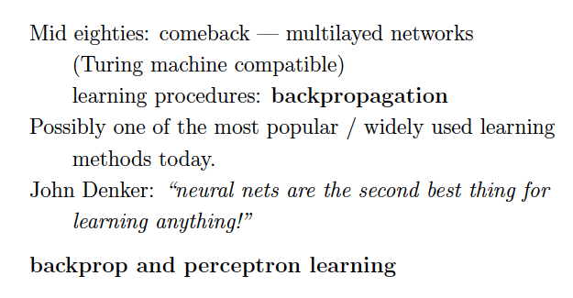
Update: or perhaps the best!

Slide 38
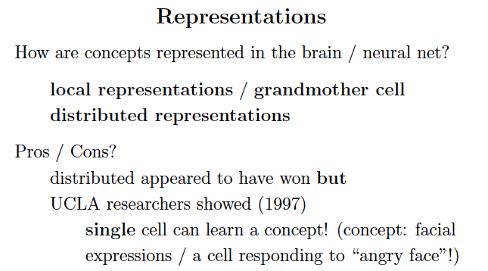
Note: can discover hidden features (“regularities”)
unsupervised with multi-layer networks.

Slide 39
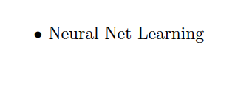

Slide 40
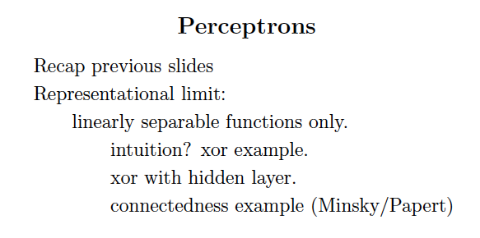

Slide 41
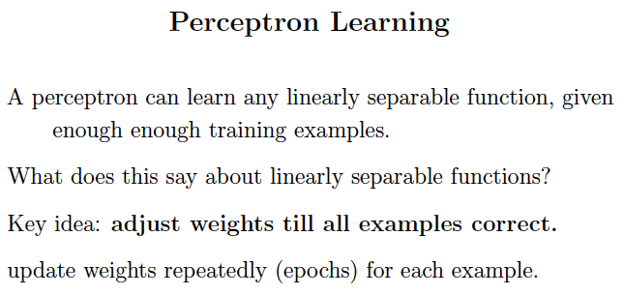

Slide 42
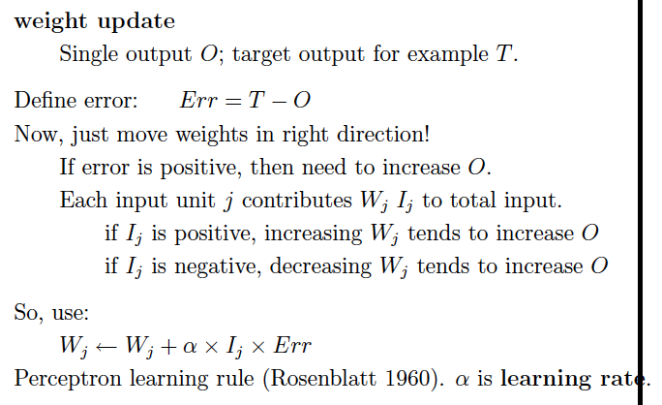

Slide 43
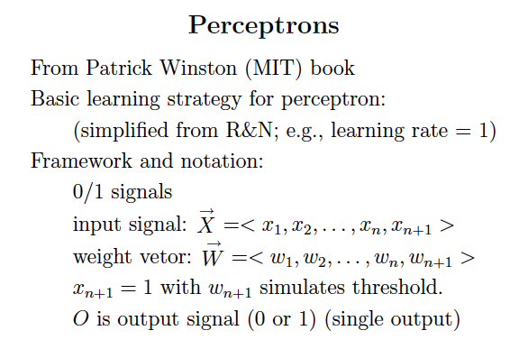

Slide 44
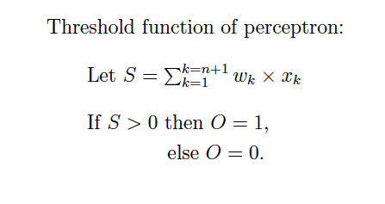

Slide 45
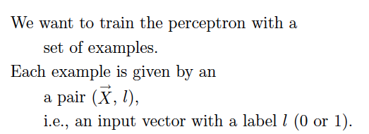

Slide 46
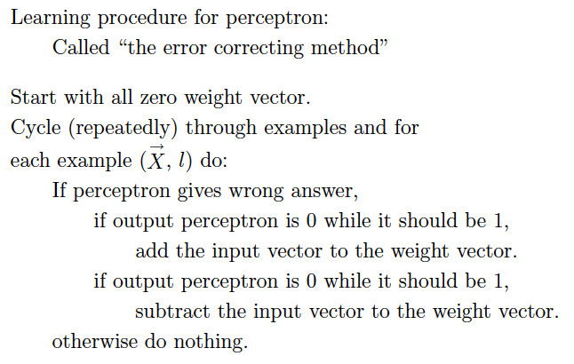
1
0,

Slide 47
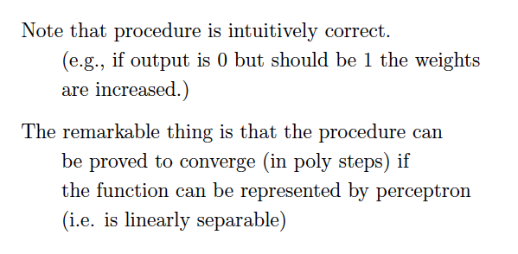

Slide 48
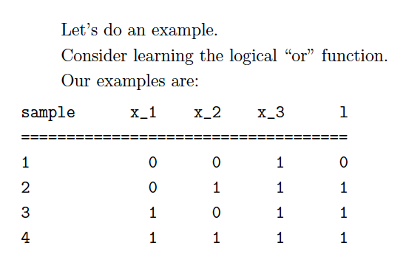
Note: x_3 input fixed at 1 to model threshold. Side benefit: no total 0 input.
Why needed? Note: if all zero input is “incorrect.”

Slide 49
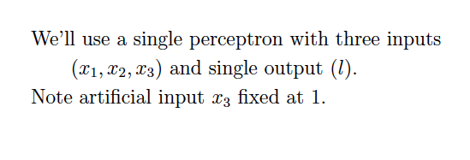

Slide 50
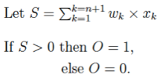
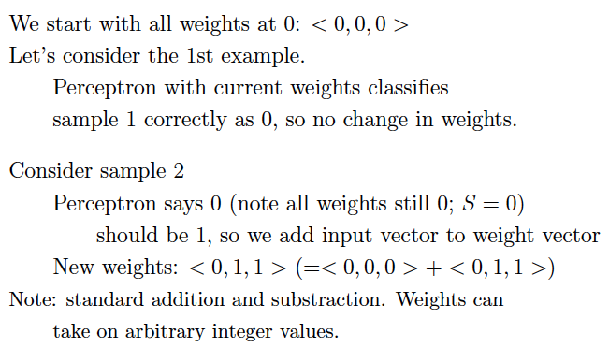

Slide 51


Slide 52


Slide 53

& 1M+
Always works, if inputs are linearly separable!
Single layer of units.
What about multi-layer NNs? No known
learning method until early 80s…

Slide 54


Slide 55

Side note: New book by Les Valiant on PAC!
Also, an attempt to quantify evolution as a PAC
learning process. Bottom-line: evolution based
on random permutations is too slow! (Earth not
old enough to explain our complexity.) But a
mutation process guided by structure in our environment
may be sufficiently fast.
NYT review

Slide 56


Slide 57


Slide 58


Slide 59




Slide 60


Slide 61


Slide 62

Ok… details
backpropagation
NOT on exam.

Slide 63


Slide 64


Slide 65


Slide 66


Slide 67

It’s “just” multivariate (or multivariable) calculus.

Slide 68


Optimization
and
gradient descent.
Consider
x and y our
two weights
and f(x,y)
the error
signal.
Multi-layer
network:
composition
of sigmoids;
use chain rule.

Slide 69



Reminder:
Gradient descent optimization.
(Wikipedia)

Slide 70


Slide 71


Slide 72


Slide 73

So, first we “backpropagate” the error
signal, and then we update the weights, layer
by layer.
That’s why it’s called “backprop learning.”
Now changing speech recognition, image
recognition etc.!

Slide 74

For home (but not on exam).

Slide 75

Trace example at home!

Slide 76


Slide 77


Slide 78


Slide 79


Slide 80


Slide 81


Slide 82


Slide 83


Slide 84
Summary ☺
A tour of AI:
AI
--- motivation
--- intelligent agents
II) Problem-Solving
--- search techniques
--- adversarial search
--- reinforcement learning

Slide 85
Summary, cont. ☺
III) Knowledge Representation and Reasoning
--- logical agents
--- Boolean satisfiability (SAT) solvers
--- first-order logic and inference
Learning
--- from examples
--- decision tree learning (info gain)
--- neural networks
The field has grown (and continues to grow) exponentially but you
have now seen a good part!
Have a great winter break!!!!

