Slide 1
CS 4700:
Foundations of Artificial Intelligence
Prof. Bart Selman
selman@cs.cornell.edu
Module:
Intro Learning
Part V R&N --- Learning
Chapter 18: Learning from Examples

Slide 2
Intelligence
Intelligence:
  “the capacity to learn and solve problems”
    (Webster dictionary)
  the ability to act rationally (requires reasoning)

Slide 3
What's involved in Intelligence?
A) Ability to interact with the real world
  to perceive, understand, and act
  speech recognition and understanding
  image understanding (computer vision)
  B) Reasoning and Planning
  modelling the external world
  problem solving, planning, and decision making
  ability to deal with unexpected problems, uncertainties
C) Learning and Adaptation
We are continuously learning and adapting.
  We want systems that adapt to us!
Part I and PartII
Part III

Slide 4
Learning
Examples
  Walking (motor skills)
  Riding a bike (motor skills)
  Telephone number (memorizing)
  Playing backgammon (strategy)
  Develop scientific theory (abstraction)
  Language
  Recognize fraudulent credit card transactions
  Etc.

Slide 5
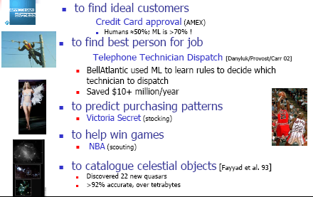
Different Learning tasks
Source: R. Greiner

Slide 6
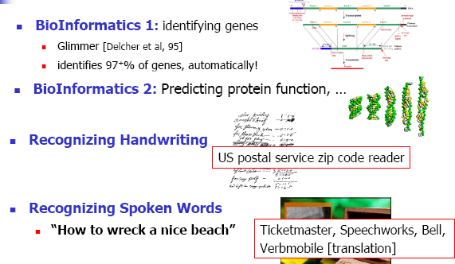
Different Learning Tasks
????
problems in developing systems that
recognize spontaneous speech
How to recognize speech

Slide 7
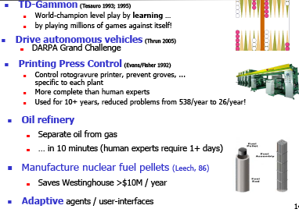
Different Learning Tasks

Slide 8
(One) Definition of Learning
Definition [Mitchell]:
  A computer program is said to learn from
    experience E with respect to some class of
    tasks T and
    performance measure P,
  if its performance at tasks in T, as measured by P, improves with experience E.
Notes:
What if the learned knowledge is never needed? e.g. a telephone number that you never call?
What if you cannot measure performance/task? e.g. learned a advertisement slogan.

Slide 9
Examples
Spam Filtering
  T: Classify emails HAM / SPAM
  E: Examples (e₁,HAM),(e₂,SPAM),(e₃,HAM),(e₄,SPAM), ...
  P: Prob. of error on new emails
Personalized Retrieval
  T: find documents the user wants for query
  E: watch person use Google (queries / clicks)
  P: # relevant docs in top 10
Play Checkers
  T: Play checkers
  E: games against self
  P: percentage wins

Slide 10
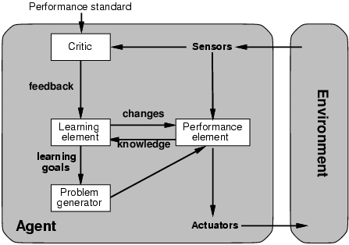
Learning agents
Learning enables an agent to modify its
decision mechanisms to improve performance
Module:
Learning
More complicated when agent needs to learn
utility information → Reinforcement learning
(reward or penalty: e.g., high tip or no tip)
Part V
R&N
Quick turn is not safe
No quick turn
Road conditions, etc
Takes percepts
and selects actions
Try out the brakes on
different road surfaces

Slide 11
A General Model of Learning Agents
Design of a learning element is affected by
  What feedback is available to learn these components
  Which components of the performance element are to be learned
  What representation is used for the components
Quick turn is not safe
No quick turn
Road conditions, etc
Takes percepts
and selects actions
Try out the brakes on
different road surfaces

Slide 12
Learning:
Types of learning
rote learning - (memorization) -- storing facts – no inference.
learning from instruction - Teach a robot how to hold a cup.
learning by analogy - transform existing knowledge to new situation; → learn how to hold a cup and learn to hold objects with a handle.
learning from observation and discovery – unsupervised learning; ambitious → goal of science! → cataloguing celestial objects.
learning from examples – special case of inductive learning - well studied in machine learning. Example of good/bad credit card customers.
–Carbonell, Michalski & Mitchell.
Notes:
This is the view since the MID-80's (ML really began in the 50's but
got popular in the early 80's.
rote learning -- (memorization) -- storing facts – no inference. RL did some of this
learning from instruction -- (learning by being told, requires that the program (a) transform knowledge from input language to an internally usable form ({\em operationalize}). may require integration into existing knowledge base.
learning by analogy -- (transform existing knowledge to new situation) -- example take car driving skills to help learn to drive a truck
learning from observation and discovery -- (unsupervised learning)
learning from examples -- (a special case of inductive learning) -- most well known and where we will start

Slide 13
Learning:
Type of feedback
Supervised Learning
  learn a function from examples of its inputs and outputs.
  Example – an agent is presented with many camera images and is told which ones contain buses; the agent learns a function from images to a Boolean output (whether the image contains a bus)
  Learning decision trees is a form of supervised learning
Unsupervised Learning
  learn a patterns in the input when no specific output values are supplied
  Example: Identify communities in the Internet; identify celestial objcets
Reinforcement Learning
  learn from reinforcement or (occasional) rewards --- most general form of learning
  Example: An agent learns how to play Backgammon by playing against itself; it gets a reward (or not) at the end of each game.

Slide 14
Learning:
Type of representation and Prior Knowledge
Type of representation of the learned information
  Propositional logic (e.g., Decision Trees)
  First order logic (e.g., Inductive Logic Programming)
  Probabilistic descriptions (E.g. Bayesian Networks)
  Linear weighted polynomials (E.g., utility functions in game playing)
  Neural networks (which includes linear weighted polynomials as special case; (E.g., utility functions in game playing)
Availability of Prior Knowledge
  No prior knowledge (majority of learning systems)
  Prior knowledge (E.g., used in statistical learning)

Slide 15
Inductive Learning Example
Instance Space X: Set of all possible objects described by attributes (often called features).
Target Function f: Mapping from Attributes to Target Feature
(often called label) (f is unknown)
Hypothesis Space H: Set of all classification rules h_{i} we allow.
Training Data D: Set of instances labeled with Target Feature

Slide 16
Inductive Learning / Concept Learning
Task:
  Learn (to imitate) a function f: X → Y
Training Examples:
  Learning algorithm is given the correct value of the function for particular inputs → training examples
  An example is a pair (x, f(x)), where x is the input and f(x) is the output of the function applied to x.
Goal:
  Learn a function h: X → Y that approximates
  f: X → Y as well as possible.
Notes:
Inductive learning: system tries to induce a ``general rule'' from a set of observed instances.
Supervised learning: learning algorithm is given the correct value of the function for particular inputs, and changes its representation of the function to try to match the information provided by the feedback.
An example is a pair ($x, f(x)$), where $x$ is the input and $f(x)$ is the output of the function applied to $x$.
What are examples of concept learning?
Spam filter (X is email, Y is {SPAM, HAM}
Personalized Retrieval (X is query, Y is ranking)
Checkers? Not directly in self play. Maybe for “games against expert” we could learn to mimic the expert.

Slide 17
Classification and Regression Tasks
Naming:
If Y is a discrete set, then called “classification”.
If Y is a not a discrete set, then called “regression”.
Examples:
Steering a vehicle: road image → direction to turn the wheel (how far)
Medical diagnosis: patient symptoms → has disease / does not have disease
Forensic hair comparison: image of two hairs → match or not
Stock market prediction: closing price of last few days → market will go up or down tomorrow (how much)
Noun phrase coreference: description of two noun phrases in a document → do they refer to the same real world entity

Slide 18
Inductive Learning Algorithm
Task:
  Given: collection of examples
  Return: a function h (hypothesis) that approximates f
Inductive Learning Hypothesis:
Any hypothesis found to approximate the target function well over a sufficiently large set of training examples will also approximate the target function well over any other unobserved examples.
Assumptions of Inductive Learning:
  The training sample represents the population
  The input features permit discrimination
Notes:
Given: a universe of objects described by a collection of
attributes each labeled with one of a discrete number of
classes
Return: a classification “rule” that can determine the class
of any object from its attributes’ values

Slide 19
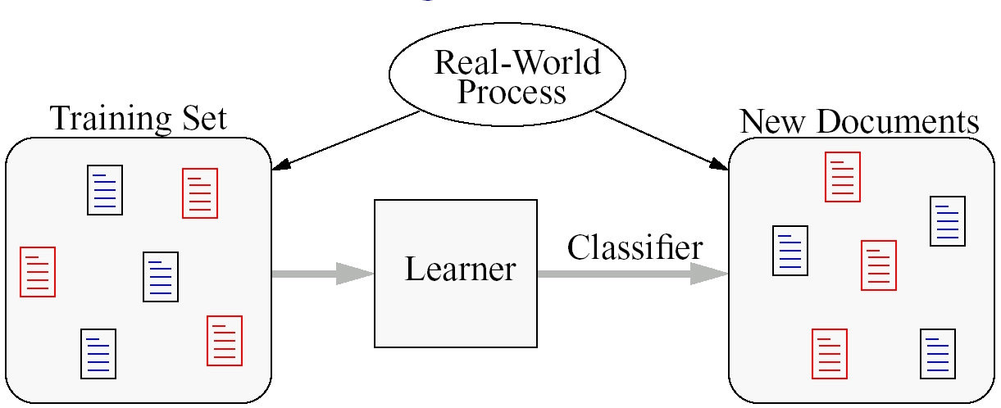
Inductive Learning Setting
New examples
h: X → Y
Task:
Learner (or inducer) induces a general rule h from a set of observed examples that classifies new examples accurately. An algorithm that takes as input specific instances and produces a model that generalizes beyond these instances.
Classifier - A mapping from unlabeled instances to (discrete) classes.
Classifiers have a form (e.g., decision tree) plus an interpretation procedure (including how to handle unknowns, etc.)

Slide 20
Inductive learning:
Summary
Learn a function from examples
f is the target function
An example is a pair (x, f(x))
Problem: find a hypothesis h
  such that h ≈ f
  given a training set of examples
(This is a highly simplified model of real learning:
  Ignores prior knowledge
  Assumes examples are given)
→ Learning a discrete function is called classification learning.
→ Learning a continuous function is called regression learning.

Slide 21
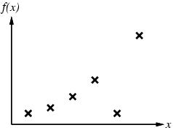
Inductive learning method
Fitting a function of a single variable to some data points
Examples are (x, f(x)) pairs;
Hypothesis space H – set of hypotheses we will consider for function f, in this case polynomials of degree at most k
Construct/adjust h to agree with f on training set
(h is consistent if it agrees with f on all examples)

Slide 22
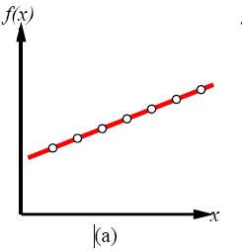
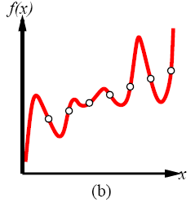
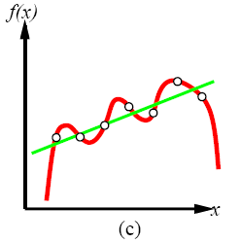
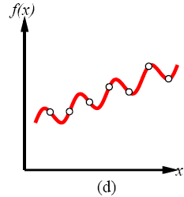
Multiple consistent hypotheses?
Polynomials of degree at most k
Degree 6 polynomial
and approximate linear fit
Linear hypothesis
Degree 7 polynomial
hypothesis
How to choose from among
multiple consistent hypotheses?
Ockham's razor: maximize a combination
of consistency and simplicity
Sinusoidal hypothesis

Slide 23
Preference Bias: Ockham's Razor
Aka Occam’s Razor, Law of Economy, or Law of Parsimony
Principle stated by William of Ockham (1285-1347/49), an English philosopher, that
  “non sunt multiplicanda entia praeter necessitatem”
  or, entities are not to be multiplied beyond necessity.
The simplest explanation that is consistent with all observations is the best.
  E.g, the smallest decision tree that correctly classifies all of the training examples is the best.
  Finding the provably smallest decision tree is NP-Hard, so instead of constructing the absolute smallest tree consistent with the training examples, construct one that is pretty small.

Slide 24
Different Hypothesis Spaces
Learning can be seen as fitting a function to the data. We can consider
different functions as the target function and therefore different hypothesis
spaces. Examples:
Propositional if-then rules
Decision Trees
First-order if-then rules
First-order logic theory
Linear functions
Polynomials of degree at most k
Neural networks
Java programs
Etc

Slide 25
Tradeoff in expressiveness and complexity
A learning problem is realizable if its hypothesis space contains the true function.
Why not pick the largest possible hypothesis
space, say the class of all Turing machines?
Tradeoff between expressiveness of a hypothesis space
and the complexity of finding simple, consistent hypotheses
within the space (also risk of “overfitting”).
Extreme overfitting: Just remember all training examples.

Slide 26
Summary
Learning needed for unknown environments.
Learning agent = performance element + learning element
For supervised learning, the aim is to find a simple hypothesis approximately consistent with training examples.

