Slide 1
CS 4700:
Foundations of Artificial Intelligence
Instructor:
Prof. Selman
selman@cs.cornell.edu
Introduction
(Reading R&N: Chapter 1)

Slide 2
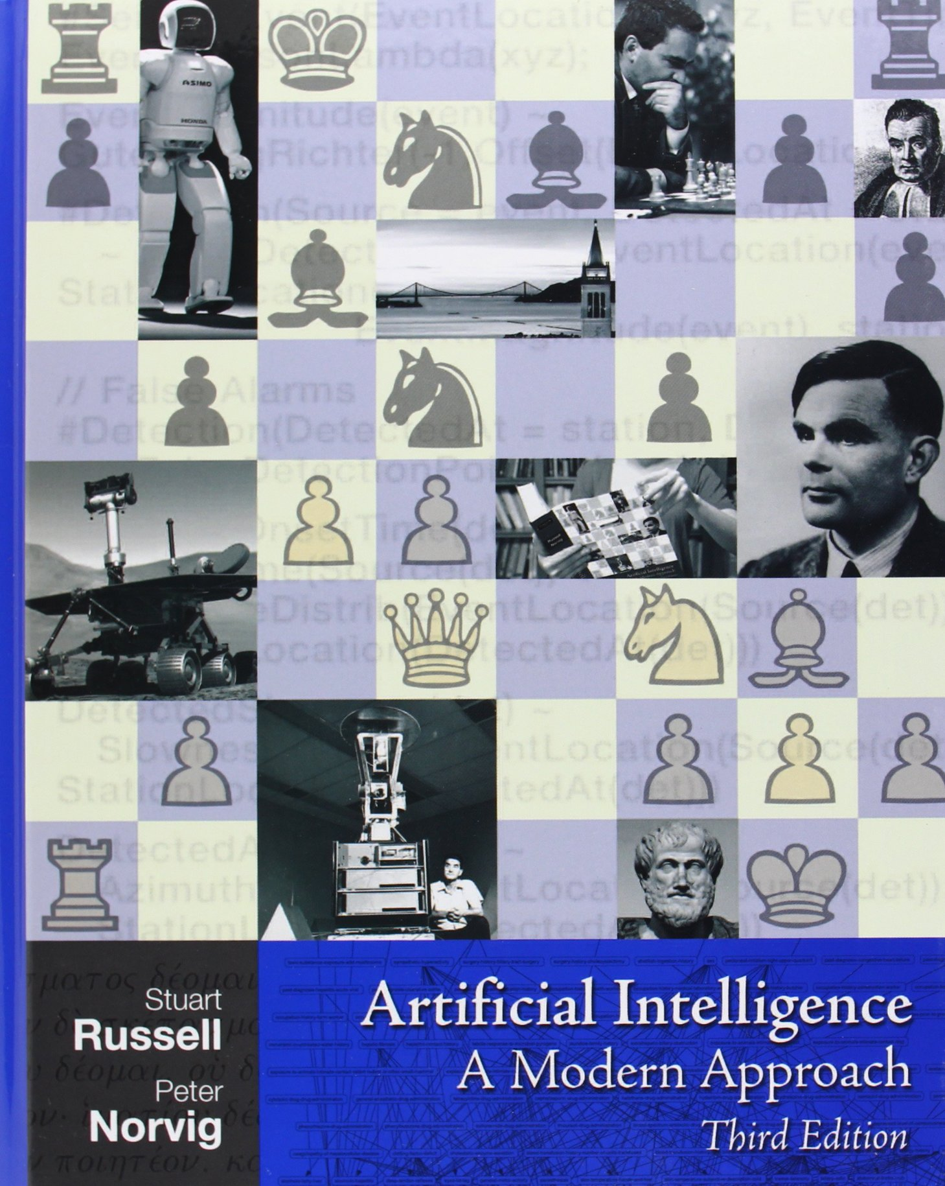

Slide 3
Course Administration
Office hours and web page early next week
Text book: Russell & Norvig --- Artificial Intelligence: A Modern Approach (AIMA)

Slide 4
Grading
Prelim/Midterm (1/2?) (25%)
Homework (35%)
Participation (5%)
Final (35%)
Late policy: 4 one-day extensions to be used however
you want during the term. (Count weekend as 1 day.)
Medium grade: B+ Approx 35% - 38% in A range

Slide 5
Other remarks
Class is over-subscribed with many folks on a waiting list. So, if you intend to drop the course (or have signed up by mistake ☺ ), please de-enroll asap. Thanks!!
CS-4701 is a project course. We will have brief organizational meeting next week. TBA
All announcements for CS-4701 made in
CS4700 class, web page, and via CMS email.

Slide 6
Homework
Homework is very important. It is the best way for you to learn the material. You are encouraged to discuss the problems with your classmates, but all work handed in should be original, and written by you in your own words.

Slide 7
✓
Course Administration
What is Artificial Intelligence?
Course Themes, Goals, and Syllabus

Slide 8
AI: Goals
Ambitious goals:
  understand “intelligent” behavior
  build “intelligent” agents / artifacts
  autonomous systems
  understand human cognition (learning,
  reasoning, planning, and decision making)
  as a computational process.

Slide 9
What is Intelligence?
Intelligence:
  capacity to learn and solve problems”
    (Webster dictionary)
  the ability to act rationally
Hmm… Not so easy to define.

Slide 10
What is AI?
Views of AI fall into four different perspectives
--- two dimensions:
  1) Thinking versus Acting
  2) Human versus Rational (which is “easier”?)
Human-like
Intelligence
“Ideal” Intelligent/
Pure Rationality
Which is
closest to
a ‘real’ human?
Thought/
Reasoning
(“modeling thought /
brain)
2. Thinking humanly | 3. Thinking Rationally
1. Acting Humanly | 4. Acting Rationally
Behavior/
Actions
“behaviorism”
“mimics behavior”
Furthest?
Notes:
A system is intelligent if it does the right thing given what it knows.

Slide 11
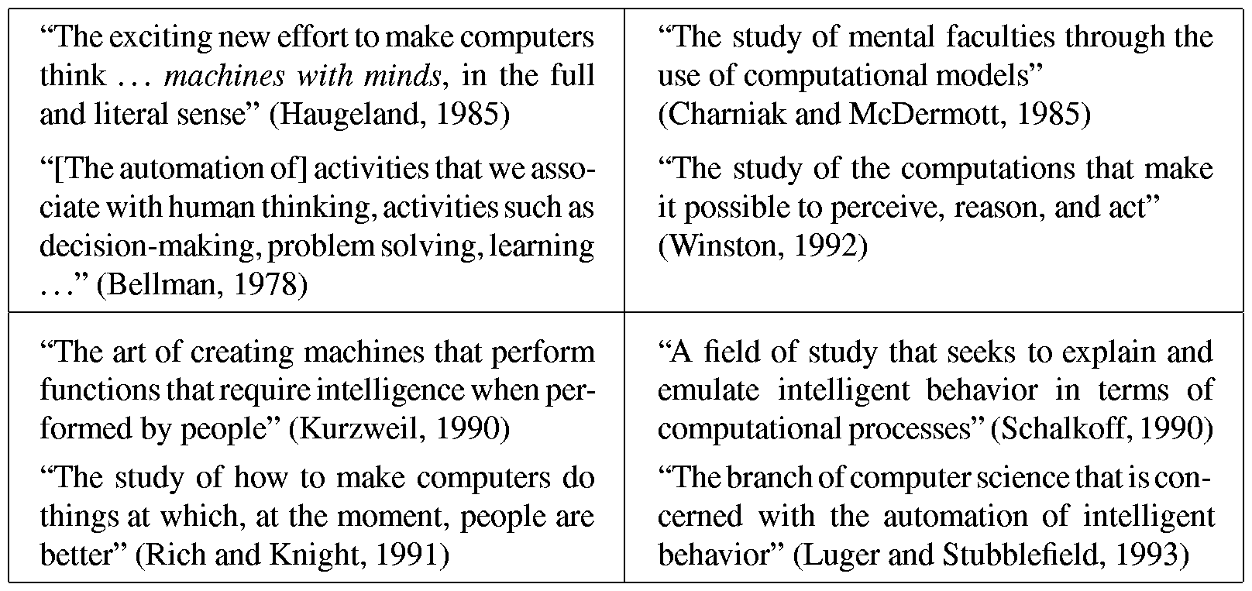
Different AI Perspectives
3. Systems that think rationally
(optimally)
2. Systems that think like humans
Human Thinking
Human Acting
Rational Thinking
Rational Acting
1. Systems that act like humans
4. Systems that act rationally
Note: A system may be able to act like a human without thinking
like a human! Could easily “fool” us into thinking it was human!

Slide 12
1. Acting Humanly
Human-like
Intelligence
“Ideal” Intelligent/
Rationally
2. Thinking humanly | 3. Thinking Rationally
1. Acting Humanly →Turing Test | 4. Acting Rationally
Thought/
Reasoning
Behavior/
Actions
Notes:
A system is intelligent if it does the right thing given what it knows.

Slide 13
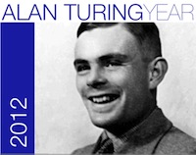
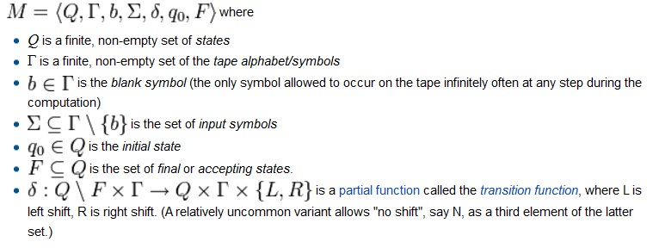
Mathematical Formulation of notion of Computation and Computability
(1936)
Universality of Computation
23 June 2012
Turing Centenary
Abstract model of a
digital Computer:
rich enough to capture
any computational process.
Notes:
In 1936 Alan Turing introduce a very elegant and powerful model to formally define the notion of computation

Slide 14
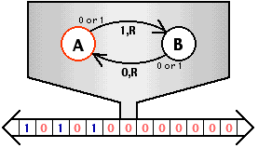


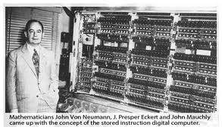
Universal Computer
Turing Machine
Description
+ input
Turing Centennial
Information
Processing Model
of a Universal
Computer
Universal
Turing
Machine
⬄
Vending Machine
von Neumann architecture (1947)
Architecture of modern computers.
Data and program are stored in the computer's memory.
(inspired by Turing’s model)
Notes:
In 1936 Alan Turing introduce a very elegant and powerful model to formally define the notion of computatioan

Slide 15
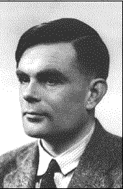
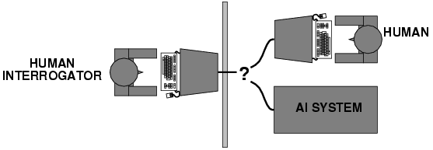
Acting humanly: Turing Test
Turing (1950) "Computing machinery and intelligence”
Alan Turing
"Can machines think?“ "Can machines behave intelligently?"
  Operational test for intelligent behavior: the Imitation Game
Predicted that by 2000, a machine might have a 30% chance of fooling a lay person for 5 minutes.
But, by scientific consensus, we are still several decades away
from truly passing the Turing test (as the test was intended).
AI system passes
if interrogator
cannot tell which one
is the machine.
(interaction via written questions)
No computer vision or robotics or physical presence required!
Achieved. (Siri! ☺ )

Slide 16
Trying to pass the Turing test:
Some Famous Human Imitation “Games”
1960s ELIZA
  Joseph Weizenbaum
  Rogerian psychotherapist
1990s ALICE
Loebner prize
  win $100,000 if you pass the test
Still, passing Turing test is somewhat of questionable value.
Because, deception appears required and allowed!
Consider questions: Where were you born? How tall are you?

Slide 17

ELIZA: impersonating a Rogerian psychotherapist
1960s ELIZA Joseph Weizenbaum
You: Well, I feel sad
Eliza: Do you often feel sad?
You: not very often.
Eliza: Please go on.
☺

Slide 18
Recent alternative
See: The New Yorker, August 16, 2013
Why Can’t My Computer Understand Me?
Posted by Gary Marcus
http://www.newyorker.com/online/blogs/elements/2013/08/why-cant-my-computer-understand-me.html
Discusses alternative test by Hector Levesque:
http://www.cs.toronto.edu/~hector/Papers/ijcai-13-paper.pdf

Slide 19



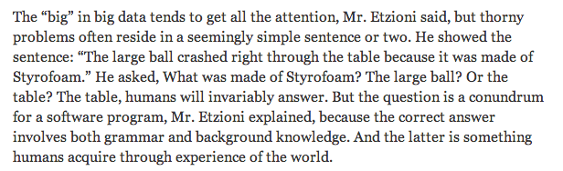
News item --- Big Data vs. Semantics
Link NYT

Slide 20
2. Thinking Humanly
Human-like
Intelligence
“Ideal” Intelligent/
Rationally
2. Thinking humanly → Cognitive Modeling | Thinking Rationally
Acting Humanly →Turing Test | Acting Rationally
Thought/
Reasoning
Behavior/
Actions
Notes:
A system is intelligent if it does the right thing given what it knows.

Slide 21
Thinking humanly: modeling cognitive processes
Requires scientific theories of internal activities of the brain.
1) Cognitive Science (top-down) computer models + experimental techniques from psychology
→ Predicting and testing behavior of human subjects
2) Cognitive Neuroscience (bottom-up)
→ Direct identification from neurological data
Distinct disciplines but especially 2) has become very active. Connection to AI: Neural Nets. (Large
Google / MSR / Facebook AI Lab efforts.)

Slide 22
Neuroscience: The Hardware
The brain
  a neuron, or nerve cell, is the basic information
  processing unit (10^11 )
  many more synapses (10^14) connect the neurons
  cycle time: 10^(-3) seconds (1 millisecond)
How complex can we make computers?
  10^9 or more transistors per CPU
  Ten of thousands of cores, 10^10 bits of RAM
  cycle times: order of 10^(-9) seconds
Numbers are getting close! Hardware will surpass human brain within next 20 yrs.

Slide 23
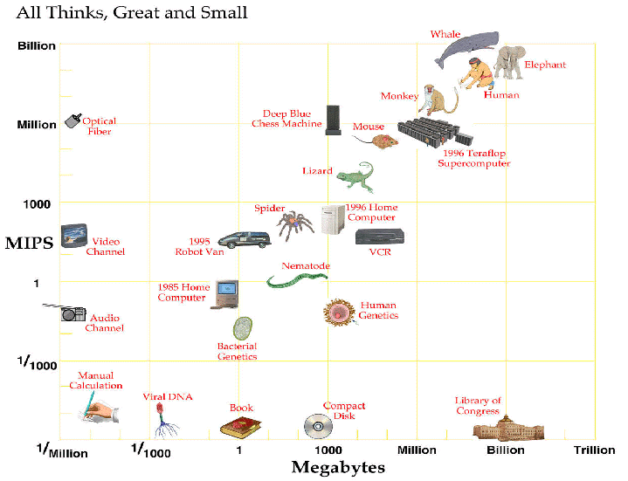
Computer vs. Brain
approx. 2025
Current:
Nvidia: tesla
personal super-
computer
1000 cores
4 teraflop
Aside: Whale vs. human brain

Slide 24
So,
  In near future, we can have computers with as many processing elements as our brain, but:
  far fewer interconnections (wires or synapses)
  then again, much faster updates.
Fundamentally different hardware may
require fundamentally different algorithms!
  Still an open question.
  Neural net research.
  Can a digital computer simulate our brain?
Likely: Church-Turing Thesis
(But, might we need quantum computing?)
(Penrose; consciousness; free will)

Slide 25
A Neuron

Slide 26
An Artificial Neural Network
(Perceptrons)
Output Unit
Input Units

Slide 27
An artificial neural network is an abstraction (well, really, a “drastic simplification”) of a real neural network.
Start out with random connection weights on the links between units. Then train from input examples and environment, by changing network weights.
Recent breakthrough: Deep Learning
(automatic discovery of “deep” features
by a large neural network. Google/Stanford
project.)

Slide 28
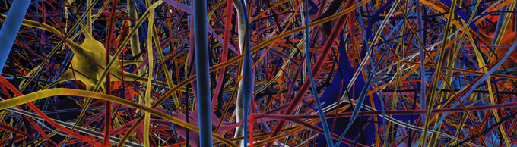
Neurons in the News
The Human Brain Project
European investment: 1B Euro (yeap, with a “b” ☺ )
http://www.humanbrainproject.eu/introduction.html
“… to simulate the actual working of the brain. Ultimately, it will attempt to simulate the complete human brain.”
http://www.newscientist.com/article/dn23111-human-brain-model-and-graphene-win-sciences-x-factor.html

Slide 29
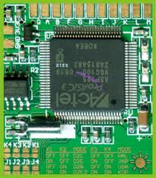
Bottom-line: Neural networks with machine learning
techniques are providing new insights in to how to achieve AI. So, studying the brain seems to helps AI research.
Obviously?
Consider the following gedankenexperiment.
1) Consider a laptop running “something.” You have no idea what the laptop is doing, although it is getting pretty warm… ☺
2) I give you voltage and current meter and microscope
to study the chips and the wiring inside the laptop.
Could you figure out what the laptop was doing?
3) E.g. Consider it’s running a quicksort on a large list of integers. Could studying the running hardware ever reveal that? (Discuss)
Seems unlikely… Alternatively, from I/O
behavior, you might stumble on a sorting algorithm,
possibly quicksort!

Slide 30
So, consider I/O behavior as an information processing task.
This is a general strategy driving much of current AI:
Discover underlying computational process that mimics desired
I/O behavior.
E.g.
In: 3, -4, 5 , 9 , 6, 20 Out: -4, 3, 5, 6, 9, 20
In: 8, 5, -9, 7, 1, 4, 3 Out: -9, 1, 3, 4, 5, 7, 8
Now, consider hundreds of such examples.
A machine learning technique, called Inductive Logic Programming, can uncover a sorting algorithm that provides this kind of I/O behavior. So, it learns the underlying information processing task. (Also, Genetic Genetic programming.)

Slide 31
But, sorting numbers doesn’t have much to do with general
intelligence… However many related scenarios.
E.g., consider the area of activity recognition and planning.
Setting: A robot observes a human performing a series of actions.
Goal: Build a computational model of how to generate such
action sequences for related tasks.
Concrete example domain: Cooking. Goal: Build household robot.
Robot observe a set of actions (e.g., boiling water, rinsing,
chopping, etc.). Robot can learn which actions are required
for what type of meal.
But, how do we get the right sequence of actions?
Certain orderings are dictated by domain, e.g. “fill pot with
water, before boiling.” Knowledge-based component (e.g. learn).

Slide 32
But how should robot decide on actions that can be ordered
in different ways? Is there a general principle to do so?
Answer: Yes, minimize time for meal preparation.
Planning and scheduling algorithms will do so. Works quite well even though but we have no idea of how a human brain actually creates such sequences. I.e., we viewed the task of generating the sequence of actions as an information processing task optimizing a certain objective or “utility” function (i.e., the overall duration). AI: We want to discover such principles!
General area: sequential decision making in uncertain environments. (Markov Decision Processes.)
Analogously: Game theory tells us how to make good decision in multi-agent settings. Gives powerful game playing agents (for chess, poker, video games, etc.).

Slide 33
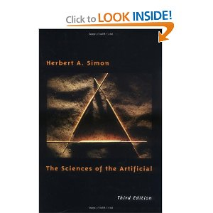
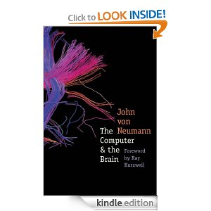
Wonderful (little) book:
The Sciences of the Artificial
by Herb Simon
One of the founders of AI. Nobel Prize in economics. How to build decision making machines operating in complex environments. Theory of Information Processing Systems. First to move computers from “number crunchers” (fancy calculators) to “symbolic processing.”
Another absolute classic:
The Computer and the Brain
by John von Neumann.
Renowned mathematician and the father of modern computing.

Slide 34
3. Thinking Rationally
Human-like
Intelligence
“Ideal” Intelligent/
Rationally
Thinking humanly → Cognitive Modeling | 3. Thinking Rationally →formalizing ”Laws of Thought”
Acting Humanly →Turing Test | Acting Rationally
Thought/
Reasoning
Behavior/
Actions
Notes:
A system is intelligent if it does the right thing given what it knows.

Slide 35
Thinking rationally: formalizing the "laws of thought”
Long and rich history!
Logic: Making the right inferences!
Remarkably effective in science, math, and engineering.
Several Greek schools developed various forms of logic: notation and rules of derivation for thoughts.
Aristotle: what are correct arguments/thought processes? (characterization of “right thinking”).
Socrates is a man
    All men are mortal
    --------------------------
    Therefore, Socrates is mortal
    Can we mechanize it? (strip interpretation)
    Use: legal cases, diplomacy, ethics etc. (?)
Syllogisms
Aristotle

Slide 36
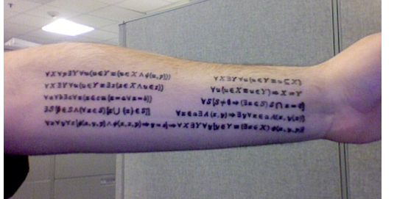
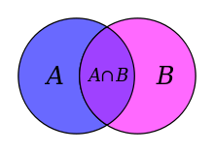
More contemporary logicians (e.g. Boole, Frege, and Tarski).
Ambition: Developing the “language of thought.”
Direct line through mathematics and philosophy to modern AI.
Key notion:
Inference derives new information from stored facts.
Axioms can be very compact. E.g. much of mathematics can be derived from the logical axioms of Set Theory.
Zermelo-Fraenkel with axiom of choice.
Also,
Godel’s
incompleteness.

Slide 37
Limitations:
  Not all intelligent behavior is mediated by logical deliberation (much appears not…)
  (Logical) representation of knowledge underlying intelligence is quite non-trivial. Studied in the area of “knowledge representation.” Also brings in probabilistic representations. E.g. Bayesian networks.
  What is the purpose of thinking?
  What thoughts should I have?

Slide 38
4. Acting Rationally
Human-like
Intelligence
“Ideal” Intelligent/
Rationally
Thinking humanly Cognitive Modeling / Neural nets | 3. Thinking Rationally →”Laws of Thought“
Acting Humanly →Turing Test | 4. Acting Rationally
Thought/
Reasoning
Many current
AI advances
Behavior/
Actions
Notes:
A system is intelligent if it does the right thing given what it knows.

Slide 39
Rational agents
An agent is an entity that perceives and acts in
the world (i.e. an “autonomous system” (e.g.
self-driving cars) / physical robot or software robot
(e.g. an electronic trading system))
This course is about designing rational agents
For any given class of environments and tasks, we seek the agent (or class of agents) with the best performance
Caveat: computational limitations may make perfect rationality unachievable
  → design best program for given machine resources

Slide 40
Building Intelligent Machines
I Building exact models of human cognition
  view from psychology, cognitive science, and neuroscience
II Developing methods to match or exceed human
performance in certain domains, possibly by
very different means
Main focus of current AI.
But, I) often provides inspiration for II). Also, Neural Nets
blur the separation.

Slide 41
Key research areas in AI
Problem solving, planning, and search --- generic problem solving architecture based on ideas from cognitive science (game playing, robotics).
Knowledge Representation – to store and manipulate information (logical and probabilistic representations)
Automated reasoning / Inference – to use the stored information to answer questions and draw new conclusions
Machine Learning – intelligence from data; to adapt to new circumstances and to detect and extrapolate patterns
Natural Language Processing – to communicate with the machine
Computer Vision --- processing visual information
Robotics --- Autonomy, manipulation, full integration of AI capabilities

