Slide 1
CS 4700:
Foundations of Artificial Intelligence
Bart Selman
selman@cs.cornell.edu
Module: Knowledge, Reasoning, and Planning
Part 2
First-Order Logic and Inference
R&N: Chapters 8 and 9

Slide 2
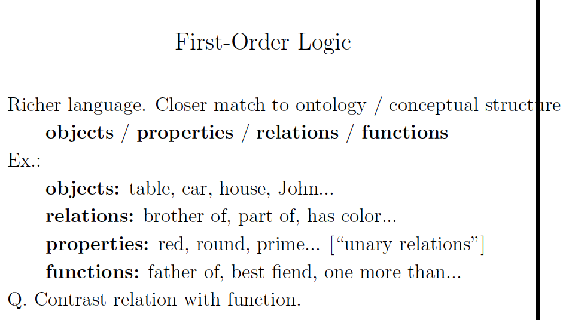

Slide 3
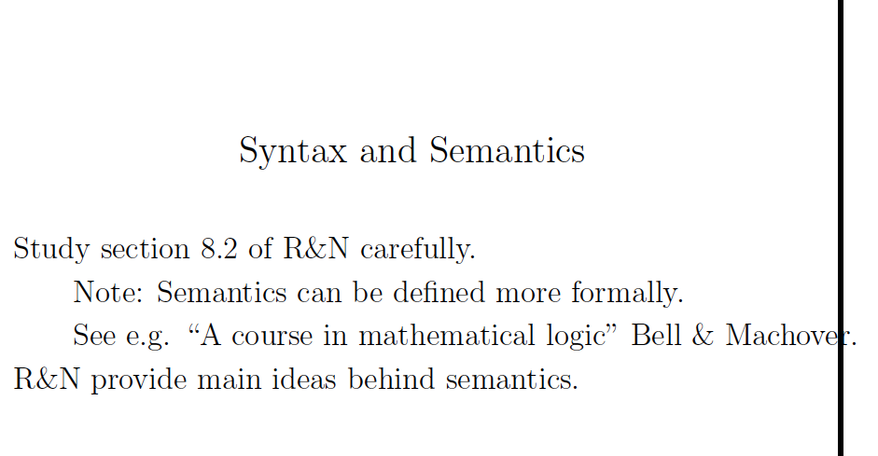

Slide 4
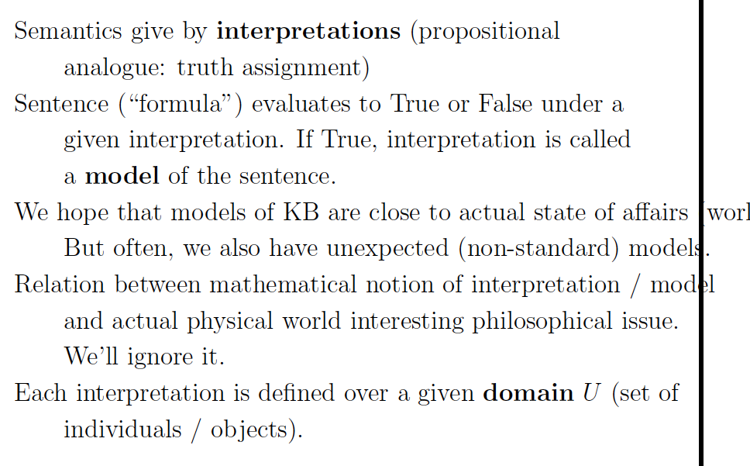

Slide 5
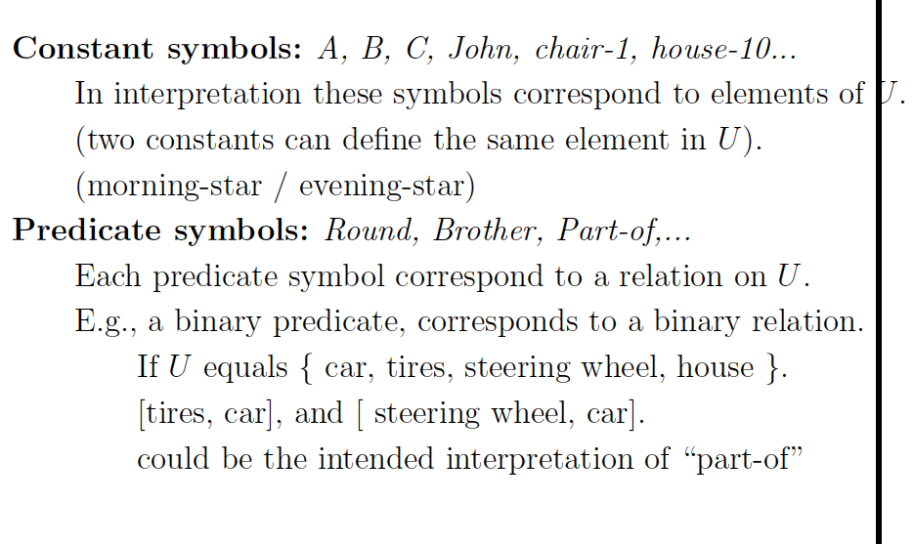

Slide 6
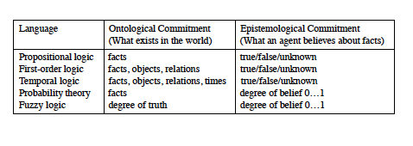

Slide 7
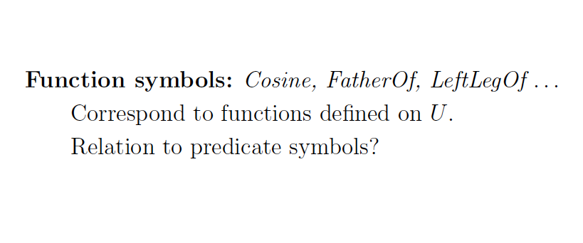

Slide 8
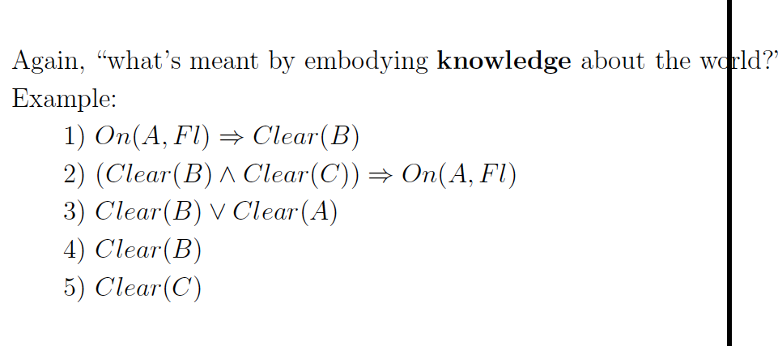

Slide 9
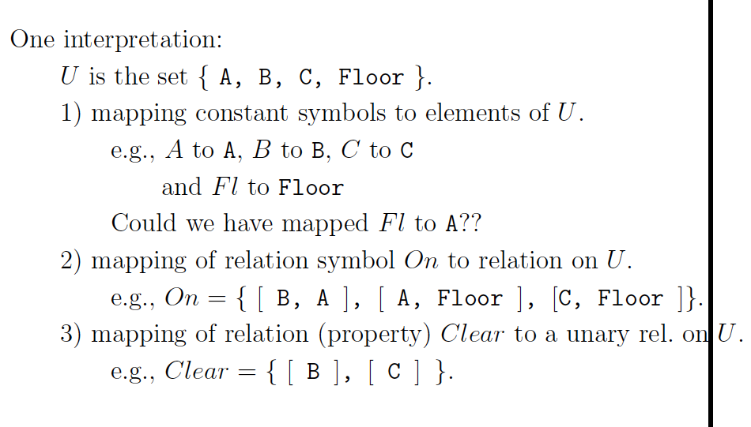

Slide 10
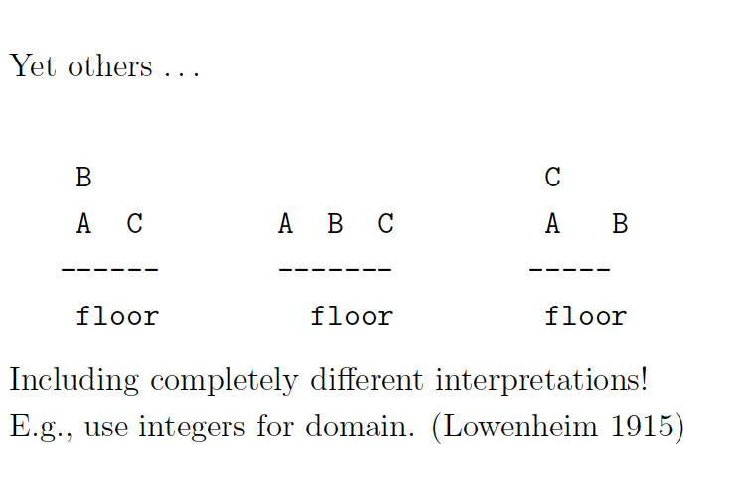

Slide 11
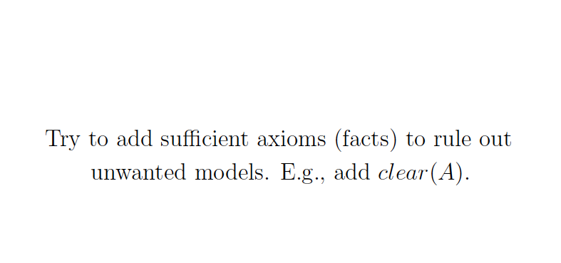

Slide 12
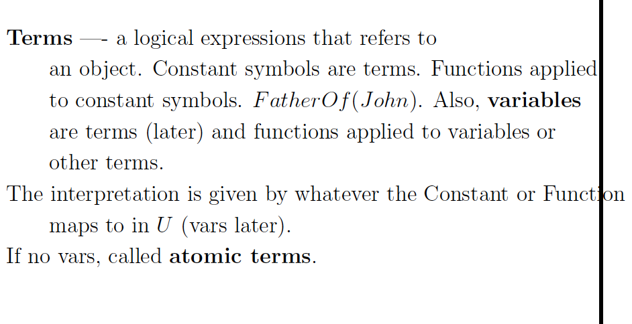

Slide 13
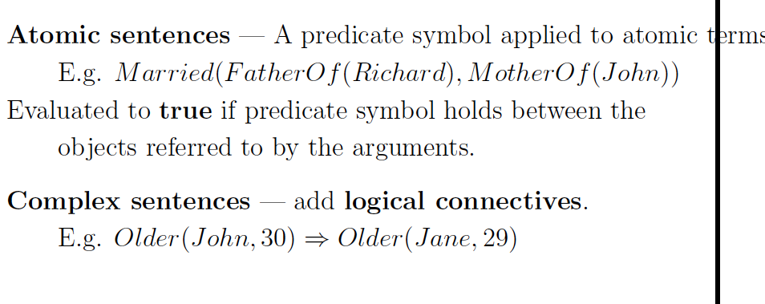

Slide 14
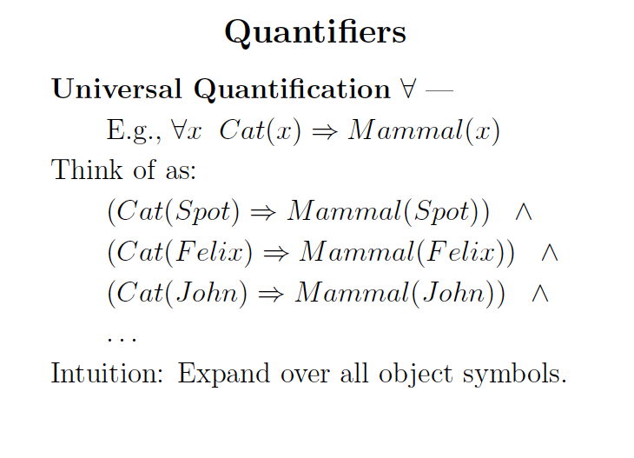

Slide 15
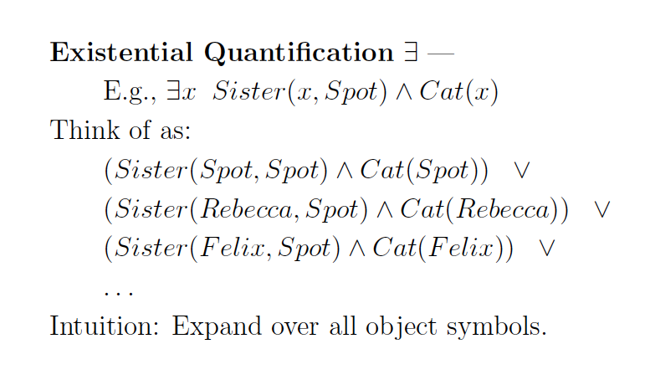

Slide 16
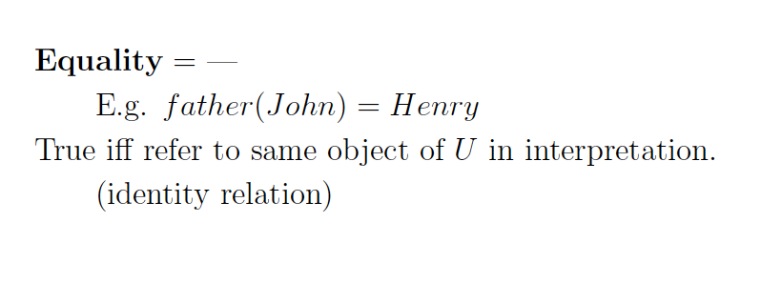

Slide 17
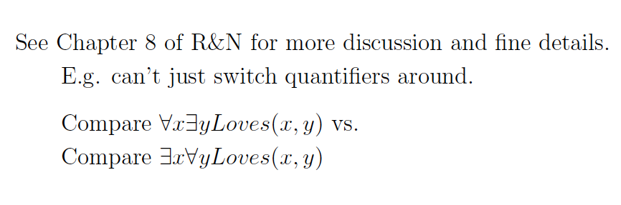

Slide 18
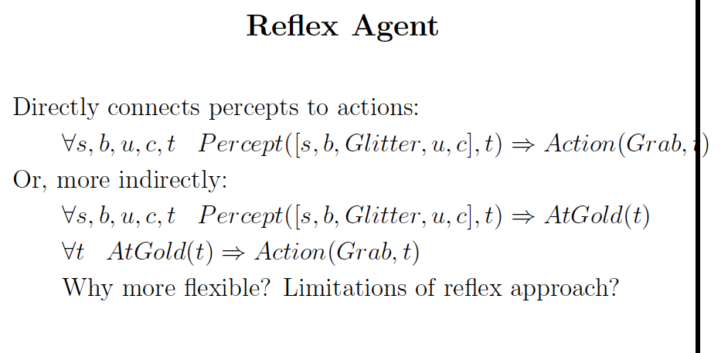

Slide 19
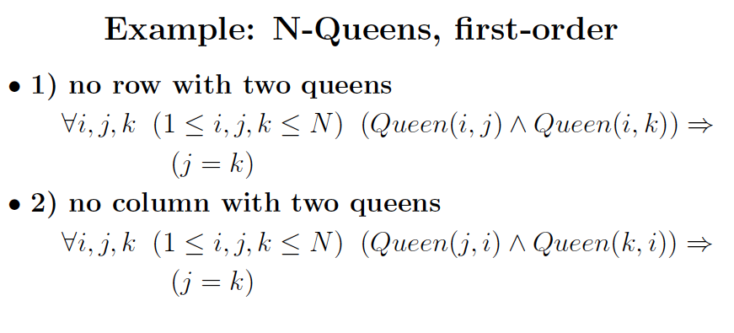
Done with propositional logic. Just check at home for syntax and FOL form.

Slide 20
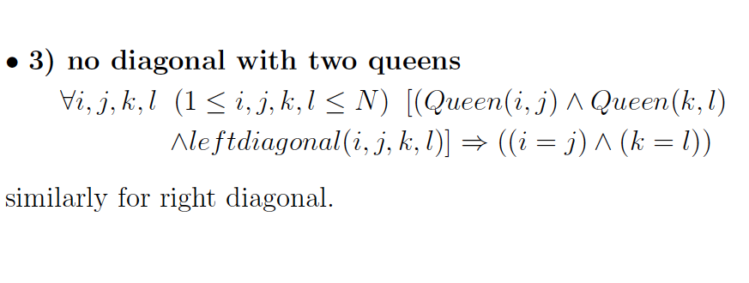

Slide 21
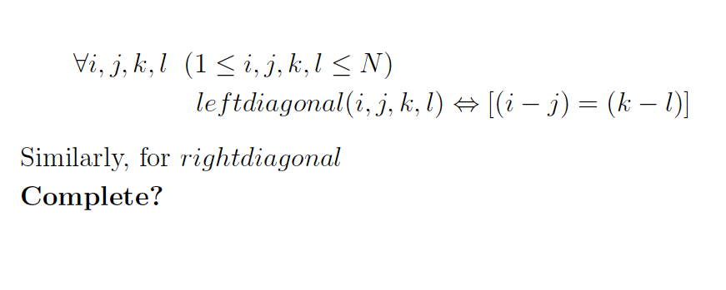

Slide 22
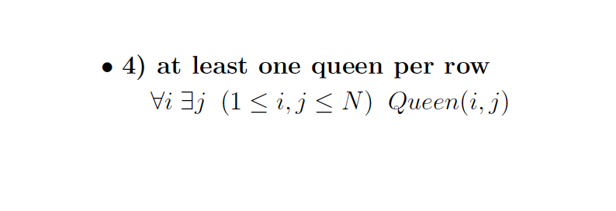

Slide 23
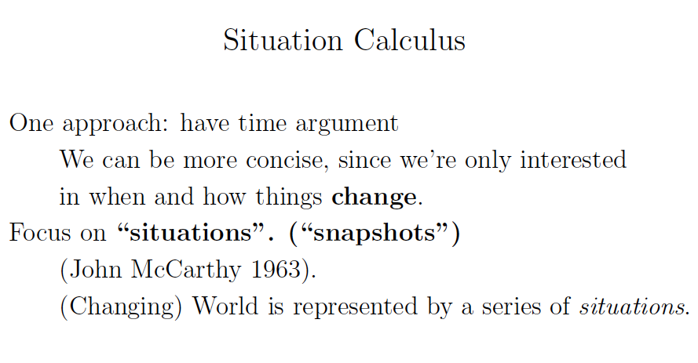
Also discussed earlier. Here some additional axiom details. R&N Section 10.4.2.

Slide 24
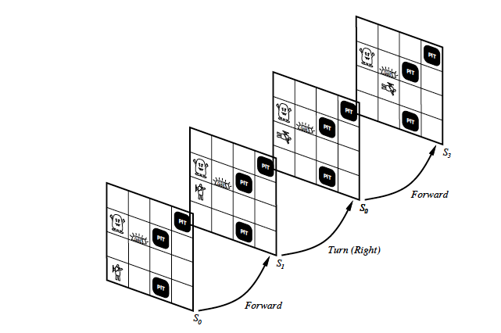

Slide 25
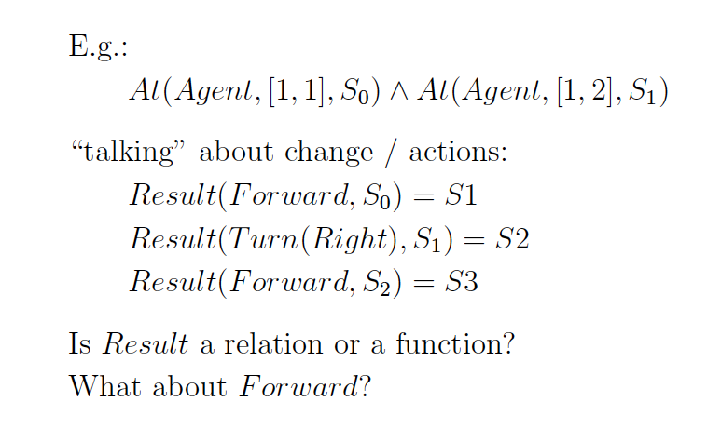
Result(action, situation) → situation (unique outcome)

Slide 26
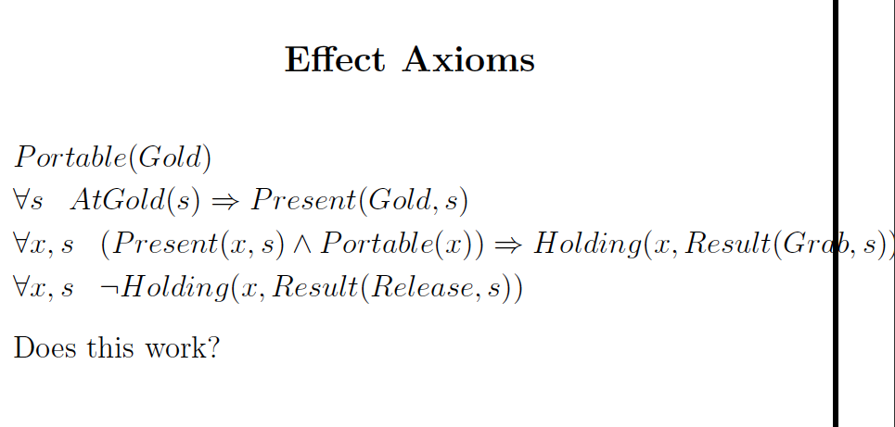

Slide 27
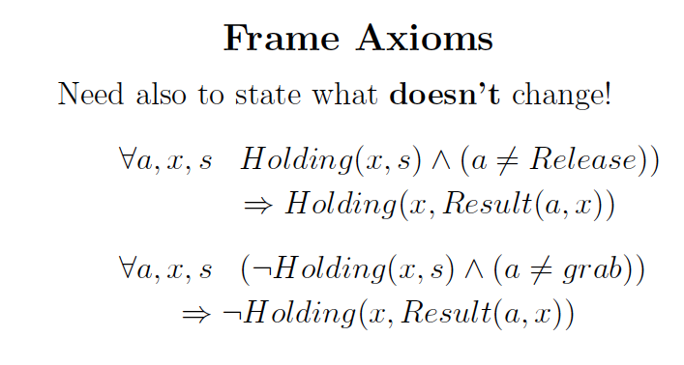
Again, as discussed in propositional case.

Slide 28
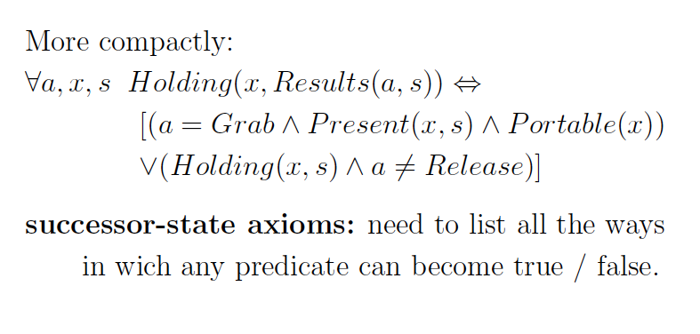

Slide 29
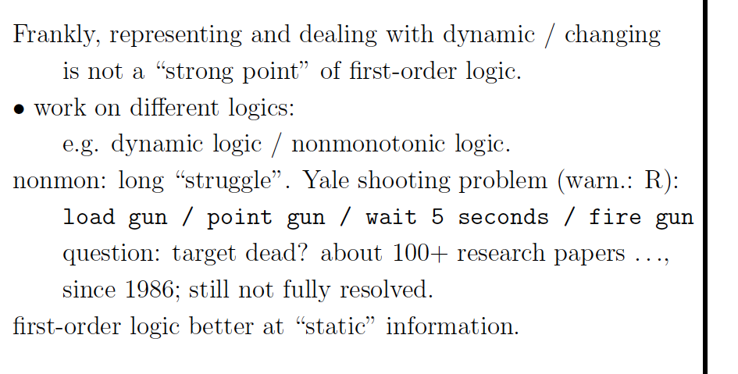

Slide 30
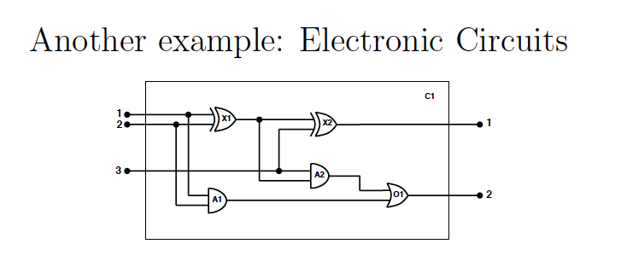
R&N 8.4.2.
Further illustration of FOL formulation.
Expands on earlier diagnosis example.

Slide 31
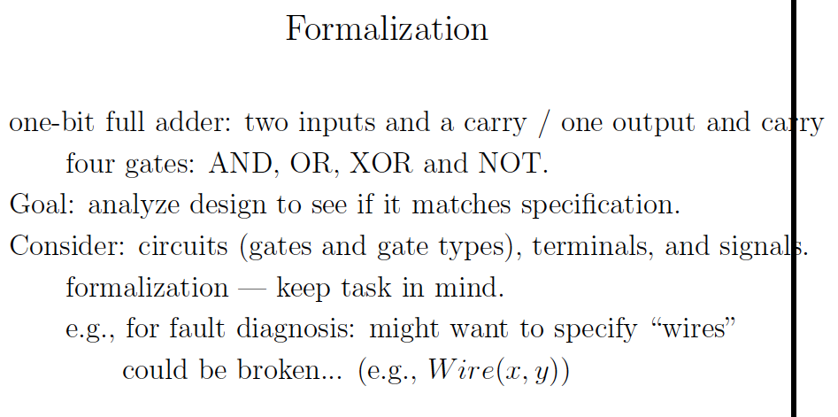

Slide 32
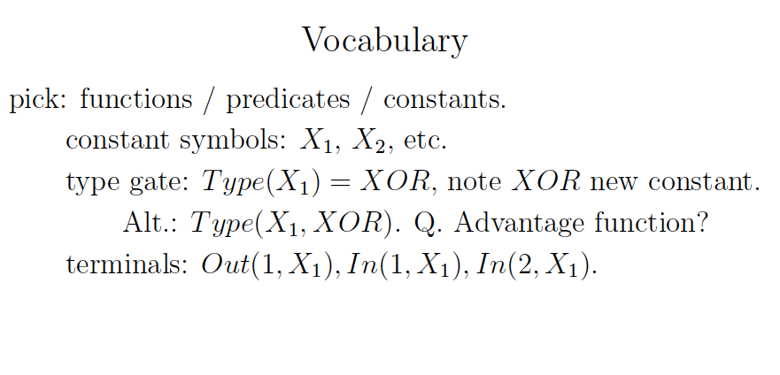
Always define first and
carefully.

Slide 33
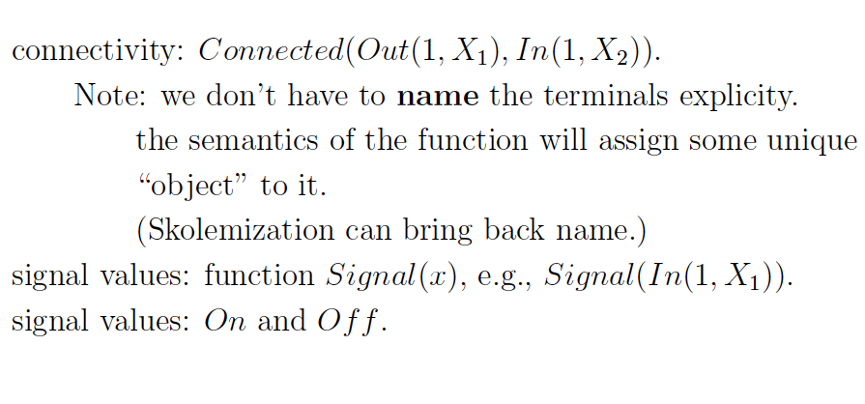

Slide 34
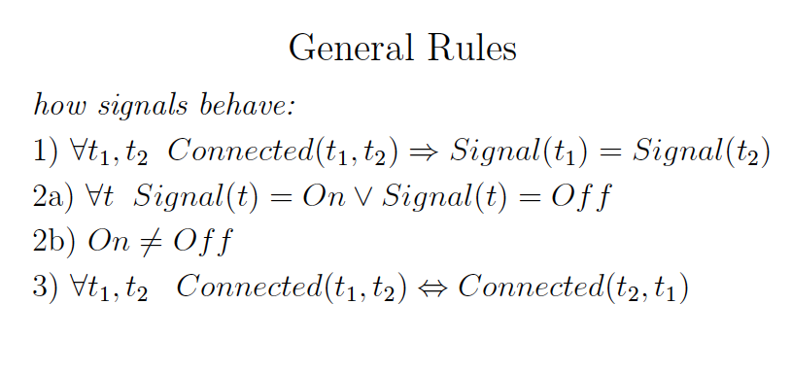

Slide 35
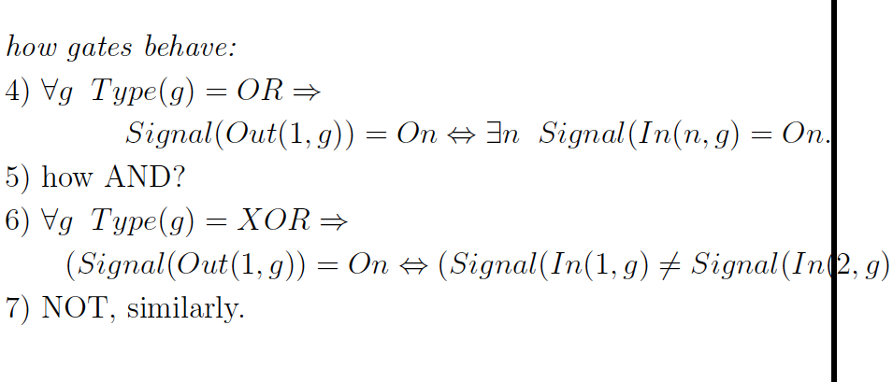

Slide 36
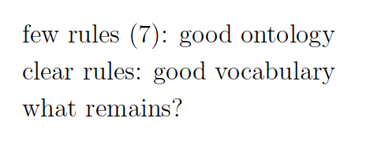

Slide 37
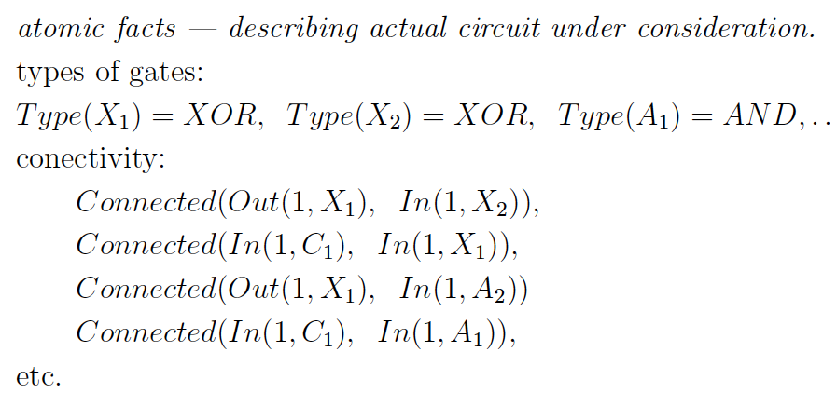

Slide 38
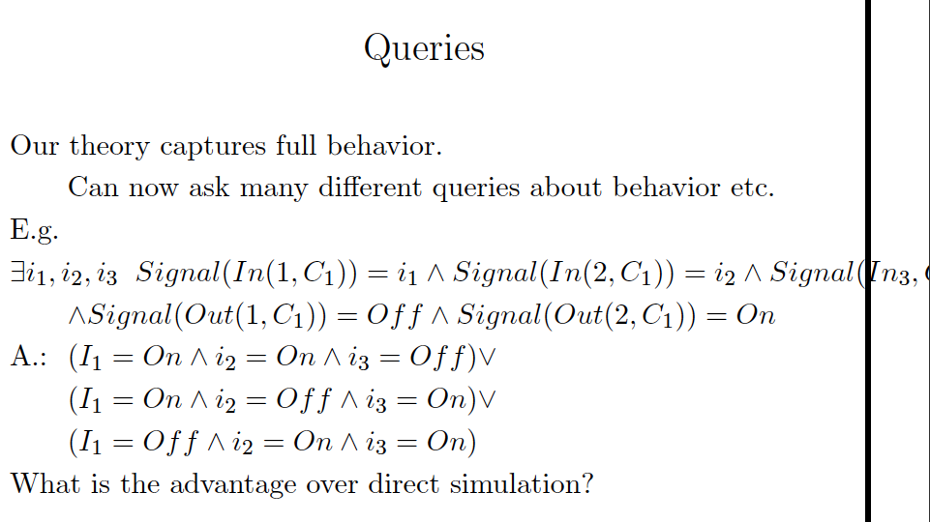
Aside: previously KB ² ® The same here but we want a bit more “detailed answer”. Inference will also give us variable bindings if existential query is entailed.
Consistency based diagnosis/abduction, requires addition of “OK”
or “Functioning” predicates. See earlier.

Slide 39
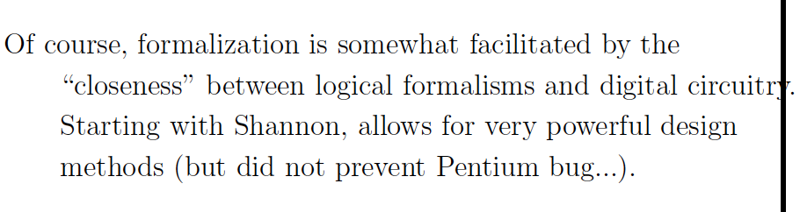

Slide 40
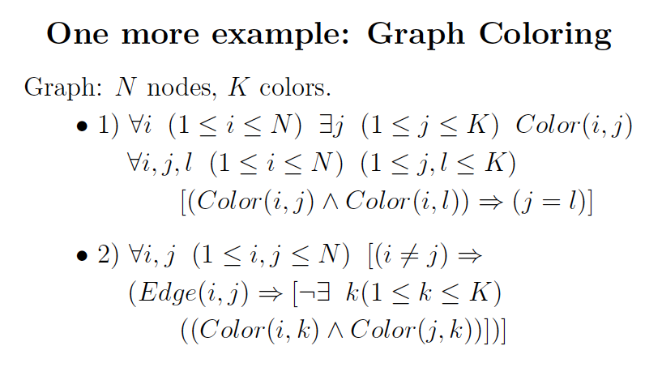
Done with prop. logic. Just check for syntax and FOL form.

Slide 41
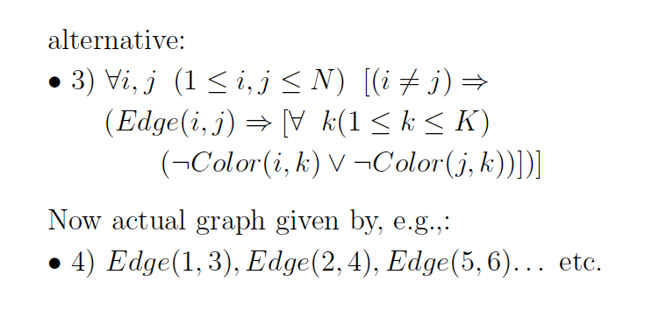

Slide 42
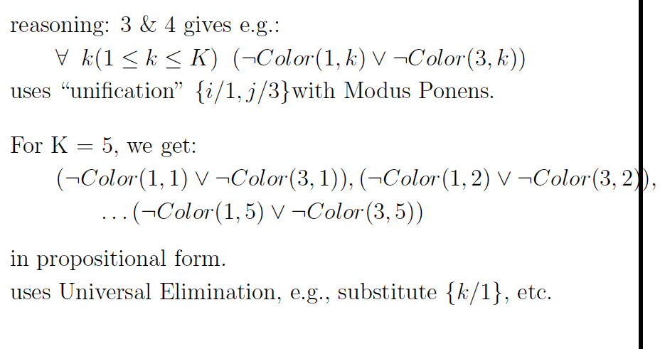

Slide 43
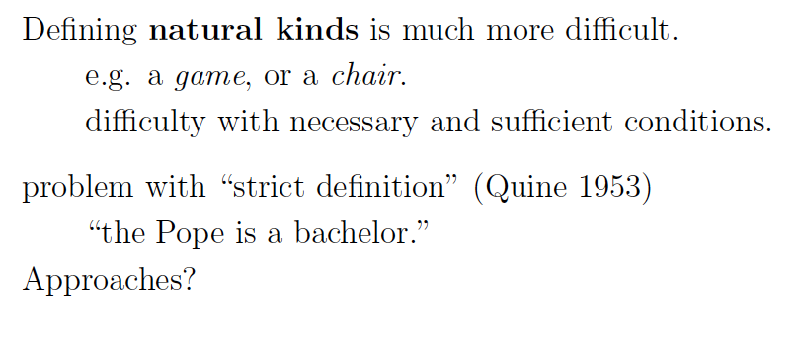
See R&N p. 443
FOL formalizations can be challenging
for “everyday” concepts.
Probabilistic representations (extending prop. logic /
FOL) can help!

Slide 44
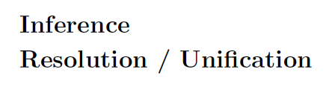
Chapter 9 R&N.
But for finite domains that are not too large,
better to “ground to” propositional and use
SAT solver.

Slide 45
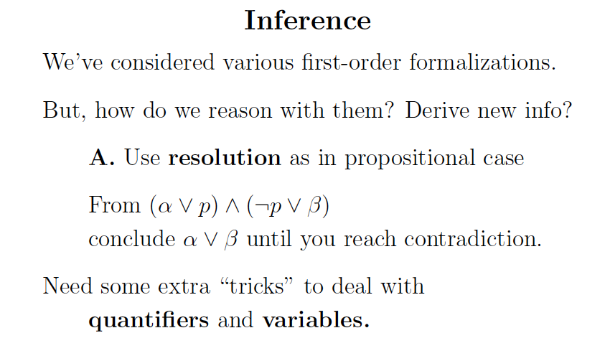

Slide 46
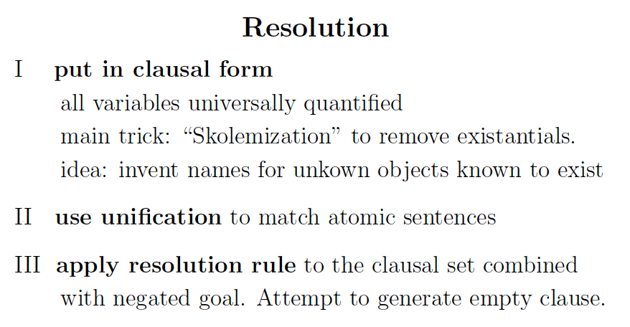

Slide 47
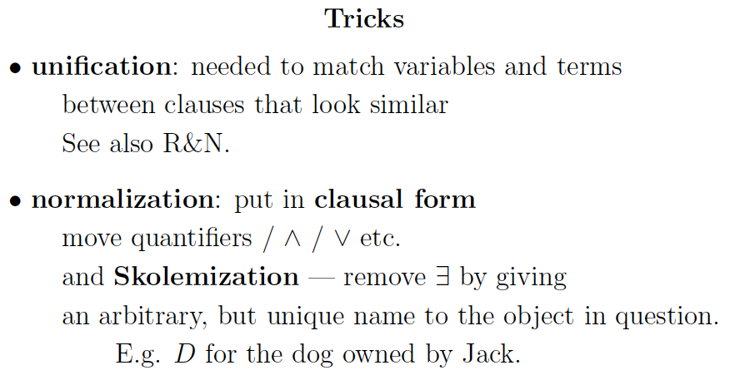

Slide 48
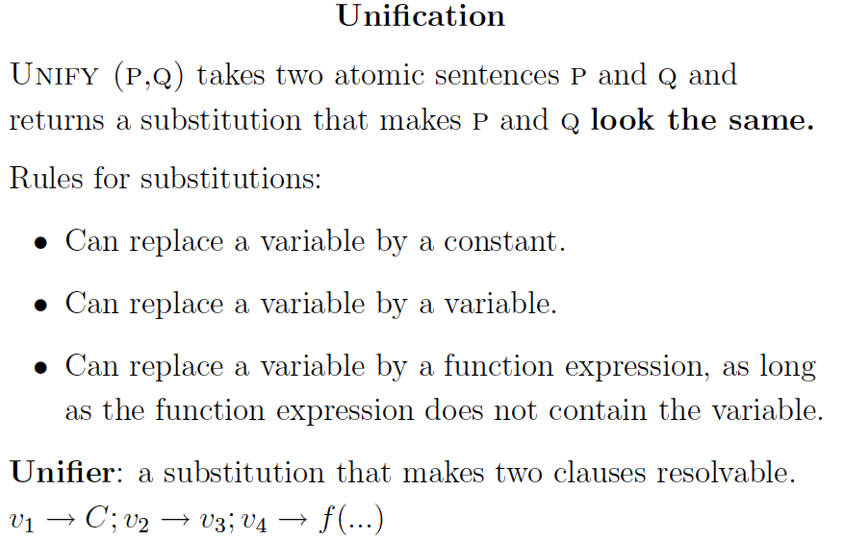

Slide 49
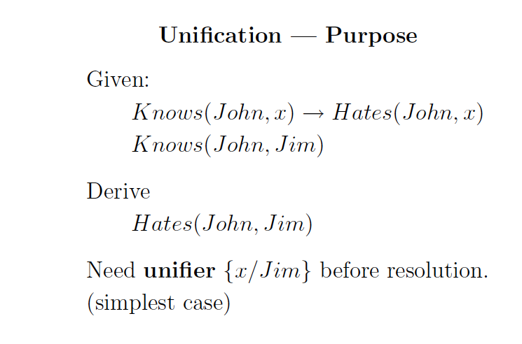
8 x (: Knows(John, x) Ç Hates(John,x))
Find the “right” substitution for
a universal quantified variable.

Slide 50
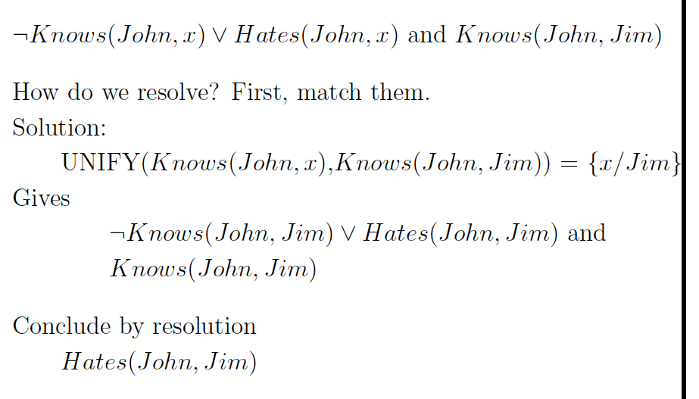

Slide 51
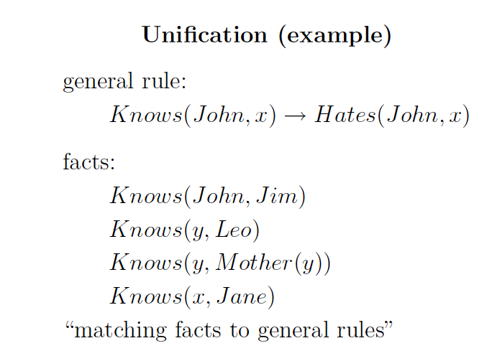
Can substitute in because original clause universally quantified.

Slide 52


Slide 53


Slide 54


Slide 55


Slide 56


Slide 57


Slide 58


Slide 59


Slide 60


Slide 61

Equiv to
: Kills(Curiosity,Tuna)

Slide 62


Slide 63


Slide 64


Slide 65


Slide 66


Slide 67


Slide 68

Or, better yet, for finite domains, fall back to SAT solvers.

