Slide 1
CS 4700: Foundations of Artificial Intelligence
Bart Selman
selman@cs.cornell.edu
Module:
Informed Search
Readings R&N - Chapter 3: 3.5 and 3.6

Slide 2
Search
Search strategies determined by choice of node (in queue) to expand
Uninformed search:
Distance to goal not taken into account
Informed search :
Information about cost to goal taken into account
Aside: “Cleverness” about what option to explore next, almost seems a hallmark of intelligence. E.g., a sense of what might be a good move in chess or what step to try next in a mathematical proof. We don’t do blind search…

Slide 3
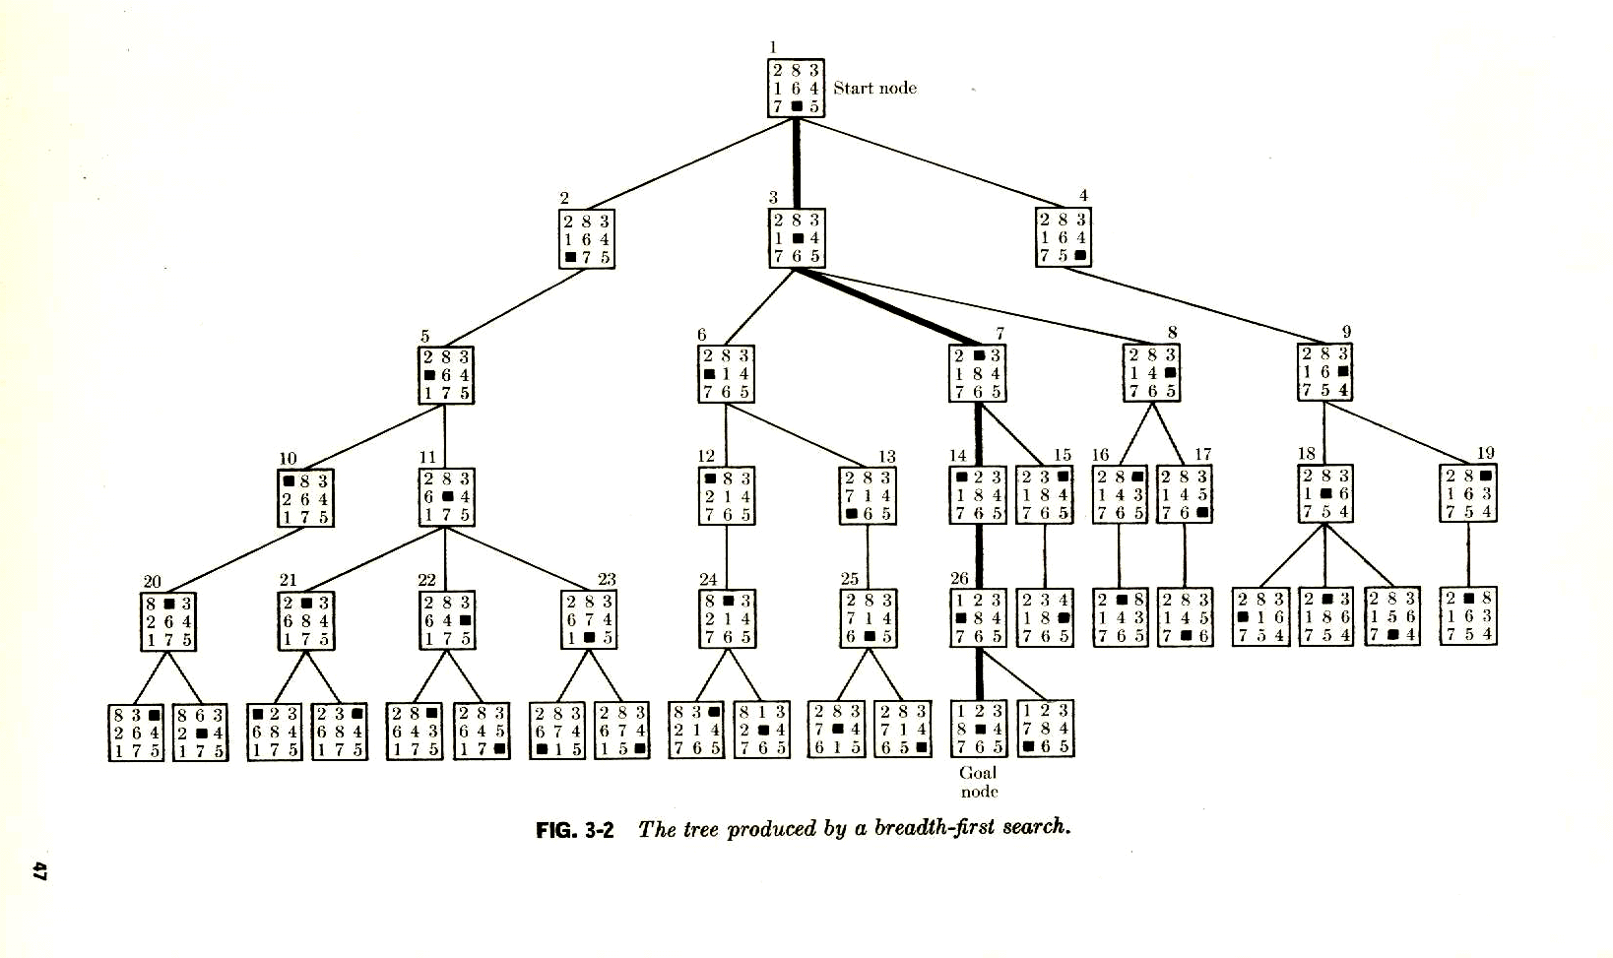
d = min dist. to goal
Reminder: Perfect distance
to goal info.
Eliminates search.
d = 5
Start state
d >= 5
Select
d = 4
d >= 4
d >= 4
Select
d = 3
d >= 3
d = 2
Select
Select
d = 1
Select
d = 0
d >= 1
Goal
A breadth-first search tree.
Practice:
Only have estimate of distance to goal (“heuristic information”).

Slide 4
Basic idea: State evaluation function can effectively guide search.
Also in multi-agent settings. (Chess: board eval.)
Reinforcement learning: Learn the state eval function.
Start state
Goal
A breadth-first search tree.
Perfect “heuristics,” eliminates search.
Approximate heuristics, significantly reduces search.
Best (provably) use of search heuristic info: Best-first / A* search.

Slide 5
Outline
Best-first search
Greedy best-first search
A* search
Heuristics

Slide 6
How to take information into account? Best-first search.
Idea : use an evaluation function for each node
Estimate of “desirability” of node
Expand most desirable unexpanded node first (“best-first search”)
Heuristic Functions :
f: States → Numbers
f(n): expresses the quality of the state n
Allows us to express problem-specific knowledge,
Can be imported in a generic way in the algorithms.
Use uniform-cost search. See Figure 3.14 but use f(n) instead of path cost g(n).
Queuing based on f(n):
Order the nodes in fringe in decreasing order of desirability
Special cases:
greedy best-first search
A* search

Slide 7
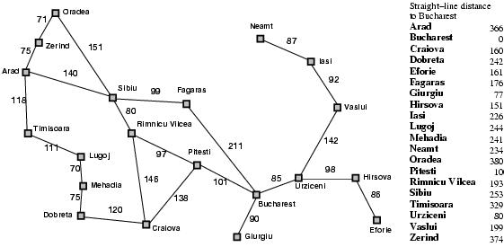
Romanian path finding problem
Base eg on GPS info.
No map needed.
Straight-line
dist. to Bucharest
374
253
329
Searching for good path from Arad to Bucharest,
what is a reasonable “desirability measure” to expand nodes
on the fringe?

Slide 8
Greedy best-first search
Evaluation function at node n, f(n) = h(n) (heuristic)
= estimate of cost from n to goal
e.g., h_{SLD}(n) = straight-line distance from n to Bucharest
Greedy best-first search expands the node that
appears to have shortest path to goal.
Idea: those nodes may lead to solution quickly.
Similar to depth-first search: It prefers to follow a single
path to goal (guided by the heuristic), backing up when it
hits a dead-end.

Slide 9
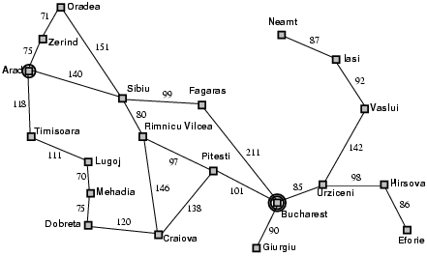
Greedy best-first search example

Slide 10
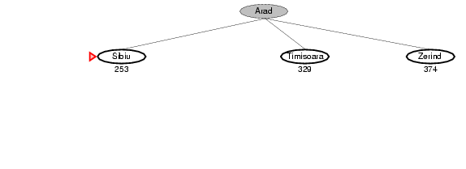
Greedy best-first search example

Slide 11
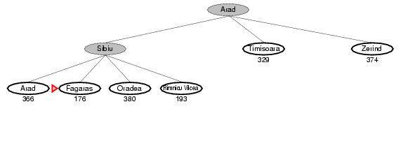
Greedy best-first search example

Slide 12
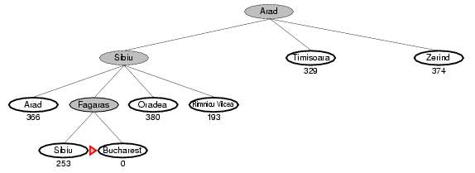
Greedy best-first search example
So, Arad --- Sibiu --- Fagaras --- Bucharest
140+99+211 = 450
Is it optimal?
What are we ignoring?
Also, consider going from
Iasi to Fagaras – what can happen?

Slide 13
Properties of greedy best-first search
Complete? No – can get stuck in loops, e.g.,
Iasi → Neamt → Iasi → Neamt…
But, complete in finite space with repeated state elimination.
Time? O(b^{m}) (imagine nodes all have same distance estimate to goal)
but a good heuristic can give dramatic improvement → Becomes more similar to depth-first search, with reduced branching.
Space? O(b^{m}) -- keeps all nodes in memory
Optimal?
How can we fix this?
No!
b: maximum branching factor of the search tree
d: depth of the least-cost solution
m: maximum depth of the state space (may be ∞)

Slide 14
A* search
Note: Greedy best-first search expands the node that appears to have shortest path to goal. But what about cost of getting to that node? Take it into account!
Idea: avoid expanding paths that are already expensive
Evaluation function f(n) = g(n) + h(n)
g(n) = cost so far to reach n
h(n) = estimated cost from n to goal
f(n) = estimated total cost of path through n to goal
Aside: do we still have “looping problem”?
Iasi to Fagaras:
Iasi → Neamt → Iasi → Neamt…
No! We’ll eventually get out of it. g(n) keeps going up.

Slide 15
A* search example
Using: f(n) = g(n) + h(n)

Slide 16
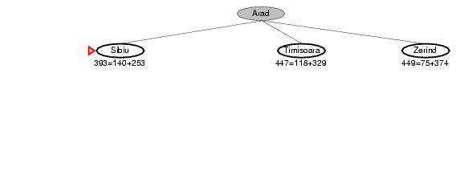
A* search example
Using: f(n) = g(n) + h(n)

Slide 17
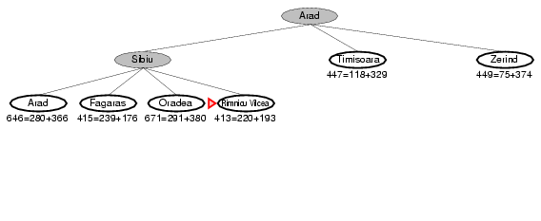
A* search example
Using: f(n) = g(n) + h(n)

Slide 18
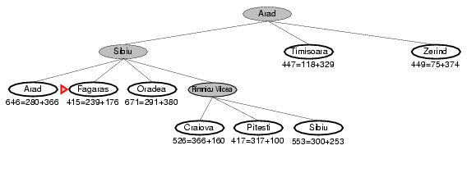
A* search example
Using: f(n) = g(n) + h(n)

Slide 19
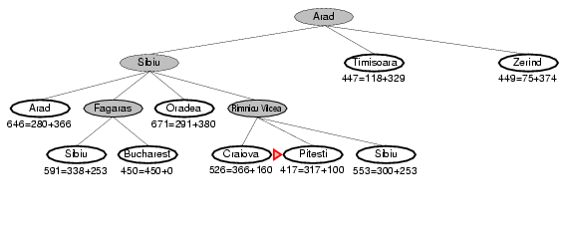
A* search example
Using: f(n) = g(n) + h(n)
What happens if
h(Pitesti) = 150?
Bucharest appears on the fringe
but not selected for expansion
since its cost (450)
is higher than that of Pitesti (417).
Important to understand for the proof of
optimality of A*

Slide 20
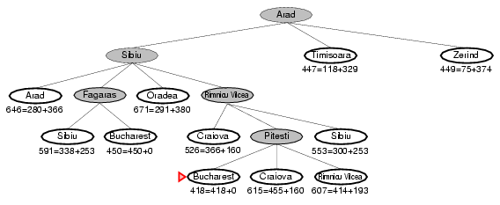
A* search example
Using: f(n) = g(n) + h(n)
Arad --- Sibiu --- Rimnicu --- Pitesti --- Bucharest
Claim: Optimal path found!
1) Can it go wrong?
Note: Best first
Arad --- Sibiu --- Fagaras --- Bucharest
2) What’s special about “straight distance” to goal?
It underestimates true path
distance!
Uniform cost search
3) What if all our estimates to goal are 0? Eg h(n) = 0
4) What if we overestimate?
5) What if h(n) is true distance (h*(n))?
What is f(n)?
Shortest dist. through n --- perfect heuristics --- no search

Slide 21
A* properties
Under some reasonable conditions for the heuristics, we have:
Complete
Yes, unless there are infinitely many nodes with f(n) < f(Goal)
Time
Sub-exponential grow when
So, a good heuristics can bring exponential search down
significantly!
Space
Fringe nodes in memory. Often exponential. Solution: IDA*
Optimal
Yes (under admissible heuristics; discussed next)
Also, optimal use of heuristics information!
Widely used. After almost 40 yrs, still new applications found.
Also, optimal use of heuristic information.
Provably: Can’t do better!
Notes:
The error in the heuristic function grows no faster than the logarithm of the actual path cost.

Slide 22
Heuristics: (1) Admissibility
A heuristic h(n) is admissible if for every node n,
h(n) ≤ h*(n), where h*(n) is the true cost to reach the goal state from n.
An admissible heuristic never overestimates the cost to reach the goal,
i.e., it is optimistic. (But no info of where the goal is if set to 0.)
Example: h_{SLD}(n) (never overestimates the actual road distance)
Note: it follows that h(goal) = 0.
Note: less optimistic heuristic push nodes to be expanded
later. Can prune a lot more.

Slide 23
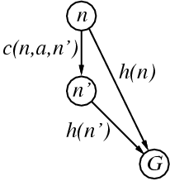
Heuristics: (2) Consistency
A heuristic is consistent (or monotone) if for every node n, every successor n' of n generated by any action a,
h(n) ≤ c(n,a,n') + h(n')
(form of the triangle inequality)
If h is consistent, we have
f(n') = g(n') + h(n')
= g(n) + c(n,a,n') + h(n')
≥ g(n) + h(n)
= f(n)
i.e., f(n) is non-decreasing along any path.
f(n') ≥ f(n)
→ sequence of nodes expanded by A* is in nondecreasing order of f(n)
→ the first goal selected for expansion must be an optimal goal.
Note: Monotonicity is a stronger condition than admissibility.
Any consistent heuristic is also admissible.
(Exercise 3.29)

Slide 24
A*: Tree Search vs. Graph Search
TREE SEARCH (See Fig. 3.7; used in earlier examples):
If h(n) is admissible, A* using tree search is optimal.
GRAPH SEARCH (See Fig. 3.7) A modification of tree search that includes an
“explored set” (or “closed list”; list of expanded nodes to avoid re-visiting the same
state); if the current node matches a node on the closed list, it is discarded instead
of being expanded. In order to guarantee optimality of A*, we need to make sure
that the optimal path to any repeated state is always the first one followed:
If h(n) is monotonic, A* using graph search is optimal.
(proof next)
(see details page 95 R&N)
Reminder: Bit of “sloppiness” in fig. 3.7.
Need to be careful with nodes on frontier;
allow repetitions or as in Fig. 3.14.

Slide 25
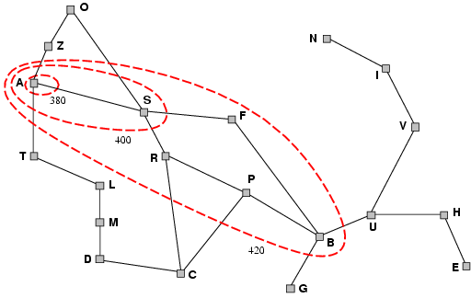
Intuition: Contours of A*
A* expands nodes in order of increasing f value.
Gradually adds "f-contours" of nodes.
Contour i has all nodes with f <= f_{i}, where f_{i} < f_{i+1}
Note: with uniform cost (h(n)=0) the bands will be circular around the start state.
A* expands all nodes
with f(n)<C*
Uniform-cost (h(n)=0)
expands in circles.
Completeness (intuition)
As we add bands of increasing f, we must eventually reach a band where f is equal to the cost of the path to a goal state. (assuming b finite and step cost exceed some positive finite ε).
380
400
Optimality (intuition)
1st solution found (goal node expanded) must be an optimal one since goal nodes in subsequent contours will have higher f-cost and therefore higher g-cost (since h(goal)=0)
420
Notes:
Why1 – H(goal)=0;
Why 2 - Finite number of nodes with cost less than or eqaul to C*

Slide 26
A* Search: Optimality
Theorem:
A* used with a consistent heuristic ensures optimality with
graph search.

Slide 27
Proof:
If h(n) is consistent, then the values of f(n) along any path are
non-decreasing. See consistent heuristics slide.
(2) Whenever A* selects a node n for expansion, the optimal path
to that node has been found. Why?
Assume not. Then, the optimal path, P, must have some not yet
expanded nodes. (*) Thus, on P, there must be an unexpanded
node n` on the current frontier (because of graph separation;
fig. 3.9; frontier separates explored region from unexplored
region). But, because f is nondecreasing along any path, n`
would have a lower f-cost than n and would have been selected
first for expansion before n. Contradiction.
From (1) and (2), it follows that the sequence of nodes expanded by A*
using Graph-Search is in non-decreasing order of f(n). Thus, the first
goal node selected must have the optimal path, because f(n) is the true
path cost for goal nodes (h(Goal) = 0), and all later goal nodes have paths
that are are at least as expensive. QED
(*) requires a bit of thought. Must argue that there cannot be a shorter
path going only through expanded nodes (by contradiction).

Slide 28
Note: Termination / Completeness
Termination is guaranteed when the number of nodes
with is finite.
None-termination can only happen when
There is a node with an infinite branching factor, or
There is a path with a finite cost but an infinite number of nodes along it.
Can be avoided by assuming that the cost of each action is larger than a positive constant d
≤

Slide 29
A* Optimal in Another Way
It has also been shown that A* makes optimal use of the heuristics in the sense that there is no search algorithm that could expand fewer nodes using the heuristic information (and still find the optimal / least cost solution.
So, A* is “the best we can get” (in this setting).
Note: We’re assuming a search based approach with states/nodes, actions on them leading to other states/nodes, start and goal states/nodes.

Slide 30
Example: Contrasting A* with Uniform Cost (Dijkstra’s algorithm)
Example: The shortest route from Hannover to Munich
Dijkstra’s alg., i.e., A* with h(n)=0 (Uniform cost search)
2) A* search
Example thanks to Meinolf Sellmann

Slide 31
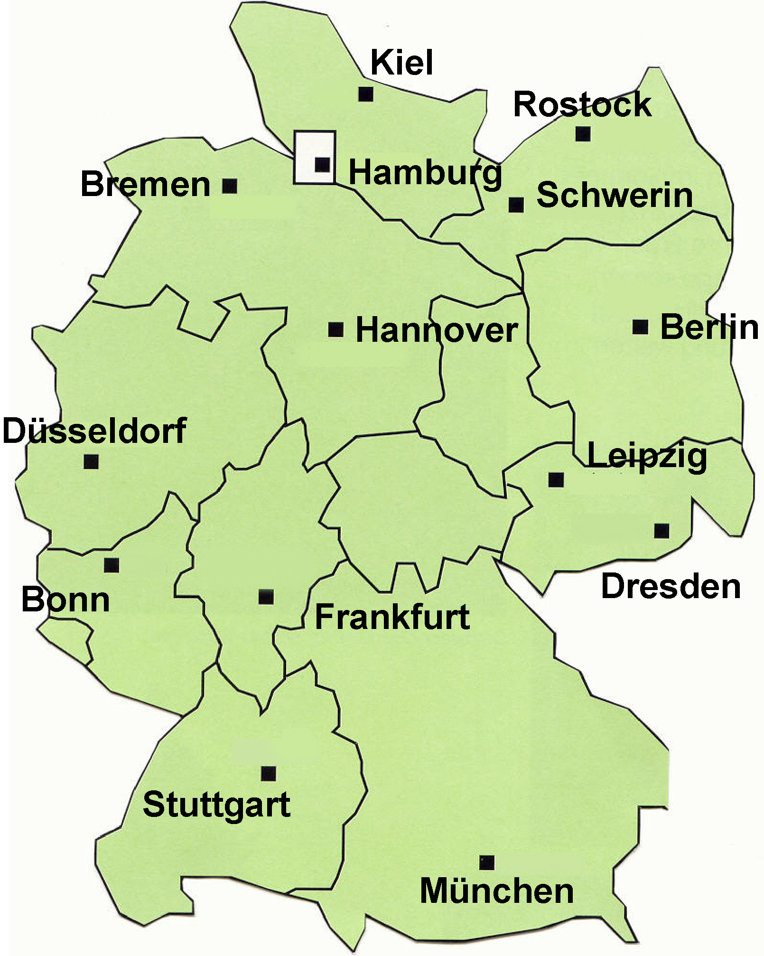
Shortest Paths in Germany
Hannover 0
Bremen ∞
Hamburg ∞
Kiel ∞
Leipzig ∞
Schwerin ∞
Duesseldorf ∞
Rostock ∞
Frankfurt ∞
Dresden ∞
Berlin ∞
Bonn ∞
Stuttgart ∞
Muenchen ∞
110
85
90
120
155
200
270
320
255
365
185
240
140
410
180
410
200
435
210

Slide 32
Shortest Paths in Germany
Hannover 0
Bremen 120
Hamburg 155
Kiel ∞
Leipzig 255
Schwerin 270
Duesseldorf 320
Rostock ∞
Frankfurt 365
Dresden ∞
Berlin ∞
Bonn ∞
Stuttgart ∞
Muenchen ∞
110
85
90
120
155
200
270
320
255
365
185
240
140
410
180
410
200
435
210

Slide 33
Shortest Paths in Germany
Hannover 0
Bremen 120
Hamburg 155
Kiel ∞
Leipzig 255
Schwerin 270
Duesseldorf 320
Rostock ∞
Frankfurt 365
Dresden ∞
Berlin ∞
Bonn ∞
Stuttgart ∞
Muenchen ∞
110
85
90
120
155
200
270
320
255
365
185
240
140
410
180
410
200
435
210

Slide 34
Shortest Paths in Germany
Hannover 0
Bremen 120
Hamburg 155
Kiel 240
Leipzig 255
Schwerin 270
Duesseldorf 320
Rostock ∞
Frankfurt 365
Dresden ∞
Berlin ∞
Bonn ∞
Stuttgart ∞
Muenchen ∞
110
85
90
120
155
200
270
320
255
365
185
240
140
410
180
410
200
435
210

Slide 35
Shortest Paths in Germany
Hannover 0
Bremen 120
Hamburg 155
Kiel 240
Leipzig 255
Schwerin 270
Duesseldorf 320
Rostock ∞
Frankfurt 365
Dresden ∞
Berlin ∞
Bonn ∞
Stuttgart ∞
Muenchen ∞
110
85
90
120
155
200
270
320
255
365
185
240
140
410
180
410
200
435
210

Slide 36
Shortest Paths in Germany
Hannover 0
Bremen 120
Hamburg 155
Kiel 240
Leipzig 255
Schwerin 270
Duesseldorf 320
Rostock ∞
Frankfurt 365
Dresden 395
Berlin 440
Bonn ∞
Stuttgart ∞
Muenchen 690
110
85
90
120
155
200
270
320
255
365
185
240
140
410
180
410
200
435
210

Slide 37
Shortest Paths in Germany
Hannover 0
Bremen 120
Hamburg 155
Kiel 240
Leipzig 255
Schwerin 270
Duesseldorf 320
Rostock 360
Frankfurt 365
Dresden 395
Berlin 440
Bonn ∞
Stuttgart ∞
Muenchen 690
110
85
90
120
155
200
270
320
255
365
185
240
140
410
180
410
200
435
210

Slide 38
Shortest Paths in Germany
Hannover 0
Bremen 120
Hamburg 155
Kiel 240
Leipzig 255
Schwerin 270
Duesseldorf 320
Rostock 360
Frankfurt 365
Dresden 395
Berlin 440
Bonn ∞
Stuttgart ∞
Muenchen 690
110
85
90
120
155
200
270
320
255
365
185
240
140
410
180
410
200
435
210

Slide 39
Shortest Paths in Germany
Hannover 0
Bremen 120
Hamburg 155
Kiel 240
Leipzig 255
Schwerin 270
Duesseldorf 320
Rostock 360
Frankfurt 365
Dresden 395
Berlin 440
Bonn ∞
Stuttgart ∞
Muenchen 690
110
85
90
120
155
200
270
320
255
365
185
240
140
410
180
410
200
435
210

Slide 40
Shortest Paths in Germany
Hannover 0
Bremen 120
Hamburg 155
Kiel 240
Leipzig 255
Schwerin 270
Duesseldorf 320
Rostock 360
Frankfurt 365
Dresden 395
Berlin 440
Bonn 545
Stuttgart 565
Muenchen 690
110
85
90
120
155
200
270
320
255
365
185
240
140
410
180
410
200
435
210
Note: route via Frankfurt longer than current one.

Slide 41
Shortest Paths in Germany
Hannover 0
Bremen 120
Hamburg 155
Kiel 240
Leipzig 255
Schwerin 270
Duesseldorf 320
Rostock 360
Frankfurt 365
Dresden 395
Berlin 440
Bonn 545
Stuttgart 565
Muenchen 690
110
85
90
120
155
200
270
320
255
365
185
240
140
410
180
410
200
435
210

Slide 42
Shortest Paths in Germany
Hannover 0
Bremen 120
Hamburg 155
Kiel 240
Leipzig 255
Schwerin 270
Duesseldorf 320
Rostock 360
Frankfurt 365
Dresden 395
Berlin 440
Bonn 545
Stuttgart 565
Muenchen 690
110
85
90
120
155
200
270
320
255
365
185
240
140
410
180
410
200
435
210

Slide 43
Shortest Paths in Germany
Hannover 0
Bremen 120
Hamburg 155
Kiel 240
Leipzig 255
Schwerin 270
Duesseldorf 320
Rostock 360
Frankfurt 365
Dresden 395
Berlin 440
Bonn 545
Stuttgart 565
Muenchen 690
110
85
90
120
155
200
270
320
255
365
185
240
140
410
180
410
200
435
210

Slide 44
Shortest Paths in Germany
Hannover 0
Bremen 120
Hamburg 155
Kiel 240
Leipzig 255
Schwerin 270
Duesseldorf 320
Rostock 360
Frankfurt 365
Dresden 395
Berlin 440
Bonn 545
Stuttgart 565
Muenchen 690
110
85
90
120
155
200
270
320
255
365
185
240
140
410
180
410
200
435
210

Slide 45
Shortest Paths in Germany
Hannover 0
Bremen 120
Hamburg 155
Kiel 240
Leipzig 255
Schwerin 270
Duesseldorf 320
Rostock 360
Frankfurt 365
Dresden 395
Berlin 440
Bonn 545
Stuttgart 565
Muenchen 690
110
85
90
120
155
200
270
320
255
365
185
240
140
410
180
410
200
435
210

Slide 46
Shortest Paths in Germany
We just solved a shortest path problem by means of the algorithm from Dijkstra.
If we denote the cost to reach a state n by g(n), then Dijkstra chooses the state n from the fringe that has minimal cost g(n). (I.e., uniform cost search.)
The algorithm can be implemented to run in time O(n log n + m) where n is the number of nodes, and m is the number of edges in the graph. (As noted before, in most settings n (number of world states) and m (number of possible transitions between world states) grow exponentially with problem size. E.g. (N^2-1)-puzzle.)
Approach is rather wasteful. Moves in circles around start city. Let’s try A* with non-zero heuristics (i.e., straight distance).

Slide 47
Shortest Paths in Germany
750
740
110
85
90
720
720
680
120
155
200
270
610
590
320
255
540
365
185
410
240
140
410
380
400
180
480
410
200
435
180
210

Slide 48
Shortest Paths in Germany
750
740
Hannover 0 + 610 = 610
Bremen 120 + 720 = 840
Hamburg 155 + 720 = 875
Kiel ∞ + 750 = ∞
Leipzig 255 + 410 = 665
Schwerin 270 + 680 = 950
Duesseldorf 320 + 540 = 860
Rostock ∞ + 740 = ∞
Frankfurt 365 + 380 = 745
Dresden ∞ + 400 = ∞
Berlin ∞ + 590 = ∞ Bonn ∞ + 480 = ∞
Stuttgart ∞ + 180 = ∞
Muenchen ∞ + 0 = ∞
720
110
85
720
90
680
120
155
200
270
590
320
610
540
365
255
185
410
240
140
410
380
400
180
480
410
200
435
180
210

Slide 49
Shortest Paths in Germany
750
740
Hannover 0 + 610 = 610
Bremen 120 + 720 = 840
Hamburg 155 + 720 = 875
Kiel ∞ + 750 = ∞
Leipzig 255 + 410 = 665
Schwerin 270 + 680 = 950
Duesseldorf 320 + 540 = 860
Rostock ∞ + 740 = ∞
Frankfurt 365 + 380 = 745
Dresden 395 + 400 = 795
Berlin 440 + 590 = 1030 Bonn ∞ + 480 = ∞
Stuttgart ∞ + 180 = ∞
Muenchen 690 + 0 = 690
720
110
85
720
90
680
120
155
200
270
590
320
610
540
365
255
185
410
240
140
410
380
400
180
480
410
200
435
180
210

Slide 50
Shortest Paths in Germany
750
740
Hannover 0 + 610 = 610
Bremen 120 + 720 = 840
Hamburg 155 + 720 = 875
Kiel ∞ + 750 = ∞
Leipzig 255 + 410 = 665
Schwerin 270 + 680 = 950
Duesseldorf 320 + 540 = 860
Rostock ∞ + 740 = ∞
Frankfurt 365 + 380 = 745
Dresden 395 + 400 = 795
Berlin 440 + 590 = 1030 Bonn ∞ + 480 = ∞
Stuttgart ∞ + 180 = ∞
Muenchen 690 + 0 = 690
720
110
85
720
90
680
120
155
200
270
590
320
610
540
365
255
185
410
240
140
410
380
400
180
480
410
200
435
180
210

Slide 51
Heuristics

Slide 52
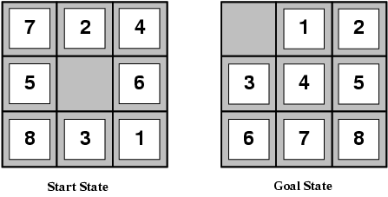
8-Puzzle
Slide the tiles horizontally or vertically into the empty space until the
configuration matches the goal configuration
What’s the branching factor?
(slide “empty space”)
About 3, depending on location of empty tile:
middle → 4; corner → 2; edge → 3
The average solution cost for a randomly generated 8-puzzle instance → about 22 steps
So, search space to depth 22 is about 3²² ≈ 3.1 × 10¹⁰ states.
Reduced to by a factor of about 170,000 by keeping track of repeated states
(9!/2 = 181,440 distinct states) note: 2 sets of disjoint states. See exercise 3.4
But: 15-puzzle → 10¹³ distinct states!
We’d better find a good heuristic
to speed up search! Can you suggest one?
Note: “Clever” heuristics now allow us to solve the 15-puzzle in
a few milliseconds!

Slide 53
Admissible heuristics
E.g., for the 8-puzzle:
h₁(n) = number of misplaced tiles
h₂(n) = total Manhattan distance
(i.e., no. of steps from desired location of each tile)
h₁(Start) = ?
h₂(Start) = ?
Why are heuristics admissible?
Which is better?
How can we get the optimal heuristics? (Given H_opt(Start) = 26. How would we find the next board on the optimal path to the goal?)
8
3+1+2+2+2+3+3+2 = 18
True cost = 26
Desired properties heuristics:
(1) consistent (admissible)
(2) As close to opt as we can get (sometimes go a bit over…)
(3) Easy to compute! We want to explore many nodes.
Note: each empty-square-move = 1 step tile move.

Slide 54
Comparing heuristics
Effective Branching Factor, b*
If A* generates N nodes to find the goal at depth d
b* = branching factor such that a uniform tree of depth d contains N+1 nodes (we add one for the root node that wasn’t included in N)
N+1 = 1 + b* + (b*)² + … + (b*)^{d}
E.g., if A* finds solution at depth 5 using 52 nodes, then the effective branching factor is 1.92.
b* close to 1 is ideal
because this means the heuristic guided the A* search is
closer to ideal (linear).
If b* were 100, on average, the heuristic had to consider 100 children for each node
Compare heuristics based on their b*

Slide 55
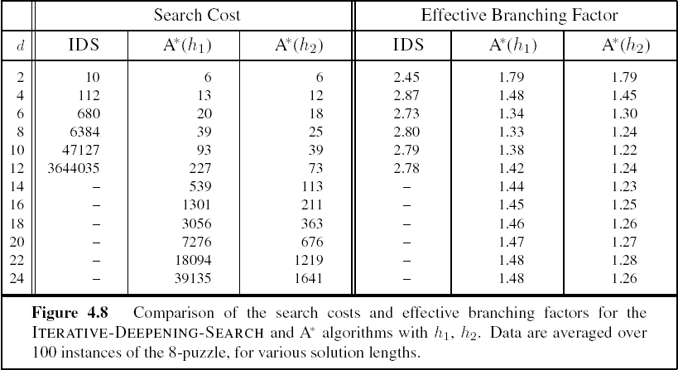
Comparison of heuristics
h2 indeed significantly better than h1
d – depth of goal node

Slide 56
Dominating heuristics
h₂ is always better than h₁
Because for any node, n, h₂(n) >= h₁(n). (Why?)
We say h₂ dominates h₁
It follows that h1 will expand at least as many nodes as h2.
Because:
Recall all nodes with f(n) < C* will be expanded.
This means all nodes, h(n) + g(n) < C*, will be expanded.
So, all nodes n where h(n) < C* - g(n) will be expanded
All nodes h₂ expands will also be expanded by h₁ and because h₁ is smaller, others may be expanded as well

Slide 57
Inventing admissible heuristics: Relaxed Problems
Can we generate h(n) automatically?
Simplify problem by reducing restrictions on actions
A problem with fewer restrictions on the actions is called a
relaxed problem

Slide 58
Examples of relaxed problems
Original: A tile can move from square A to square B iff
(1) A is horizontally or vertically adjacent to B and (2) B is blank
Relaxed versions:
A tile can move from A to B if A is adjacent to B (“overlap”; Manhattan distance)
A tile can move from A to B if B is blank (“teleport”)
A tile can move from A to B (“teleport and overlap”)
Key: Solutions to these relaxed problems can be computed without search
and therefore provide a heuristic that is easy/fast to compute.
This technique was used by ABSOLVER (1993) to invent heuristics for the 8-puzzle
better than existing ones and it also found a useful heuristic for famous Rubik’s
cube puzzle.

Slide 59
Inventing admissible heuristics: Relaxed Problems
The cost of an optimal solution to a relaxed problem is an admissible heuristic
for the original problem. Why?
1) The optimal solution in the original problem is also a solution to the relaxed problem (satisfying in addition all the relaxed constraints). So, the solution cost matches at most the original optimal solution.
2) The relaxed problem has fewer constraints. So, there may be other, less
expensive solutions, given a lower cost (admissible) relaxed solution.
What if we have multiple heuristics available? I.e., h_1(n), h_2(n), …
h(n) = max {h₁(n), h₂(n), …, h_{m}(n)}
If component heuristics are admissible so is the composite.

Slide 60
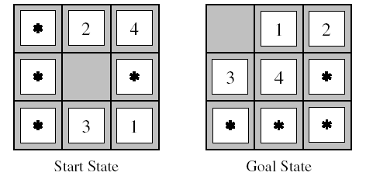
Inventing admissible heuristics: Sub-problem solutions as heuristic
What is the optimal cost of solving some portion of original problem?
subproblem solution is heuristic of original problem

Slide 61
Pattern Databases
Store optimal solutions to subproblems in database
We use an exhaustive search to solve every permutation of the 1,2,3,4-piece subproblem of the 8-puzzle
During solution of 8-puzzle, look up optimal cost to solve the 1,2,3,4-piece sub-problem and use as heuristic
Other configurations can be considered

Slide 62
Inventing admissible heuristics: Learning
Also automatically learning admissible heuristics
using machine learning techniques, e.g., inductive learning and reinforcement learning.
Generally, you try to learn a “state-evaluation” function or “board evaluation” function. (How desirable is state in terms of getting to the goal?) Key: What “features / properties” of state are most useful?
More later…
Notes:
Could also build pattern database while solving cases of the 8-puzzle
Must keep track of intermediate states and true final cost of solution
Inductive learning builds mapping of state features -> cost
Because too many permutations of actual states
Construct important features to reduce size of space

Slide 63
Memory problems with A*
A* is similar to breadth-first:
d = 1
A*
f1
Breadth-
first
d = 2
f2
d = 3
f3
d = 4
f4
Expand by depth-layers
Expands by f-contours
IDA* : Iterative Deepening A* (Korf 1985)
Use idea similar to Iterative Deepening DFS.
Slides adapted from Daniel de Schreye‘s

Slide 64
Iterative deepening A* (IDA*)
Depth-first
in each f-
contour
f1
Perform depth-first search LIMITED to some f-bound.
If goal found: ok.
Else: increase f-bound and restart.
Note: DFS does not need to “sort” the frontier nodes. All at f-bound value.
f2
f3
f4
How to establish the f-bounds?
- initially: f(S) (S – start node)
generate all successors
record the minimal f(succ) > f(S)
Continue with minimal f(succ) instead of f(S)

Slide 65
Example [check at home]
f-limited, f-bound = 100
f-new = 120
S
f=100
A
f=120
B
f=130
C
f=120
D
f=140
G
f=125
E
f=140
F
f=125

Slide 66
f-limited, f-bound = 120
f-new = 125
S
f=100
A
f=120
B
f=130
C
f=120
D
f=140
G
f=125
E
f=140
F
f=125

Slide 67
f-limited, f-bound = 125
S
f=100
A
f=120
B
f=130
C
f=120
D
f=140
G
f=125
E
f=140
F
f=125
SUCCESS

Slide 68
Properties: practical
If there are only a reduced number of different contours:
IDA* is one of the very best optimal state-space search techniques!
Example: the 15-puzzle
Also for many other practical problems
Else, the gain of the extended f-contour is not sufficient to compensate recalculating the previous parts. Do:
increase f-bound by a fixed number ε at each iteration:
effects: less re-computations, BUT: optimality is lost: obtained solution can deviate up to ε
Can be remedied by completing the search at this layer
Issue: finding goal state potentially “too early” in final
layer, without having the optimal path. (Consider
“Bucharest” twice on frontier; but we don’t keep full frontier
in memory, with DFS.)

Slide 69
Summary
Uninformed search:
(1) Breadth-first search (2) Uniform-cost search
(3) Depth-first search (4) Depth-limited search
(5) Iterative deepening search (6) Bidirectional search
Informed search:
Greedy Best-First
A*
(3) IDA*
To be added: Current state-of-the-art:
Heuristic search planners.

Slide 70
Summary, cont.
Heuristics allow us to scale up solutions dramatically!
Can now search combinatorial (exponential size) spaces with
easily 10^15 states and even up to 10^100 or more states.
Especially, in modern heuristics search planners (eg FF).
Before informed search, considered totally infeasible.
Still many variations and subtleties:
There are conferences and journals dedicated solely to search.
Lots of variants of A*. Research in A* has increased
dramatically since A* is the key algorithm used by map engines.
Also used in path planning algorithms (autonomous vehicles), and general
(robotics) planning, problem solving, and even NLP parsing.

