Slide 1
CS 4700: Foundations of Artificial Intelligence
Prof. Bart Selman
selman@cs.cornell.edu
Machine Learning:
Neural Networks
R&N 18.7

Slide 2
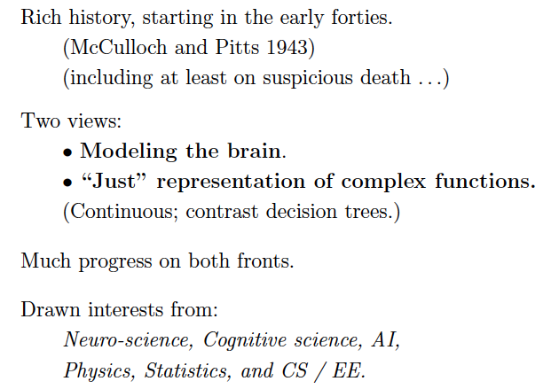

Slide 3
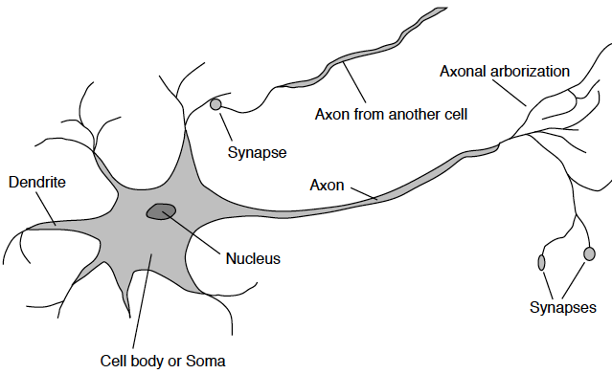

Slide 4
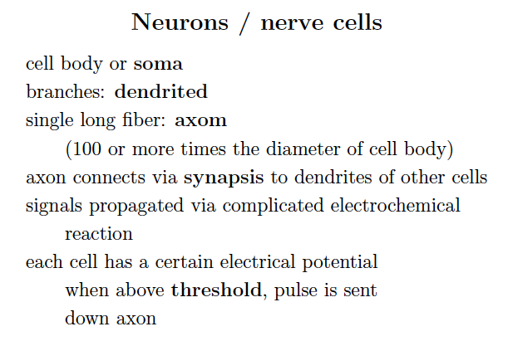

Slide 5
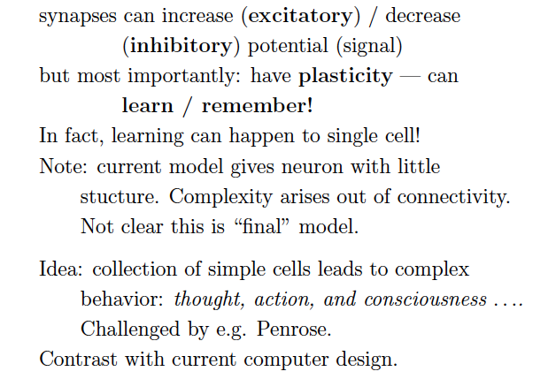

Slide 6
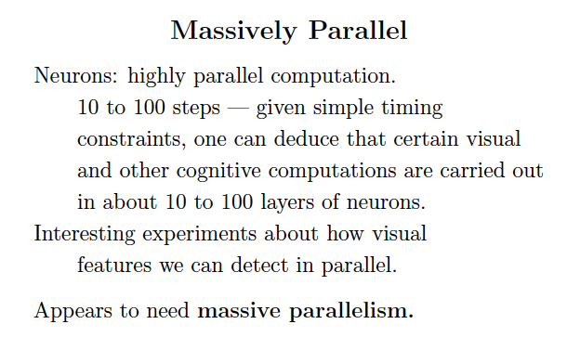

Slide 8
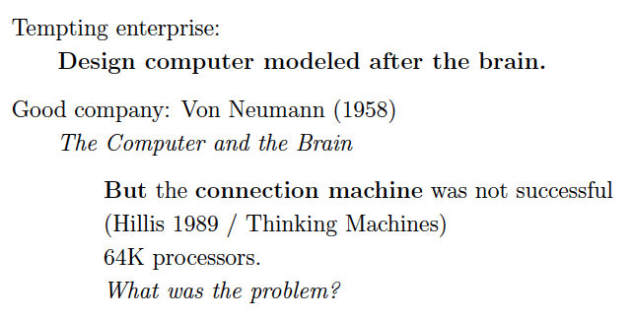

Slide 9
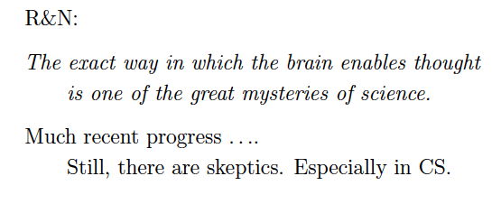

Slide 10
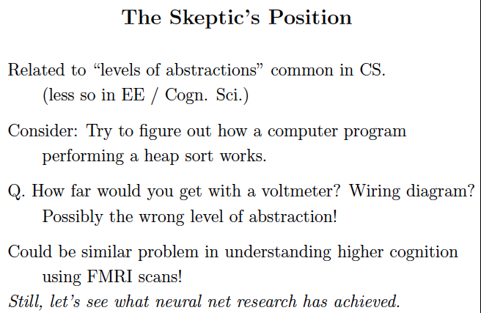

Slide 11
New York Times: “Scientists See Promise in Deep-Learning
Programs,” Saturday, Nov. 24, front page.
http://www.nytimes.com/2012/11/24/science/scientists-see-advances-in-deep-learning-a-part-of-artificial-intelligence.html?hpw
Multi-layer neural networks, a resurgence!
Winner one of the most recent learning competitions
Automatic (unsupervised) learning of “cat” and “human face” from 10 million of Google images; 16,000 cores 3 days; multi-layer neural network (Stanford & Google).
Speech recognition and real-time translation (Microsoft Research, China).
Aside: see web site for great survey article
“A Few Useful Things to Know About
Machine Learning” by Domingos, CACM, 2012.

Slide 12
Start at min. 3:00. Deep Neural Nets in speech recognition.

Slide 13
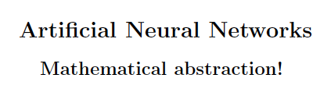

Slide 14
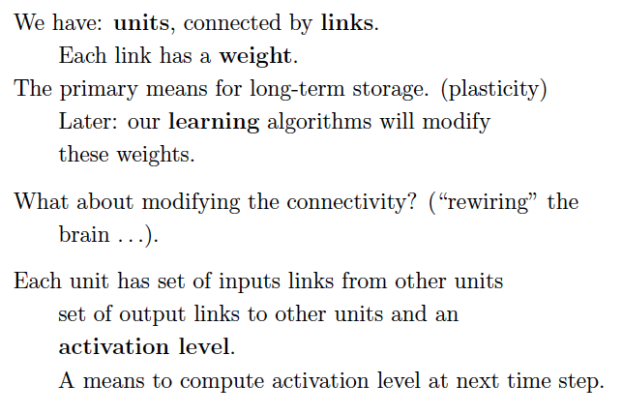

Slide 15
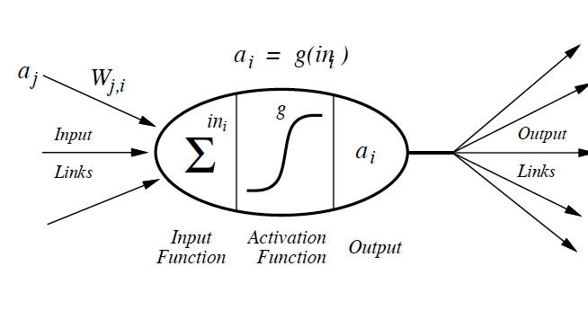

Slide 16
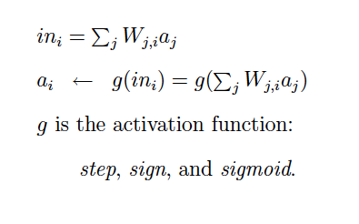

Slide 17
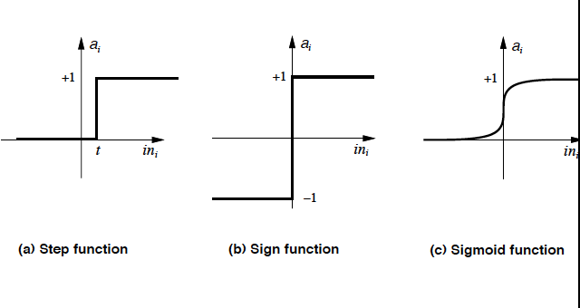

Slide 18
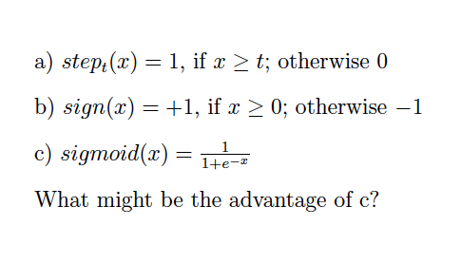

Slide 19
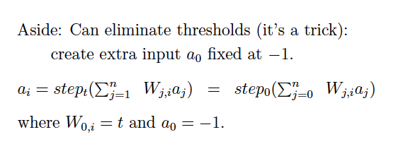

Slide 22
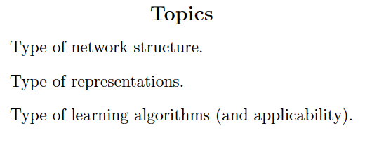

Slide 23
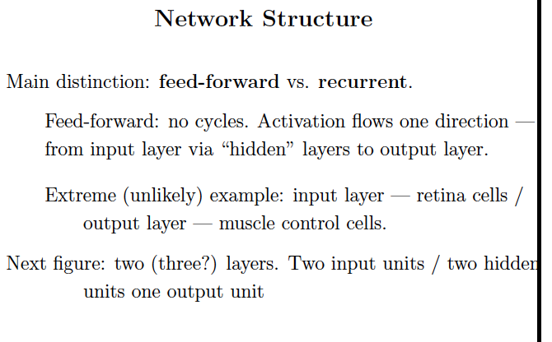

Slide 24
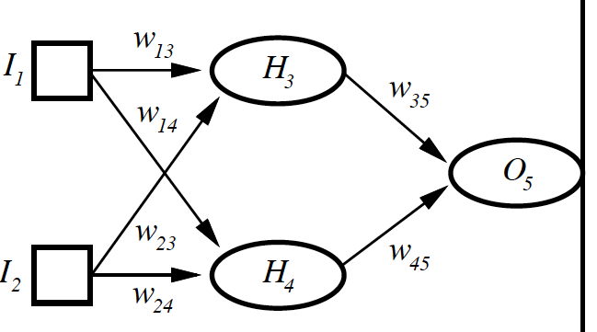

Slide 26
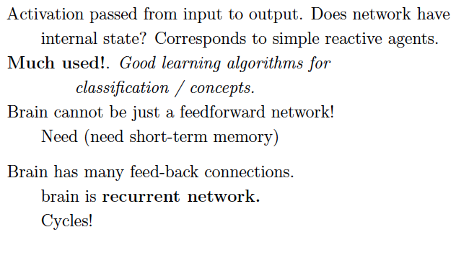

Slide 27
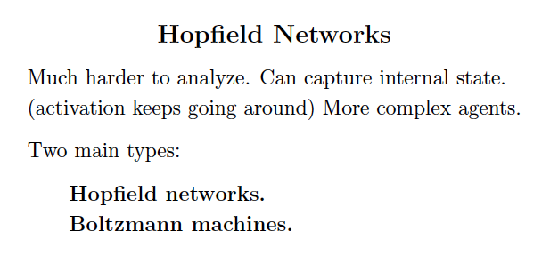

Slide 28
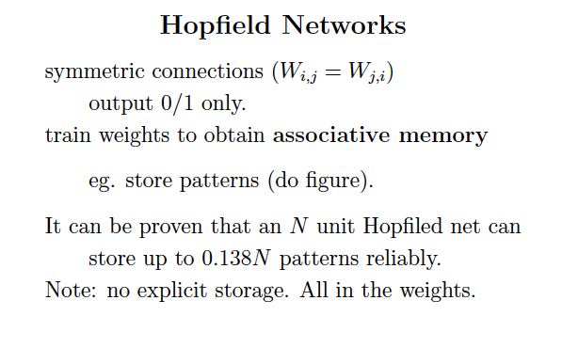

Slide 29
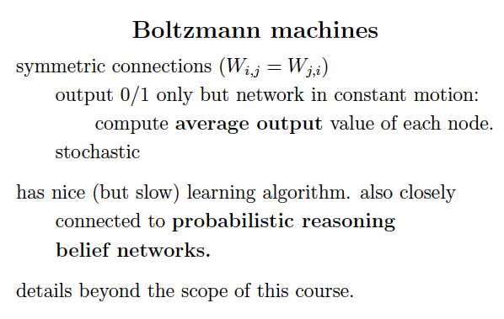

Slide 30
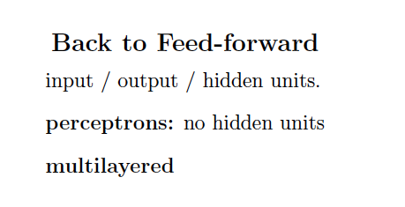

Slide 31
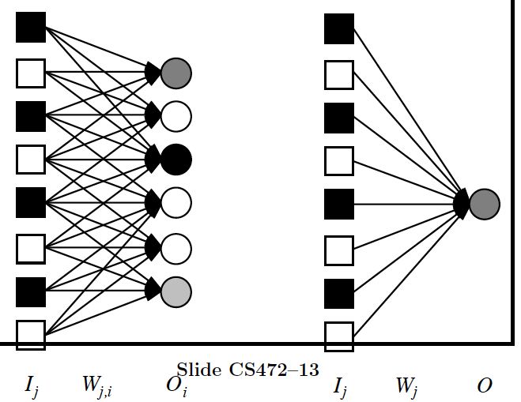

Slide 32
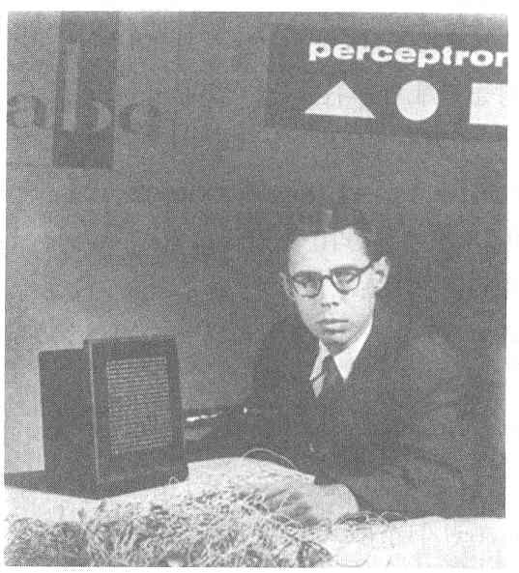
Perceptron
Perceptron
Invented by Frank Rosenblatt in 1957 in an attempt to understand human memory, learning, and cognitive processes.
The first neural network model by computation, with a remarkable learning algorithm:
If function can be represented by perceptron, the learning algorithm is guaranteed to quickly converge to the hidden function!
Became the foundation of pattern recognition research
Cornell Aeronautical Laboratory
One of the earliest and most influential neural networks:
An important milestone in AI.
Rosenblatt &
Mark I Perceptron:
the first machine that could "learn" to recognize and identify optical patterns.
Notes:
Perceptron invented by Frank Rosenblatt in 1957.
When perceptron was first introduced, this issue created considerable sensation.
Perceptron was the first neural network modeled by correct computation and affected many fields.
Perceptron also became the foundation of pattern recognition research.
<사진>
This guy is Frank Rosenblatt inventor of perceptron.
And this one is Mark ⅠPerceptron image sensor that is the first neural network equipment.

Slide 33
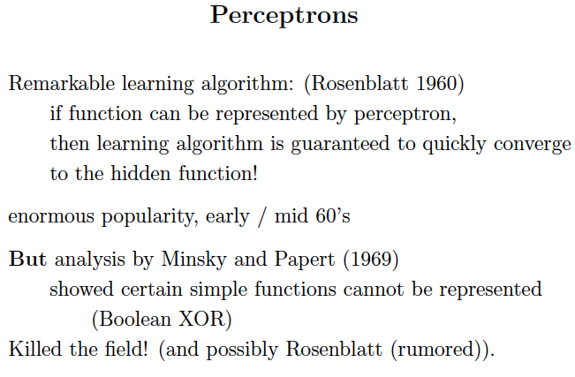

Slide 34
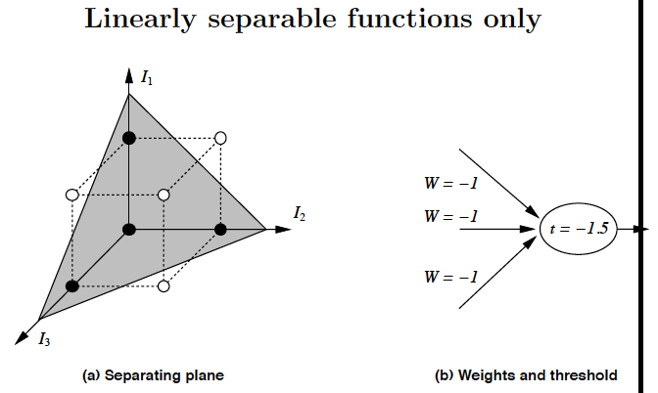

Slide 35
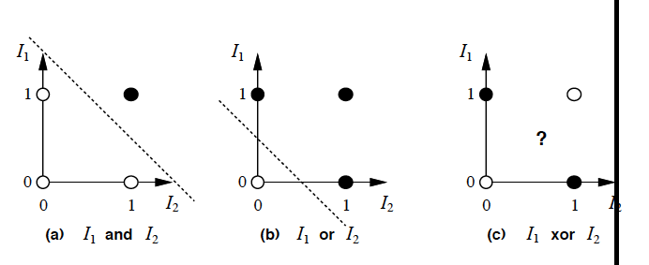

Slide 36
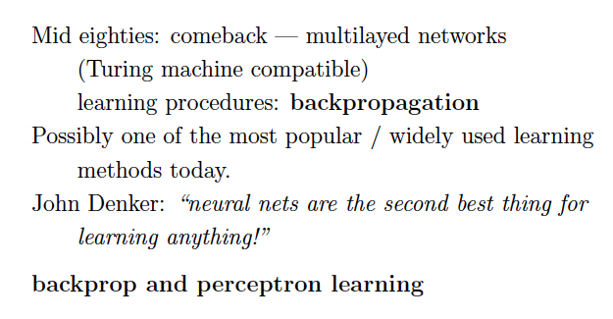
Update: or perhaps the best!

Slide 37
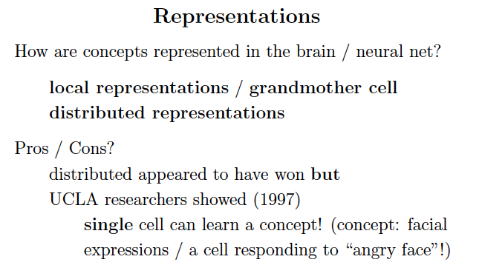

Slide 38
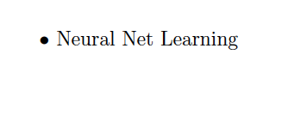

Slide 41
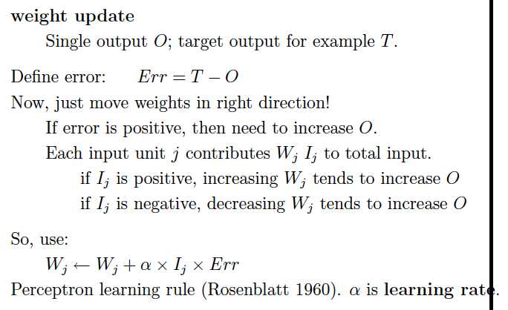

Slide 42
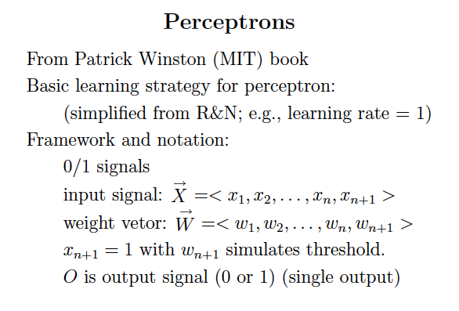

Slide 43
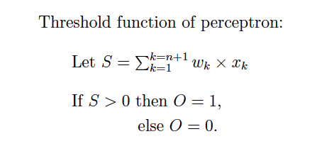

Slide 44
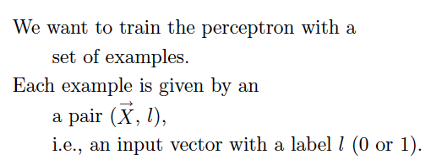

Slide 45
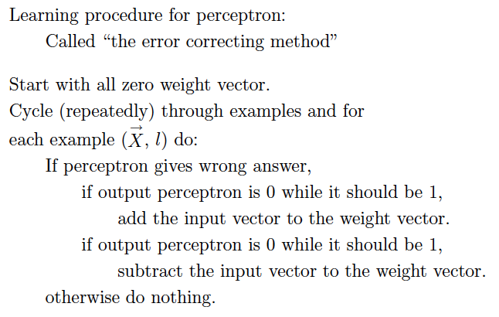
1
0,

Slide 46
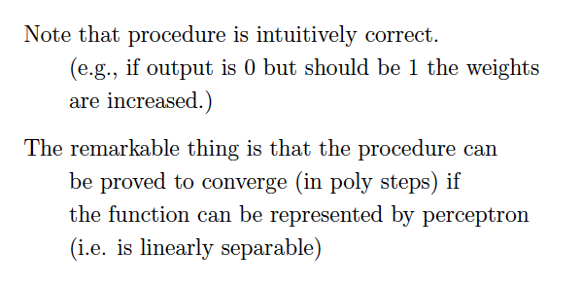

Slide 47
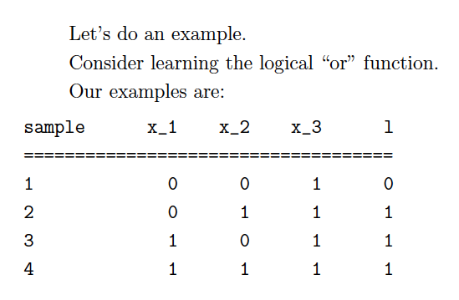
Note: x_3 input fixed at 1 to model threshold. Side benefit: no total 0 input.

Slide 48
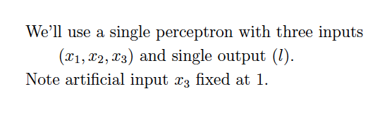

Slide 49
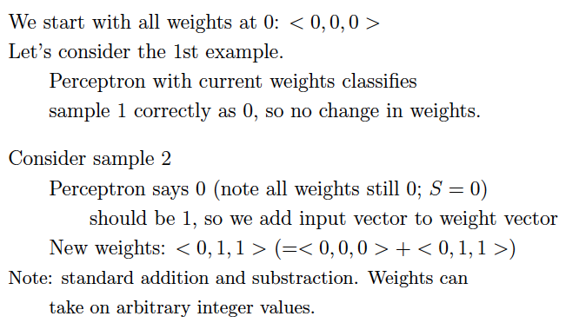

Slide 50
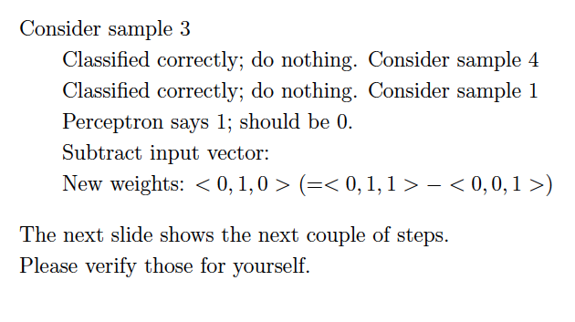

Slide 51
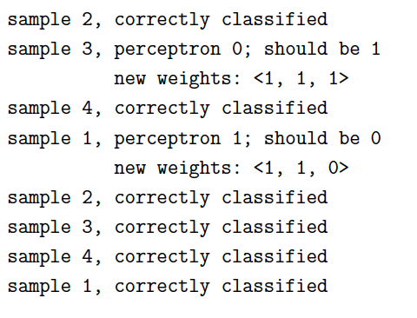

Slide 52
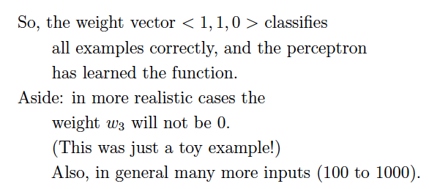
Always works, if inputs are linearly separable!
Single layer of units.
What about multi-layer NNs? No known
learning method until early 80s…

Slide 53
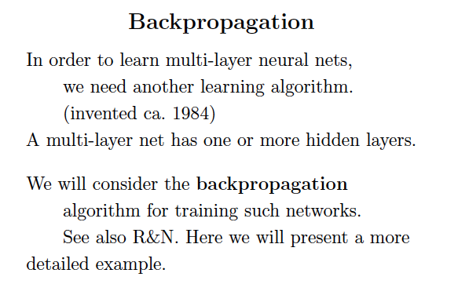

Slide 55
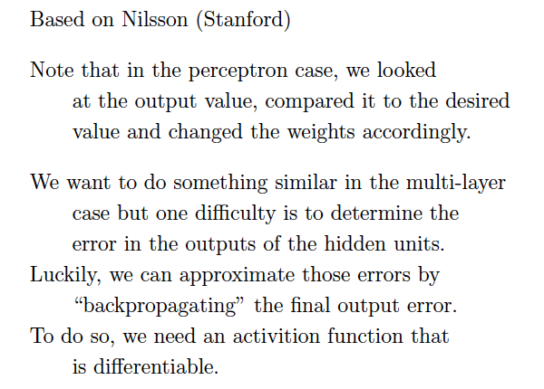

Slide 56
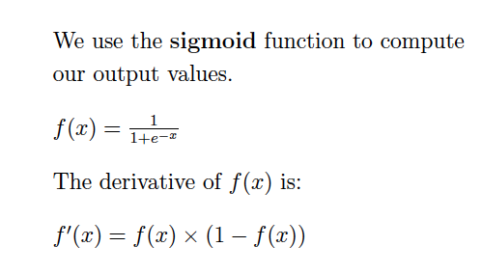

Slide 57
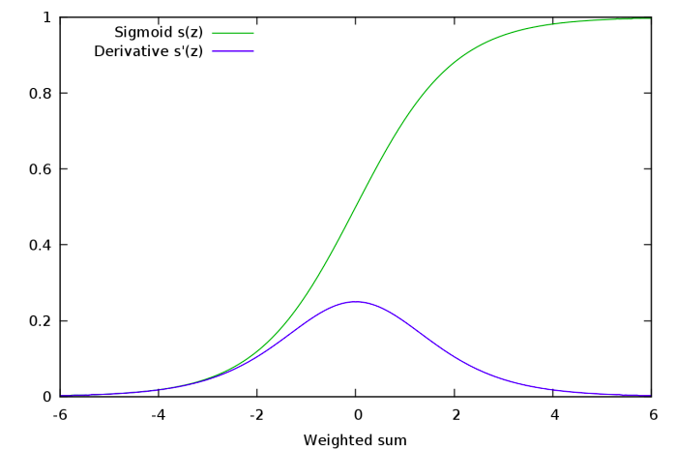
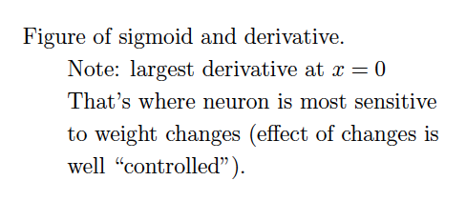

Slide 58
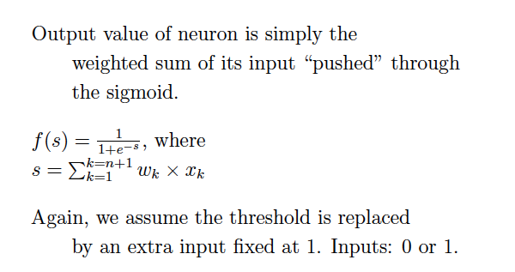

Slide 59
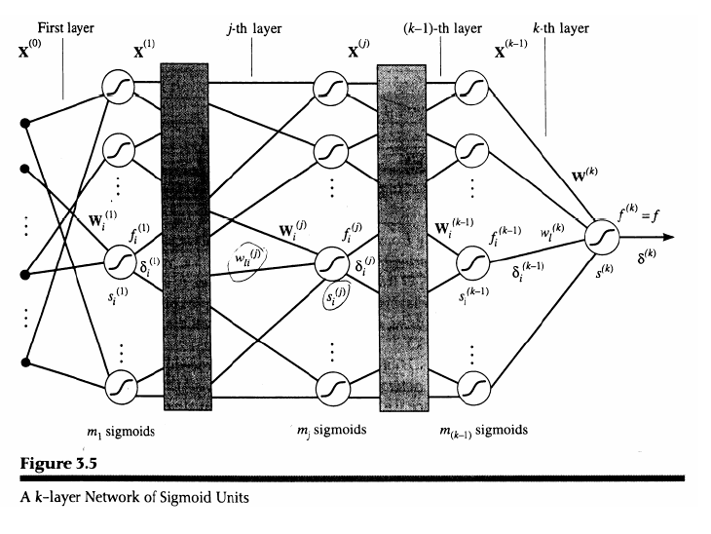

Slide 65
It’s “just” multivariate (or multivariable) calculus.

Slide 69
So, first we “backpropagate” the error
signal, and then we update the weights, layer
by layer.
That’s why it’s called “backprop learning.”
Now changing speech recognition, image
recognition etc.!

Slide 71
Trace example at home!

Slide 80
Summary ☺
A tour of AI:
AI
--- motivation
--- intelligent agents
II) Problem-Solving
--- search techniques
--- adversarial search
--- constraint satisfaction

Slide 81
Summary, cont. ☺
III) Knowledge Representation and Reasoning
--- logical agents
--- first-order logic and inference
Learning
--- from examples
--- decision tree learning (info gain)
--- PAC learning
--- neural networks
The field has grown (and continues to grow) exponentially but you
have now seen a good part!
Have a great winter break!!!!

