Slide 1
Exploring convnet architectures

Slide 2
Deeper is better
7 layers
16 layers

Slide 3
Deeper is better
Alexnet
VGG16

Slide 4
The VGG pattern
Every convolution is 3x3, padded by 1
Every convolution followed by ReLU
ConvNet is divided into “stages”
  Layers within a stage: no subsampling
  Subsampling by 2 at the end of each stage
Layers within stage have same number of channels
Every subsampling → double the number of channels

Slide 5
Example network
5
5
10
10
20
20

Slide 6
Deeper is better
Can we go deeper?
Alexnet
VGG16

Slide 7
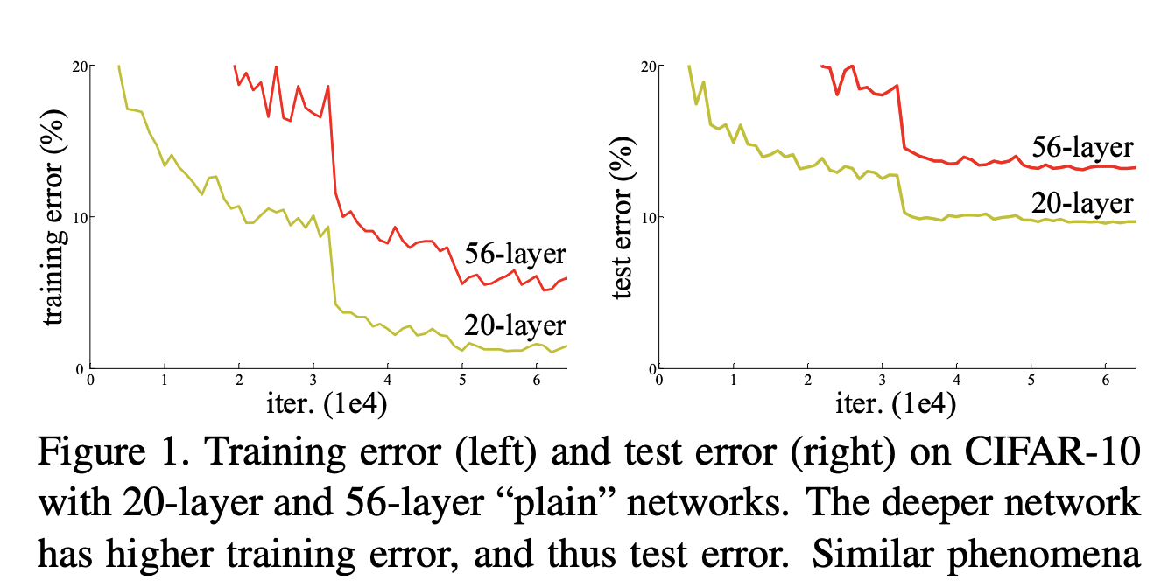
Is deeper better?

Slide 8
Challenges in training: exploding / vanishing gradients
Vanishing / exploding gradients
  If each term is (much) greater than 1 → explosion of gradients
  If each term is (much) less than 1 → vanishing gradients

Slide 9
Challenges in training: noisy gradients
Vanishing / exploding gradients
Gradient for i-th layer depends on all subsequent layers
But subsequent layers are initially random
  Implies noisy gradients for earlier layers

Slide 10
Residual connections
Instead of:
We will have:

Slide 11
With and without residual connections
Without residual connections
With residual connections
Noisy

Slide 12
Residual block
Conv + ReLU
Conv+ReLU

Slide 13
Residual connections
Assumes all z_{i} have the same size
True within a stage
Across stages?
  Doubling of feature channels
  Subsampling
Increase channels by 1x1 convolution
Decrease spatial resolution by subsampling

Slide 14
The ResNet pattern
Decrease resolution substantially in first layer
  Reduces memory consumption due to intermediate outputs
Divide into stages
  maintain resolution, channels in each stage
  halve resolution, double channels between stages
Divide each stage into residual blocks
At the end, compute average value of each channel to feed linear classifier

Slide 15
Putting it all together - Residual networks

Slide 16
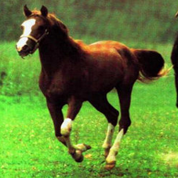
Transfer learning with convolutional networks
Linear classifier
Horse
Trained feature extractor

Slide 17
Transfer learning with convolutional networks
What do we do for a new image classification problem?
Key idea:
  Freeze parameters in feature extractor
  Retrain classifier
Linear classifier
Trained feature extractor

Slide 18
Transfer learning with convolutional networks
Dataset | Best Non-Convnet perf | Pretrained convnet + classifier | Improvement
Caltech 101 | 84.3 | 87.7 | +3.4
VOC 2007 | 61.7 | 79.7 | +18
CUB 200 | 18.8 | 61.0 | +42.2
Aircraft | 61.0 | 45.0 | -16
Cars | 59.2 | 36.5 | -22.7

Slide 19
Why transfer learning?
Availability of training data
Computational cost
Ability to pre-compute feature vectors and use for multiple tasks
Con: NO end-to-end learning

Slide 20
Finetuning
Horse

Slide 21
Finetuning
Bakery
Initialize with pre-trained, then train with low learning rate

Slide 22
Finetuning
Dataset | Best Non-Convnet perf | Pretrained convnet + classifier | Finetuned convnet | Improvement
Caltech 101 | 84.3 | 87.7 | 88.4 | +4.1
VOC 2007 | 61.7 | 79.7 | 82.4 | +20.7
CUB 200 | 18.8 | 61.0 | 70.4 | +51.6
Aircraft | 61.0 | 45.0 | 74.1 | +13.1
Cars | 59.2 | 36.5 | 79.8 | +20.6

