Slide 1
Feature descriptors and matching

Slide 2
The SIFT Descriptor Pipeline
Scale and rotation invariance as before:
  Find dominant orientation and rotate till orientation is along X (say)
  Use scale output by corner detector to crop patch of appropriate size
Divide into cells and construct orientation histograms per cell

Slide 3
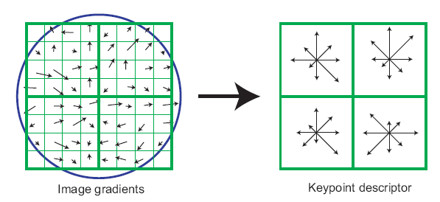
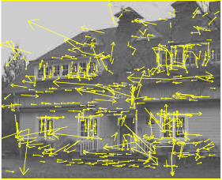
The SIFT descriptor
SIFT – Lowe IJCV 2004
Notes:
Do scale-space invariant feature detection using DoG.

Slide 4

Multiple modes when measuring dominant orientation
0
$$π$$

Slide 5
Linear interpolation into orientation grid
A
Blue arrows are centers of orientation bin
Pixel with red orientation contributes to:
  Histogram A with weight q
  Histogram B with weight p
B
p
q

Slide 6
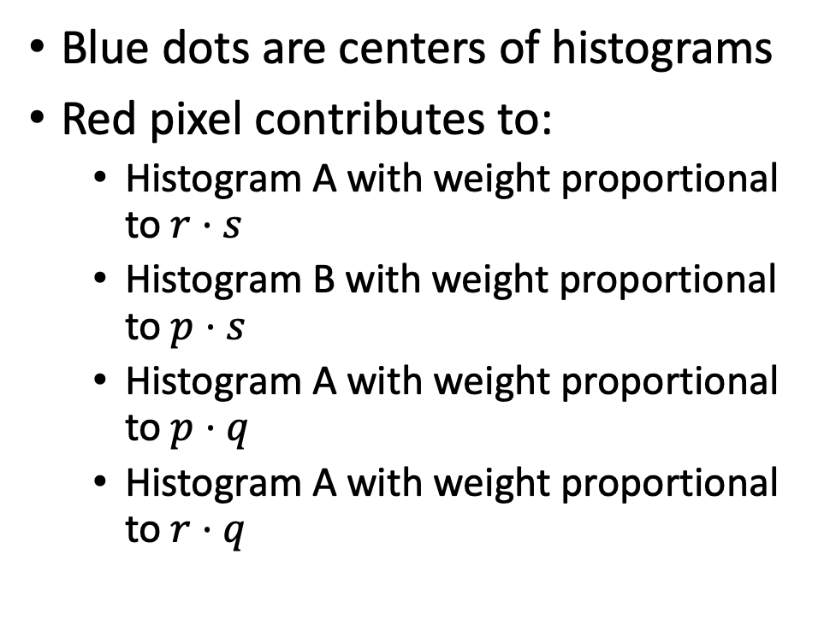
Bilinear interpolation into spatial grid cells
Blue dots are centers of histograms
Red pixel contributes to:
  Histogram A with weight proportional to $r⋅s$
  Histogram B with weight proportional to $p⋅s$
  Histogram A with weight proportional to $p⋅q$
  Histogram A with weight proportional to $r⋅q$
A
B
q
p
r
s
D
C

Slide 7
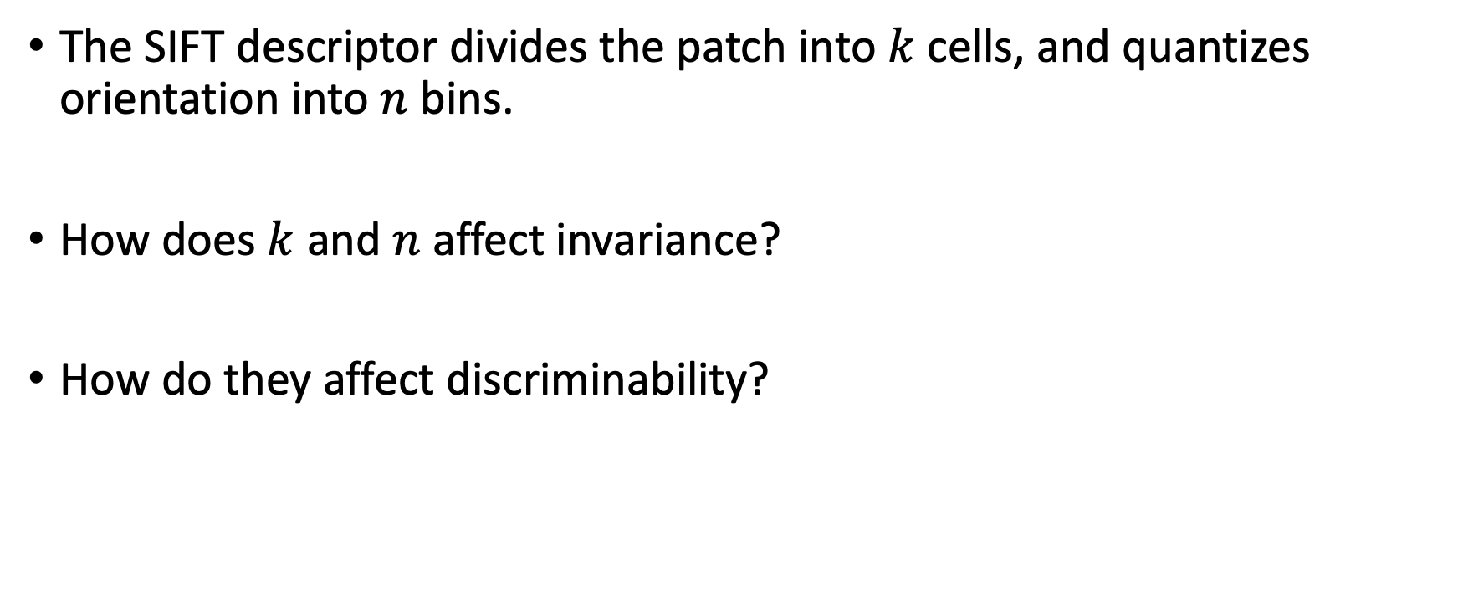
Question
The SIFT descriptor divides the patch into $k$ cells, and quantizes orientation into $n$ bins.
How does $k$ and $n$ affect invariance?
How do they affect discriminability?

Slide 8
Feature matching
Given a feature in I₁, how to find the best match in I₂?
  Define distance function that compares two descriptors
  Test all the features in I₂, find the one with min distance

Slide 9
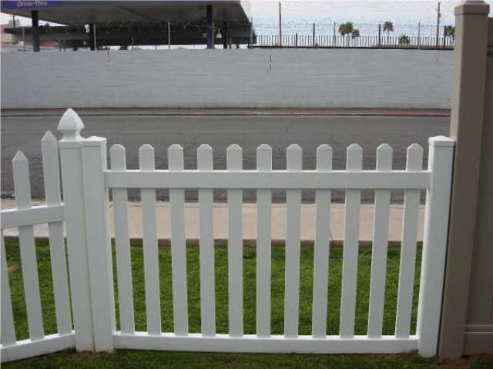
Feature distance
How to define the difference between two features f₁, f₂?
  Simple approach: L₂ distance, ||f₁ - f₂ ||
  can give good scores to ambiguous (incorrect) matches
f₁
f₂
I₁
I₂

Slide 10
Feature distance
How to define the difference between two features f₁, f₂?
  Better approach: ratio distance = ||f₁ - f₂ || / || f₁ - f₂’ ||
    f₂ is best SSD match to f₁ in I₂
    f₂’ is 2nd best SSD match to f₁ in I₂
    gives large values for ambiguous matches
f₁
f₂'
f₂
I₁
I₂

Slide 11
Geometry of Image Formation

Slide 12
The pinhole camera
Let’s abstract out the details

Slide 13
The pinhole camera
We don’t care about the other walls of the box, so let’s remove those

Slide 14
The pinhole camera
Let’s look at a individual points in the world and not worry about what they are.

Slide 15
The pinhole camera
Y
P = (X,Y,Z)
p = (x,y)
Z
O
Z=-1
X
Let’s place the origin at the pinhole, with Z axis pointing away from the screen (called camera plane)

Slide 16
The pinhole camera
Y
P = (X,Y,Z)
p = (x,y)
Z
O
Z=-1
X
Let’s remove the wall with the pinhole: all we care about is that all light rays of interest must pass through the pinhole, i.e., the origin

Slide 17
The pinhole camera
Y
P = (X,Y,Z)
p = (x,y)
Z
O
Z=-1
X
Question: Where will we see the “image” of point P on the camera plane?

Slide 18

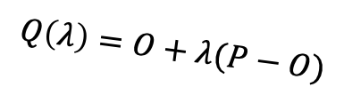
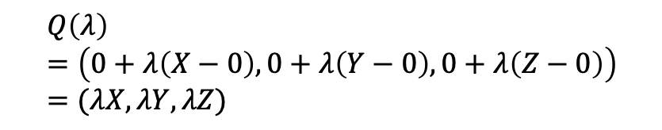

The pinhole camera
Y
P = (X,Y,Z)
$$Q\left(λ\right)=O+λ(P−O)$$
p = (x,y)
Z
O
$$λ=0⇒Q\left(λ\right)=O$$
$$λ=1⇒Q\left(λ\right)=P$$
Z=-1
X
$$Q\left(λ\right)=\left(0+λ\left(X−0\right), 0+λ\left(Y−0\right), 0+λ\left(Z−0\right)\right)=(λX, λY, λZ)$$

Slide 19
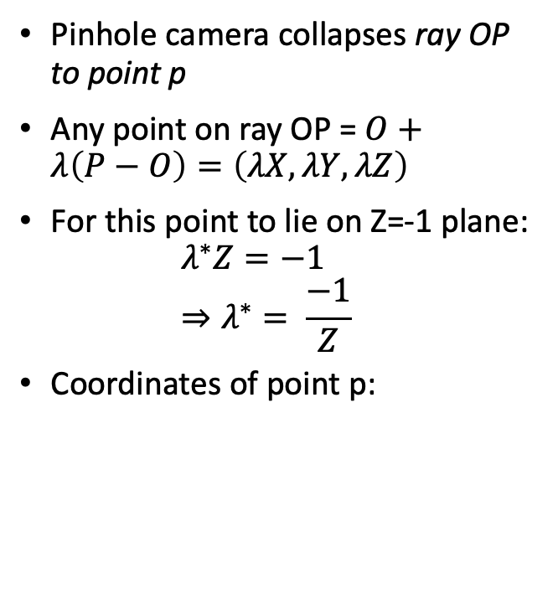
The pinhole camera
Pinhole camera collapses ray OP to point p
Any point on ray OP = $O+λ\left(P−O\right)=\left(λX, λY, λZ\right)$
For this point to lie on Z=-1 plane:
$λ^{∗}Z=−1$
$⇒λ^{∗}= \frac{−1}{Z}$
Coordinates of point p:
Y
p = (x,y)
P = (X,Y,Z)
Z
O
Z=-1
X

Slide 20
The projection equation
A point P = (X, Y, Z) in 3D projects to a point p = (x,y) in the image
But pinhole camera’s image is inverted, invert it back!

Slide 21
Another derivation
P = (X,Y,Z)
Y
1
O
Z
y
p = (x,y,z)

Slide 22
A virtual image plane
A pinhole camera produces an inverted image
Imagine a ”virtual image plane” in the front of the camera
P
P
Y
Y
y
1
Z
O
y
1
O
Z

Slide 23
The projection equation

Slide 24
Consequence 1: Farther away objects are smaller
(X, Y + h, Z)
(X, Y, Z)
Image of foot:
Image of head:

Slide 25
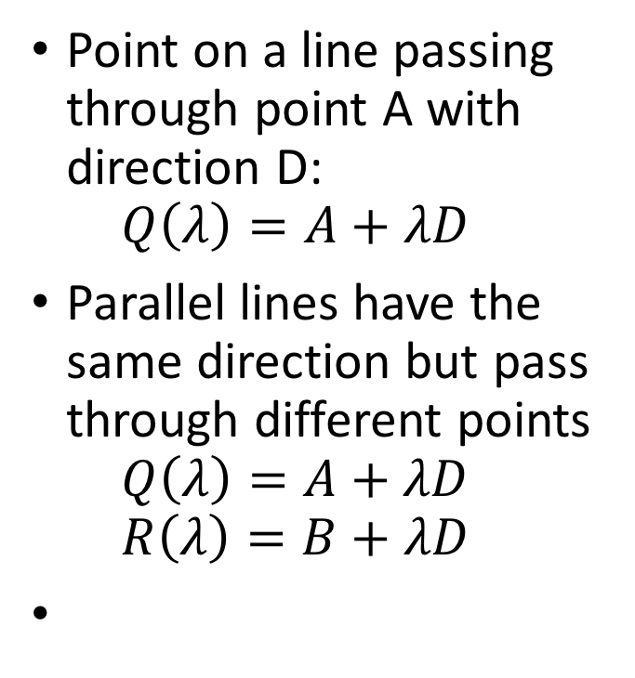
Consequence 2: Parallel lines converge at a point
Point on a line passing through point A with direction D:
$Q\left(λ\right)=A+λD$
Parallel lines have the same direction but pass through different points
$Q\left(λ\right)=A+λD$
$R\left(λ\right)=B+λD$

Slide 26
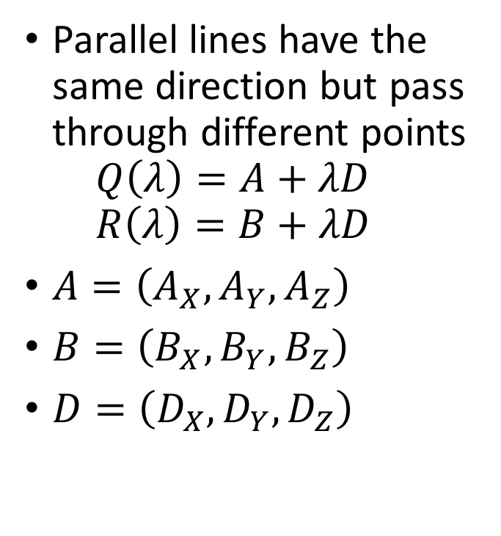
Consequence 2: Parallel lines converge at a point
Parallel lines have the same direction but pass through different points
$Q\left(λ\right)=A+λD$
$R\left(λ\right)=B+λD$
$A=\left(A_{X}, A_{Y}, A_{Z}\right)$
$B=\left(B_{X},B_{Y},B_{Z}\right)$
$D=\left(D_{X},D_{Y},D_{Z}\right)$

Slide 27
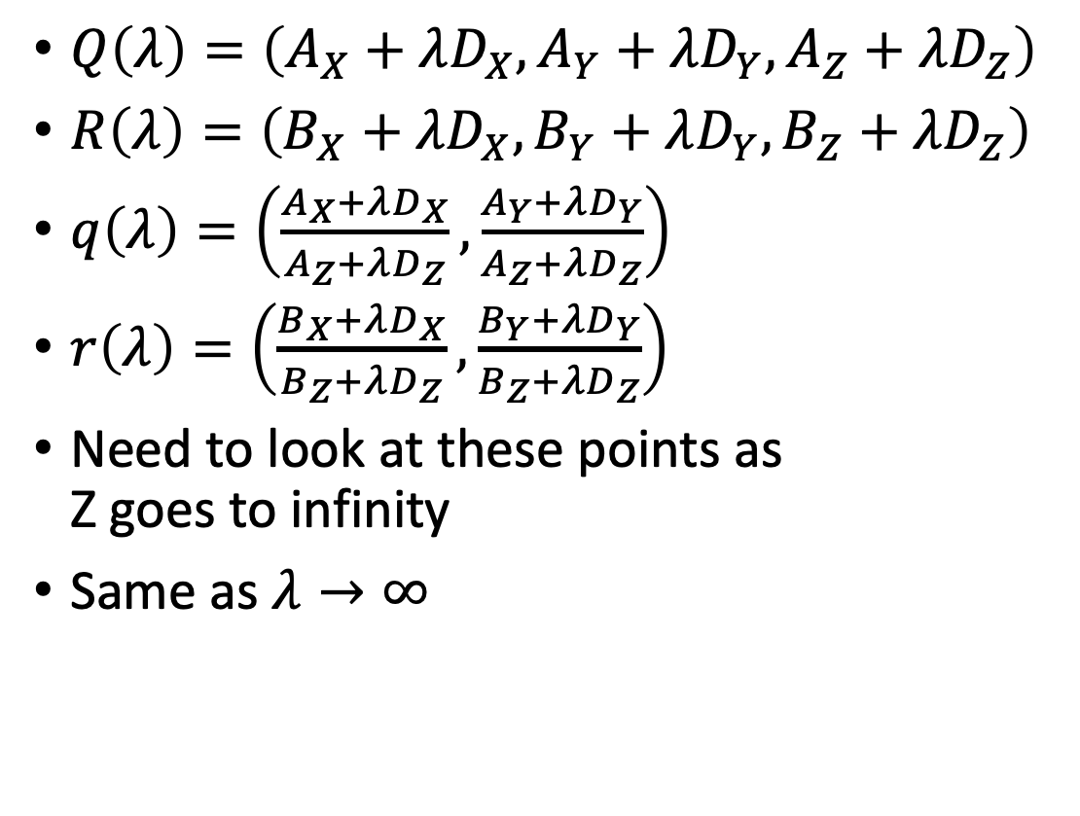
Consequence 2: Parallel lines converge at a point
$Q\left(λ\right)=\left(A_{X}+λD_{X}, A_{Y}+λD_{Y}, A_{Z}+λD_{Z}\right)$
$R\left(λ\right)=\left(B_{X}+λD_{X}, B_{Y}+λD_{Y}, B_{Z}+λD_{Z}\right)$
$q\left(λ\right)=\left(\frac{A_{X}+λD_{X}}{A_{Z}+λD_{Z}}, \frac{A_{Y}+λD_{Y}}{A_{Z}+λD_{Z}}\right)$
$r\left(λ\right)=\left(\frac{B_{X}+λD_{X}}{B_{Z}+λD_{Z}}, \frac{B_{Y}+λD_{Y}}{B_{Z}+λD_{Z}}\right)$
Need to look at these points as
Z goes to infinity
Same as $λ→∞$

Slide 28
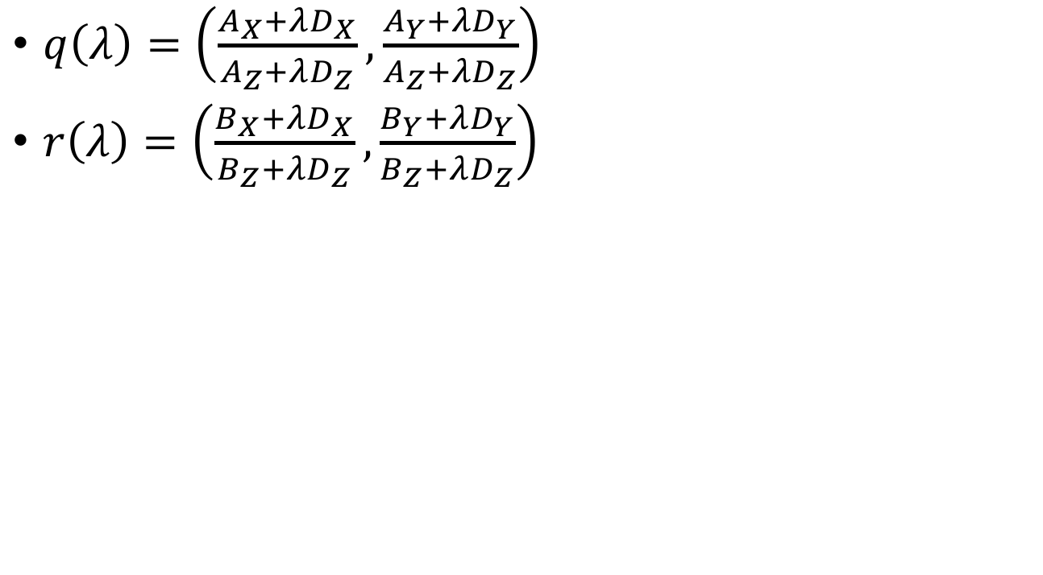
Consequence 2: Parallel lines converge at a point
$q\left(λ\right)=\left(\frac{A_{X}+λD_{X}}{A_{Z}+λD_{Z}}, \frac{A_{Y}+λD_{Y}}{A_{Z}+λD_{Z}}\right)$
$r\left(λ\right)=\left(\frac{B_{X}+λD_{X}}{B_{Z}+λD_{Z}}, \frac{B_{Y}+λD_{Y}}{B_{Z}+λD_{Z}}\right)$

Slide 29
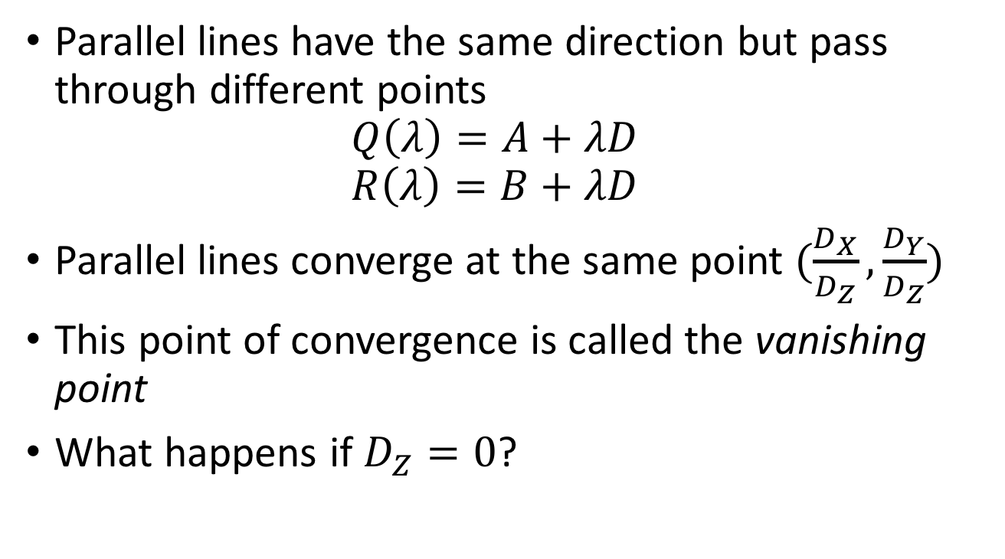
Consequence 2: Parallel lines converge at a point
Parallel lines have the same direction but pass through different points
$Q\left(λ\right)=A+λD$
$R\left(λ\right)=B+λD$
Parallel lines converge at the same point $(\frac{D_{X}}{D_{Z}},\frac{D_{Y}}{D_{Z}})$
This point of convergence is called the vanishing point
What happens if $D_{Z}=0$?

Slide 30
Consequence 2: Parallel lines converge at a point

Slide 31
What about planes?
Vanishing line of a plane
Take the limit as Z approaches infinity

Slide 32
What about planes?
Normal: (N_{X}, N_{Y}, N_{Z})
What do parallel planes look like?
Vanishing lines
Parallel planes converge!

Slide 33
Vanishing line
What happens if N_{X} = N_{Y} = 0?
Equation of the plane: Z = c
Vanishing line?

Slide 34
Changing coordinate systems
Y
Y
P = (X,Y,Z)
Z
O
O’
X
X
Z

Slide 35
Changing coordinate systems
Y
Y
Z
O’
X
X
Z

Slide 36
Changing coordinate systems
Y
Y
Z
O’
X
Z
X

Slide 37
Changing coordinate systems
Y
Y
Z
O’
X
Z
X

Slide 38
Changing coordinate systems
Y
Y
Z
O’
X
Z
X

Slide 39
Changing coordinate systems
Y
Y
Z
O’
X
Z
X

Slide 40
Rotations and translations
How do you represent a rotation?
A point in 3D: (X,Y,Z)
Rotations can be represented as a matrix multiplication
What are the properties of rotation matrices?

Slide 41
Properties of rotation matrices
Rotation does not change the length of vectors

Slide 42
Properties of rotation matrices
Rotation
Reflection

Slide 43
Rotation matrices
Rotations in 3D have an axis and an angle
Axis: vector that does not change when rotated
Rotation matrix has eigenvector that has eigenvalue 1

Slide 44

Rotation matrices from axis and angle
Rotation matrix for rotation about axis $v$ and $θ$
First define the following matrix
Interesting fact: this matrix represents cross product

Slide 45
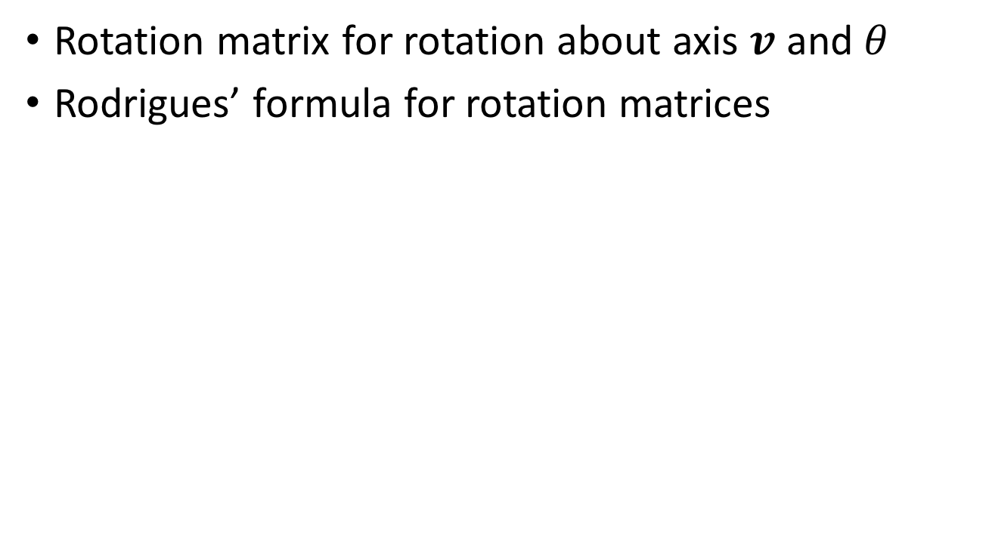
Rotation matrices from axis and angle
Rotation matrix for rotation about axis $v$ and $θ$
Rodrigues’ formula for rotation matrices

Slide 46
Translations
Can this be written as a matrix multiplication?

Slide 47
Putting everything together
Change coordinate system so that center of the coordinate system is at pinhole and Z axis is along viewing direction
Perspective projection

