Slide 1
Feature descriptors and matching

Slide 2
Basic correspondence
Image patch as descriptor, NCC as similarity
Invariant to?
  Photometric transformations?
  Translation?
  Rotation?
  Scaling?

Slide 3

Rotation invariance for feature descriptors
Find dominant orientation of the image patch
  This is given by x_{max}, the eigenvector of M corresponding to λ_{max} (the larger eigenvalue)
  Rotate the patch according to this angle
  Figure: line represents x_{max}, box represents patch we take as feature descriptor
Figure by Matthew Brown

Slide 4
Scale invariance for feature descriptors
Recall that corner detector searches over scales for maximum response: record scale which gives maximum response
Use a patch of the same scale, then resize it to a fixed size

Slide 5

Multiscale Oriented PatcheS descriptor
Take 40x40 oriented square window around detected feature at appropriate scale
Scale to 1/5 size (using prefiltering)
Rotate to horizontal
Sample 8x8 square window centered at feature
Intensity normalize the window by subtracting the mean, dividing by the standard deviation in the window
40 pixels
8 pixels
Adapted from slide by Matthew Brown

Slide 6
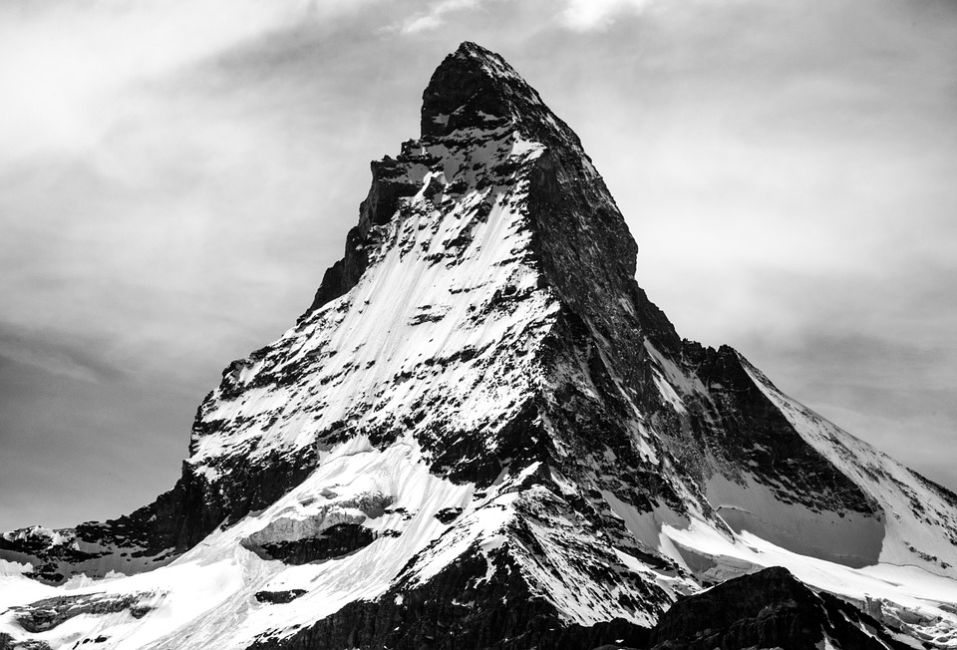
Multiscale Oriented PatcheS descriptor
Describe a corner by the patch around that pixel
Scale invariance by using scale identified by corner detector
Rotation invariance by using orientation identified by corner detector
Photometric invariance by subtracting mean and dividing by standard deviation

Slide 7
Multiscale Oriented PatcheS descriptor
Take 40x40 square window around detected feature at the right scale
Scale to 1/5 size (using prefiltering)
Rotate to horizontal
Sample 8x8 square window centered at feature
Intensity normalize the window by subtracting the mean, dividing by the standard deviation in the window
40 pixels
8 pixels
Adapted from slide by Matthew Brown

Slide 8
MOPS descriptor
You can combine transformations together to get the final transformation
x
T = ?
y
Notes:
Pass this transformation matrix to cv2.warpAffine

Slide 9
Translate
x
y
T = M_{T1}

Slide 10
Rotate
x
y
T = M_{R}M_{T1}

Slide 11
Scale
x
y
T = M_{S}M_{R}M_{T1}

Slide 12
Translate
x
y
T = M_{T2}M_{S}M_{R}M_{T1}

Slide 13

Crop
x
y
Notes:
cv2.warpAffine also takes care of the cropping

Slide 14
MOPS

Slide 15
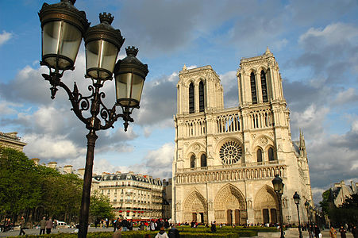
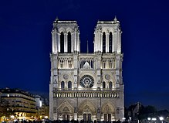
Color and Lighting
MOPS invariant to additive and multiplicative changes to intensity
But what about more sophisticated changes to intensity?

Slide 16
Better representation than color: Edges
Normal discontinuity
Depth Discontinuity
Albedo Edge
Shadow

Slide 17
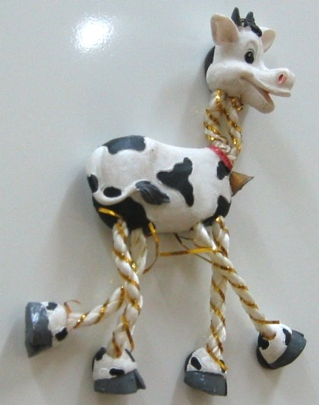
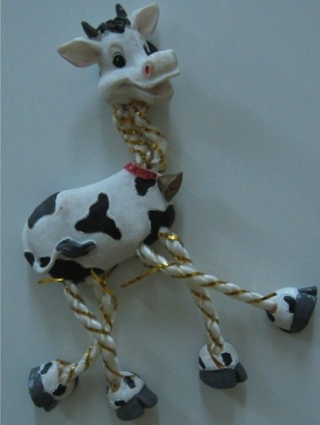
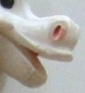
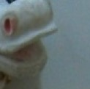
Beyond translation and rotation
MOPS invariant to translation and rotation
But what about more sophisticated geometric transformations
  World is 3D, so 2D translation and rotation not enough: out-of-plane rotations
corner
corner
patch
patch

Slide 18
Towards a better feature descriptor
Match pattern of edges
  Edge orientation – clue to shape
  Invariant to almost all photometric transformations
Be resilient to small out-of-plane rotations
  Small out-of-plane rotations might move pixels around in unpredictable ways
    But only slightly
  They might change edge orientations in unpredictable ways
    But slightly
  More generally, want invariance to small deformations

Slide 19
Invariance to small deformations
Precise edge orientations are not resilient to out-of-plane rotations
But we can quantize edge orientation: descriptor should only record rough orientation
  Hope: rough orientation should stay the same!
37
42
Between 30 and 45

Slide 20
Quantized orientation

Slide 21
Quantization
Quantization is a general trick
Converts from continuous, real numbers to discrete choices

Slide 22

Invariance to small deformation
Deformation can also move pixels around
Again, instead of precise location of each pixel, only want to record rough location
Divide patch into a grid of cells
Record total magnitude of each orientation bin in each cell: orientation histograms
Orientation histogram

Slide 23
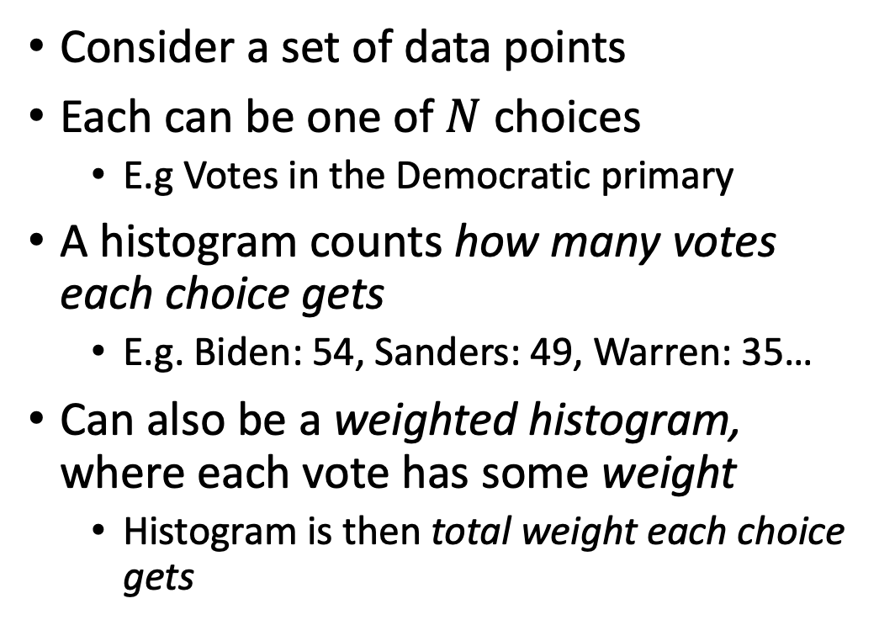
Histograms
Consider a set of data points
Each can be one of $N$ choices
  E.g Votes in the Democratic primary
A histogram counts how many votes each choice gets
  E.g. Biden: 54, Sanders: 49, Warren: 35…
Can also be a weighted histogram, where each vote has some weight
  Histogram is then total weight each choice gets
Biden
Warren
Sanders

Slide 24
Orientation histograms
Divide patch into (say) 9 cells
Divide set of orientations (0-360) into (say) 3 bins
Create one histogram for each cell
  Weighted histogram of 3 “choices”
  Each pixel “votes” into appropriate bin using gradient magnitude as “weight”

Slide 25
Orientation histograms
Divide patch into (say) 9 cells
Divide set of orientations (0-360) into (say) 3 bins
Create one histogram for each cell
  Weighted histogram of 3 “choices”
  Each pixel “votes” into appropriate bin using gradient magnitude as “weight”
Concatenate all histograms into descriptor

Slide 26
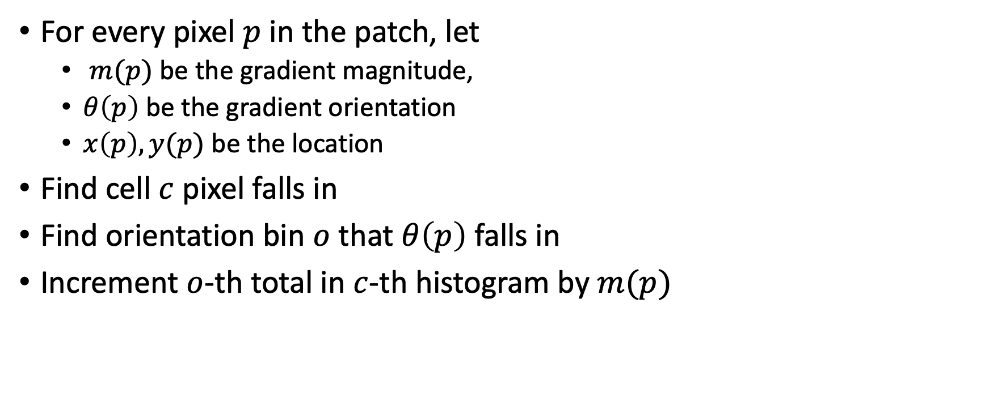
Orientation Histograms
For every pixel $p$ in the patch, let
  $m(p)$ be the gradient magnitude,
  $θ\left(p\right)$ be the gradient orientation
  $x\left(p\right), y(p)$ be the location
Find cell $c$ pixel falls in
Find orientation bin $o$ that $θ\left(p\right)$ falls in
Increment $o$-th total in $c$-th histogram by $m(p)$

Slide 27
The SIFT Descriptor Pipeline
Scale and rotation invariance as before:
  Find dominant orientation and rotate till orientation is along X (say)
  Use scale output by corner detector to crop patch of appropriate size
Divide into cells and construct orientation histograms per cell

Slide 28
Rotation Invariance by Orientation Normalization
[Lowe, SIFT, 1999]
Compute orientation histogram over entire patch
Select dominant orientation (mode of the histogram; alternative to eigenvector of second moment matrix)
Normalize: rotate patch to fixed orientation
0
2
π

Slide 29
Tips and tricks 1: Weak edges
Lots of weak edge pixels with low gradient magnitude might dominate histogram
Orientation is unreliable for low gradient magnitude
Idea: Threshold gradient magnitude: only keep edges of high gradient magnitude

Slide 30
Tips and tricks 2: Soft voting
Small deformations can cause pixels on edge of cells to switch to new cell
  If edge pixel, drastically different descriptor
Idea: soft voting
  Pixel votes into 4 nearest cells based on distance
  Similar to bilinear interpolation
Use same idea for orientation bins

Slide 31
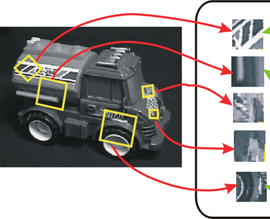
Tips and tricks 3: Reduce effect of illumination
Gradient magnitudes affected by multiplicative intensity changes
Normalize descriptor to unit norm
Threshold gradient magnitudes to avoid excessive influence of high gradients
  after normalization, clamp gradients >0.2
  renormalize

Slide 32
Detail: Feature detection
We have talked about Harris corner detector
Other feature detectors available too
SIFT implementations usually use Difference-of-Gaussians filters
  Peaks in DoG response

Slide 33
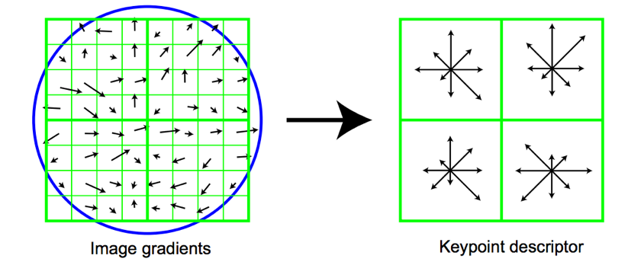
The SIFT descriptor
Compute edge magnitudes + orientations
Quantize orientations (invariance to def)
Divide into spatial cells
Compute orientation histogram in each cell (spatial invariance)
Distinctive Image Features from Scale-Invariant Keypoints. Lowe. In IJCV 2004

Slide 34


Properties of SIFT
Extraordinarily robust matching technique
  Can handle changes in viewpoint
    Up to about 60 degree out of plane rotation
  Can handle significant changes in illumination
    Sometimes even day vs. night (below)
  Fast and efficient—can run in real time
  Lots of code available: http://people.csail.mit.edu/albert/ladypack/wiki/index.php/Known_implementations_of_SIFT

Slide 35
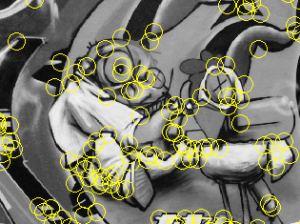
Summary
Keypoint detection: repeatable and distinctive
  Corners, blobs, stable regions
  Harris, DoG
Descriptors: robust and selective
  spatial histograms of orientation
  SIFT and variants are typically good for stitching and recognition
  But, need not stick to one

Slide 36
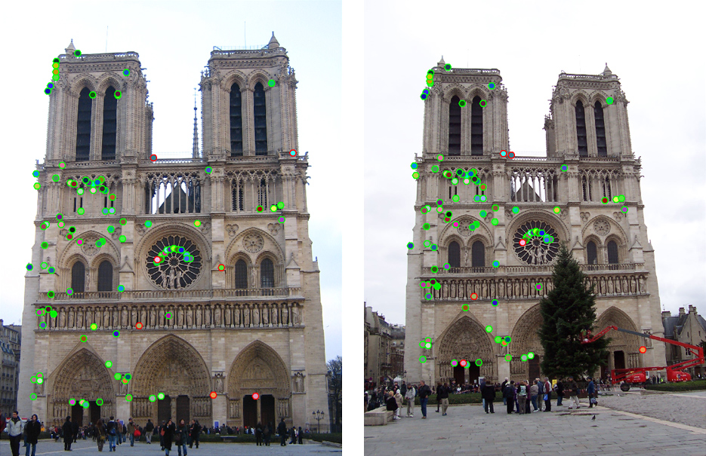
Which features match?

Slide 37
Feature matching
Given a feature in I₁, how to find the best match in I₂?
  Define distance function that compares two descriptors
  Test all the features in I₂, find the one with min distance

Slide 38
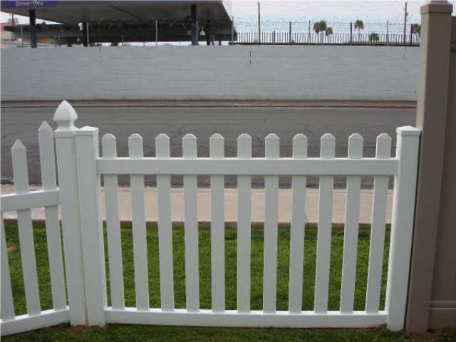
Feature distance
How to define the difference between two features f₁, f₂?
  Simple approach: L₂ distance, ||f₁ - f₂ ||
  can give good scores to ambiguous (incorrect) matches
f₁
f₂
I₁
I₂

Slide 39
Feature distance
How to define the difference between two features f₁, f₂?
  Better approach: ratio distance = ||f₁ - f₂ || / || f₁ - f₂’ ||
    f₂ is best SSD match to f₁ in I₂
    f₂’ is 2nd best SSD match to f₁ in I₂
    gives large values for ambiguous matches
f₁
f₂'
f₂
I₁
I₂

