Slide 1
Reconstruction

Slide 2
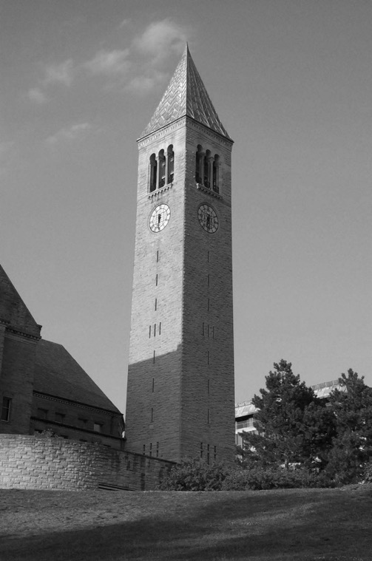
Reconstruction
Given an image, can we reconstruct the 3D world that created the image?

Slide 3
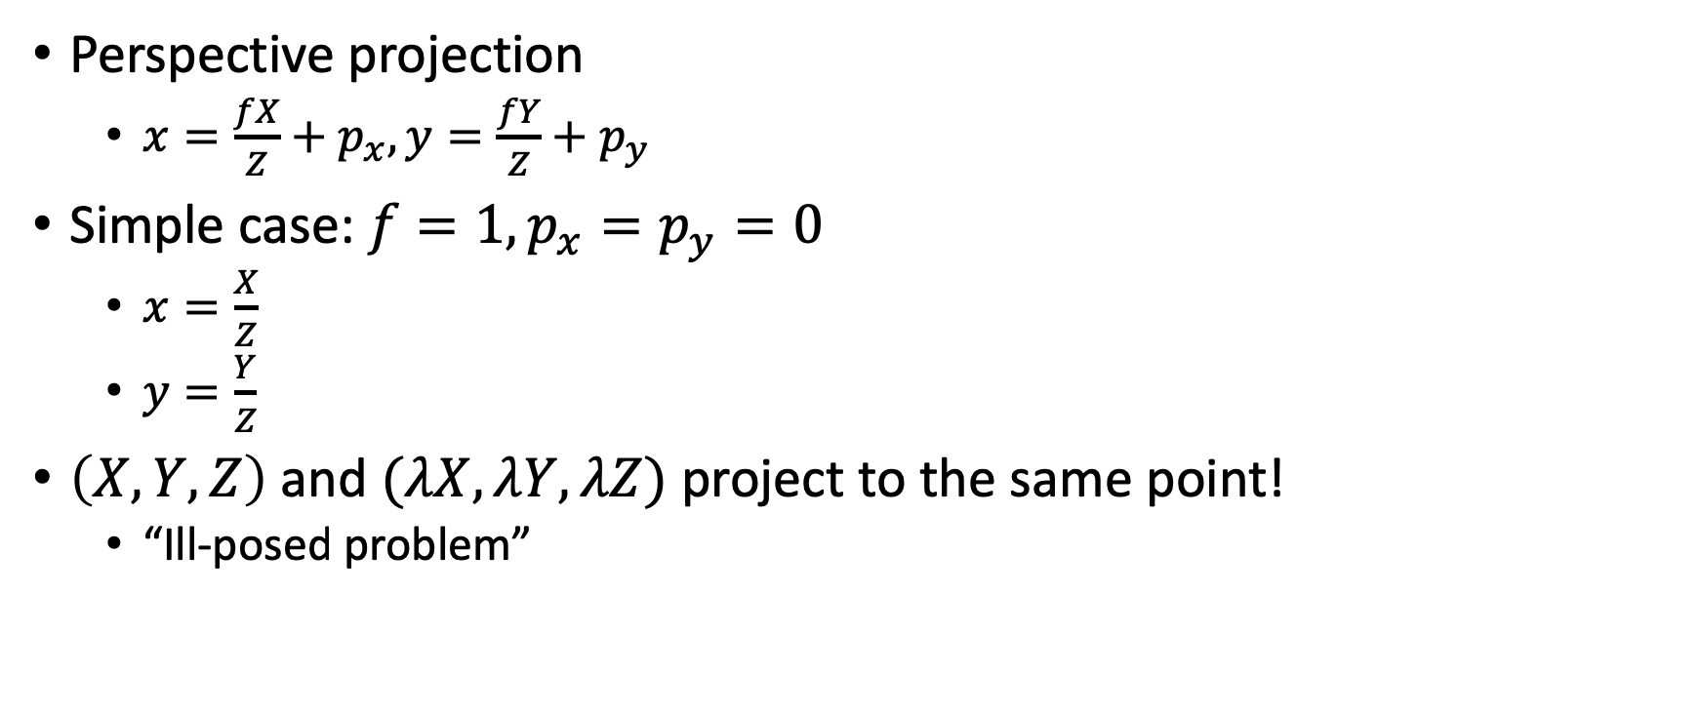
Why is reconstruction hard?
Perspective projection
$x=\frac{fX}{Z}+p_{x}, y=\frac{fY}{Z}+p_{y}$
Simple case: $f=1, p_{x}=p_{y}=0$
$x=\frac{X}{Z}$
$y=\frac{Y}{Z}$
$\left(X, Y, Z\right)$ and $(λX, λY, λZ)$ project to the same point!
“Ill-posed problem”

Slide 4
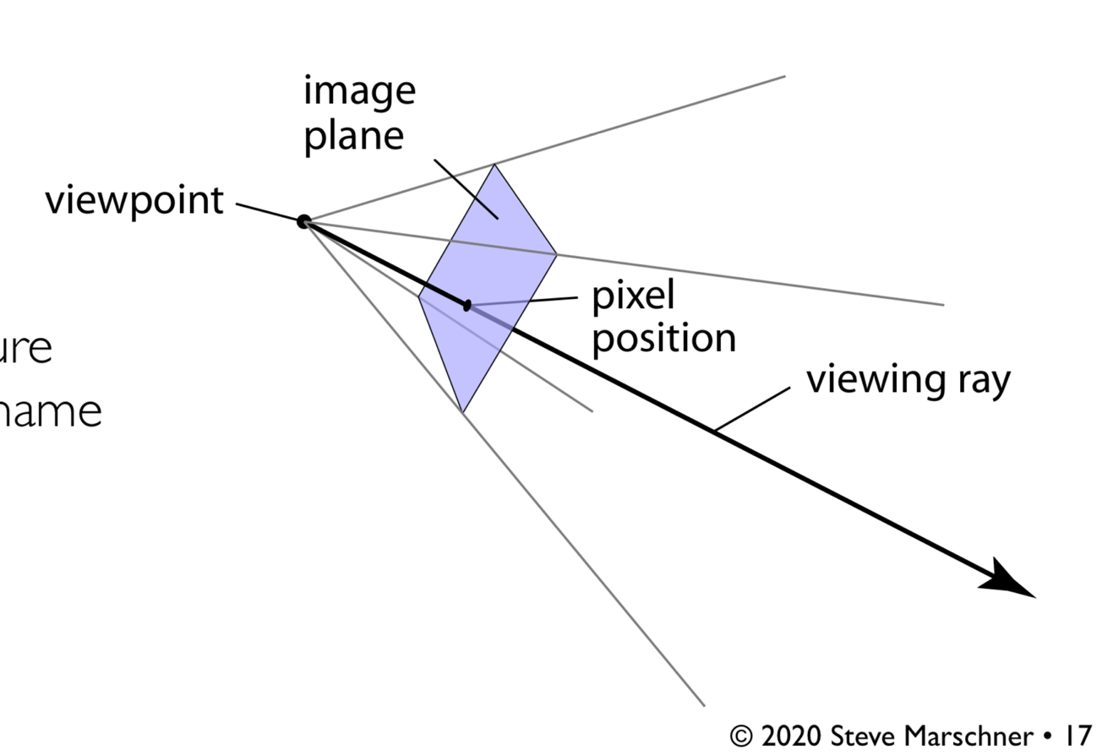
Why is reconstruction hard?

Slide 5


One way out: multiple images
Multiple images can give a clue about 3D structure

Slide 6


One way out: multiple images
Parallax: nearby objects move more than far away objects

Slide 7


One way out: multiple images

Slide 8


One way out: multiple images
Step 1: Need to find correspondences between pixels in image 1 and image 2
Step 2: Use correspondences to locate point in 3D

Slide 9
Reconstruction from correspondence
Given known cameras, correspondence gives the location of 3D point (Triangulation)

Slide 10
Reconstruction from correspondence
Given a 3D point, correspondence gives relationship between cameras (Pose estimation / camera calibration)

Slide 11
Next few classes
How do we find correspondences?
How do we use correspondences to reconstruct 3D?

Slide 12
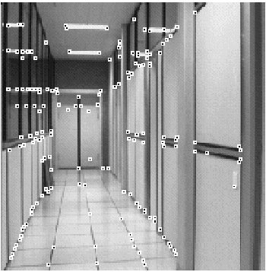
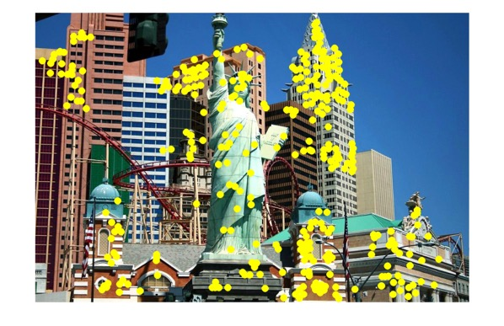
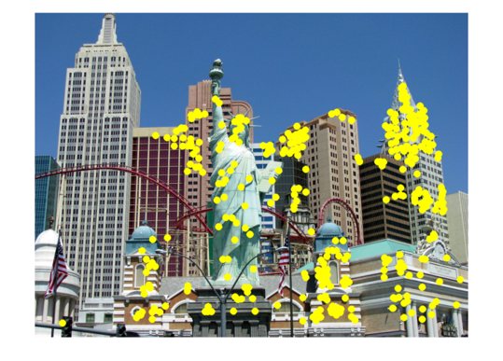
Other applications of correspondence
Image alignment
Motion tracking
Robot navigation

Slide 13
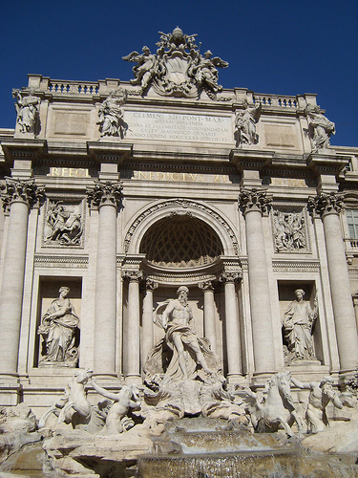
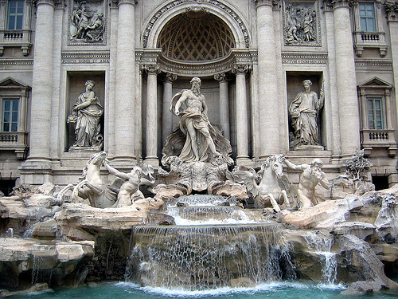
Easy correspondence
by Diva Sian
by swashford

Slide 14
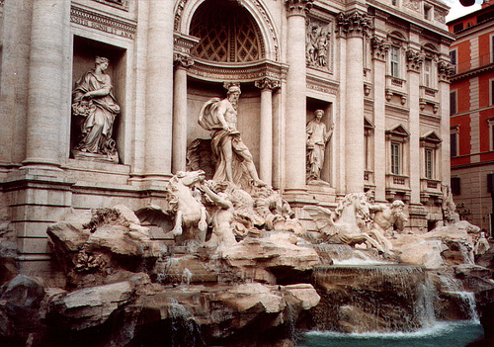
Harder case
by Diva Sian
by scgbt

Slide 15
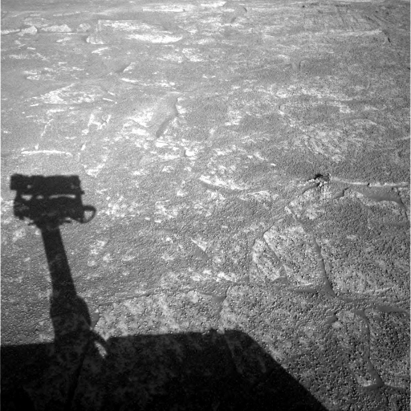
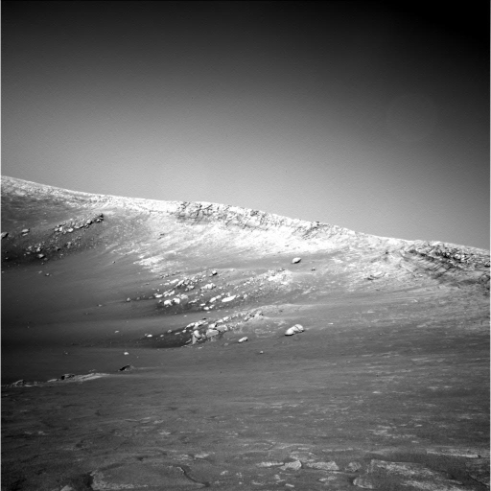
Harder still?

Slide 16
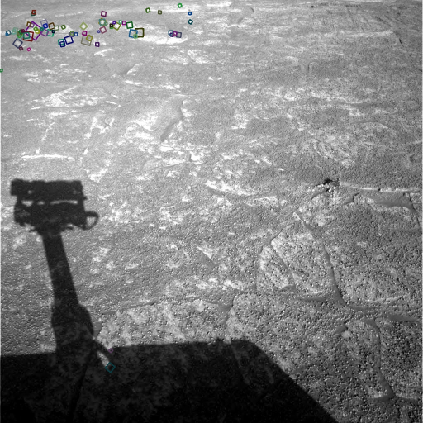
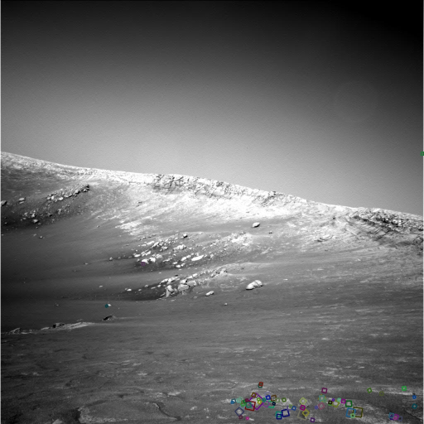
Answer below (look for tiny colored squares…)
NASA Mars Rover images
with SIFT feature matches

Slide 17
Sparse vs dense correspondence
Sparse correspondence: produce a few, high confidence matches
Good enough for estimating pose or relationship between cameras
Easier
Dense correspondence: try to match every pixel
Needed if we want 3D location of every pixel

Slide 18
A general pipeline for correspondence
Feature detection: If sparse correspondences are enough, choose points for which we will search for correspondences (feature points)
Feature description: For each point (or every pixel if dense correspondence), describe point using a feature descriptor
Feature matching: Find best matching descriptors across two images (feature matching)
Use feature matches to perform downstream task, e.g., pose estimation

Slide 19
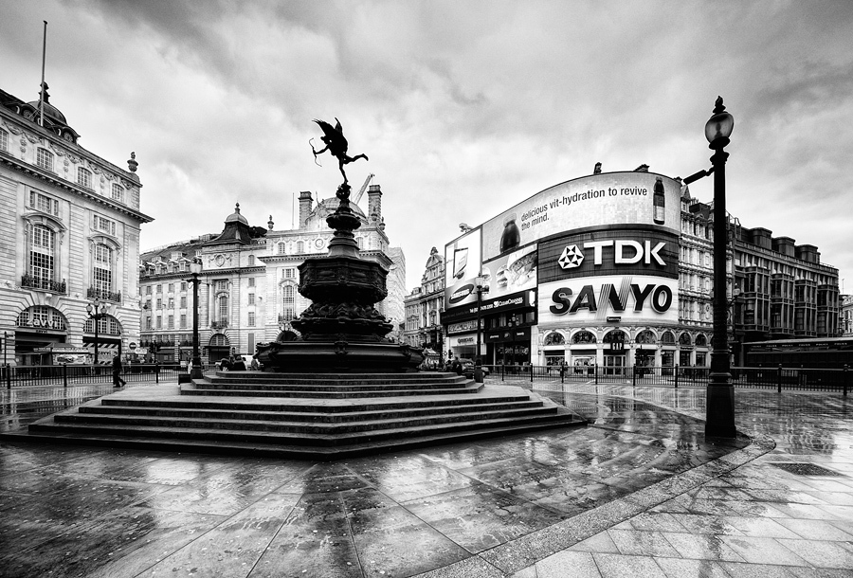
What makes a good feature point?
Snoop demo

Slide 20
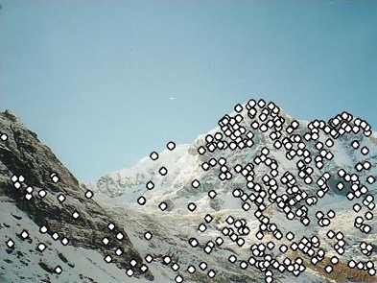
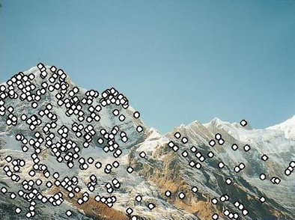
Characteristics of good feature points
Repeatability / invariance
The same feature point can be found in several images despite geometric and photometric transformations
Saliency / distinctiveness
Each feature point is distinctive
Fewer ”false” matches

Slide 21
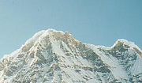

Goal: repeatability
We want to detect (at least some of) the same points in both images.
Yet we have to be able to run the detection procedure independently per image.
No chance to find true matches!
Kristen Grauman
Notes:
21

Slide 22
Goal: distinctiveness
The feature point should be distinctive enough that it is easy to match
Should at least be distinctive from other patches nearby
????

Slide 23
The aperture problem
A single pixel by itself is not distinctive
Matching pixels
Input pixel
Pixel appearance

Slide 24
The aperture problem
Individual pixels are ambiguous
Idea: Look at whole patches!

Slide 25
The aperture problem
Individual pixels are ambiguous
Idea: Look at whole patches!
Input patch
Matching patch centers

Slide 26
The aperture problem
Patches can be ambiguous too!
What patches are distinctive?

Slide 27
The aperture problem
Corners are distinctive!
How do we define/find corners?

Slide 28
Corner detection
Main idea: Translating window should cause large differences in patch appearance

Slide 29

Corner Detection: Basic Idea
We should easily recognize the point by looking through a small window
Shifting a window in any direction should give a large change in intensity
“flat” region: no change in all directions
“edge”: no change along the edge direction
“corner”: significant change in all directions
Source: A. Efros

Slide 30
Corner detection the math
Consider shifting the window W by (u,v)
how do the pixels in W change?
Write pixels in window as a vector:
W

Slide 31
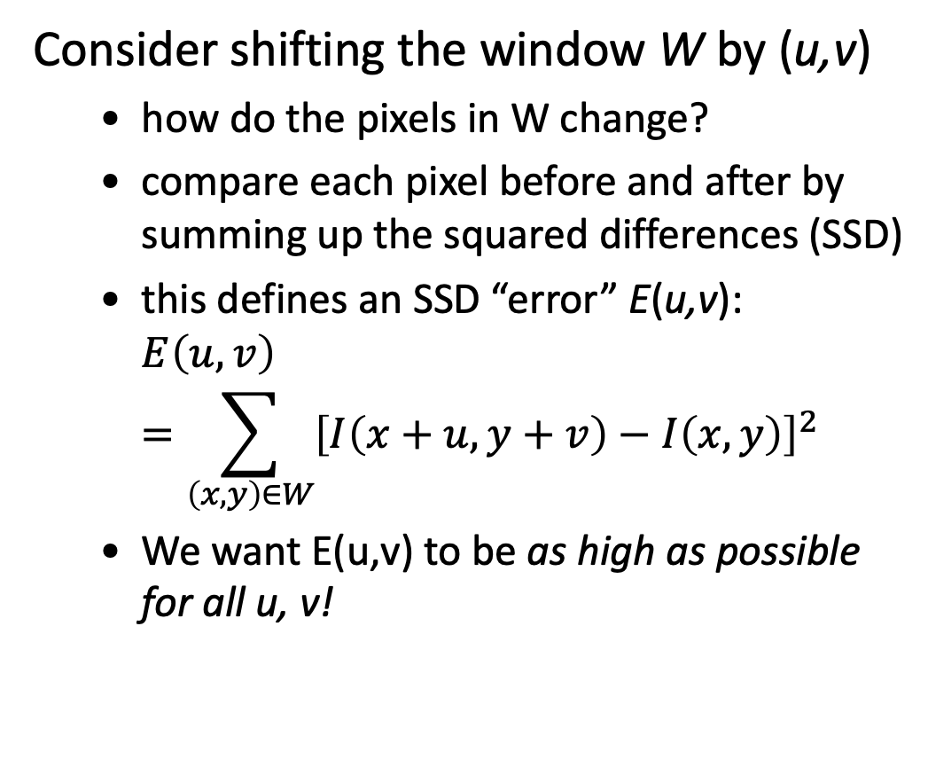
Corner detection: the math
Consider shifting the window W by (u,v)
how do the pixels in W change?
compare each pixel before and after by summing up the squared differences (SSD)
this defines an SSD “error” E(u,v): $E\left(u,v\right)=\sum_{\left(x,y\right)∈W}{{\left[I\left(x+u,y+v\right)−I\left(x,y\right)\right]}^{2}}$
We want E(u,v) to be as high as possible for all u, v!
W

Slide 32
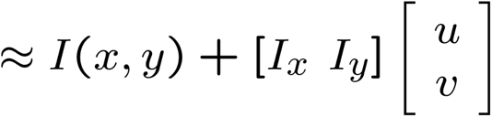
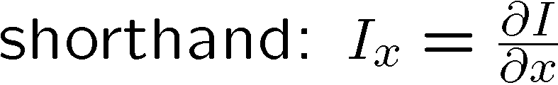
Small motion assumption
Taylor Series expansion of I:
If the motion (u,v) is small, then first order approximation is good
Plugging this into the formula on the previous slide…

Slide 33
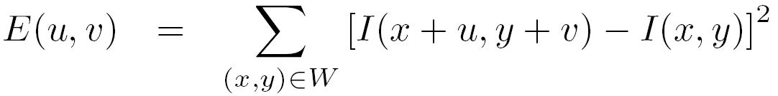
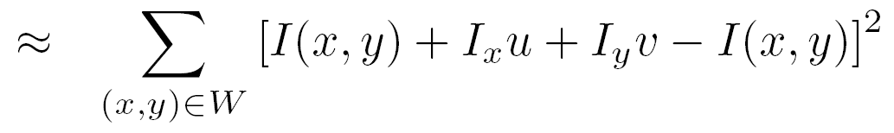
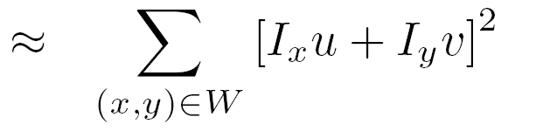
Corner detection: the math
Consider shifting the window W by (u,v)
define an SSD “error” E(u,v):
W

Slide 34
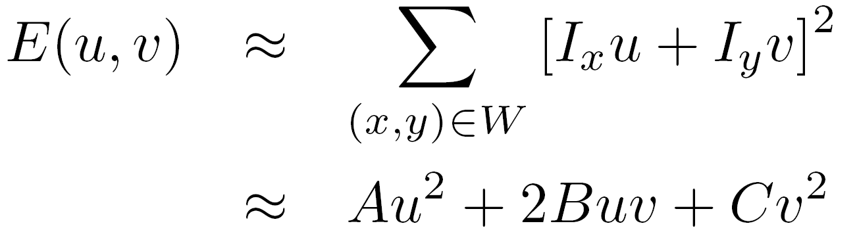
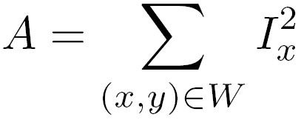
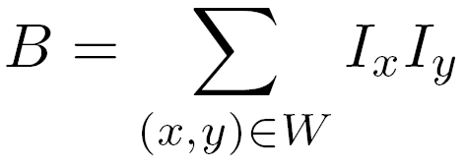
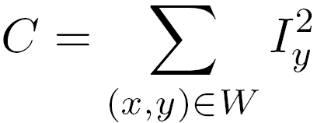
Corner detection: the math
Consider shifting the window W by (u,v)
define an “error” E(u,v):
W
Thus, E(u,v) is locally approximated as a quadratic error function

Slide 35
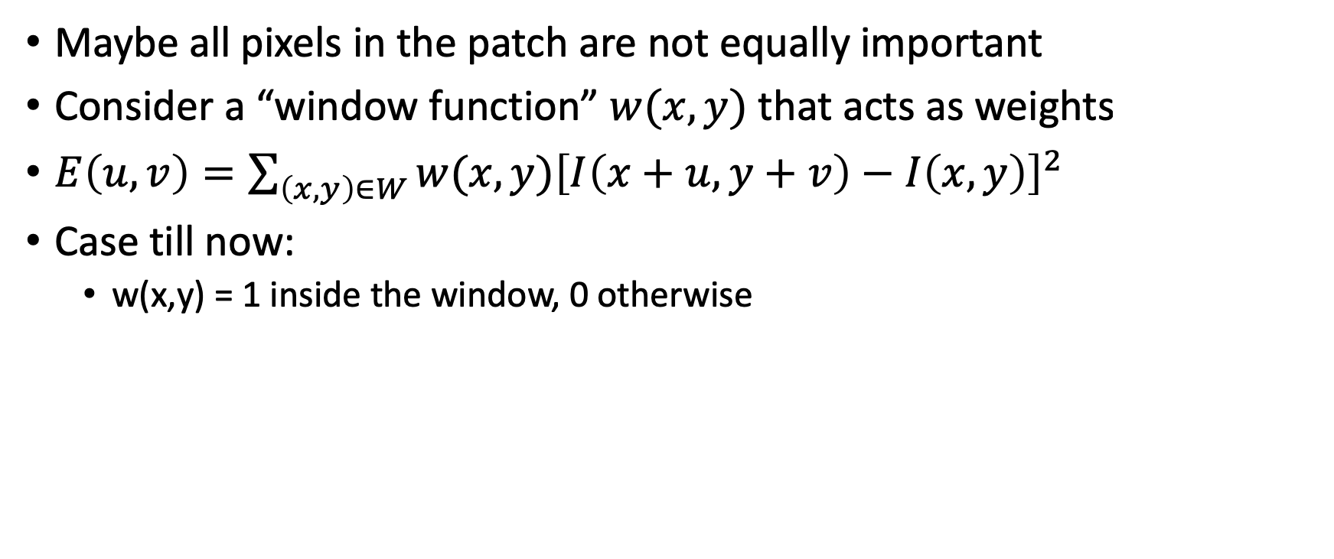
A more general formulation
Maybe all pixels in the patch are not equally important
Consider a “window function” $w(x,y)$ that acts as weights
$E\left(u,v\right)=\sum_{\left(x,y\right)∈W}{w(x,y){\left[I\left(x+u,y+v\right)−I\left(x,y\right)\right]}^{2}}$
Case till now:
w(x,y) = 1 inside the window, 0 otherwise

Slide 36
Using a window function
Change in appearance of window w(x,y) for the shift [u,v]:
Window function
Shifted intensity
Intensity
Window function w(x,y) =
or
1 in window, 0 outside
Gaussian
Source: R. Szeliski

Slide 37
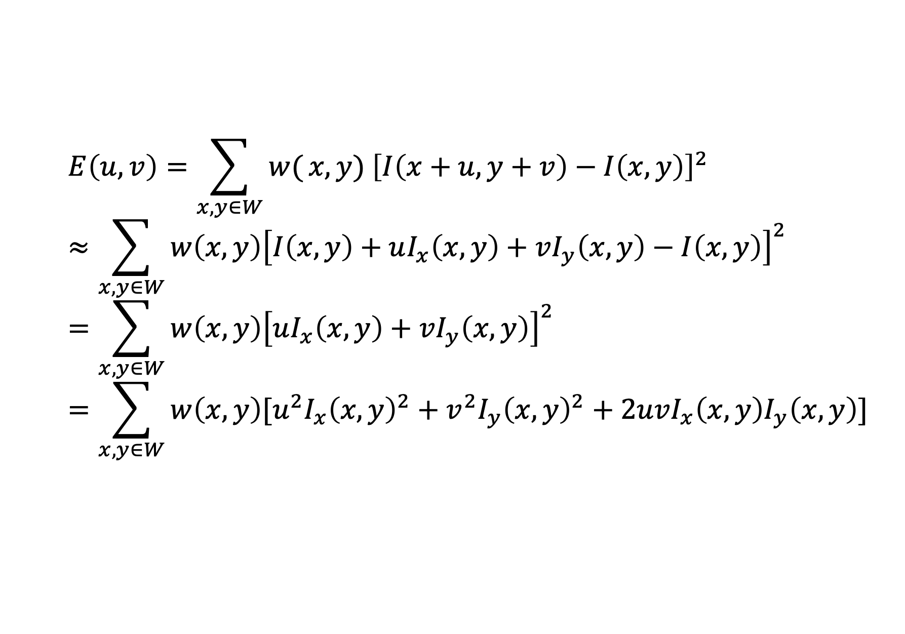
Redoing the derivation using a window function
$$E\left(u,v\right)=\sum_{x,y∈W}{w(}x,y) {\left[I\left(x+u,y+v\right)−I\left(x,y\right)\right]}^{2} \\ ≈\sum_{x,y∈W}{w\left(x,y\right){\left[I\left(x,y\right)+uI_{x}\left(x,y\right)+vI_{y}\left(x,y\right)−I\left(x,y\right)\right]}^{2}} \\ =\sum_{x,y∈W}{w\left(x,y\right){\left[uI_{x}\left(x,y\right)+vI_{y}\left(x,y\right)\right]}^{2}} \\ =\sum_{x,y∈W}{w\left(x,y\right)[u^{2}I_{x}{\left(x,y\right)}^{2}+v^{2}I_{y}{\left(x,y\right)}^{2}+2uvI_{x}\left(x,y\right)I_{y}\left(x,y\right)]}$$

Slide 38
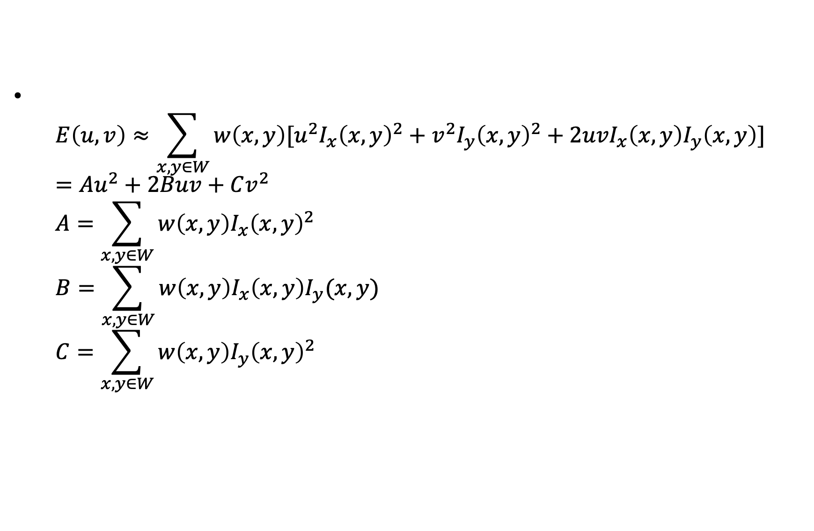
Redoing the derivation using a window function
$E\left(u,v\right)≈\sum_{x,y∈W}{w\left(x,y\right)[u^{2}I_{x}{\left(x,y\right)}^{2}+v^{2}I_{y}{\left(x,y\right)}^{2}+2uvI_{x}\left(x,y\right)I_{y}\left(x,y\right)]}$ $=Au^{2}+2Buv+Cv^{2}$ $A=\sum_{x,y∈W}{w\left(x,y\right)I_{x}{\left(x,y\right)}^{2}}$ $B=\sum_{x,y∈W}{w\left(x,y\right)I_{x}\left(x,y\right)I_{y}(x,y)}$ $C=\sum_{x,y∈W}{w\left(x,y\right)I_{y}{\left(x,y\right)}^{2}}$

Slide 39
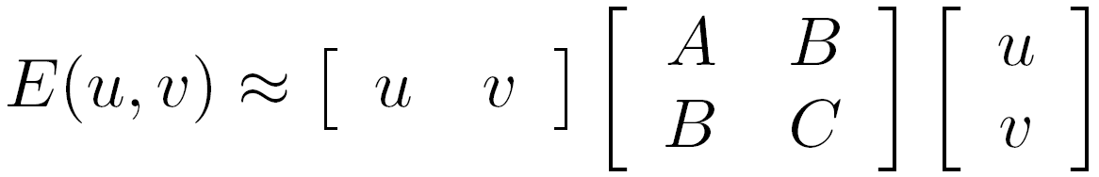
The second moment matrix
M
Second moment matrix

Slide 40
The second moment matrix
M
Second moment matrix
Recall that we want E(u,v) to be as large as possible for all u,v
What does this mean in terms of M?

Slide 41


M
Flat patch:

Slide 42
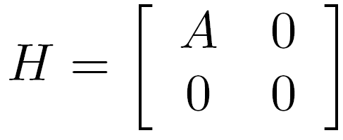
M
M
Vertical edge:

Slide 43
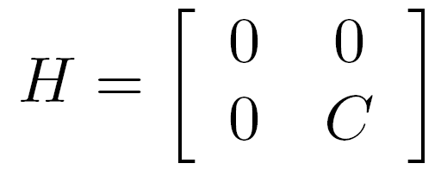
M
M
M
Horizontal edge:

Slide 44
What about edges in arbitrary orientation?

Slide 45
Solutions to Mx = 0 are directions for which E is 0: window can slide in this direction without changing appearance

Slide 46
Solutions to Mx = 0 are directions for which E is 0: window can slide in this direction without changing appearance
For corners, we want no such directions to exist

Slide 47
E(u,v)
E(u,v)
E(u,v)
E(u,v)
v
u
v
v
v
u
u
u

Slide 48
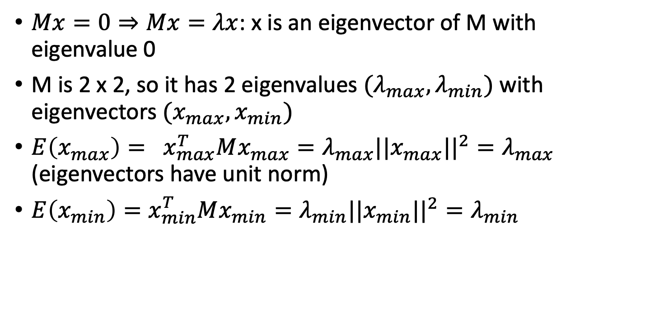
Eigenvalues and eigenvectors of M
$Mx=0⇒Mx=λx$: x is an eigenvector of M with eigenvalue 0
M is 2 x 2, so it has 2 eigenvalues $(λ_{max}, λ_{min})$ with eigenvectors ${(x}_{max}, x_{min})$
$E\left(x_{max}\right)= x_{max}^{T}Mx_{max}=λ_{max}||x_{max}||^{2}=λ_{max}$ (eigenvectors have unit norm)
$E\left(x_{min}\right)=x_{min}^{T}Mx_{min}=λ_{min}||x_{min}||^{2}=λ_{min}$

Slide 49
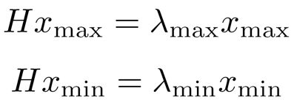
Eigenvalues and eigenvectors of M
x_{min}
M
x_{max}
M
Eigenvalues and eigenvectors of M
Define shift directions with the smallest and largest change in error
x_{max} = direction of largest increase in E
λ_{max} = amount of increase in direction x_{max}
x_{min} = direction of smallest increase in E
λ_{min} = amount of increase in direction x_{min}

Slide 50
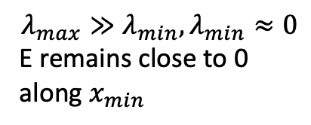



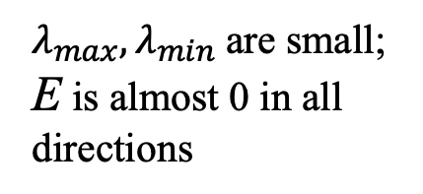
Interpreting the eigenvalues
$$λ_{min}$$
Corner
$$λ_{max}≈λ_{min} ≫0$$
E very high in all directions
$λ_{max}, λ_{min}$are small; E is almost 0 in all directions
Edge
$$λ_{max}≫λ_{min}, λ_{min}≈0$$
E remains close to 0 along $x_{min}$
Flat patch
$$λ_{max}$$

