Slide 1
Resizing and resampling

Slide 2
Aliasing
Images are made up of high frequency and low frequency components
High frequency components: pixel-to-pixel details
Low frequency components: high-level structure
What subsampling should do: remove pixel-to-pixel details, keep high-level structure
What naïve subsampling does: converts pixel-to-pixel details to new coarse structures → problem

Slide 3
Aliasing

Slide 4
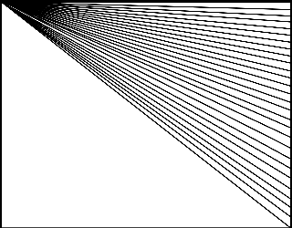
Aliasing
Aliasing artifacts

Slide 5
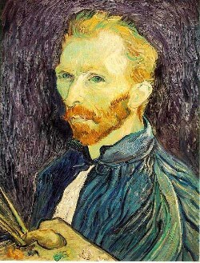
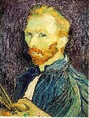

Image sub-sampling
1/2
1/4 (2x zoom)
1/16 (4x zoom)
Why does this look so crufty? Aliasing!
Source: S. Seitz

Slide 6
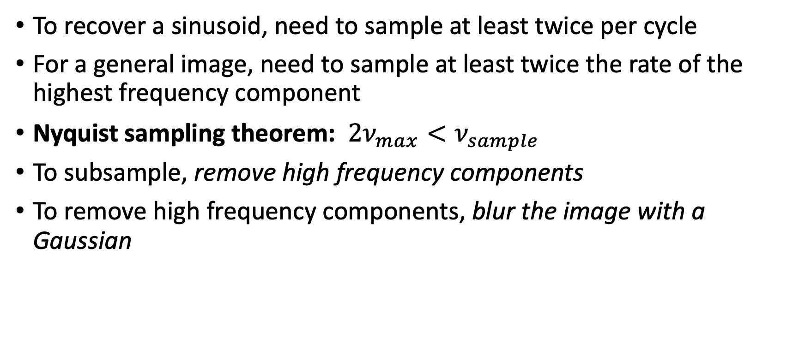
How to avoid aliasing
To recover a sinusoid, need to sample at least twice per cycle
For a general image, need to sample at least twice the rate of the highest frequency component
Nyquist sampling theorem: $2ν_{max}<ν_{sample}$
To subsample, remove high frequency components
To remove high frequency components, blur the image with a Gaussian

Slide 7
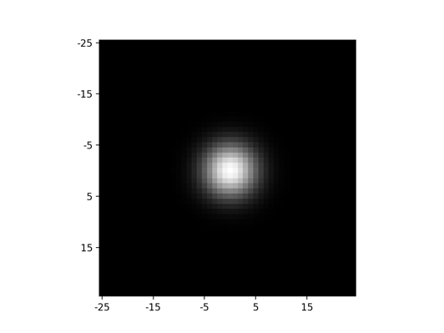
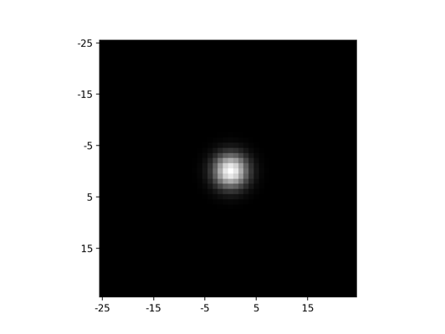
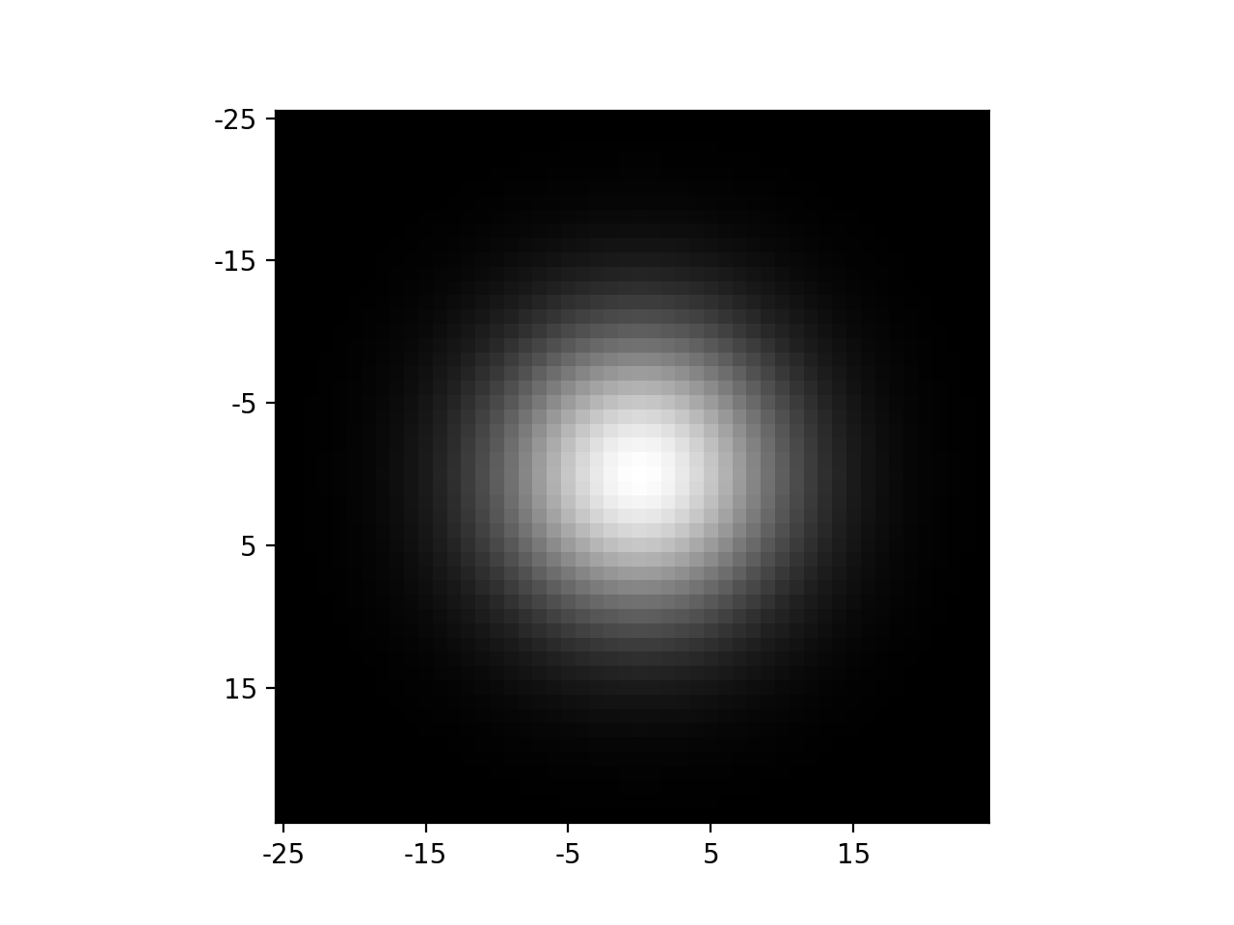
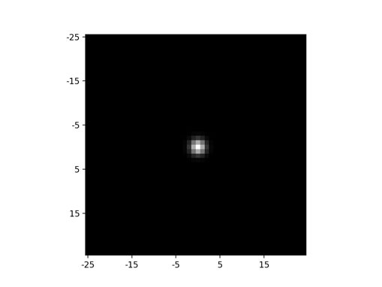
Fourier spectrum
Image
Zeros out high frequencies
Keeps low frequencies
Gaussian filters
Fourier transform

Slide 8
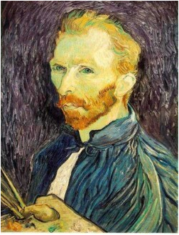







Gaussian pre-filtering
Solution: filter the image, then subsample
F₀
F₁
F₂
…
blur
subsample
blur
subsample
F₀ H
F₁ H
*
*

Slide 9
{
Gaussian pyramid
F₀
F₁
F₂
…
blur
subsample
blur
subsample
F₀ H
F₁ H
*
*

Slide 10
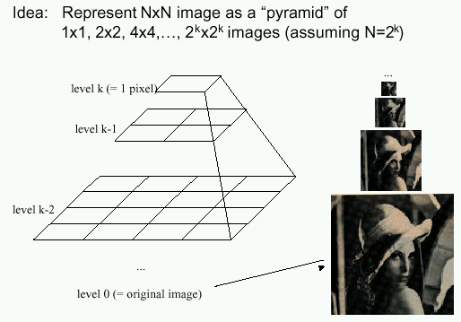
Gaussian pyramids
[Burt and Adelson, 1983]
In computer graphics, a mip map [Williams, 1983]
Gaussian Pyramids have all sorts of applications in computer vision
Source: S. Seitz

Slide 11
Gaussian pyramids - Searching over scales

Slide 12
Gaussian pyramids - Searching over scales

Slide 13
The Gaussian Pyramid
Low resolution
blur
sub-sample
blur
sub-sample
sub-sample
blur
sub-sample
blur
High resolution

Slide 14
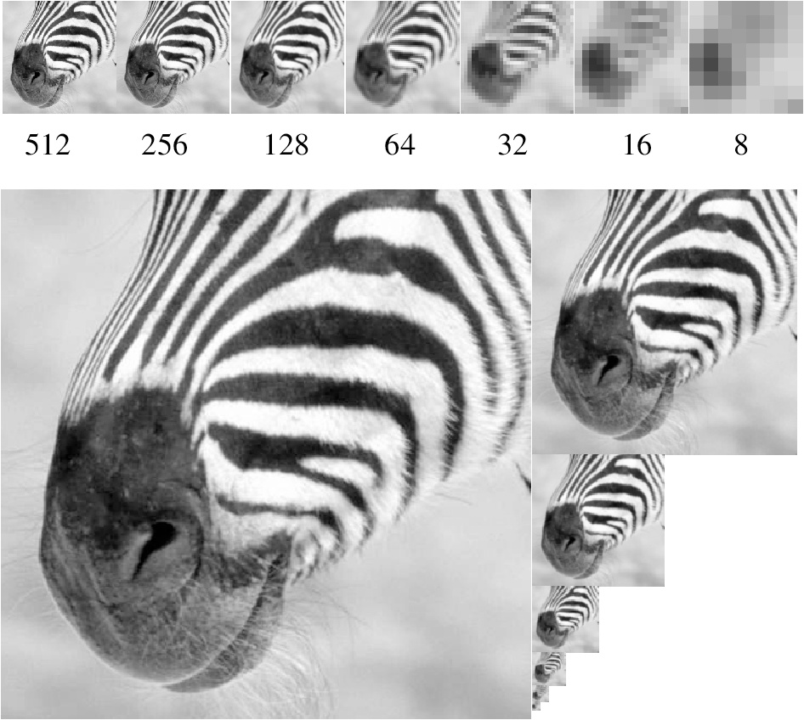
Gaussian pyramid and stack
Source: Forsyth

Slide 15
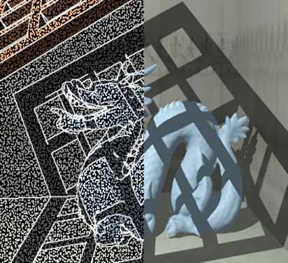
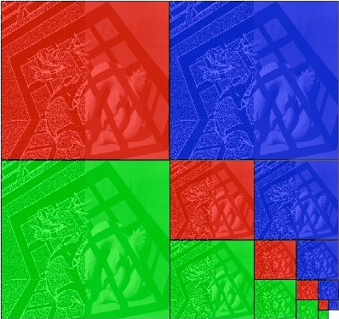
Memory Usage
Each color is a separate pyramid
3 pyramids fit into 2W x 2H image
Notes:
4/3

Slide 16
What about upsampling?
Simple solution: Fill rest of the pixels with zeros
Obviously wrong. How can we do better?

Slide 17
Upsampling
Need to interpolate intermediate pixels. What is the best way to interpolate?
  Find the most likely high-res image
Recall: before subsampling, we removed high frequencies
Key idea: upsampled image should not have high frequencies either
Gaussian blur again!

Slide 18
Upsampling
Step 1: upsample and fill with 0s
Step 2: Gaussian blur to interpolate
Step 3: Scale correction
  Gaussian blur is just weighted average
  But we just introduced a bunch of zeros ==> need to scale up the resulting image

Slide 19
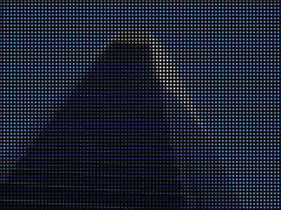
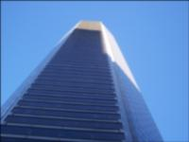
Upsampling: Step 1

Slide 20
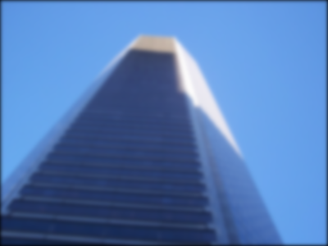
Upsampling: Step 2 + 3

Slide 21





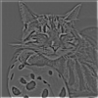


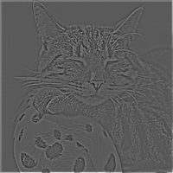

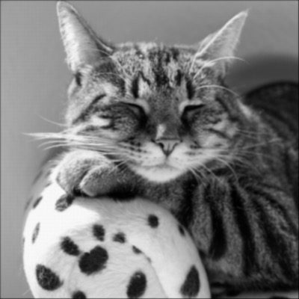
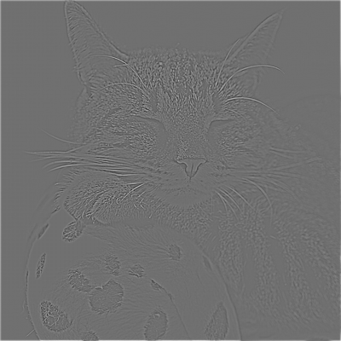
Laplacian pyramid
Expand (upsample + blur)
-
=
Expand (upsample + blur)
-
=
Expand (upsample + blur)
Re-duce
-
=
Expand (upsample + blur)
-
=

Slide 22
Laplacian pyramid
L₄ = G₄ =
L₃ = G₃ - expand(G₄) =
L₂ = G₂ - expand(G₃) =
L₁ = G₁ - expand(G₂) =
L₀ = G₀ - expand(G₁) =

Slide 23
Reconstructing the image from a Laplacian pyramid
Expand (upsample + blur)
+
=
Expand (upsample + blur)
+
=
Expand (upsample + blur)
+
=
Expand (upsample + blur)
+
=

Slide 24
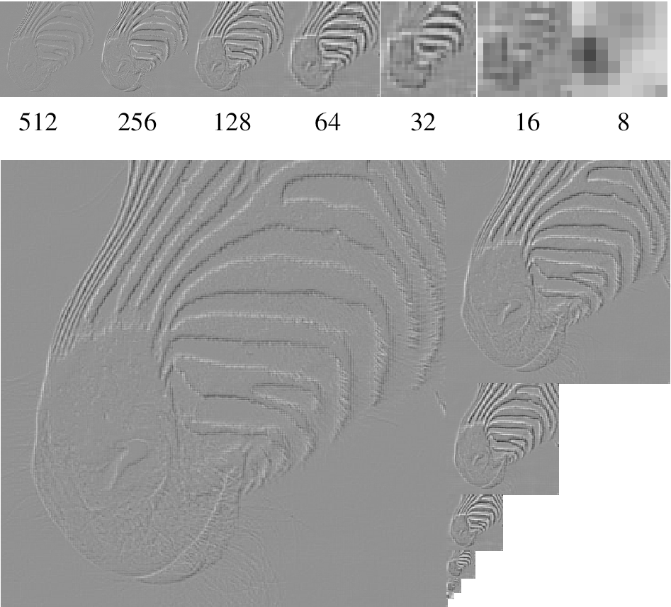
Laplacian pyramid
Source: Forsyth

Slide 25
Interpolation in general
A more general question
Given some known pixels in the image (shown in blue) how can we get the value of other pixels (shown in red)
In our case, known pixels are in every other row/column

Slide 26
Interpolation in general
Gaussian interpolation: set new pixels to be weighted combination of known pixels
Other forms of interpolation: other weights

Slide 27
Interpolation in general
Nearest neighbor interpolation
  Find the nearest known pixel
  Copy its value

Slide 28
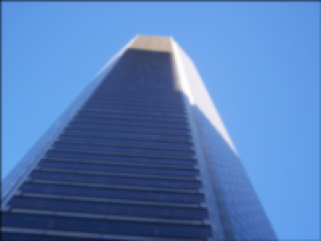
Nearest-neighnbor interpolation

Slide 29
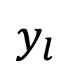
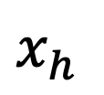


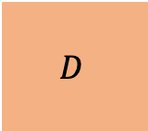

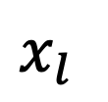

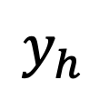

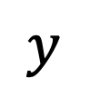
Bilinear interpolation
$$y_{l}$$
$$A$$
$$D$$
Find the four nearest neighbors
  $\left(x_{l},y_{l}\right), \left(x_{l}, y_{h}\right), \left(x_{h}, y_{h}\right), \left(x_{h}, y_{l}\right)$
Compute weighted average of the four
$$y$$
$$B$$
$$C$$
$$y_{h}$$
$$x_{l}$$
$$x$$
$$x_{h}$$

Slide 30
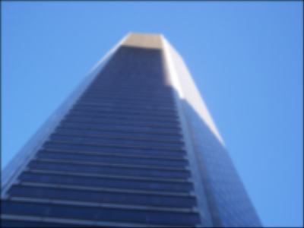
Bilinear interpolation

Slide 31
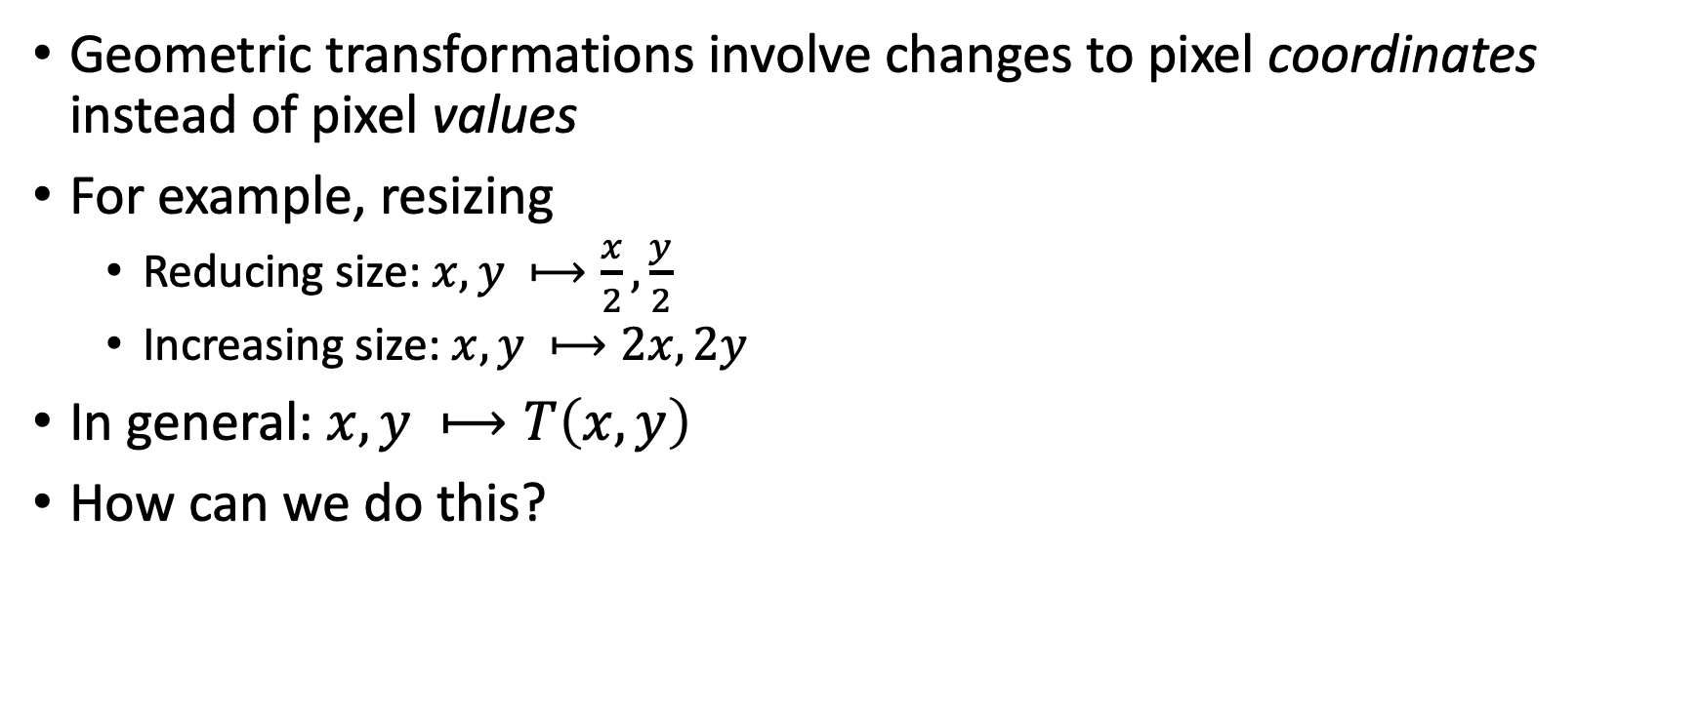
Geometric transformations
Geometric transformations involve changes to pixel coordinates instead of pixel values
For example, resizing
  Reducing size: $x, y ⟼\frac{x}{2},\frac{y}{2}$
  Increasing size: $x, y ⟼2x, 2y$
In general: $x, y ⟼T\left(x,y\right)$
How can we do this?

Slide 32
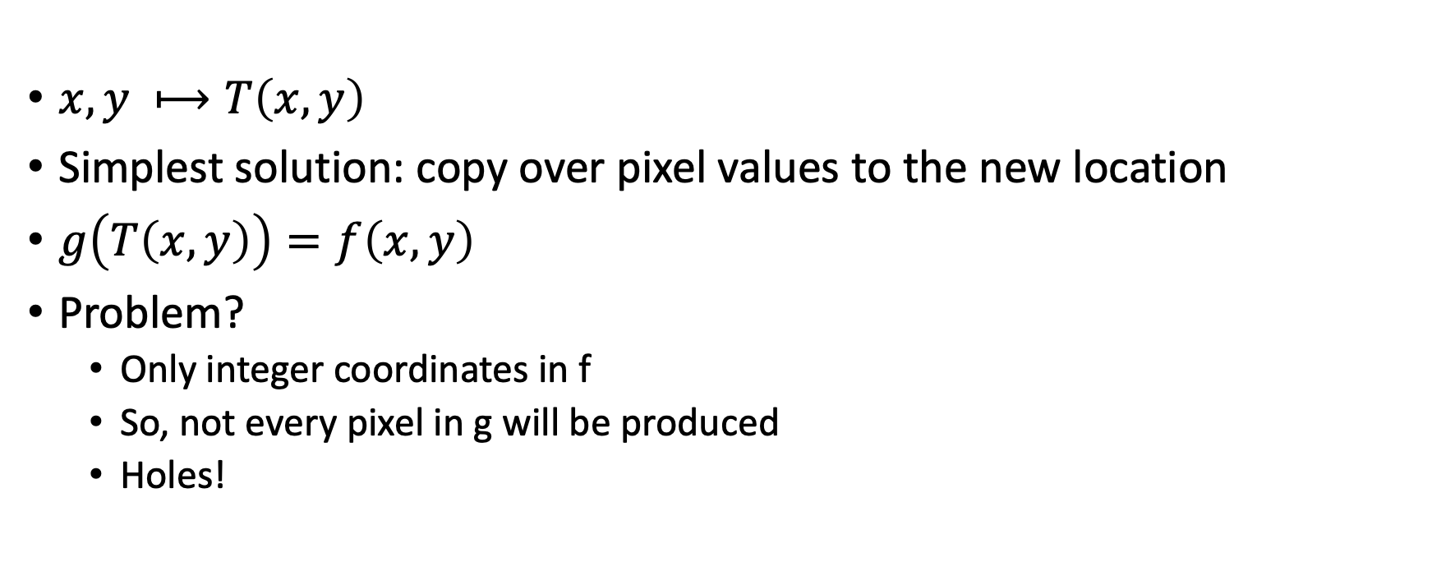
Geometric transformations
$x, y ⟼T\left(x,y\right)$
Simplest solution: copy over pixel values to the new location
$g\left(T\left(x,y\right)\right)=f\left(x,y\right)$
Problem?
  Only integer coordinates in f
  So, not every pixel in g will be produced
  Holes!

Slide 33
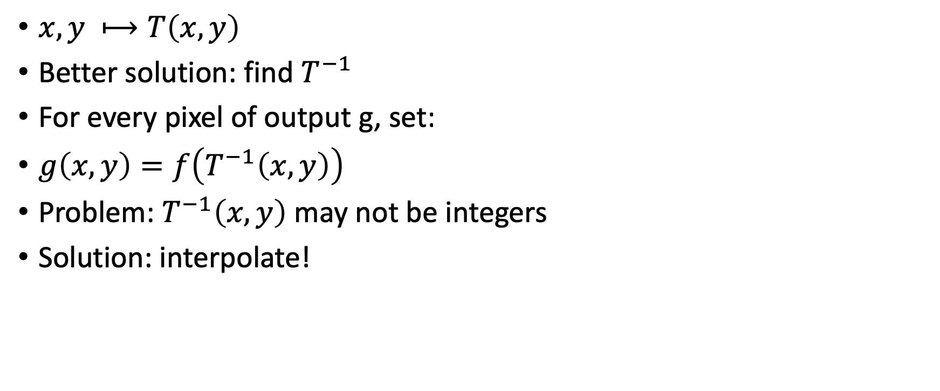
Geometric transformations
$x, y ⟼T\left(x,y\right)$
Better solution: find $T^{−1}$
For every pixel of output g, set:
$g\left(x,y\right)=f\left(T^{−1}\left(x,y\right)\right)$
Problem: $T^{−1}\left(x,y\right)$ may not be integers
Solution: interpolate!

