Slide 1
Fourier Transforms

Slide 2
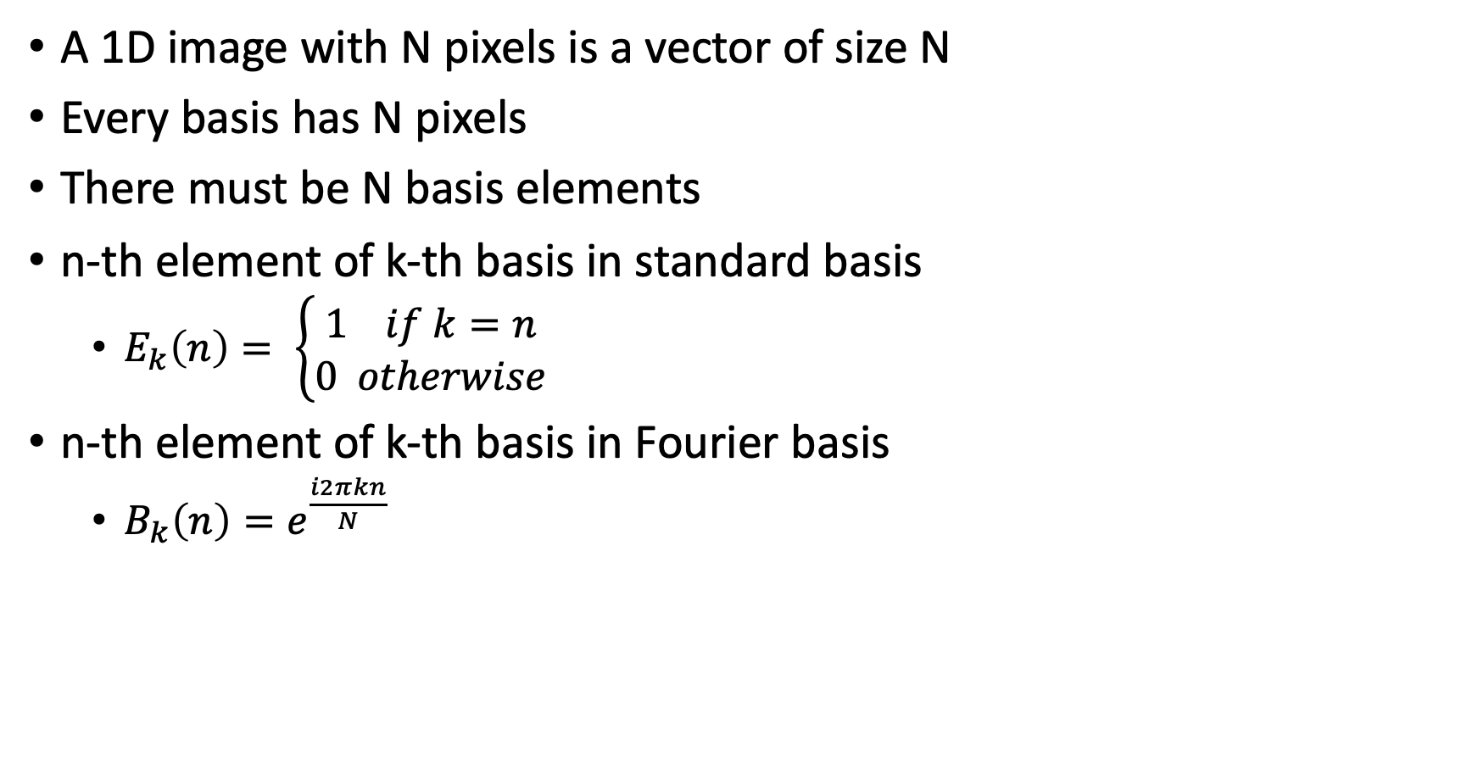
Fourier transform for 1D images
A 1D image with N pixels is a vector of size N
Every basis has N pixels
There must be N basis elements
n-th element of k-th basis in standard basis
  $E_{k}\left(n\right)= \left\{\begin{aligned}1 if k=n \\ 0 otherwise\end{aligned}\right.$
n-th element of k-th basis in Fourier basis
  $B_{k}\left(n\right)=e^{\frac{i2πkn}{N}}$

Slide 3
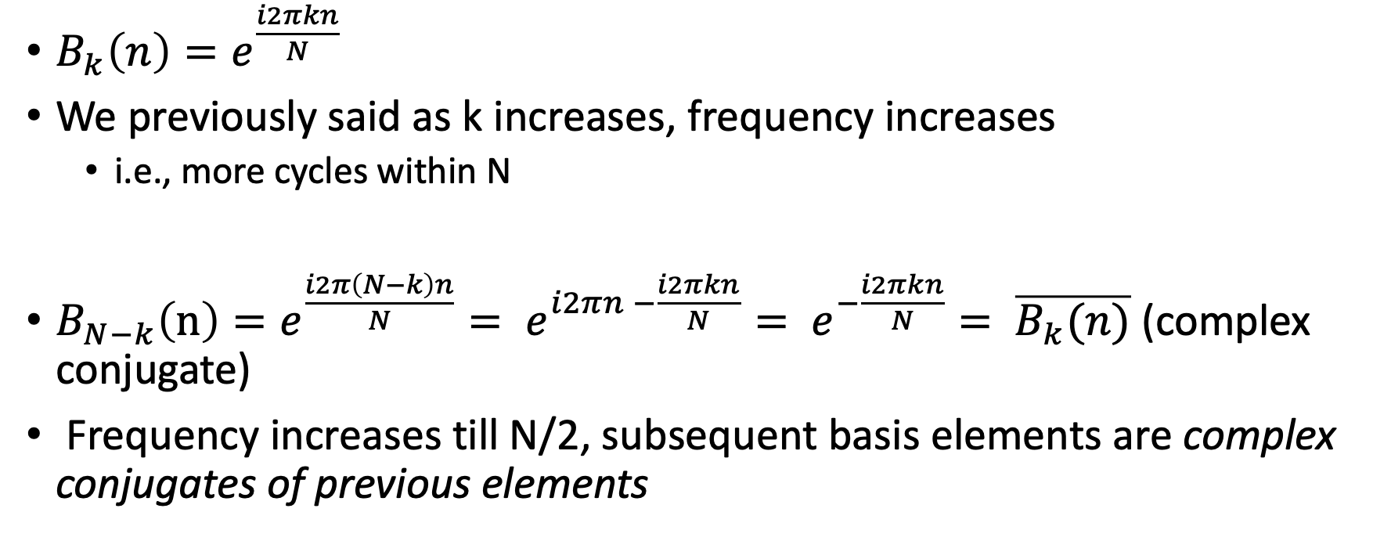
A nuance
$B_{k}\left(n\right)=e^{\frac{i2πkn}{N}}$
We previously said as k increases, frequency increases
  i.e., more cycles within N
$B_{N−k}\left(n\right)=e^{\frac{i2π\left(N−k\right)n}{N}}= e^{i2πn −\frac{i2πkn}{N}}= e^{−\frac{i2πkn}{N}}= \overline{B_{k}(n)}$ (complex conjugate)
Frequency increases till N/2, subsequent basis elements are complex conjugates of previous elements

Slide 4
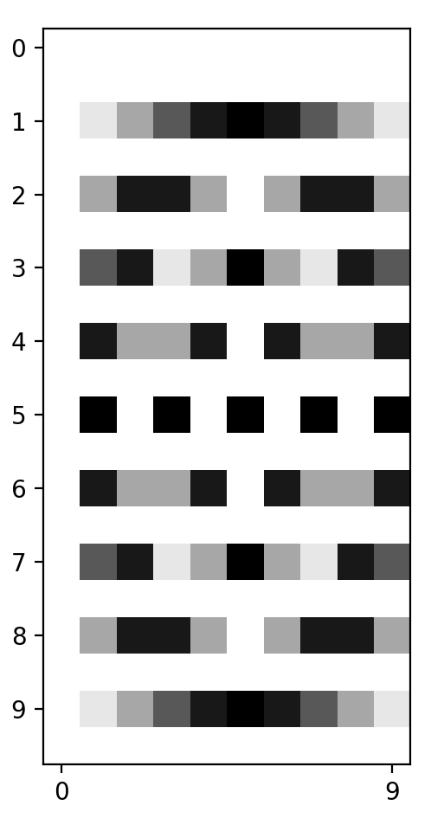
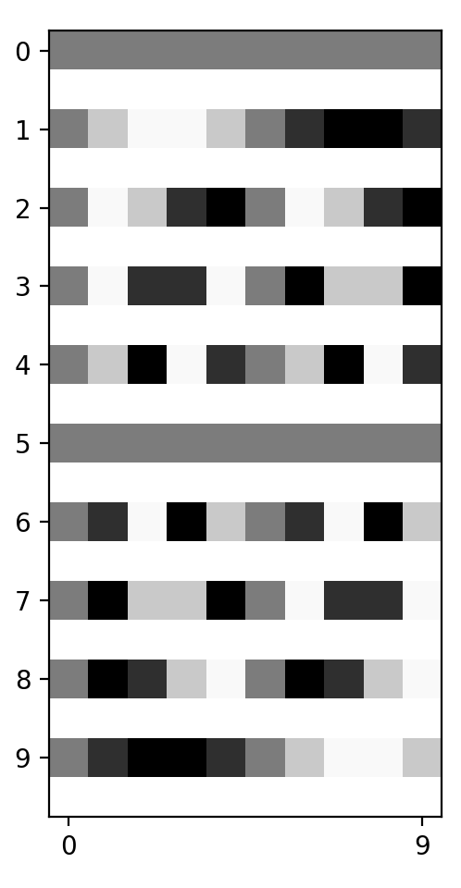
The full Fourier basis (N=10)
Real
Imaginary
Basis number
Highest frequency basis element
Complex conjugates

Slide 5
The full Fourier basis (N=10)
Real
Imaginary
Basis number
Frequency

Slide 6
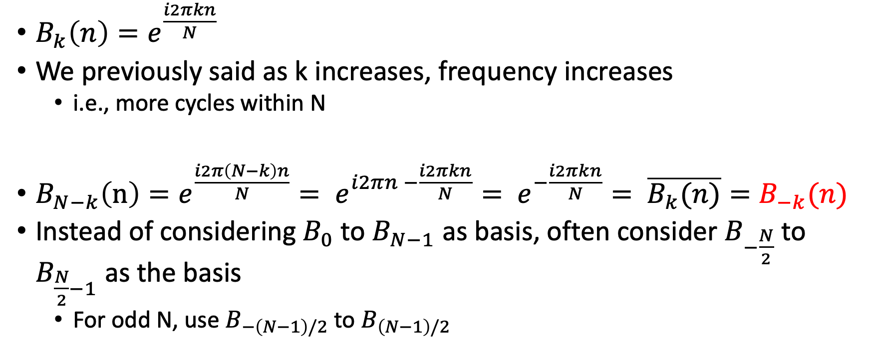
A nuance
$B_{k}\left(n\right)=e^{\frac{i2πkn}{N}}$
We previously said as k increases, frequency increases
  i.e., more cycles within N
$B_{N−k}\left(n\right)=e^{\frac{i2π\left(N−k\right)n}{N}}= e^{i2πn −\frac{i2πkn}{N}}= e^{−\frac{i2πkn}{N}}= \overline{B_{k}(n)}=B_{−k}(n)$
Instead of considering $B_{0}$ to $B_{N−1}$ as basis, often consider $B_{−\frac{N}{2}}$ to $B_{\frac{N}{2}−1}$ as the basis
  For odd N, use $B_{−\left(N−1\right)/2}$ to $B_{\left(N−1\right)/2}$

Slide 7
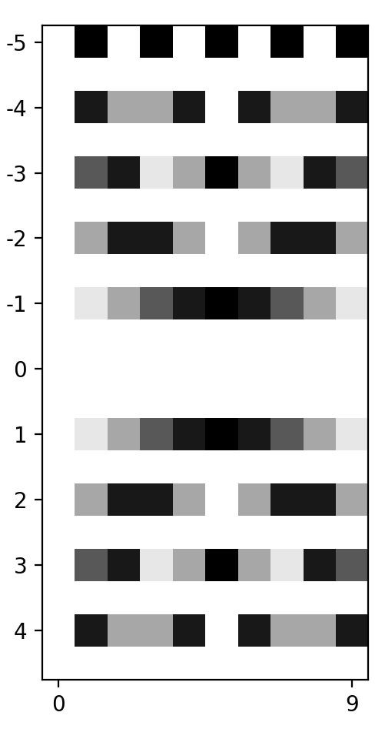
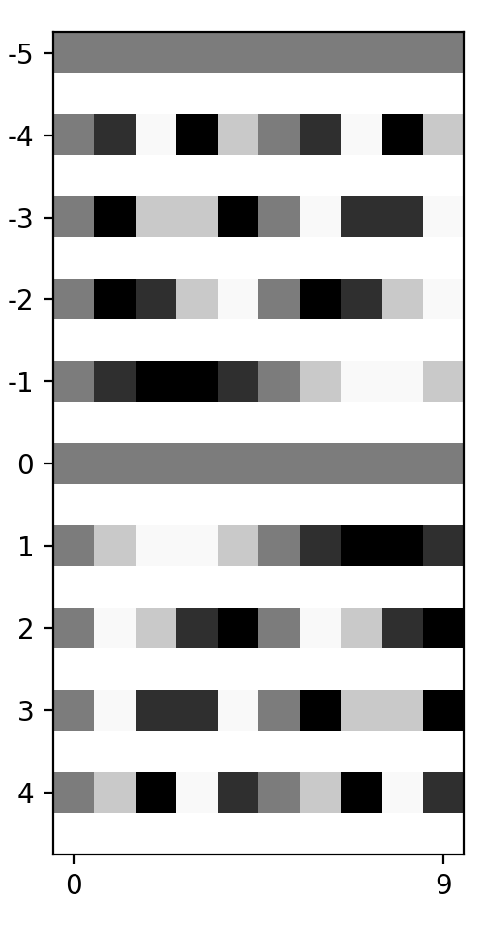
The full Fourier basis (N=10)
Real
Imaginary
Basis number
Frequency

Slide 8
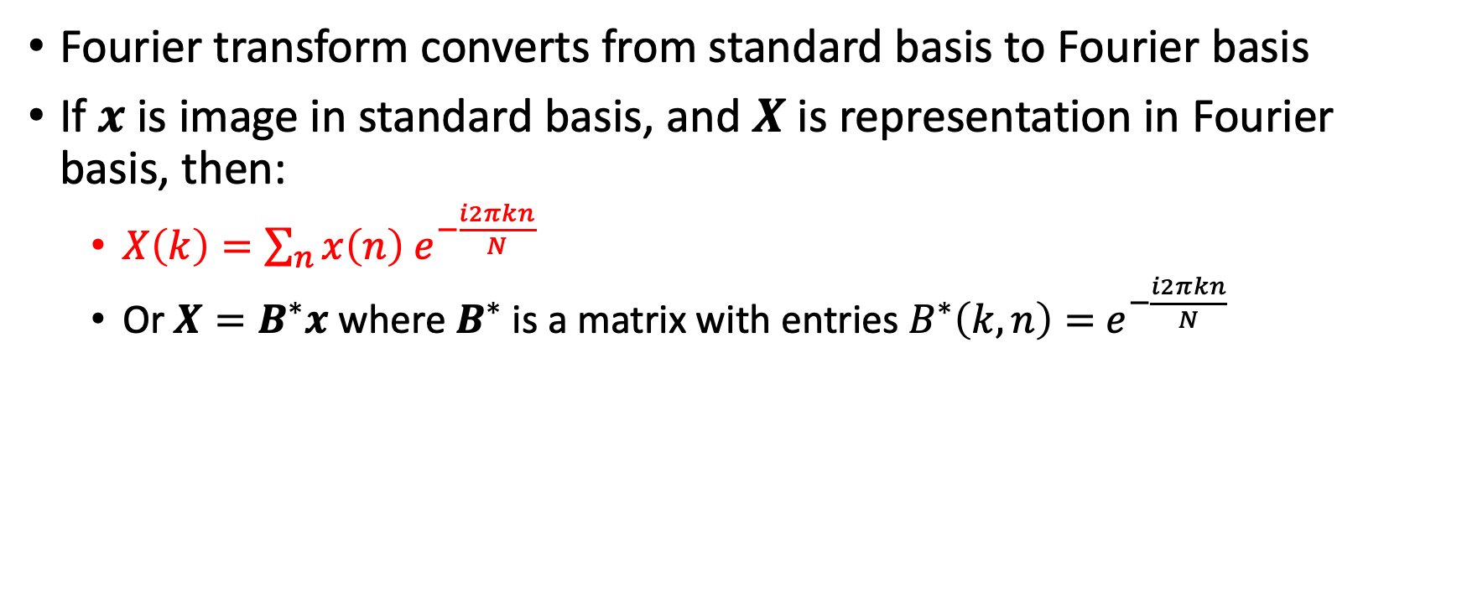
Fourier transform for 1D images
Fourier transform converts from standard basis to Fourier basis
If $x$ is image in standard basis, and $X$ is representation in Fourier basis, then:
  $X\left(k\right)=\sum_{n}{x\left(n\right) e^{−\frac{i2πkn}{N}}}$
  Or $X=B^{∗}x$ where $B^{∗}$ is a matrix with entries $B^{∗}\left(k,n\right)=$ $e^{−\frac{i2πkn}{N}}$

Slide 9
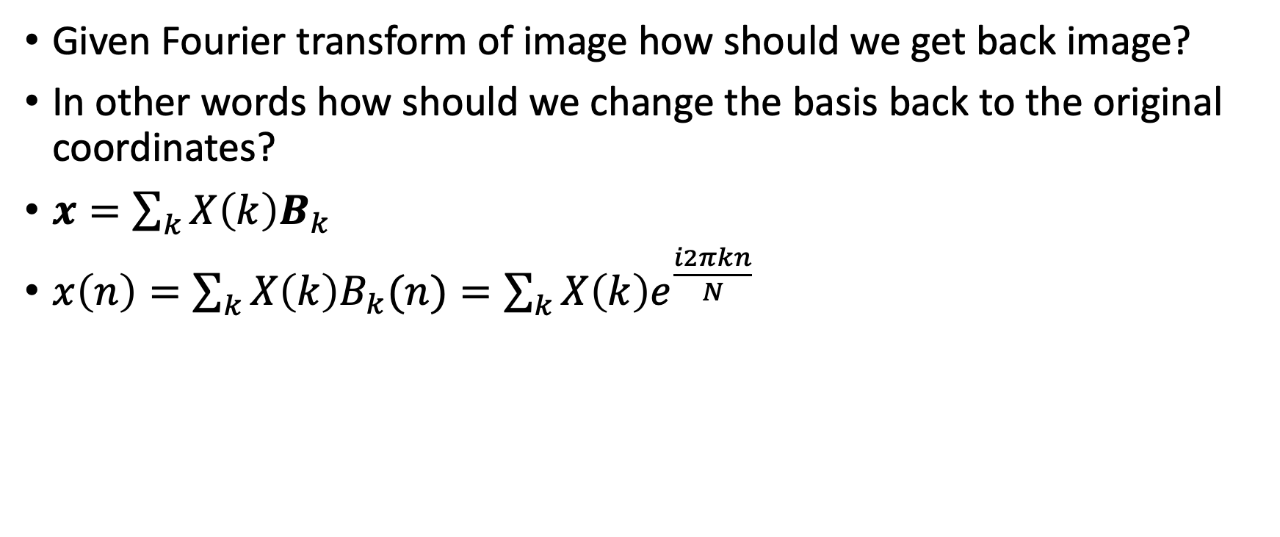
Inverse Fourier transform
Given Fourier transform of image how should we get back image?
In other words how should we change the basis back to the original coordinates?
$x=\sum_{k}{X\left(k\right)B_{k}}$
$x\left(n\right)=\sum_{k}{X\left(k\right)B_{k}(n)}=\sum_{k}{X\left(k\right)e^{\frac{i2πkn}{N}}}$

Slide 10
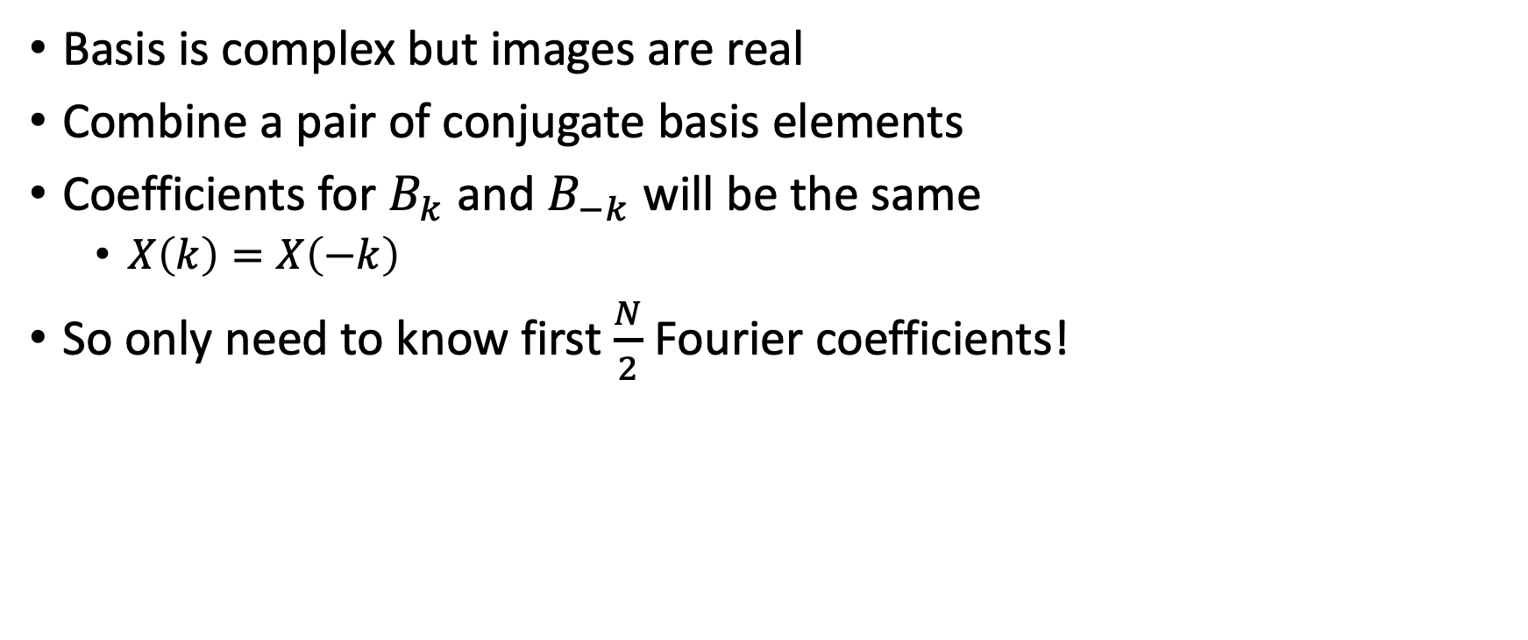
Real images in the Fourier basis
Basis is complex but images are real
Combine a pair of conjugate basis elements
Coefficients for $B_{k}$ and $B_{−k}$ will be the same
  $X\left(k\right)=X\left(−k\right)$
So only need to know first $\frac{N}{2}$ Fourier coefficients!

Slide 11
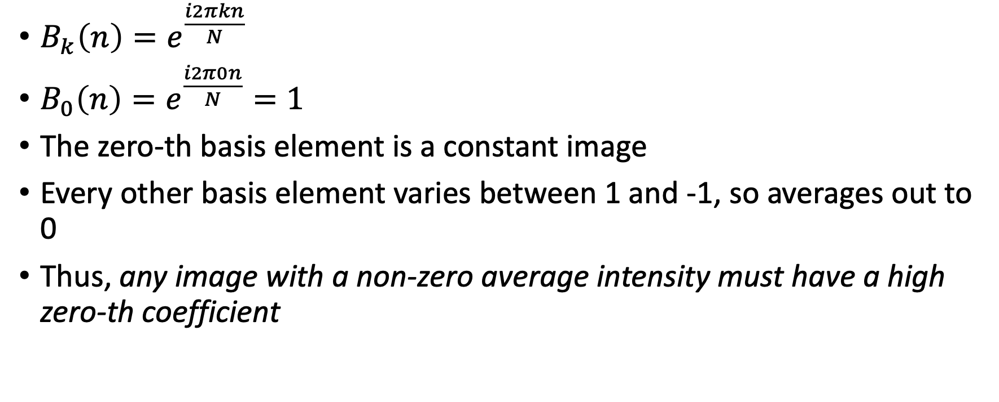
The 0-th basis
$B_{k}\left(n\right)=e^{\frac{i2πkn}{N}}$
$B_{0}\left(n\right)=e^{\frac{i2π0n}{N}}=1$
The zero-th basis element is a constant image
Every other basis element varies between 1 and -1, so averages out to 0
Thus, any image with a non-zero average intensity must have a high zero-th coefficient

Slide 12
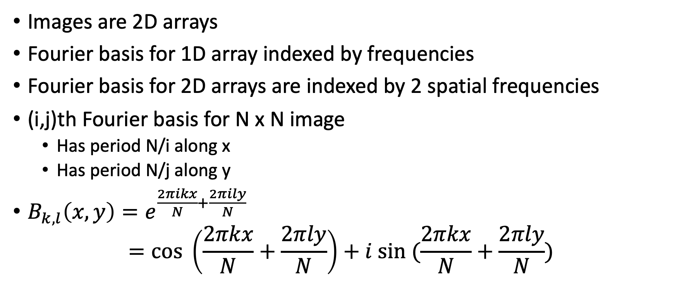
Fourier transform for 2D images
Images are 2D arrays
Fourier basis for 1D array indexed by frequencies
Fourier basis for 2D arrays are indexed by 2 spatial frequencies
(i,j)th Fourier basis for N x N image
  Has period N/i along x
  Has period N/j along y
$B_{k,l}\left(x,y\right)=e^{\frac{2πikx}{N}+\frac{2πily}{N}}$
$=cos \left(\frac{2πkx}{N}+\frac{2πly}{N}\right)+i sin (\frac{2πkx}{N}+\frac{2πly}{N})$

Slide 13




Visualizing the Fourier basis for images
$$B_{1,1}$$
$$B_{3,20}$$

Slide 14
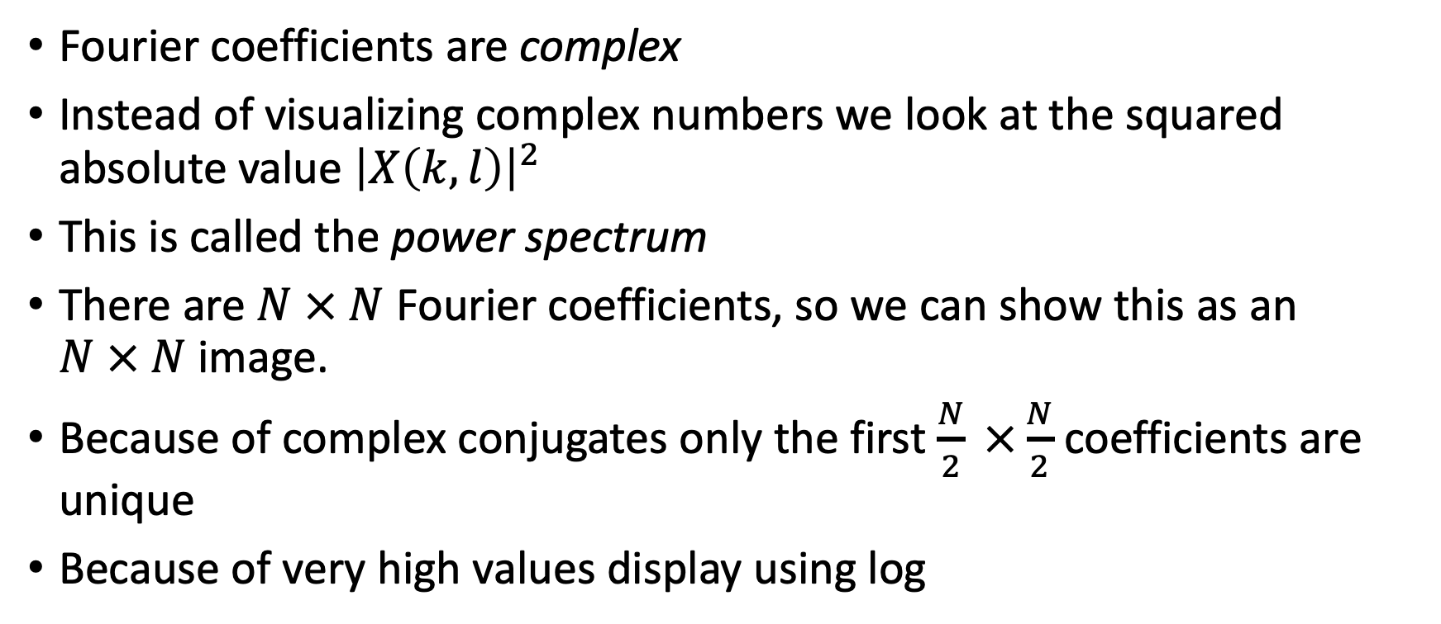
Visualizing the Fourier transform
Fourier coefficients are complex
Instead of visualizing complex numbers we look at the squared absolute value ${\left|X\left(k,l\right)\right|}^{2}$
This is called the power spectrum
There are $N × N$ Fourier coefficients, so we can show this as an $N × N$image.
Because of complex conjugates only the first $\frac{N}{2} ×\frac{N}{2}$coefficients are unique
Because of very high values display using log

Slide 15
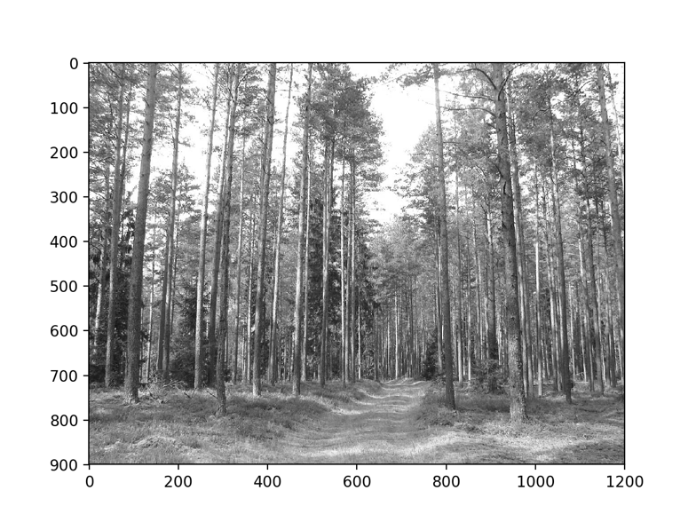
Visualizing the Fourier transform

Slide 16
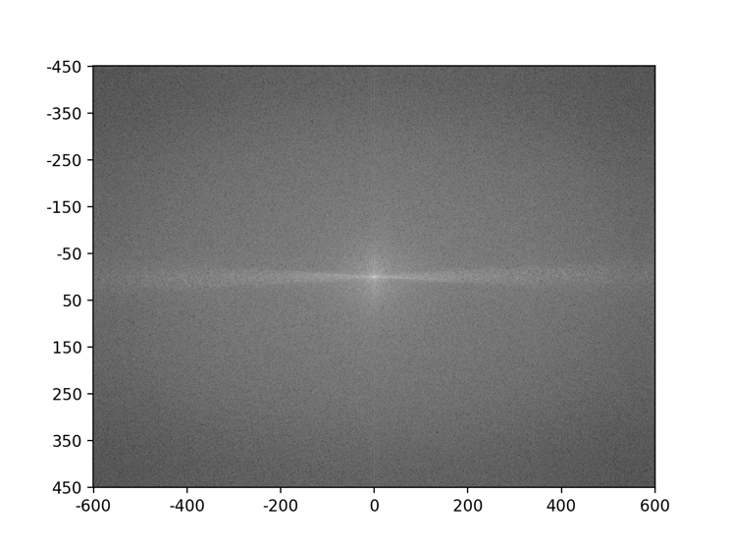
Visualizing the Fourier transform
Spatial frequency in y
Spatial frequency in x

Slide 17

Visualizing the Fourier transform
High peak for $B_{0,0}$. Why?
High values on the X axis and low values on the Y axis. Why?

Slide 18
Why Fourier transforms?
Think of image in terms of low and high frequency information
Low frequency: large scale structure, no details
High frequency: fine structure

Slide 19

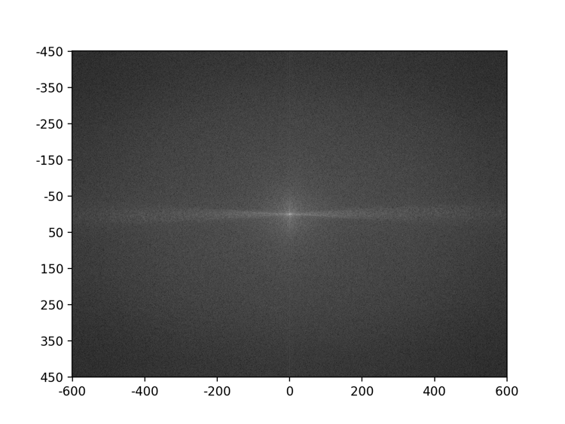
Why Fourier transforms?

Slide 20
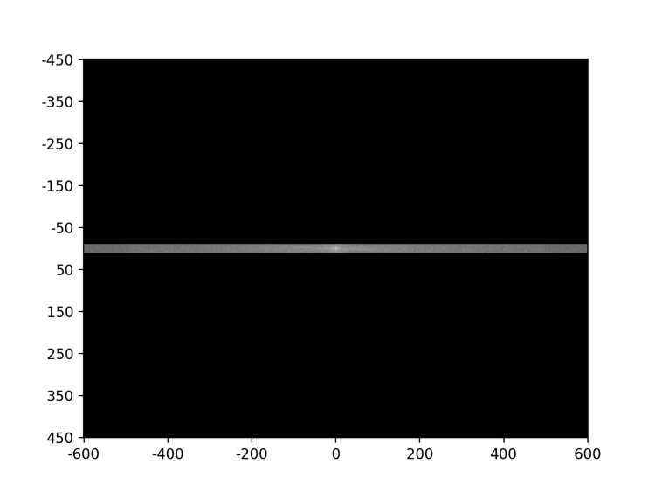
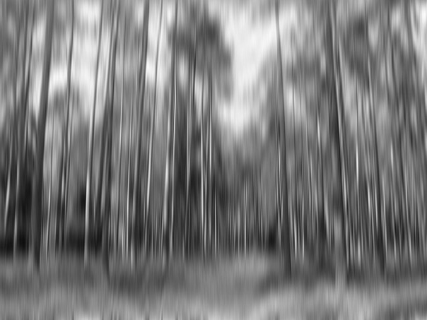
What if we zero out all high y-frequency components?

Slide 21
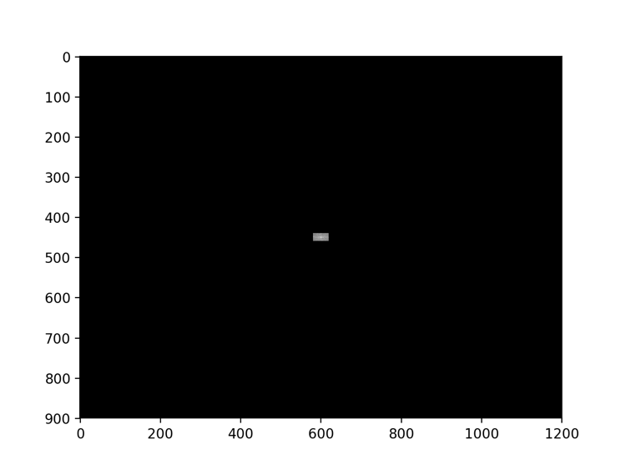
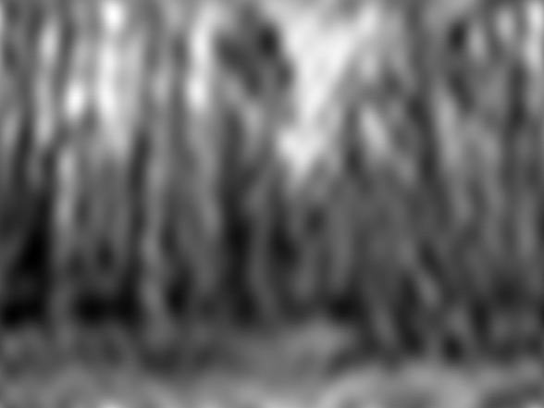
What if we zero out all high frequencies?
Removing high frequency components looks like Gaussian / mean filtering. Is there more to this relationship?

Slide 22
Dual domains
Image: Spatial domain
Fourier Transform: Frequency domain
  Amplitudes are called spectrum
For any transformations we do in spatial domain, there are corresponding transformations we can do in the frequency domain
And vice-versa
Spatial Domain

Slide 23
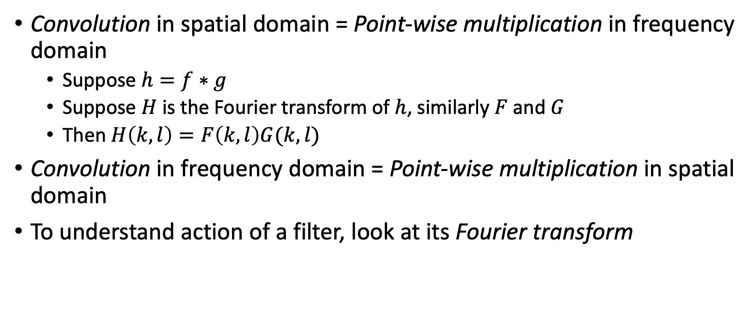
Dual domains
Convolution in spatial domain = Point-wise multiplication in frequency domain
  Suppose $h=f∗g$
  Suppose $H$ is the Fourier transform of $h$, similarly $F$ and $G$
  Then $H\left(k,l\right)=F\left(k,l\right)G(k,l)$
Convolution in frequency domain = Point-wise multiplication in spatial domain
To understand action of a filter, look at its Fourier transform

Slide 24
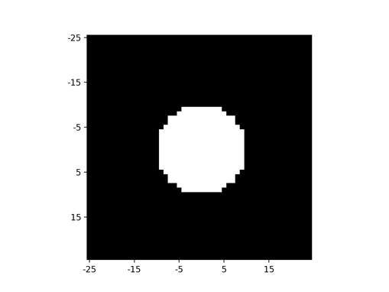
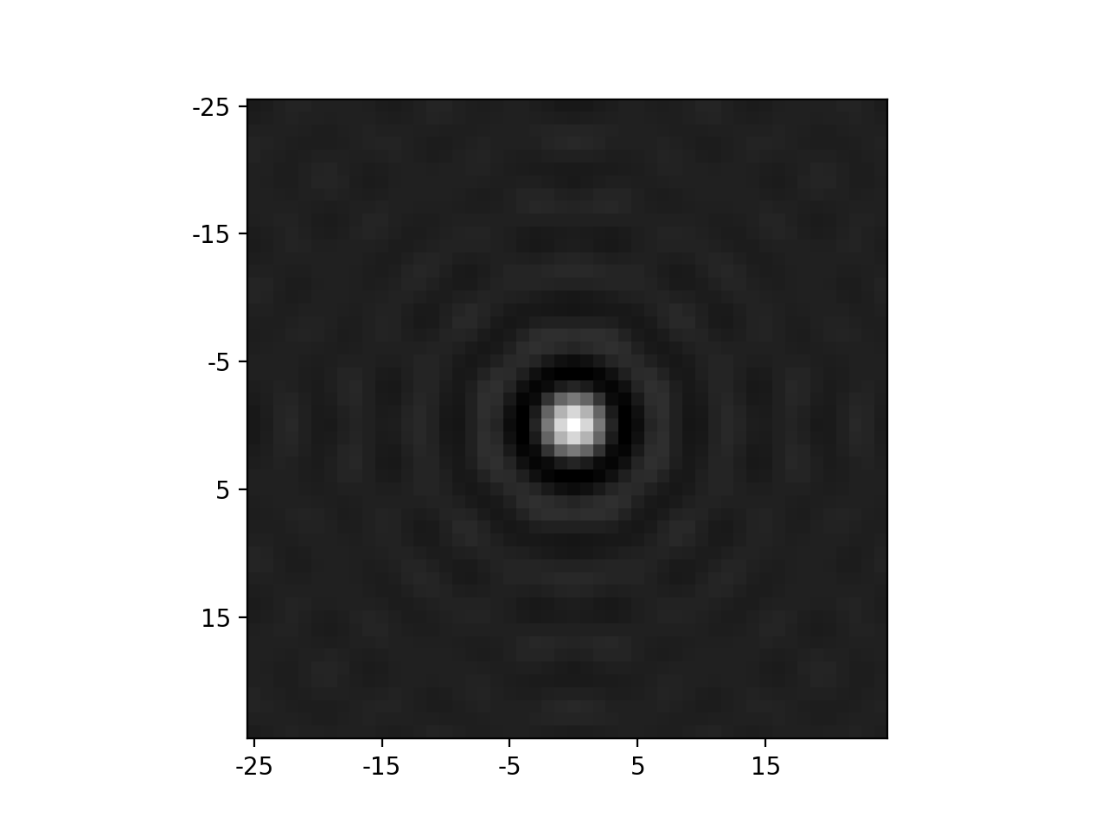
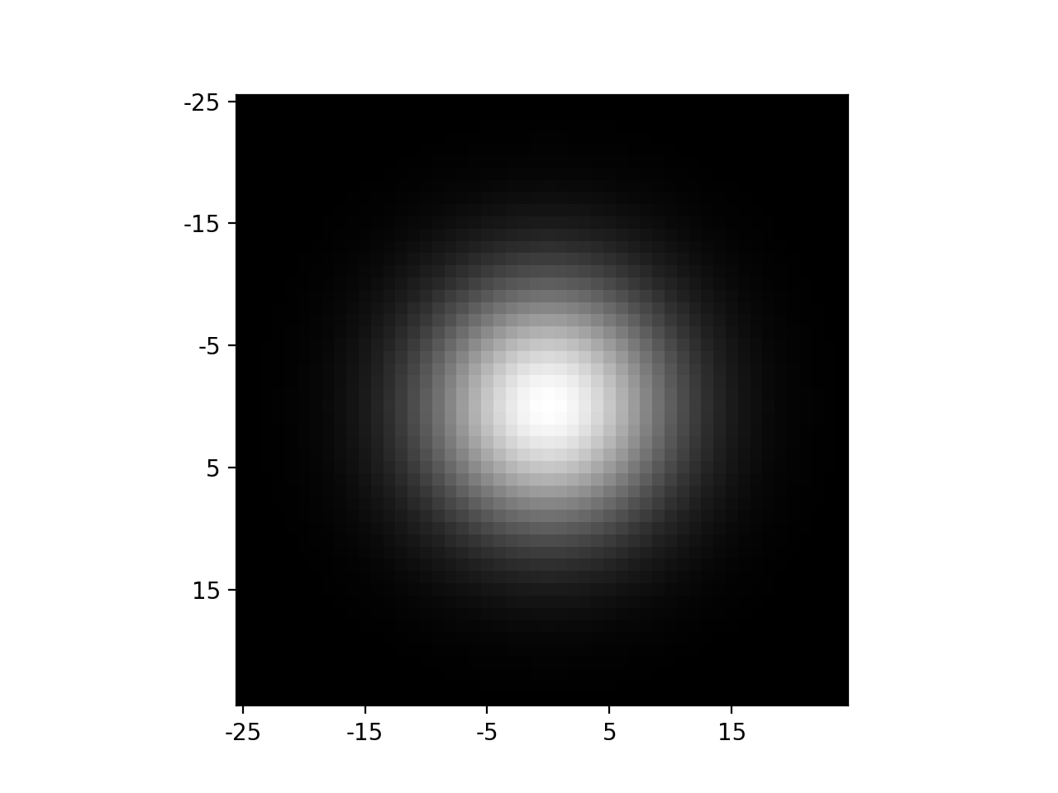

Fourier transform (Power spectrum)
Filter

Slide 25
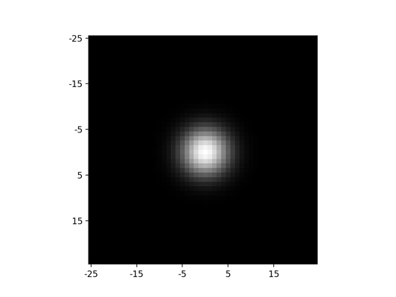
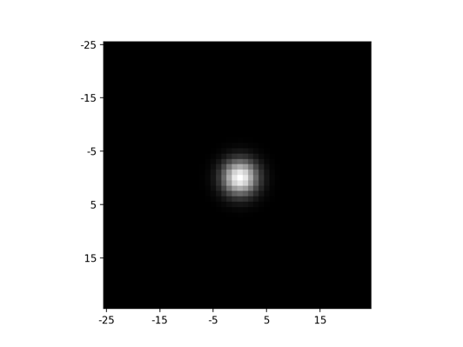
Fourier transform (Power spectrum)
Filter

Slide 26
Gaussian filtering
Fourier transform of a Gaussian is another Gaussian!
So convolving with a Gaussian in spatial domain = multiplying with Gaussian in frequency domain
  High frequencies get zeroed out
Higher the standard deviation in spatial domain = lower the std in frequency domain
  More frequencies get zeroed out.

