Slide 1
CS4670/5670: Intro to Computer Vision
Instructor: Bharath Hariharan

Slide 2
Today
Administrivia
What is computer vision?
Course overview
(Today not to be tested)

Slide 3
Course web page
http://www.cs.cornell.edu/courses/cs4670/2020sp/

Slide 4
Instructor
Bharath Hariharan (bharathh@cs.cornell.edu)
Office hours:
M/F: 2:30 – 3:30 pm, or by appointment, Gates 311
Research interests:
  Computer vision
  Machine learning

Slide 5
Grading
Scribing lectures (2%)
  Take notes and share with class
  Sign up here
Programming assignments 1 - 4 (40% total)
  These have to be done in groups of 2. Find a partner!
Written homeworks (10% total)
  These have to be done individually (no discussion)
Prelim (20%)
Final (28%)

Slide 6
Late policy
Five free “slip days” will be available for the semester

Slide 7
Important personnel
Lindsay Fei
Apoorv Khandelwal
Jiwon Kim
Eric Landgrebe
Frank Li
Mason Liu
Alisha Mithal
Riley Niu
Kane Tian
Albert Tsao
Ziyang Wu
Xiaokai (Steven) Ye
Stephanie Chang

Slide 8

Other administrative details
Reference for more details (not textbook):
  Rick Szeliski, Computer Vision: Algorithms and Applications
  online at: http://szeliski.org/Book/
Course webpage (lectures, assignments, OH): http://www.cs.cornell.edu/courses/cs4670/2020sp/
Announcements/grades via Piazza/CMS
    Sign up on piazza
    https://cmsx.cornell.edu/

Slide 9
Course requirements
Prerequisites—these are essential!
  Data structures
  A good working knowledge of python programming
  Calculus (plus basic multivariate calculus)
Pre-requisites (highly encouraged)
  Linear algebra (tutorial)
Course does not assume prior imaging experience
  computer vision, image processing, graphics, etc.

Slide 10
Questions?

Slide 11
Today
What is computer vision?
  What is the input?
  What should be the output?
How easy or hard is it?
What have we done so far?
Our course

Slide 12
What is computer vision?

Slide 13
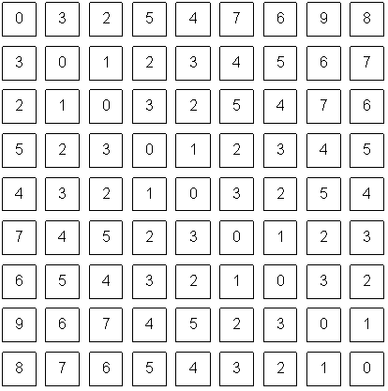
What is computer vision?
What is the input?

Slide 14
What is the input?
A (gray-scale) image is a 2D array
For purposes of this course, array of real numbers
  Any 2D array of real numbers can be treated as an image
  Typically white = high, black = low

Slide 15
What is the input?
An image is a 2D array
For purposes of this course, array of real numbers
  Any 2D array of real numbers can be treated as an image
What about color images?

Slide 16

What is the input
Channels(=3)
height
width

Slide 17
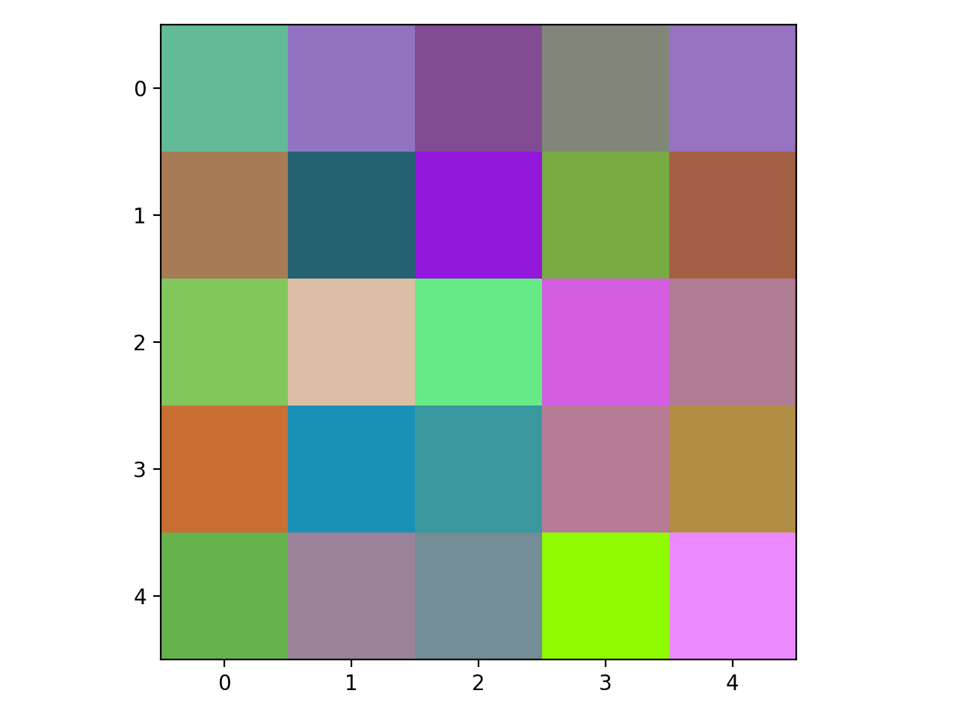
What is the input
[130,76,149]
[130,199,92]

Slide 18
What is the output?
Depends on what we want to do with the image

Slide 19
What do we do with images?
Example 1: Robotics
Understanding terrain and identifying obstacles
Notes:
Need computer vision to perceive the world
Why do we need perception?
Example 1: robots in environments humans can’t go, like Mars Rover.
Navigating requires understanding environment so as to not bump into nasty things, fall into crevasses etc.
Vision useful tool because can ”see” a very large part of the environment, and potentially very far away.

Slide 20
What do we do with images?
Example 1: Robotics
Understanding terrain and identifying obstacles
Identifying people and understanding their intentions
http://theoatmeal.com/blog/google_self_driving_car
Notes:
For robots in human environments, need to perceive not just obstacles or navigational stuff but also where humans are, what they are doing, and even what they intend to do. For example, self driving cars need to not only find out if there are pedestrians, but also figure out the intent of the pedestrian: is she going to cross? Should we wait? Etc.

Slide 21
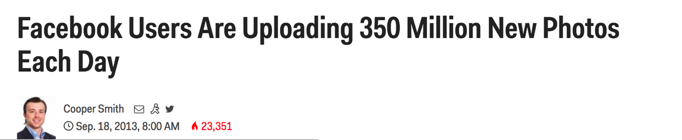
What do we do with images?
Example 2: Internet Vision
Recognizing obscene/ violent content
Creating new content (image editing)
Notes:
Example 2: The internet is full of visual data. Need to understand this visual data to: prune out or flag objectionable content, understand what people like or hate or are looking for, and use that for nefarious purposes like selling things, or help visually impaired people consume this visual content. Example: is this livestream video the video of a crime? Should this be reported and the people apprehended? Is this just news coverage?

Slide 22
What do we do with images?
Example 3: AR/VR
Understand 3D structure of the world
Notes:
Example 3: A big promise nowadays is AR (Augmented Reality), where we can see virtual things interacting with the real world. This can be used for education, for visualizing in engineering and STEM fields, for playing games and so on. But for virtual things to interact correctly with the real world, need to perceive the real world properly. Is this a table? Should things bounce off of it, or sink into it? Where’s the surface of the table?

Slide 23
The goal(s) or computer vision
Reconstruction
  Understanding 3D structure of the world
Grouping
  Group pixels into objects
Recognition
  Classify objects, scenes, actions…
Notes:
If we want to check for objectionable content, then we may just want to know what the image is about.
In a self driving car, we may want to know if there are any pedestrians, or other cars, in the visual field, and if so, where are they so that we don’t run into them.
We may also want to know how they are oriented in space and where they are moving.
To navigate the scene successfully, both robots and self driving cars will need to know what the layout of the scene is in 3D.
If we are building a robot that has to pick things up, it probably needs to know the location and orientation fairly precisely, but it will also need to know the shape of the object and where it can be grasped.
And so on.
As humans, we do this fairly easily, and so many of you may not understand why this is so hard. Give example.

Slide 24
How easy/HARD is it?

Slide 25
Vision is easy for humans

Slide 26
Vision is easy for humans
Attneave’s cat

Slide 27
Vision is easy for humans
Mooney faces

Slide 28

Vision is easy for humans
Source: “80 million tiny images” by Torralba, et al.

Slide 29
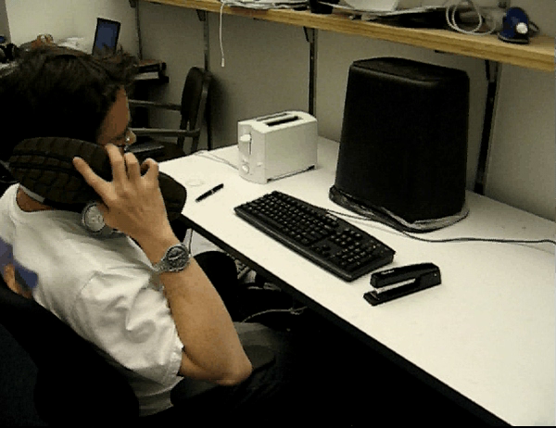


Slide 30
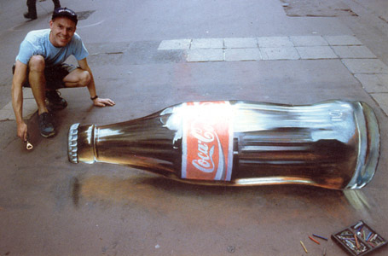
Vision is hard: Images are ambiguous

Slide 31
Vision is hard: Objects blend together
Notes:
For example, do you see something weird in this photograph of a Hollywood actor?
Do you think the actor’s body is this?

Slide 32
Vision is hard: Objects blend together
Notes:
And the thing is, a lot of the animal life on this planet has evolved to take advantage of this ambiguity, through camouflage.
Do you see the spider in here?
If we want a system that can detect spiders and lions and tigers and leopards in their natural environments, well we have to find a way around this ambiguity.

Slide 33
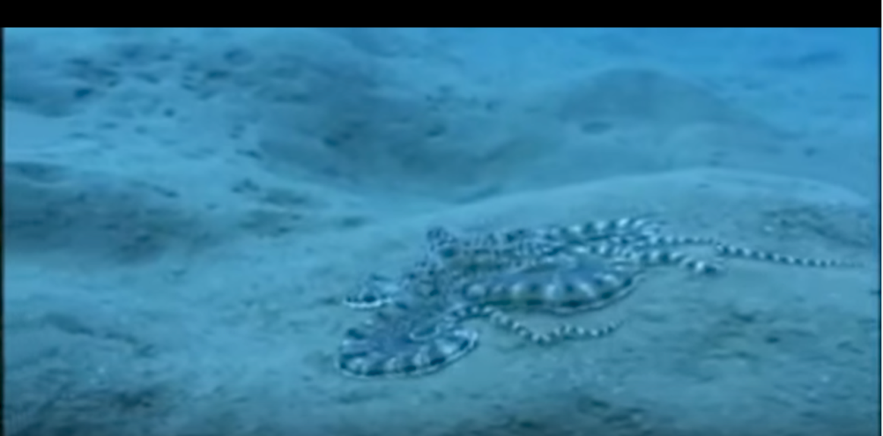
Vision is hard: Concepts have variance
Notes:
As if this ambiguity is not enough, a lot of things in the world can change shape and can look very different when you look at them from different directions. This mimic octopus here is a particularly egregious example, as it intentionally pretends to be something else.

Slide 34
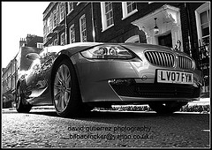
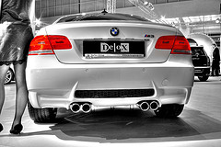
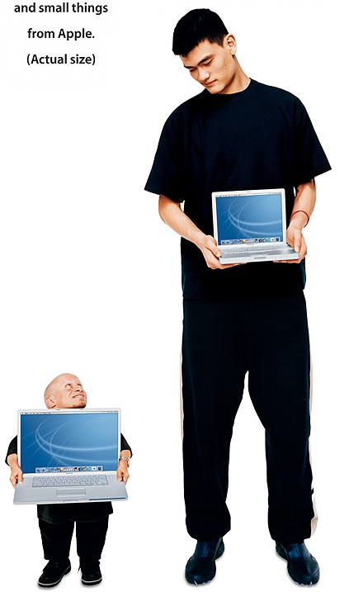
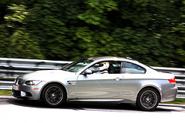
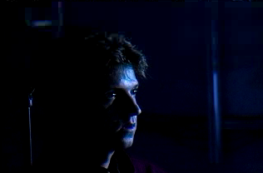
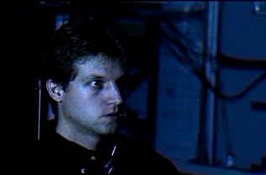
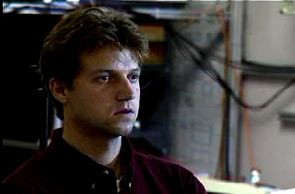
The many faces of intra-class variance
Viewpoint variation
Scale
Illumination

Slide 35
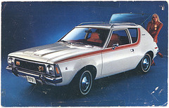
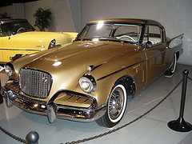
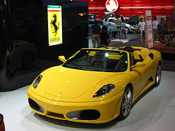
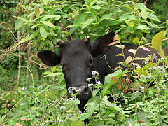
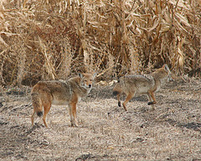
The many faces of intra-class variance
Shape variation
Occlusion
Background clutter

Slide 36
Vision is hard: Concepts are subtle
Tenessee Warbler
Orange Crowned Warbler
https://www.allaboutbirds.org
Notes:
At the same time, two things might look very similar, but be completely different. For example, these are two different species of birds even though they look very similar.

Slide 37
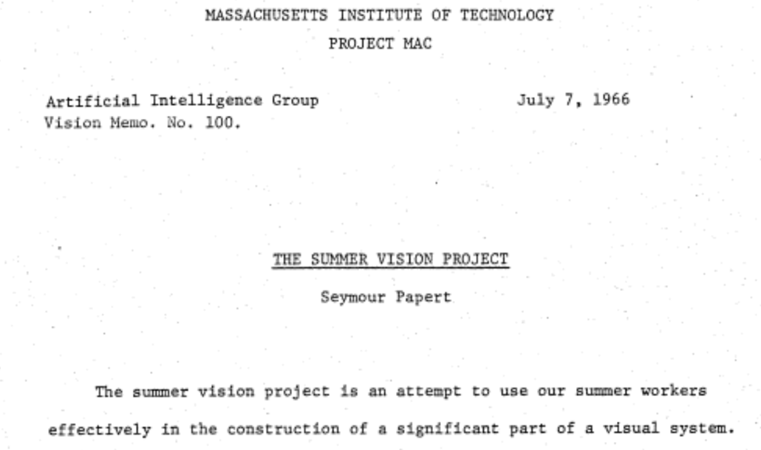
The “summer vision project”

Slide 38
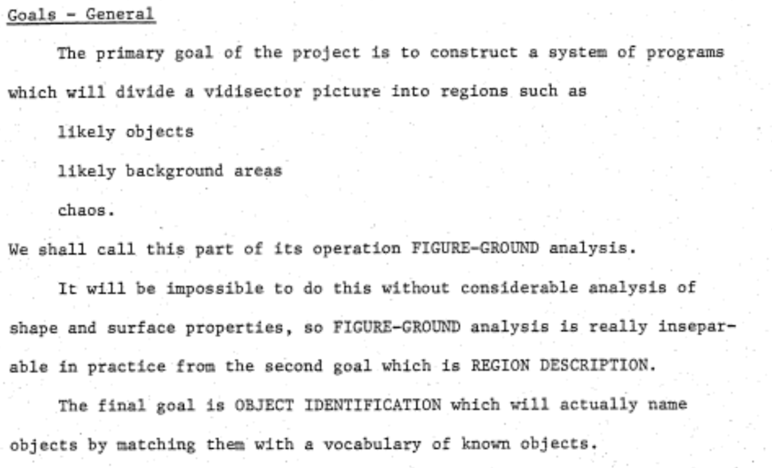
The “summer vision project”

Slide 39
The big reveal
“… in the 1960s almost no one realized that machine vision was difficult… The common and almost despairing feeling of the early investigators like B.K.P. Horn and T.O. Binford was that practically anything could happen in an image and furthermore that practically everything did."
--- Marr, 1982

Slide 40
Perception is the big problem
Our first foray into Artificial Intelligence was a program that did a credible job of solving problems in college calculus. Armed with that success, we tackled high school algebra; we found, to our surprise, that it was much harder. Attempts at grade school arithmetic provide problems of current research interest. An exploration of the child’s world of blocks proved insurmountable, except under the most rigidly constrained circumstances.
It finally dawned on us that the overwhelming majority of what we call intelligence is developed by the end of the first year of life.”
– Marvin Minsky, 1977

Slide 41
Where are we now?

Slide 42
Deployed: depth cameras
https://realsense.intel.com/stereo/
Microsoft Kinect

Slide 43
Deployed: depth cameras
Iphone TrueDepth

Slide 44
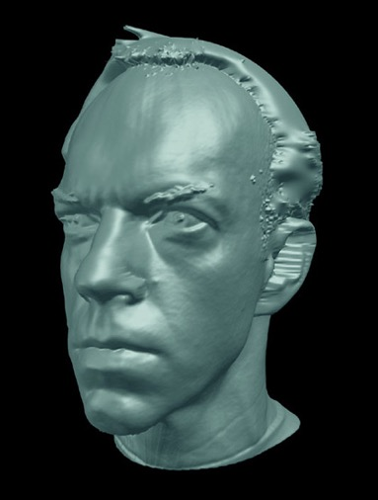
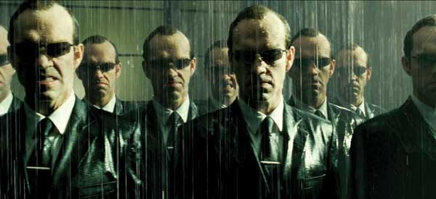
Deployed: shape capture
The Matrix movies, ESC Entertainment, XYZRGB, NRC
Source: S. Seitz

Slide 45
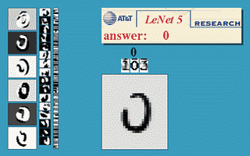
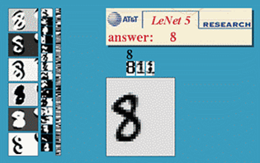
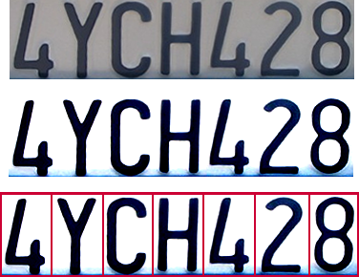
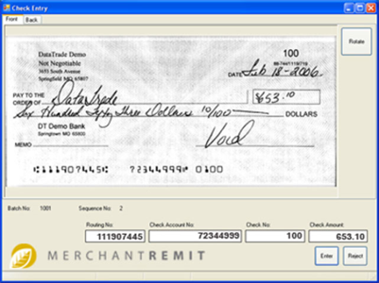
Deployed: Optical character recognition (OCR)
  If you have a scanner, it probably came with OCR software
Digit recognition, AT&T labs
http://www.research.att.com/~yann/
License plate readers
http://en.wikipedia.org/wiki/Automatic_number_plate_recognition
Automatic check processing
Source: S. Seitz

Slide 46
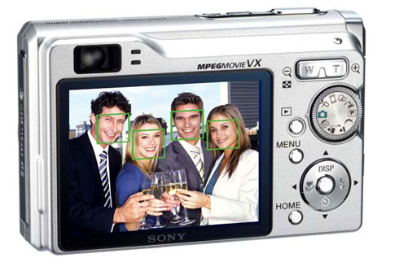
Deployed: Face detection
Cameras now detect faces
  Canon, Sony, Fuji, …
Source: S. Seitz
Notes:
Why would this be useful? Main reason is focus. Also enables “smart” cropping.

Slide 47
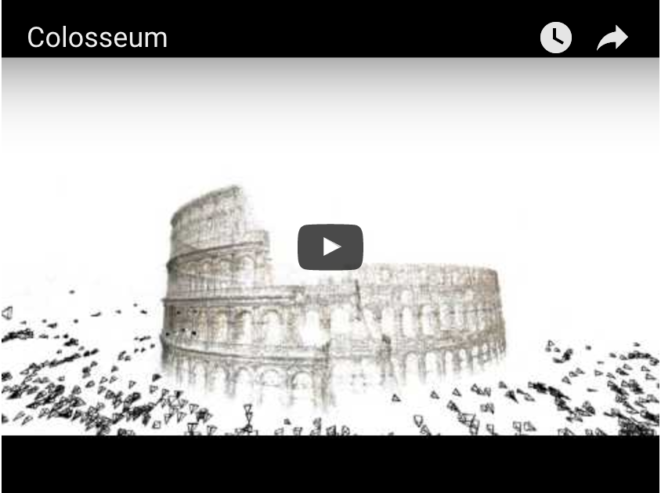
Established technology: 3D Models of the world
Building Rome in a Day.
Sameer Agarwal, Noah Snavely, Ian Simon, Steven M. Seitz and Richard Szeliski.
ICCV, 2009, Kyoto, Japan.

Slide 48
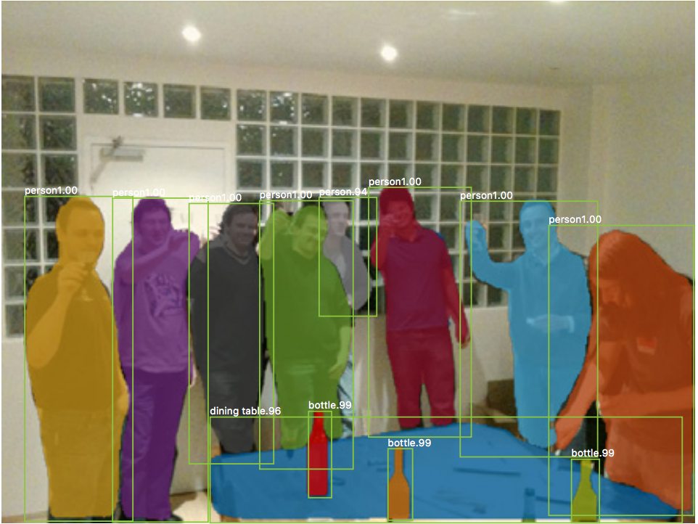
Significant progress: Recognizing objects
Mask R-CNN. Kaiming He, Georgia Gkioxari, Piotr Dollar, Ross Girshick. ICCV 2017

Slide 49

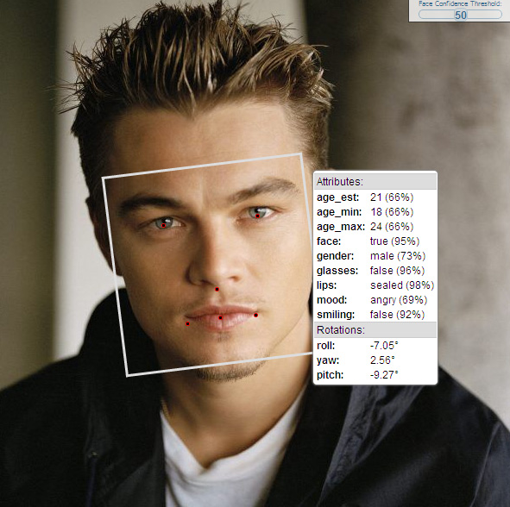
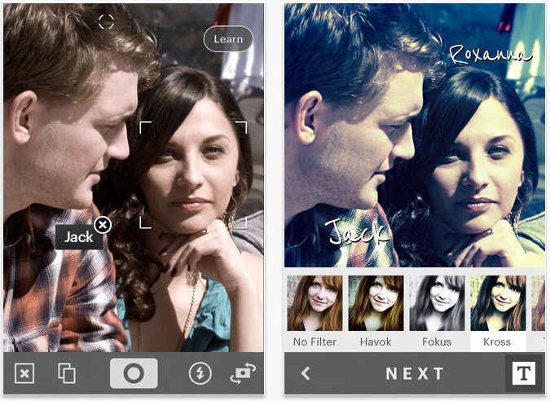
Significant progress: Face Recognition

Slide 50

Recognition-based product search

Slide 51
Significant progress: Species recognition
[iNaturalist]

Slide 52
Our Course

Slide 53
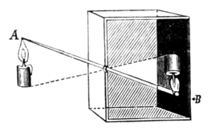
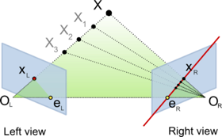
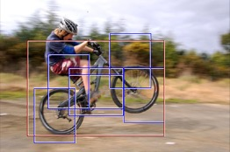
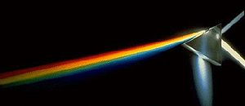
Course overview (tentative)
Low and mid-level vision
  basic image formation
  image processing, segmentation
Reconstruction
  cameras, geometry and physics of image formation
  stereo, structure from motion
Recognition
  primer on machine learning, convolutional networks
  classification, detection, segmentation

Slide 54
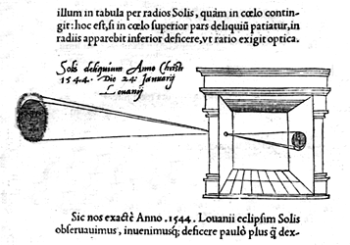


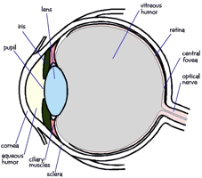

1. Low-level vision
Basic image processing and image formation
*
=
Filtering, edge detection
Image formation

Slide 55
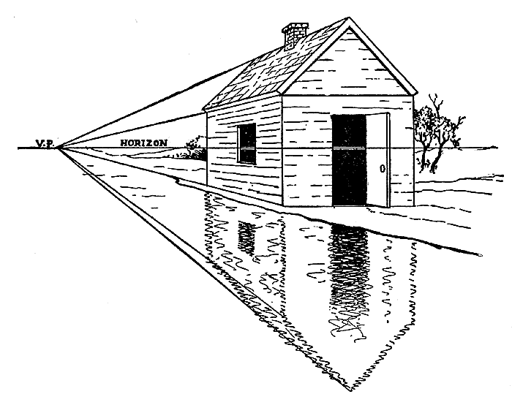
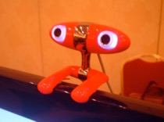
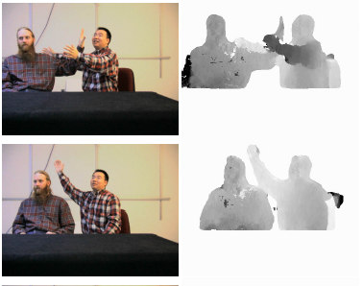
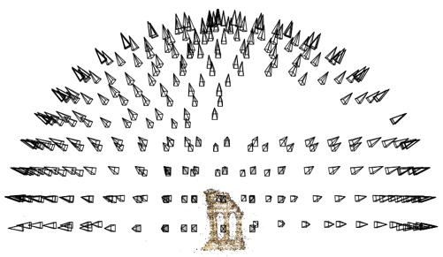
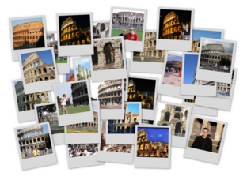
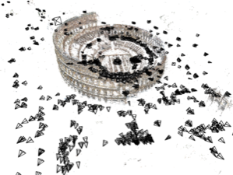
2. Reconstruction
Projective geometry
Stereo
Multi-view stereo
Structure from motion

Slide 56

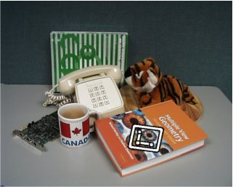


Project: Feature detection and matching

Slide 57
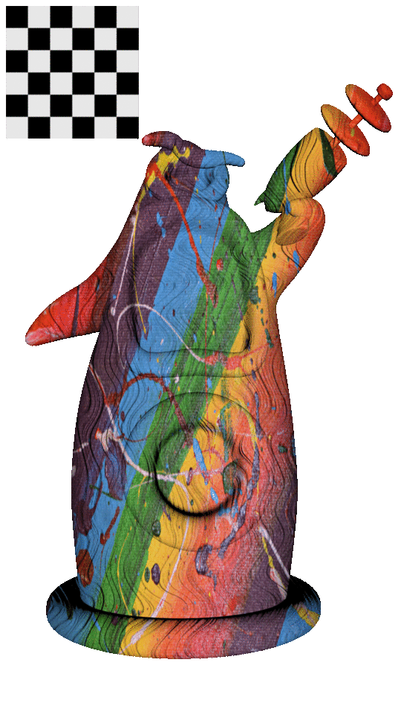
Project: Stereo and photometric stereo

Slide 58
3. Recognition
“Cat”
Image classification
Object detection
cat
grass
Semantic segmentation
Sources: D. Lowe, L. Fei-Fei

Slide 59
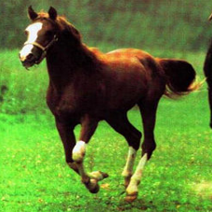
Project: Deep learning for classification
Horse

