Slide 1
Other approaches to obtaining 3D structure

Slide 2

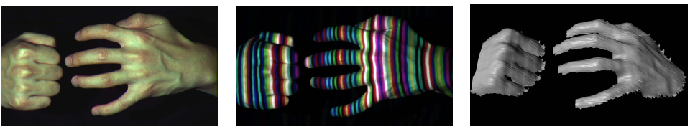
Active stereo with structured light
Project “structured” light patterns onto the object
simplifies the correspondence problem
Allows us to use only one camera
camera
projector
L. Zhang, B. Curless, and S. M. Seitz. Rapid Shape Acquisition Using Color Structured Light and Multi-pass Dynamic Programming. 3DPVT 2002

Slide 3
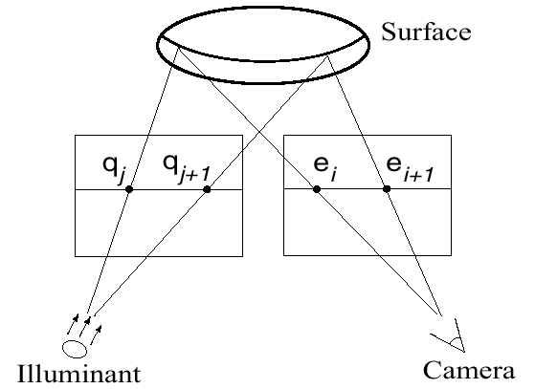
Active stereo with structured light
L. Zhang, B. Curless, and S. M. Seitz. Rapid Shape Acquisition Using Color Structured Light and Multi-pass Dynamic Programming. 3DPVT 2002

Slide 4
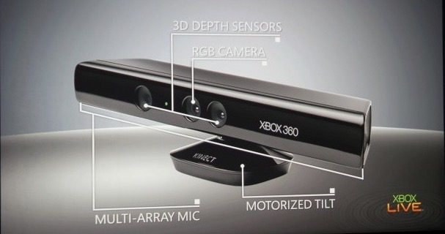
Microsoft Kinect

Slide 5
Light and geometry

Slide 6
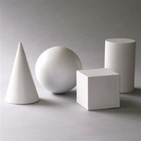
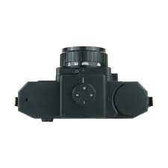
Till now: 3D structure from multiple cameras
Problems:
requires calibrated cameras
requires correspondence
Other cues to 3D structure?
Key Idea: use feature motion to understand shape

Slide 7
What does 3D structure mean?
We have been talking about the depth of a pixel
(X,Y,Z)
(x,y)
Pinhole

Slide 8
What does 3D structure mean?
But we can also look at the orientation of the surface at each pixel: surface normal
(N_{X},N_{Y},N_{Z})
(x,y)
Pinhole
Not enough by itself to reveal absolute locations, but gives enough of a clue to object shape

Slide 9
Shading is a cue to surface orientation
Facing away from the sun, hence dark – “shadow”
Facing the sun, hence bright
Facing orthogonal to the sun, hence dark

Slide 10
Shading is a cue to surface orientation
Till now we have looked at where a pixel comes from
Now: what is its color?
Depends on:
Color and amount of lighting
Orientation of surface relative to lighting
Paint on the surface

Slide 11
How does light interact with the scene?
Light is a bunch of photons
Photons are energy packets
Light starts from the light source, is reflected / absorbed by surfaces and lands on the camera
Two key questions:
What property of light does a camera pixel record? Radiance
How does the radiance of a pixel depend on lighting, shape and paint?

Slide 12
Radiance
How do we measure the “strength” of a beam of light?
Idea: put a sensor and see how much energy it gets
If the sensor is slanted it gets less energy
A larger sensor captures more energy

Slide 13
Radiance
How do we measure the “strength” of a beam of light?
Radiance: power in a particular direction per unit area when surface is orthogonal to direction
If the sensor is slanted it gets less energy
A larger sensor captures more energy

Slide 14
Radiance
Pixels measure radiance
This pixel
Measures radiance along this ray

Slide 15

Where do the rays come from?
Rays from the light source “reflect” off a surface and reach camera
Surface gets some energy from the light source: irradiance
Depending on paint, some of this energy is reflected back

Slide 16
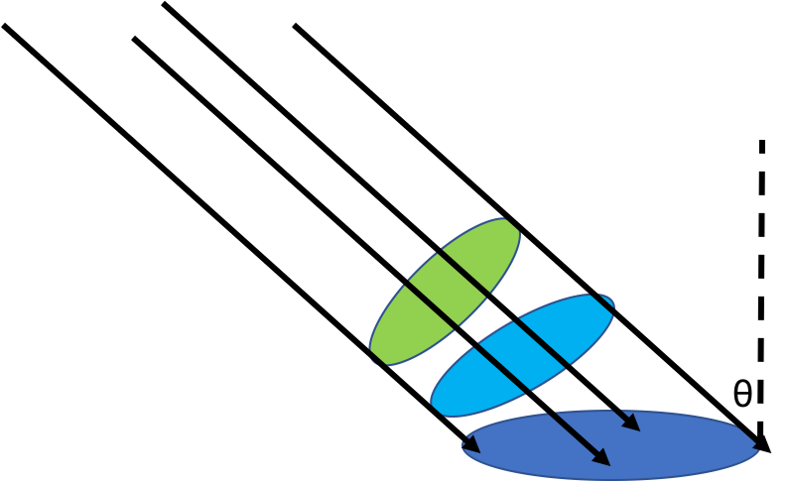


Irradiance
What is the energy received by a surface from a light source?
Depends on the area of the surface and its orientation relative to light
A$\cos{θ}$
All disks receive same energy
$$θ$$
A

Slide 17

Irradiance
Power received by a surface patch
of area A
from a beam of radiance L
coming at angle $θ$= LAcos$θ$
A$\cos{θ}$
$$θ$$
A

Slide 18
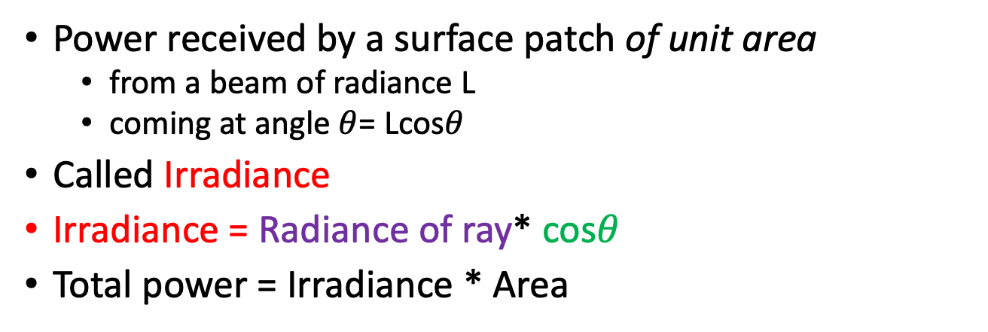
Irradiance
Power received by a surface patch of unit area
from a beam of radiance L
coming at angle $θ$= Lcos$θ$
Called Irradiance
Irradiance = Radiance of ray* cos$θ$
Total power = Irradiance * Area
A$\cos{θ}$
$$θ$$
A

Slide 19
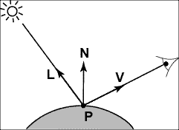
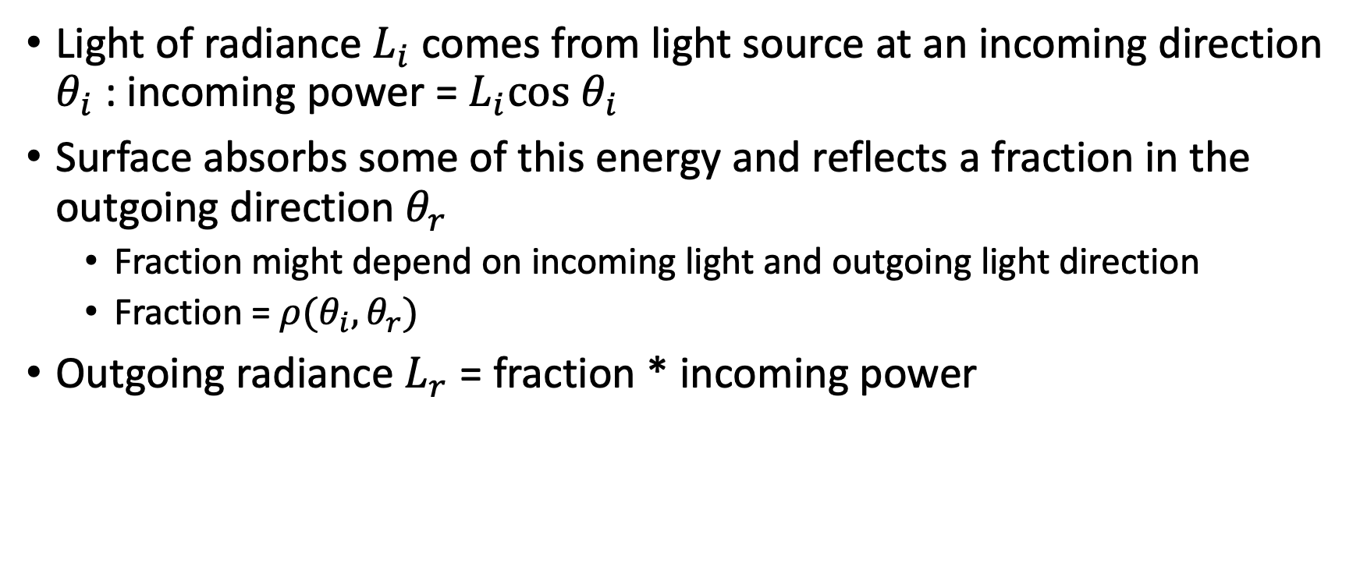
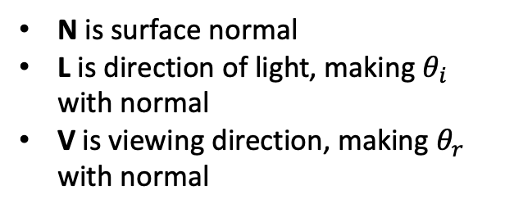


Light rays interacting with a surface
Light of radiance $L_{i}$comes from light source at an incoming direction $θ_{i}$ : incoming power = $L_{i}cos θ_{i}$
Surface absorbs some of this energy and reflects a fraction in the outgoing direction $θ_{r}$
Fraction might depend on incoming light and outgoing light direction
Fraction = $ρ(θ_{i},θ_{r})$
Outgoing radiance $L_{r}$ = fraction * incoming power
N is surface normal
L is direction of light, making $θ_{i}$ with normal
V is viewing direction, making $θ_{r}$ with normal
$$θ_{i}$$
$$θ_{r}$$

Slide 20

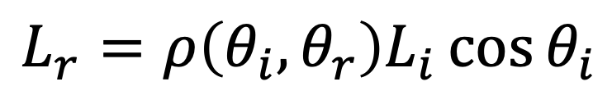
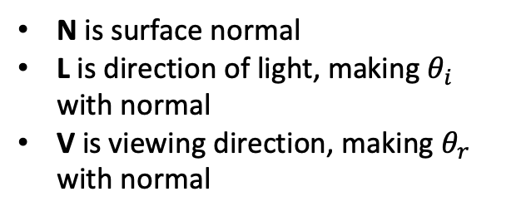

Light rays interacting with a surface
N is surface normal
L is direction of light, making $θ_{i}$ with normal
V is viewing direction, making $θ_{r}$ with normal
$$θ_{i}$$
$$θ_{r}$$
Output radiance along V
$$L_{r}=ρ\left(θ_{i},θ_{r}\right)L_{i}\cos{θ_{i}}$$
Incoming irradiance along L
Bi-directional reflectance function (BRDF)

Slide 21
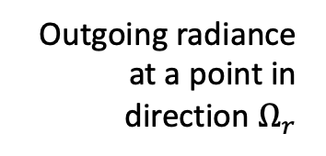
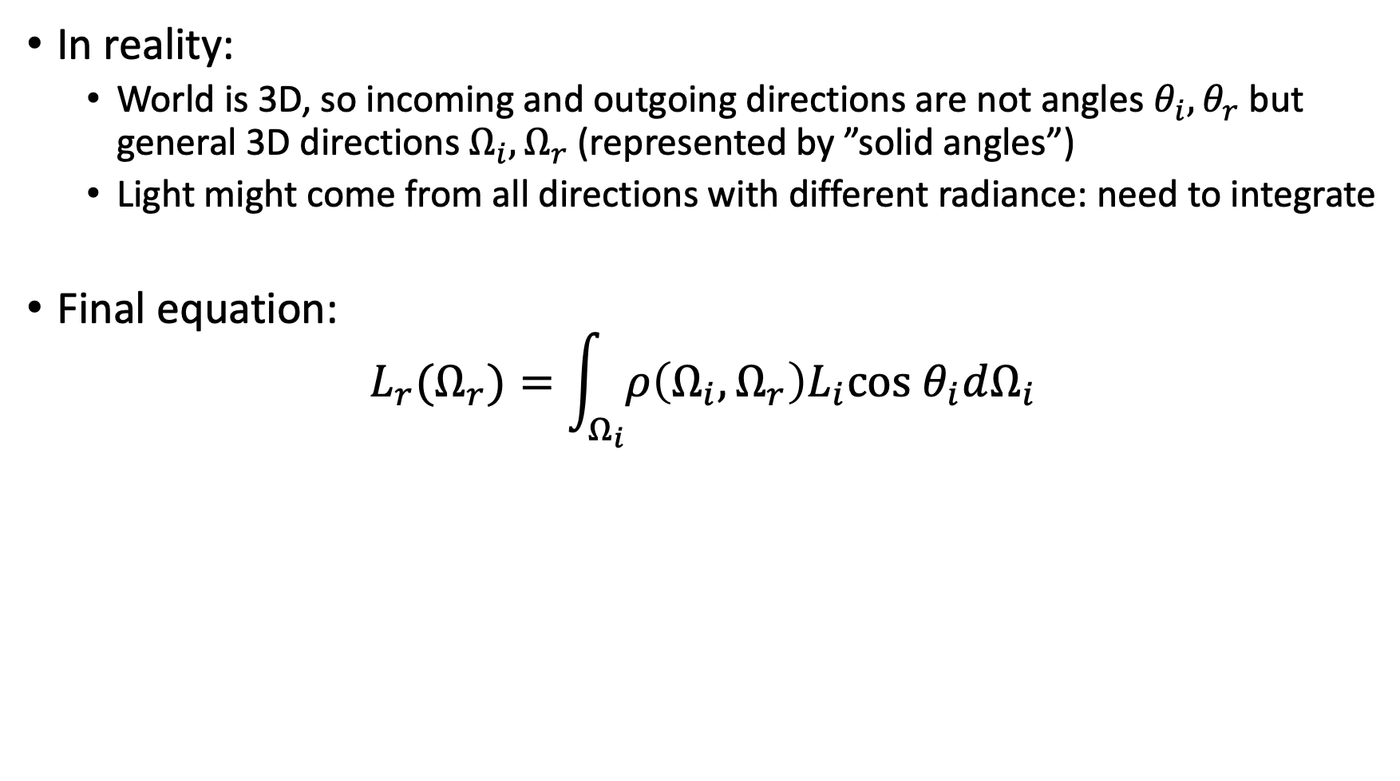

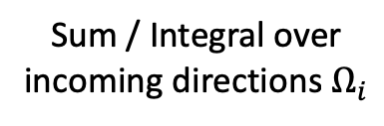
Light rays interacting with a surface
In reality:
World is 3D, so incoming and outgoing directions are not angles $θ_{i}, θ_{r}$ but general 3D directions $Ω_{i}, Ω_{r}$ (represented by ”solid angles”)
Light might come from all directions with different radiance: need to integrate
Final equation: $L_{r}(Ω_{r})=\int_{Ω_{i}}{ρ\left(Ω_{i}, Ω_{r}\right)L_{i}cos θ_{i}dΩ_{i}}$
BRDF
Outgoing radiance at a point in direction $Ω_{r}$
Incoming irradiance in direction $Ω_{i}$
Sum / Integral over incoming directions $Ω_{i}$

Slide 22



Radiance, irradiance and light
A separate radiance for every direction for every surface point
Color at (x,y) = $I\left(x,y\right)=L_{r}(x, Ω_{r})$
N
$$Ω_{i}$$
$$Ω_{r}$$
x
(x,y)
Pinhole

Slide 23
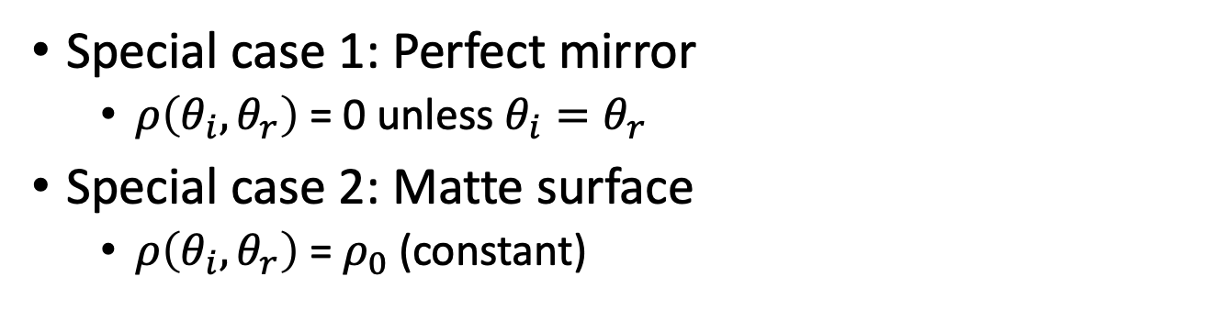
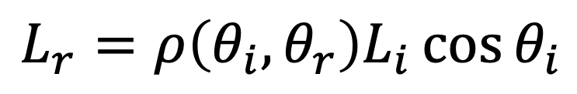
What should BRDF be?
$$L_{r}=ρ\left(θ_{i},θ_{r}\right)L_{i}\cos{θ_{i}}$$
$$θ_{i}$$
$$θ_{r}$$
Special case 1: Perfect mirror
$ρ\left(θ_{i},θ_{r}\right)$ = 0 unless $θ_{i}=θ_{r}$
Special case 2: Matte surface
$ρ\left(θ_{i},θ_{r}\right)$ = $ρ_{0}$(constant)

Slide 24
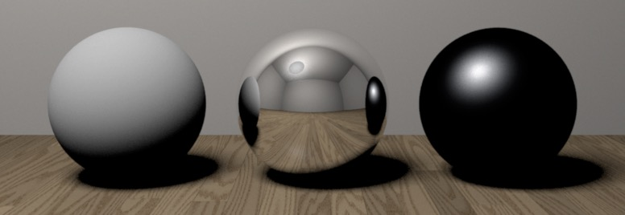
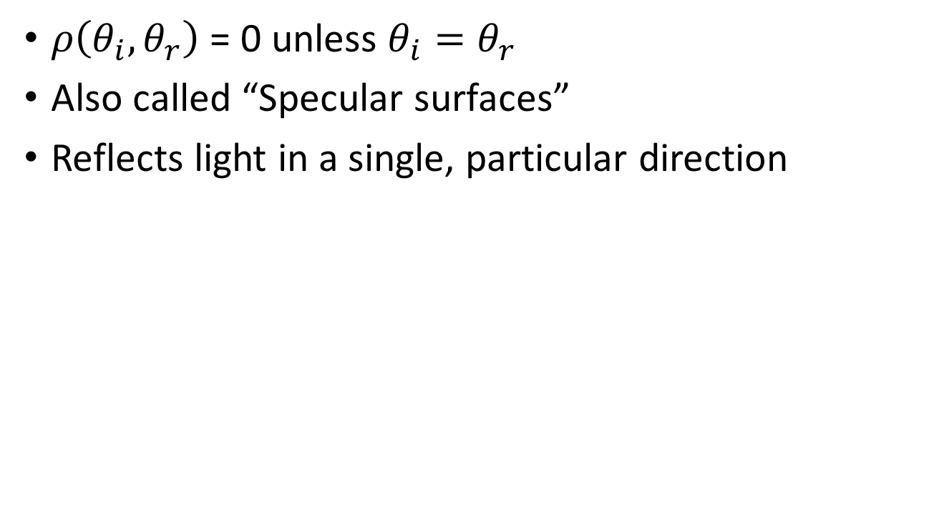
Special case 1: Perfect mirror
$ρ\left(θ_{i},θ_{r}\right)$ = 0 unless $θ_{i}=θ_{r}$
Also called “Specular surfaces”
Reflects light in a single, particular direction

Slide 25
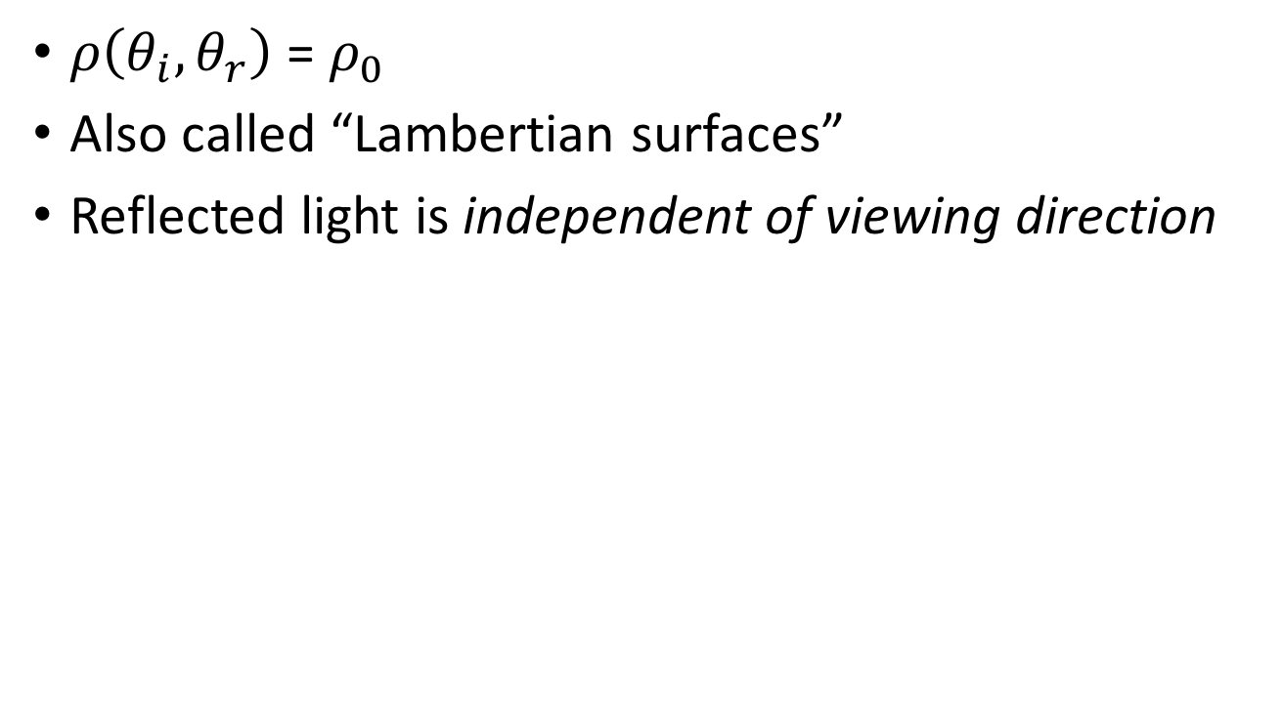
Special case 2: Matte surface
$ρ\left(θ_{i},θ_{r}\right)$ = $ρ_{0}$
Also called “Lambertian surfaces”
Reflected light is independent of viewing direction

Slide 26

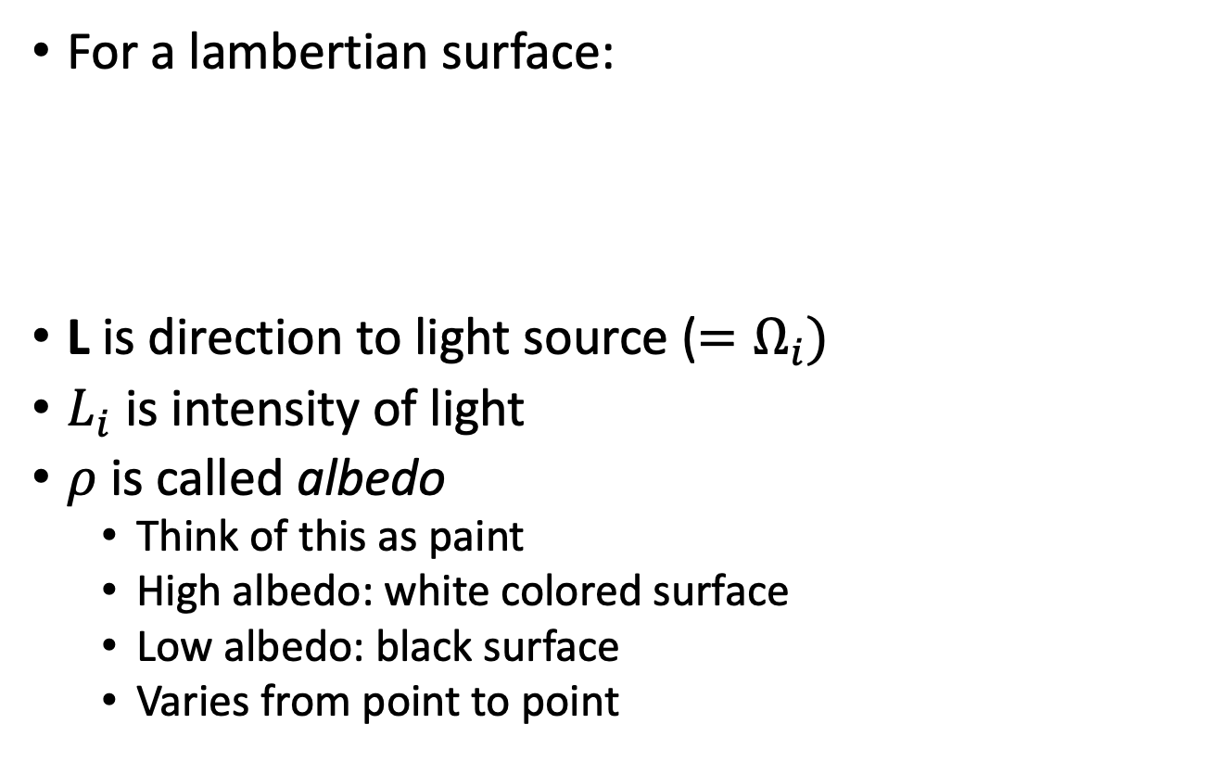

Lambertian surfaces
For a lambertian surface:
L is direction to light source ($=Ω_{i})$
$L_{i}$ is intensity of light
$ρ$ is called albedo
Think of this as paint
High albedo: white colored surface
Low albedo: black surface
Varies from point to point
$$θ_{i}$$
$$θ_{r}$$

Slide 27

Lambertian surfaces
Assume the light is directional: all rays from light source are parallel
Equivalent to a light source infinitely far away
All pixels get light from the same direction L and of the same intensity L_{i}
$$θ_{i}$$
$$θ_{r}$$

Slide 28
Lambertian surfaces
Intrinsic Image Decomposition
Reflectance image: albedo of surface corresponding to each pixel
Shading image: dot product between light and normal direction at each pixel

Slide 29

Lambertian surfaces
Notes:
But what can we do with just a single images? Humans have no problem inferring shape, reflectance, and illumination, but we have no algorithms for it.

Slide 30
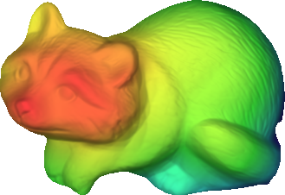




Lambertian surfaces
Far
Near
shape / depth
Shading image of Z and L
illumination
Reflectance
Lambertian reflectance

Slide 31
Reconstructing Lambertian surfaces
Equation is a constraint on albedo and normals
Can we solve for albedo and normals?

Slide 32
Recovery from multiple images
Represents an equation in the albedo and normals
Multiple images give constraints on albedo and normals
Solve for albedo and normals
Called Photometric Stereo
Image credit: Wikipedia

Slide 33
Multiple Images: Photometric Stereo
N
L₃
L₂
L₁
V

Slide 34

Photometric stereo - the math
Consider single pixel
Assume $L_{i}=1$
Write
G is a 3-vector
Norm of G = $ρ$
Direction of G = N

Slide 35

Photometric stereo - the math
Consider single pixel
Assume $L_{i}=1$
Write
G is a 3-vector
Norm of G = $ρ$
Direction of G = N

Slide 36
Photometric stereo - the math
Multiple images with different light sources but same viewing direction?

Slide 37
Photometric stereo - the math
Assume lighting directions are known
Each is a linear equation in G
Stack everything up into a massive linear system of equations!

Slide 38
Photometric stereo - the math
k x 3 matrix of lighting directions
k x 1 vector of intensities
3x1 vector of unknowns

Slide 39
Photometric stereo - the math
k x 1 k x 3 3 x 1
What is the minimum value of k to allow recovery of G?
How do we recover G if the problem is overconstrained?

Slide 40
Photometric stereo - the math
How do we recover G if the problem is overconstrained?
More than 3 lights: more than 3 images
Least squares
Solved using normal equations

Slide 41
Normal equations
Take derivative with respect to G and set to 0

Slide 42
Estimating normals and albedo from G
Recall that

Slide 43
Multiple pixels
We’ve looked at a single pixel till now
How do we handle multiple pixels?
Essentially independent equations!

Slide 44
Multiple pixels: matrix form
Note that all pixels share the same set of lights

Slide 45
Multiple pixels: matrix form
Can stack these into columns of a matrix

Slide 46
Multiple pixels: matrix form
#pixels
3
#pixels
I
L^{T}
G
3
=
#lights
#lights

Slide 47
Estimating depth from normals
So we got surface normals, can we get depth?
Yes, given boundary conditions
Normals provide information about the derivative

Slide 48
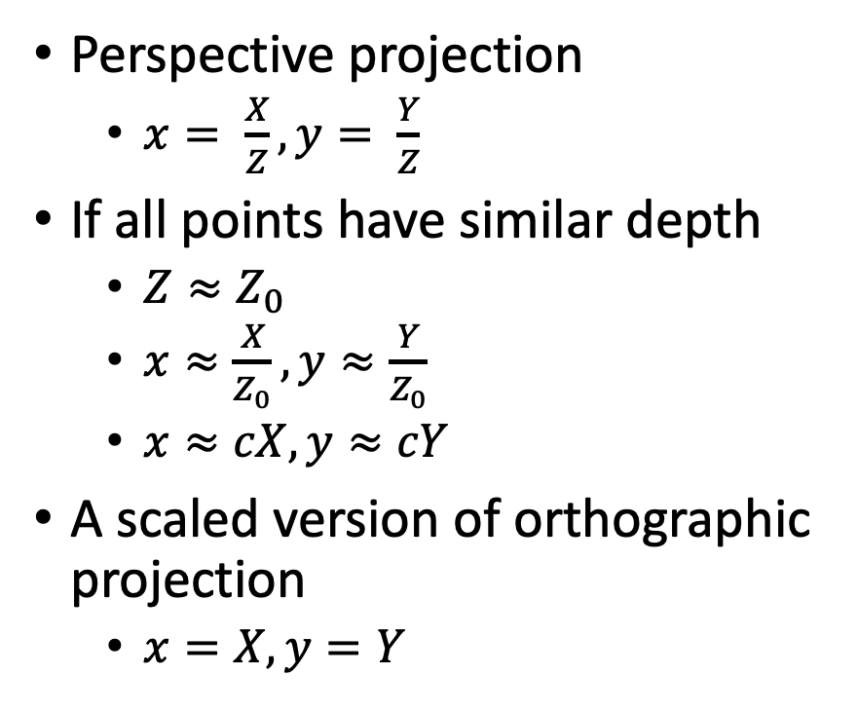
Brief detour: Orthographic projection
Perspective projection
$x= \frac{X}{Z}, y= \frac{Y}{Z}$
If all points have similar depth
$Z≈Z_{0}$
$x≈\frac{X}{Z_{0}}, y≈\frac{Y}{Z_{0}}$
$x≈cX, y≈cY$
A scaled version of orthographic projection
$x=X, y=Y$
Perspective
Scaled orthographic

Slide 49



Depth Map from Normal Map
We now have a surface normal, but how do we get depth?
Assume a smooth surface
V₂
V₁
N
Get a similar equation for V₂
Each normal gives us two linear constraints on z
compute z values by solving a matrix equation
49

Slide 50
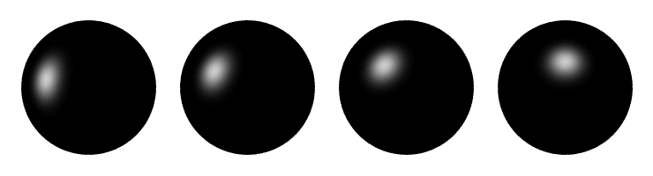
Determining Light Directions
Trick: Place a mirror ball in the scene.
The location of the highlight is determined by the light source direction.
Can relate the direction of highlight mathematically to direction of light source
50

Slide 51
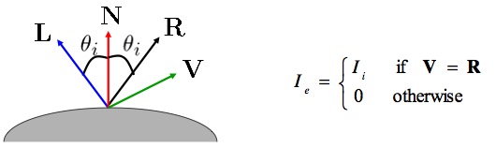
Optional: Determining Light Directions
For a perfect mirror, the light is reflected across N:
51

Slide 52

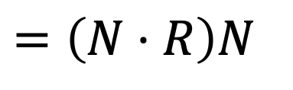

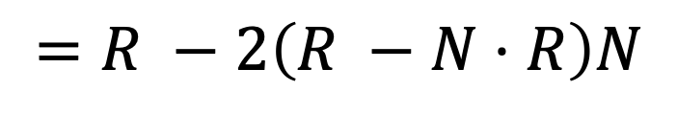
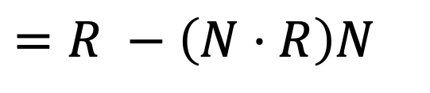
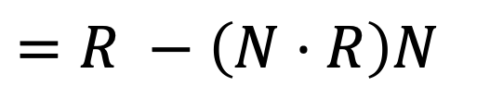
Optional: Determining Light Directions
N
$$=\left(N⋅R\right)N$$
L
||
||
R
$$=R −\left(N⋅R\right)N$$
$$=R −\left(N⋅R\right)N$$
= - 2
$$=R −2\left(R −N⋅R\right)N$$
$$=2\left(N⋅R\right)N −R$$
So the light source direction is given by:
52

Slide 53


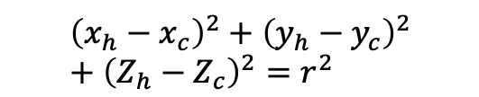




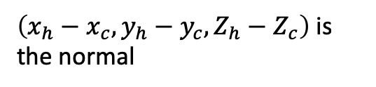
Optional: Determining Light Directions
Assume orthographic projection
Viewing direction R = [0,0,-1]
Normal?
$Z_{h}$ and $Z_{c}$ are unknown, but:
$${\left(x_{h}−x_{c}\right)}^{2}+{\left(y_{h}−y_{c}\right)}^{2}+{\left(Z_{h}−Z_{c}\right)}^{2}=r^{2}$$
$$(x_{h},y_{h}, Z_{h})$$
$$(x_{h},y_{h})$$
$\left(Z_{h}−Z_{c}\right)$ can be computed
$$(x_{c},y_{c}, Z_{c})$$
$\left(x_{h}−x_{c}, y_{h}−y_{c}, Z_{h}−Z_{c}\right)$ is the normal
$$(x_{c},y_{c})$$
Z=1

Slide 54
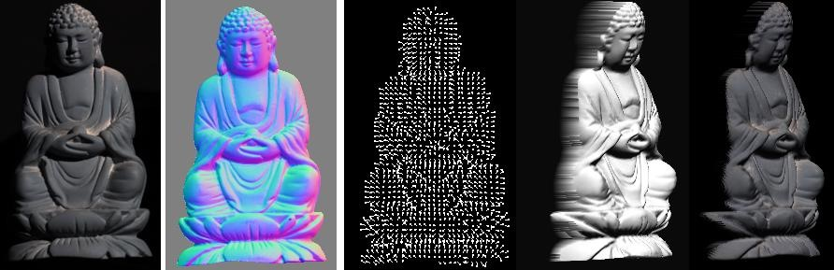
Photometric Stereo
What results can you get?
Input
(1 of 12)
Normals (RGB colormap)
Normals (vectors)
Shaded 3D rendering
Textured 3D rendering

Slide 55
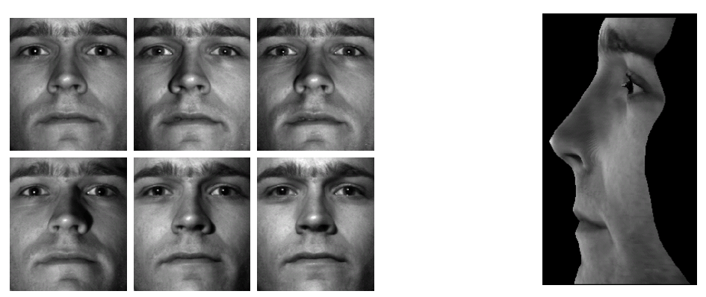
Results
from Athos Georghiades
55

Slide 56

Unknown Lighting
Surface normals
Light directions
$$I=ρN⋅L_{i}L$$
Diffuse albedo
Light intensity
56

Slide 57

Unknown Lighting
Surface normals, scaled by albedo
Light directions, scaled by intensity
$$I=G⋅M$$
57

Slide 58
Unknown Lighting
p = # pixels
G
n = # images
I
=
M^{T}
58

Slide 59
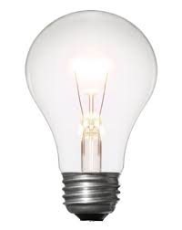
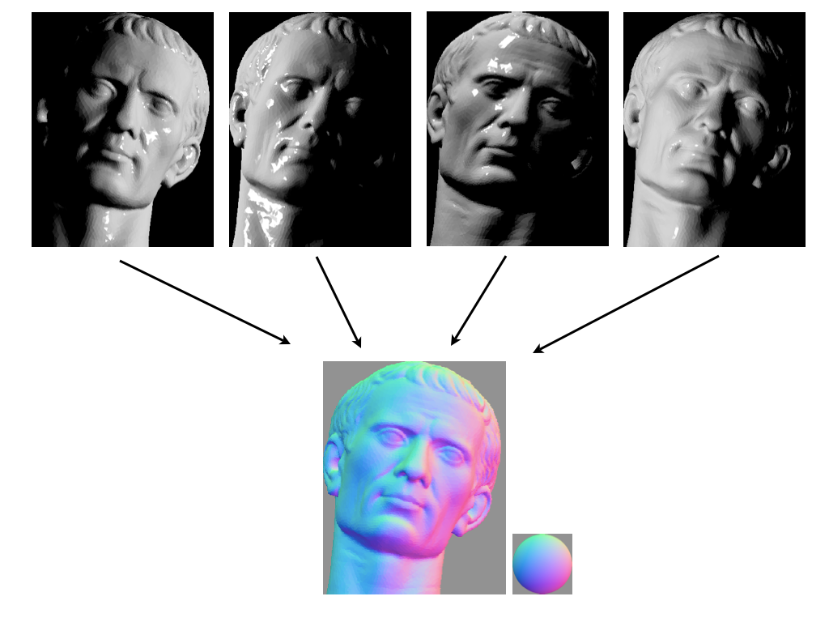
Unknown Lighting
Measurements
(one image per row)
Light directions
(scaled by intensity)
Surface normals
(scaled by albedo)
*
=
G
I
M^{T}
Both M and G are now unknown!
This is a matrix factorization problem.
59

Slide 60


Unknown Lighting
*
=
G
(3 x p)
I
(n x p)
M
(n x 3)
There’s hope: We know that I is rank 3

Slide 61
Unknown Lighting
Use the SVD to decompose I:
V
I
=
U
SVD gives the best rank-3 approximation of a matrix.

Slide 62
Unknown Lighting
Use the SVD to decompose I:
V
I
=
U
SVD gives the best rank-3 approximation of a matrix.
What do we do with $Σ$?

Slide 63

Unknown Lighting
Use the SVD to decompose I:
V
I
=
U
Can we just do that?

Slide 64

Unknown Lighting
Use the SVD to decompose I:
V
I
=
U
…almost.
Can we just do that?
The decomposition is unique up to an invertible 3x3 A.

Slide 65

Unknown Lighting
Use the SVD to decompose I:
V
I
=
U
…almost.
$$M=U\sqrt{Σ}A, G=A^{−1}\sqrt{Σ}V$$
Can we just do that?
The decomposition is unique up to an invertible 3x3 A.

