Slide 1
Epipolar geometry

Slide 2
Binocular stereo
Special case: cameras are parallel to each other and translated along X axis
X axis
Z axis

Slide 3
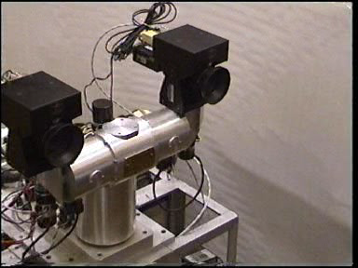
Stereo head
Kinect / depth cameras

Slide 4
Perspective projection in rectified cameras
Without loss of generality, assume origin is at pinhole of 1st camera
X coordinate differs by t_{x}/Z
Y coordinate is the same!

Slide 5
Perspective projection in rectified cameras
X coordinate differs by t_{x}/Z
That is, difference in X coordinate is inversely proportional to depth
Difference in X coordinate is called disparity
Translation between cameras (tx) is called baseline
disparity = baseline / depth

Slide 6
The NCC cost volume
Consider M x N image
Suppose there are D possible disparities.
For every pixel, D possible scores
Can be written as an M x N x D array
To get disparity, take max along 3rd axis

Slide 7
Computing the NCC volume
For every pixel (x, y)
For every disparity d
Get normalized patch from image 1 at (x, y)
Get normalized patch from image 2 at (x + d, y)
Compute NCC

Slide 8
Computing the NCC volume
For every disparity d
For every pixel (x, y)
Get normalized patch from image 1 at (x, y)
Get normalized patch from image 2 at (x + d, y)
Compute NCC
Assume all pixels lie at same disparity d (i.e., lie on same plane) and compute cost for each
Plane sweep stereo

Slide 9
Perspective projection in rectified cameras
For rectified cameras, correspondence problem is easier
Only requires searching along a particular row.

Slide 10
Perspective projection in rectified cameras
What about non-rectified cameras?
Is there an equivalent?
For rectified cameras, correspondence problem is easier
Only requires searching along a particular row.

Slide 11
Epipolar constraint
Reduces 2D search problem to search along a particular line: epipolar line

Slide 12
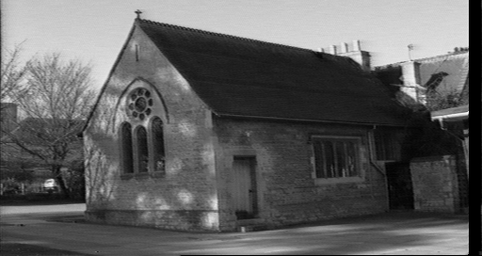
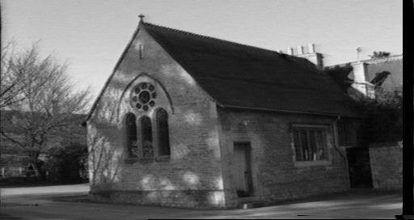
Epipolar constraint
True in general!
Given pixel (x,y) in one image, corresponding pixel in the other image must lie on a line
Line function of (x,y) and parameters of camera
These lines are called epipolar line

Slide 13
Epipolar geometry

Slide 14
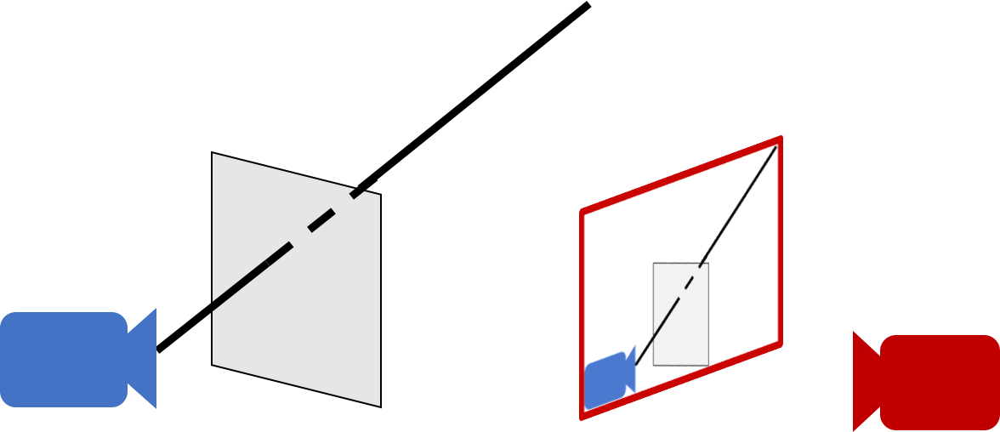
Epipolar geometry - why?
For a single camera, pixel in image plane must correspond to point somewhere along a ray

Slide 15
Epipolar geometry
When viewed in second image, this ray looks like a line: epipolar line
The epipolar line must pass through image of the first camera in the second image - epipole
Epipole
Epipolar line

Slide 16
Epipolar geometry
Given an image point in one view, where is the corresponding point in the other view?
?
epipolar line
C
C
/
epipole
baseline
A point in one view “generates” an epipolar line in the other view
The corresponding point lies on this line

Slide 17
Epipolar line
Epipolar constraint
Reduces correspondence problem to 1D search along an epipolar line

Slide 18
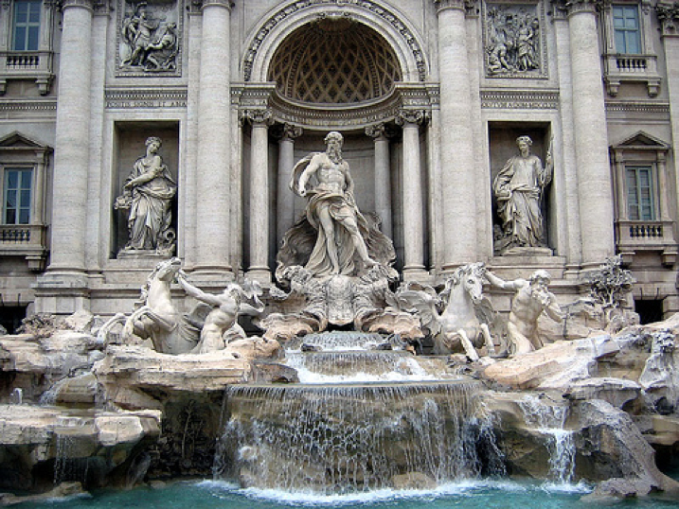
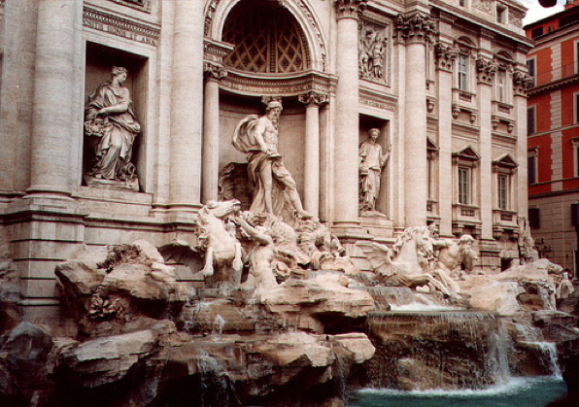
Epipolar lines

Slide 19
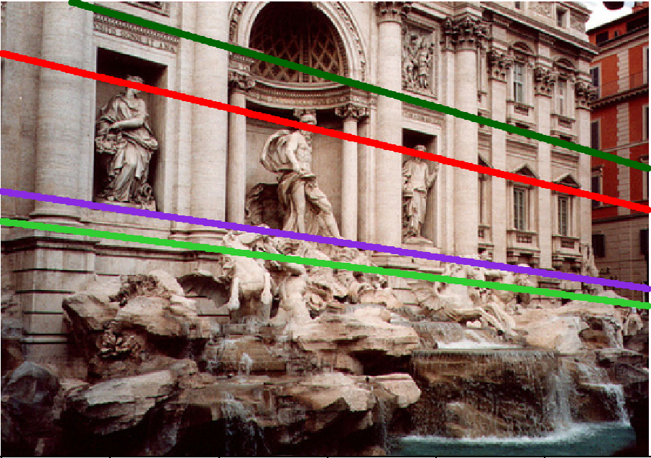
Epipolar lines

Slide 20
Epipolar lines
Epipole

Slide 21
Epipolar geometry continued
Epipolar geometry is a consequence of the coplanarity of the camera centres and scene point
X
x
x
/
C
C
/
The camera centres, corresponding points and scene point lie in a single plane, known as the epipolar plane

Slide 22
Nomenclature
X
l/
right epipolar line
left epipolar line
x
/
x
e
e
/
C
C
/
The epipolar line l/ is the image of the ray through x
The epipole e is the point of intersection of the line joining the camera centres with the image plane
this line is the baseline for a stereo rig, and
the translation vector for a moving camera
The epipole is the image of the centre of the other camera: e = PC/ , e/ = P/C

Slide 23
The epipolar pencil
X
e
/
e
baseline
As the position of the 3D point X varies, the epipolar planes “rotate” about the baseline. This family of planes is known as an epipolar pencil (a pencil is a one parameter family).
All epipolar lines intersect at the epipole.

Slide 24
The epipolar pencil
X
e
/
e
baseline
As the position of the 3D point X varies, the epipolar planes “rotate” about the baseline. This family of planes is known as an epipolar pencil (a pencil is a one parameter family).
All epipolar lines intersect at the epipole.

Slide 25
Epipolar geometry - the math
Assume intrinsic parameters K are identity
Assume world coordinate system is centered at 1st camera pinhole with Z along viewing direction

Slide 26
Epipolar geometry - the math
Assume intrinsic parameters K are identity
Assume world coordinate system is centered at 1st camera pinhole with Z along viewing direction

Slide 27
Epipolar geometry - the math
Assume intrinsic parameters K are identity
Assume world coordinate system is centered at 1st camera pinhole with Z along viewing direction

Slide 28
Epipolar geometry - the math
Assume intrinsic parameters K are identity
Assume world coordinate system is centered at 1st camera pinhole with Z along viewing direction

Slide 29
Epipolar geometry - the math
Assume intrinsic parameters K are identity
Assume world coordinate system is centered at 1st camera pinhole with Z along viewing direction

Slide 30
Epipolar geometry - the math
0
0

Slide 31
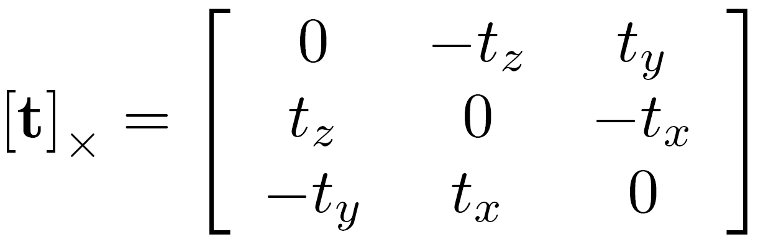
Epipolar geometry - the math
Can we write this as matrix vector operations?
Cross product can be written as a matrix

Slide 32
Epipolar geometry - the math
Can we write this as matrix vector operations?
Dot product can be written as a vector-vector times

Slide 33
Epipolar geometry - the math
Can we write this as matrix vector operations?
Dot product can be written as a vector-vector times

Slide 34
Epipolar geometry - the math

Slide 35
Epipolar geometry - the math
Homogenous coordinates of point in image 2
Homogenous coordinates of point in image 1
Essential matrix

Slide 36
Epipolar constraint and epipolar lines
Consider a known, fixed pixel in the first image
What constraint does this place on the corresponding pixel?
where
What kind of equation is this?

Slide 37
Epipolar constraint and epipolar lines
Consider a known, fixed pixel in the first image
where
Line!

Slide 38
Epipolar constraint: putting it all together
If p is a pixel in first image and q is the corresponding pixel in the second image, then: q^{T}Ep = 0
E = [t]_{X}R
For fixed p, q must satisfy: q^{T}l = 0, where l = Ep
For fixed q, p must satisfy: l^{T}p = 0 where l^{T} = q^{T}E, or l = E^{t}q
These are epipolar lines!
Epipolar line in 2nd image
Epipolar line in 1st image

Slide 39
Essential matrix and epipoles
E = [t]_{X}R
Ep is an epipolar line in 2nd image
All epipolar lines in second image pass through c₂
c₂ is epipole in 2nd image

Slide 40
Essential matrix and epipoles
E = [t]_{X}R
E^{T}q is an epipolar line in 1st image
All epipolar lines in first image pass through c₁
c₁ is the epipole in 1st image

Slide 41
Epipolar geometry - the math
We assumed that intrinsic parameters K are identity
What if they are not?

Slide 42
Fundamental matrix

Slide 43
Fundamental matrix

Slide 44
Fundamental matrix

Slide 45
Fundamental matrix

Slide 46
Fundamental matrix
Fundamental matrix

Slide 47
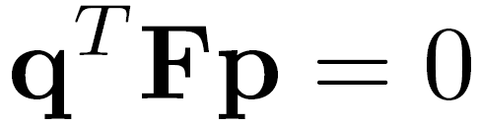

Fundamental matrix result

Slide 48


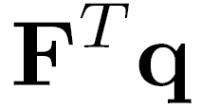




Properties of the Fundamental Matrix
is the epipolar line associated with
is the epipolar line associated with
T
0
Notes:
5 parameters

Slide 49
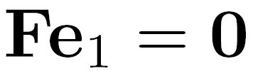
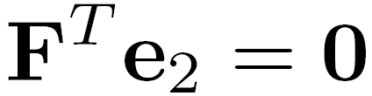
Properties of the Fundamental Matrix
is the epipolar line associated with
is the epipolar line associated with
and
All epipolar lines contain epipole
T
0
Notes:
5 parameters

Slide 50

Properties of the Fundamental Matrix
is the epipolar line associated with
is the epipolar line associated with
and
is rank 2
T
0
Notes:
Prove that F is rank 2. F

Slide 51
Why is F rank 2?
F is a 3 x 3 matrix
But there is a vector c₁ and c₂ such that Fc₁ = 0 and F^{T}c₂ = 0

Slide 52
Fundamental matrix song

Slide 53


Estimating F
If we don’t know K₁, K₂, R, or t, can we estimate F for two images?
Yes, given enough correspondences

Slide 54
Estimating F – 8-point algorithm
The fundamental matrix F is defined by
for any pair of matches x and x’ in two images.
Let x=(u,v,1)^{T} and x’=(u’,v’,1)^{T},
each match gives a linear equation

Slide 55
8-point algorithm
In reality, instead of solving , we seek f to minimize , least eigenvector of .

Slide 56
8-point algorithm – Problem?
F should have rank 2
To enforce that F is of rank 2, F is replaced by F’ that minimizes subject to the rank constraint.
This is achieved by SVD. Let , where
, let
then is the solution.
Notes:
The problem is that the resulting often is ill-conditioned. In theory, should have one singular value equal to zero and the rest are non-zero. In practice, however, some of the non-zero singular values can become small relative to the larger ones. If more than eight corresponding points are used to construct , where the coordinates are only approximately correct, there may not be a well-defined singular value which can be identified as approximately zero. Consequently, the solution of the homogeneous linear system of equations may not be sufficiently accurate to be useful.

Slide 57
Recovering camera parameters from F / E
Can we recover R and t between the cameras from F?
No: K₁ and K₂ are in principle arbitrary matrices
What if we knew K₁ and K₂ to be identity?

Slide 58
Recovering camera parameters from E
t is a solution to E^{T}x = 0
Can’t distinguish between t and ct for constant scalar c
How do we recover R?

Slide 59
Recovering camera parameters from E
We know E and t
Consider taking SVD of E and [t]_{X}

Slide 60
Recovering camera parameters from E
t is a solution to E^{T}x = 0
Can’t distinguish between t and ct for constant scalar c

Slide 61
8-point algorithm
Pros: it is linear, easy to implement and fast
Cons: susceptible to noise
Degenerate: if points are on same plane
Normalized 8-point algorithm: Hartley
Position origin at centroid of image points
Rescale coordinates so that center to farthest point is sqrt (2)

Slide 62
Structure-from-motion
Given 2 (or more) images from unknown cameras and with 3D world unknown
Can we recover both the cameras and the 3D world structure?
Step 1: Get correspondences
Step 2: Estimate Essential matrix, get R and t (assuming K known)
Step 3: Use calibrated cameras + correspondence to get 3D locations of points

