Slide 1
Binocular stereo

Slide 2
Binocular stereo
General case: cameras can be arbitrary locations and orientations

Slide 3
Binocular stereo
Special case: cameras are parallel to each other and translated along X axis
X axis
Z axis

Slide 4
Stereo with rectified cameras
Special case: cameras are parallel to each other and translated along X axis
X axis
Z axis

Slide 5
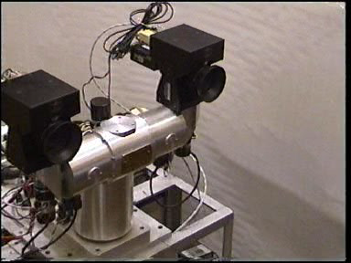
Stereo head
Kinect / depth cameras

Slide 6
Stereo with “rectified cameras”

Slide 7
Perspective projection in rectified cameras
Without loss of generality, assume origin is at pinhole of 1st camera

Slide 8
Perspective projection in rectified cameras
Without loss of generality, assume origin is at pinhole of 1st camera

Slide 9
Perspective projection in rectified cameras
Without loss of generality, assume origin is at pinhole of 1st camera

Slide 10
Perspective projection in rectified cameras
Without loss of generality, assume origin is at pinhole of 1st camera

Slide 11
Perspective projection in rectified cameras
Without loss of generality, assume origin is at pinhole of 1st camera

Slide 12
Perspective projection in rectified cameras
Without loss of generality, assume origin is at pinhole of 1st camera

Slide 13
Perspective projection in rectified cameras
Without loss of generality, assume origin is at pinhole of 1st camera

Slide 14
Perspective projection in rectified cameras
Without loss of generality, assume origin is at pinhole of 1st camera
X coordinate differs by t_{x}/Z
Y coordinate is the same!

Slide 15
Perspective projection in rectified cameras
X coordinate differs by t_{x}/Z
That is, difference in X coordinate is inversely proportional to depth
Difference in X coordinate is called disparity
Translation between cameras (tx) is called baseline
disparity = baseline / depth

Slide 16
The disparity image
For pixel (x,y) in one image, only need to know disparity to get correspondence
Create an image with color at (x,y) = disparity
right image
disparity
left image

Slide 17
Perspective projection in rectified cameras
For rectified cameras, correspondence problem is easier
Only requires searching along a particular row.

Slide 18
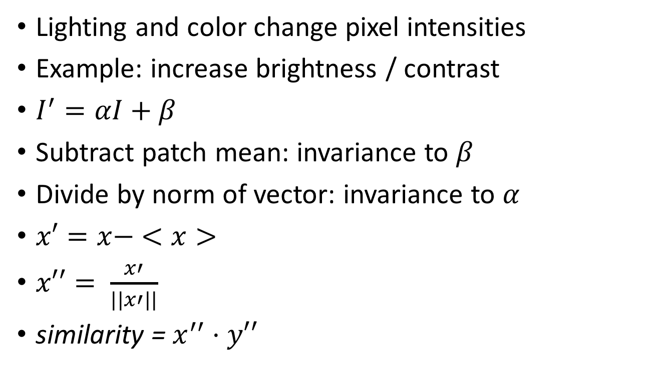
NCC - Normalized Cross Correlation
Lighting and color change pixel intensities
Example: increase brightness / contrast
$I^{′}=αI+β$
Subtract patch mean: invariance to $β$
Divide by norm of vector: invariance to $α$
$x′=x− <x>$
$x′′= \frac{x′}{||x′||}$
similarity = $x^{′′}⋅y′′$
Why not SIFT?

Slide 19
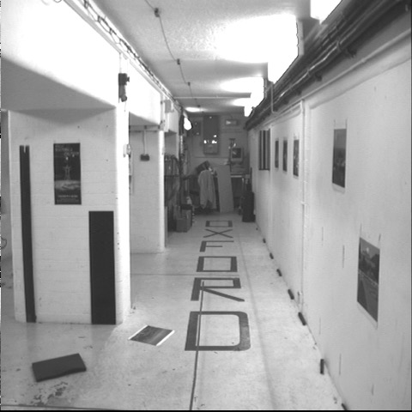
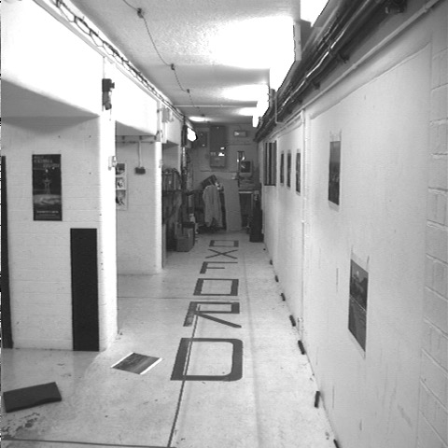


Cross-correlation of neighborhood
translate so that mean is zero

Slide 20

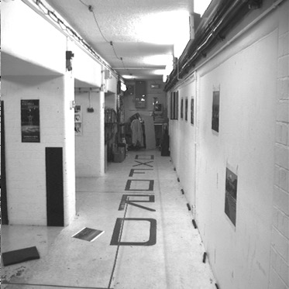
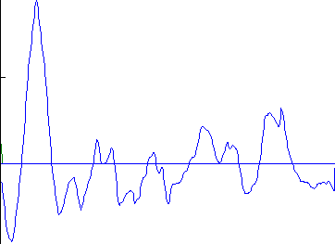
left image band
right image band
1
0.5
cross correlation
0
x

Slide 21
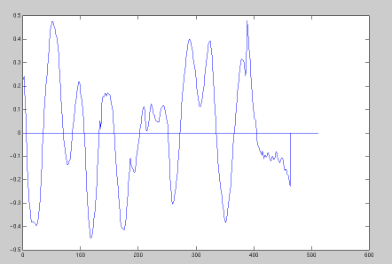
target region
left image band
right image band
1
0.5
cross correlation
0
x

Slide 22
The NCC cost volume
Consider M x N image
Suppose there are D possible disparities.
For every pixel, D possible scores
Can be written as an M x N x D array
To get disparity, take max along 3rd axis

Slide 23
Computing the NCC volume
For every pixel (x, y)
  For every disparity d
    Get normalized patch from image 1 at (x, y)
    Get normalized patch from image 2 at (x + d, y)
    Compute NCC

Slide 24
Computing the NCC volume
For every disparity d
  For every pixel (x, y)
    Get normalized patch from image 1 at (x, y)
    Get normalized patch from image 2 at (x + d, y)
    Compute NCC
Assume all pixels lie at same disparity d (i.e., lie on same plane) and compute cost for each
Plane sweep stereo

Slide 25
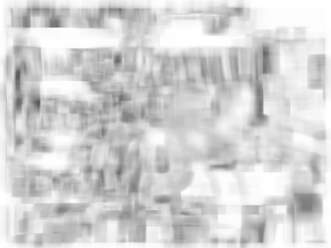
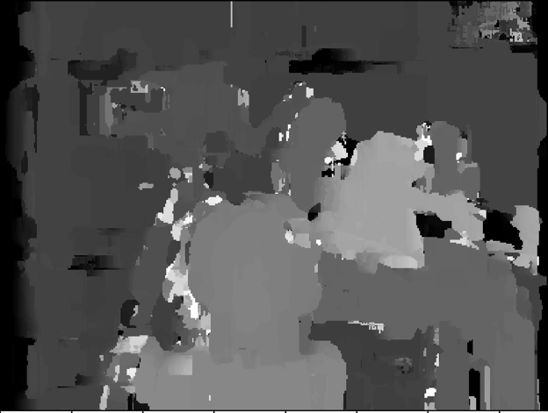
NCC volume
Disparity

Slide 26
Perspective projection in rectified cameras
Without loss of generality, assume origin is at pinhole of 1st camera
X coordinate differs by t_{x}/Z
Y coordinate is the same!

Slide 27
Perspective projection in rectified cameras
disparity = t_{x}/Z
If t_{x} is known, disparity gives Z
Otherwise, disparity gives Z in units of t_{x}
  Small-baseline, near depth = large-baseline, far depth

Slide 28
Perspective projection in rectified cameras
For rectified cameras, correspondence problem is easier
Only requires searching along a particular row.

Slide 29
Rectifying cameras
Given two images from two cameras with known P, can we rectify them?
  Can we create new images corresponding to a rectified setup?

Slide 30
Rectifying cameras
Can we rotate / translate cameras?
  Do we need to know the 3D structure of the world to do this?

Slide 31
Rotating cameras
Assume K is identity
Assume coordinate system at camera pinhole

Slide 32
Rotating cameras
Assume K is identity
Assume coordinate system at camera pinhole

Slide 33
Rotating cameras
What happens if the camera is rotated?

Slide 34
Rotating cameras
What happens if the camera is rotated?
No need to know the 3D structure
Rotation matrix
Homogenous coordinates of mapped pixel
Homogenous coordinates of original pixel

Slide 35
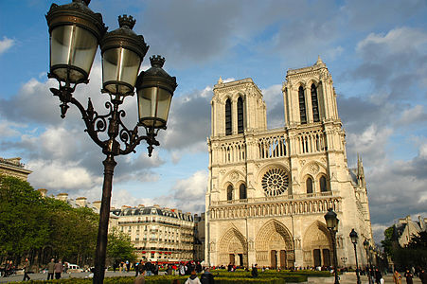
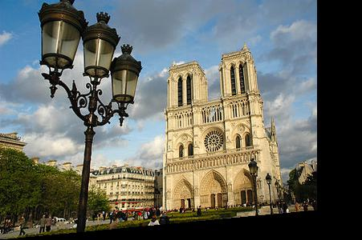
Rotating cameras

Slide 36
Rectifying cameras

Slide 37
Rectifying cameras

Slide 38
Rectifying cameras

Slide 39
Rectifying cameras

Slide 40
