Slide 1
RANSAC Recap

Slide 2
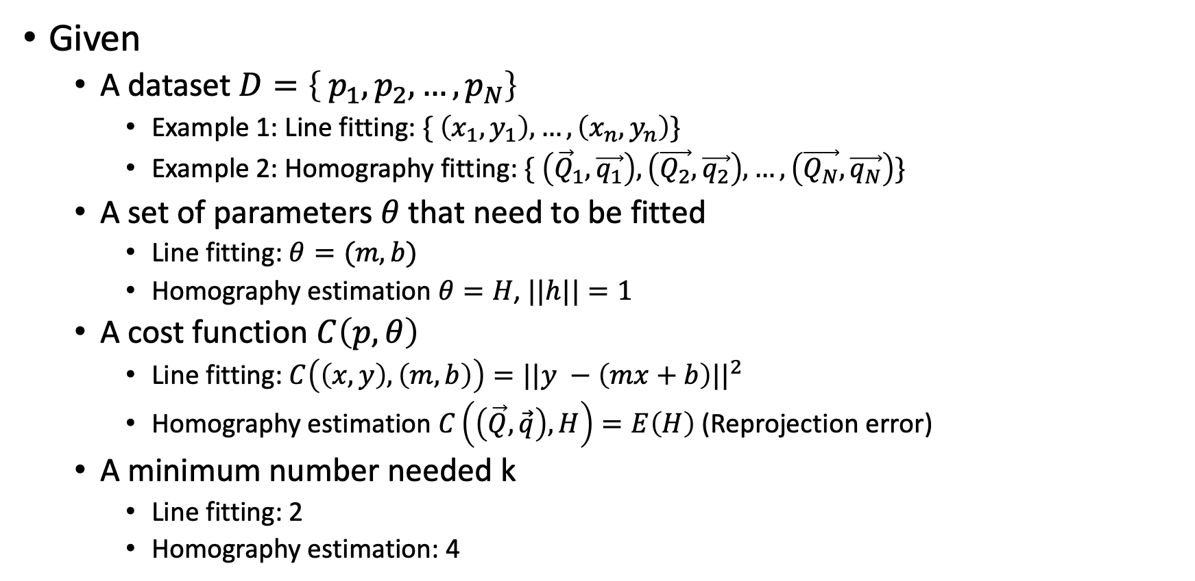
RANSAC - Setup
Given
  A dataset $D=\left\{ p_{1},p_{2}, …,p_{N}\right\}$
    Example 1: Line fitting: $\{ \left(x_{1},y_{1}\right), …, \left(x_{n}, y_{n}\right)\}$
    Example 2: Homography fitting: $\{ \left({\vec{Q}}_{1}, \vec{q_{1}}\right), \left(\vec{Q_{2}}, \vec{q_{2}}\right), …, \left(\vec{Q_{N}}, \vec{q_{N}}\right)\}$
  A set of parameters $θ$ that need to be fitted
    Line fitting: $θ=(m, b)$
    Homography estimation $θ=H$, $||h||=1$
  A cost function $C\left(p, θ\right)$
    Line fitting: $C\left(\left(x,y\right), \left(m,b\right)\right)=||y −\left(mx+b\right)||^{2}$
    Homography estimation $C\left(\left(\vec{Q},\vec{q}\right), H\right)=E\left(H\right)$ (Reprojection error)
  A minimum number needed k
    Line fitting: 2
    Homography estimation: 4

Slide 3

RANSAC - Setup
Given
  A dataset $D=\left\{ p_{1},p_{2}, …,p_{N}\right\}$
  A set of parameters $θ$ that need to be fitted
  A cost function $C\left(p, θ\right)$
  k
  $θ^{∗}=\min_{θ} \sum_{i}{C(p_{i}, θ)}$?
  Problem: outliers

Slide 4
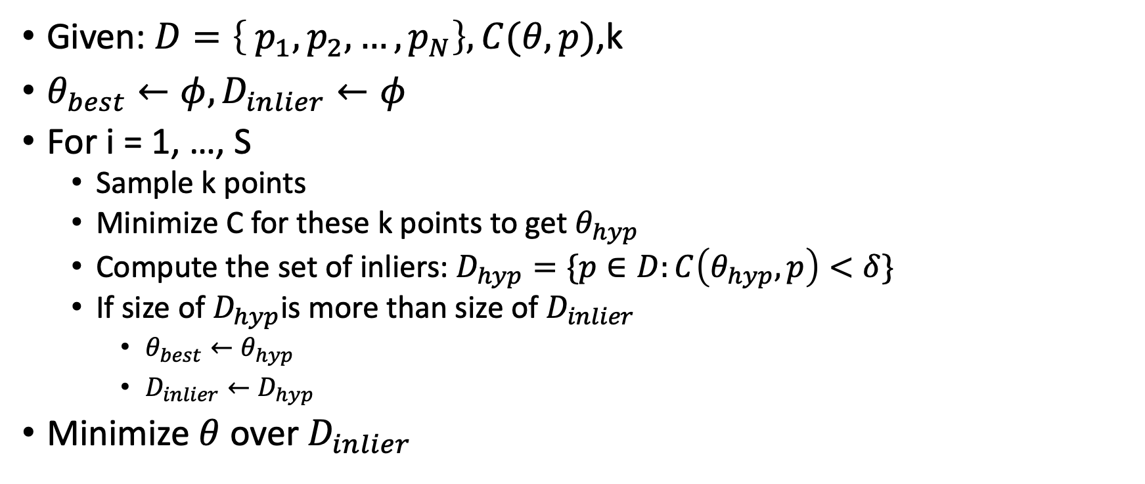
RANSAC - Algorithm
Given: $D=\left\{ p_{1},p_{2}, …,p_{N}\right\}, C(θ,p)$,k
$θ_{best}←φ, D_{inlier}←φ$
For i = 1, …, S
  Sample k points
  Minimize C for these k points to get $θ_{hyp}$
  Compute the set of inliers: $D_{hyp}=\{p∈D:C\left(θ_{hyp}, p\right)<δ\}$
  If size of $D_{hyp}$is more than size of $D_{inlier}$
    $θ_{best}←θ_{hyp}$
    $D_{inlier}←D_{hyp}$
Minimize $θ$ over $D_{inlier}$

Slide 5

RANSAC: how many iterations do we need?
p = inlier fraction
k = minimum number of data points
S = iter
$P=(1 −{\left(1−p^{k}\right)}^{S})$

Slide 6
Binocular Stereo

Slide 7
Binocular stereo
General case: cameras can be arbitrary locations and orientations
If we know where cameras are, we can shoot rays from corresponding pixels and intersect

Slide 8
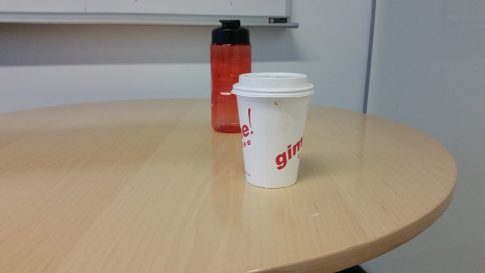
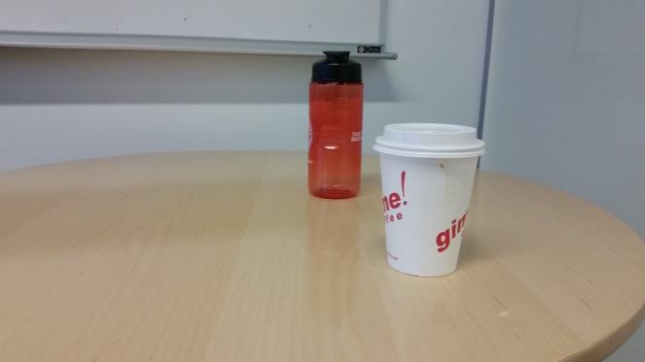
Binocular stereo : Triangulation
Suppose we have two cameras
  Calibrated: parameters known
And a pair of corresponding pixels
Find 3D location of point!

Slide 9
Triangulation
Suppose we have two cameras
  Calibrated: parameters known
And a pair of corresponding pixels
Find 3D location of point!
(x₁,y₁)
(x₂,y₂)

Slide 10
Triangulation

Slide 11
Triangulation

Slide 12
Triangulation
1 image gives 2 equations
Need 2 images!
Solve linear equations to get 3D point location

Slide 13
Linear vs non-linear optimization

Slide 14
Linear vs non-linear optimization
Reprojection error

Slide 15
Linear vs non-linear optimization
Reprojection error
Reprojection error is the squared error between the true image coordinates of a point and the projected coordinates of hypothesized 3D point
Actual error we care about
Minimize total sum of reprojection error across all images
Non-linear optimization

Slide 16
Binocular stereo
General case: cameras can be arbitrary locations and orientations

Slide 17
Binocular stereo
Special case: cameras are parallel to each other and translated along X axis
X axis
Z axis

Slide 18
Stereo with rectified cameras
Special case: cameras are parallel to each other and translated along X axis
X axis
Z axis

Slide 19
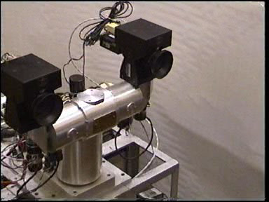
Stereo head
Kinect / depth cameras

Slide 20
Stereo with “rectified cameras”

Slide 21
Perspective projection in rectified cameras
Without loss of generality, assume origin is at pinhole of 1st camera

Slide 22
Perspective projection in rectified cameras
Without loss of generality, assume origin is at pinhole of 1st camera

Slide 23
Perspective projection in rectified cameras
Without loss of generality, assume origin is at pinhole of 1st camera

Slide 24
Perspective projection in rectified cameras
Without loss of generality, assume origin is at pinhole of 1st camera

Slide 25
Perspective projection in rectified cameras
Without loss of generality, assume origin is at pinhole of 1st camera

Slide 26
Perspective projection in rectified cameras
Without loss of generality, assume origin is at pinhole of 1st camera

Slide 27
Perspective projection in rectified cameras
Without loss of generality, assume origin is at pinhole of 1st camera

Slide 28
Perspective projection in rectified cameras
Without loss of generality, assume origin is at pinhole of 1st camera
X coordinate differs by t_{x}/Z
Y coordinate is the same!

Slide 29
Perspective projection in rectified cameras
X coordinate differs by t_{x}/Z
That is, difference in X coordinate is inversely proportional to depth
Difference in X coordinate is called disparity
Translation between cameras (tx) is called baseline
disparity = baseline / depth

Slide 30
The disparity image
For pixel (x,y) in one image, only need to know disparity to get correspondence
Create an image with color at (x,y) = disparity
right image
disparity
left image

Slide 31
Perspective projection in rectified cameras
For rectified cameras, correspondence problem is easier
Only requires searching along a particular row.

Slide 32
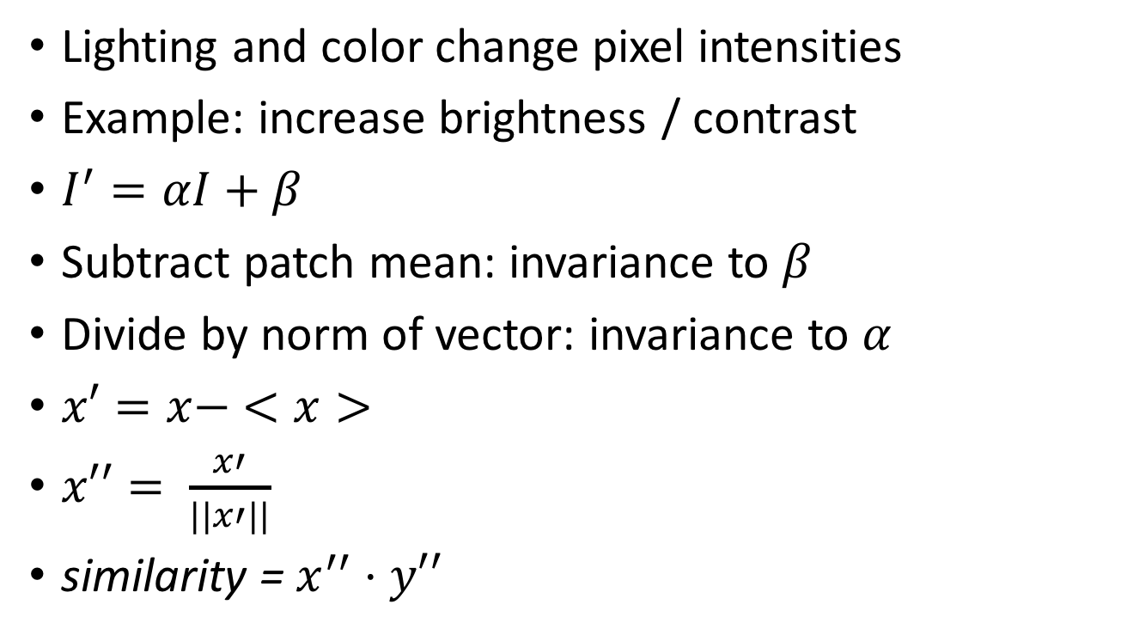
NCC - Normalized Cross Correlation
Lighting and color change pixel intensities
Example: increase brightness / contrast
$I^{′}=αI+β$
Subtract patch mean: invariance to $β$
Divide by norm of vector: invariance to $α$
$x′=x− <x>$
$x′′= \frac{x′}{||x′||}$
similarity = $x^{′′}⋅y′′$
Why not SIFT?

Slide 33
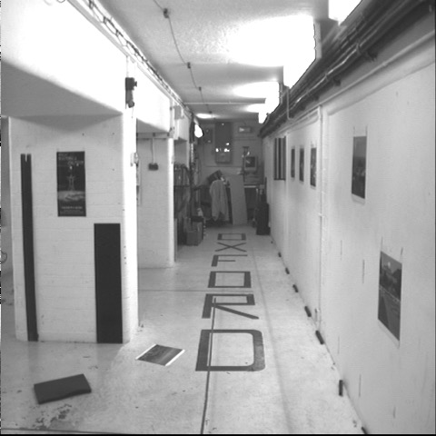
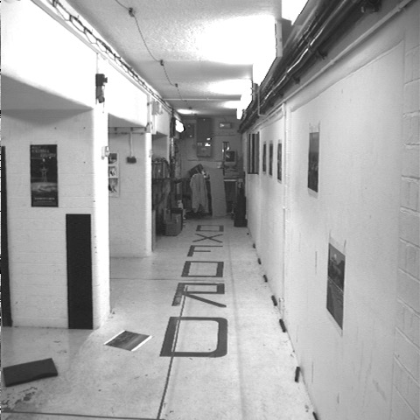


Cross-correlation of neighborhood
translate so that mean is zero

Slide 34

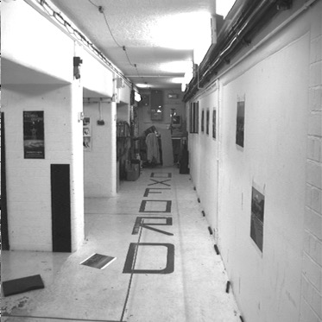
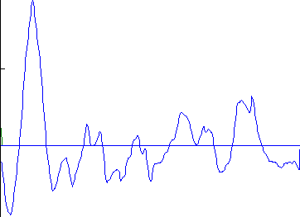
left image band
right image band
1
0.5
cross correlation
0
x

Slide 35
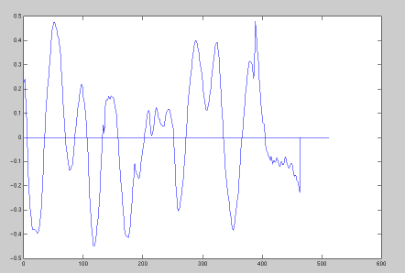
target region
left image band
right image band
1
0.5
cross correlation
0
x

Slide 36
The NCC cost volume
Consider M x N image
Suppose there are D possible disparities.
For every pixel, D possible scores
Can be written as an M x N x D array
To get disparity, take max along 3rd axis

Slide 37
Computing the NCC volume
For every pixel (x, y)
  For every disparity d
    Get normalized patch from image 1 at (x, y)
    Get normalized patch from image 2 at (x + d, y)
    Compute NCC

Slide 38
Computing the NCC volume
For every disparity d
  For every pixel (x, y)
    Get normalized patch from image 1 at (x, y)
    Get normalized patch from image 2 at (x + d, y)
    Compute NCC
Assume all pixels lie at same disparity d (i.e., lie on same plane) and compute cost for each
Plane sweep stereo

Slide 39
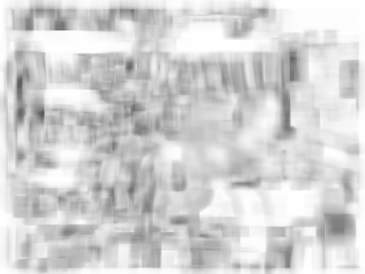
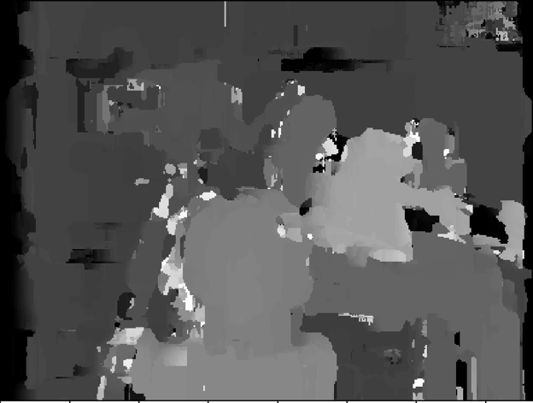
NCC volume
Disparity

