Slide 1
Calibration and homographies

Slide 2
Final perspective projection
Camera extrinsics: where your camera is relative to the world. Changes if you move the camera
Camera intrinsics: how your camera handles pixel. Changes if you change your camera

Slide 3
Final perspective projection
Camera parameters

Slide 4
Camera calibration
Goal: find the parameters of the camera
Why?
  Tells you where the camera is relative to the world/particular objects
  Equivalently, tells you where objects are relative to the camera
  Can allow you to ”render” new objects into the scene

Slide 5
Camera calibration
Y
Y’
Z
O
O’
X’
X
Z’

Slide 6
Camera calibration
Need to estimate P
How many parameters does P have?
  Size of P : 3 x 4
  But:
  P can only be known upto a scale
  3*4 - 1 = 11 parameters

Slide 7
Camera calibration
Suppose we know that (X,Y,Z) in the world projects to (x,y) in the image.
How many equations does this provide?
Need to convert equivalence into equality.

Slide 8
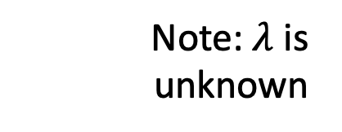
Camera calibration
Suppose we know that (X,Y,Z) in the world projects to (x,y) in the image.
How many equations does this provide?
Note: $λ$ is unknown

Slide 9
Camera calibration
Suppose we know that (X,Y,Z) in the world projects to (x,y) in the image.
How many equations does this provide?

Slide 10
Camera calibration
Suppose we know that (X,Y,Z) in the world projects to (x,y) in the image.
How many equations does this provide?

Slide 11
Camera calibration
Suppose we know that (X,Y,Z) in the world projects to (x,y) in the image.
How many equations does this provide?
2 equations!
Are the equations linear in the parameters?
How many equations do we need?

Slide 12
Camera calibration
In matrix vector form: Ap = 0
6 points give 12 equations, 12 variables to solve for
But can only solve upto scale

Slide 13

Camera calibration
In matrix vector form: Ap = 0
We want non-trivial solutions
If p is a solution, $α$p is a solution too
Let’s just search for a solution with unit norm
s.t

Slide 14
Camera calibration
Direct Linear Transformation
In matrix vector form: Ap = 0
But there may be noise in the inputs
Least squares solution:
Eigenvector of ATA with smallest eigenvalue! (also right singular vector pf A with smallest singular value)
s.t
s.t

Slide 15
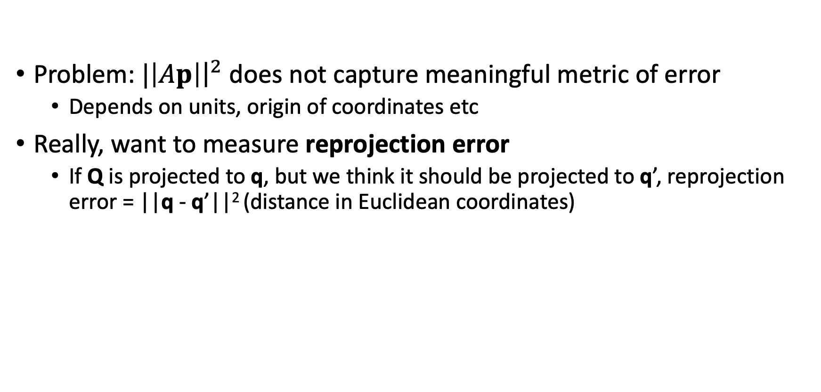
Camera calibration through non-linear minimization
Problem: $|\left|Ap\right|{\left.​\right|}^{2}$ does not capture meaningful metric of error
  Depends on units, origin of coordinates etc
Really, want to measure reprojection error
  If Q is projected to q, but we think it should be projected to q’, reprojection error = ||q - q’||² (distance in Euclidean coordinates)

Slide 16
Reprojection error
Reprojection error

Slide 17
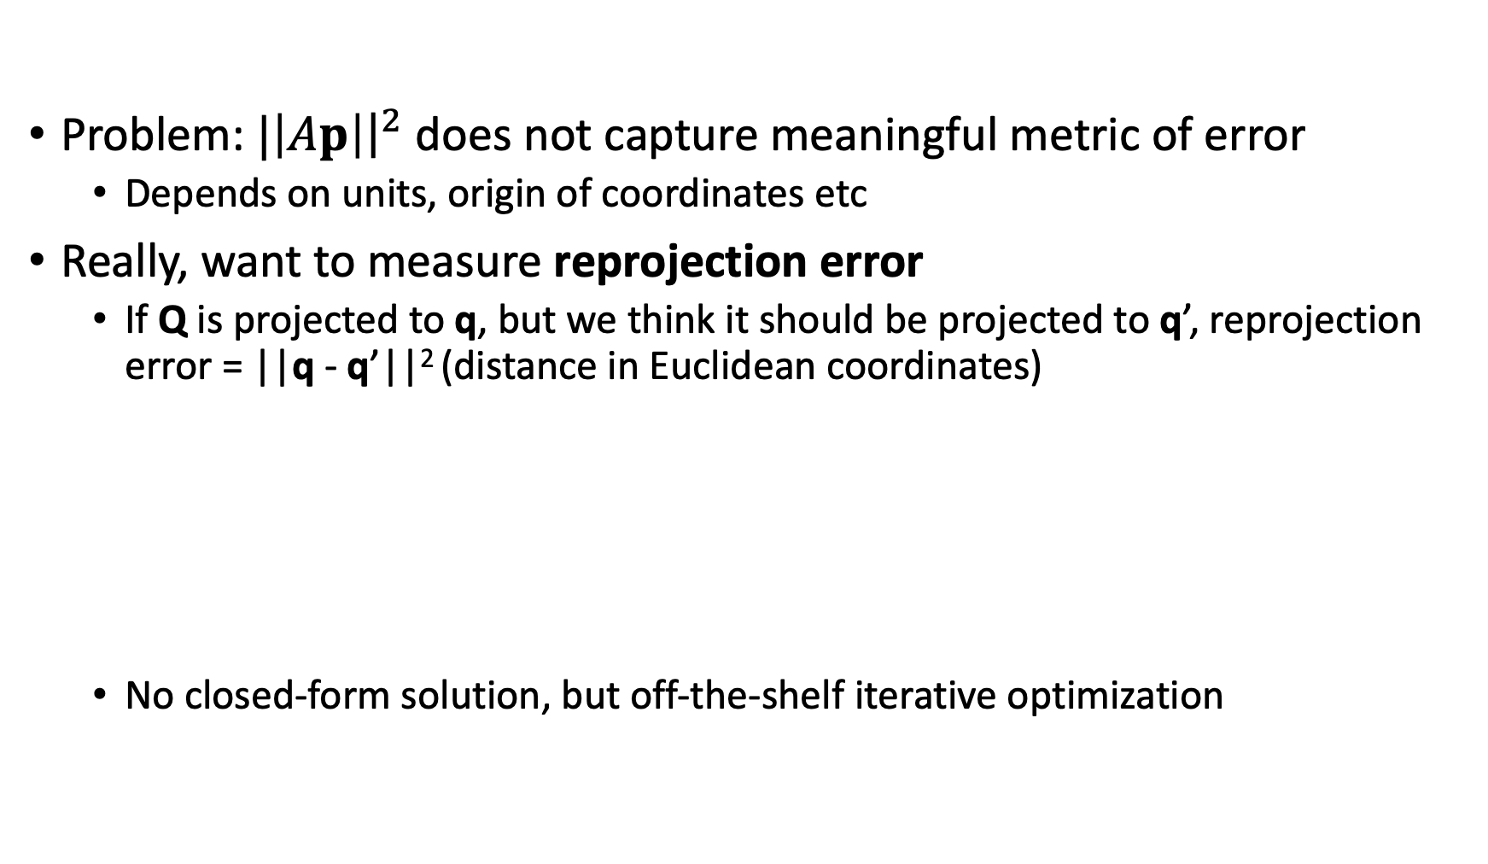
Camera calibration through non-linear minimization
Problem: $|\left|Ap\right|{\left.​\right|}^{2}$ does not capture meaningful metric of error
  Depends on units, origin of coordinates etc
Really, want to measure reprojection error
  If Q is projected to q, but we think it should be projected to q’, reprojection error = ||q - q’||² (distance in Euclidean coordinates)
  No closed-form solution, but off-the-shelf iterative optimization

Slide 18
Camera calibration
We need 6 world points for which we know image locations
Would any 6 points work?
  What if all 6 points are the same?
Need at least 6 non-coplanar points!

Slide 19
Camera calibration
Y
Y’
Z
O
O’
X’
X
Z’

Slide 20
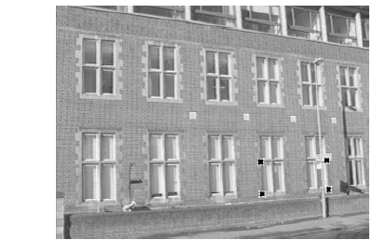
What if object of interest is plane?
Not that uncommon….

Slide 21
What if object of interest is plane?
Let’s choose world coordinate system so that plane is X-Y plane
Z
Y’
Y
X
Z’
O
X’

Slide 22
What if object of interest is a plane?
Imagine that plane is equipped with two axes.
Points on the plane are represented by two euclidean coordinates
…Or 3 homogenous coordinates
3D object
2D object (plane)
3 x 4
3 x 3

Slide 23
What if object of interest is a plane?
Homography maps points on the plane to pixels in the image
Homography
3 x 3

Slide 24
Fitting homographies
How many parameters does a homography have?
Given a single point on the plane and corresponding image location, what does that tell us?

Slide 25
Fitting homographies
How many parameters does a homography have?
Given a single point on the plane and corresponding image location, what does that tell us?
Convince yourself that this gives 2 linear equations!

Slide 26
Fitting homographies
Homography has 9 parameters
But can’t determine scale factor, so only 8: 4 points!
Or because we will have noise:

Slide 27
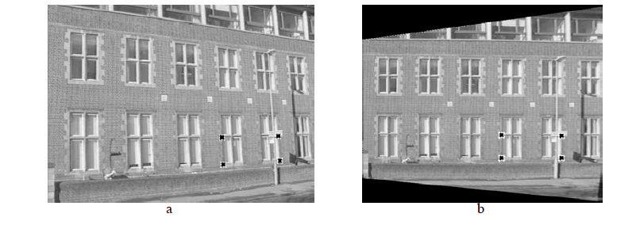
Fitting homographies

Slide 28
Homographies for image alignment
A general mapping from one plane to another!
Can also be used to align one photo of a plane to another photo of the same plane
Image 2
Image 1
Original plane

Slide 29
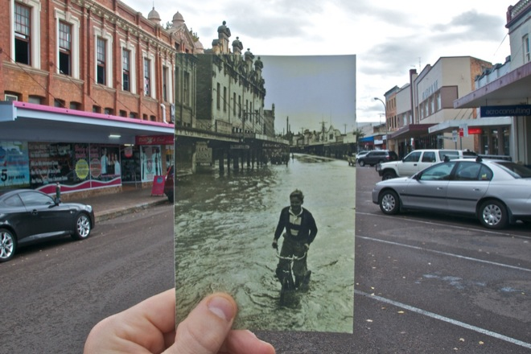
Homographies for image alignment
Can also be used to align one photo of a plane to another photo of the same plane
http://www.wired.com/gadgetlab/2010/07/camera-software-lets-you-see-into-the-past/

Slide 30
Image Alignment Algorithm
Given images A and B
Compute image features for A and B
Match features between A and B
Compute homography between A and B
What could go wrong?

Slide 31
Fitting in general
Fitting: find the parameters of a model that best fit the data
Other examples:
  least squares linear regression

Slide 32
Least squares: linear regression
(y_{i}, x_{i})
y = mx + b

Slide 33
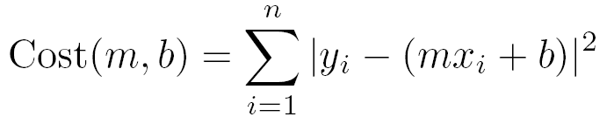
Linear regression
residual error

Slide 34
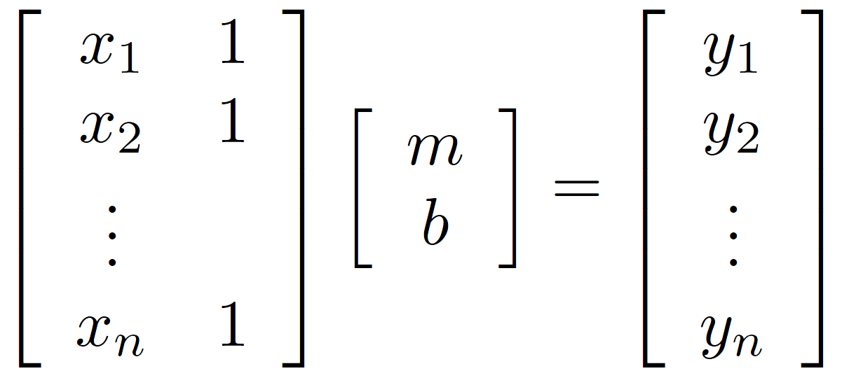
Linear regression

Slide 35
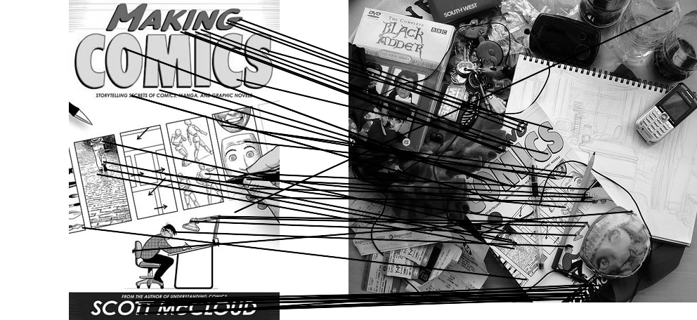
Outliers
outliers
inliers

Slide 36
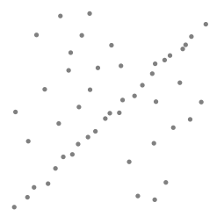
Robustness
Problem: Fit a line to these datapoints
Least squares fit

Slide 37
Idea
Given a hypothesized line
Count the number of points that “agree” with the line
  “Agree” = within a small distance of the line
  I.e., the inliers to that line
For all possible lines, select the one with the largest number of inliers

Slide 38
Counting inliers

Slide 39
Counting inliers
Inliers: 3

Slide 40
Counting inliers
Inliers: 20

Slide 41
How do we find the best line?
Unlike least-squares, no simple closed-form solution
Hypothesize-and-test
  Try out many lines, keep the best one
  Which lines?

Slide 42
RANSAC (Random Sample Consensus)
Line fitting example
Algorithm:
Sample (randomly) the number of points required to fit the model (#=2)
Solve for model parameters using samples
Score by the fraction of inliers within a preset threshold of the model
Repeat 1-3 until the best model is found with high confidence
Illustration by Savarese
Notes:
Let me give you an intuition of what is going on. Suppose we have the standard line fitting problem in presence of outliers.
We can formulate this problem as follows: want to find the best partition of points in inlier set and outlier set such that…
The objective consists of adjusting the parameters of a model function so as to best fit a data set.
"best" is defined by a function f that needs to be minimized.
Such that the best parameter of fitting the line give rise to a residual error lower that delta
as when the sum, S, of squared residuals

Slide 43
RANSAC
Line fitting example
Algorithm:
Sample (randomly) the number of points required to fit the model (#=2)
Solve for model parameters using samples
Score by the fraction of inliers within a preset threshold of the model
Repeat 1-3 until the best model is found with high confidence
Notes:
Let me give you an intuition of what is going on. Suppose we have the standard line fitting problem in presence of outliers.
We can formulate this problem as follows: want to find the best partition of points in inlier set and outlier set such that…
The objective consists of adjusting the parameters of a model function so as to best fit a data set.
"best" is defined by a function f that needs to be minimized.
Such that the best parameter of fitting the line give rise to a residual error lower that delta
as when the sum, S, of squared residuals

Slide 44
RANSAC
Line fitting example
Algorithm:
Sample (randomly) the number of points required to fit the model (#=2)
Solve for model parameters using samples
Score by the fraction of inliers within a preset threshold of the model
Repeat 1-3 until the best model is found with high confidence
Notes:
Let me give you an intuition of what is going on. Suppose we have the standard line fitting problem in presence of outliers.
We can formulate this problem as follows: want to find the best partition of points in inlier set and outlier set such that…
The objective consists of adjusting the parameters of a model function so as to best fit a data set.
"best" is defined by a function f that needs to be minimized.
Such that the best parameter of fitting the line give rise to a residual error lower that delta
as when the sum, S, of squared residuals

Slide 45
RANSAC
Algorithm:
Sample (randomly) the number of points required to fit the model (#=2)
Solve for model parameters using samples
Score by the fraction of inliers within a preset threshold of the model
Repeat 1-3 until the best model is found with high confidence
Notes:
Let me give you an intuition of what is going on. Suppose we have the standard line fitting problem in presence of outliers.
We can formulate this problem as follows: want to find the best partition of points in inlier set and outlier set such that…
The objective consists of adjusting the parameters of a model function so as to best fit a data set.
"best" is defined by a function f that needs to be minimized.
Such that the best parameter of fitting the line give rise to a residual error lower that delta
as when the sum, S, of squared residuals

Slide 46
RANSAC
Idea:
  All the inliers will agree with each other on the translation vector; the (hopefully small) number of outliers will (hopefully) disagree with each other
    RANSAC only has guarantees if there are < 50% outliers
  “All good matches are alike; every bad match is bad in its own way.”
  – Tolstoy via Alyosha Efros

Slide 47

Translations

Slide 48
RAndom SAmple Consensus
Select one match at random, count inliers

Slide 49
RAndom SAmple Consensus
Select another match at random, count inliers

Slide 50
RAndom SAmple Consensus
Output the translation with the highest number of inliers

Slide 51
Final step: least squares fit
Find average translation vector over all inliers

Slide 52
RANSAC
Inlier threshold related to the amount of noise we expect in inliers
  Often model noise as Gaussian with some standard deviation (e.g., 3 pixels)
Number of rounds related to the percentage of outliers we expect, and the probability of success we’d like to guarantee
  Suppose there are 20% outliers, and we want to find the correct answer with 99% probability
  How many rounds do we need?

Slide 53
How many rounds?
If we have to choose k samples each time
  with an inlier ratio p
  and we want the right answer with probability P
 | proportion of inliers p
k | 95% | 90% | 80% | 75% | 70% | 60% | 50%
2 | 2 | 3 | 5 | 6 | 7 | 11 | 17
3 | 3 | 4 | 7 | 9 | 11 | 19 | 35
4 | 3 | 5 | 9 | 13 | 17 | 34 | 72
5 | 4 | 6 | 12 | 17 | 26 | 57 | 146
6 | 4 | 7 | 16 | 24 | 37 | 97 | 293
7 | 4 | 8 | 20 | 33 | 54 | 163 | 588
8 | 5 | 9 | 26 | 44 | 78 | 272 | 1177
P = 0.99
Source: M. Pollefeys

Slide 54
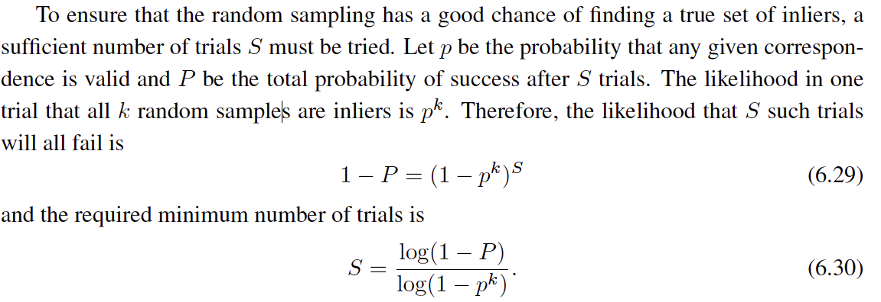
 | proportion of inliers p
k | 95% | 90% | 80% | 75% | 70% | 60% | 50%
2 | 2 | 3 | 5 | 6 | 7 | 11 | 17
3 | 3 | 4 | 7 | 9 | 11 | 19 | 35
4 | 3 | 5 | 9 | 13 | 17 | 34 | 72
5 | 4 | 6 | 12 | 17 | 26 | 57 | 146
6 | 4 | 7 | 16 | 24 | 37 | 97 | 293
7 | 4 | 8 | 20 | 33 | 54 | 163 | 588
8 | 5 | 9 | 26 | 44 | 78 | 272 | 1177
P = 0.99
Notes:
(1-(1-e)^s)^N = 1-p
(1-e)^s = all fail = 1-P

Slide 55
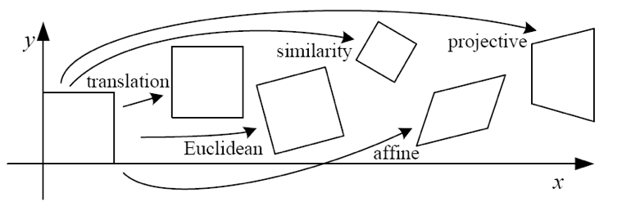
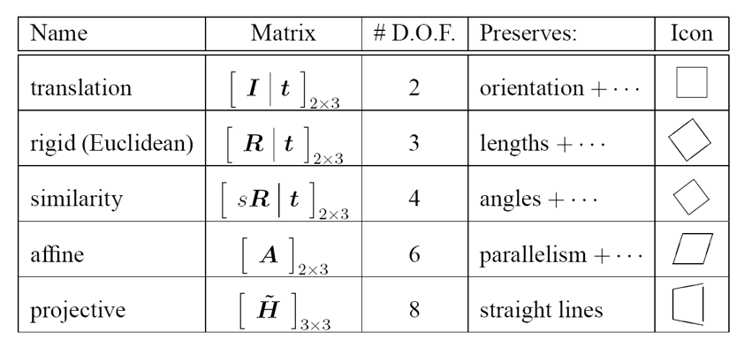
How big is k?
For alignment, depends on the motion model
  Here, each sample is a correspondence (pair of matching points)

Slide 56
RANSAC pros and cons
Pros
  Simple and general
  Applicable to many different problems
  Often works well in practice
Cons
  Parameters to tune
  Sometimes too many iterations are required
  Can fail for extremely low inlier ratios

Slide 57
RANSAC
An example of a “voting”-based fitting scheme
Each hypothesis gets voted on by each data point, best hypothesis wins
There are many other types of voting schemes
  E.g., Hough transforms…

