Slide 1
Image formation

Slide 2
The projection equation

Slide 3
Changing coordinate systems
Y
Y
P = (X,Y,Z)
Z
O
O’
X
X
Z

Slide 4
Changing coordinate systems
Y
Y
Z
O’
X
X
Z

Slide 5
Changing coordinate systems
Y
Y
Z
O’
X
Z
X

Slide 6
Changing coordinate systems
Y
Y
Z
O’
X
Z
X

Slide 7
Changing coordinate systems
Y
Y
Z
O’
X
Z
X

Slide 8
Changing coordinate systems
Y
Y
Z
O’
X
Z
X

Slide 9
Rotations and translations
How do you represent a rotation?
A point in 3D: (X,Y,Z)
Rotations can be represented as a matrix multiplication
What are the properties of rotation matrices?

Slide 10
Properties of rotation matrices
Rotation does not change the length of vectors

Slide 11
Properties of rotation matrices
Rotation
Reflection

Slide 12
Rotation matrices
Rotations in 3D have an axis and an angle
Axis: vector that does not change when rotated
Rotation matrix has eigenvector that has eigenvalue 1

Slide 13

Rotation matrices from axis and angle
Rotation matrix for rotation about axis $v$ and $θ$
First define the following matrix
Interesting fact: this matrix represents cross product

Slide 14
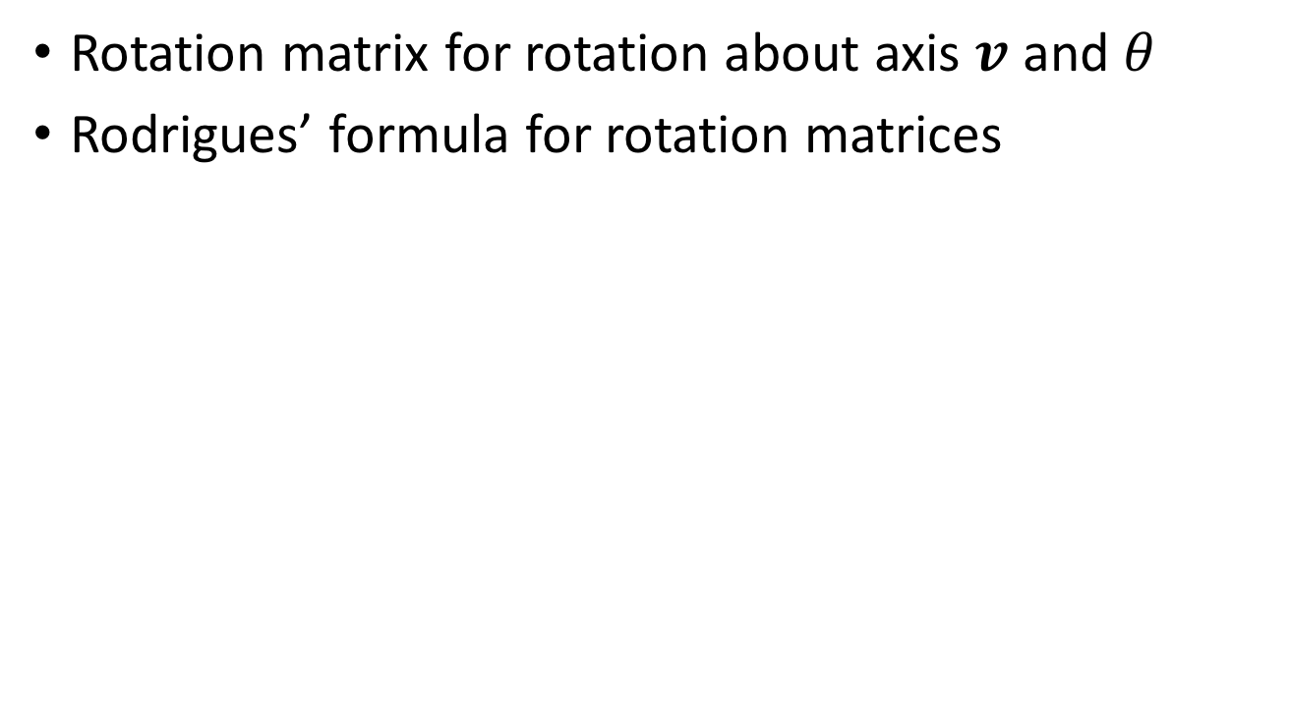
Rotation matrices from axis and angle
Rotation matrix for rotation about axis $v$ and $θ$
Rodrigues’ formula for rotation matrices

Slide 15
Translations
Can this be written as a matrix multiplication?

Slide 16
Putting everything together
Change coordinate system so that center of the coordinate system is at pinhole and Z axis is along viewing direction
Perspective projection

Slide 17
The projection equation
Is this equation linear?
Can this equation be represented by a matrix multiplication?

Slide 18
Is projection linear?

Slide 19
Can projection be represented as a matrix multiplication?
Matrix multiplication
Perspective projection

Slide 20

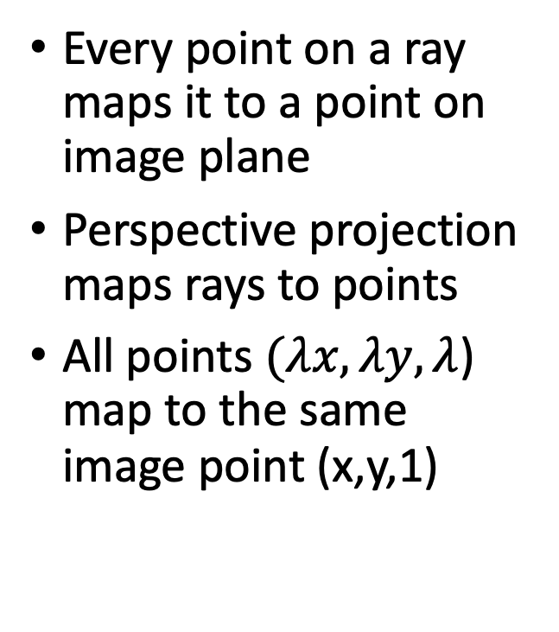
The space of rays
Every point on a ray maps it to a point on image plane
Perspective projection maps rays to points
All points $(λx, λy, λ$) map to the same image point (x,y,1)
($λx, λy, λ$)
(x,y,1)
O

Slide 21
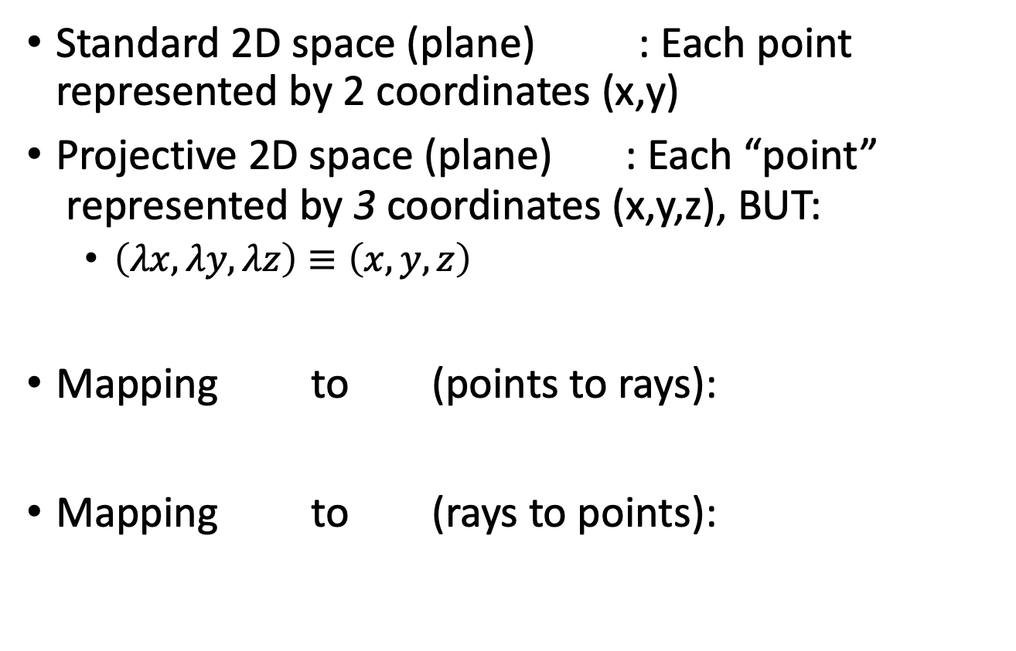
Projective space
Standard 2D space (plane) : Each point represented by 2 coordinates (x,y)
Projective 2D space (plane) : Each “point”
represented by 3 coordinates (x,y,z), BUT:
  $\left(λx, λy, λz\right)≡\left(x,y,z\right)$
Mapping to (points to rays):
Mapping to (rays to points):

Slide 22
Projective space and homogenous coordinates
Mapping to (points to rays):
Mapping to (rays to points):
A change of coordinates
Also called homogenous coordinates

Slide 23
Homogenous coordinates
In standard Euclidean coordinates
  2D points : (x,y)
  3D points : (x,y,z)
In homogenous coordinates
  2D points : (x,y,1)
  3D points : (x,y,z,1)

Slide 24
Why homogenous coordinates?
Homogenous coordinates of world point
Homogenous coordinates of image point

Slide 25
Why homogenous coordinates?
Perspective projection is matrix multiplication in homogenous coordinates!

Slide 26
Why homogenous coordinates?
Translation is matrix multiplication in homogenous coordinates!

Slide 27
Homogenous coordinates

Slide 28
Homogenous coordinates

Slide 29
Perspective projection in homogenous coordinates

Slide 30
More about matrix transformations
3 x 4 : Perspective projection
4 x 4 : Translation
4 x 4 : Affine transformation (linear transformation + translation)

Slide 31
More about matrix transformations
Euclidean

Slide 32
More about matrix transformations
Similarity transformation

Slide 33
More about matrix transformations
Anisotropic scaling and translation

Slide 34
More about matrix transformations
General affine transformation

Slide 35
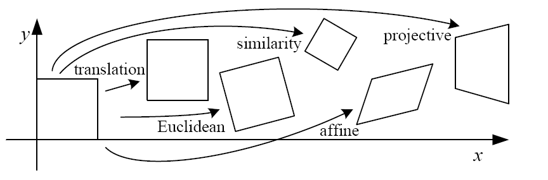
Matrix transformations in 2D

