Slide 1
Feature descriptors and matching

Slide 2
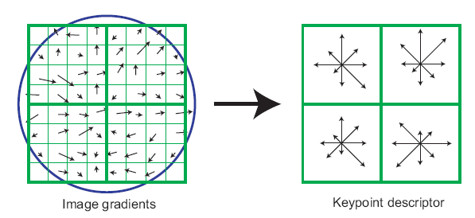
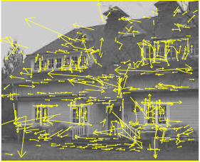
The SIFT descriptor
SIFT – Lowe IJCV 2004
Notes:
Do scale-space invariant feature detection using DoG.

Slide 3
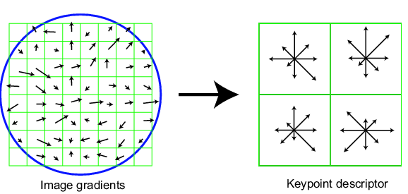
Scale Invariant Feature Transform
DoG for scale-space feature detection
Take 16x16 square window around detected feature at appropriate scale
Compute gradient orientation for each pixel
Throw out weak edges (threshold gradient magnitude)
Create histogram of surviving edge orientations: note: each pixel contributes vote proportional to gradient magnitude
Find mode of histogram and rotate patch so that mode is 0
Mode=dominant orientation
0
2π
angle histogram
Adapted from slide by David Lowe

Slide 4
SIFT descriptor
Create histogram
Divide the 16x16 window into a 4x4 grid of cells (2x2 case shown below)
Compute an orientation histogram for each cell
16 cells * 8 orientations = 128 dimensional descriptor
Adapted from slide by David Lowe

Slide 5
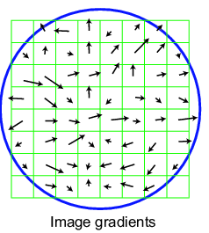
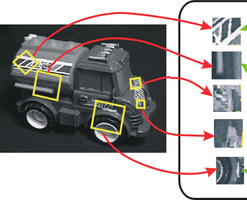
SIFT vector formation
Computed on rotated and scaled version of window according to computed orientation & scale
resample the window

Slide 6
Reduce effect of illumination
128-dim vector normalized to 1: invariance to contrast changes
Threshold gradient magnitudes to avoid excessive influence of high gradients
after normalization, clamp gradients >0.2
renormalize

Slide 7
Other tips and tricks
When identifying dominant orientation, if multiple modes, create multiple keypoints
Weigh pixels in center of patch more highly (Gaussian weights)
Trilinear interpolation
a given gradient contributes to 8 bins: 4 in space times 2 in orientation

Slide 8

Multiple modes when measuring dominant orientation
0
$$π$$

Slide 9
Linear interpolation into orientation grid
A
Blue arrows are centers of orientation bin
Pixel with red orientation contributes to:
Histogram A with weight q
Histogram B with weight p
B
p
q

Slide 10
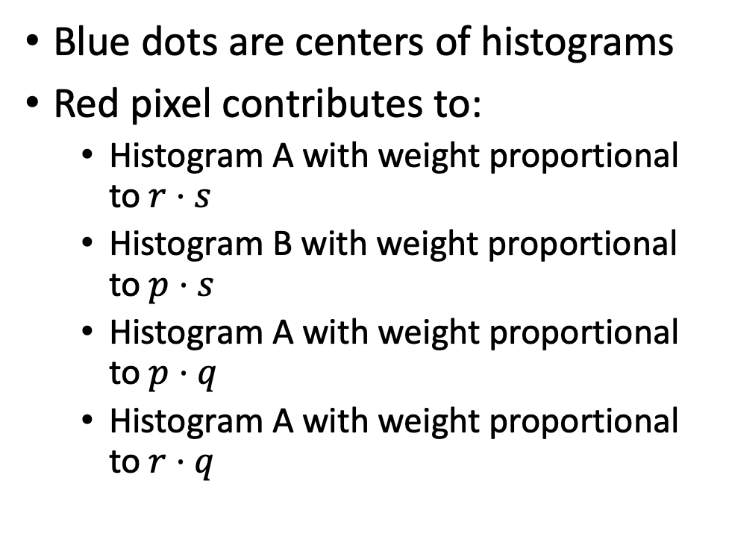
Bilinear interpolation into spatial grid cells
Blue dots are centers of histograms
Red pixel contributes to:
Histogram A with weight proportional to $r⋅s$
Histogram B with weight proportional to $p⋅s$
Histogram A with weight proportional to $p⋅q$
Histogram A with weight proportional to $r⋅q$
A
B
q
p
r
s
D
C

Slide 11
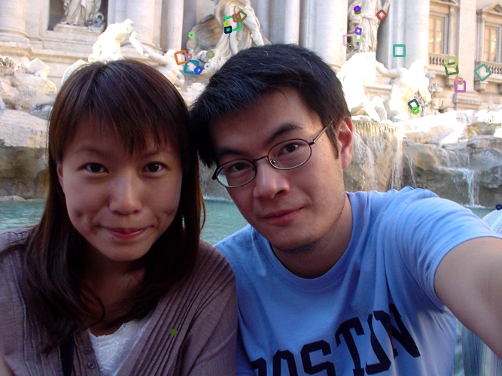
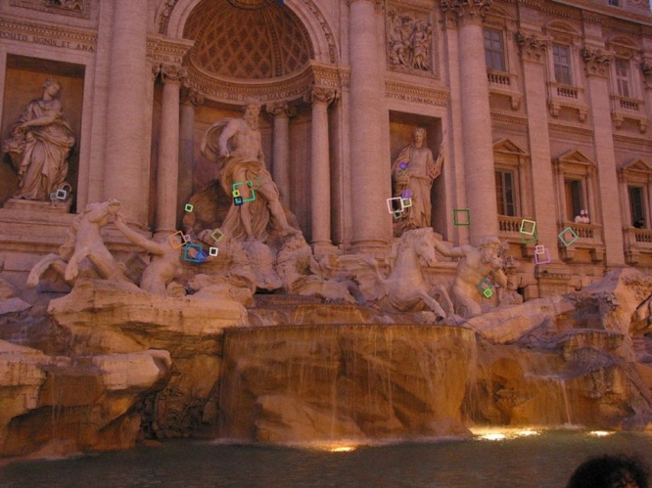
Properties of SIFT
Extraordinarily robust matching technique
Can handle changes in viewpoint
Up to about 60 degree out of plane rotation
Can handle significant changes in illumination
Sometimes even day vs. night (below)
Fast and efficient—can run in real time
Lots of code available: http://people.csail.mit.edu/albert/ladypack/wiki/index.php/Known_implementations_of_SIFT

Slide 12
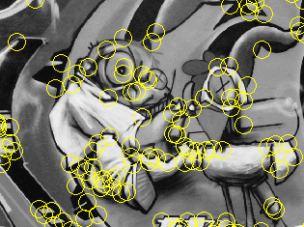
Summary
Keypoint detection: repeatable and distinctive
Corners, blobs, stable regions
Harris, DoG
Descriptors: invariant and discriminative
spatial histograms of orientation
Next up: using correspondences for reconstruction

Slide 13
Geometry of Image Formation

Slide 14
The pinhole camera
Let’s abstract out the details

Slide 15
The pinhole camera
We don’t care about the other walls of the box, so let’s remove those

Slide 16
The pinhole camera
Let’s look at a individual points in the world and not worry about what they are.

Slide 17
The pinhole camera
Y
P = (X,Y,Z)
p = (x,y)
Z
O
Z=-1
X
Let’s place the origin at the pinhole, with Z axis pointing away from the screen (called camera plane)

Slide 18
The pinhole camera
Y
P = (X,Y,Z)
p = (x,y)
Z
O
Z=-1
X
Let’s remove the wall with the pinhole: all we care about is that all light rays of interest must pass through the pinhole, i.e., the origin

Slide 19
The pinhole camera
Y
P = (X,Y,Z)
p = (x,y)
Z
O
Z=-1
X
Question: Where will we see the “image” of point P on the camera plane?

Slide 20

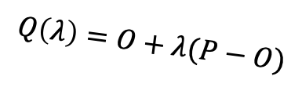
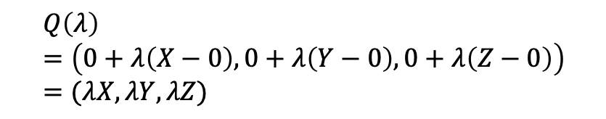

The pinhole camera
Y
P = (X,Y,Z)
$$Q\left(λ\right)=O+λ(P−O)$$
p = (x,y)
Z
O
$$λ=0⇒Q\left(λ\right)=O$$
$$λ=1⇒Q\left(λ\right)=P$$
Z=-1
X
$$Q\left(λ\right)=\left(0+λ\left(X−0\right), 0+λ\left(Y−0\right), 0+λ\left(Z−0\right)\right)=(λX, λY, λZ)$$

Slide 21
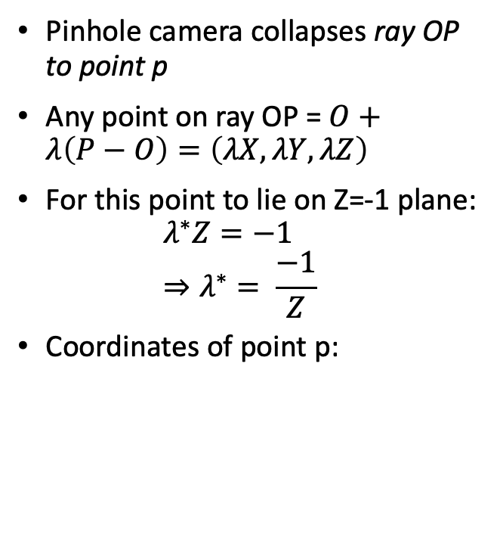
The pinhole camera
Pinhole camera collapses ray OP to point p
Any point on ray OP = $O+λ\left(P−O\right)=\left(λX, λY, λZ\right)$
For this point to lie on Z=-1 plane: $λ^{∗}Z=−1$ $⇒λ^{∗}= \frac{−1}{Z}$
Coordinates of point p:
Y
p = (x,y)
P = (X,Y,Z)
Z
O
Z=-1
X

Slide 22
The projection equation
A point P = (X, Y, Z) in 3D projects to a point p = (x,y) in the image
But pinhole camera’s image is inverted, invert it back!

Slide 23
Another derivation
P = (X,Y,Z)
Y
1
O
Z
y
p = (x,y,z)

Slide 24
A virtual image plane
A pinhole camera produces an inverted image
Imagine a ”virtual image plane” in the front of the camera
P
P
Y
Y
y
1
Z
O
y
1
O
Z

Slide 25
The projection equation

Slide 26
Consequence 1: Farther away objects are smaller
(X, Y + h, Z)
(X, Y, Z)
Image of foot:
Image of head:

Slide 27
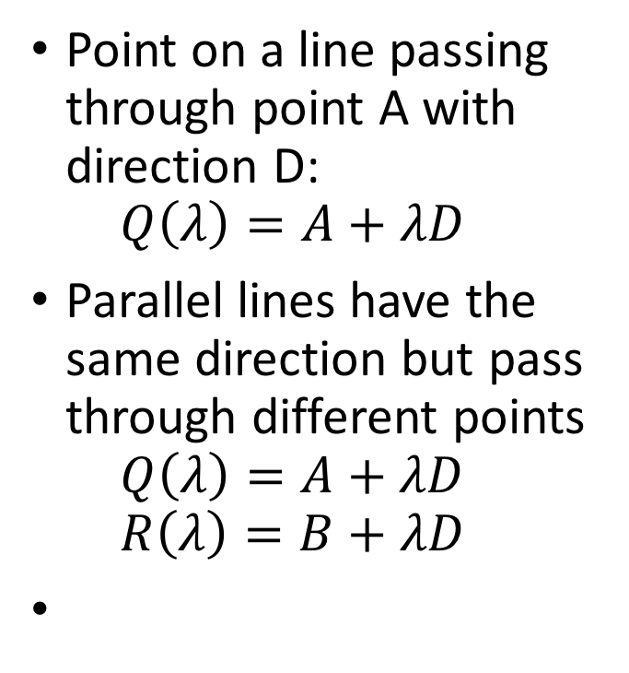
Consequence 2: Parallel lines converge at a point
Point on a line passing through point A with direction D: $Q\left(λ\right)=A+λD$
Parallel lines have the same direction but pass through different points $Q\left(λ\right)=A+λD$ $R\left(λ\right)=B+λD$

Slide 28
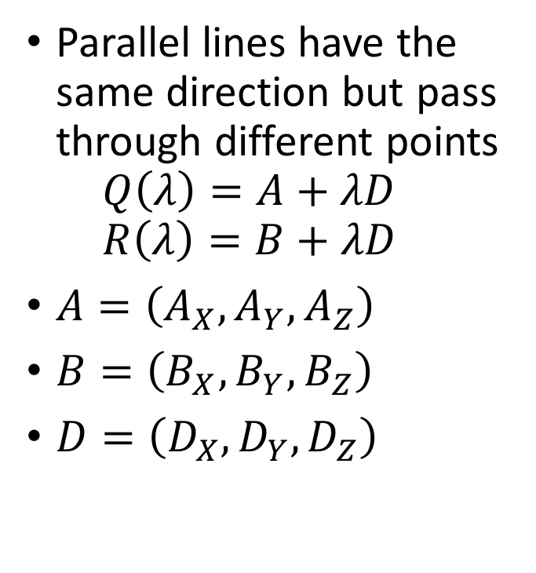
Consequence 2: Parallel lines converge at a point
Parallel lines have the same direction but pass through different points $Q\left(λ\right)=A+λD$ $R\left(λ\right)=B+λD$
$A=\left(A_{X}, A_{Y}, A_{Z}\right)$
$B=\left(B_{X},B_{Y},B_{Z}\right)$
$D=\left(D_{X},D_{Y},D_{Z}\right)$

Slide 29
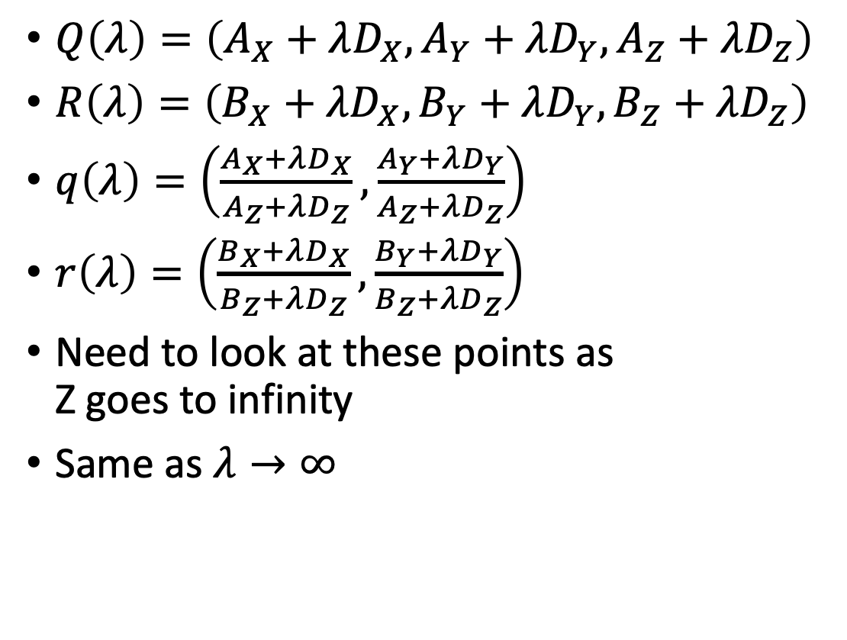
Consequence 2: Parallel lines converge at a point
$Q\left(λ\right)=\left(A_{X}+λD_{X}, A_{Y}+λD_{Y}, A_{Z}+λD_{Z}\right)$
$R\left(λ\right)=\left(B_{X}+λD_{X}, B_{Y}+λD_{Y}, B_{Z}+λD_{Z}\right)$
$q\left(λ\right)=\left(\frac{A_{X}+λD_{X}}{A_{Z}+λD_{Z}}, \frac{A_{Y}+λD_{Y}}{A_{Z}+λD_{Z}}\right)$
$r\left(λ\right)=\left(\frac{B_{X}+λD_{X}}{B_{Z}+λD_{Z}}, \frac{B_{Y}+λD_{Y}}{B_{Z}+λD_{Z}}\right)$
Need to look at these points as Z goes to infinity
Same as $λ→∞$

Slide 30
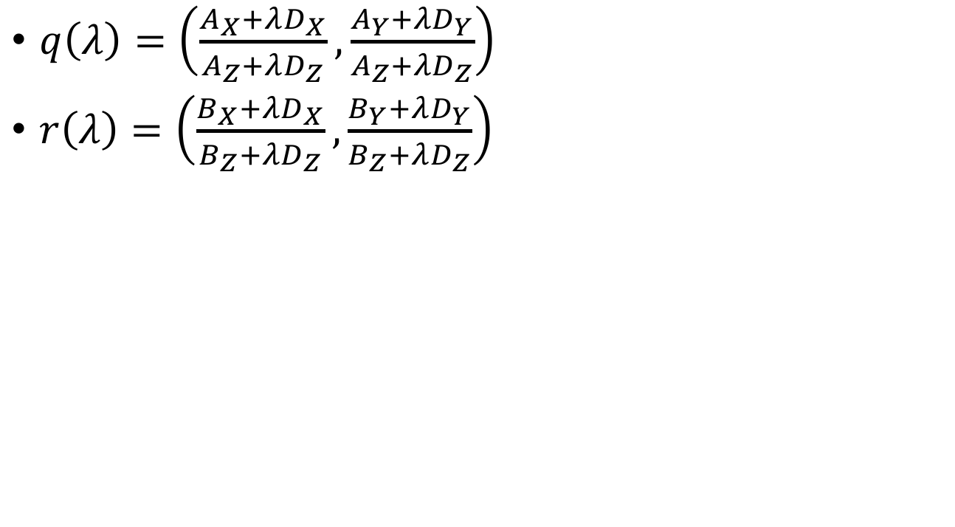
Consequence 2: Parallel lines converge at a point
$q\left(λ\right)=\left(\frac{A_{X}+λD_{X}}{A_{Z}+λD_{Z}}, \frac{A_{Y}+λD_{Y}}{A_{Z}+λD_{Z}}\right)$
$r\left(λ\right)=\left(\frac{B_{X}+λD_{X}}{B_{Z}+λD_{Z}}, \frac{B_{Y}+λD_{Y}}{B_{Z}+λD_{Z}}\right)$

Slide 31
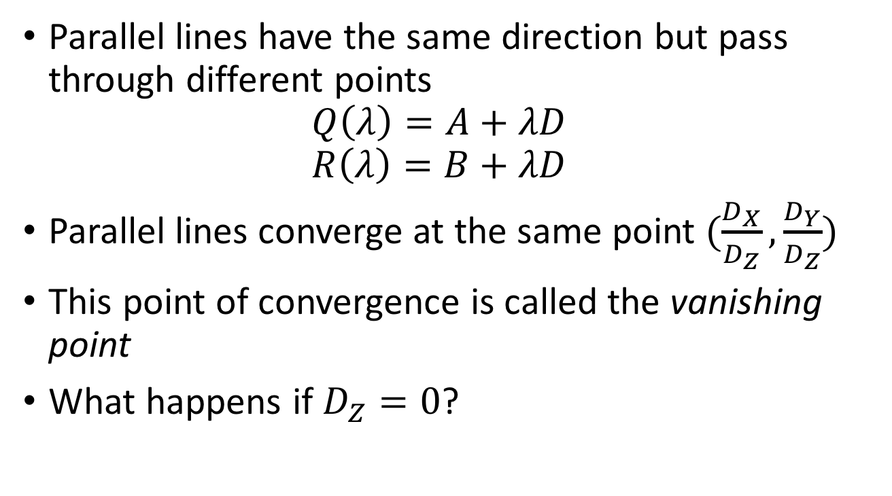
Consequence 2: Parallel lines converge at a point
Parallel lines have the same direction but pass through different points $Q\left(λ\right)=A+λD$ $R\left(λ\right)=B+λD$
Parallel lines converge at the same point $(\frac{D_{X}}{D_{Z}},\frac{D_{Y}}{D_{Z}})$
This point of convergence is called the vanishing point
What happens if $D_{Z}=0$?

Slide 32
Consequence 2: Parallel lines converge at a point

Slide 33
What about planes?
Vanishing line of a plane
Take the limit as Z approaches infinity

Slide 34
What about planes?
Normal: (N_{X}, N_{Y}, N_{Z})
What do parallel planes look like?
Vanishing lines
Parallel planes converge!

Slide 35
Vanishing line
What happens if N_{X} = N_{Y} = 0?
Equation of the plane: Z = c
Vanishing line?

Slide 36
Changing coordinate systems
Y
Y
P = (X,Y,Z)
Z
O
O’
X
X
Z

Slide 37
Changing coordinate systems
Y
Y
Z
O’
X
X
Z

Slide 38
Changing coordinate systems
Y
Y
Z
O’
X
Z
X

Slide 39
Changing coordinate systems
Y
Y
Z
O’
X
Z
X

Slide 40
Changing coordinate systems
Y
Y
Z
O’
X
Z
X

Slide 41
Changing coordinate systems
Y
Y
Z
O’
X
Z
X

Slide 42
Rotations and translations
How do you represent a rotation?
A point in 3D: (X,Y,Z)
Rotations can be represented as a matrix multiplication
What are the properties of rotation matrices?

Slide 43
Properties of rotation matrices
Rotation does not change the length of vectors

Slide 44
Properties of rotation matrices
Rotation
Reflection

Slide 45
Rotation matrices
Rotations in 3D have an axis and an angle
Axis: vector that does not change when rotated
Rotation matrix has eigenvector that has eigenvalue 1

Slide 46

Rotation matrices from axis and angle
Rotation matrix for rotation about axis $v$ and $θ$
First define the following matrix
Interesting fact: this matrix represents cross product

Slide 47
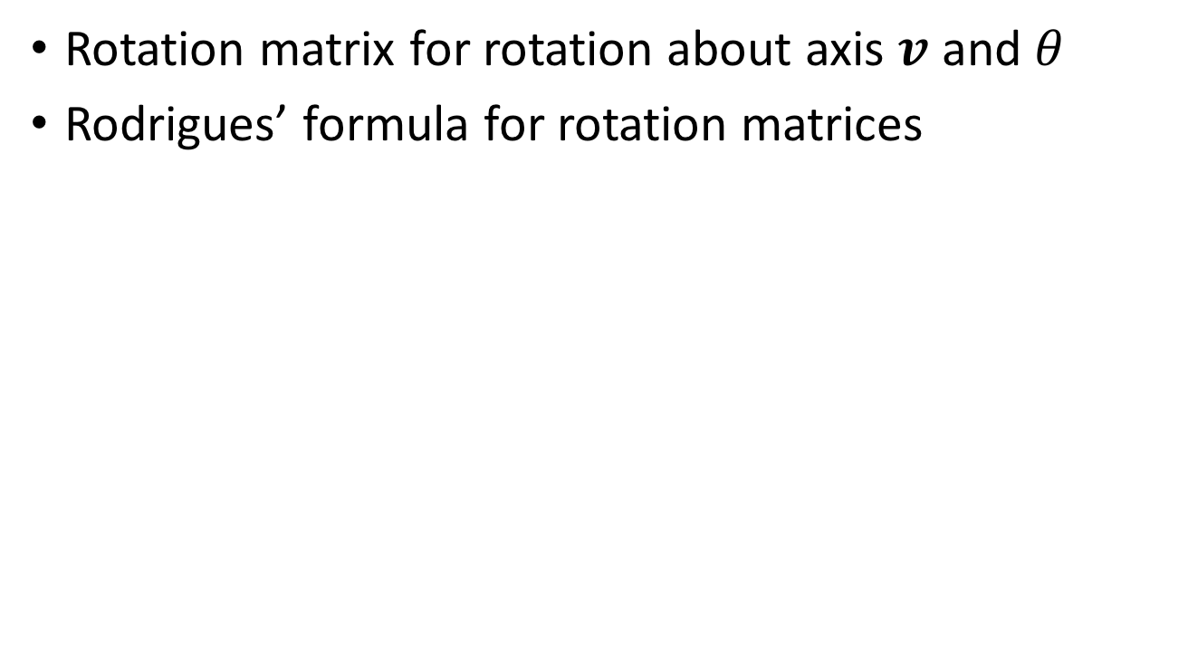
Rotation matrices from axis and angle
Rotation matrix for rotation about axis $v$ and $θ$
Rodrigues’ formula for rotation matrices

Slide 48
Translations
Can this be written as a matrix multiplication?

Slide 49
Putting everything together
Change coordinate system so that center of the coordinate system is at pinhole and Z axis is along viewing direction
Perspective projection

