Slide 1
Feature descriptors and matching

Slide 2
Feature detection and description
Harris corner detection gives:
Location of each detected corner
Orientation of the corner (given by x_{max})
Scale of the corner (the image scale which gives the maximum response at this location)
Want feature descriptor that is
Invariant to photometric transformations, translation, rotation, scaling
Discriminative
P

Slide 3
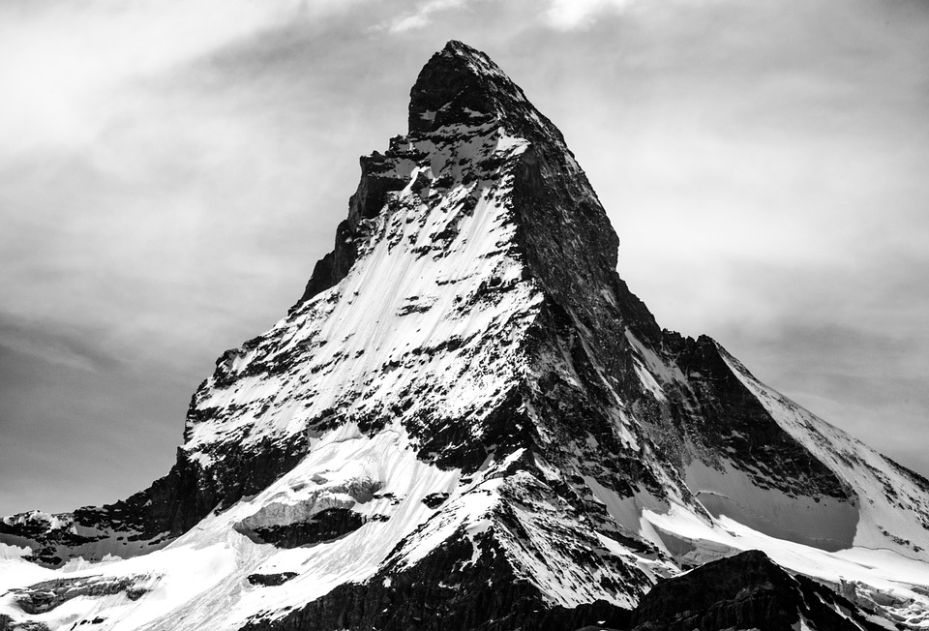
Multiscale Oriented PatcheS descriptor
Describe a corner by the patch around that pixel
Scale invariance by using scale identified by corner detector
Rotation invariance by using orientation identified by corner detector
Photometric invariance by subtracting mean and dividing by standard deviation

Slide 4
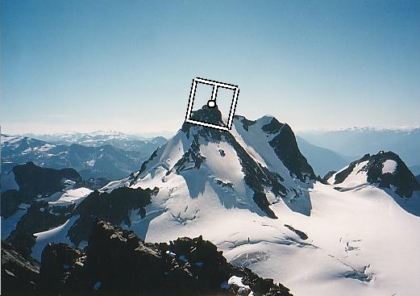
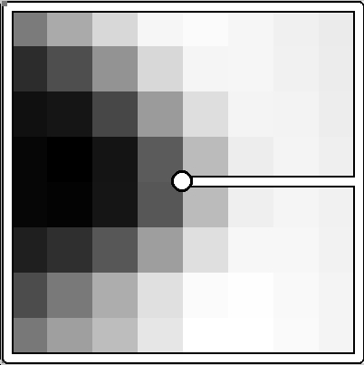
Multiscale Oriented PatcheS descriptor
Take 40x40 square window around detected feature at the right scale
Scale to 1/5 size (using prefiltering)
Rotate to horizontal
Sample 8x8 square window centered at feature
Intensity normalize the window by subtracting the mean, dividing by the standard deviation in the window
40 pixels
8 pixels
Adapted from slide by Matthew Brown

Slide 5
MOPS

Slide 6
Detour: Image transformations
What does it mean to rotate a patch?
Each pixel has coordinates (x,y)
Rotation represented by a matrix R
Pixel’s new coordinates:
I’(x’,y’) = I(x,y)

Slide 7
Detour: Image transformations
What if destination pixel is fractional?
Flip computation: for every destination pixel figure out source pixel
Use interpolation if source location is fractional
I’(x’, y’) = I(x,y)

Slide 8
Multiscale Oriented PatcheS descriptor
Take 40x40 square window around detected feature
Scale to 1/5 size (using prefiltering)
Rotate to horizontal
Sample 8x8 square window centered at feature
Intensity normalize the window by subtracting the mean, dividing by the standard deviation in the window
40 pixels
8 pixels
Adapted from slide by Matthew Brown

Slide 9
MOPS descriptor
You can combine transformations together to get the final transformation
x
T = ?
y
Notes:
Pass this transformation matrix to cv2.warpAffine

Slide 10
Translate
x
y
T = M_{T1}

Slide 11
Rotate
x
y
T = M_{R}M_{T1}

Slide 12
Scale
x
y
T = M_{S}M_{R}M_{T1}

Slide 13
Translate
x
y
T = M_{T2}M_{S}M_{R}M_{T1}

Slide 14

Crop
x
y
Notes:
cv2.warpAffine also takes care of the cropping

Slide 15
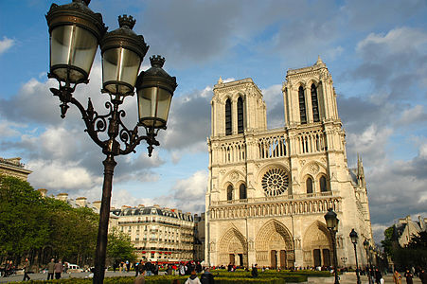
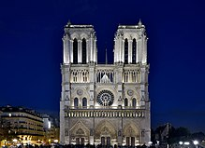
Color and Lighting
Have invariance to additive and multiplicative changes to intensity
But what about more sophisticated changes to intensity?

Slide 16
Better representation than color: Edges
Normal discontinuity
Depth Discontinuity
Albedo Edge
Shadow

Slide 17
Out-of-plane rotation
Invariant to translation and rotation
But what about more sophisticated geometric transformations
Out-of-plane rotation

Slide 18
Towards a better feature descriptor
Match pattern of edges
Edge orientation – clue to shape
Invariant to almost all photometric transformations
Be resilient to small deformations
Deformations might move pixels around, but slightly
Deformations might change edge orientations, but slightly

Slide 19
Invariance to deformation
Precise edge orientations are not resilient to out-of-plane rotations and deformations
But we can quantize edge orientation: only record rough orientation
37
42
Between 30 and 45

Slide 20
Invariance to deformation

Slide 21
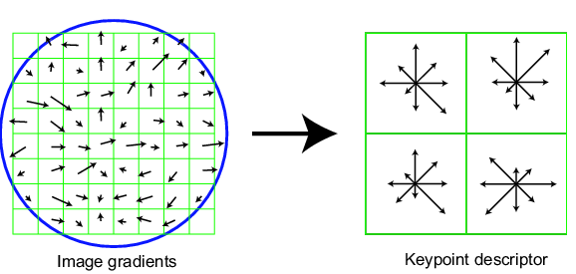
Invariance to deformation
Deformation can also move pixels around
Again, instead of precise location of each pixel, only want to record rough location
Divide patch into a grid of cells
Record counts of each orientation in each cell: orientation histograms
Orientation histogram

Slide 22
Rotation Invariance by Orientation Normalization
[Lowe, SIFT, 1999]
Compute orientation histogram
Select dominant orientation (mode of the histogram; alternative to eigenvector of second moment matrix)
Normalize: rotate to fixed orientation
0
2
π

Slide 23
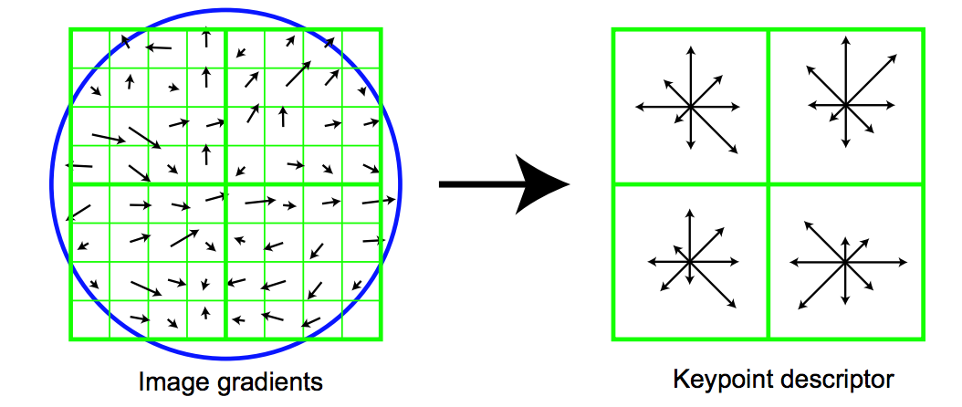
The SIFT descriptor
Compute edge magnitudes + orientations
Quantize orientations (invariance to def)
Divide into spatial cells
Compute orientation histogram in each cell (spatial invariance)
Distinctive Image Features from Scale-Invariant Keypoints. Lowe. In IJCV 2004

Slide 24
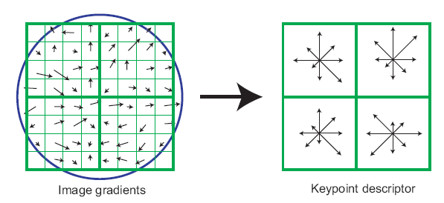
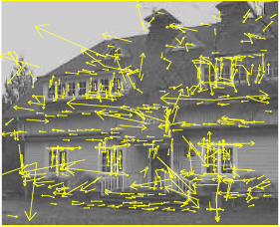
The SIFT descriptor
SIFT – Lowe IJCV 2004
Notes:
Do scale-space invariant feature detection using DoG.

Slide 25
Scale Invariant Feature Transform
Basic idea:
DoG for scale-space feature detection
Take 16x16 square window around detected feature
Compute gradient orientation for each pixel
Throw out weak edges (threshold gradient magnitude)
Create histogram of surviving edge orientations
0
2π
angle histogram
Adapted from slide by David Lowe

Slide 26
SIFT descriptor
Create histogram
Divide the 16x16 window into a 4x4 grid of cells (2x2 case shown below)
Compute an orientation histogram for each cell
16 cells * 8 orientations = 128 dimensional descriptor
Adapted from slide by David Lowe

Slide 27
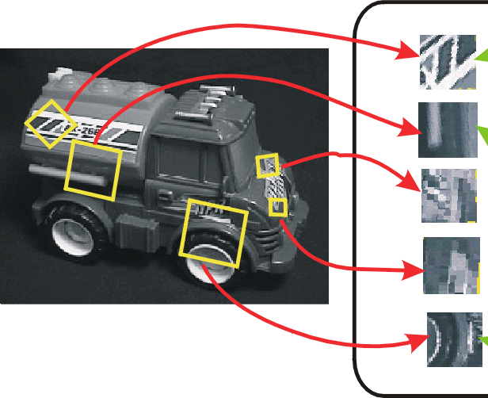
SIFT vector formation
Computed on rotated and scaled version of window according to computed orientation & scale
resample the window
Based on gradients weighted by a Gaussian

Slide 28
Ensure smoothness
Trilinear interpolation
a given gradient contributes to 8 bins: 4 in space times 2 in orientation

Slide 29
Reduce effect of illumination
128-dim vector normalized to 1
Threshold gradient magnitudes to avoid excessive influence of high gradients
after normalization, clamp gradients >0.2
renormalize

Slide 30
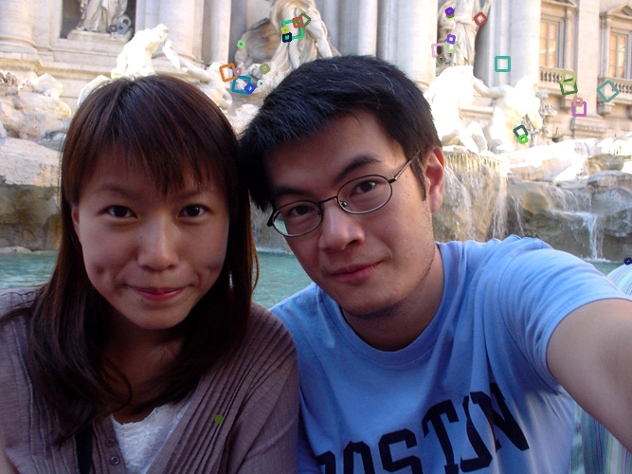
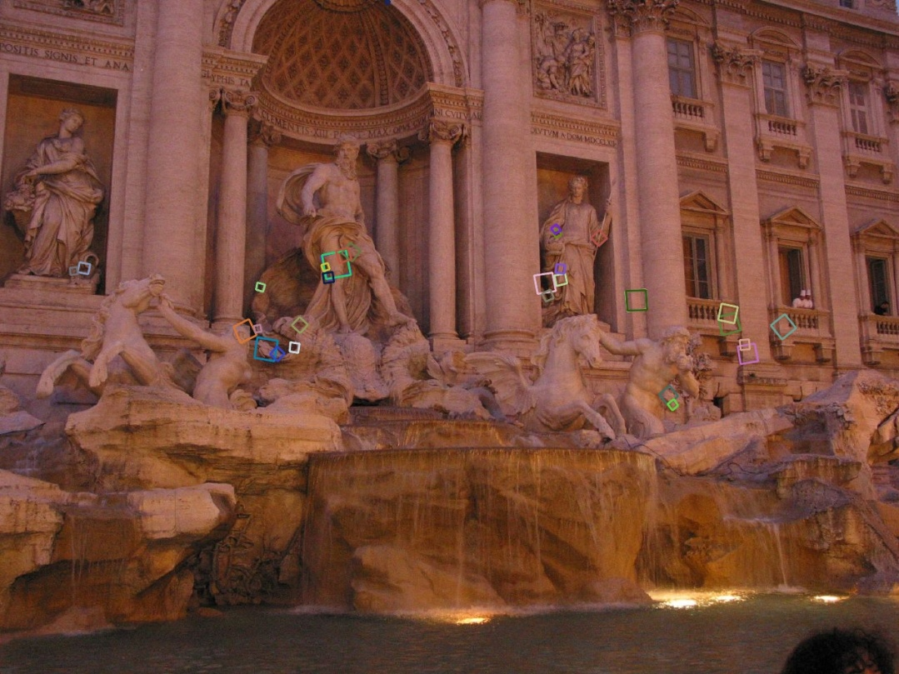
Properties of SIFT
Extraordinarily robust matching technique
Can handle changes in viewpoint
Up to about 60 degree out of plane rotation
Can handle significant changes in illumination
Sometimes even day vs. night (below)
Fast and efficient—can run in real time
Lots of code available: http://people.csail.mit.edu/albert/ladypack/wiki/index.php/Known_implementations_of_SIFT

Slide 31
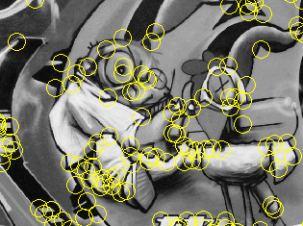
Summary
Keypoint detection: repeatable and distinctive
Corners, blobs, stable regions
Harris, DoG
Descriptors: robust and selective
spatial histograms of orientation
SIFT and variants are typically good for stitching and recognition
But, need not stick to one

Slide 32
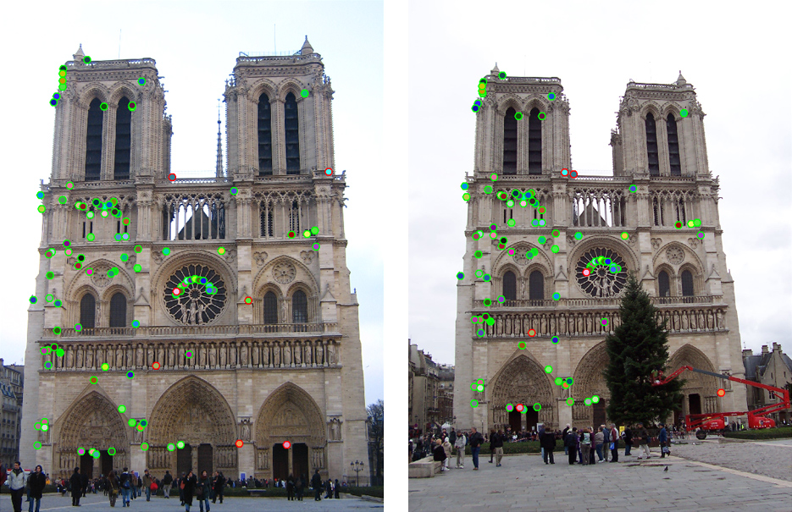
Which features match?

Slide 33
Feature matching
Given a feature in I₁, how to find the best match in I₂?
Define distance function that compares two descriptors
Test all the features in I₂, find the one with min distance

Slide 34
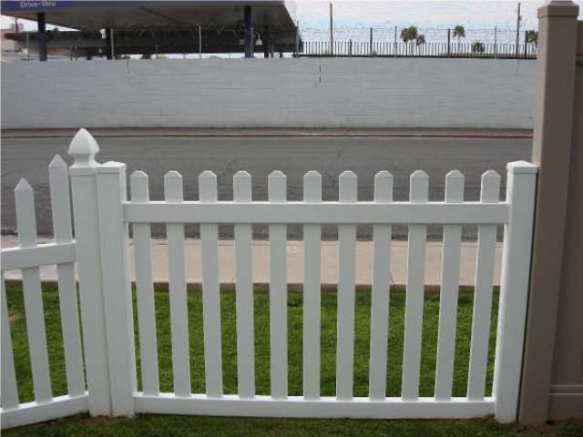
Feature distance
How to define the difference between two features f₁, f₂?
Simple approach: L₂ distance, ||f₁ - f₂ ||
can give good scores to ambiguous (incorrect) matches
f₁
f₂
I₁
I₂

Slide 35
Feature distance
How to define the difference between two features f₁, f₂?
Better approach: ratio distance = ||f₁ - f₂ || / || f₁ - f₂’ ||
f₂ is best SSD match to f₁ in I₂
f₂’ is 2nd best SSD match to f₁ in I₂
gives large values for ambiguous matches
f₁
f₂'
f₂
I₁
I₂

