Slide 2
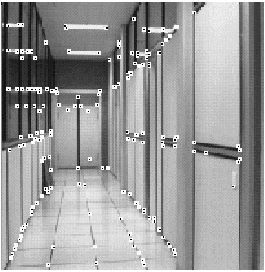
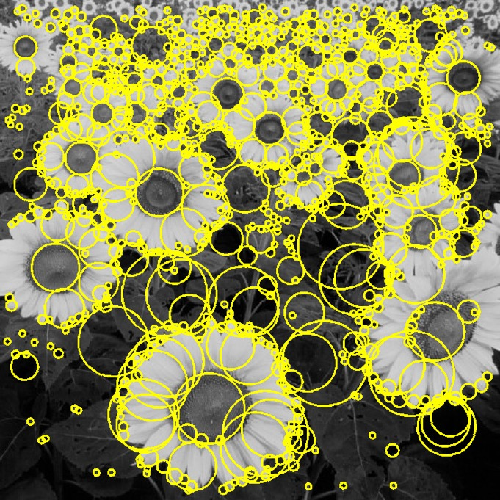
Another kind of feature: blob
“Peak” or “Valley” in intensity

Slide 3


Detecting peaks and valleys
The Laplacian of Gaussian (LoG)
(very similar to a Difference of Gaussians (DoG) – i.e. a Gaussian minus a slightly smaller Gaussian)

Slide 4
Scale selection
At what scale does the Laplacian achieve a maximum response for a binary circle of radius r?
r
image
Laplacian

Slide 5
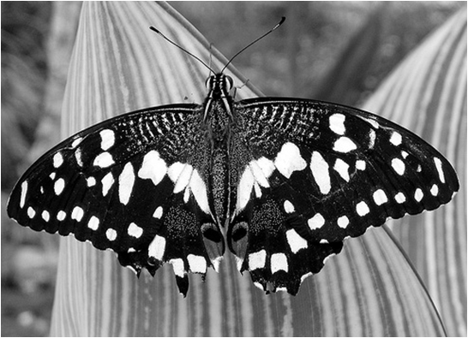
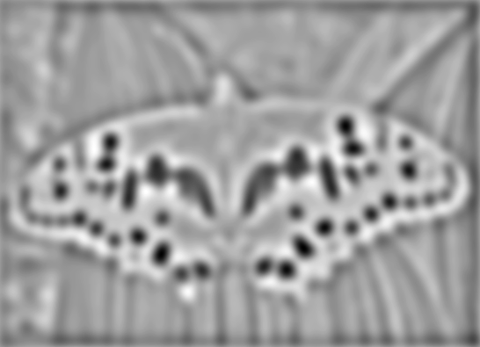

Laplacian of Gaussian
“Blob” detector
Find maxima and minima of LoG operator in space and scale
minima
*
=
maximum

Slide 6
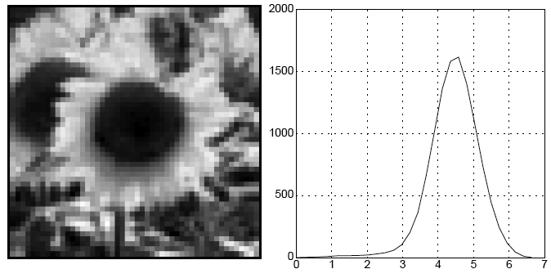
Characteristic scale
The scale that produces peak of Laplacian response
characteristic scale
T. Lindeberg (1998). "Feature detection with automatic scale selection." International Journal of Computer Vision 30 (2): pp 77--116.

Slide 7
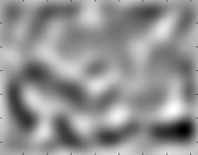
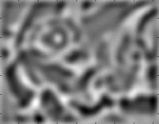


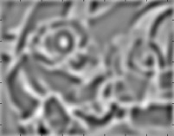
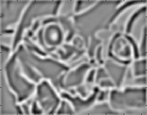

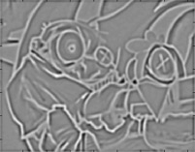
Find local maxima in position-scale space
σ⁵
σ⁴
σ³
σ²
⇒ List of
(x, y, s)
σ
Notes:
Blob detector is distinct from harris corner detector

Slide 8
Scale-space blob detector: Example

Slide 9
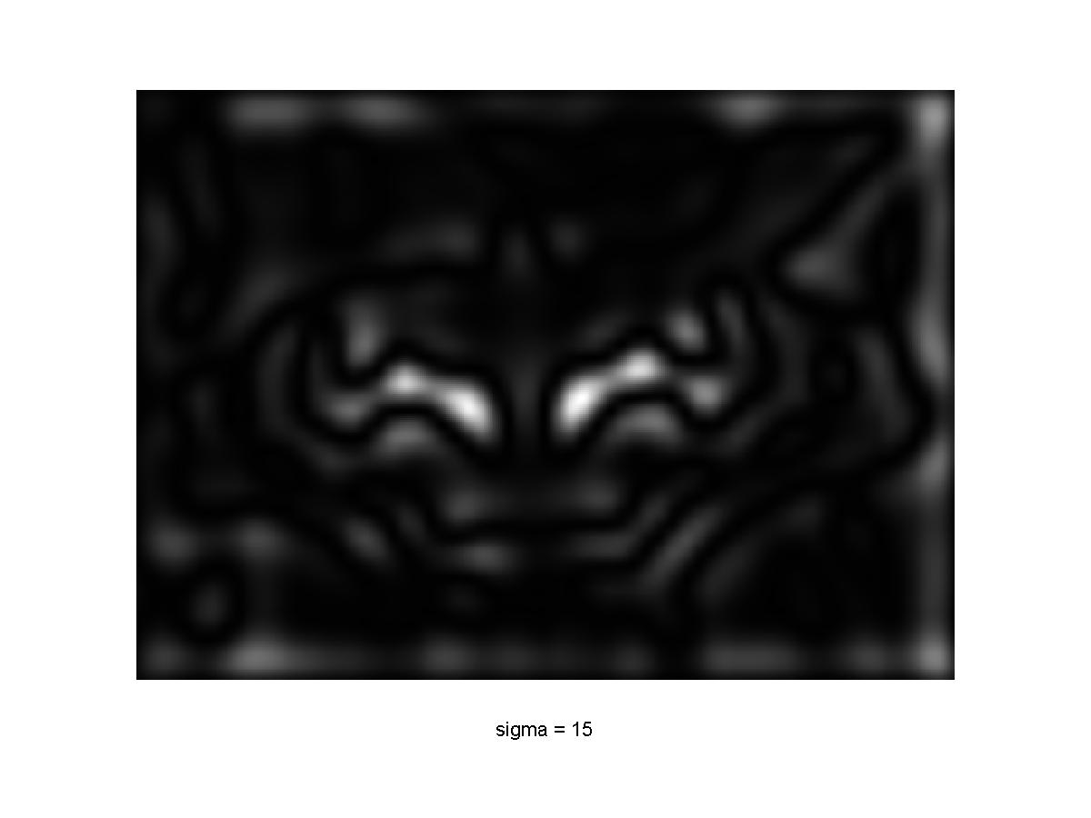
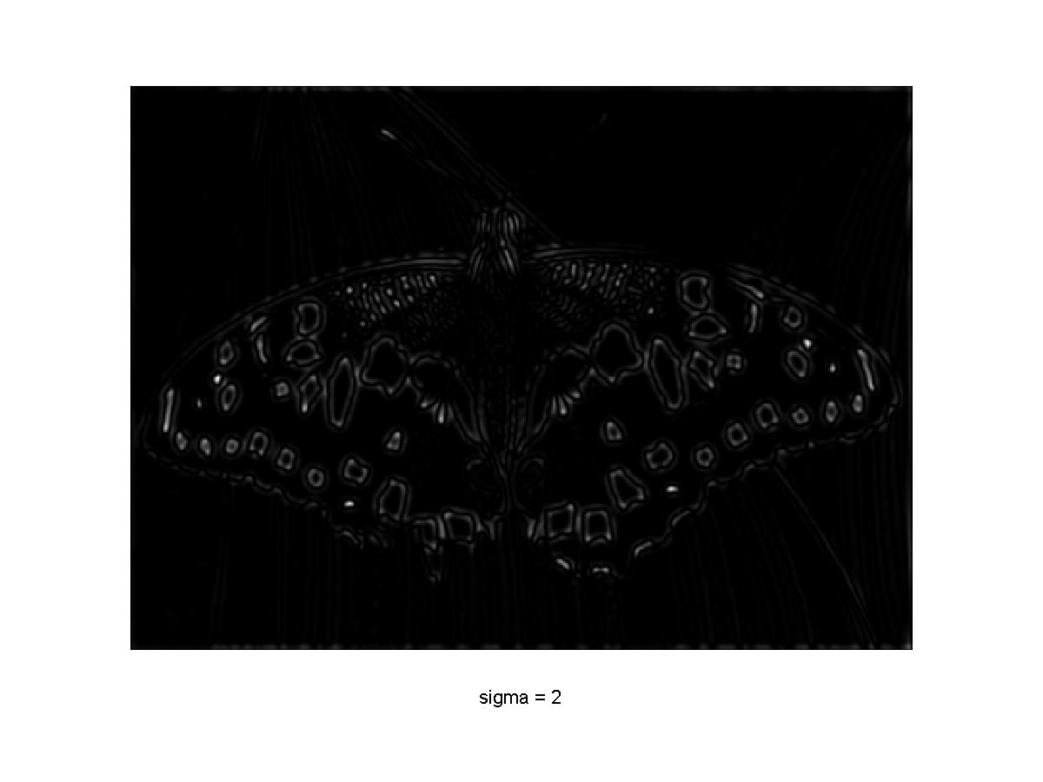
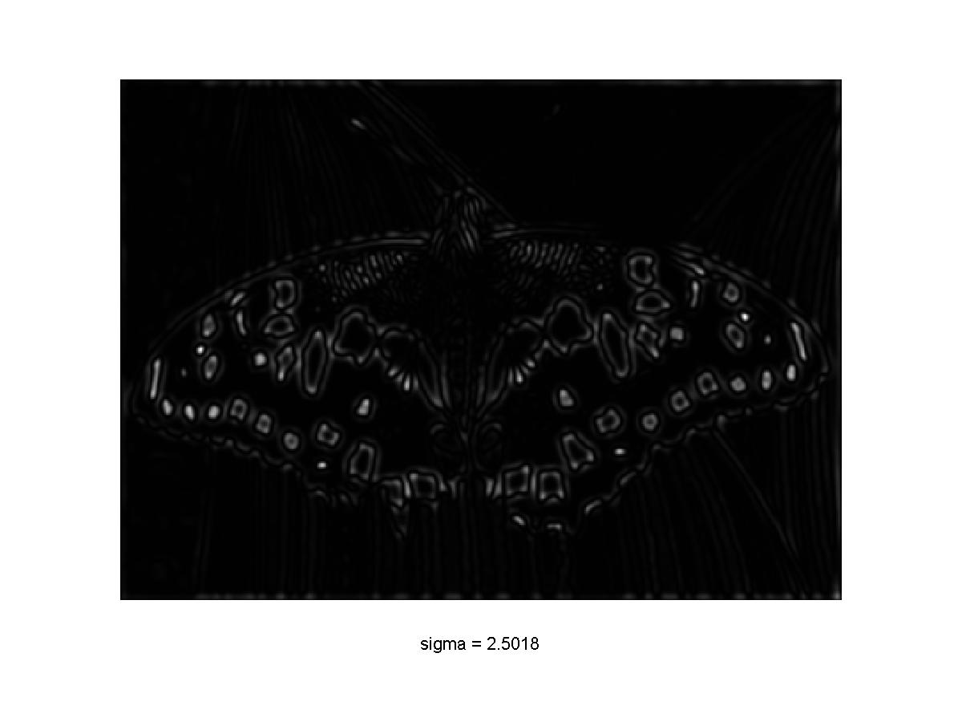
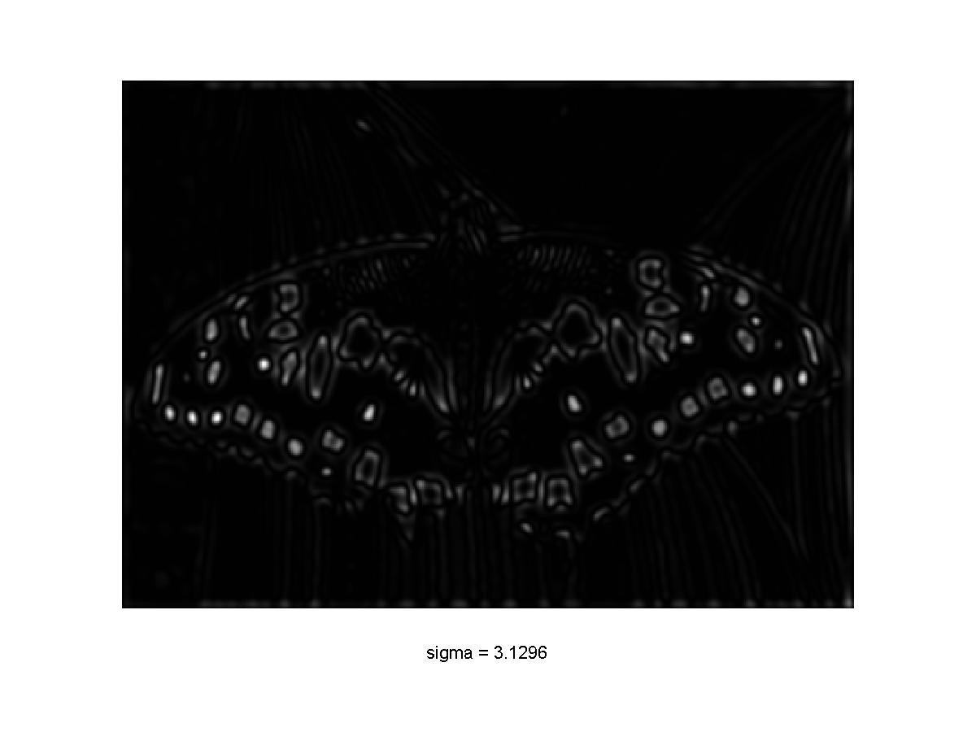
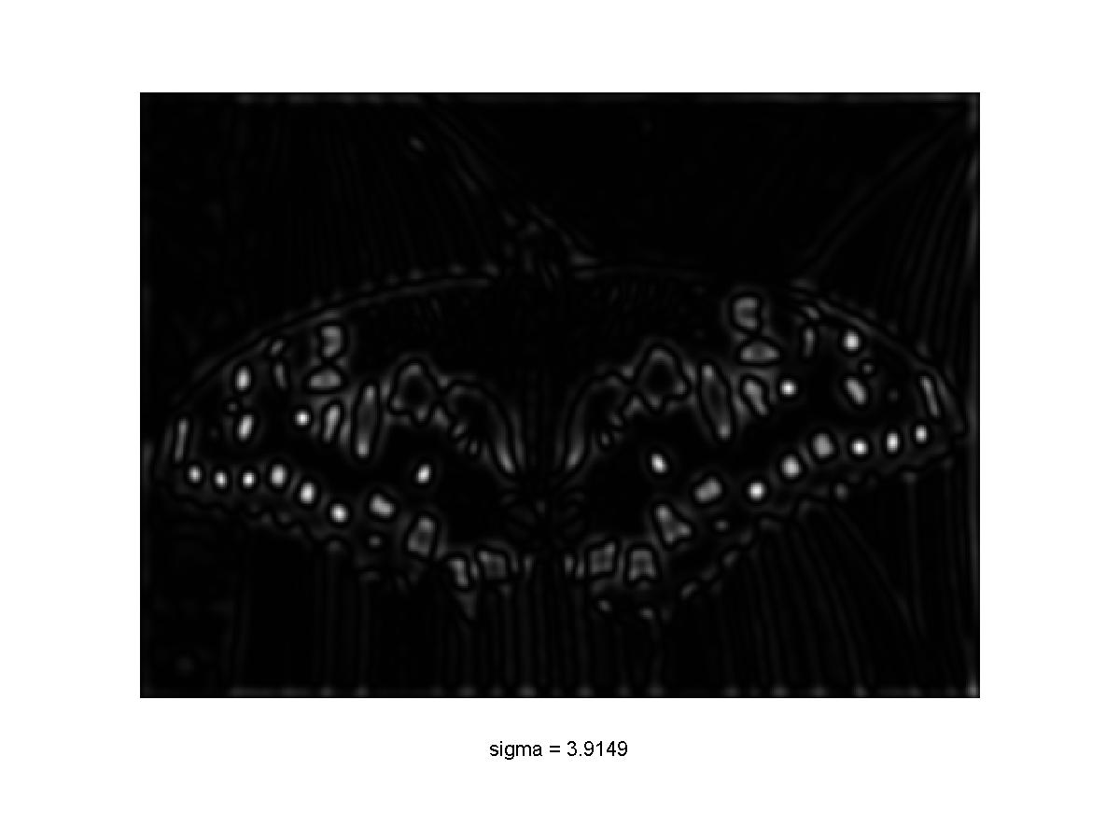
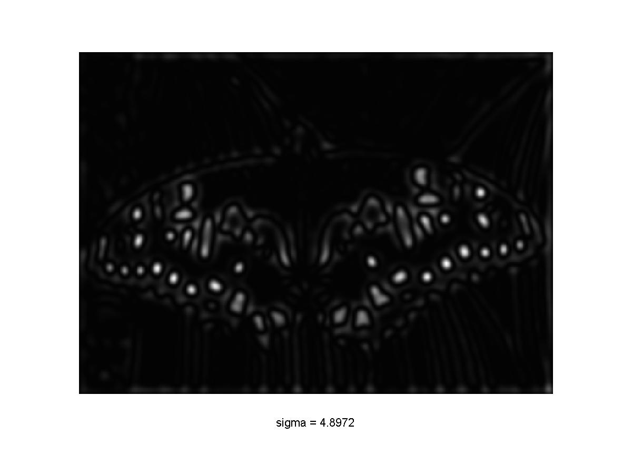

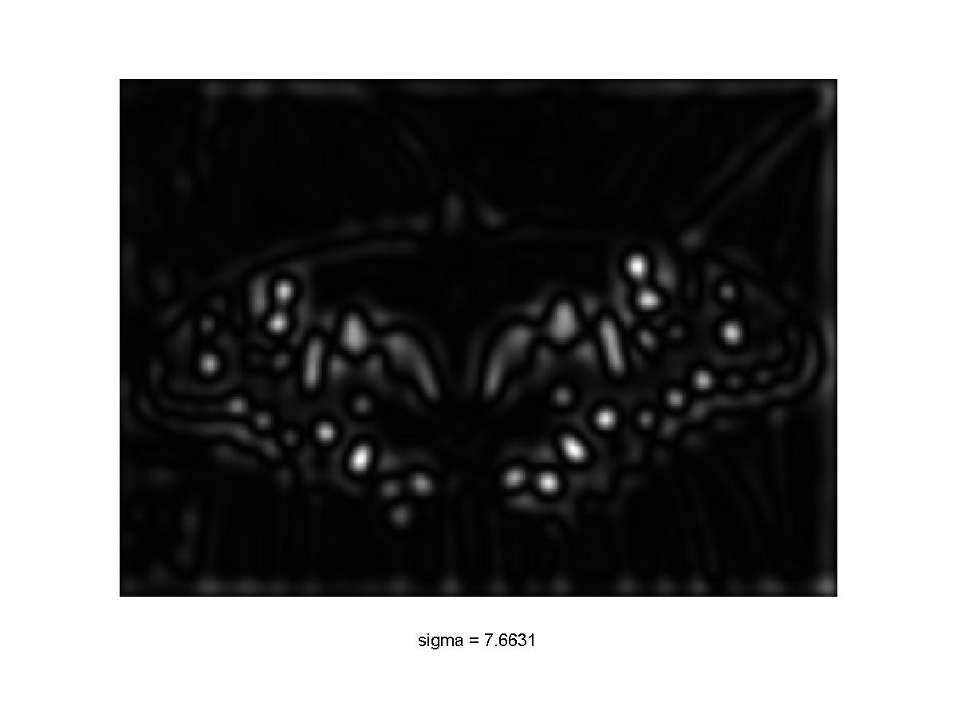
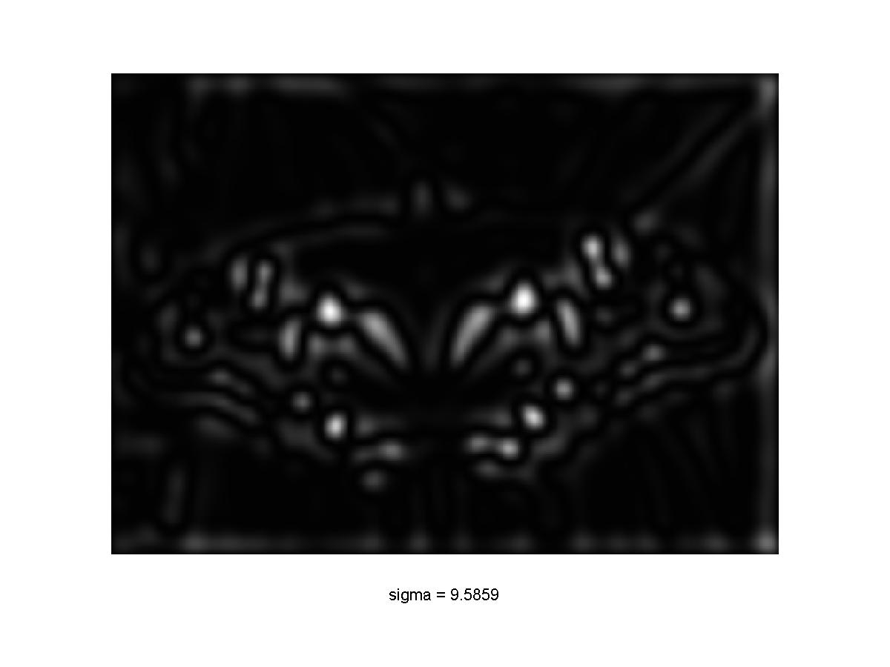
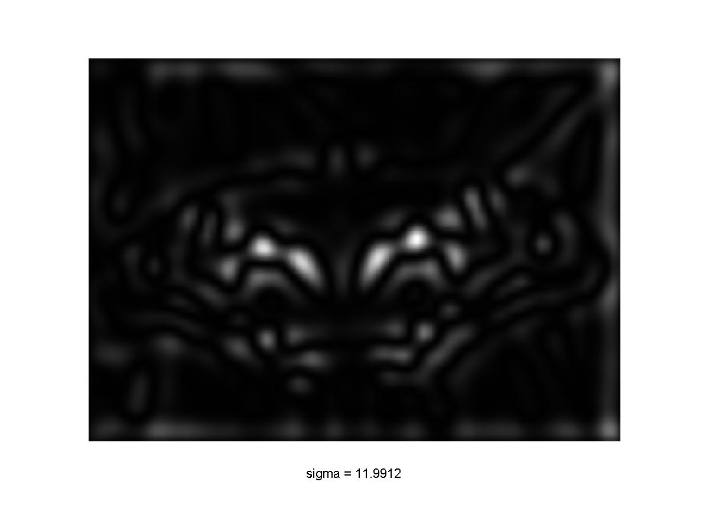
Scale-space blob detector: Example

Slide 10
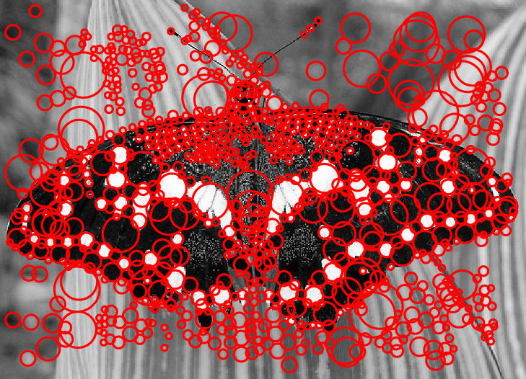
Scale-space blob detector: Example

Slide 11


Matching feature points
We know how to detect good points
Next question: How to match them?
Two interrelated questions:
How do we describe each feature point?
How do we match descriptions?
?

Slide 12
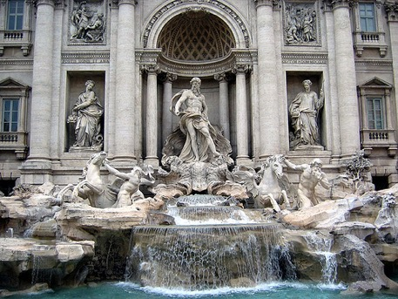
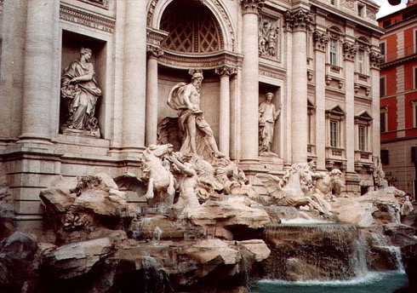




Feature descriptor
$$x_{1}$$
$$x_{2}$$
$$y_{1}$$
$$y_{2}$$

Slide 13
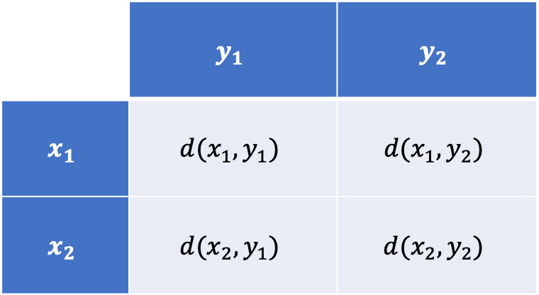
Feature matching
Measure the distance between (or similarity between) every pair of descriptors
 | $$y_{1}$$ | $$y_{2}$$
$$x_{1}$$ | $$d(x_{1},y_{1})$$ | $$d(x_{1},y_{2})$$
$$x_{2}$$ | $$d(x_{2},y_{1})$$ | $$d(x_{2},y_{2})$$

Slide 14
Invariance vs. discriminability
Invariance:
  Distance between descriptors of corresponding points should be small even if image is transformed
Discriminability:
  Descriptor for a point should be highly unique for each point (far away from other points in the image)

Slide 15
Invariance
Most feature descriptors are designed to be invariant to
  Translation, 2D rotation, scale
They can usually also handle
  Limited 3D rotations (SIFT works up to about 60 degrees)
  Limited affine transformations (some are fully affine invariant)
  Limited illumination/contrast changes

Slide 16
Simple baseline descriptors
Design an invariant feature descriptor
  Simplest descriptor: a single 0
    What’s this invariant to?
    Is this discriminative?
  Next simplest descriptor: a single pixel
    What’s this invariant to?
    Is this discriminative?

Slide 17
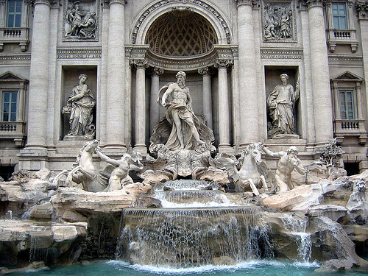

The aperture problem revisited
If we describe the corner by its color alone then it won’t be discriminative
Will it be invariant?

Slide 18
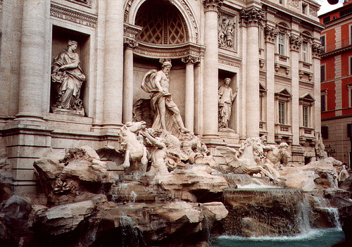

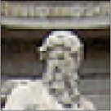
The aperture problem
We can increase the aperture and look at a whole patch
How does this affect discriminability? Invariance?

Slide 19
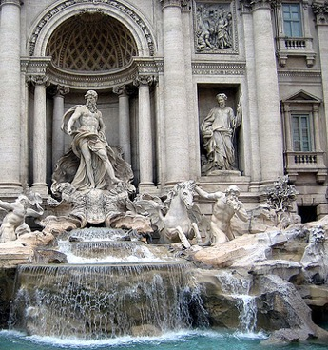
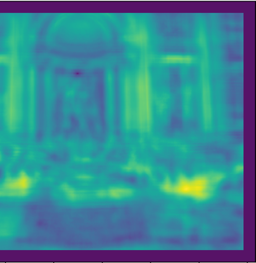
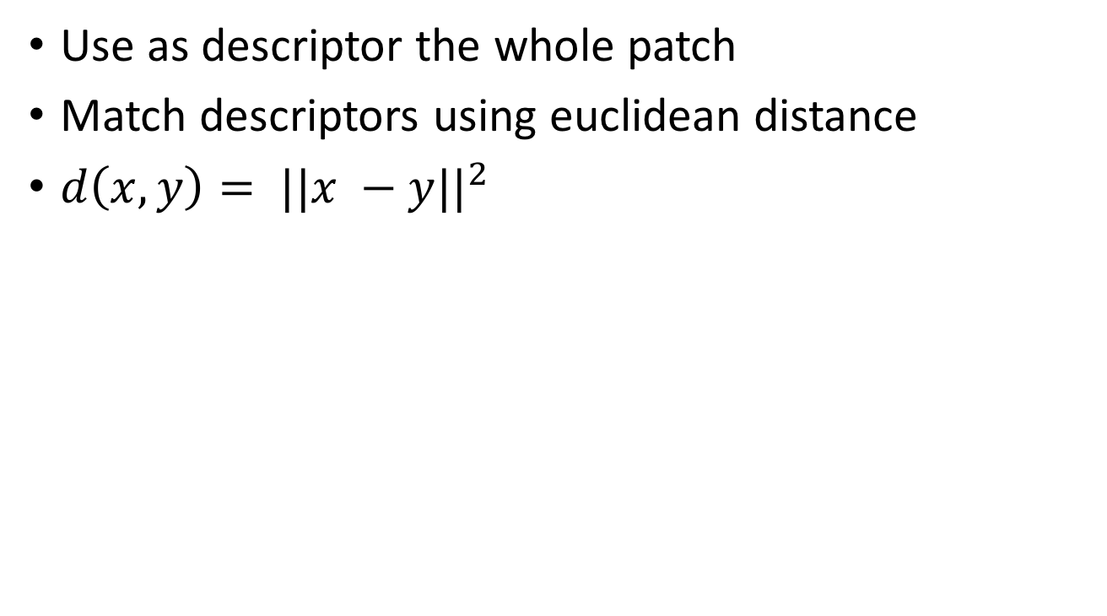
SSD
Use as descriptor the whole patch
Match descriptors using euclidean distance
$d\left(x,y\right)= ||x −y||^{2}$

Slide 20
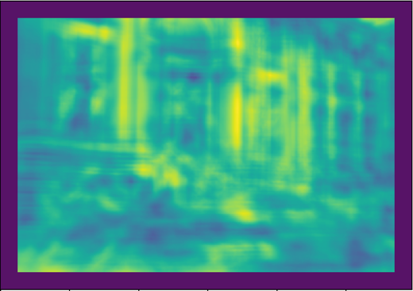
SSD

Slide 21
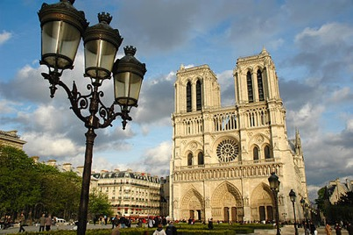
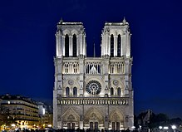
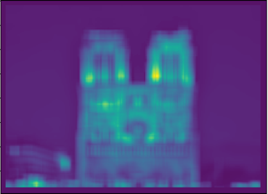

SSD

Slide 22
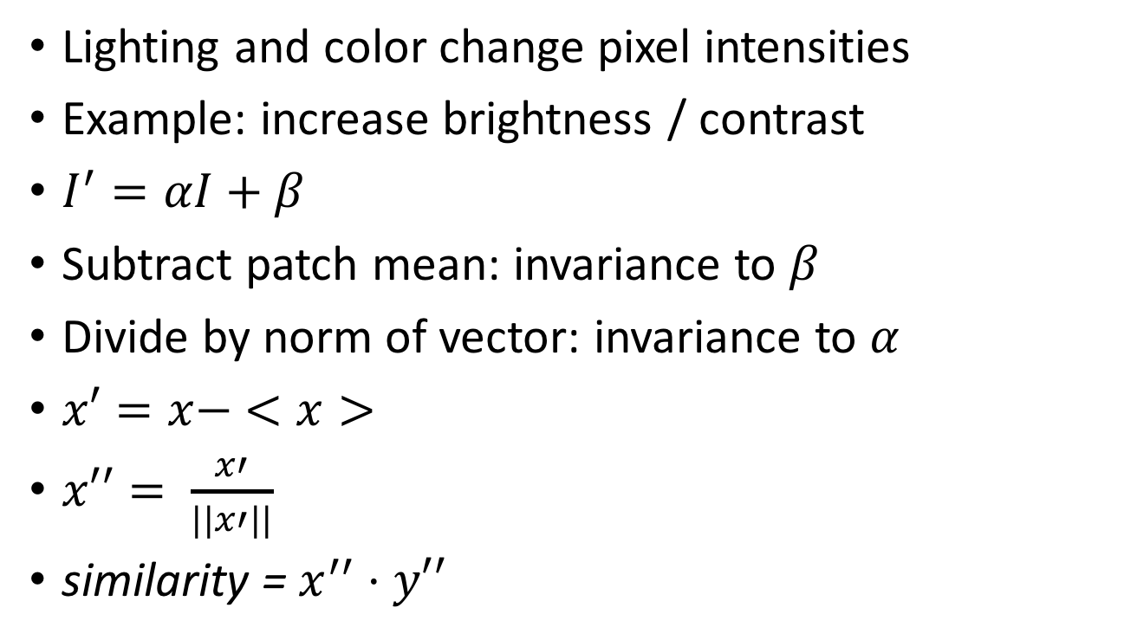
NCC - Normalized Cross Correlation
Lighting and color change pixel intensities
Example: increase brightness / contrast
$I^{′}=αI+β$
Subtract patch mean: invariance to $β$
Divide by norm of vector: invariance to $α$
$x′=x− <x>$
$x′′= \frac{x′}{||x′||}$
similarity = $x^{′′}⋅y′′$

Slide 23
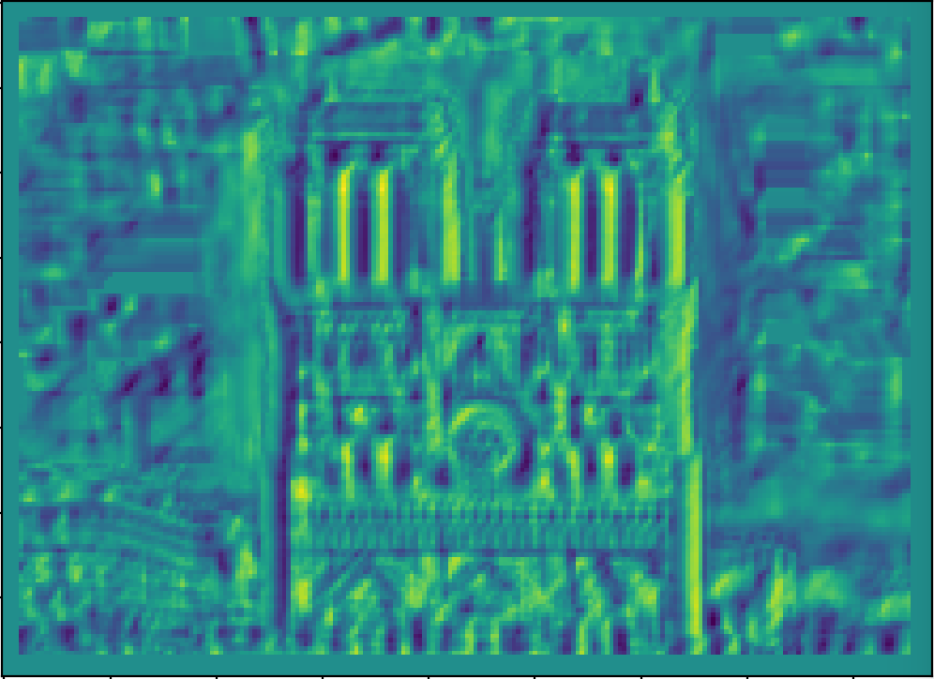
NCC - Normalized cross correlation

Slide 24
Basic correspondence
Image patch as descriptor, NCC as similarity
Invariant to?
  Photometric transformations?
  Translation?
  Rotation?

Slide 25

Rotation invariance for feature descriptors
Find dominant orientation of the image patch
  This is given by x_{max}, the eigenvector of M corresponding to λ_{max} (the larger eigenvalue)
  Rotate the patch according to this angle
  Figure: line represents x_{max}, box represents patch we take as feature descriptor
Figure by Matthew Brown

Slide 26

Multiscale Oriented PatcheS descriptor
Take 40x40 square window around detected feature
  Scale to 1/5 size (using prefiltering)
  Rotate to horizontal
  Sample 8x8 square window centered at feature
  Intensity normalize the window by subtracting the mean, dividing by the standard deviation in the window
40 pixels
8 pixels
Adapted from slide by Matthew Brown

Slide 27
Scale invariance for feature descriptors
Recall that corner detector searches over scales for maximum response: record scale which gives maximum response
Use a patch of the same scale, then resize it to a fixed size

Slide 28
Multiscale Oriented PatcheS descriptor
Take 40x40 square window around detected feature at appropriate scale
  Scale to 1/5 size (using prefiltering)
  Rotate to horizontal
  Sample 8x8 square window centered at feature
  Intensity normalize the window by subtracting the mean, dividing by the standard deviation in the window
40 pixels
8 pixels
Adapted from slide by Matthew Brown

Slide 29
Detections at multiple scales

Slide 30
Feature matching
Given a feature in I₁, how to find the best match in I₂?
  Define distance function that compares two descriptors
  Test all the features in I₂, find the one with min distance

