Slide 1
Grouping / segmentation

Slide 2


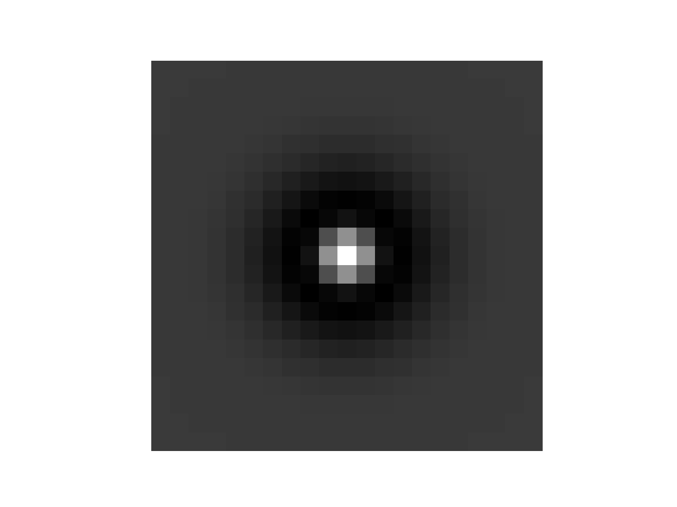
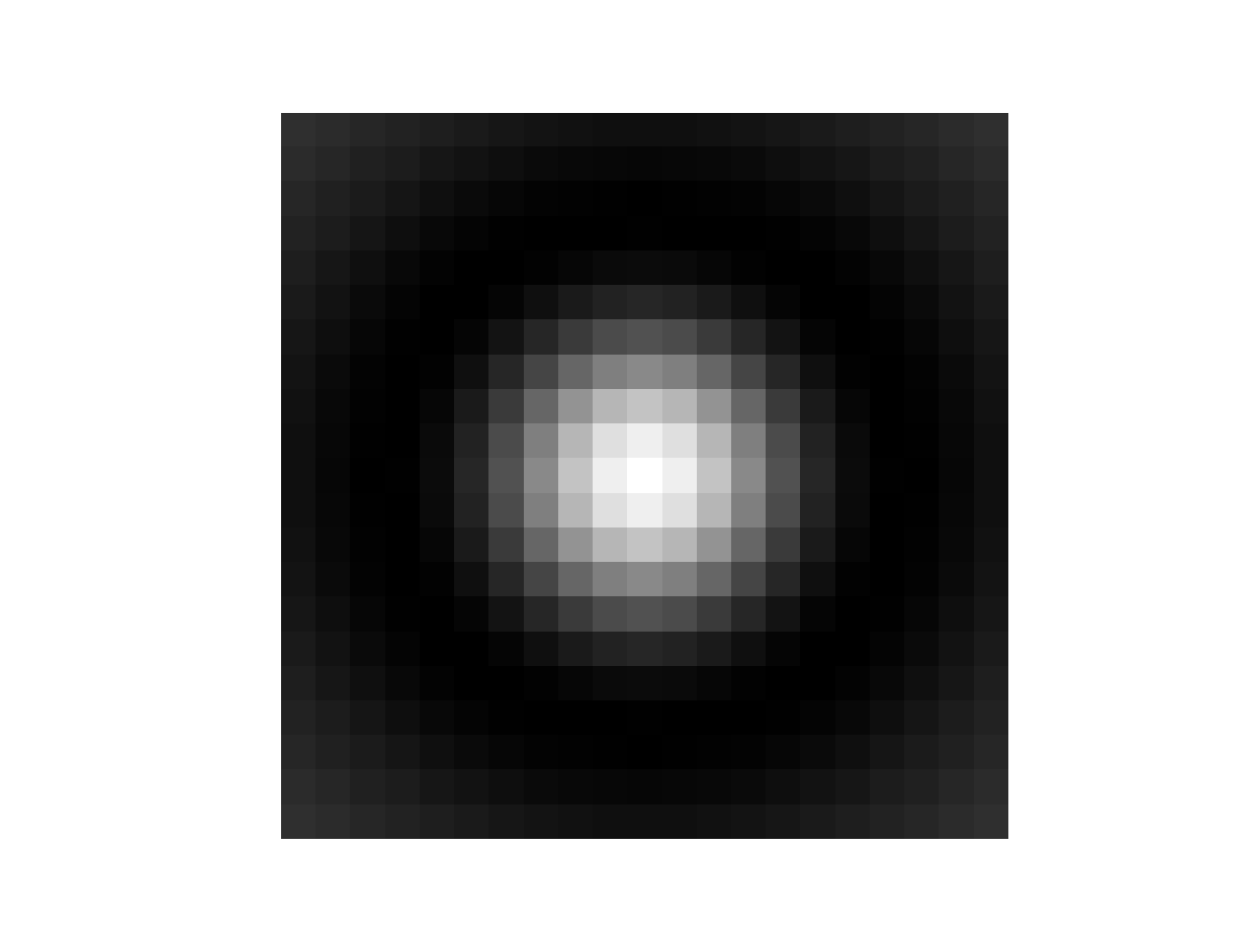
Texture gradient pipeline
Step 0: Create set of filters (called filter bank)
Usually oriented edge detectors
And Difference of Gaussians

Slide 3
Texture gradient pipeline
Step 1: Convolve image with all filters in filter bank
If filter bank has n filters, end up with n outputs per pixel
Step 2: Use n outputs per pixel as pixel representation to perform k-means
K-means centers = “textons”
Step 3: Assign each pixel to its nearest texton
Nearest measured based on Euclidean distance in n-dimensional pixel space

Slide 4
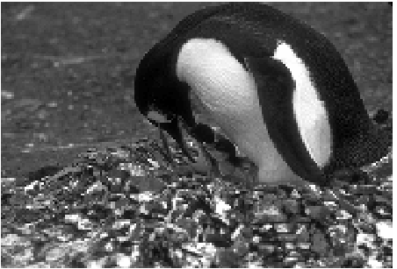
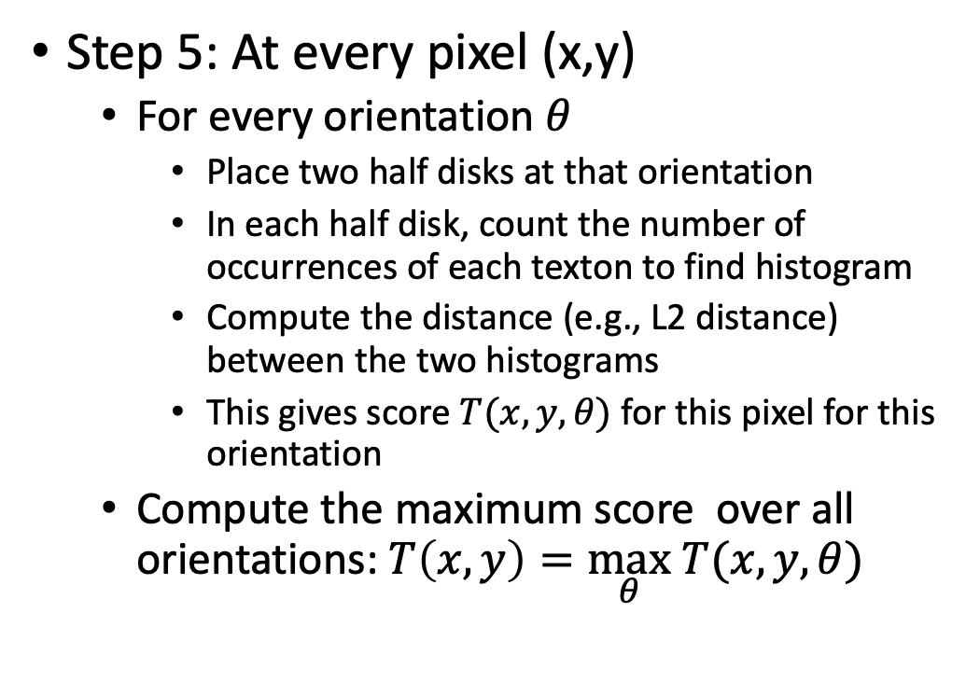
Texture gradient pipeline
Step 5: At every pixel (x,y)
For every orientation $θ$
Place two half disks at that orientation
In each half disk, count the number of occurrences of each texton to find histogram
Compute the distance (e.g., L2 distance) between the two histograms
This gives score $T(x,y,θ)$ for this pixel for this orientation
Compute the maximum score over all orientations: $T\left(x,y\right)=\max_{θ} T(x,y,θ)$

Slide 5

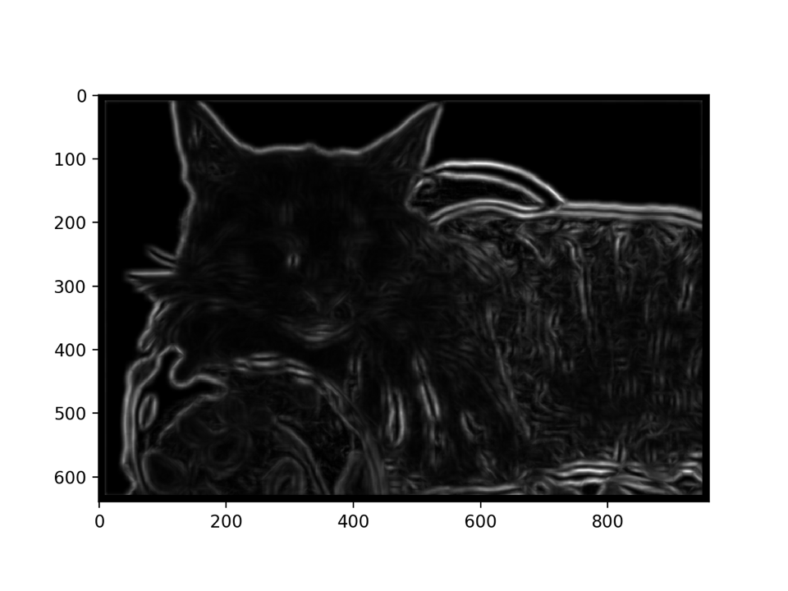
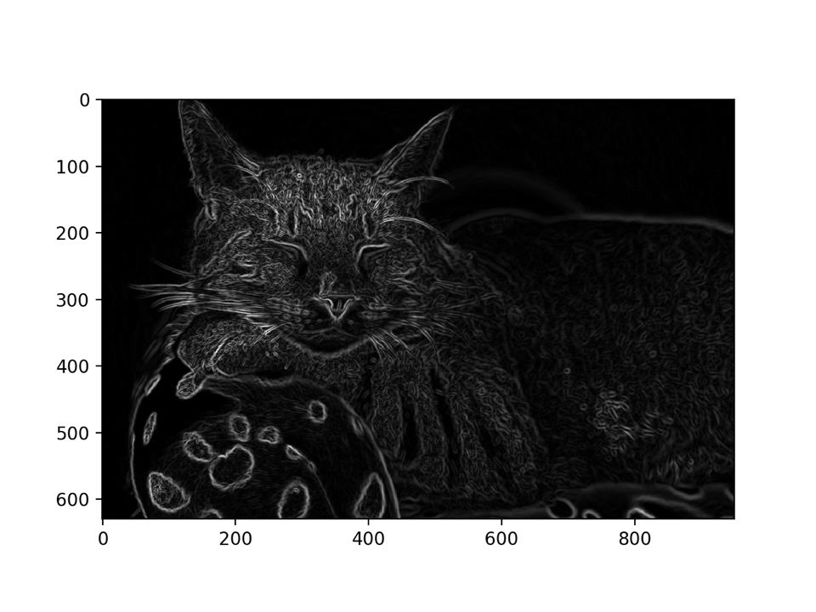
Texture gradient
Texture gradient
Image gradient

Slide 6
Other techniques for grouping / segmentation
Better contour detection
Learning-based edge detection (random forests, neural networks)
Contour completion and forming closed boundaries
Better clustering
Graph-based clustering techniques (spectral clustering)
Clustering techniques that take contour information into account

Slide 7
Grouping/Segmentation: a summary
Goal: group pixels into objects
Simple solutions: edge detection, k-means
Challenges:
Texture: Possible solution: texture gradient
What is k?
Grouping still a research problem!

Slide 8
Reconstruction

Slide 9
The reconstruction problem
Camera is in 3D, taking a picture of the 3D world.
Given an image / multiple images
Where is each pixel in 3D?
Where is the camera in 3D?
Objects in 3D are made up of different materials, painted in different colors, illuminated under different lights
What is the “true color” of the object?
What is its “true material”?
Need to understand the geometry and physics of image formation!

Slide 10
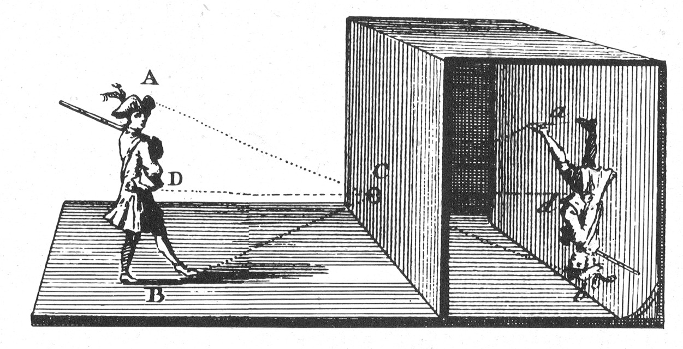
The pinhole camera - Camera Obscura

Slide 11
The pinhole camera
We will get into the math later

Slide 12
The pinhole camera

Slide 13
3D Reconstruction is an ill-posed problem
Actual 3D point can be anywhere along this line

Slide 14
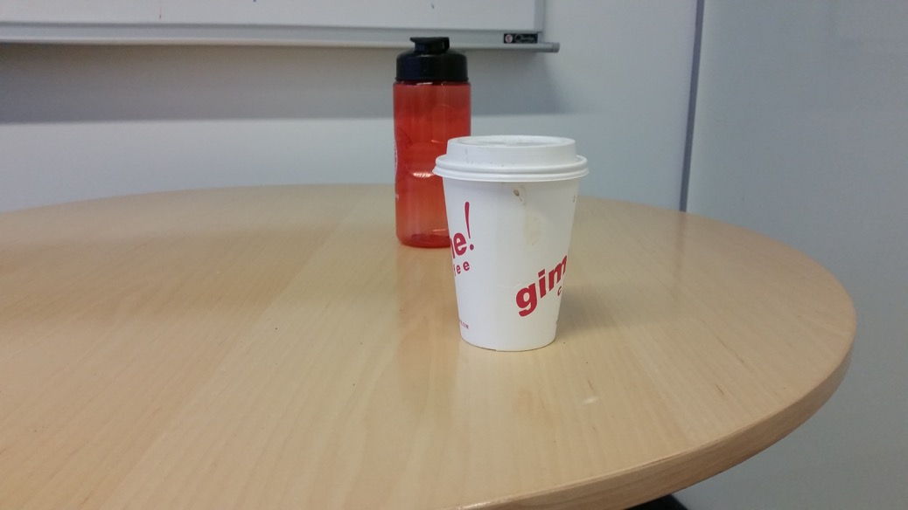
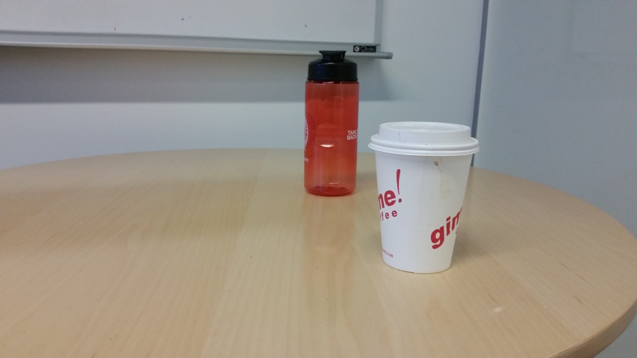
One way out: multiple images
Multiple images can give a clue about 3D structure

Slide 15


One way out: multiple images
Parallax: nearby objects move more than far away objects

Slide 16

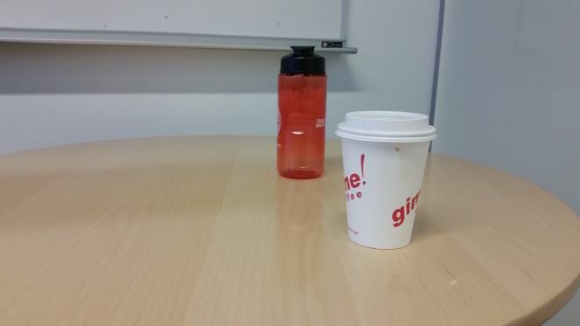
One way out: multiple images
Need to find which pixel in image 2 matches which in image 1 - the correspondence problem

Slide 17
Reconstruction from correspondence
Given known cameras, correspondence gives the location of 3D point (Triangulation)

Slide 18
Reconstruction from correspondence
Given a 3D point, correspondence gives relationship between cameras (Pose estimation / camera calibration)

Slide 19
Next few classes
How do we find correspondences?
How do we use correspondences to reconstruct 3D?

Slide 20
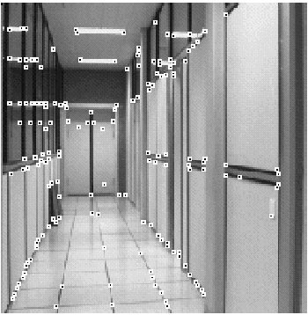
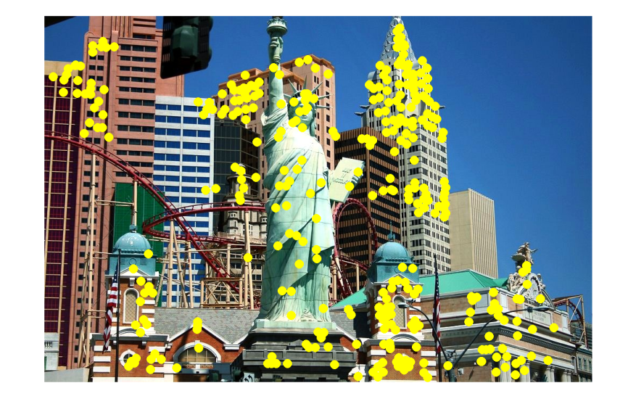
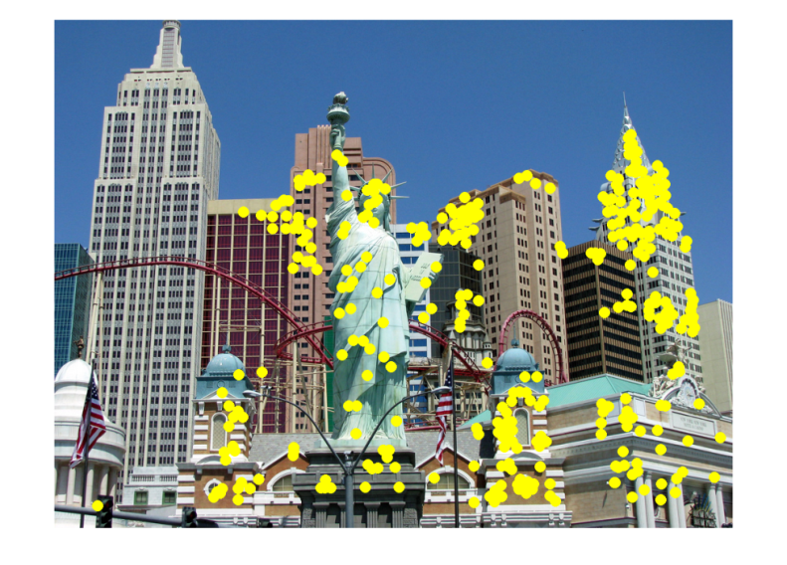
Other applications of correspondence
Image alignment
Motion tracking
Robot navigation

Slide 21
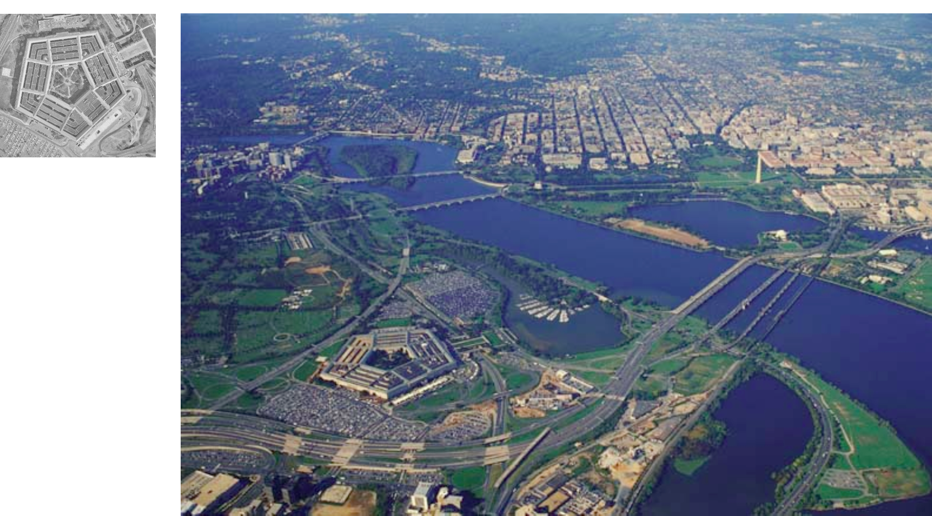
Correspondence can be challenging
Fei-Fei Li

Slide 22
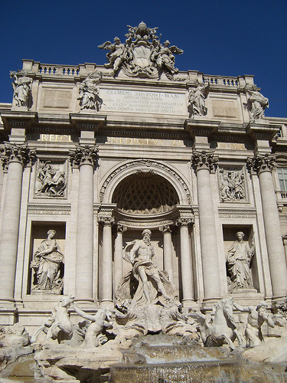
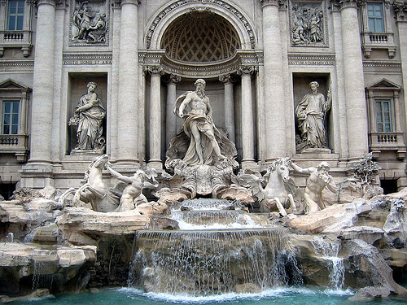
Correspondence
by Diva Sian
by swashford

Slide 23
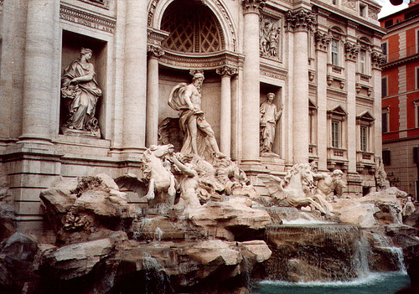
Harder case
by Diva Sian
by scgbt

Slide 24
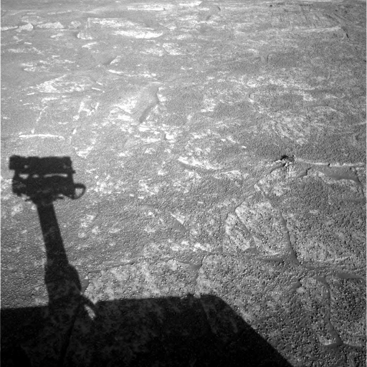
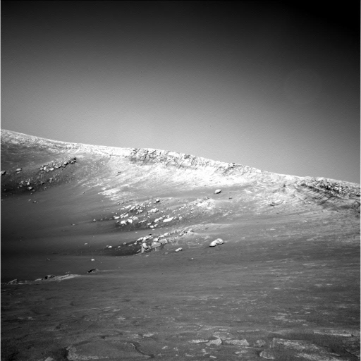
Harder still?

Slide 25
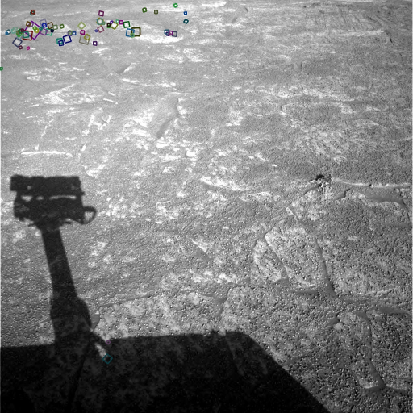
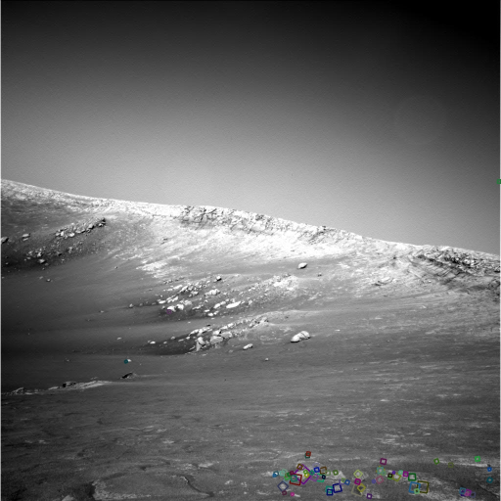
Answer below (look for tiny colored squares…)
NASA Mars Rover images
with SIFT feature matches

Slide 26
Sparse vs dense correspondence
Sparse correspondence: produce a few, high confidence matches
Good enough for estimating pose or relationship between cameras
Easier
Dense correspondence: try to match every pixel
Needed if we want 3D location of every pixel

Slide 27
Sparse correspondence
How do we do sparse correspondence?
Step 1: In each image, separately identify a few key pixels
These pixels are called Feature points / keypoints
This step is called feature detection
Step 2: Try to find matching pairs of keypoints in the two images
This step is called feature description and matching

Slide 28
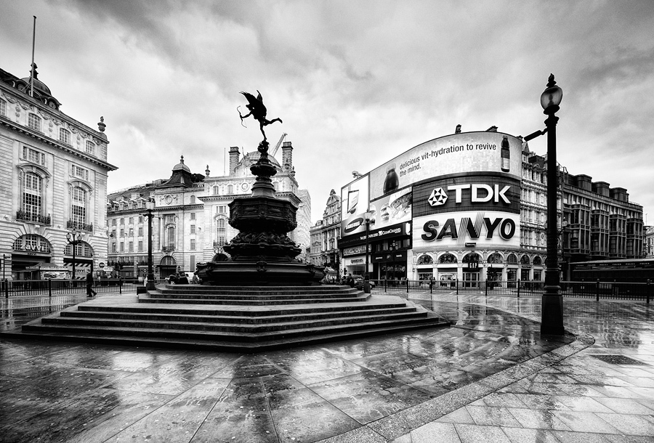
What makes a good feature point?
Snoop demo

Slide 29
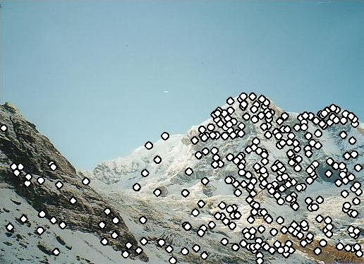
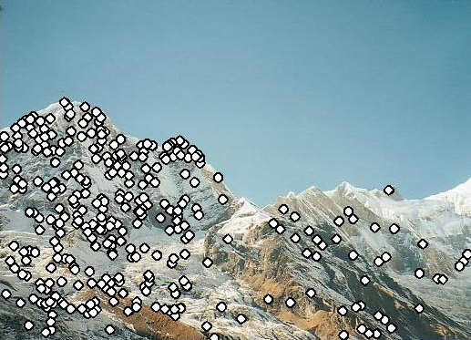
Characteristics of good feature points
Repeatability / invariance
The same feature point can be found in several images despite geometric and photometric transformations
Saliency / distinctiveness
Each feature point is distinctive
Fewer ”false” matches

Slide 30
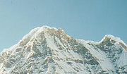

Goal: repeatability
We want to detect (at least some of) the same points in both images.
Yet we have to be able to run the detection procedure independently per image.
No chance to find true matches!
Kristen Grauman
Notes:
30

Slide 31
Goal: distinctiveness
The feature point should be distinctive enough that it is easy to match
Should at least be distinctive from other patches nearby
????

Slide 32
The aperture problem

Slide 33
The aperture problem
Individual pixels are ambiguous
Idea: Look at whole patches!

Slide 34
The aperture problem
Individual pixels are ambiguous
Idea: Look at whole patches!

Slide 35
The aperture problem
Some local neighborhoods are ambiguous

Slide 36
The aperture problem

