Slide 1
Grouping

Slide 2
Canny edge detection

Slide 3
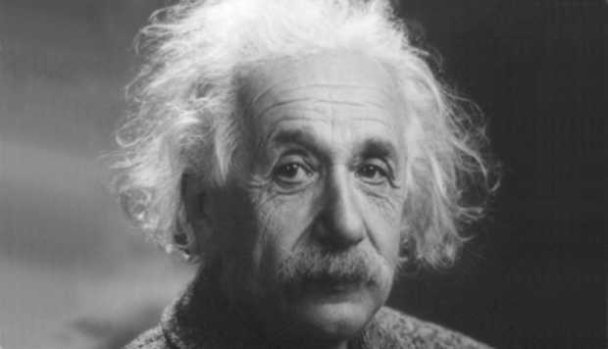
Image

Slide 4
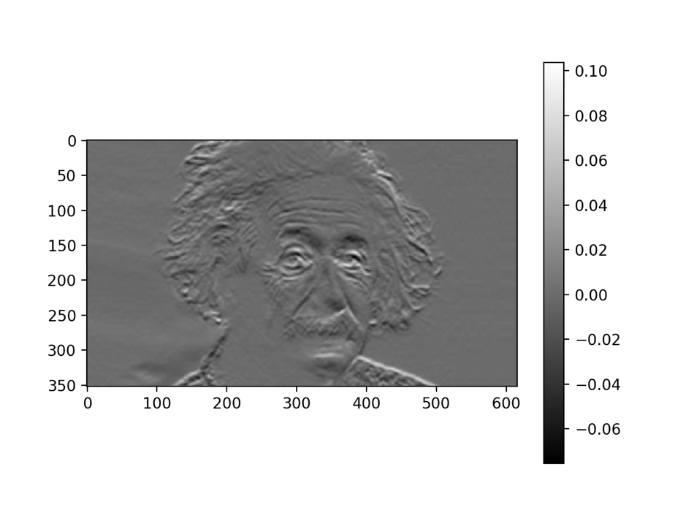
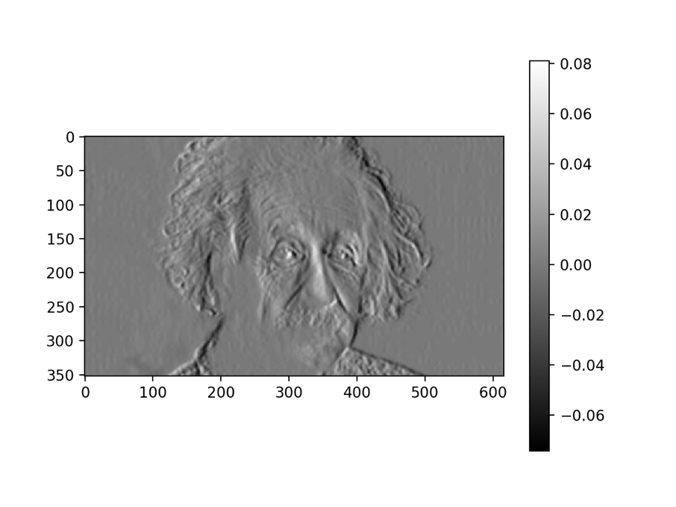
Step 1: Compute derivative in X and Y

Slide 5
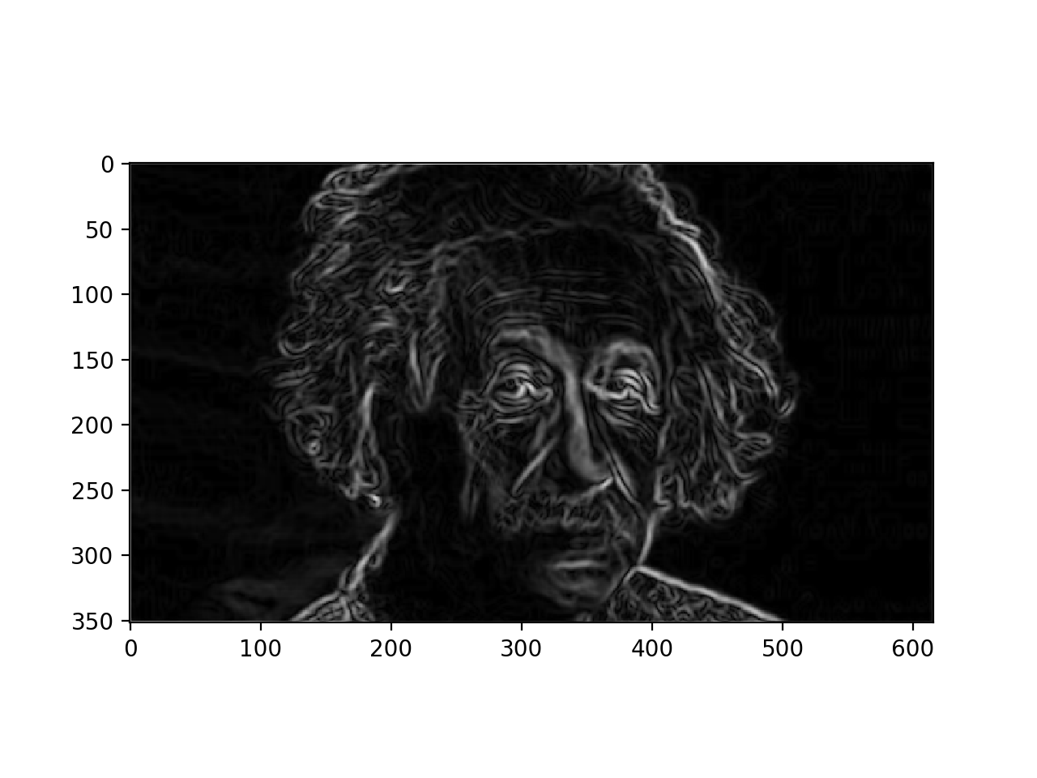
Step 1: Compute derivative in X and Y
Gradient magnitude

Slide 6
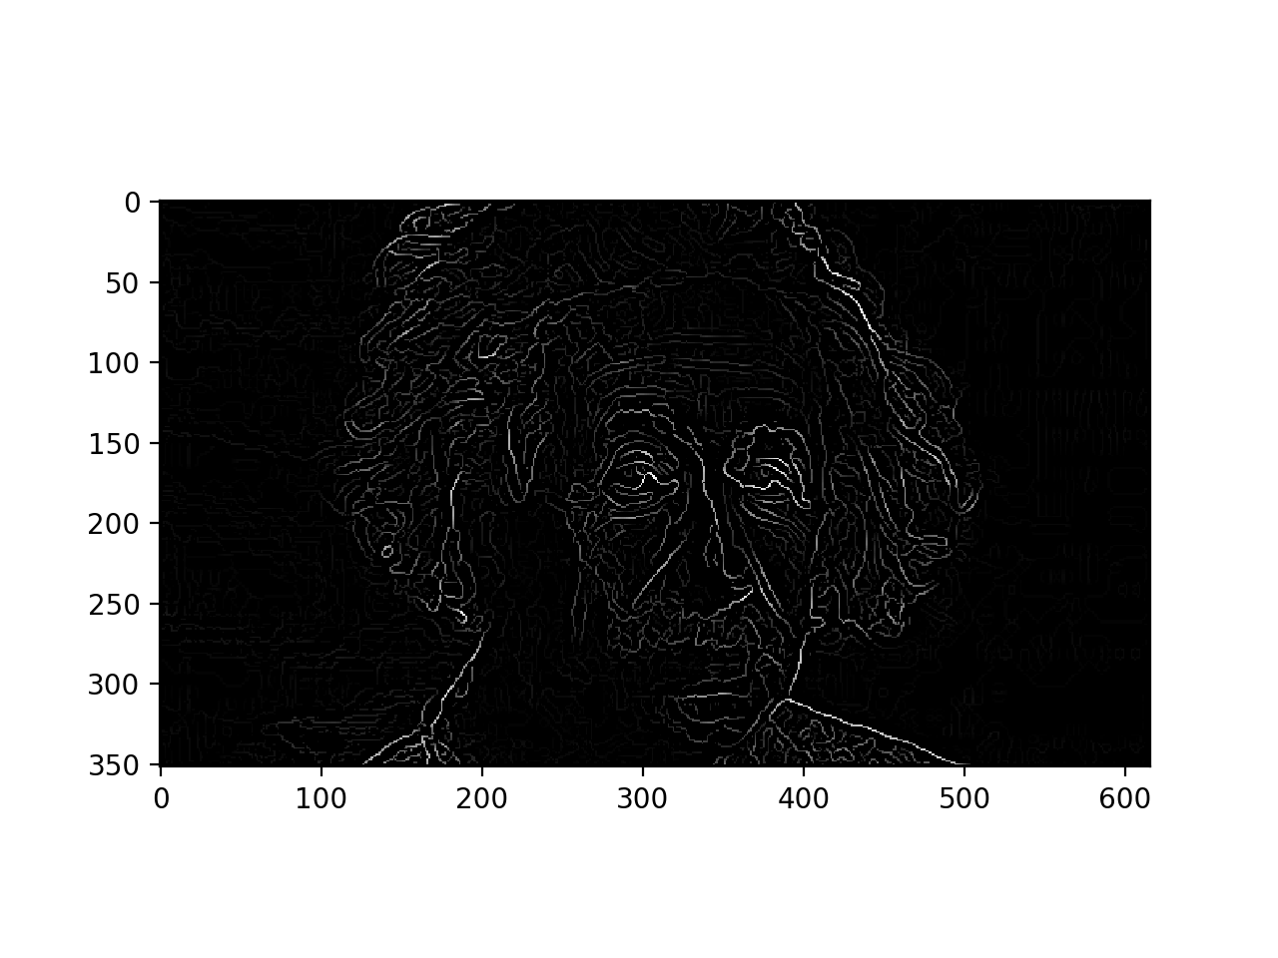
Step 2: Perform non-max suppression

Slide 7
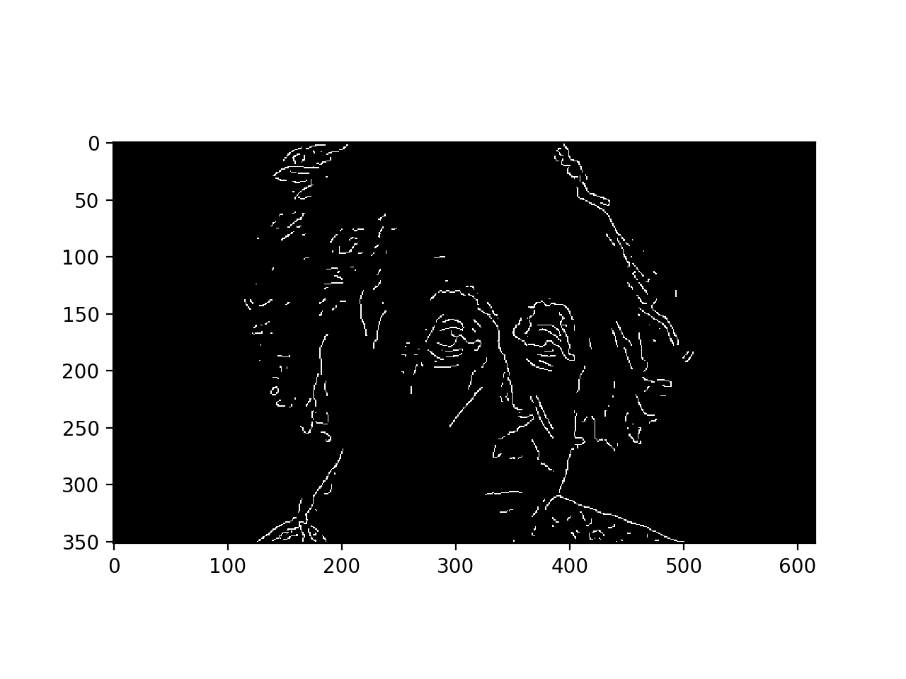
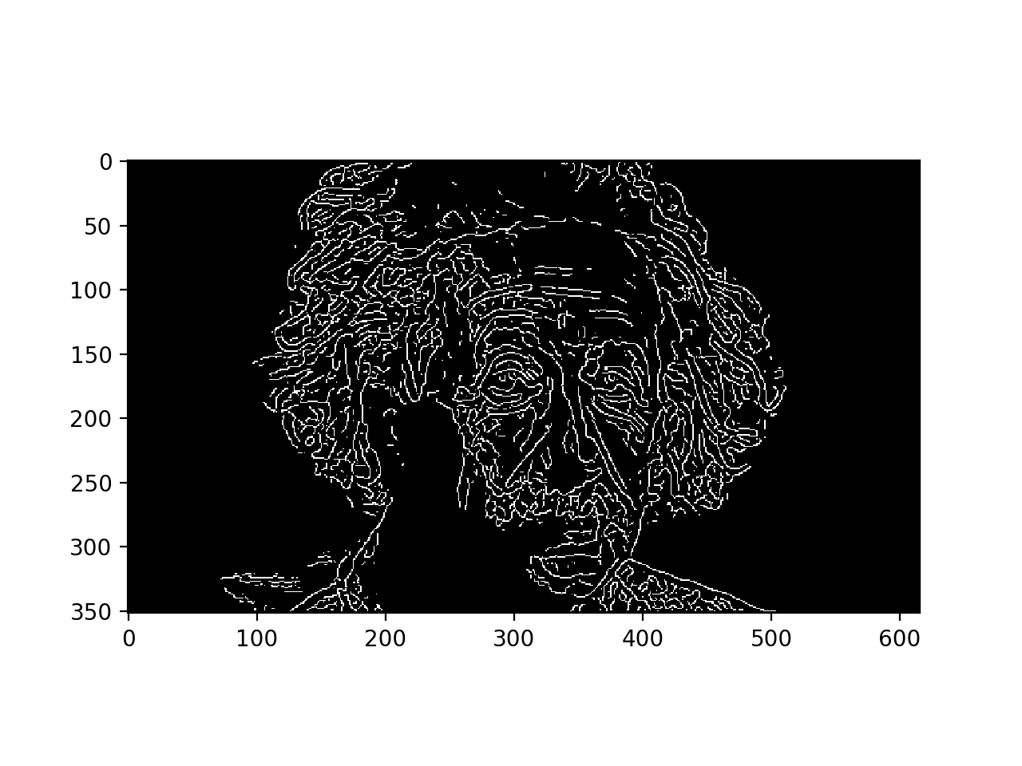
Step 3: Perform Hysteresis thresholding
High thresholds will only keep most confident pixels
Low thresholds will produce spurious edges
High threshold
Low threshold

Slide 8
Step 3: Perform hysteresis thresholding
Start with a high threshold
Then grow high threshold edges by looking for neighbors that clear a lower threshold
White: Clears high threshold
Gray: clears low threshold but not high threshold

Slide 9
Step 3: Perform hysteresis thresholding
Start with a high threshold
Then grow high threshold edges by looking for neighbors that clear a lower threshold
Mark pixels that clear high threshold as boundary

Slide 10
Step 3: Perform hysteresis thresholding
Start with a high threshold
Then grow high threshold edges by looking for neighbors that clear a lower threshold
Mark pixels that clear high threshold as boundary
If there are pixels that clear low threshold and are connected to a boundary, mark them as boundary too

Slide 11
Step 3: Perform hysteresis thresholding
Start with a high threshold
Then grow high threshold edges by looking for neighbors that clear a lower threshold
Mark pixels that clear high threshold as boundary
If there are pixels that clear low threshold and are connected to a boundary, mark them as boundary too

Slide 12
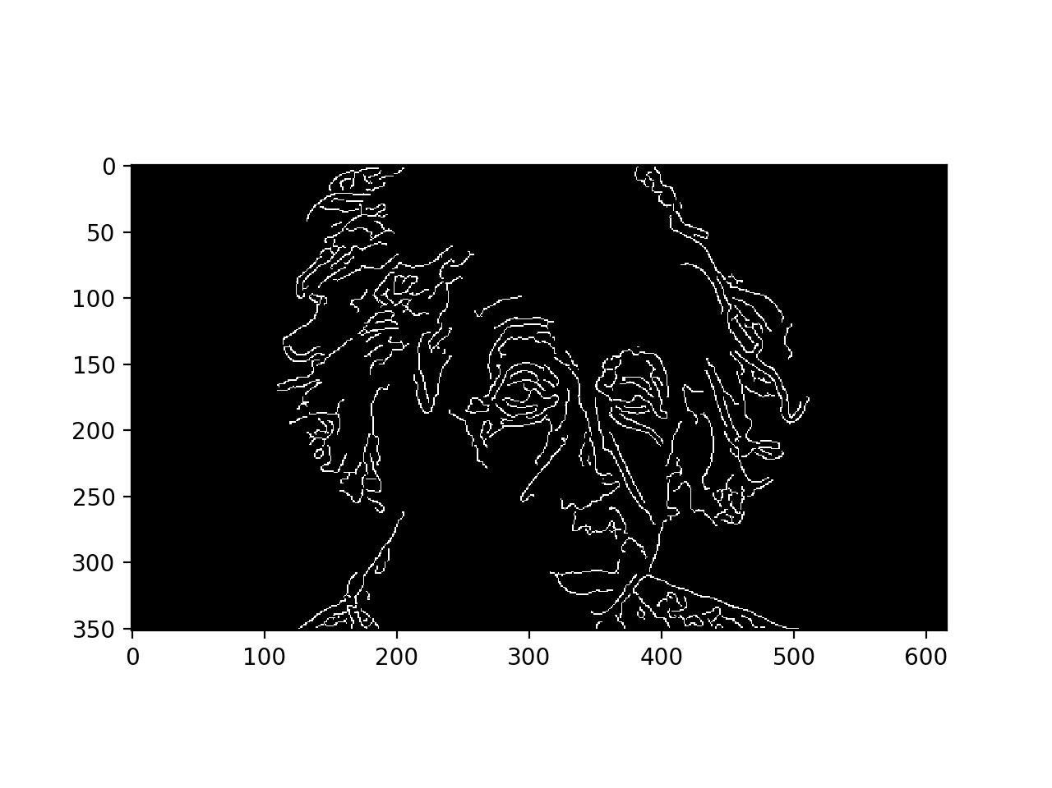
Step 3: Perform hysteresis thresholding
Start with a high threshold
Then grow high threshold edges by looking for neighbors that clear a lower threshold

Slide 13
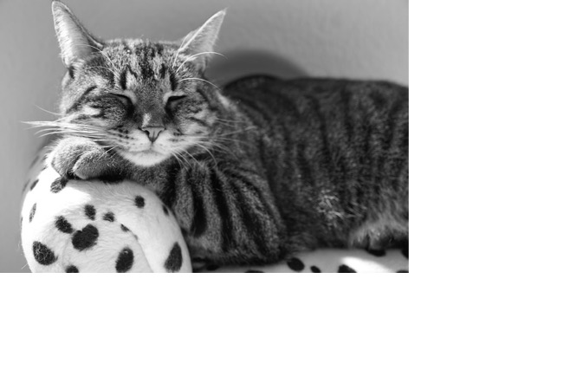
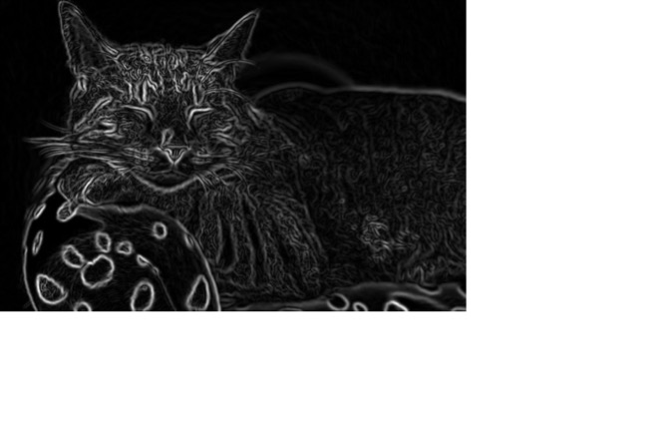
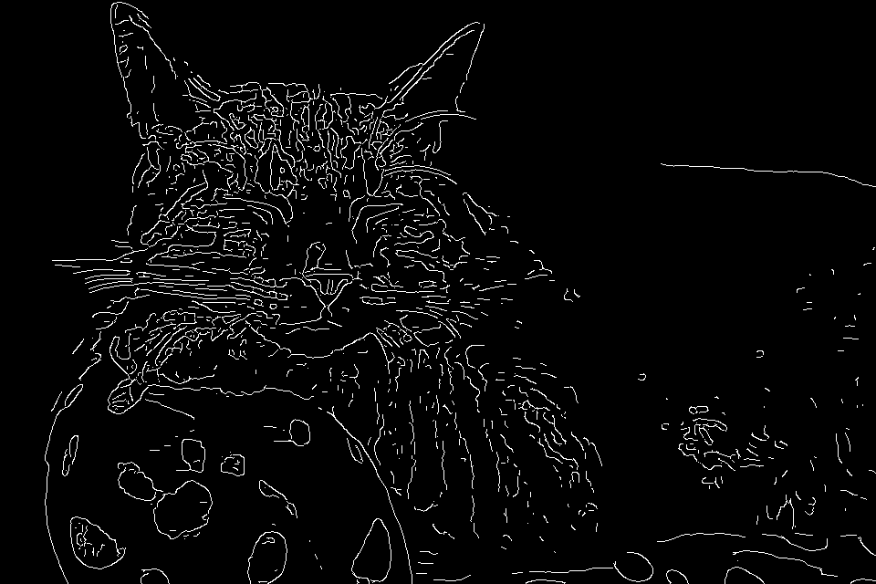
Does Canny always work?

Slide 14
The challenges of edge detection
Texture
Low-contrast boundaries

Slide 15
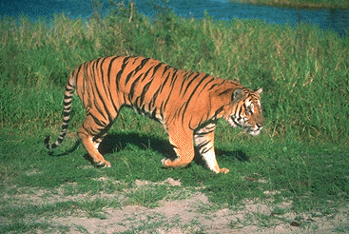
Regions Boundaries

Slide 16
Grouping by clustering
G
R
B

Slide 17
Grouping by clustering
Idea: embed pixels into high-dimensional space (e.g. 3-dimensions)
Each pixel is a point
Group together points

Slide 18
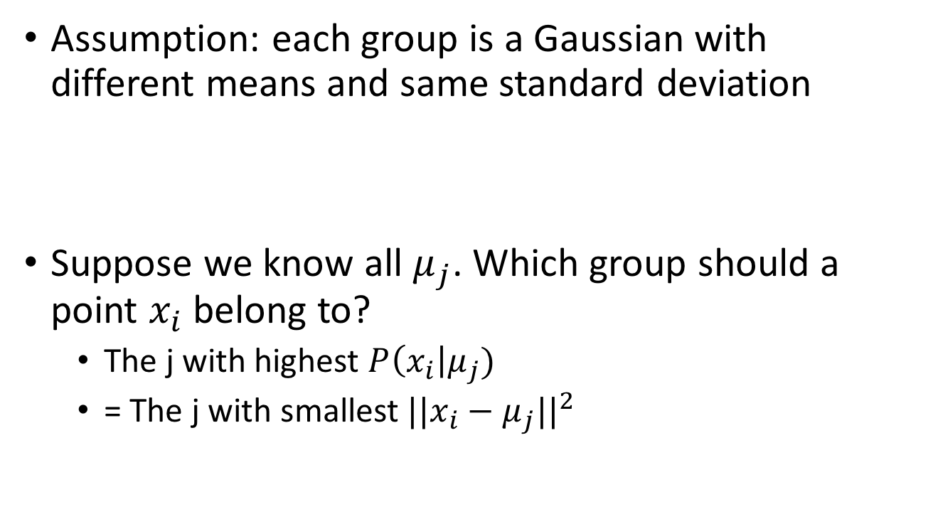
K-means
Assumption: each group is a Gaussian with different means and same standard deviation
Suppose we know all $μ_{j}$. Which group should a point $x_{i}$ belong to?
  The j with highest $P\left(x_{i}\right|μ_{j})$
  = The j with smallest $||x_{i}−μ_{j}||^{2}$

Slide 19
K-means
Assumption: each group = a Gaussian with different means and same standard deviation
If means are known, then trivial assignment to groups. How?
Assign data point to nearest mean!

Slide 20
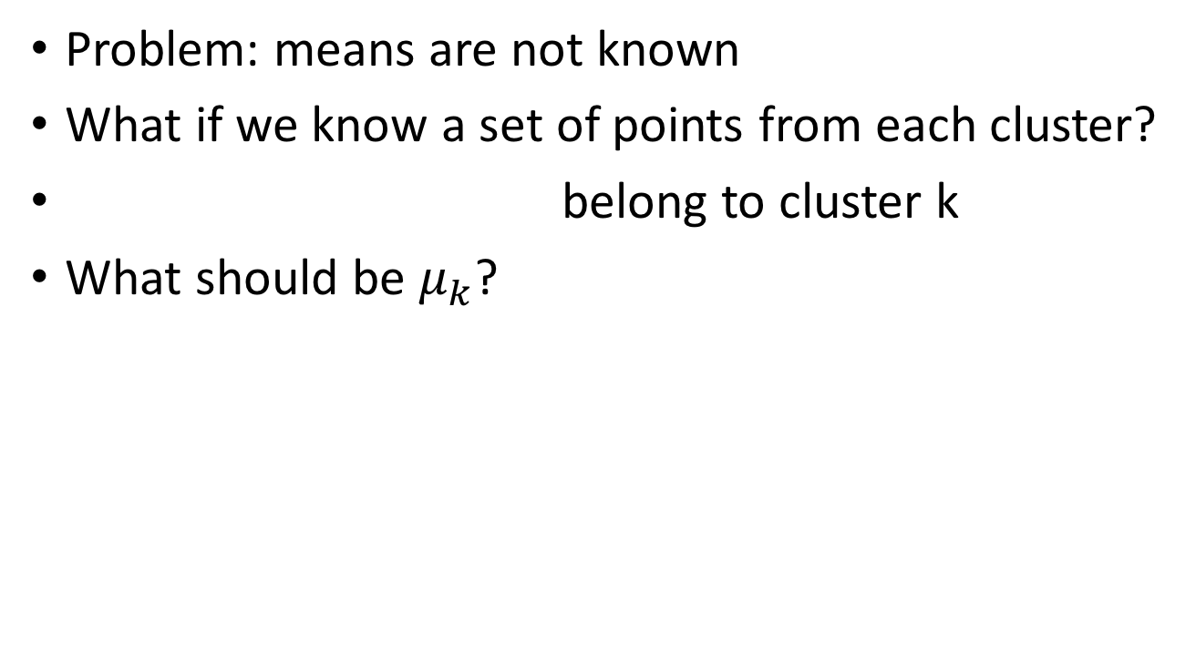
K-means
Problem: means are not known
What if we know a set of points from each cluster?
belong to cluster k
What should be $μ_{k}$?

Slide 21
K-means
Problem: means are not known
If assignment of points to clusters is known, then finding means is easy
How? Compute the mean of every cluster!

Slide 22
K-means
Given means, can assign points to clusters
Given assignments, can compute means
Idea: iterate!

Slide 23
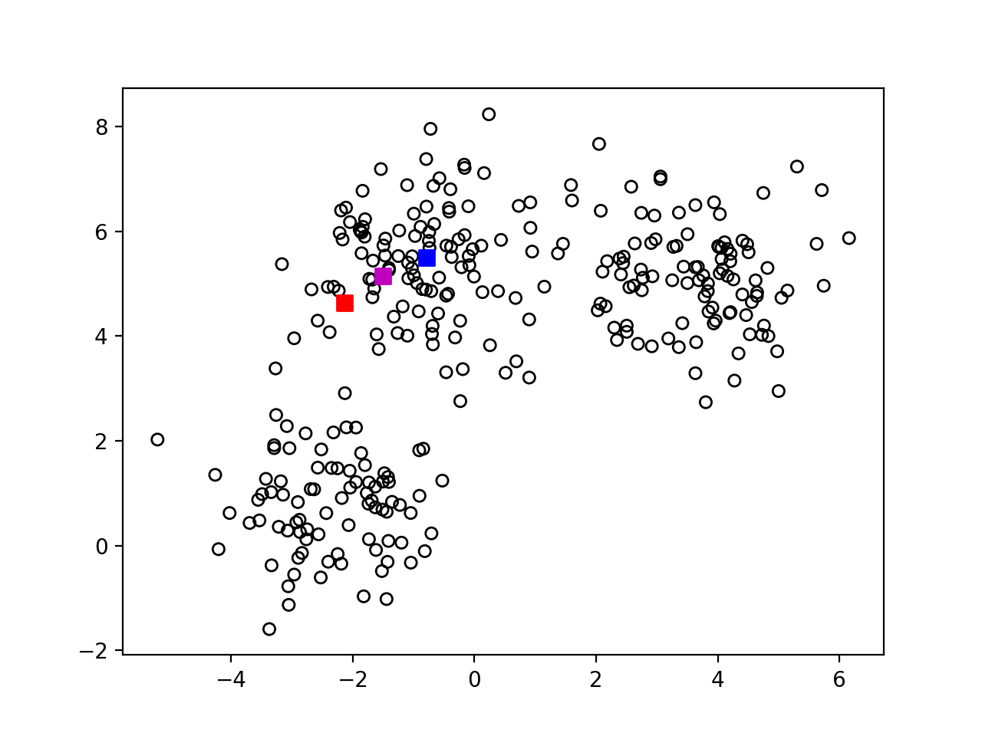
K-means
Step-1 : randomly pick k centers

Slide 24
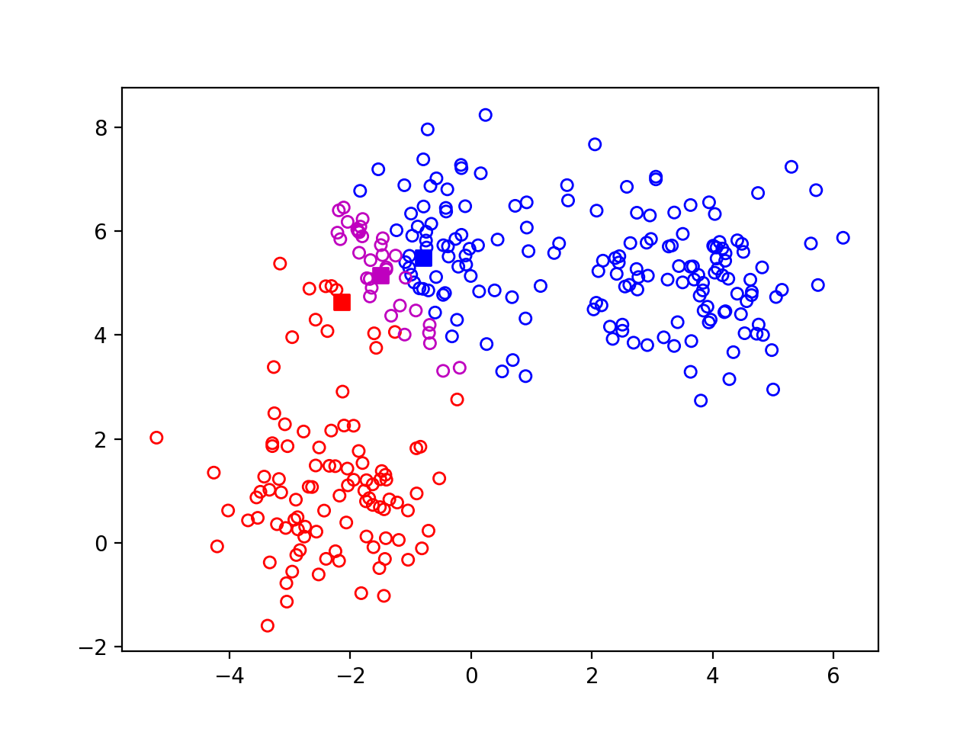
K-means
Step 2: Assign each point to nearest center

Slide 25

K-means
Step 3: re-estimate centers

Slide 26

K-means
Step 4: Repeat

Slide 27
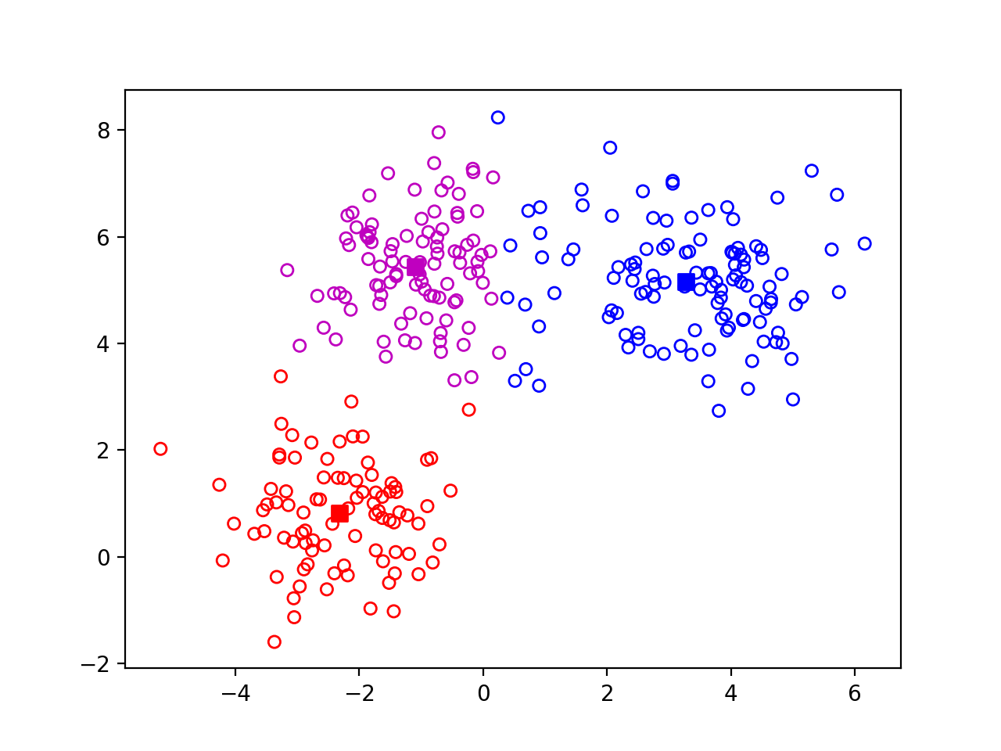
K-means
Step 4: Repeat

Slide 28
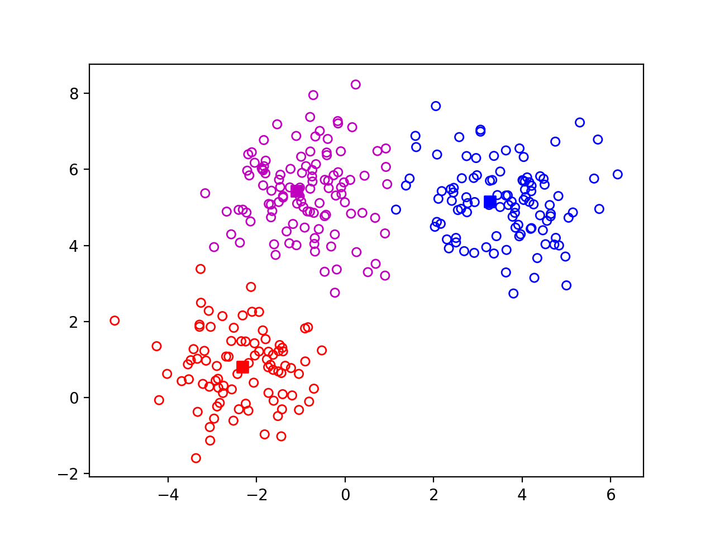
K-means
Step 4: Repeat

Slide 29
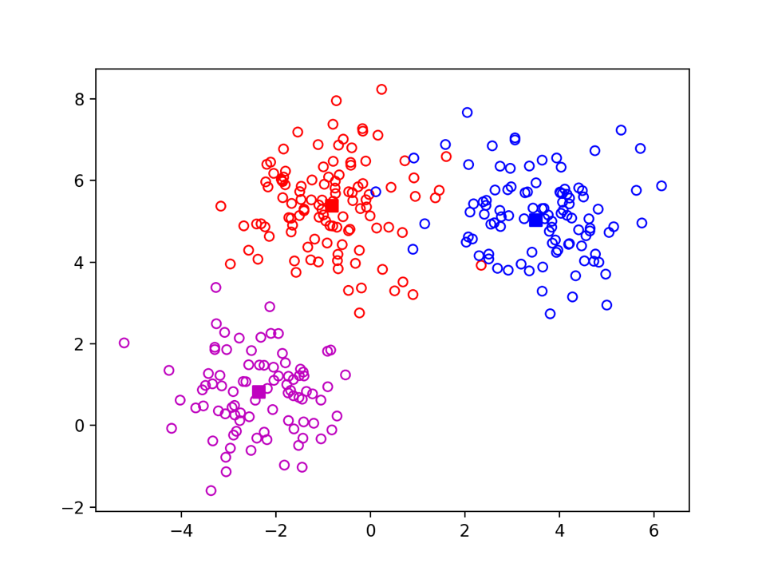

K-means
Ground-truth vs k-means
Ground truth
K-means 100 iterations

Slide 30
K-means - another example

Slide 31
K-means
Input: set of data points, k
Randomly pick k points as means
For i in [0, maxiters]:
  Assign each point to nearest center
  Re-estimate each center as mean of points assigned to it

Slide 32
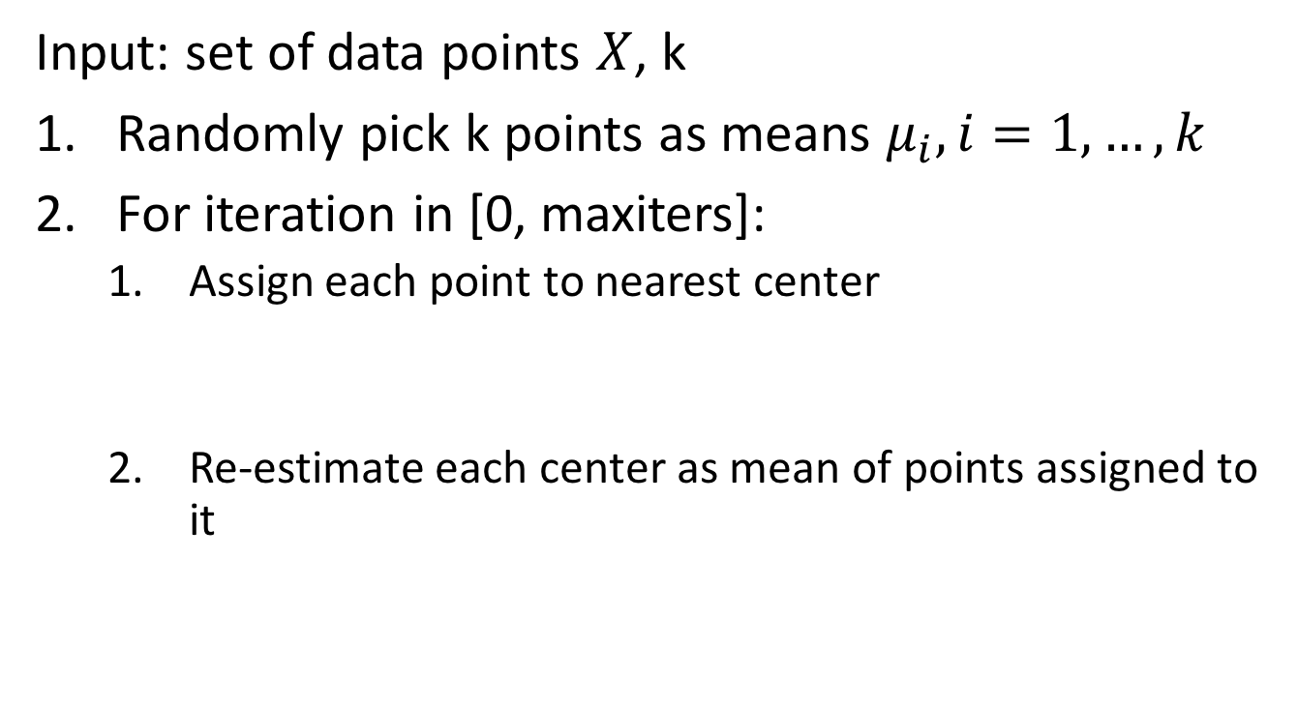
K-means - the math
Input: set of data points $X$, k
Randomly pick k points as means $μ_{i}, i=1,…, k$
For iteration in [0, maxiters]:
  Assign each point to nearest center
  Re-estimate each center as mean of points assigned to it

Slide 33
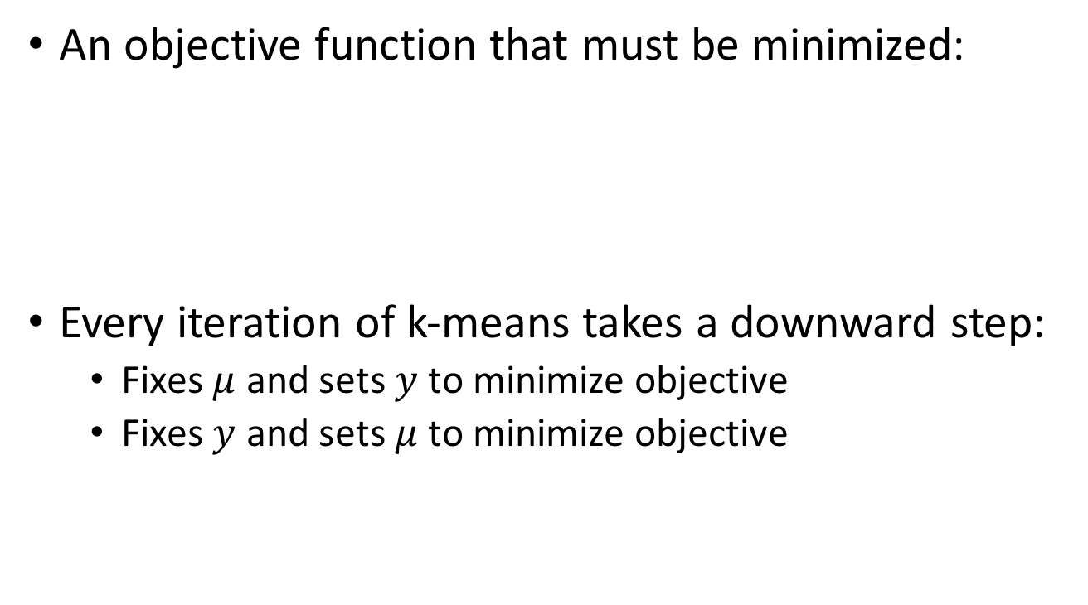
K-means - the math
An objective function that must be minimized:
Every iteration of k-means takes a downward step:
  Fixes $μ$ and sets $y$ to minimize objective
  Fixes $y$ and sets $μ$ to minimize objective

Slide 34

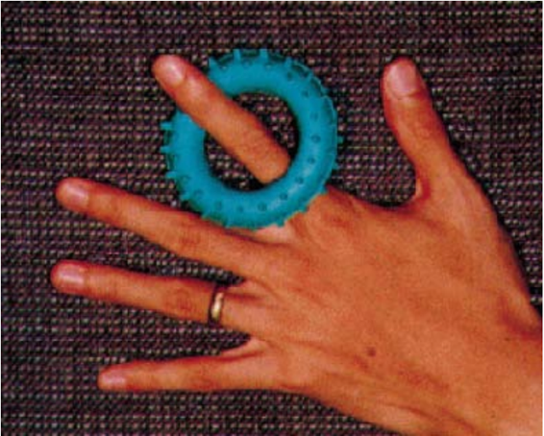
K-means on image pixels

Slide 35
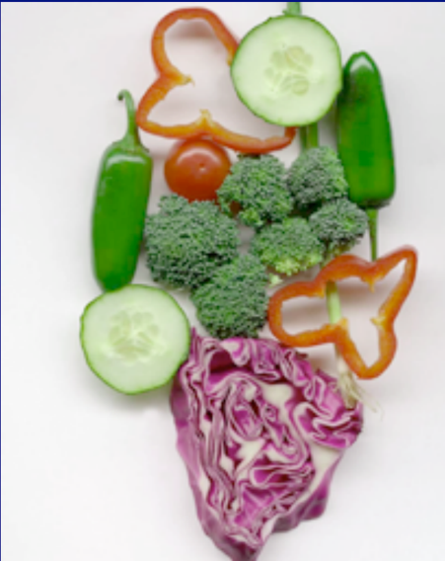

K-means on image pixels
Picture courtesy David Forsyth
One of the clusters from k-means

Slide 36

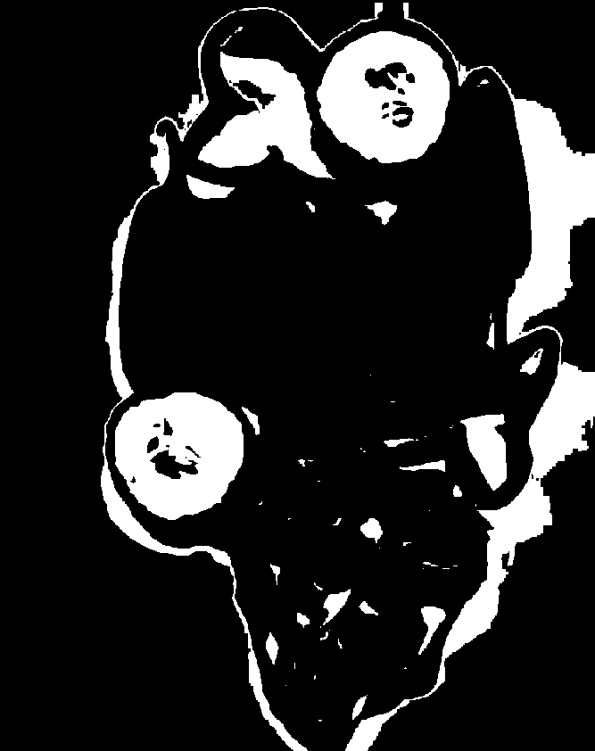
K-means on image pixels
What is wrong?
Pixel position
  Nearby pixels are likely to belong to the same object
  Far-away pixels are likely to belong to different objects
How do we incorporate pixel position?
  Instead of representing each pixel as (r,g,b)
  Represent each pixel as (r,g,b,x,y)

Slide 37


K-means on image pixels+position

Slide 38
The issues with k-means
Captures pixel similarity but
  Doesn’t capture continuity of contours
  Captures near/far relationships only weakly
  Can merge far away objects together
Requires knowledge of k!
Can it deal with texture?

Slide 39
Oversegmentation and superpixels
We don’t know k. What is a safe choice?
Idea: Use large k
  Can potentially break big objects, but will hopefully not merge unrelated objects
  Later processing can decide which groups to merge
  Called superpixels

