Slide 1
Resizing and resampling

Slide 2
Aliasing
Images are made up of high frequency and low frequency components
High frequency components: pixel-to-pixel details
Low frequency components: high-level structure
What subsampling should do: remove pixel-to-pixel details, keep high-level structure
What naïve subsampling does: converts pixel-to-pixel details to new coarse structures → problem

Slide 3
Aliasing

Slide 4
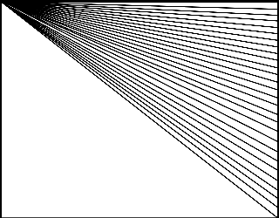
Aliasing
Aliasing artifacts

Slide 5



Image sub-sampling
1/2
1/4 (2x zoom)
1/16 (4x zoom)
Why does this look so crufty? Aliasing!
Source: S. Seitz

Slide 6
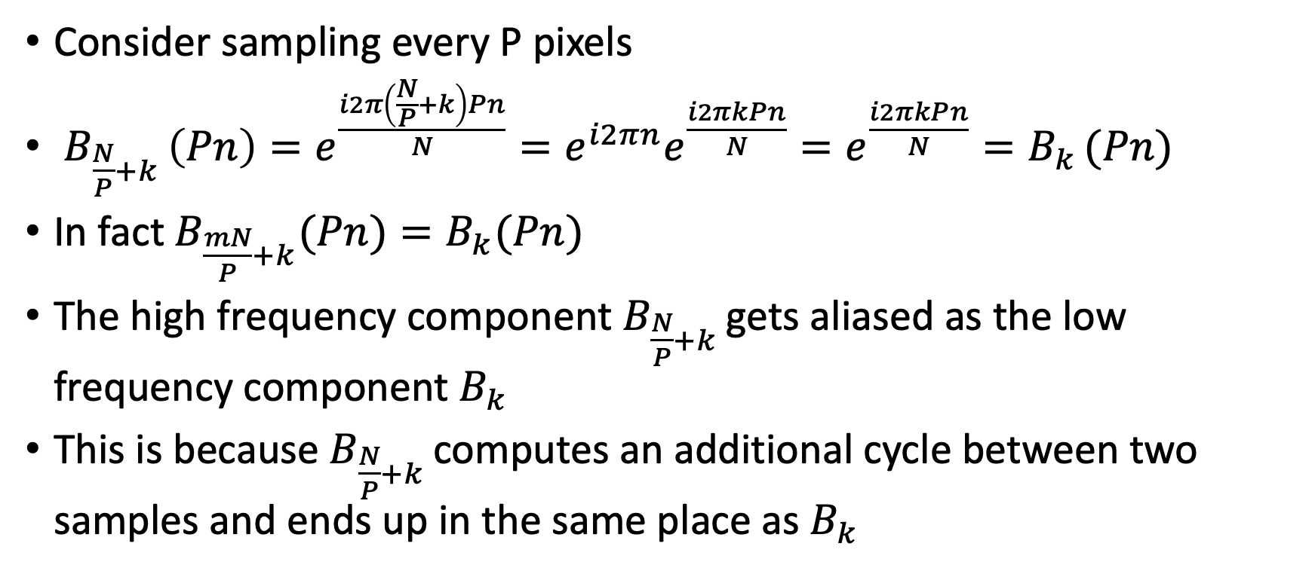
Why does aliasing happen?
Consider sampling every P pixels
$B_{\frac{N}{P}+k }\left(Pn\right)=e^{\frac{i2π\left(\frac{N}{P}+k\right)Pn}{N}}=e^{i2πn}e^{\frac{i2πkPn}{N}}=e^{\frac{i2πkPn}{N}}=B_{k }(Pn)$
In fact $B_{\frac{mN}{P}+k}(Pn)=B_{k}(Pn)$
The high frequency component $B_{\frac{N}{P}+k }$gets aliased as the low frequency component $B_{k }$
This is because $B_{\frac{N}{P}+k }$computes an additional cycle between two samples and ends up in the same place as $B_{k}$

Slide 7
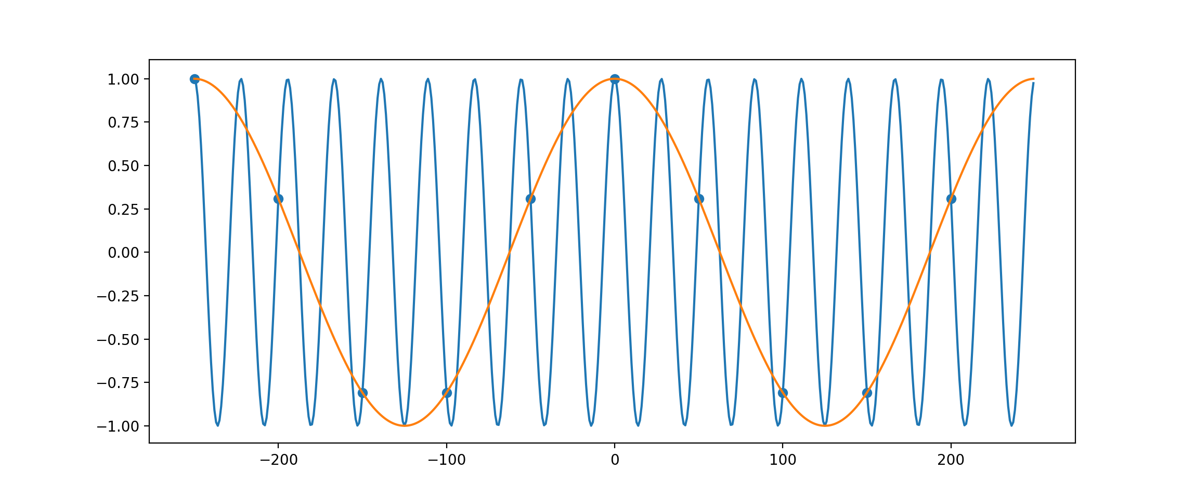
Why does aliasing happen?
Blue gets aliased as orange

Slide 8
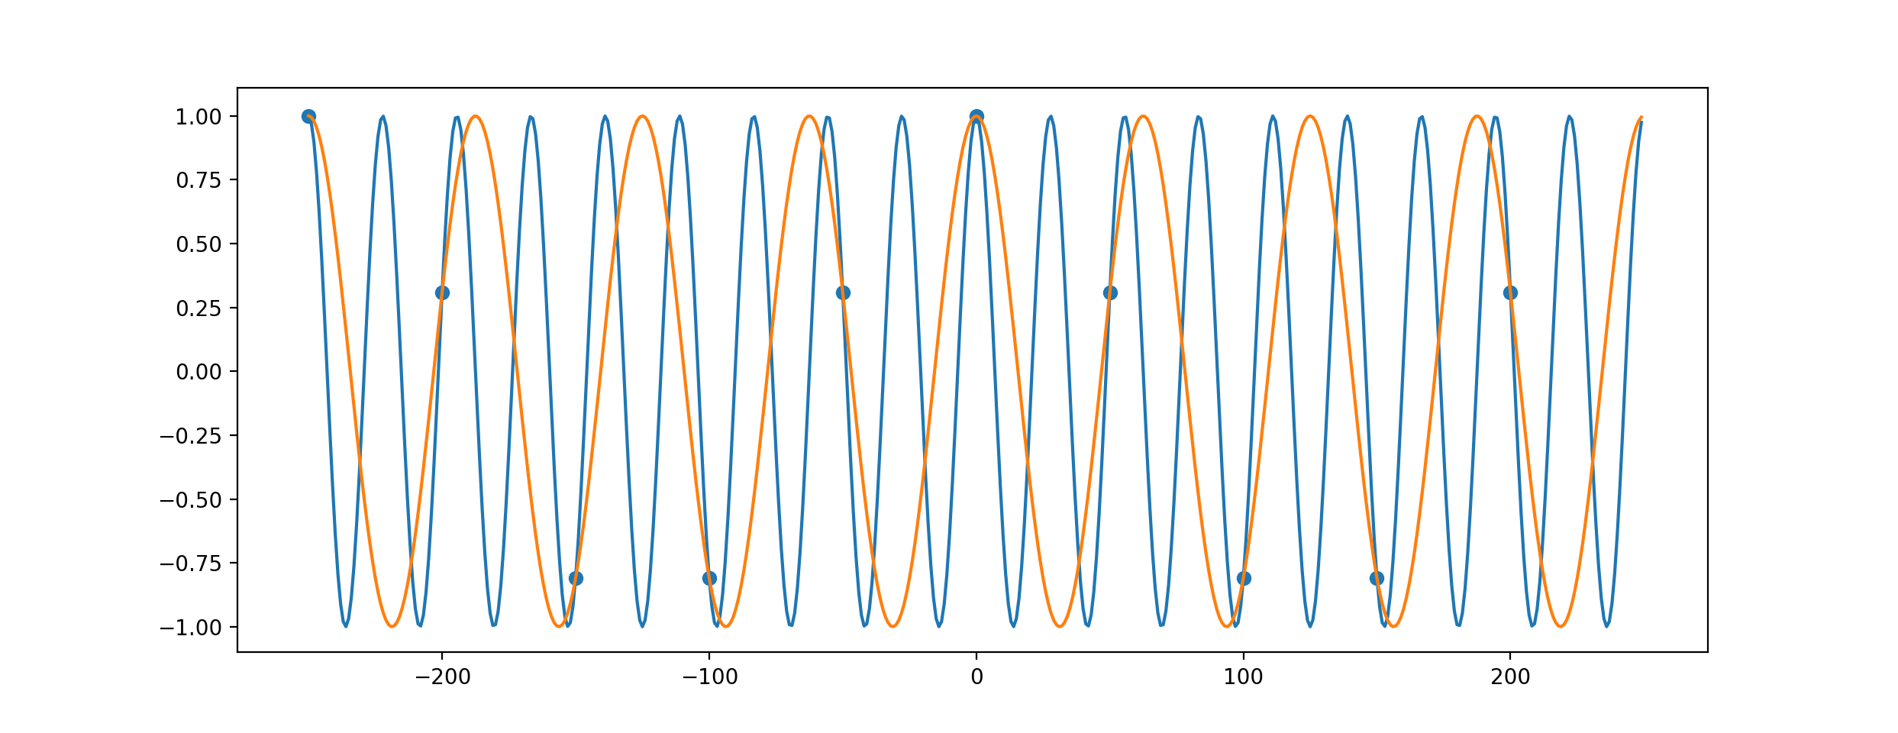
Why does aliasing happen?
Blue gets aliased as orange

Slide 9
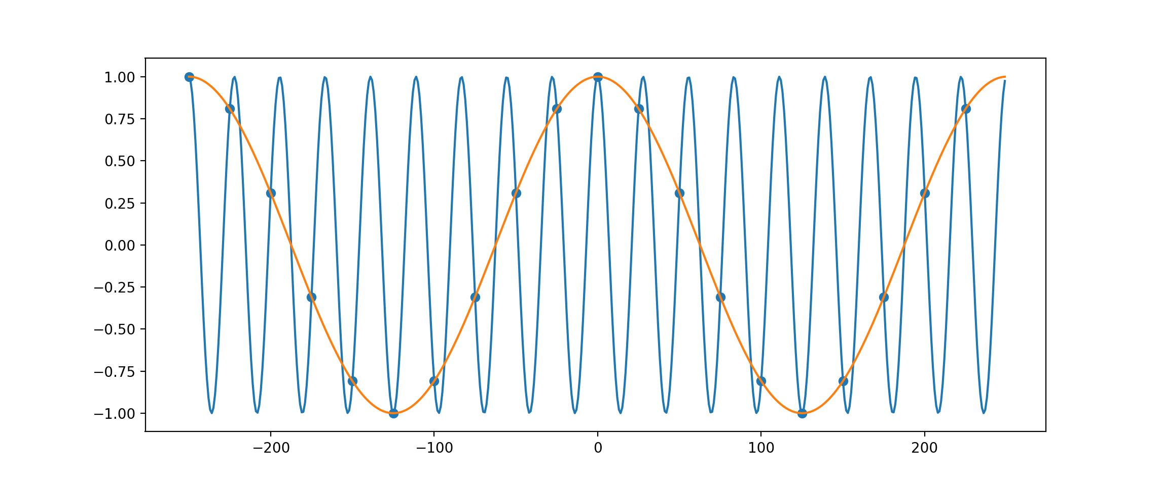
Why does aliasing happen?
Blue gets aliased as orange

Slide 10
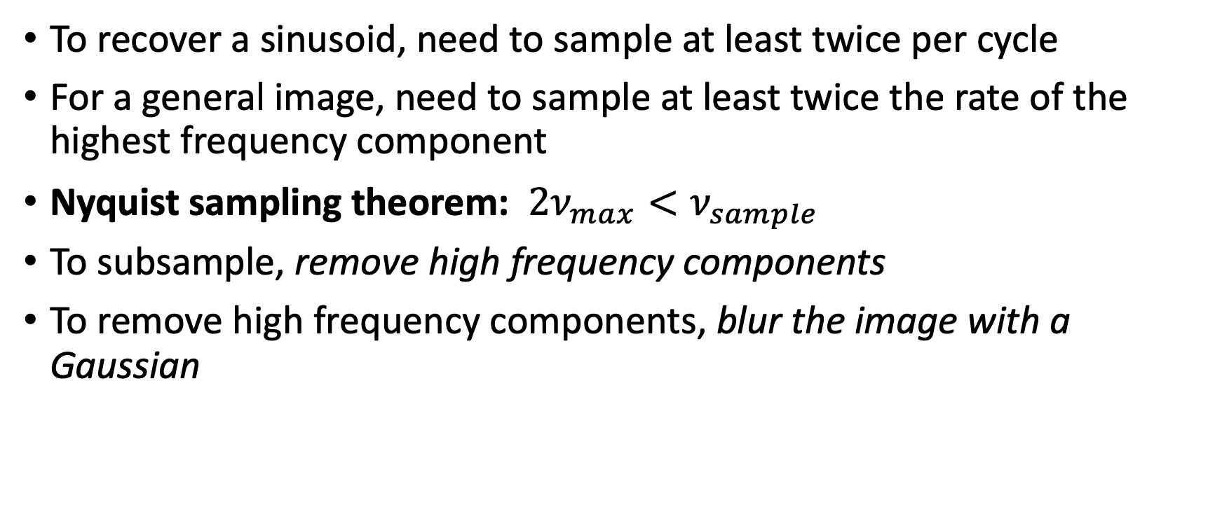
How to avoid aliasing
To recover a sinusoid, need to sample at least twice per cycle
For a general image, need to sample at least twice the rate of the highest frequency component
Nyquist sampling theorem: $2ν_{max}<ν_{sample}$
To subsample, remove high frequency components
To remove high frequency components, blur the image with a Gaussian

Slide 11
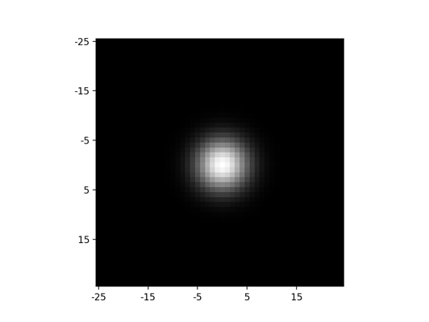
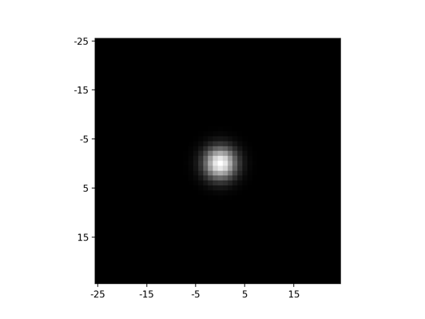
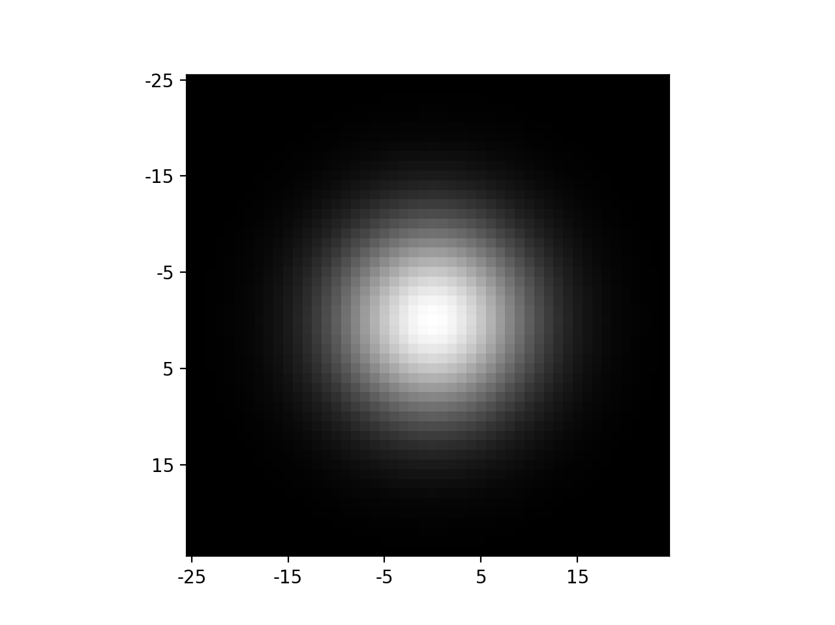
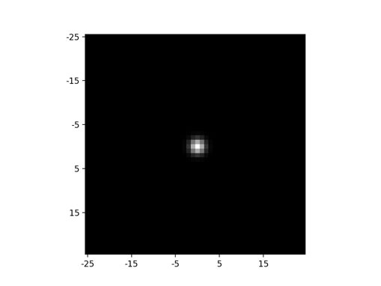
Fourier transform
Image
Zeros out high frequencies
Keeps low frequencies
Gaussian filters
Fourier transform

Slide 12
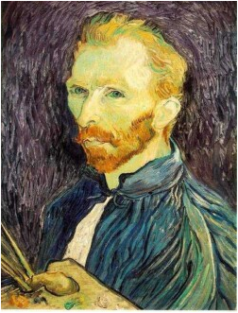







Gaussian pre-filtering
Solution: filter the image, then subsample
F₀
F₁
F₂
…
blur
subsample
blur
subsample
F₀ H
F₁ H
*
*

Slide 13
{
Gaussian pyramid
F₀
F₁
F₂
…
blur
subsample
blur
subsample
F₀ H
F₁ H
*
*

Slide 14
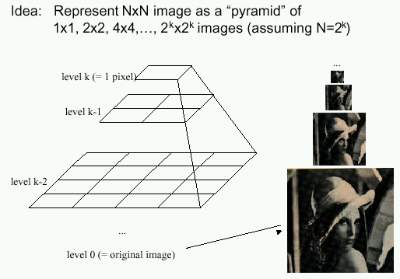
Gaussian pyramids
[Burt and Adelson, 1983]
In computer graphics, a mip map [Williams, 1983]
Gaussian Pyramids have all sorts of applications in computer vision
Source: S. Seitz

Slide 15
Gaussian pyramids - Searching over scales

Slide 16
Gaussian pyramids - Searching over scales

Slide 17
The Gaussian Pyramid
Low resolution
blur
sub-sample
blur
sub-sample
sub-sample
blur
sub-sample
blur
High resolution

Slide 18
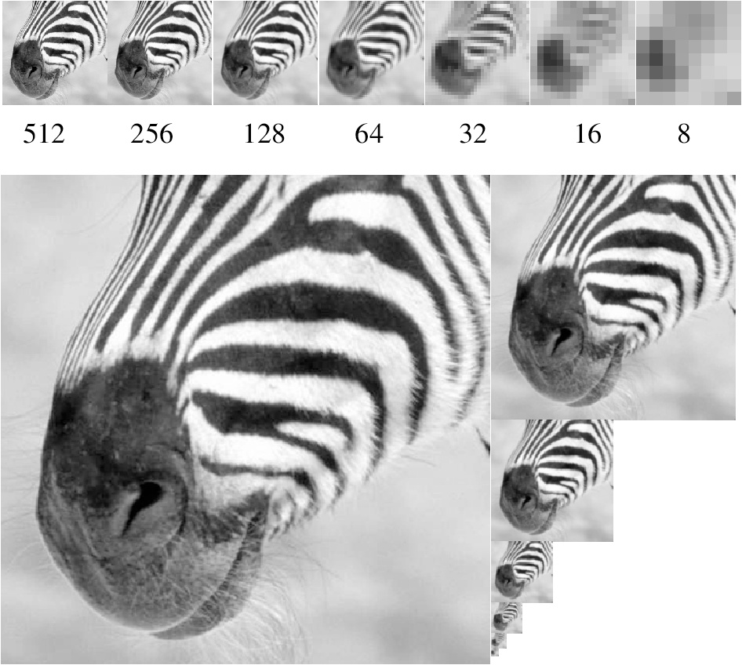
Gaussian pyramid and stack
Source: Forsyth

Slide 19
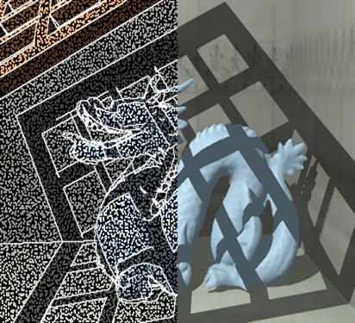
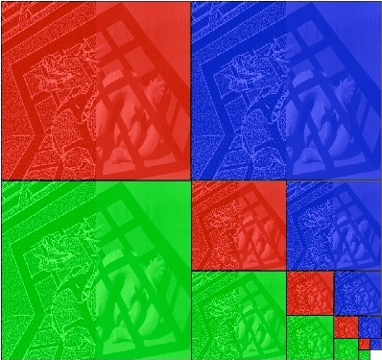
Memory Usage
Each color is a separate pyramid
3 pyramids fit into 2W x 2H image
Notes:
4/3

Slide 20
What about upsampling?
Simple solution: Fill rest of the pixels with zeros
Obviously wrong. How can we do better?

Slide 21
Upsampling
Need to interpolate intermediate pixels. What is the best way to interpolate?
Recall: before subsampling, we removed high frequencies
Key idea: upsampled image should not have high frequencies either
Gaussian blur again!

Slide 22
Upsampling
Step 1: upsample and fill with 0s
Step 2: Gaussian blur to interpolate
Step 3: Scale correction
  Gaussian blur is just weighted average
  But we just introduced a bunch of zeros ==> need to scale up the resulting image

Slide 23



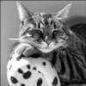
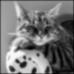
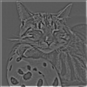


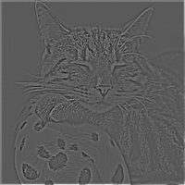
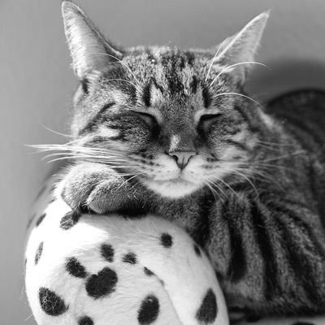

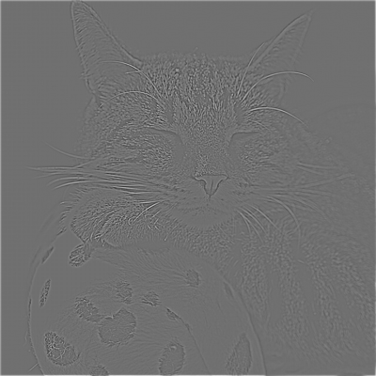
Laplacian pyramid
Expand (upsample + blur)
-
=
Expand (upsample + blur)
-
=
Expand (upsample + blur)
Re-duce
-
=
Expand (upsample + blur)
-
=

Slide 24
Laplacian pyramid
L₄ = G₄ =
L₃ = G₃ - expand(G₄) =
L₂ = G₂ - expand(G₃) =
L₁ = G₁ - expand(G₂) =
L₀ = G₀ - expand(G₁) =

Slide 25
Reconstructing the image from a Laplacian pyramid
Expand (upsample + blur)
+
=
Expand (upsample + blur)
+
=
Expand (upsample + blur)
+
=
Expand (upsample + blur)
+
=

Slide 26
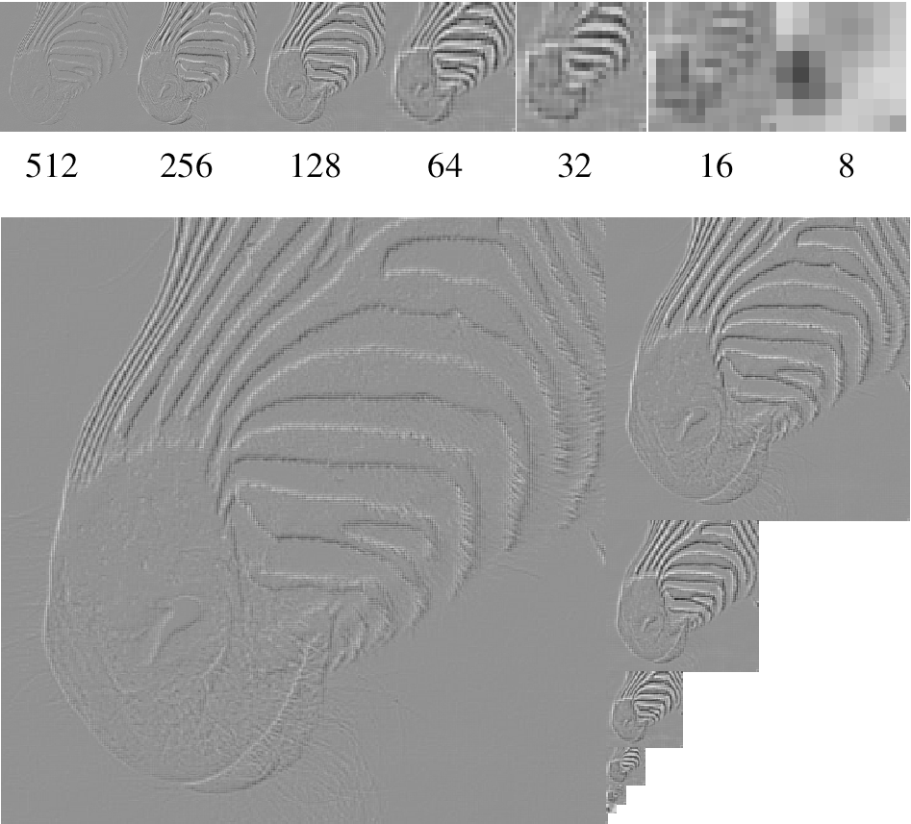
Laplacian pyramid
Source: Forsyth

Slide 27
Low-pass and high-pass filtering
Convolving with a Gaussian = remove high frequencies
“Low-pass” filtering: low frequencies “pass” through filter, high frequencies don’t
Identity – Low-pass filtered image = “High-pass filtering”

Slide 28
Hybrid images (PA1)
From afar, images look tiny, we only see low frequencies
Up close, we see high frequencies
Low frequencies of one image + high frequencies of another

