Slide 1
Fourier Transforms

Slide 2
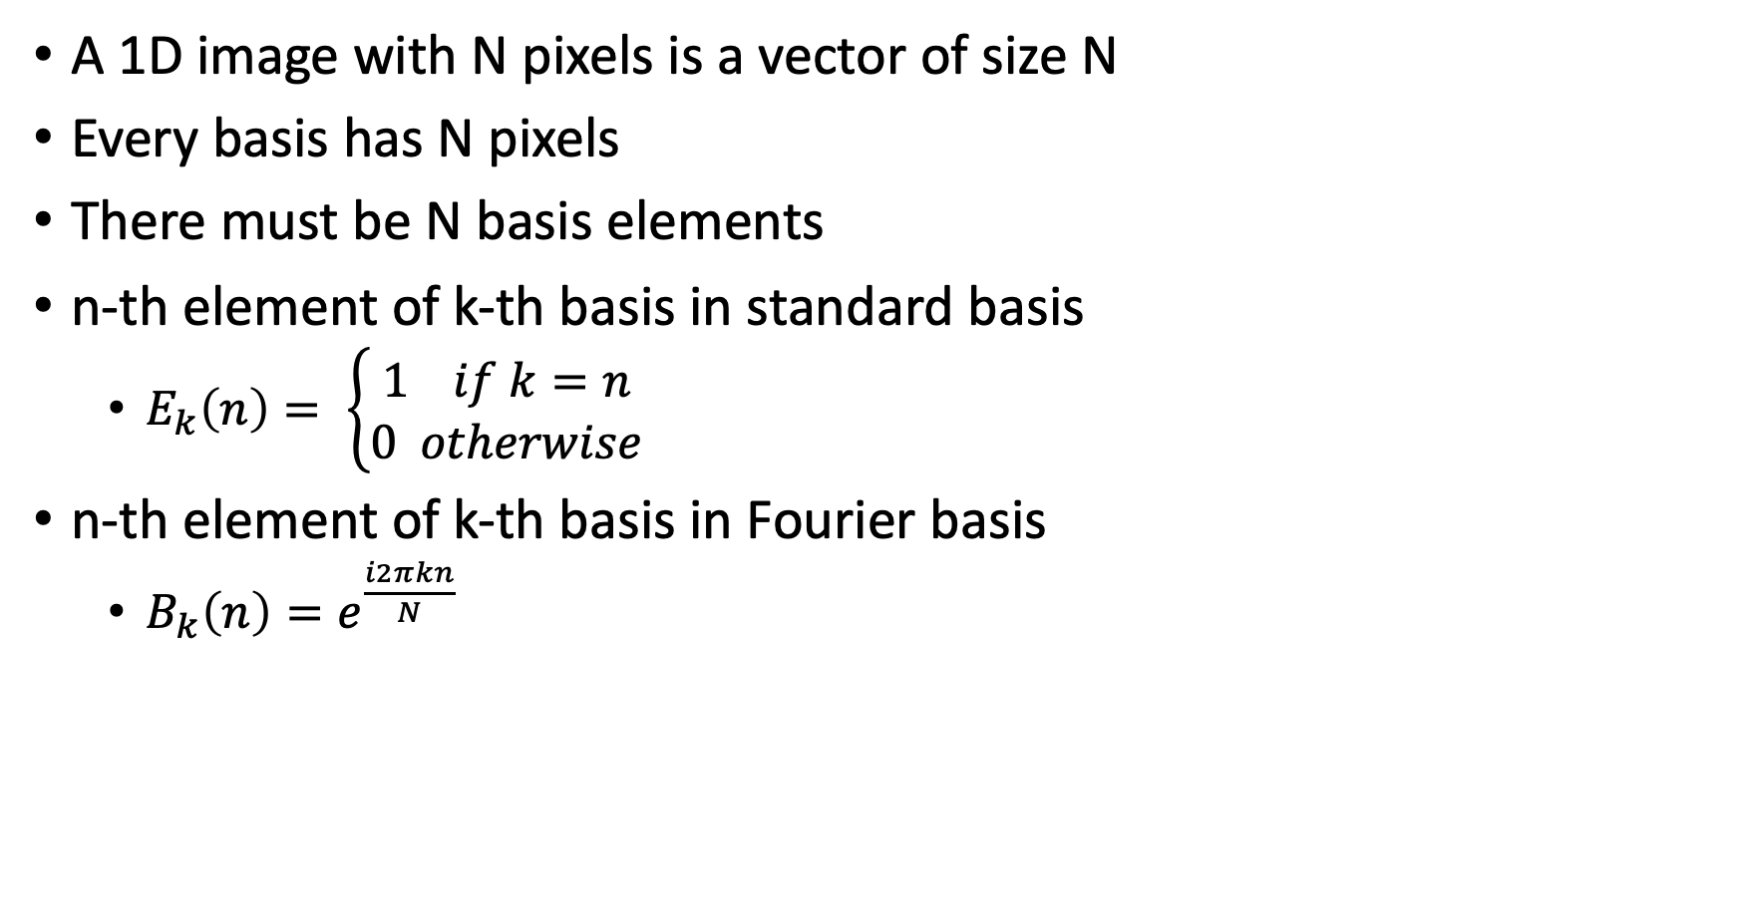
Fourier transform for 1D images
A 1D image with N pixels is a vector of size N
Every basis has N pixels
There must be N basis elements
n-th element of k-th basis in standard basis
$E_{k}\left(n\right)= \left\{\begin{aligned}1 if k=n \\ 0 otherwise\end{aligned}\right.$
n-th element of k-th basis in Fourier basis
$B_{k}\left(n\right)=e^{\frac{i2πkn}{N}}$

Slide 3
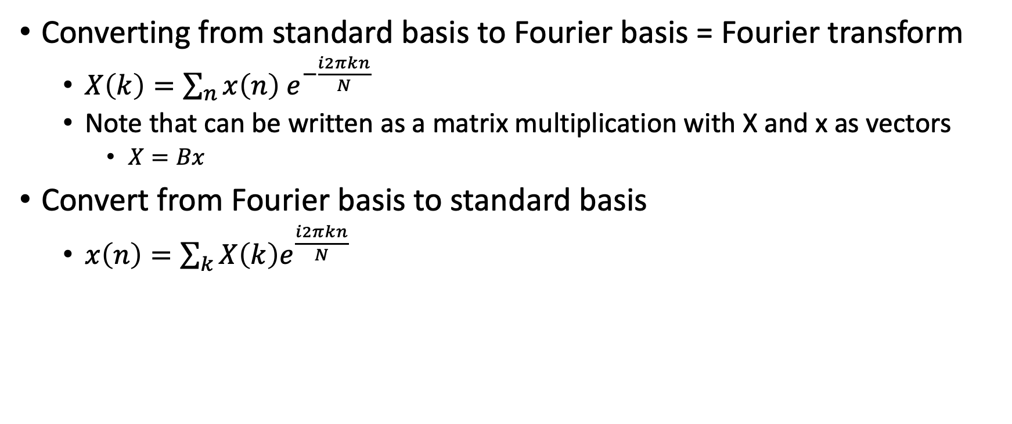
Fourier transform for 1D images
Converting from standard basis to Fourier basis = Fourier transform
$X\left(k\right)=\sum_{n}{x\left(n\right) e^{−\frac{i2πkn}{N}}}$
Note that can be written as a matrix multiplication with X and x as vectors
$X=Bx$
Convert from Fourier basis to standard basis
$x\left(n\right)=\sum_{k}{X\left(k\right)e^{\frac{i2πkn}{N}}}$

Slide 4
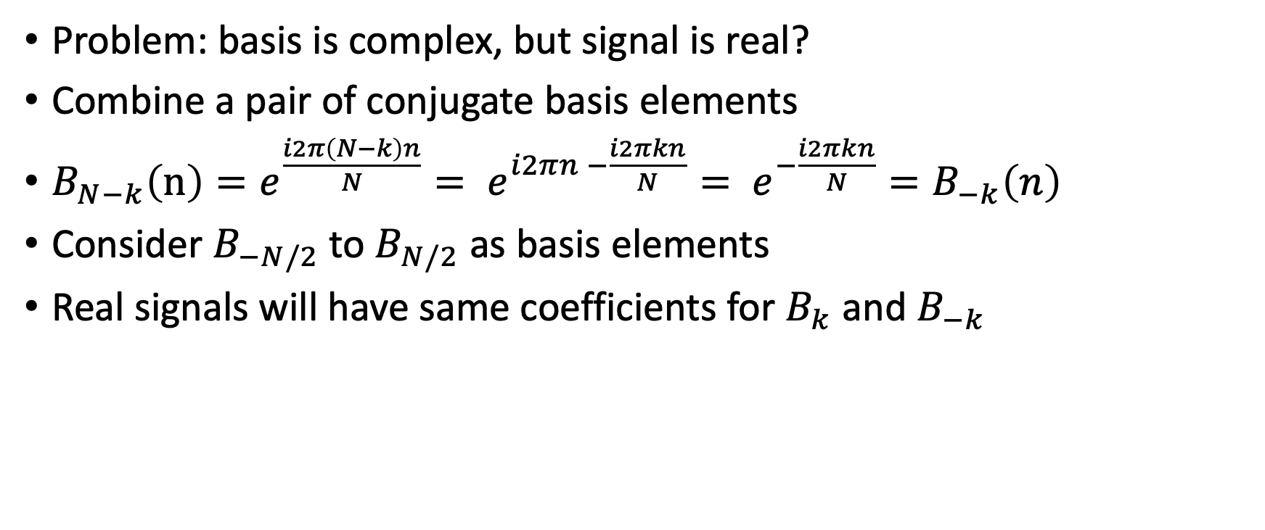
Fourier transform
Problem: basis is complex, but signal is real?
Combine a pair of conjugate basis elements
$B_{N−k}\left(n\right)=e^{\frac{i2π\left(N−k\right)n}{N}}= e^{i2πn −\frac{i2πkn}{N}}= e^{−\frac{i2πkn}{N}}=B_{−k}\left(n\right)$
Consider $B_{−N/2}$to $B_{N/2}$ as basis elements
Real signals will have same coefficients for $B_{k}$ and $B_{−k}$

Slide 5
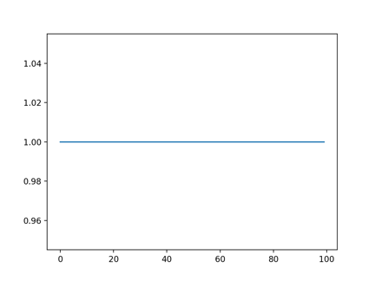
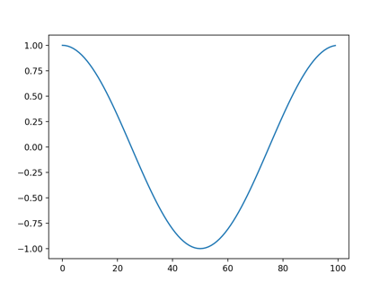
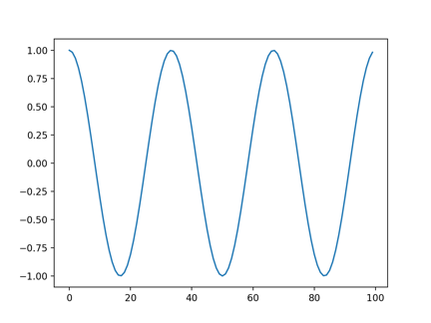
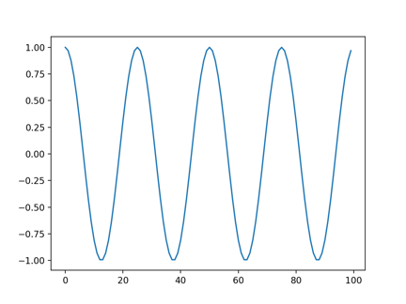
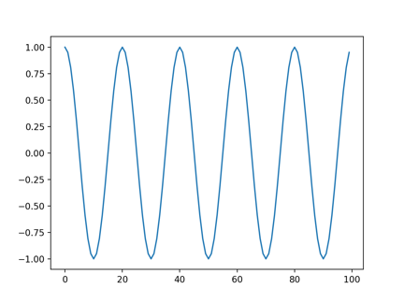
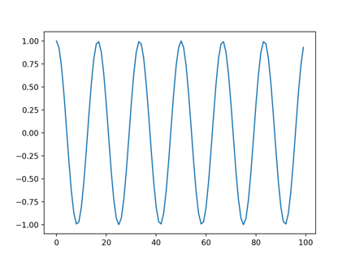
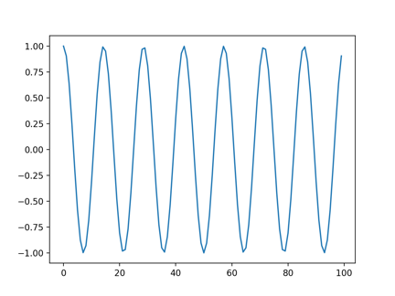
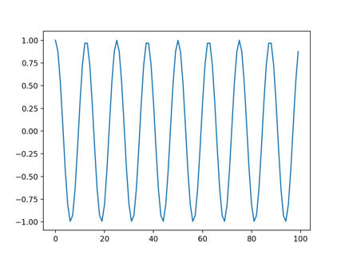
Visualizing the Fourier basis for 1D images

Slide 6
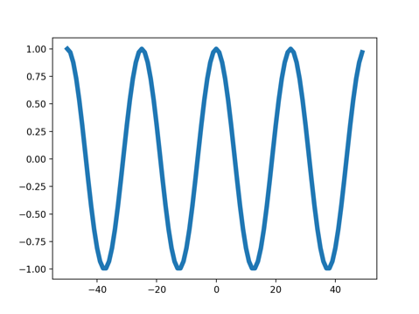
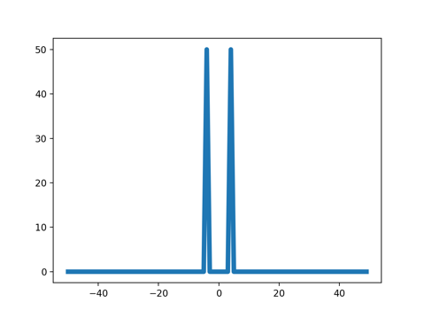
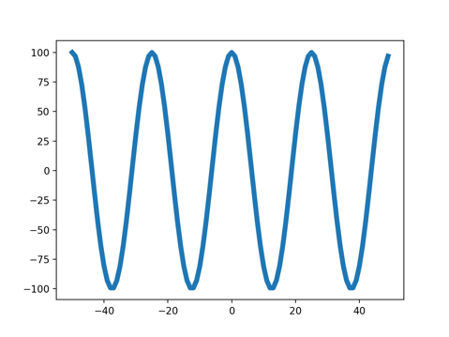
Fourier transform
Signal
impulse
cos
impulse
cos

Slide 7
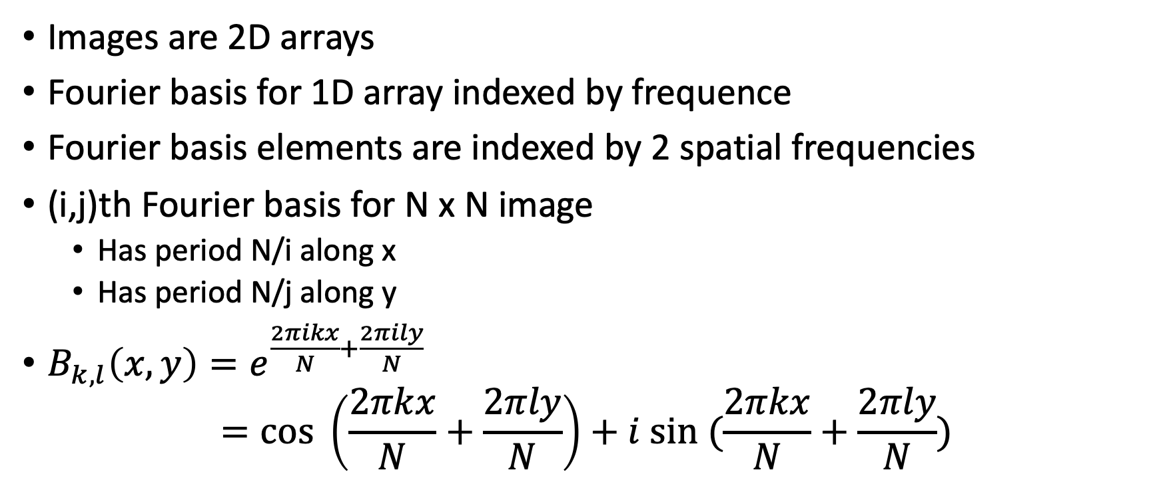
Fourier transform for images
Images are 2D arrays
Fourier basis for 1D array indexed by frequence
Fourier basis elements are indexed by 2 spatial frequencies
(i,j)th Fourier basis for N x N image
Has period N/i along x
Has period N/j along y
$B_{k,l}\left(x,y\right)=e^{\frac{2πikx}{N}+\frac{2πily}{N}}$ $=cos \left(\frac{2πkx}{N}+\frac{2πly}{N}\right)+i sin (\frac{2πkx}{N}+\frac{2πly}{N})$

Slide 8
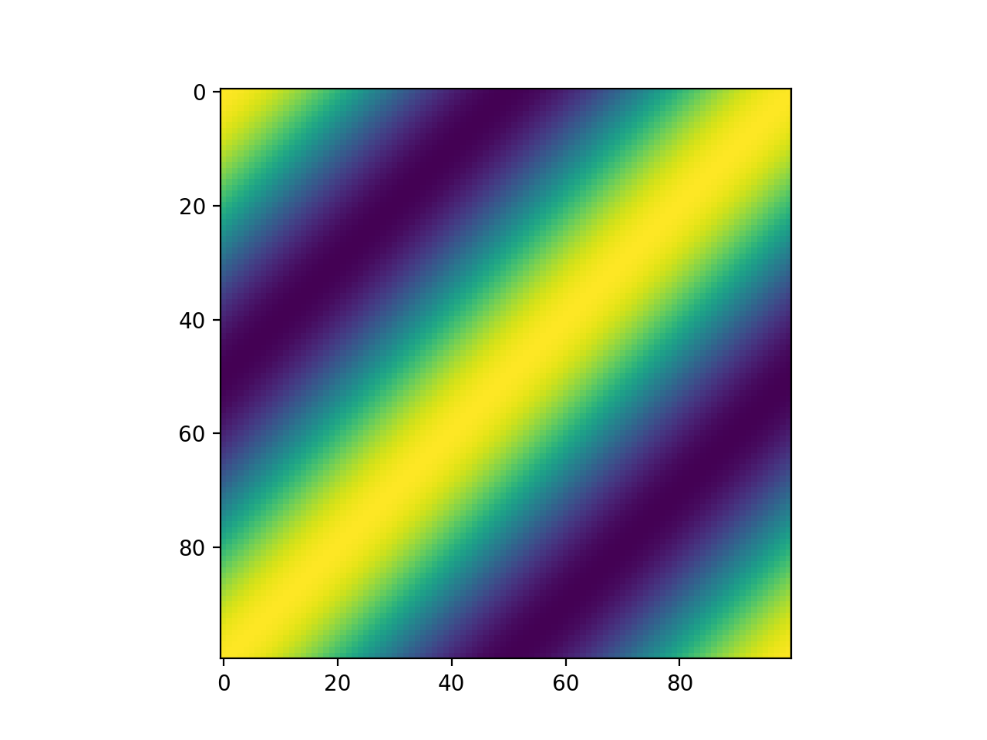
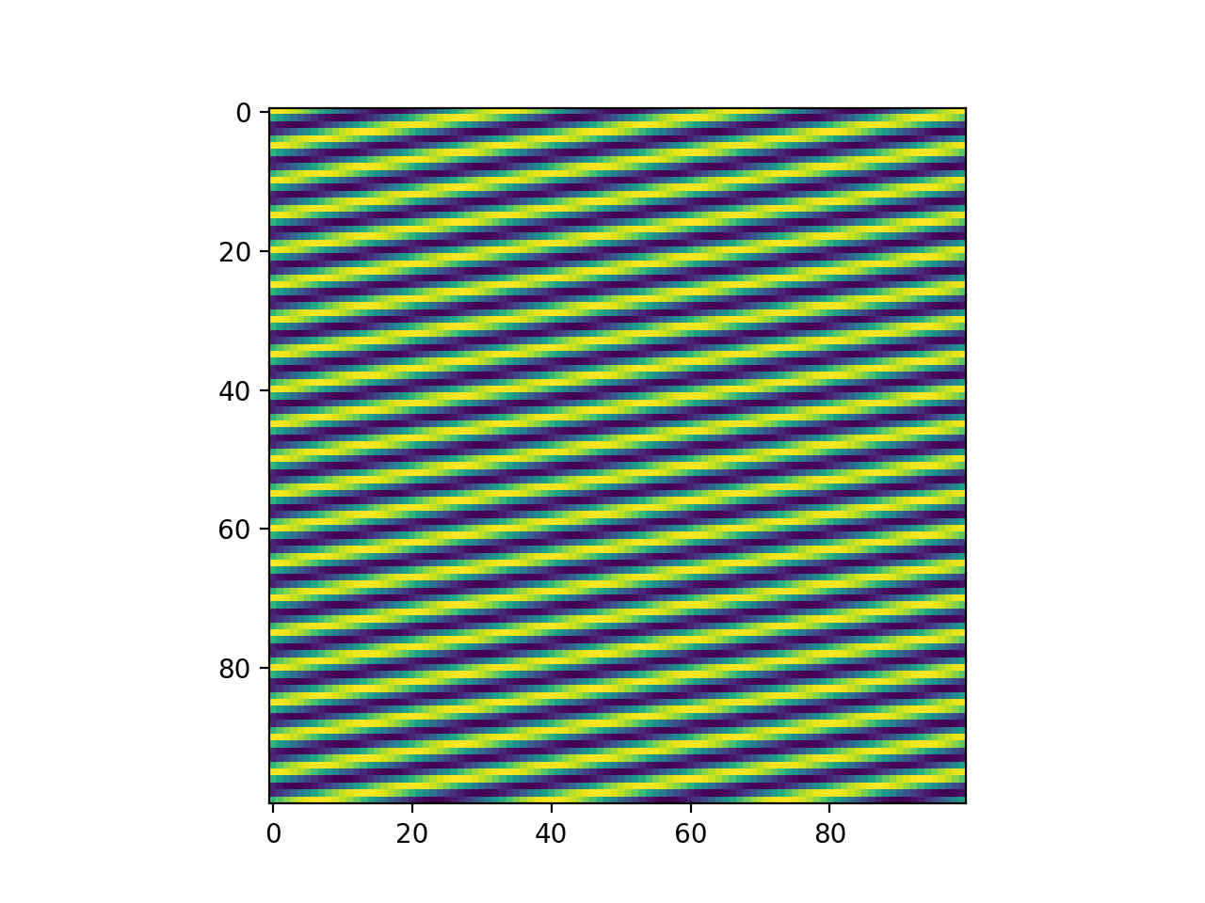
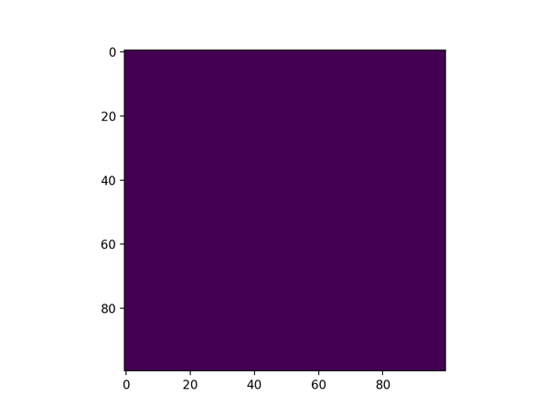
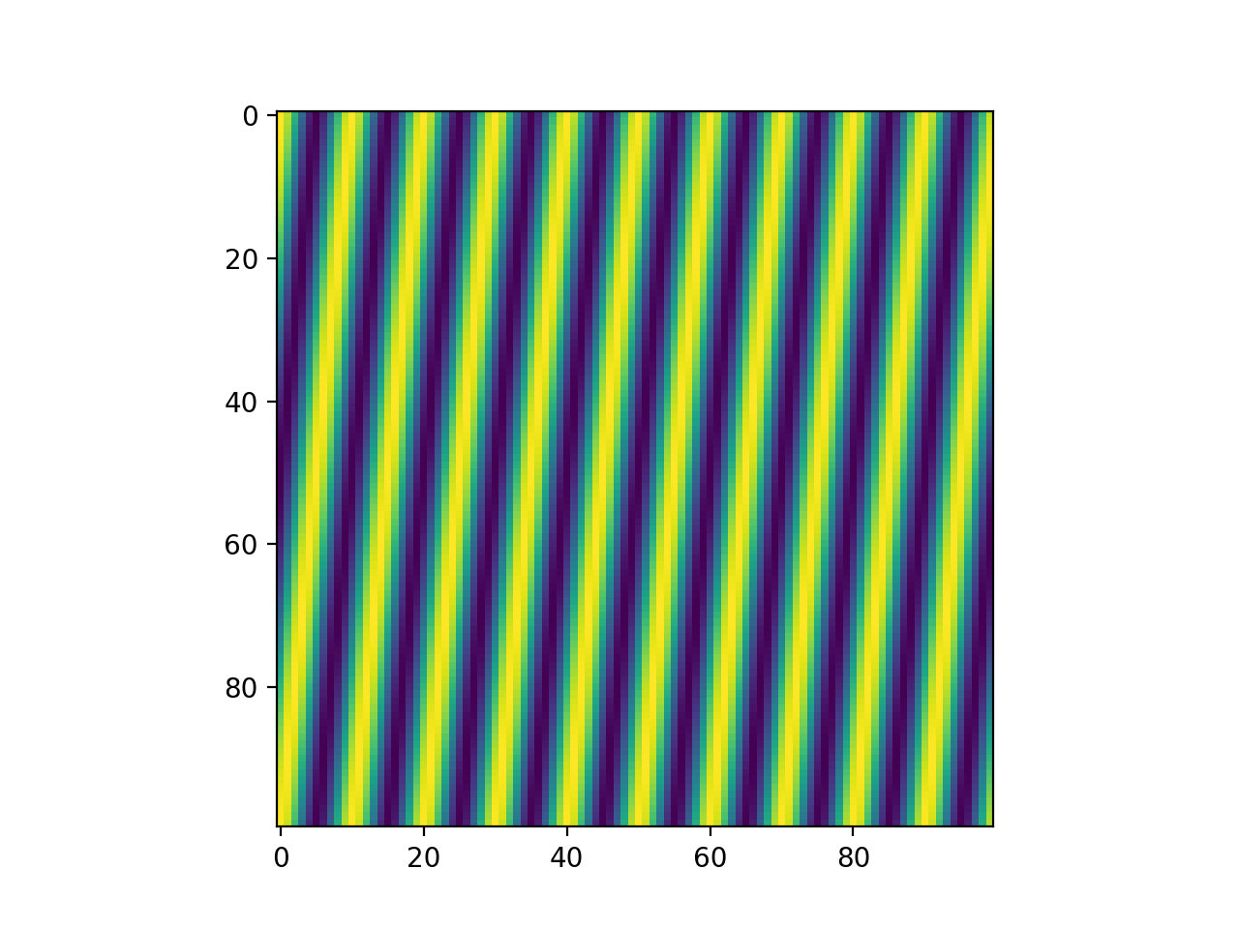




Visualizing the Fourier basis for images
$$B_{1,1}$$
$$B_{3,20}$$
$$B_{0,0}$$
$$B_{10,1}$$

Slide 9
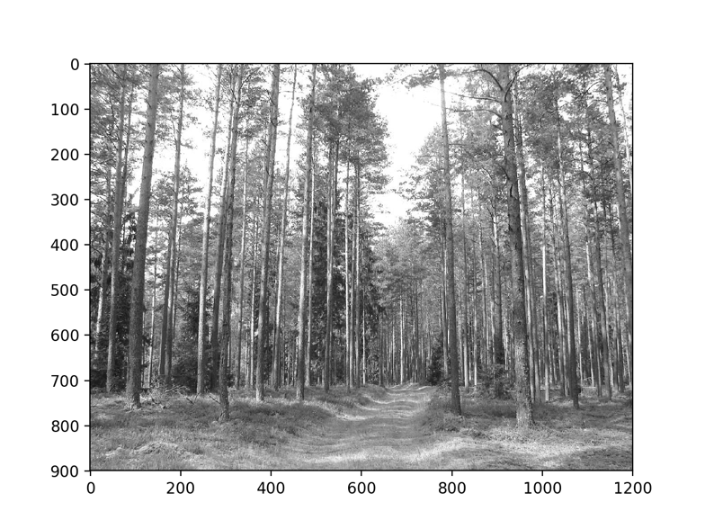
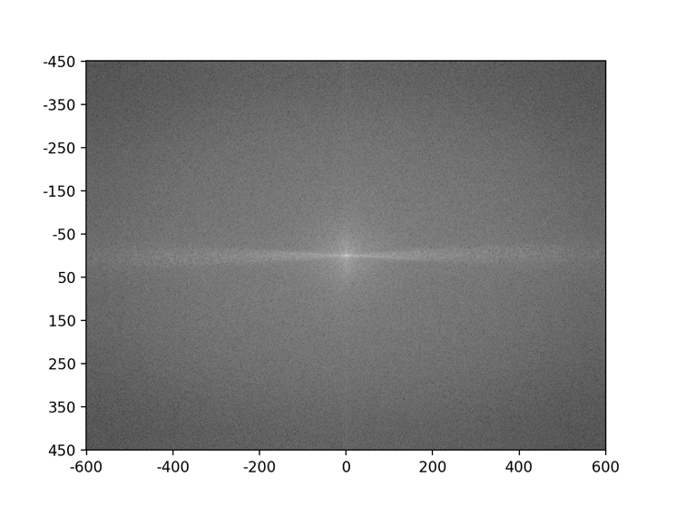
Visualizing the Fourier transform
Given NxN image, there are NxN basis elements
Fourier coefficients can be represented as an NxN image

Slide 10
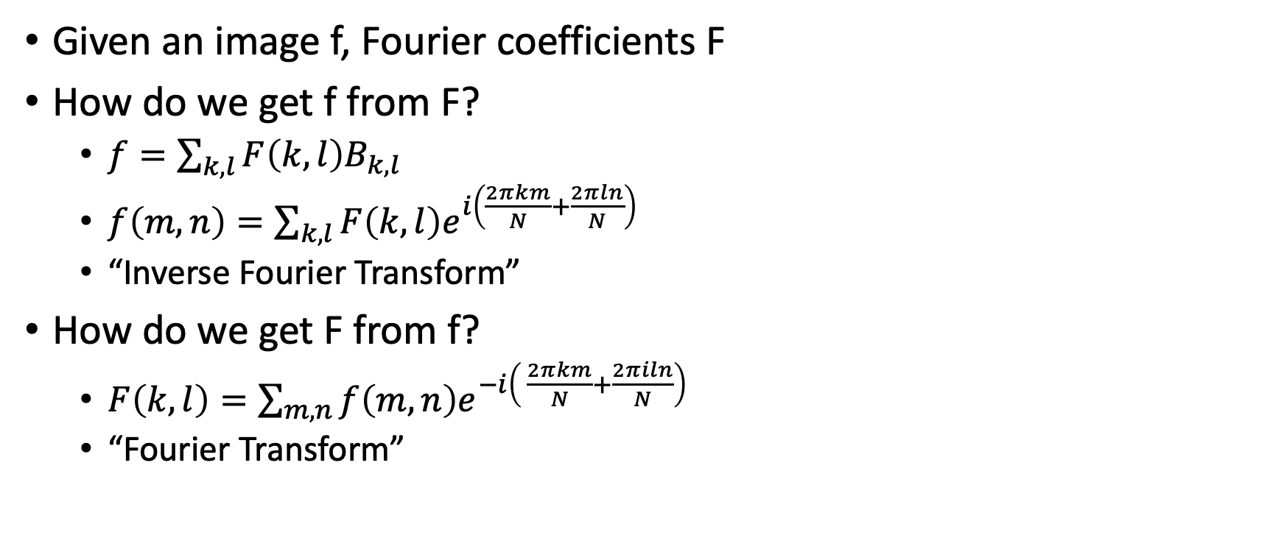
Converting to and from the Fourier basis
Given an image f, Fourier coefficients F
How do we get f from F?
$f=\sum_{k,l}{F\left(k,l\right)B_{k,l}}$
$f\left(m,n\right)=\sum_{k,l}{F\left(k,l\right)e^{i\left(\frac{2πkm}{N}+\frac{2πln}{N}\right)}}$
“Inverse Fourier Transform”
How do we get F from f?
$F\left(k,l\right)=\sum_{m,n}{f\left(m,n\right)e^{−i\left( \frac{2πkm}{N}+\frac{2πiln}{N}\right)}}$
“Fourier Transform”

Slide 11
Why Fourier transforms?
Think of image in terms of low and high frequency information
Low frequency: large scale structure, no details
High frequency: fine structure

Slide 12

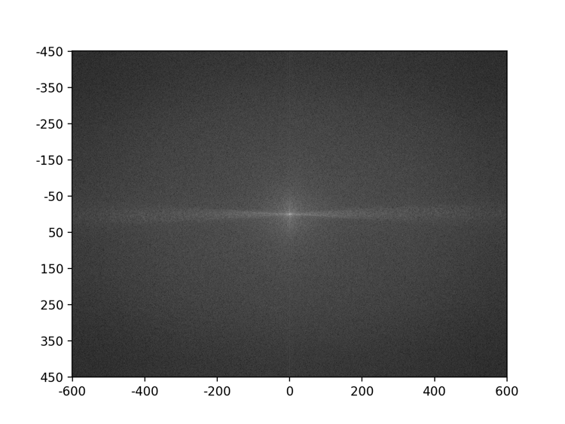
Why Fourier transforms?

Slide 13
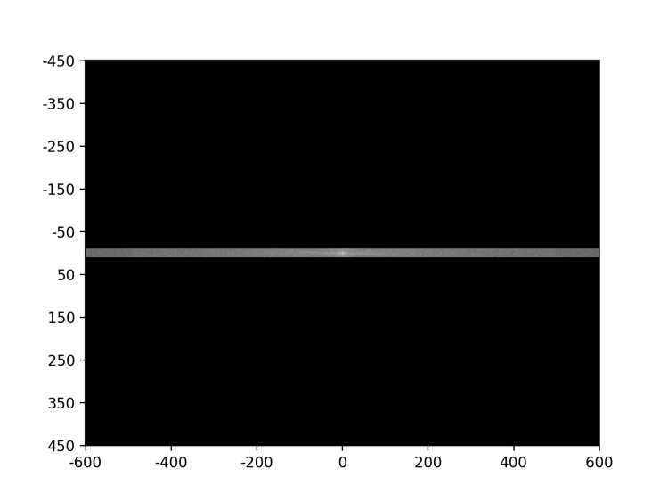
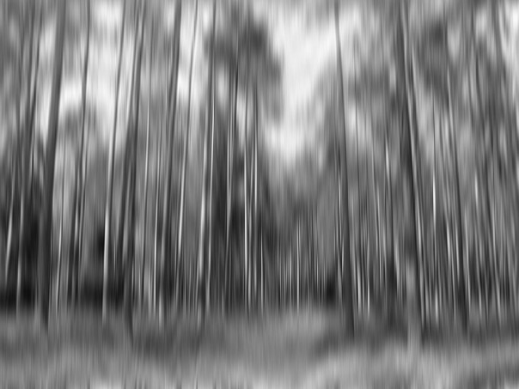
Why Fourier transforms?

Slide 14
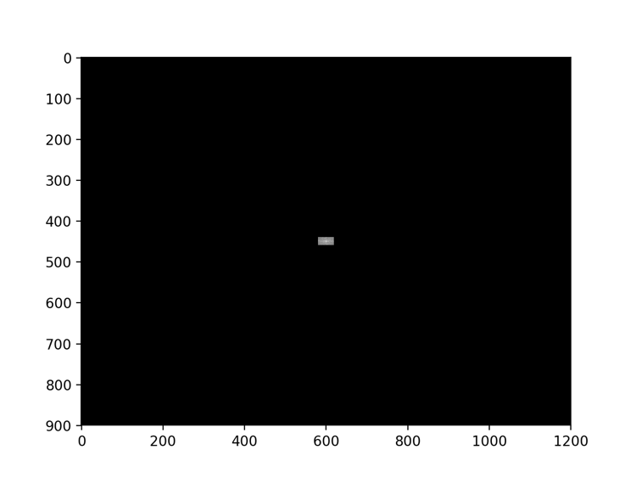
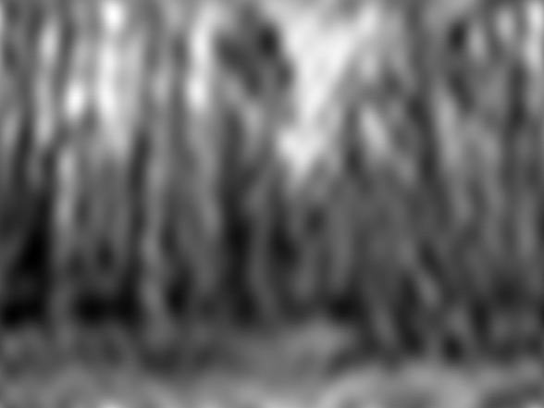
Why Fourier transforms?
Removing high frequency components looks like blurring. Is there more to this relationship?

Slide 15
Dual domains
Image: Spatial domain
Fourier Transform: Frequency domain
Amplitudes are called spectrum
For any transformations we do in spatial domain, there are corresponding transformations we can do in the frequency domain
And vice-versa
Spatial Domain

Slide 16
Dual domains
Convolution in spatial domain = Point-wise multiplication in frequency domain
Convolution in frequency domain = Point-wise multiplication in spatial domain

Slide 17
Fourier transform
Signal
impulse
cos
impulse
cos

Slide 18
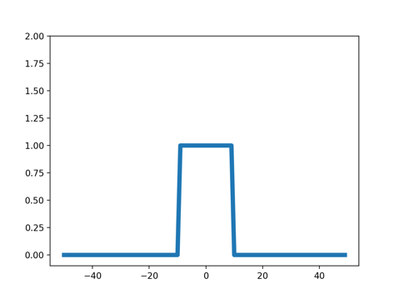
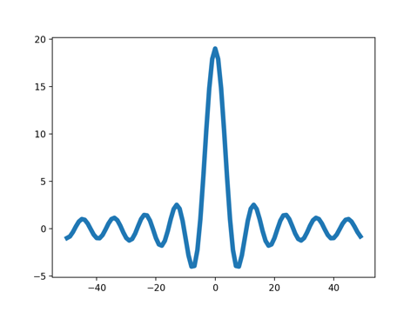
Fourier transform
Signal
box
“sinc” = sin(x)/x
“sinc” = sin(x)/x
box

Slide 19
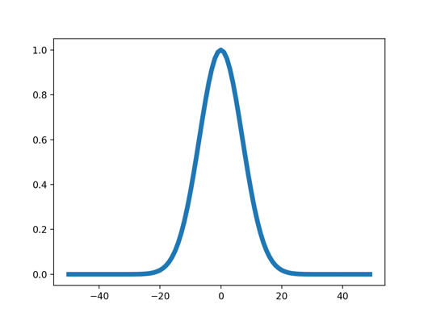
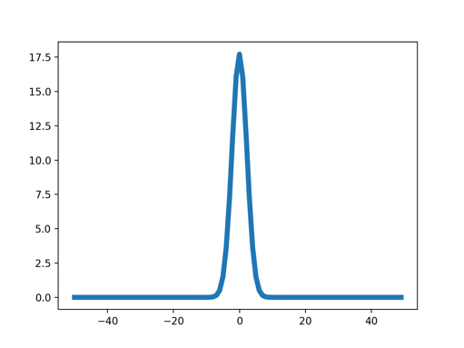
Fourier transform
Signal
Gaussian
Gaussian

Slide 20
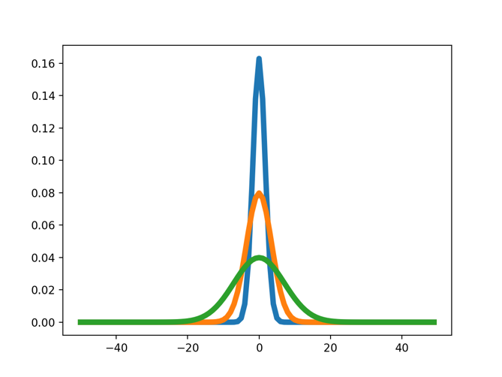
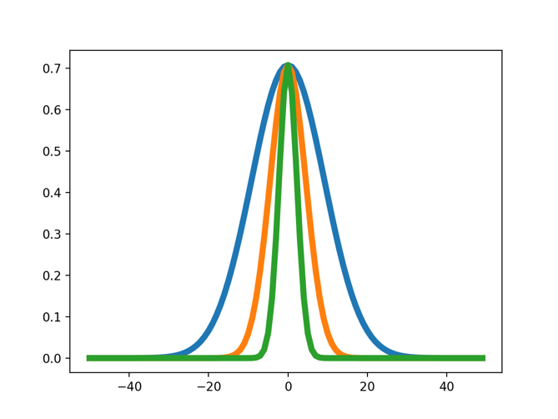
Fourier transform
Signal
Gaussian
Gaussian

Slide 21
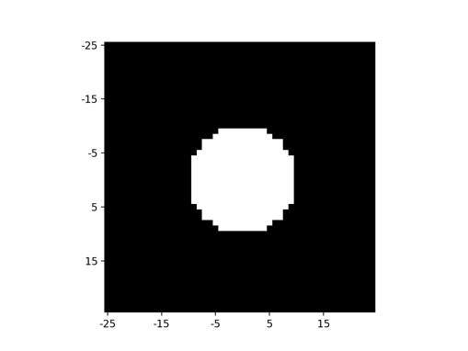
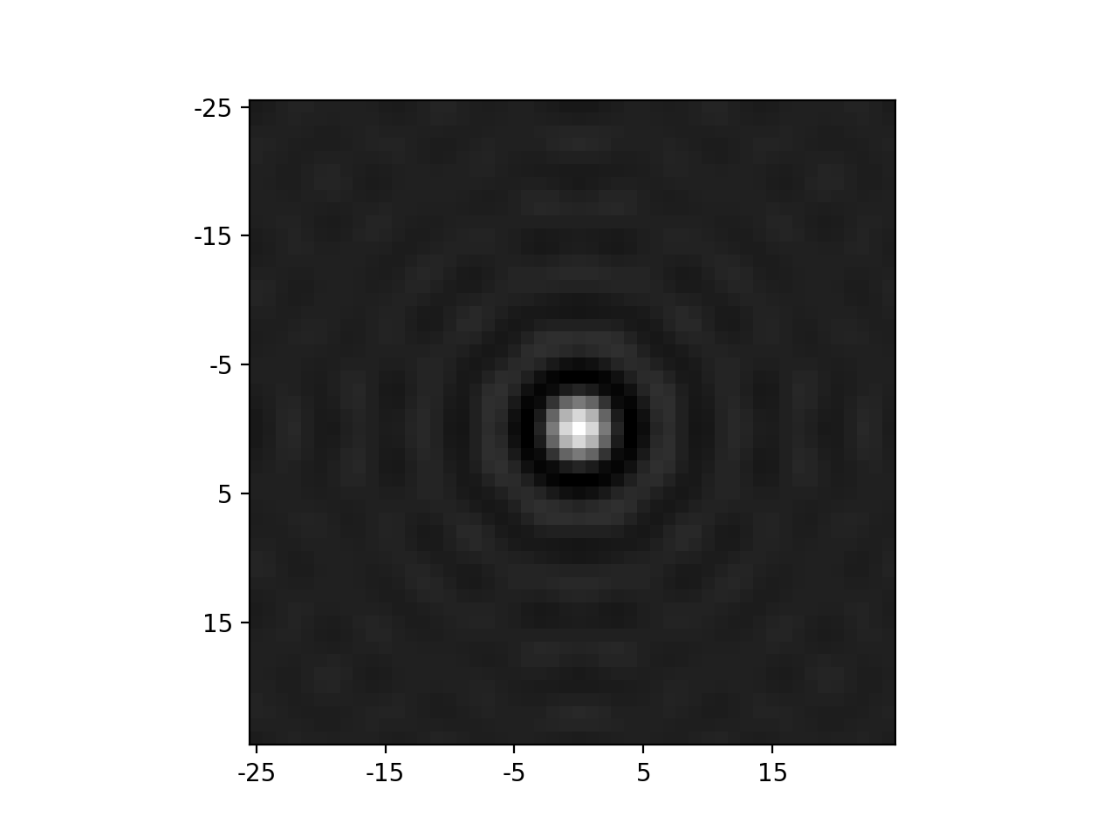
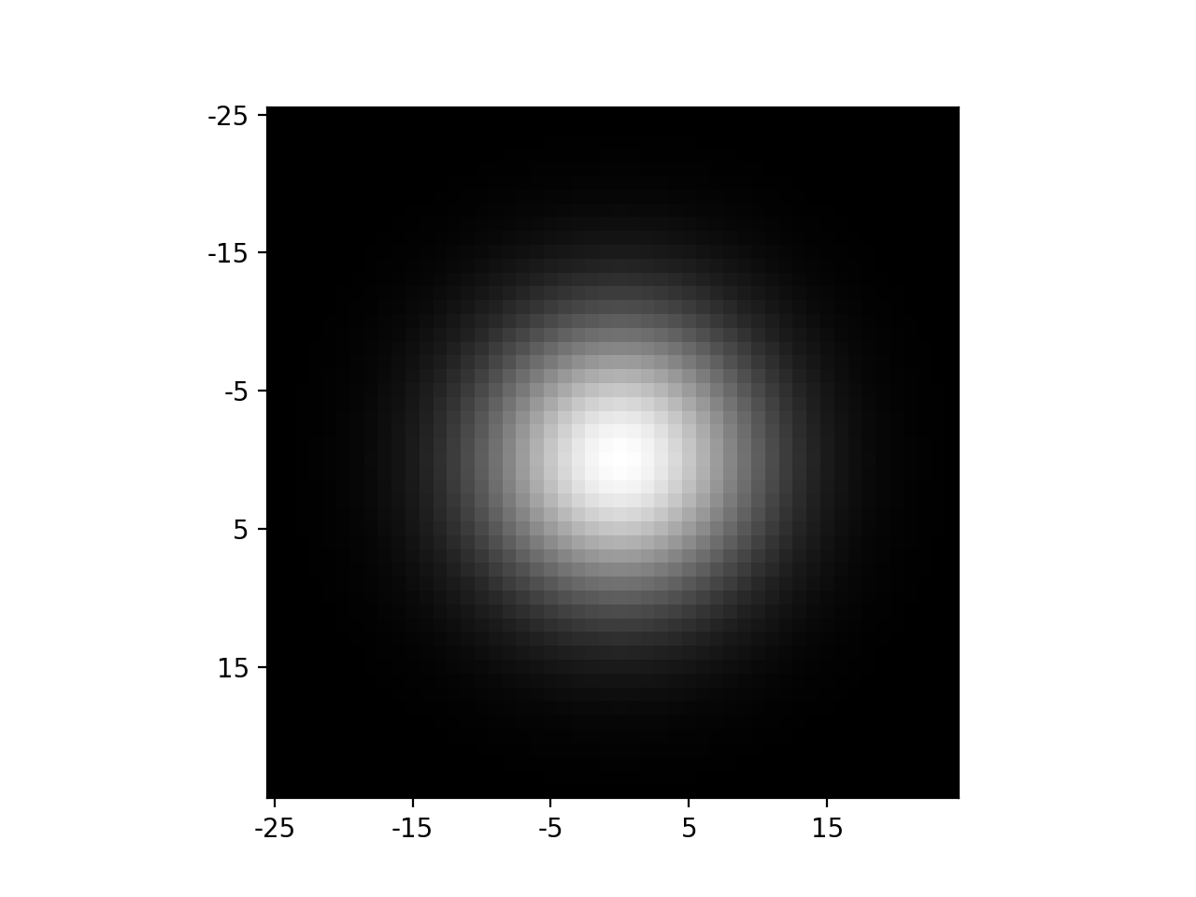

Fourier transform
Image

Slide 22
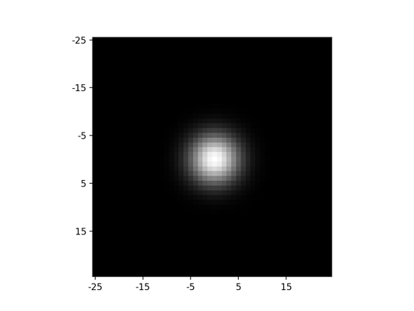
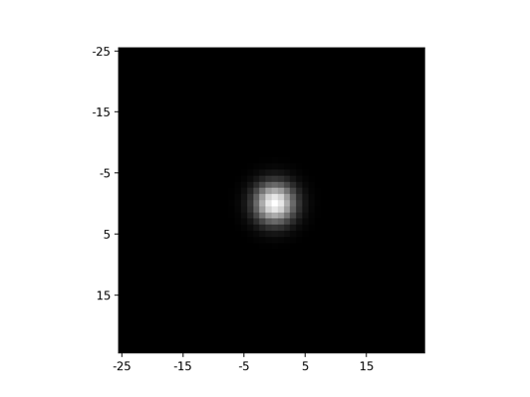
Fourier transform
Image

Slide 23
Detour: Time complexity of convolution
Image is w x h
Filter is k x k
Every entry takes O(k²) operations
Number of output entries:
(w+k-1)(h+k-1) for full
wh for same
Total time complexity:
O(whk²)

Slide 24
Optimization: separable filters
basic alg. is O(r²): large filters get expensive fast!
definition: w(x,y) is separable if it can be written as:
Write u as a k x 1 filter, and v as a 1 x k filter
Claim:

Slide 25
Separable filters
u₁
u₂
u₃
*
v₁ | v₂ | v₃
u₁
u₂
u₃
u₃
u₂
u₁
u₁v₁

Slide 26
Separable filters
u₁
u₂
u₃
*
v₁ | v₂ | v₃
u₁
u₂
u₃
u₃
u₂
u₁
u₁v₁ | u₁v₂

Slide 27
Separable filters
u₁
u₂
u₃
*
v₁ | v₂ | v₃
u₁
u₂
u₃
u₃
u₂
u₁
u₁v₁ | u₁v₂ | u₁v₃

Slide 28
Separable filters
u₁
u₂
u₃
*
v₁ | v₂ | v₃
u₁
u₂
u₃
u₃
u₂
u₁
u₁v₁ | u₁v₂ | u₁v₃
u₂v₁

Slide 29
Separable filters
u₁
u₂
u₃
*
v₁ | v₂ | v₃
u₁
u₂
u₃
u₃
u₂
u₁
u₁v₁ | u₁v₂ | u₁v₃
u₂v₁ | u₂v₂

Slide 30
Separable filters
u₁
u₂
u₃
*
v₁ | v₂ | v₃
u₁
u₂
u₃
u₃
u₂
u₁
u₁v₁ | u₁v₂ | u₁v₃
u₂v₁ | u₂v₂ | u₂v₃

Slide 31
Separable filters
u₁
u₂
u₃
*
v₁ | v₂ | v₃
u₁
u₂
u₃
u₃
u₂
u₁
u₁v₁ | u₁v₂ | u₁v₃
u₂v₁ | u₂v₂ | u₂v₃
u₃v₁

Slide 32
Separable filters
u₁
u₂
u₃
*
v₁ | v₂ | v₃
u₁
u₂
u₃
u₃
u₂
u₁
u₁v₁ | u₁v₂ | u₁v₃
u₂v₁ | u₂v₂ | u₂v₃
u₃v₁ | u₃v₂

Slide 33
Separable filters
u₁
u₂
u₃
*
v₁ | v₂ | v₃
w
u₁
u₂
u₃
u₃
u₂
u₁
u₁v₁ | u₁v₂ | u₁v₃
u₂v₁ | u₂v₂ | u₂v₃
u₃v₁ | u₃v₂ | u₃v₃

Slide 34
Separable filters
Time complexity of original : O(whk²)
Time complexity of separable version : O(whk)

