Slide 1
Fourier transforms

Slide 2







Gaussian filter
21x21, $σ$=0.5
21x21, $σ$=1
21x21, $σ$=3

Slide 3


Difference of Gaussians
21x21, $σ$=3
21x21, $σ$=1

Slide 4
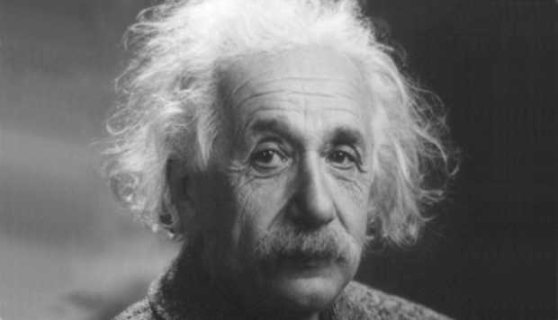
Images have structure at various scales

Slide 5
Images have structure at various scales
Let’s formalize this!

Slide 6
A change of basis
Want to write image I as:
Basis:
What should basis be?

Slide 7
A change of basis
Each basis should capture structure at a particular scale
Coarse structure: Corresponding to large regions of the image
Fine structure: corresponding to individual pixels as details
One such basis: Fourier basis

Slide 8
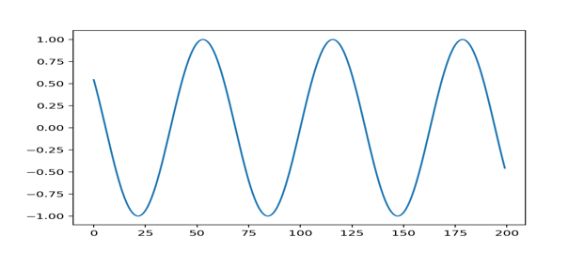
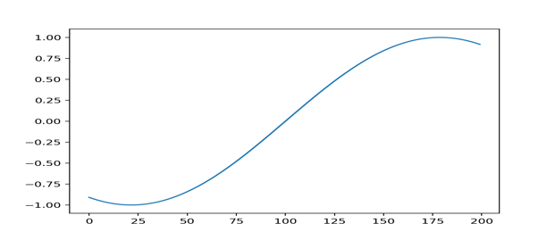
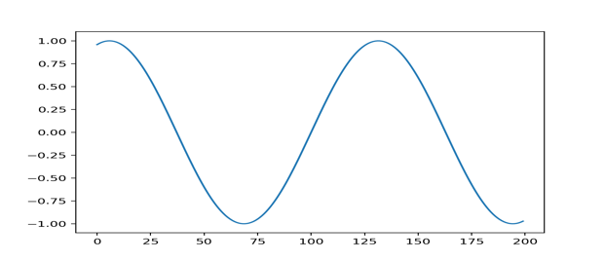
Fourier bases for 1D signals
Consider sines and cosines of various frequencies as basis

Slide 9
A combination of frequencies
0.1 X
+
0.3 X
+
0.5 X
=

Slide 10
Fourier transform
Can we figure out the canonical single-frequency signals that make up a complex signal?
  Yes!
Can any signal be decomposed in this way?
  Yes!

Slide 11
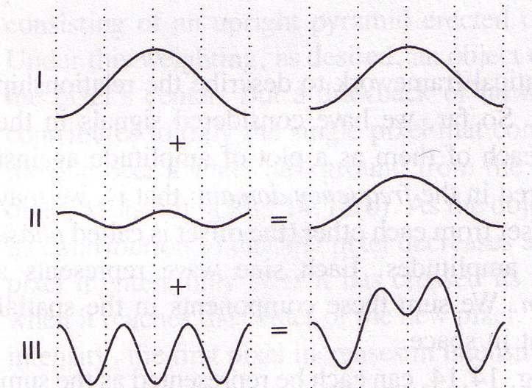
Idea of Fourier Analysis
Every signal (doesn’t matter what it is)
  Sum of sine/cosine waves

Slide 12
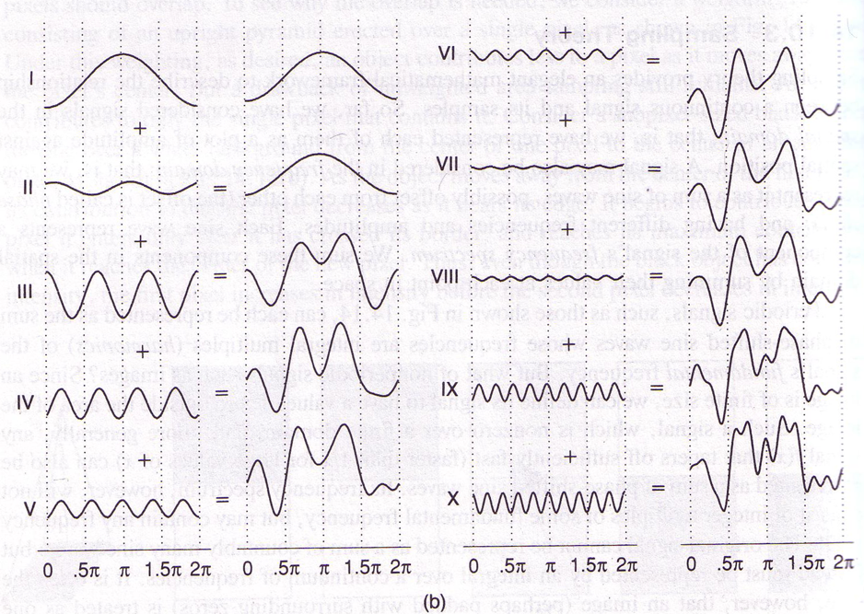
Idea of Fourier Analysis
Every signal (doesn’t matter what it is)
  Sum of sine/cosine waves

Slide 13
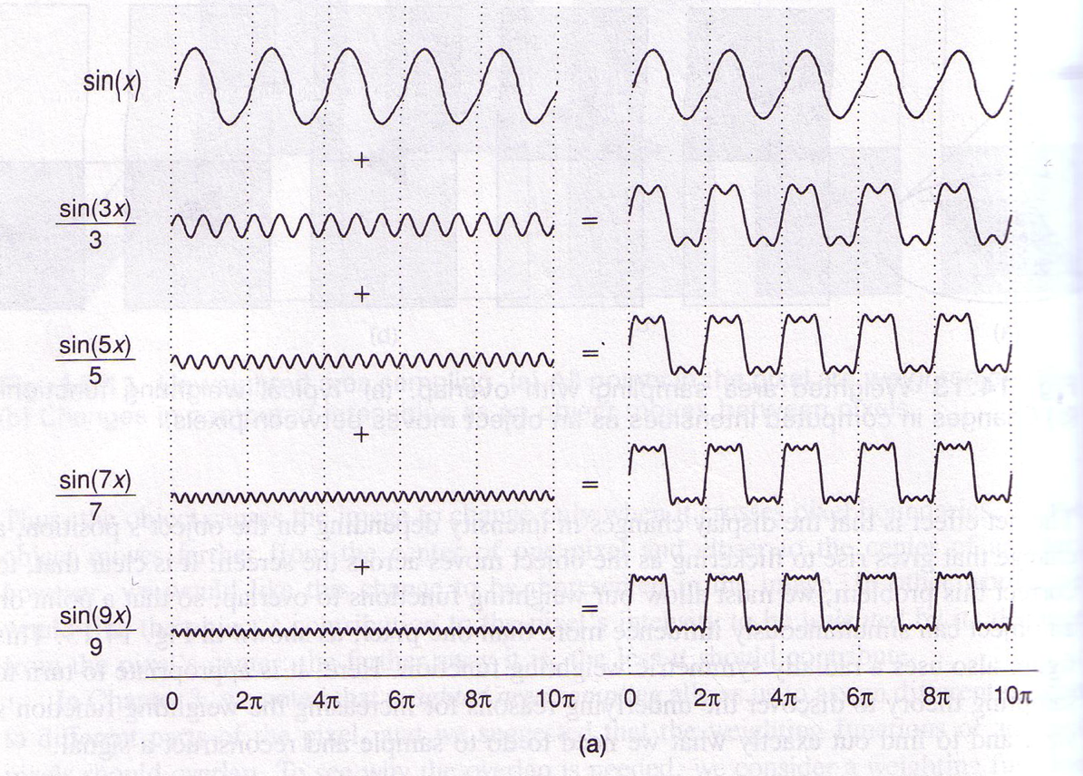
A box-like example

Slide 14
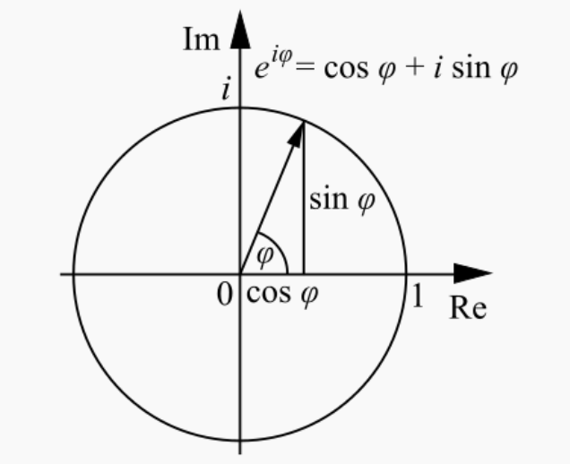

Fourier bases for 1D signals
Not exactly sines and cosines, but complex variants
Euler’s formula
$ν$ is the frequency
Period is $\frac{1}{ν}$

Slide 15
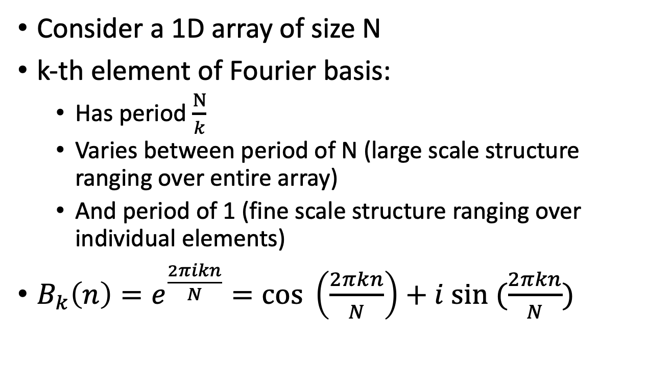
Fourier basis for 1D signals
Consider a 1D array of size N
k-th element of Fourier basis:
  Has period $\frac{N}{k}$
  Varies between period of N (large scale structure ranging over entire array)
  And period of 1 (fine scale structure ranging over individual elements)
$B_{k}\left(n\right)=e^{\frac{2πikn}{N}}=cos \left(\frac{2πkn}{N}\right)+i sin (\frac{2πkn}{N})$

Slide 16
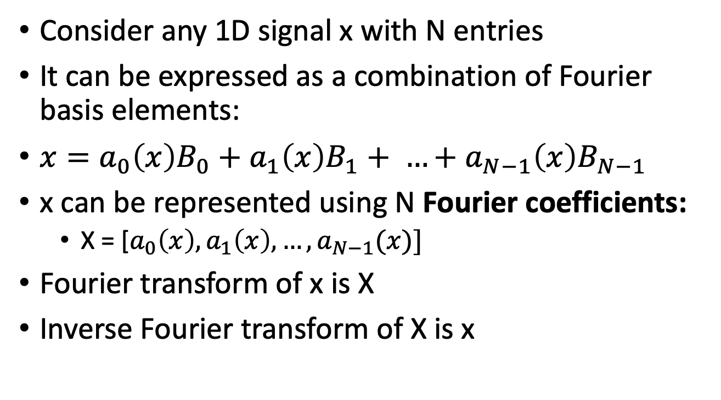
Fourier transform
Consider any 1D signal x with N entries
It can be expressed as a combination of Fourier basis elements:
$x=a_{0}\left(x\right)B_{0}+a_{1}\left(x\right)B_{1}+ …+a_{N−1}\left(x\right)B_{N−1}$
x can be represented using N Fourier coefficients:
  X = [$a_{0}\left(x\right), a_{1}\left(x\right), …, a_{N−1}(x)]$
Fourier transform of x is X
Inverse Fourier transform of X is x

Slide 17
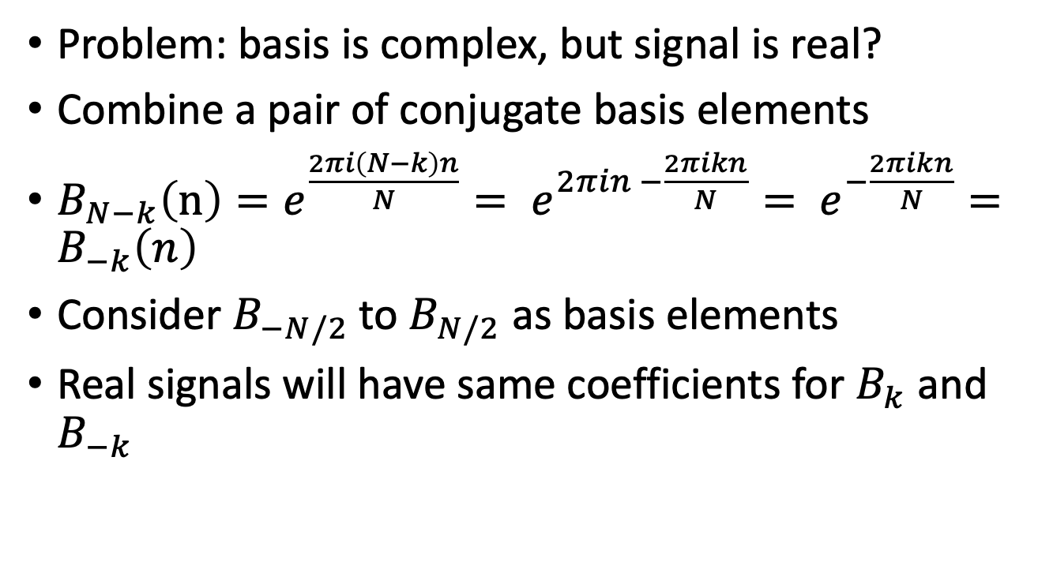
Fourier transform
Problem: basis is complex, but signal is real?
Combine a pair of conjugate basis elements
$B_{N−k}\left(n\right)=e^{\frac{2πi\left(N−k\right)n}{N}}= e^{2πin −\frac{2πikn}{N}}= e^{−\frac{2πikn}{N}}=B_{−k}\left(n\right)$
Consider $B_{−N/2}$to $B_{N/2}$ as basis elements
Real signals will have same coefficients for $B_{k}$ and $B_{−k}$

Slide 18
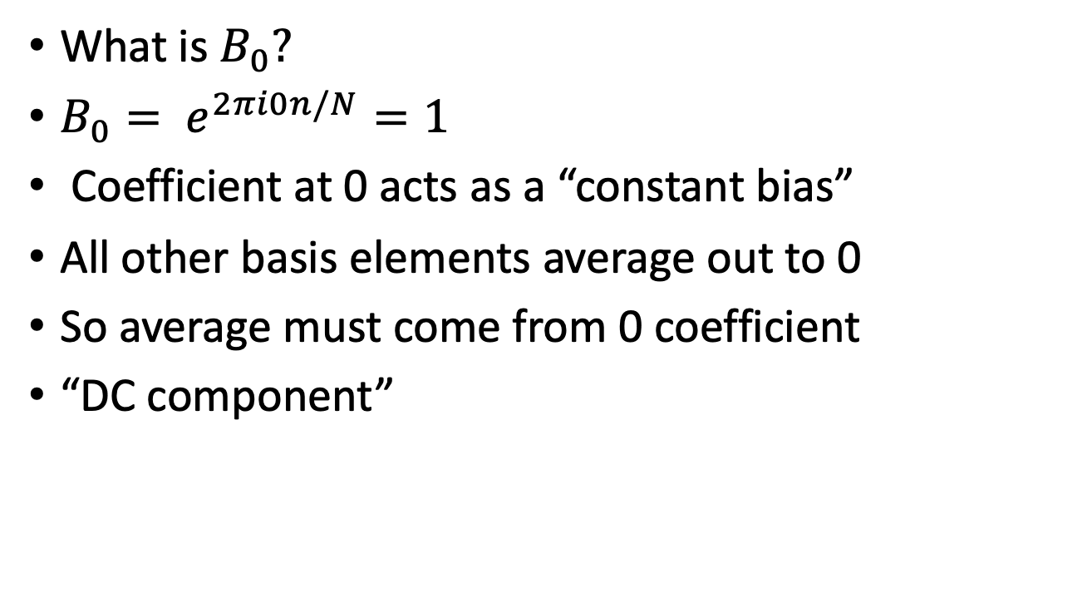
Fourier transform
What is $B_{0}?$
$B_{0}= e^{2πi0n/N}=1$
Coefficient at 0 acts as a “constant bias”
All other basis elements average out to 0
So average must come from 0 coefficient
“DC component”

