Slide 1
All about convolution

Slide 2
Last time: Convolution and cross-correlation
Cross correlation
Convolution

Slide 3
Cross correlation
0 | 10 | 5 | 7 | 0
5 | 11 | 6 | 8 | 3
9 | 22 | 4 | 5 | 1
2 | 9 | 14 | 6 | 7
3 | 10 | 15 | 12 | 9
 |  | 7
Local image data
Kernel size = 2k+1

Slide 4
Properties: Linearity

Slide 5
Properties: Linearity

Slide 6
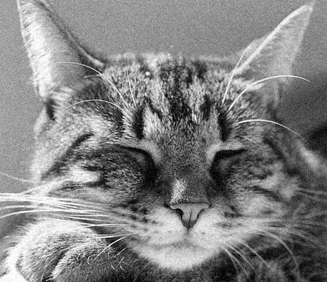
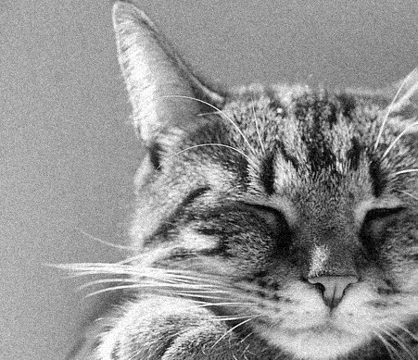
Shift equivariance
Shift, then convolve = convolve, then shift
Output of convolution does not depend on where the pixel is
f
f’

Slide 7
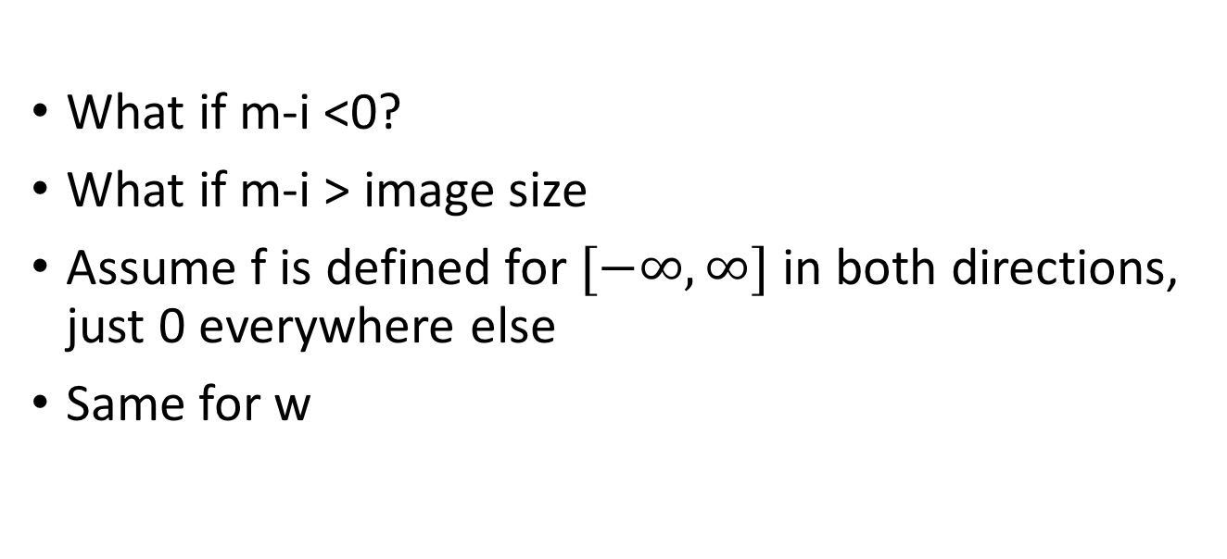
Boundary conditions
What if m-i <0?
What if m-i > image size
Assume f is defined for $[−∞,∞]$ in both directions, just 0 everywhere else
Same for w

Slide 8
Boundary conditions
90 | 0 | 0 | 0 | 0 | 0 | 0 | 0 | 0 | 0
0 | 0 | 0 | 10 | 10 | 10 | 0 | 0 | 0 | 0
0 | 0 | 10 | 20 | 20 | 20 | 10 | 40 | 0 | 0
0 | 10 | 20 | 30 | 0 | 20 | 10 | 0 | 0 | 0
0 | 10 | 0 | 30 | 40 | 30 | 20 | 10 | 0 | 0
0 | 10 | 20 | 30 | 40 | 30 | 20 | 10 | 0 | 0
0 | 10 | 20 | 10 | 40 | 30 | 20 | 10 | 0 | 0
0 | 10 | 20 | 30 | 30 | 20 | 10 | 0 | 0 | 0
0 | 0 | 10 | 20 | 20 | 0 | 10 | 0 | 20 | 0
0 | 0 | 0 | 10 | 10 | 10 | 0 | 0 | 0 | 0

Slide 9
Boundary conditions
90 | 0 | 0 | 0 | 0 | 0 | 0 | 0 | 0 | 0
0 | 0 | 0 | 10 | 10 | 10 | 0 | 0 | 0 | 0
0 | 0 | 10 | 20 | 20 | 20 | 10 | 40 | 0 | 0
0 | 10 | 20 | 30 | 0 | 20 | 10 | 0 | 0 | 0
0 | 10 | 0 | 30 | 40 | 30 | 20 | 10 | 0 | 0
0 | 10 | 20 | 30 | 40 | 30 | 20 | 10 | 0 | 0
0 | 10 | 20 | 10 | 40 | 30 | 20 | 10 | 0 | 0
0 | 10 | 20 | 30 | 30 | 20 | 10 | 0 | 0 | 0
0 | 0 | 10 | 20 | 20 | 0 | 10 | 0 | 20 | 0
0 | 0 | 0 | 10 | 10 | 10 | 0 | 0 | 0 | 0

Slide 10
Boundary conditions
90 | 0 | 0 | 0 | 0 | 0 | 0 | 0 | 0 | 0
0 | 0 | 0 | 10 | 10 | 10 | 0 | 0 | 0 | 0
0 | 0 | 10 | 20 | 20 | 20 | 10 | 40 | 0 | 0
0 | 10 | 20 | 30 | 0 | 20 | 10 | 0 | 0 | 0
0 | 10 | 0 | 30 | 40 | 30 | 20 | 10 | 0 | 0
0 | 10 | 20 | 30 | 40 | 30 | 20 | 10 | 0 | 0
0 | 10 | 20 | 10 | 40 | 30 | 20 | 10 | 0 | 0
0 | 10 | 20 | 30 | 30 | 20 | 10 | 0 | 0 | 0
0 | 0 | 10 | 20 | 20 | 0 | 10 | 0 | 20 | 0
0 | 0 | 0 | 10 | 10 | 10 | 0 | 0 | 0 | 0

Slide 11
Boundary conditions
90 | 0 | 0 | 0 | 0 | 0 | 0 | 0 | 0 | 0
0 | 0 | 0 | 10 | 10 | 10 | 0 | 0 | 0 | 0
0 | 0 | 10 | 20 | 20 | 20 | 10 | 40 | 0 | 0
0 | 10 | 20 | 30 | 0 | 20 | 10 | 0 | 0 | 0
0 | 10 | 0 | 30 | 40 | 30 | 20 | 10 | 0 | 0
0 | 10 | 20 | 30 | 40 | 30 | 20 | 10 | 0 | 0
0 | 10 | 20 | 10 | 40 | 30 | 20 | 10 | 0 | 0
0 | 10 | 20 | 30 | 30 | 20 | 10 | 0 | 0 | 0
0 | 0 | 10 | 20 | 20 | 0 | 10 | 0 | 20 | 0
0 | 0 | 0 | 10 | 10 | 10 | 0 | 0 | 0 | 0

Slide 12
Boundary conditions
90 | 0 | 0 | 0 | 0 | 0 | 0 | 0 | 0 | 0
0 | 0 | 0 | 10 | 10 | 10 | 0 | 0 | 0 | 0
0 | 0 | 10 | 20 | 20 | 20 | 10 | 40 | 0 | 0
0 | 10 | 20 | 30 | 0 | 20 | 10 | 0 | 0 | 0
0 | 10 | 0 | 30 | 40 | 30 | 20 | 10 | 0 | 0
0 | 10 | 20 | 30 | 40 | 30 | 20 | 10 | 0 | 0
0 | 10 | 20 | 10 | 40 | 30 | 20 | 10 | 0 | 0
0 | 10 | 20 | 30 | 30 | 20 | 10 | 0 | 0 | 0
0 | 0 | 10 | 20 | 20 | 0 | 10 | 0 | 20 | 0
0 | 0 | 0 | 10 | 10 | 10 | 0 | 0 | 0 | 0

Slide 13
Boundary conditions in practice
“Full convolution”: compute if any part of kernel intersects with image
requires padding
Output size = m+k-1
“Same convolution”: compute if center of kernel is in image
requires padding
output size = m
“Valid convolution”: compute only if all of kernel is in image
no padding
output size = m-k+1

Slide 14
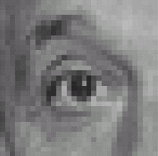
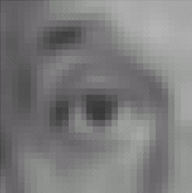

Filters: examples
*
1
1
1
=
1
1
1
1
1
1
Kernel (k)
Original (f)
Blur (with a mean filter) (g)
Source: D. Lowe

Slide 15
Filters: examples
*
0
0
0
=
0
1
0
0
0
0
Kernel (k)
Original (f)
Identical image (g)
Source: D. Lowe

Slide 16
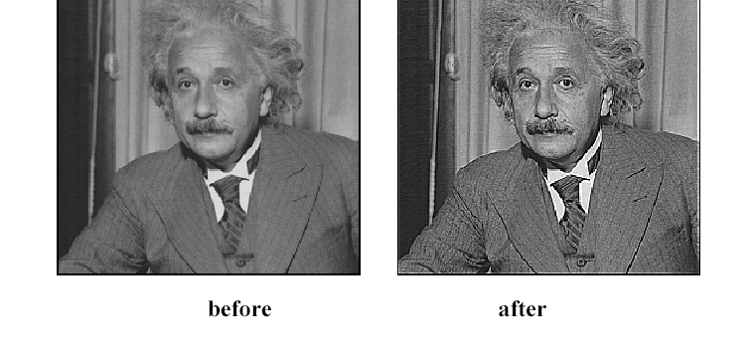
Sharpening
Source: D. Lowe

Slide 17
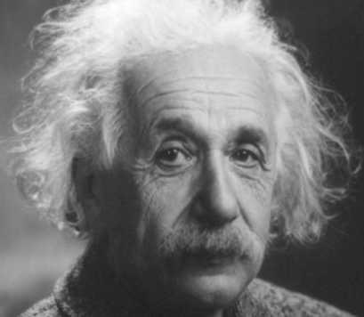
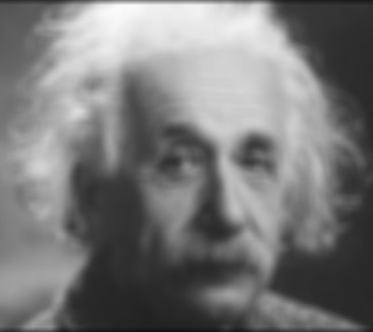
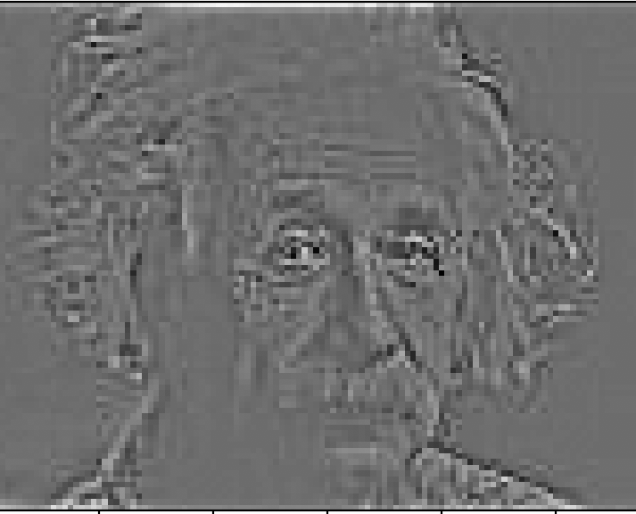
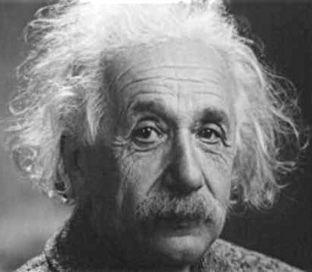
Sharpening
What does blurring take away?
–
=
Let’s add it back:
+ α
=
original
detail

Slide 18
Sharpening

Slide 19
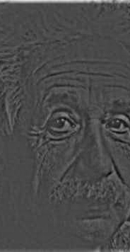
Sharpening
What does blurring take away?
–
=
Let’s add it back:
+ α
=
original
detail

Slide 20
Sharpening
0
0
0
1
1
1
0
1
0
1
1
1
0
0
0
1
1
1

Slide 21
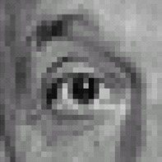



Sharpening filter
*
0
0
0
-
1
1
1
=
0
2
0
1
1
1
0
0
0
1
1
1
Sharpening filter (accentuates edges)
Original
Source: D. Lowe

Slide 22
Another example
-1 | -1 | -1 | -1 | -1 | -1 | -1 | -1 | -1 | -1 | -1
1 | -1 | -1 | -1 | -1 | -1 | -1 | -1 | -1 | -1 | -1
1 | 1 | -1 | -1 | -1 | -1 | -1 | -1 | -1 | -1 | -1
1 | 1 | 1 | -1 | -1 | -1 | -1 | -1 | -1 | -1 | -1
1 | 1 | 1 | 1 | -1 | -1 | -1 | -1 | -1 | -1 | -1
1 | 1 | 1 | 1 | 1 | -1 | -1 | -1 | -1 | -1 | -1
1 | 1 | 1 | 1 | 1 | 1 | -1 | -1 | -1 | -1 | -1
1 | 1 | 1 | 1 | 1 | 1 | 1 | -1 | -1 | -1 | -1
1 | 1 | 1 | 1 | 1 | 1 | 1 | 1 | -1 | -1 | -1
1 | 1 | 1 | 1 | 1 | 1 | 1 | 1 | 1 | -1 | -1
1 | 1 | 1 | 1 | 1 | 1 | 1 | 1 | 1 | 1 | -1

Slide 23
Another example

Slide 24
Another example

Slide 25
More properties of convolution

Slide 26
More properties of convolution
Convolution is linear
Convolution is shift-invariant
Convolution is commutative (w*f = f*w)
Convolution is associative ( v*(w*f) = (v*w)*f )
Every linear shift-invariant operation is a convolution

Slide 27
More convolution filters
1 | 1 | 1 | 1 | 1
1 | 1 | 1 | 1 | 1
1 | 1 | 1 | 1 | 1
1 | 1 | 1 | 1 | 1
1 | 1 | 1 | 1 | 1
Mean filter
But nearby pixels are more correlated than far-away pixels
Weigh nearby pixels more
1/25

Slide 28
Gaussian filter

Slide 29

Gaussian filter
0.003 | 0.013 | 0.022 | 0.013 | 0.003
0.013 | 0.060 | 0.098 | 0.060 | 0.013
0.022 | 0.098 | 0.162 | 0.098 | 0.022
0.013 | 0.060 | 0.098 | 0.060 | 0.013
0.003 | 0.013 | 0.022 | 0.013 | 0.003
Ignore factor in front, instead, normalize filter to sum to 1
5x5, $σ$=1

Slide 30

Gaussian filter
Ignore factor in front, instead, normalize filter to sum to 1
5x5, $σ$=1

Slide 31







Gaussian filter
21x21, $σ$=0.5
21x21, $σ$=1
21x21, $σ$=3

Slide 32


Difference of Gaussians
21x21, $σ$=3
21x21, $σ$=1

Slide 33
Time complexity of convolution
Image is w x h
Filter is k x k
Every entry takes O(k²) operations
Number of output entries:
(w+k-1)(h+k-1) for full
wh for same
Total time complexity:
O(whk²)

Slide 34
Optimization: separable filters
basic alg. is O(r²): large filters get expensive fast!
definition: w(x,y) is separable if it can be written as:
Write u as a k x 1 filter, and v as a 1 x k filter
Claim:

Slide 35
Separable filters
u₁
u₂
u₃
*
v₁ | v₂ | v₃
u₁
u₂
u₃
u₃
u₂
u₁
u₁v₁

Slide 36
Separable filters
u₁
u₂
u₃
*
v₁ | v₂ | v₃
u₁
u₂
u₃
u₃
u₂
u₁
u₁v₁ | u₁v₂

Slide 37
Separable filters
u₁
u₂
u₃
*
v₁ | v₂ | v₃
u₁
u₂
u₃
u₃
u₂
u₁
u₁v₁ | u₁v₂ | u₁v₃

Slide 38
Separable filters
u₁
u₂
u₃
*
v₁ | v₂ | v₃
u₁
u₂
u₃
u₃
u₂
u₁
u₁v₁ | u₁v₂ | u₁v₃
u₂v₁

Slide 39
Separable filters
u₁
u₂
u₃
*
v₁ | v₂ | v₃
u₁
u₂
u₃
u₃
u₂
u₁
u₁v₁ | u₁v₂ | u₁v₃
u₂v₁ | u₂v₂

Slide 40
Separable filters
u₁
u₂
u₃
*
v₁ | v₂ | v₃
u₁
u₂
u₃
u₃
u₂
u₁
u₁v₁ | u₁v₂ | u₁v₃
u₂v₁ | u₂v₂ | u₂v₃

Slide 41
Separable filters
u₁
u₂
u₃
*
v₁ | v₂ | v₃
u₁
u₂
u₃
u₃
u₂
u₁
u₁v₁ | u₁v₂ | u₁v₃
u₂v₁ | u₂v₂ | u₂v₃
u₃v₁

Slide 42
Separable filters
u₁
u₂
u₃
*
v₁ | v₂ | v₃
u₁
u₂
u₃
u₃
u₂
u₁
u₁v₁ | u₁v₂ | u₁v₃
u₂v₁ | u₂v₂ | u₂v₃
u₃v₁ | u₃v₂

Slide 43
Separable filters
u₁
u₂
u₃
*
v₁ | v₂ | v₃
w
u₁
u₂
u₃
u₃
u₂
u₁
u₁v₁ | u₁v₂ | u₁v₃
u₂v₁ | u₂v₂ | u₂v₃
u₃v₁ | u₃v₂ | u₃v₃

Slide 44
Separable filters
Time complexity of original : O(whk²)
Time complexity of separable version : O(whk)

Slide 45
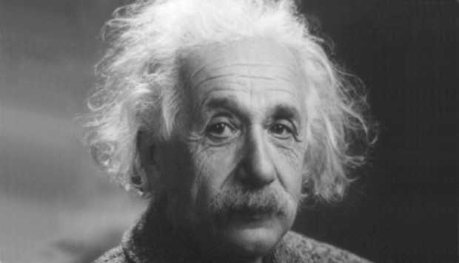
Images have structure at various scales

