Slide 1
Lecture 2: Image filtering

Slide 2
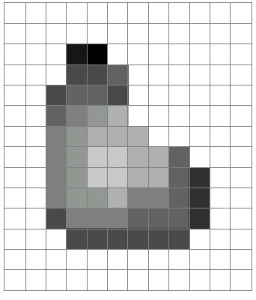
What is an image?
A grid (matrix) of intensity values
(common to use one byte per value: 0 = black, 255 = white)
255 | 255 | 255 | 255 | 255 | 255 | 255 | 255 | 255 | 255 | 255 | 255
255 | 255 | 255 | 255 | 255 | 255 | 255 | 255 | 255 | 255 | 255 | 255
255 | 255 | 255 | 20 | 0 | 255 | 255 | 255 | 255 | 255 | 255 | 255
255 | 255 | 255 | 75 | 75 | 75 | 255 | 255 | 255 | 255 | 255 | 255
255 | 255 | 75 | 95 | 95 | 75 | 255 | 255 | 255 | 255 | 255 | 255
255 | 255 | 96 | 127 | 145 | 175 | 255 | 255 | 255 | 255 | 255 | 255
255 | 255 | 127 | 145 | 175 | 175 | 175 | 255 | 255 | 255 | 255 | 255
255 | 255 | 127 | 145 | 200 | 200 | 175 | 175 | 95 | 255 | 255 | 255
255 | 255 | 127 | 145 | 200 | 200 | 175 | 175 | 95 | 47 | 255 | 255
255 | 255 | 127 | 145 | 145 | 175 | 127 | 127 | 95 | 47 | 255 | 255
255 | 255 | 74 | 127 | 127 | 127 | 95 | 95 | 95 | 47 | 255 | 255
255 | 255 | 255 | 74 | 74 | 74 | 74 | 74 | 74 | 255 | 255 | 255
255 | 255 | 255 | 255 | 255 | 255 | 255 | 255 | 255 | 255 | 255 | 255
255 | 255 | 255 | 255 | 255 | 255 | 255 | 255 | 255 | 255 | 255 | 255
=

Slide 3
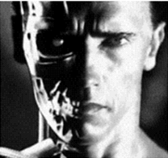
Images as functions
An image contains discrete numbers of pixels
Pixel value
grayscale/intensity
[0,255]
Color
RGB [R, G, B], where [0,255] per channel
Lab [L, a, b]: Lightness, a and b are color-opponent dimensions
HSV [H, S, V]: Hue, saturation, value

Slide 4
Images as functions
Can think of image as a function, f, from R² to R or R^{M}:
Grayscale: f (x,y) gives intensity at position (x,y)
f: [a,b] x [c,d] ➔[0,255]
Color: f (x,y) = [r(x,y), g(x,y), b(x,y)]

Slide 5
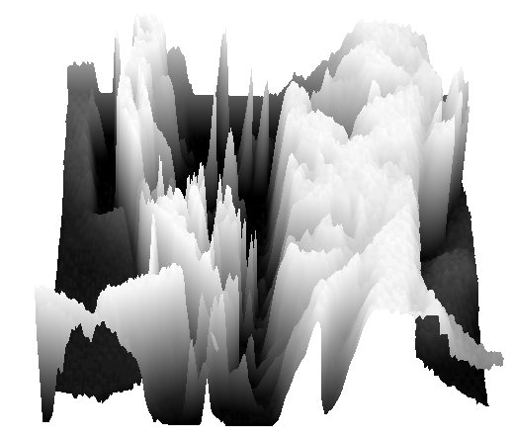
What is an image?
A digital image is a discrete (sampled, quantized) version of this function
f (x, y)
x
y

Slide 6
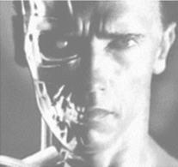
Image transformations
g (x,y) = f (x,y) + 20
g (x,y) = f (-x,y)

Slide 7
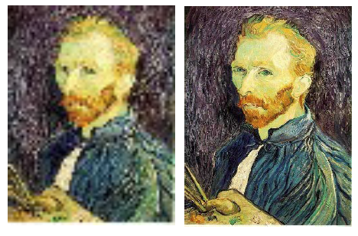
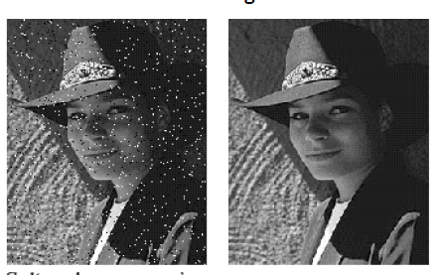
Super-resolution
Noise reduction

Slide 8
Image denoising

Slide 9
Why would images have noise?
Sensor noise
Sensors count photons: noise in count
Dead pixels
Old photographs
…

Slide 10

What is an image?
A grid (matrix) of intensity values: 1 color or 3 colors
(common to use one byte per value: 0 = black, 255 = white)
255 | 255 | 255 | 255 | 255 | 255 | 255 | 255 | 255 | 255 | 255 | 255
255 | 255 | 255 | 255 | 255 | 255 | 255 | 255 | 255 | 255 | 255 | 255
255 | 255 | 255 | 20 | 0 | 255 | 255 | 255 | 255 | 255 | 255 | 255
255 | 255 | 255 | 75 | 75 | 75 | 255 | 255 | 255 | 255 | 255 | 255
255 | 255 | 75 | 95 | 95 | 75 | 255 | 255 | 255 | 255 | 255 | 255
255 | 255 | 96 | 127 | 145 | 175 | 255 | 255 | 255 | 255 | 255 | 255
255 | 255 | 127 | 145 | 175 | 175 | 175 | 255 | 255 | 255 | 255 | 255
255 | 255 | 127 | 145 | 200 | 200 | 175 | 175 | 95 | 255 | 255 | 255
255 | 255 | 127 | 145 | 200 | 200 | 175 | 175 | 95 | 47 | 255 | 255
255 | 255 | 127 | 145 | 145 | 175 | 127 | 127 | 95 | 47 | 255 | 255
255 | 255 | 74 | 127 | 127 | 127 | 95 | 95 | 95 | 47 | 255 | 255
255 | 255 | 255 | 74 | 74 | 74 | 74 | 74 | 74 | 255 | 255 | 255
255 | 255 | 255 | 255 | 255 | 255 | 255 | 255 | 255 | 255 | 255 | 255
255 | 255 | 255 | 255 | 255 | 255 | 255 | 255 | 255 | 255 | 255 | 255
=

Slide 11
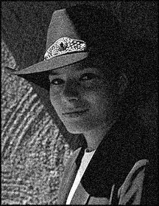
An assumption about noise
Let us assume noise at a pixel is
independent of other pixels
distributed according to a Gaussian distribution
i.e., low noise values are more likely than high noise values
“grainy images”

Slide 12
Noise reduction
Nearby pixels are likely to belong to same object
thus likely to have similar color
Replace each pixel by average of neighbors

Slide 13
Mean filtering
0 | 0 | 0 | 0 | 0 | 0 | 0 | 0 | 0 | 0
0 | 0 | 0 | 10 | 10 | 10 | 0 | 0 | 0 | 0
0 | 0 | 10 | 20 | 20 | 20 | 10 | 40 | 0 | 0
0 | 10 | 20 | 30 | 0 | 20 | 10 | 0 | 0 | 0
0 | 10 | 0 | 30 | 40 | 30 | 20 | 10 | 0 | 0
0 | 10 | 20 | 30 | 40 | 30 | 20 | 10 | 0 | 0
0 | 10 | 20 | 10 | 40 | 30 | 20 | 10 | 0 | 0
0 | 10 | 20 | 30 | 30 | 20 | 10 | 0 | 0 | 0
0 | 0 | 10 | 20 | 20 | 0 | 10 | 0 | 20 | 0
0 | 0 | 0 | 10 | 10 | 10 | 0 | 0 | 0 | 0
(0 + 0 + 0 + 10 + 40 + 0 + 10 + 0 + 0)/9 = 6.66

Slide 14
Mean filtering
0 | 0 | 0 | 0 | 0 | 0 | 0 | 0 | 0 | 0
0 | 0 | 0 | 10 | 10 | 10 | 0 | 0 | 0 | 0
0 | 0 | 10 | 20 | 20 | 20 | 10 | 40 | 0 | 0
0 | 10 | 20 | 30 | 0 | 20 | 10 | 0 | 0 | 0
0 | 10 | 0 | 30 | 40 | 30 | 20 | 10 | 0 | 0
0 | 10 | 20 | 30 | 40 | 30 | 20 | 10 | 0 | 0
0 | 10 | 20 | 10 | 40 | 30 | 20 | 10 | 0 | 0
0 | 10 | 20 | 30 | 30 | 20 | 10 | 0 | 0 | 0
0 | 0 | 10 | 20 | 20 | 0 | 10 | 0 | 20 | 0
0 | 0 | 0 | 10 | 10 | 10 | 0 | 0 | 0 | 0
(0 + 0 + 0 + 0 + 0 + 10 + 0 + 0 + 0 + 0 + 20 + 10 + 40 + 0 + 0 + 20 + 10 + 0 + 0 + 0 + 30 + 20 + 10 + 0 + 0)/25 = 6.8

Slide 15
Mean filtering
0 | 0 | 0 | 0 | 0 | 0 | 0 | 0 | 0 | 0
0 | 0 | 0 | 10 | 10 | 10 | 0 | 0 | 0 | 0
0 | 0 | 10 | 20 | 20 | 20 | 10 | 40 | 0 | 0
0 | 10 | 20 | 30 | 0 | 20 | 10 | 0 | 0 | 0
0 | 10 | 0 | 30 | 40 | 30 | 20 | 10 | 0 | 0
0 | 10 | 20 | 30 | 40 | 30 | 20 | 10 | 0 | 0
0 | 10 | 20 | 10 | 40 | 30 | 20 | 10 | 0 | 0
0 | 10 | 20 | 30 | 30 | 20 | 10 | 0 | 0 | 0
0 | 0 | 10 | 20 | 20 | 0 | 10 | 0 | 20 | 0
0 | 0 | 0 | 10 | 10 | 10 | 0 | 0 | 0 | 0
0 | 0 | 0 | 0 | 0 | 0 | 0 | 0 | 0 | 0
0 | 1 | 0 | 0 | 0 | 0 | 0 | 0 | 0 | 0
0 | 0 | 0 | 0 | 0 | 0 | 0 | 0 | 0 | 0
0 | 0 | 0 | 0 | 0 | 0 | 0 | 0 | 0 | 0
0 | 0 | 0 | 0 | 0 | 0 | 0 | 0 | 0 | 0
0 | 0 | 0 | 0 | 0 | 0 | 0 | 0 | 0 | 0
0 | 0 | 0 | 0 | 0 | 0 | 0 | 0 | 0 | 0
0 | 0 | 0 | 0 | 0 | 0 | 0 | 0 | 0 | 0
0 | 0 | 0 | 0 | 0 | 0 | 0 | 0 | 0 | 0
0 | 0 | 0 | 0 | 0 | 0 | 0 | 0 | 0 | 0
(0 + 0 + 0 + 0 + 0 + 0 + 0 + 0 + 10)/9 = 1.11

Slide 16
Mean filtering
0 | 0 | 0 | 0 | 0 | 0 | 0 | 0 | 0 | 0
0 | 0 | 0 | 10 | 10 | 10 | 0 | 0 | 0 | 0
0 | 0 | 10 | 20 | 20 | 20 | 10 | 40 | 0 | 0
0 | 10 | 20 | 30 | 0 | 20 | 10 | 0 | 0 | 0
0 | 10 | 0 | 30 | 40 | 30 | 20 | 10 | 0 | 0
0 | 10 | 20 | 30 | 40 | 30 | 20 | 10 | 0 | 0
0 | 10 | 20 | 10 | 40 | 30 | 20 | 10 | 0 | 0
0 | 10 | 20 | 30 | 30 | 20 | 10 | 0 | 0 | 0
0 | 0 | 10 | 20 | 20 | 0 | 10 | 0 | 20 | 0
0 | 0 | 0 | 10 | 10 | 10 | 0 | 0 | 0 | 0
0 | 0 | 0 | 0 | 0 | 0 | 0 | 0 | 0 | 0
0 | 1 | 4 | 0 | 0 | 0 | 0 | 0 | 0 | 0
0 | 0 | 0 | 0 | 0 | 0 | 0 | 0 | 0 | 0
0 | 0 | 0 | 0 | 0 | 0 | 0 | 0 | 0 | 0
0 | 0 | 0 | 0 | 0 | 0 | 0 | 0 | 0 | 0
0 | 0 | 0 | 0 | 0 | 0 | 0 | 0 | 0 | 0
0 | 0 | 0 | 0 | 0 | 0 | 0 | 0 | 0 | 0
0 | 0 | 0 | 0 | 0 | 0 | 0 | 0 | 0 | 0
0 | 0 | 0 | 0 | 0 | 0 | 0 | 0 | 0 | 0
0 | 0 | 0 | 0 | 0 | 0 | 0 | 0 | 0 | 0
(0 + 0 + 0 + 0 + 0 + 10 + 0 + 10 + 20)/9 = 4.44

Slide 17
Mean filtering
0 | 0 | 0 | 0 | 0 | 0 | 0 | 0 | 0 | 0
0 | 0 | 0 | 10 | 10 | 10 | 0 | 0 | 0 | 0
0 | 0 | 10 | 20 | 20 | 20 | 10 | 40 | 0 | 0
0 | 10 | 20 | 30 | 0 | 20 | 10 | 0 | 0 | 0
0 | 10 | 0 | 30 | 40 | 30 | 20 | 10 | 0 | 0
0 | 10 | 20 | 30 | 40 | 30 | 20 | 10 | 0 | 0
0 | 10 | 20 | 10 | 40 | 30 | 20 | 10 | 0 | 0
0 | 10 | 20 | 30 | 30 | 20 | 10 | 0 | 0 | 0
0 | 0 | 10 | 20 | 20 | 0 | 10 | 0 | 20 | 0
0 | 0 | 0 | 10 | 10 | 10 | 0 | 0 | 0 | 0
0 | 0 | 0 | 0 | 0 | 0 | 0 | 0 | 0 | 0
0 | 1 | 4 | 8 | 0 | 0 | 0 | 0 | 0 | 0
0 | 0 | 0 | 0 | 0 | 0 | 0 | 0 | 0 | 0
0 | 0 | 0 | 0 | 0 | 0 | 0 | 0 | 0 | 0
0 | 0 | 0 | 0 | 0 | 0 | 0 | 0 | 0 | 0
0 | 0 | 0 | 0 | 0 | 0 | 0 | 0 | 0 | 0
0 | 0 | 0 | 0 | 0 | 0 | 0 | 0 | 0 | 0
0 | 0 | 0 | 0 | 0 | 0 | 0 | 0 | 0 | 0
0 | 0 | 0 | 0 | 0 | 0 | 0 | 0 | 0 | 0
0 | 0 | 0 | 0 | 0 | 0 | 0 | 0 | 0 | 0
(0 + 0 + 0 + 0 + 10 + 10 + 10 + 20 + 20)/9 = 7.77

Slide 18
Mean filtering
0 | 0 | 0 | 0 | 0 | 0 | 0 | 0 | 0 | 0
0 | 0 | 0 | 10 | 10 | 10 | 0 | 0 | 0 | 0
0 | 0 | 10 | 20 | 20 | 20 | 10 | 40 | 0 | 0
0 | 10 | 20 | 30 | 0 | 20 | 10 | 0 | 0 | 0
0 | 10 | 0 | 30 | 40 | 30 | 20 | 10 | 0 | 0
0 | 10 | 20 | 30 | 40 | 30 | 20 | 10 | 0 | 0
0 | 10 | 20 | 10 | 40 | 30 | 20 | 10 | 0 | 0
0 | 10 | 20 | 30 | 30 | 20 | 10 | 0 | 0 | 0
0 | 0 | 10 | 20 | 20 | 0 | 10 | 0 | 20 | 0
0 | 0 | 0 | 10 | 10 | 10 | 0 | 0 | 0 | 0
0 | 0 | 0 | 0 | 0 | 0 | 0 | 0 | 0 | 0
0 | 1 | 4 | 8 | 10 | 8 | 9 | 6 | 4 | 0
0 | 4 | 11 | 13 | 16 | 11 | 12 | 7 | 4 | 0
0 | 6 | 14 | 19 | 23 | 19 | 18 | 10 | 6 | 0
0 | 8 | 18 | 23 | 28 | 23 | 17 | 8 | 2 | 0
0 | 8 | 16 | 26 | 31 | 30 | 20 | 10 | 3 | 0
0 | 10 | 18 | 27 | 29 | 27 | 17 | 8 | 2 | 0
0 | 8 | 14 | 22 | 22 | 20 | 11 | 8 | 3 | 0
0 | 4 | 11 | 17 | 17 | 12 | 6 | 4 | 2 | 0
0 | 0 | 0 | 0 | 0 | 0 | 0 | 0 | 0 | 0

Slide 19
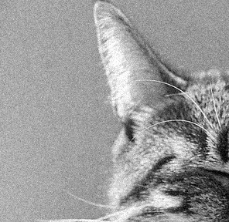
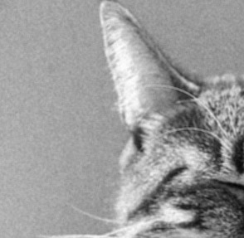
Noise reduction using mean filtering

Slide 20
Filters
Filtering
Form a new image whose pixels are a combination of the original pixels
Why?
To get useful information from images
E.g., extract edges or contours (to understand shape)
To enhance the image
E.g., to blur to remove noise
E.g., to sharpen to “enhance image” a la CSI

Slide 21
Mean filtering
Replace pixel by mean of neighborhood
10
5
3
4
5
1
4.1
1
1
7
Local image data
f
Modified image data
S[f]

Slide 22
A more general version
10
5
3
4
5
1
7
1
1
7
Local image data
Kernel / filter

Slide 23
A more general version
0 | 10 | 5 | 7 | 0
5 | 11 | 6 | 8 | 3
9 | 22 | 4 | 5 | 1
2 | 9 | 14 | 6 | 7
3 | 10 | 15 | 12 | 9
 |  | 7
Local image data
Kernel size = 2k+1

Slide 24
A more general version
w(i,j) = 1/(2k+1)² for mean filter
If w(i,j) >=0 and sum to 1, weighted mean
But w(i,j) can be arbitrary real numbers!

Slide 25
Properties: Linearity

Slide 26
Properties: Linearity

Slide 27
Properties: Linearity

Slide 28
Properties: Linearity

Slide 29
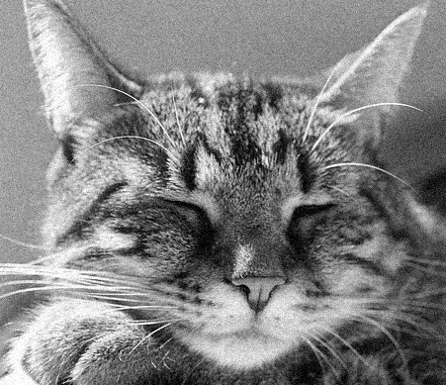
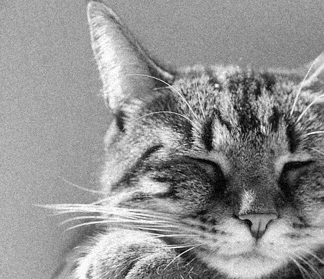
Properties: Shift invariance
f
f’

Slide 30
Shift invariance

Slide 31
Shift invariance
Shift, then convolve = convolve, then shift
Output of convolution does not depend on where the pixel is
f
f’

Slide 32
Convolution and cross-correlation
Cross correlation
Convolution

Slide 33
Cross-correlation
1 | 2 | 3
4 | 5 | 6
7 | 8 | 9
1 | 2 | 3
4 | 5 | 6
7 | 8 | 9
w
f
1*1 + 2*2 + 3*3 + 4*4 + 5*5 + 6*6 + 7*7 + 8*8 + 9*9

Slide 34
Convolution
1 | 2 | 3
4 | 5 | 6
7 | 8 | 9
1 | 2 | 3
4 | 5 | 6
7 | 8 | 9
w
f
1*9 + 2*8 + 3*7 + 4*6 + 5*5 + 6*4 + 7*3 + 8*2 + 9*1

Slide 35

Convolution
Adapted from F. Durand

Slide 36
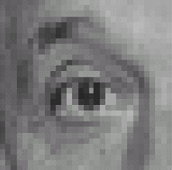
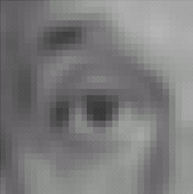

Filters: examples
*
1
1
1
=
1
1
1
1
1
1
Kernel (k)
Original (f)
Blur (with a mean filter) (g)
Source: D. Lowe

Slide 37
Filters: examples
*
0
0
0
=
0
1
0
0
0
0
Kernel (k)
Original (f)
Identical image (g)
Source: D. Lowe

Slide 38
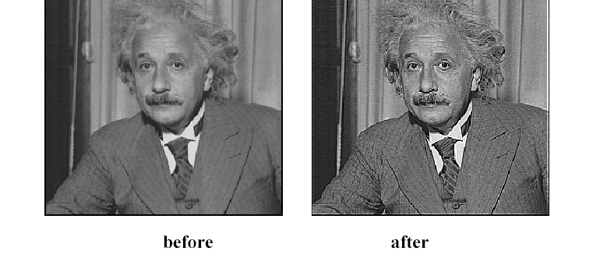
Sharpening
Source: D. Lowe

Slide 39
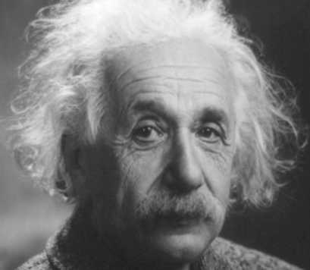
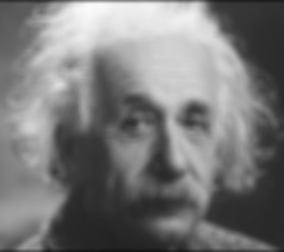
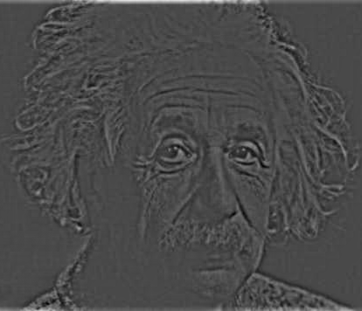
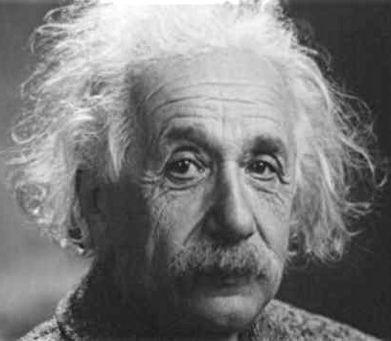
Sharpening
What does blurring take away?
–
=
Let’s add it back:
+ α
=
original
detail

Slide 40
Sharpening

Slide 41
Sharpening
What does blurring take away?
–
=
Let’s add it back:
+ α
=
original
detail

Slide 42
Sharpening
0
0
0
1
1
1
0
1
0
1
1
1
0
0
0
1
1
1

Slide 43
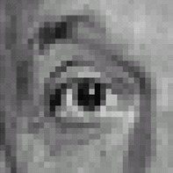



Sharpening filter
*
0
0
0
-
1
1
1
=
0
2
0
1
1
1
0
0
0
1
1
1
Sharpening filter (accentuates edges)
Original
Source: D. Lowe

Slide 44
Another example
-1 | -1 | -1 | -1 | -1 | -1 | -1 | -1 | -1 | -1 | -1
1 | -1 | -1 | -1 | -1 | -1 | -1 | -1 | -1 | -1 | -1
1 | 1 | -1 | -1 | -1 | -1 | -1 | -1 | -1 | -1 | -1
1 | 1 | 1 | -1 | -1 | -1 | -1 | -1 | -1 | -1 | -1
1 | 1 | 1 | 1 | -1 | -1 | -1 | -1 | -1 | -1 | -1
1 | 1 | 1 | 1 | 1 | -1 | -1 | -1 | -1 | -1 | -1
1 | 1 | 1 | 1 | 1 | 1 | -1 | -1 | -1 | -1 | -1
1 | 1 | 1 | 1 | 1 | 1 | 1 | -1 | -1 | -1 | -1
1 | 1 | 1 | 1 | 1 | 1 | 1 | 1 | -1 | -1 | -1
1 | 1 | 1 | 1 | 1 | 1 | 1 | 1 | 1 | -1 | -1
1 | 1 | 1 | 1 | 1 | 1 | 1 | 1 | 1 | 1 | -1

Slide 45
Another example

Slide 46
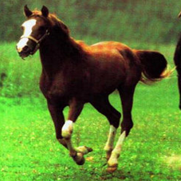
Convolution is everywhere
Horse

Slide 47


Why is convolution important?
Shift invariance is a crucial property

Slide 48
Why is convolution important?
We like linearity
Linear functions behave predictably when input changes
Lots of theory just easier with linear functions
All linear shift-invariant systems can be expressed as a convolution

Slide 49
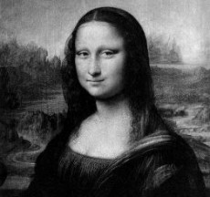
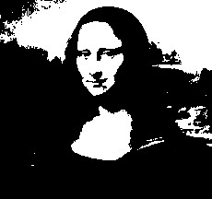

Non-linear filters: Thresholding

Slide 50
Non-linear filters: Rectification
g(m,n) = max(f(m,n), 0)
Crucial component of modern convolutional networks

Slide 51
Non-linear filters
Sometimes mean filtering does not work

Slide 52
Non-linear filters
Sometimes mean filtering does not work

Slide 53
Non-linear filters
Mean is sensitive to outliers
Median filter: Replace pixel by median of neighbors

Slide 54
Non-linear filters

Slide 55
Takeaway
Two general recipes:
convolution
cross-correlation
Properties
Shift-invariant: a sensible thing to require
Linearity: convenient
Can be used for smoothing, sharpening
Also main component of CNNs

Slide 56
Next up
Back to linear filters
Signal processing view of filtering
Filtering for detecting edges etc

Slide 57
Images as functions
An image contains discrete numbers of pixels
Pixel value
grayscale/intensity
[0,255]
Color
RGB [R, G, B], where [0,255] per channel

Slide 58
Images as functions
Can think of image as a function, f, from R² to R or R^{M}:
Grayscale: f (x,y) gives intensity at position (x,y)
f: [a,b] x [c,d] ➔[0,255]
Color: f (x,y) = [r(x,y), g(x,y), b(x,y)]
Most adjacent pixels are correlated => function is continuous

Slide 59
What is an image?
A digital image is a discrete (sampled, quantized) version of this function
f (x, y)
x
y

