Slide 1
Object detection

Slide 2
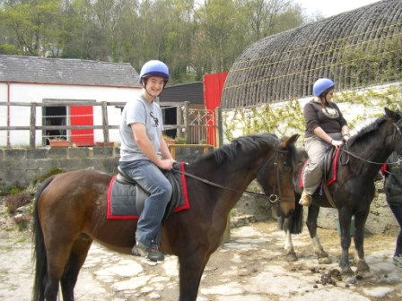
The Task
person 1
person 2
horse 1
horse 2

Slide 3
R-CNN: Regions with CNN features
Input
image
Extract region
proposals (~2k / image)
Compute CNN
features
Classify regions
(linear SVM)
Rich Feature Hierarchies for Accurate Object Detection and Semantic Segmentation R. Girshick, J. Donahue, T. Darrell, J. Malik IEEE Conference on Computer Vision and Pattern Recognition (CVPR), 2014
Slide credit : Ross Girshick
Notes:
Here’s a schematic of the system that we came up with.
Compared to previous state-of-the-art methods, R-CNN is relatively simple and does not rely on an ensemble of classifiers.
Let’s see how it works at test time.

Slide 4
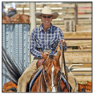
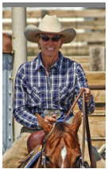
R-CNN at test time: Step 2
Input
image
Extract region
proposals (~2k / image)
Compute CNN
features
a. Crop
Slide credit : Ross Girshick
Notes:
Then, we crop out the region of interest...

Slide 5
R-CNN at test time: Step 2
Input
image
Extract region
proposals (~2k / image)
Compute CNN
features
227 x 227
a. Crop
b. Scale (anisotropic)
Slide credit : Ross Girshick
Notes:
...and scale it to a fixed size square so that it can be input into the CNN.

Slide 6
R-CNN at test time: Step 2
Input
image
Extract region
proposals (~2k / image)
Compute CNN
features
1. Crop
c. Forward propagate
Output: “fc7” features
b. Scale (anisotropic)
Slide credit : Ross Girshick
Notes:
We then forward propagate it through the network to produce a feature vector from the 7th layer, which we call fc7.

Slide 7
R-CNN at test time: Step 3
Input
image
Extract region
proposals (~2k / image)
Compute CNN
features
Classify
regions
person? 1.6
...
horse? -0.3
...
4096-dimensional
fc7 feature vector
linear classifiers
(SVM or softmax)
Warped proposal
Slide credit : Ross Girshick
Notes:
In step 3, we classify the region using a linear classifier on the four-thousand dimensional fc7 feature vectors.
We have one classifier per class that was trained to discriminate between well-localized instances of that class and poorly-localized instances.

Slide 8
Step 4: Object proposal refinement
Linear regression
on CNN features
Original
proposal
Predicted
object bounding box
Bounding-box regression
Slide credit : Ross Girshick
Notes:
Finally, we refine the original object proposals with a simple regression step.
We use a linear regressor on the CNN features to predict a new bounding box relative to the proposal.
This regression step improves localization and allows non-maximum suppression to be more effective.

Slide 9
R-CNN results on PASCAL
 | VOC 2007 | VOC 2010
DPM v5 (Girshick et al. 2011) | 33.7% | 29.6%
UVA sel. search (Uijlings et al. 2013) |  | 35.1%
Regionlets (Wang et al. 2013) | 41.7% | 39.7%
SegDPM (Fidler et al. 2013) |  | 40.4%
R-CNN | 54.2% | 50.2%
R-CNN + bbox regression | 58.5% | 53.7%
Reference systems
metric: mean average precision (higher is better)
Slide credit : Ross Girshick
Notes:
Now, let’s look at results on PASCAL in more detail.
First, here are reference systems including the most recently published top-performing methods.

Slide 10
R-CNN results on PASCAL
 | VOC 2007 | VOC 2010
DPM v5 (Girshick et al. 2011) | 33.7% | 29.6%
UVA sel. search (Uijlings et al. 2013) |  | 35.1%
Regionlets (Wang et al. 2013) | 41.7% | 39.7%
SegDPM (Fidler et al. 2013) |  | 40.4%
R-CNN | 54.2% | 50.2%
R-CNN + bbox regression | 58.5% | 53.7%
metric: mean average precision (higher is better)
Slide credit : Ross Girshick
Notes:
Here are our results using R-CNN.
R-CNN improves over the previous state-of-the-art by more than 30% relative and is the most dramatic improvement in object detection performance since the early years of the PASCAL challenge.

Slide 11
Training R-CNN
Train convolutional network on ImageNet classification
Finetune on detection
Classification problem!
Proposals with IoU > 50% are positives
Sample fixed proportion of positives in each batch because of imbalance
Notes:
Now let’s talk about how R-CNN is trained.
Unlike image classification, detection training data is relatively scarce.
One key insight in this work is that when the target task has too little training data, we can use supervised pre-training on a data-rich auxiliary task and transfer the learned representation to detection.

Slide 12
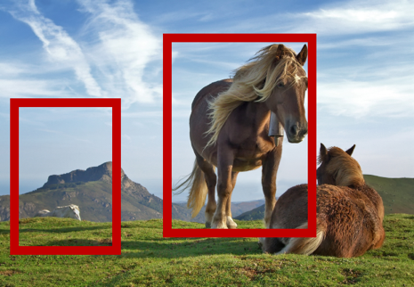
Speeding up R-CNN
CNN
CNN

Slide 13
Speeding up R-CNN
CNN

Slide 14
ROI Pooling
How do we crop from a feature map?
Step 1: Resize boxes to account for subsampling
Fast R-CNN. Ross Girshick. In ICCV 2015

Slide 15
ROI Pooling
How do we crop from a feature map?
Step 2: Snap to feature map grid

Slide 16
ROI Pooling
How do we crop from a feature map?
Step 3: Place a grid of fixed size

Slide 17
ROI Pooling
How do we crop from a feature map?
Step 4: Take max in each cell

Slide 18
Fast R-CNN
 | Fast R-CNN | R-CNN
Train time (h) | 9.5 | 84
Speedup | 8.8x | 1x
Test time / image | 0.32s | 47.0s
Speedup | 146x | 1x
mean AP | 66.9 | 66.0

Slide 19
Fast R-CNN
Bottleneck remaining (not included in time):
Object proposal generation
Slow
Requires segmentation
O(1s) per image

Slide 20
Faster R-CNN
Can we produce object proposals from convolutional networks?
A change in intuition
Instead of using grouping
Recognize likely objects?
For every possible box, score if it is likely to correspond to an object
Faster R-CNN: Towards Real-Time Object Detection with Region Proposal Networks. S. Ren, K. He, R. Girshick, J. Sun. In NIPS 2015.

Slide 21
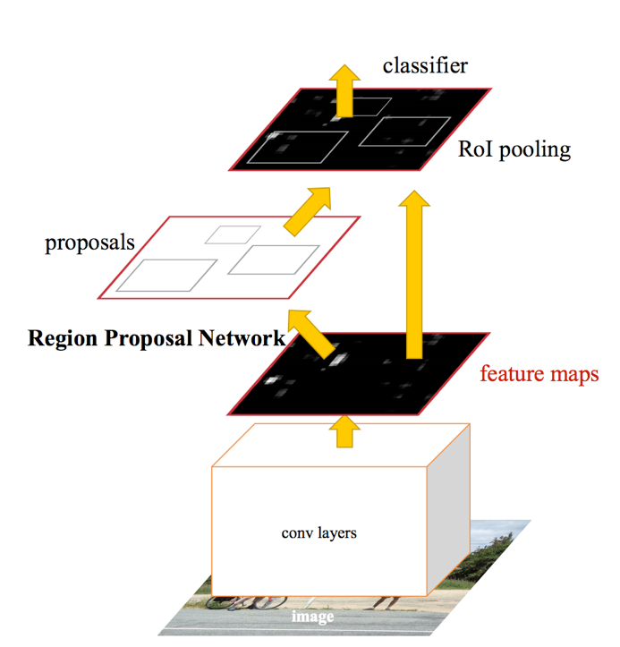
Faster R-CNN

Slide 22
Faster R-CNN
At each location, consider boxes of many different sizes and aspect ratios

Slide 23
Faster R-CNN
At each location, consider boxes of many different sizes and aspect ratios

Slide 24
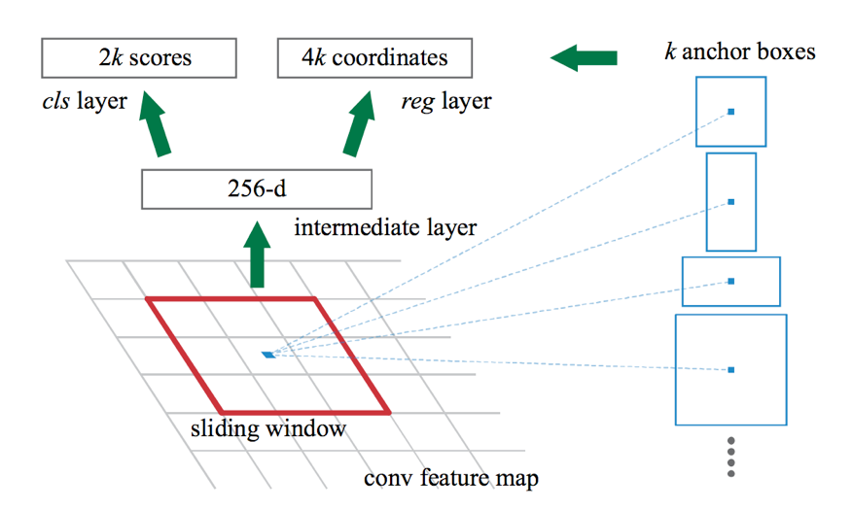
Faster R-CNN
At each location, consider boxes of many different sizes and aspect ratios

Slide 25
Faster R-CNN
s scales * a aspect ratios = sa anchor boxes
Use convolutional layer on top of filter map to produce sa scores
Pick top few boxes as proposals

Slide 26
Faster R-CNN
Method | mean AP (PASCAL VOC)
Fast R-CNN | 65.7
Faster R-CNN | 67.0

Slide 27
Impact of Feature Extractors
ConvNet | mean AP (PASCAL VOC)
VGG | 70.4
ResNet 101 | 73.8

Slide 28
Impact of Additional Data
Method | Training data | mean AP (PASCAL VOC 2012 Test)
Fast R-CNN | VOC 12 Train (10K) | 65.7
Fast R-CNN | VOC07 Trainval + VOC 12 Train | 68.4
Faster R-CNN | VOC 12 Train (10K) | 67.0
Faster R-CNN | VOC07 Trainval + VOC 12 Train | 70.4

Slide 29
The R-CNN family of detectors

Slide 30
Semantic Segmentation

Slide 31
The Task
person
grass
trees
motorbike
road

Slide 32
Evaluation metric
Pixel classification!
Accuracy?
Heavily unbalanced
Common classes are over-emphasized
Intersection over Union
Average across classes and images
Per-class accuracy
Compute accuracy for every class and then average

Slide 33
Things vs Stuff
THINGS
Person, cat, horse, etc
Constrained shape
Individual instances with separate identity
May need to look at objects
STUFF
Road, grass, sky etc
Amorphous, no shape
No notion of instances
Can be done at pixel level
“texture”

Slide 34
Challenges in data collection
Precise localization is hard to annotate
Annotating every pixel leads to heavy tails
Common solution: annotate few classes (often things), mark rest as “Other”
Common datasets: PASCAL VOC 2012 (~1500 images, 20 categories), COCO (~100k images, 20 categories)

Slide 35
Pre-convnet semantic segmentation
Things
Do object detection, then segment out detected objects
Stuff
”Texture classification”
Compute histograms of filter responses
Classify local image patches

Slide 36
Semantic segmentation using convolutional networks
w
3
h

Slide 37
Semantic segmentation using convolutional networks
c
w/4
h/4

Slide 38
Semantic segmentation using convolutional networks
c
w/4
h/4

Slide 39
Semantic segmentation using convolutional networks
c
w/4
Can be considered as a feature vector for a pixel
h/4

Slide 40
Semantic segmentation using convolutional networks
c
#classes
Convolve with #classes 1x1 filters
w/4
h/4

Slide 41
Semantic segmentation using convolutional networks
Pass image through convolution and subsampling layers
Final convolution with #classes outputs
Get scores for subsampled image
Upsample back to original size

Slide 42
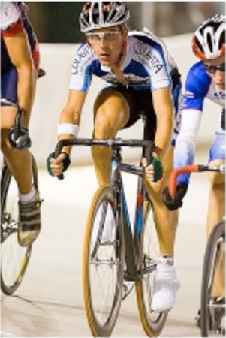
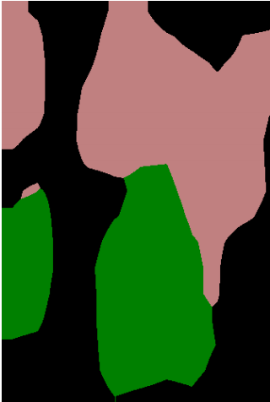
Semantic segmentation using convolutional networks
person
bicycle

Slide 43
The resolution issue
Problem: Need fine details!
Shallower network / earlier layers?
Deeper networks work better: more abstract concepts
Shallower network => Not very semantic!
Remove subsampling?
Subsampling allows later layers to capture larger and larger patterns
Without subsampling => Looks at only a small window!

Slide 44
Solution 1: Image pyramids
Higher resolution Less context
Small networks that maintain resolution
Learning Hierarchical Features for Scene Labeling. Clement Farabet, Camille Couprie, Laurent Najman, Yann LeCun. In TPAMI, 2013.

Slide 45
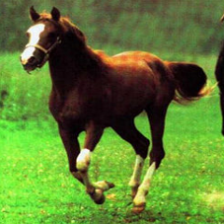
Solution 2: Skip connections
upsample
Compute class scores at multiple layers, then upsample and add

Slide 46
Solution 2: Skip connections
Red arrows indicate backpropagation

Slide 47
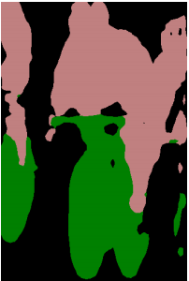
Skip connections
without skip
with skip
Fully convolutional networks for semantic segmentation. Evan Shelhamer, Jon Long, Trevor Darrell. In CVPR 2015

Slide 48
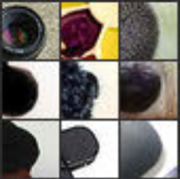
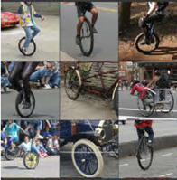
Skip connections
Problem: early layers not semantic
Horse
Visualizations from : M. Zeiler and R. Fergus. Visualizing and Understanding Convolutional Networks. In ECCV 2014.
Notes:
If you look at what one of these higher layers is detecting, here I am showing the input image patches that are highly scored by one of the units. This particular layer really likes bicycle wheels, so if this unit fires, you know that there is a bicycle wheel in the image. Unfortunately, you don’t know where the bicycle wheel is, because this unit doesn’t care where the bicycle wheel appears, or at what orientation or what scale.

Slide 49
Solution 3: Dilation
Need subsampling to allow convolutional layers to capture large regions with small filters
Can we do this without subsampling?

Slide 50
Solution 3: Dilation
Need subsampling to allow convolutional layers to capture large regions with small filters
Can we do this without subsampling?

Slide 51
Solution 3: Dilation
Need subsampling to allow convolutional layers to capture large regions with small filters
Can we do this without subsampling?

Slide 52
Solution 3: Dilation
Instead of subsampling by factor of 2: dilate by factor of 2
Dilation can be seen as:
Using a much larger filter, but with most entries set to 0
Taking a small filter and “exploding”/ “dilating” it
Not panacea: without subsampling, feature maps are much larger: memory issues

Slide 53
Putting it all together
Best Non-CNN approach: ~46.4%
Semantic Image Segmentation with Deep Convolutional Nets and Fully Connected CRFs. Liang-Chieh Chen, George Papandreou, Iasonas Kokkinos, Kevin Murphy, Alan Yuille. In ICLR, 2015.

Slide 54
Other additions
Method | mean IoU (%)
VGG16 + Skip + Dilation | 65.8
ResNet101 | 68.7
ResNet101 + Pyramid | 71.3
ResNet101 + Pyramid + COCO | 74.9
DeepLab: Semantic Image Segmentation with Deep Convolutional Nets, Atrous Convolution, and Fully Connected CRFs. Liang-Chieh Chen, George Papandreou, Iasonas Kokkinos, Kevin Murphy, Alan Yuille. Arxiv 2016.

Slide 55
Image-to-image translation problems

Slide 56
Image-to-image translation problems
Segmentation
Optical flow estimation
Depth estimation
Normal estimation
Boundary detection
…

