Slide 1
Image Classification

Slide 2
Convolutional networks - Why
Convolutions
  Reduce parameters
  Capture shift-invariance: location of patch in image should not matter
Subsampling
  Allows greater invariance to deformations
  Allows the capture of large patterns with small filters

Slide 3
How to do machine learning
Create training / validation sets
Identify loss functions
Choose hypothesis class
Find best hypothesis by minimizing training loss

Slide 4
How to do machine learning
Multiclass classification!!
Create training / validation sets
Identify loss functions
Choose hypothesis class
Find best hypothesis by minimizing training loss
Negative log likelihood for multiclass classification

Slide 5
Negative log likelihood for multiclass classification
Often represent label as a ``one-hot’’ vector y
  y = [0, 0, …, 1,… 0]
  y_{k} = 1 if label is k, 0 otherwise

Slide 6
Building a convolutional network
conv + relu + subsample
conv + relu + subsample
linear
10 classes
average pool
conv + relu + subsample

Slide 7
Building a convolutional network

Slide 8
Building a convolutional network
5x5 conv, no subsample
5x5 conv, subsample by 2
Linear
6
6
120
84
10
16
Linear(classifier)
Flatten+ Linear
5x5 conv, subsample by 2

Slide 9
Training the network
Overfitting

Slide 10


Controlling overfitting in convolutional networks
Reduce parameters?
Increase dataset size?
  Automatically by jittering examples - “Data augmentation”

Slide 11
Dropout
Without dropout
Train error: 0%
Test error: 1%
With dropout
Train error: 0.7%
Test error: 0.85%

Slide 12
Controlling overfitting in convolutional networks
Dropout: Internally create data augmentations
  Randomly zero out some fraction of values before a layer
  Can be thought of as per-layer data augmentation
  Typically applied on inputs to linear layers (since linear layers have tons of parameters)

Slide 13
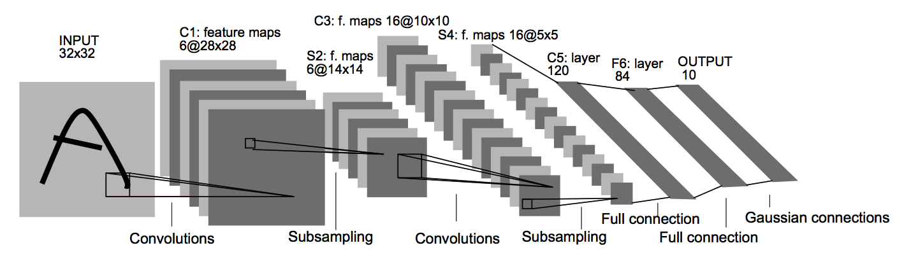
MNIST Classification
Method | Error rate (%)
Linear classifier over pixels | 12
Non-linear classifier over pixels | 1.41
Linear classifier over HOG | 1.44
Kernel SVM over HOG | 0.79
Convolutional Network | 0.95

Slide 14
ImageNet
1000 categories
~1000 instances per category
Olga Russakovsky*, Jia Deng*, Hao Su, Jonathan Krause, Sanjeev Satheesh, Sean Ma, Zhiheng Huang, Andrej Karpathy, Aditya Khosla, Michael Bernstein, Alexander C. Berg and Li Fei-Fei. (* = equal contribution) ImageNet Large Scale Visual Recognition Challenge. International Journal of Computer Vision, 2015.

Slide 15
ImageNet
Top-5 error: algorithm makes 5 predictions, true label must be in top 5
Useful for incomplete labelings

Slide 16
7-layer Convolutional Networks
19 layers
152 layers

Slide 17
Exploring convnet architectures

Slide 18
Deeper is better
7 layers
16 layers

Slide 19
Deeper is better
Alexnet
VGG16

Slide 20
The VGG pattern
Every convolution is 3x3, padded by 1
Every convolution followed by ReLU
ConvNet is divided into “stages”
  Layers within a stage: no subsampling
  Subsampling by 2 at the end of each stage
Layers within stage have same number of channels
Every subsampling → double the number of channels

Slide 21
Example network
5
5
10
10
20
20

Slide 22
Challenges in training: exploding / vanishing gradients
Vanishing / exploding gradients
  If each term is (much) greater than 1 → explosion of gradients
  If each term is (much) less than 1 → vanishing gradients

Slide 23
Residual connections
In general, gradients tend to vanish
Key idea: allow gradients to flow unimpeded

Slide 24
Residual connections
In general, gradients tend to vanish
Key idea: allow gradients to flow unimpeded

Slide 25
Residual block
Conv + ReLU
Conv+ReLU

Slide 26
Residual connections
Assumes all z_{i} have the same size
True within a stage
Across stages?
  Doubling of feature channels
  Subsampling
Increase channels by 1x1 convolution
Decrease spatial resolution by subsampling

Slide 27
The ResNet pattern
Decrease resolution substantially in first layer
  Reduces memory consumption due to intermediate outputs
Divide into stages
  maintain resolution, channels in each stage
  halve resolution, double channels between stages
Divide each stage into residual blocks
At the end, compute average value of each channel to feed linear classifier

Slide 28
Putting it all together - Residual networks

Slide 29
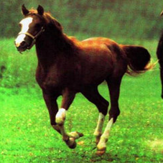
Transfer learning with convolutional networks
Linear classifier
Horse
Trained feature extractor

Slide 30
Transfer learning with convolutional networks
What do we do for a new image classification problem?
Key idea:
  Freeze parameters in feature extractor
  Retrain classifier
Linear classifier
Trained feature extractor

Slide 31
Transfer learning with convolutional networks
Dataset | Non-Convnet Method | Non-Convnet perf | Pretrained convnet + classifier | Improvement
Caltech 101 | MKL | 84.3 | 87.7 | +3.4
VOC 2007 | SIFT+FK | 61.7 | 79.7 | +18
CUB 200 | SIFT+FK | 18.8 | 61.0 | +42.2
Aircraft | SIFT+FK | 61.0 | 45.0 | -16
Cars | SIFT+FK | 59.2 | 36.5 | -22.7

Slide 32
Why transfer learning?
Availability of training data
Computational cost
Ability to pre-compute feature vectors and use for multiple tasks
Con: NO end-to-end learning

Slide 33
Finetuning
Horse

Slide 34
Finetuning
Bakery
Initialize with pre-trained, then train with low learning rate

Slide 35
Finetuning
Dataset | Non-Convnet Method | Non-Convnet perf | Pretrained convnet + classifier | Finetuned convnet | Improvement
Caltech 101 | MKL | 84.3 | 87.7 | 88.4 | +4.1
VOC 2007 | SIFT+FK | 61.7 | 79.7 | 82.4 | +20.7
CUB 200 | SIFT+FK | 18.8 | 61.0 | 70.4 | +51.6
Aircraft | SIFT+FK | 61.0 | 45.0 | 74.1 | +13.1
Cars | SIFT+FK | 59.2 | 36.5 | 79.8 | +20.6

Slide 36
Visualizing convolutional networks

Slide 37
Receptive field
Which input pixels does a particular unit in a feature map depends on
convolve with 3 x 3 filter

Slide 38
Receptive field
convolve with 3 x 3 filter
convolve with 3 x 3 filter
5x5 receptive field
3x3 receptive field

Slide 39
Receptive field
convolve with 3 x 3 filter, subsample

Slide 40
Receptive field
convolve with 3 x 3 filter, subsample by factor 2
convolve with 3 x 3 filter
7x7 receptive field: union of 9 3x3 fields with stride of 2
3x3 receptive field

Slide 41
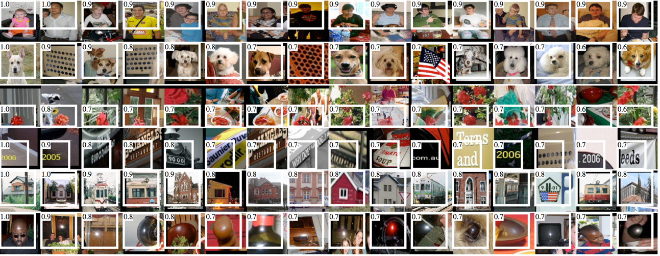
Visualizing convolutional networks
Take images for which a given unit in a feature map scores high
Identify the receptive field for each.
Rich feature hierarchies for accurate object detection and semantic segmentation. R. Girshick, J. Donahue, T. Darrell, J. Malik. In CVPR, 2014.

Slide 42
Visualizing convolutional networks II
Block regions of the image and classify
Visualizing and Understanding Convolutional Networks. M. Zeiler and R. Fergus. In ECCV 2014.

Slide 43
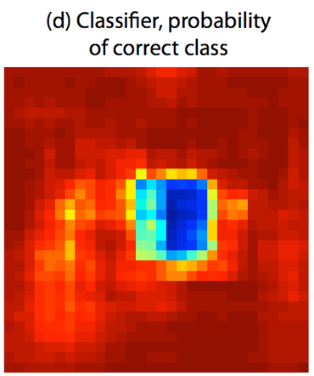
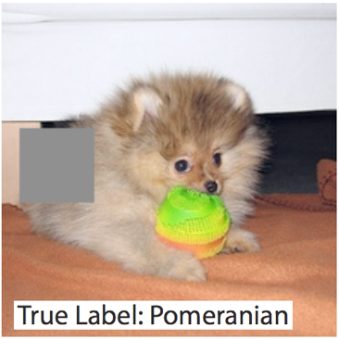
Visualizing convolutional networks II
Image pixels important for classification = pixels when blocked cause misclassification
Visualizing and Understanding Convolutional Networks. M. Zeiler and R. Fergus. In ECCV 2014.

