Slide 1
Backpropagation

Slide 2
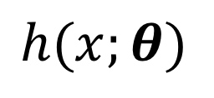

Why backpropagation
Neural networks are sequences of parametrized functions
x
$$h(x;θ)$$
conv
subsample
conv
subsample
linear
filters
filters
weights
Parameters
$$θ$$

Slide 3
Why backpropagation
Neural networks are sequences of parametrized functions
Parameters need to be set by minimizing some loss function
Convolutional network

Slide 4
Why backpropagation
Neural networks are sequences of parametrized functions
Parameters need to be set by minimizing some loss function
Minimization through gradient descent requires computing the gradient

Slide 5
Why backpropagation
Neural networks are sequences of parametrized functions
Parameters need to be set by minimizing some loss function
Minimization through gradient descent requires computing the gradient

Slide 6
Why backpropagation
Neural networks are sequences of parametrized functions
Parameters need to be set by minimizing some loss function
Minimization through gradient descent requires computing the gradient
Backpropagation: way to compute gradient

Slide 7
The gradient of convnets
z₁
z₂
z₃
z₄
z₅ = z
f₁
f₂
f₃
f₄
f₅
x
w₁
w₂
w₃
w₄
w₅

Slide 8
The gradient of convnets
z₁
z₂
z₃
z₄
z₅ = z
f₁
f₂
f₃
f₄
f₅
x
w₁
w₂
w₃
w₄
w₅

Slide 9
The gradient of convnets
z₁
z₂
z₃
z₄
z₅ = z
f₁
f₂
f₃
f₄
f₅
x
w₁
w₂
w₃
w₄
w₅

Slide 10
The gradient of convnets
z₁
z₂
z₃
z₄
z₅ = z
f₁
f₂
f₃
f₄
f₅
x
w₁
w₂
w₃
w₄
w₅

Slide 11
The gradient of convnets
z₁
z₂
z₃
z₄
z₅ = z
f₁
f₂
f₃
f₄
f₅
x
w₁
w₂
w₃
w₄
w₅

Slide 12
The gradient of convnets
z₁
z₂
z₃
z₄
z₅ = z
f₁
f₂
f₃
f₄
f₅
x
w₁
w₂
w₃
w₄
w₅

Slide 13
The gradient of convnets
z₁
z₂
z₃
z₄
z₅ = z
f₁
f₂
f₃
f₄
f₅
x
w₁
w₂
w₃
w₄
w₅
Recurrence going backward!!

Slide 14
The gradient of convnets
z₁
z₂
z₃
z₄
z₅ = z
f₁
f₂
f₃
f₄
f₅
x
w₁
w₂
w₃
w₄
w₅
Backpropagation

Slide 15
Backpropagation for a sequence of functions
Assume we can compute partial derivatives of each function
Use g(z_{i}) to store gradient of z w.r.t z_{i}, g(w_{i}) for w_{i}
Calculate g(z_{i} ) by iterating backwards
Use g(z_{i}) to compute gradient of parameters

Slide 16
Loss as a function
label
conv
subsample
conv
subsample
linear
loss
filters
filters
weights

Slide 17
Putting it all together: SGD training of ConvNets
Sample image and label
Image
label
conv
subsample
conv
subsample
linear
loss
filters
filters
weights

Slide 18
Putting it all together: SGD training of ConvNets
Sample image and label
Pass image through network to get loss (forward)
Image
label
conv
subsample
conv
subsample
linear
loss
filters
filters
weights

Slide 19
Putting it all together: SGD training of ConvNets
Sample image and label
Pass image through network to get loss (forward)
Backpropagate to get gradients (backward)
Image
label
conv
subsample
conv
subsample
linear
loss
filters
filters
weights

Slide 20
Putting it all together: SGD training of ConvNets
Sample image and label
Pass image through network to get loss (forward)
Backpropagate to get gradients (backward)
Take step along negative gradients to update weights
Image
label
conv
subsample
conv
subsample
linear
loss
filters
filters
weights

Slide 21
Putting it all together: SGD training of ConvNets
Sample image and label
Pass image through network to get loss (forward)
Backpropagate to get gradients (backward)
Take step along negative gradients to update weights
Repeat!
Image
label
conv
subsample
conv
subsample
linear
loss
filters
filters
weights

Slide 22
Beyond sequences: computation graphs
Arbitrary graphs of functions
No distinction between intermediate outputs and parameters
u
g
k
x
f
l
z
y
w
h

Slide 23
Computation graph - Functions
Each node implements two functions
  A “forward”
    Computes output given input
  A “backward”
    Computes derivative of z w.r.t input, given derivative of z w.r.t output

Slide 24
Computation graphs
a
f_{i}
b
d
c

Slide 25
Computation graphs
f_{i}

Slide 26
Computation graphs
a
f_{i}
b
d
c

Slide 27
Computation graphs
f_{i}

Slide 28




Neural network frameworks

Slide 29
Stochastic gradient descent
Noisy!

Slide 30
Momentum
Average multiple gradient steps
Use exponential averaging

Slide 31

Weight decay
Add $−αθ^{\left(t\right)}$to the gradient
Prevents $θ$from growing to infinity
Equivalent to L2 regularization of weights

Slide 32
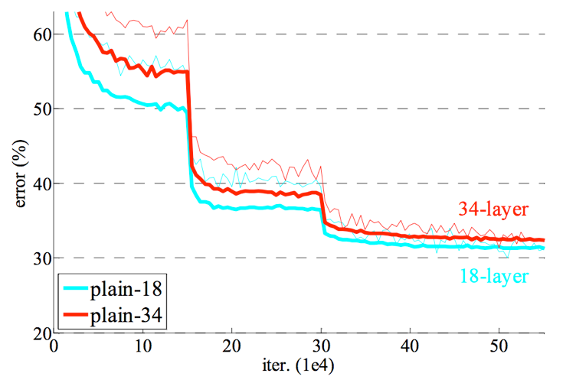
Learning rate decay
Large step size / learning rate
  Faster convergence initially
  Bouncing around at the end because of noisy gradients
Learning rate must be decreased over time
Usually done in steps

Slide 33
Convolutional network training
Initialize network
Sample minibatch of images
Forward pass to compute loss
Backpropagate loss to compute gradient
Combine gradient with momentum and weight decay
Take step according to current learning rate

Slide 34
Setting hyperparameters
How do we find a hyperparameter setting that works?
Try it!
  Train on train
  Test on test
Picking hyperparameters that work for test = Overfitting on test set
validation

Slide 35
Setting hyperparameters
Test on test
(Ideally only once)
Test on validation
Training iterations
Train
Validation
Test
Pick new hyperparameters

Slide 36
Vagaries of optimization
Non-convex
  Local optima
  Sensitivity to initialization
Vanishing / exploding gradients
  If each term is (much) greater than 1 → explosion of gradients
  If each term is (much) less than 1 → vanishing gradients

Slide 37
Image Classification

Slide 38
How to do machine learning
Create training / validation sets
Identify loss functions
Choose hypothesis class
Find best hypothesis by minimizing training loss

Slide 39
How to do machine learning
Multiclass classification!!
Create training / validation sets
Identify loss functions
Choose hypothesis class
Find best hypothesis by minimizing training loss

Slide 40
Building a convolutional network
conv + relu + subsample
conv + relu + subsample
linear
10 classes
average pool
conv + relu + subsample

Slide 41
Building a convolutional network

Slide 42
MNIST Classification
Method | Error rate (%)
Linear classifier over pixels | 12
Kernel SVM over HOG | 0.56
Convolutional Network | 0.8

Slide 43
ImageNet
1000 categories
~1000 instances per category
Olga Russakovsky*, Jia Deng*, Hao Su, Jonathan Krause, Sanjeev Satheesh, Sean Ma, Zhiheng Huang, Andrej Karpathy, Aditya Khosla, Michael Bernstein, Alexander C. Berg and Li Fei-Fei. (* = equal contribution) ImageNet Large Scale Visual Recognition Challenge. International Journal of Computer Vision, 2015.

Slide 44
ImageNet
Top-5 error: algorithm makes 5 predictions, true label must be in top 5
Useful for incomplete labelings

Slide 45
Convolutional Networks

