Slide 1
Non-linear classifiers
Neural networks

Slide 2
Linear classifiers on pixels are bad
Solution 1: Better feature vectors
Solution 2: Non-linear classifiers

Slide 3
A pipeline for recognition
Compute image gradients
Compute SIFT descriptors
Assign to k-means centers
Linear classifier
Compute histogram
Horse

Slide 4
Linear classifiers on pixels are bad
Solution 1: Better feature vectors
Solution 2: Non-linear classifiers

Slide 5
Non-linear classifiers
Suppose we have a feature vector for every image

Slide 6
Non-linear classifiers
Suppose we have a feature vector for every image
  Linear classifier

Slide 7
Non-linear classifiers
Suppose we have a feature vector for every image
  Linear classifier
  Nearest neighbor: assign each point the label of the nearest neighbor

Slide 8
Non-linear classifiers
Suppose we have a feature vector for every image
  Linear classifier
  Nearest neighbor: assign each point the label of the nearest neighbor
  Decision tree: series of if-then-else statements on different features

Slide 9
Non-linear classifiers
Suppose we have a feature vector for every image
  Linear classifier
  Nearest neighbor: assign each point the label of the nearest neighbor
  Decision tree: series of if-then-else statements on different features
  Neural networks / multi-layer perceptrons

Slide 10
A pipeline for recognition
Compute image gradients
Compute SIFT descriptors
Assign to k-means centers
Linear classifier
Compute histogram
Horse

Slide 11
Multilayer perceptrons
Key idea: build complex functions by composing simple functions
Caveat: simple functions must include non-linearities
W(U(Vx)) = (WUV)x
Let us start with only two ingredients:
  Linear: y = Wx + b
  Rectified linear unit (ReLU, also called half-wave rectification): y = max(x,0)

Slide 12
The linear function
y = Wx + b
Parameters: W,b
Input: x (column vector, or 1 data point per column)
Output: y (column vector or 1 data point per column)
Hyperparameters:
  Input dimension = # of rows in x
  Output dimension = # of rows in y
  W : outdim x indim
  b : outdim x 1

Slide 13
The linear function
y = Wx + b
Every row of y corresponds to a hyperplane in x space
=
d_{in}
d_{out}
The case when d_{in} = 2. A single row in y plotted for every possible value of x

Slide 14
Multilayer perceptrons
Key idea: build complex functions by composing simple functions
x
f(x) = Wx
g(x) = max(x,0)
f(x) = Wx
g(x) = max(x,0)
f(x) = Wx
y
z
1 row of z plotted for every value of x
1 row of y plotted for every value of x

Slide 15
Multilayer perceptron on images
An example network for cat vs dog
Linear + ReLU
Linear + ReLU
Linear + sigmoid
Reshape
256
65K
p(dog | image)
256
32
1024

Slide 16
The linear function
y = Wx + b
How many parameters does a linear function have?
=
d_{in}
d_{out}
The case when d_{in} = 2. A single row in y plotted for every possible value of x

Slide 17
The linear function for images
W
1024
65K
65K

Slide 18
Reducing parameter count
W

Slide 19
Reducing parameter count

Slide 20
Idea 1: local connectivity
Pixels only related to nearby pixels

Slide 21
Idea 2: Translation invariance
Pixels only related to nearby pixels
Weights should not depend on the location of the neighborhood

Slide 22
Linear function + translation invariance = convolution
Local connectivity determines kernel size
5.4 | 0.1 | 3.6
1.8 | 2.3 | 4.5
1.1 | 3.4 | 7.2

Slide 23
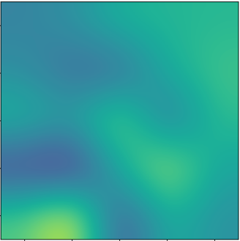
Linear function + translation invariance = convolution
Local connectivity determines kernel size
Feature map
5.4 | 0.1 | 3.6
1.8 | 2.3 | 4.5
1.1 | 3.4 | 7.2

Slide 24
Convolution with multiple filters
Feature map
5.4 | 0.1 | 3.6
1.8 | 2.3 | 4.5
1.1 | 3.4 | 7.2

Slide 25
Convolution over multiple channels
*
+
*
*
=
+
*

Slide 26
Convolution as a primitive
c
c
c’
c’
Convolution
h
h
w
w

Slide 27
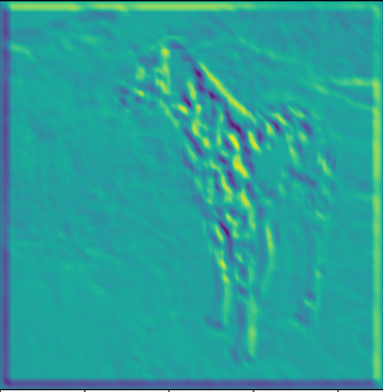

Convolution as a feature detector
score at (x,y) = dot product (filter, image patch at (x,y))
Response represents similarity between filter and image patch

Slide 28
Kernel sizes and padding
k
k

Slide 29
Kernel sizes and padding
Valid convolution decreases size by (k-1)/2 on each side
Pad by (k-1)/2!
k
Valid convolution
k
(k-1)/2

Slide 30
The convolution unit
Each convolutional unit takes a collection of feature maps as input, and produces a collection of feature maps as output
Parameters: Filters (+bias)
If c_{in} input feature maps and c_{out} output feature maps
  Each filter is k x k x c_{in}
  There are c_{out} such filters
Other hyperparameters: padding

Slide 31
Invariance to distortions

Slide 32
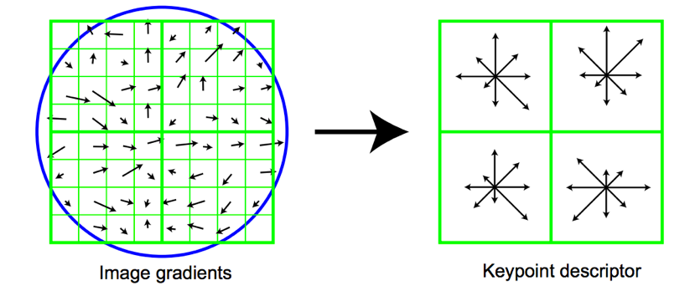
Invariance to distortions

Slide 33
Invariance to distortions

Slide 34
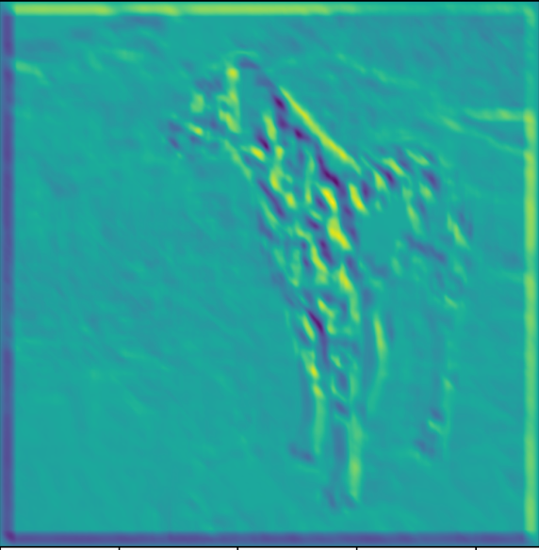
Invariance to distortions: Pooling
…

Slide 35
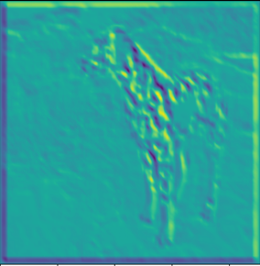
Invariance to distortions: Subsampling

Slide 36
Convolution subsampling convolution

Slide 37
Convolution subsampling convolution
Convolution in earlier steps detects more local patterns less resilient to distortion
Convolution in later steps detects more global patterns more resilient to distortion
Subsampling allows capture of larger, more invariant patterns

Slide 38
Strided convolution
Convolution with stride s = standard convolution + subsampling by picking 1 value every s values
Example: convolution with stride 2 = standard convolution + subsampling by a factor of 2

Slide 39
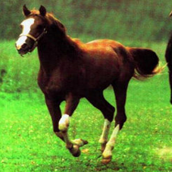
Convolutional networks
Horse

Slide 40
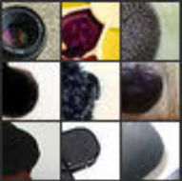
Convolutional networks
Horse
Visualizations from : M. Zeiler and R. Fergus. Visualizing and Understanding Convolutional Networks. In ECCV 2014.
Notes:
In contrast, if you look at the earlier layers, this particular unit here really likes a dark blob at a very precise location and scale in its field of view. If this unit fired, you will know exactly where the dark blob was. Unfortunately, this unit doesn’t care about the actual semantics of the dark blob: you will have no idea what the dark blob actually is.

Slide 41
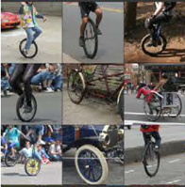
Convolutional networks
Horse
Visualizations from : M. Zeiler and R. Fergus. Visualizing and Understanding Convolutional Networks. In ECCV 2014.
Notes:
If you look at what one of these higher layers is detecting, here I am showing the input image patches that are highly scored by one of the units. This particular layer really likes bicycle wheels, so if this unit fires, you know that there is a bicycle wheel in the image. Unfortunately, you don’t know where the bicycle wheel is, because this unit doesn’t care where the bicycle wheel appears, or at what orientation or what scale.

Slide 42
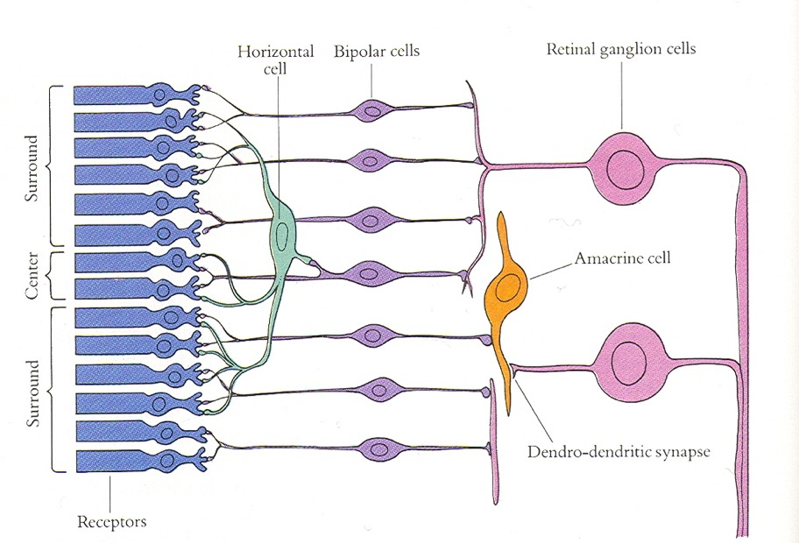
Convolutional Networks and the Brain
Slide credit: Jitendra Malik

Slide 43
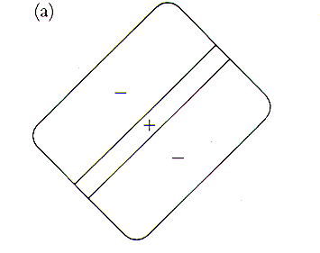
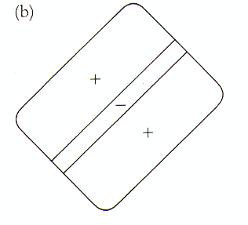
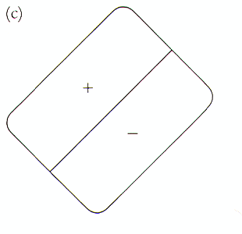
Receptive fields of simple cells
(discovered by Hubel & Wiesel)
Slide credit: Jitendra Malik

Slide 44
Convolutional networks
Yann LeCun, Léon Bottou, Yoshua Bengio, and Patrick Haffner. Gradient-based learning applied to document recognition. Proceedings of the IEEE 86.11 (1998): 2278-2324.

Slide 45
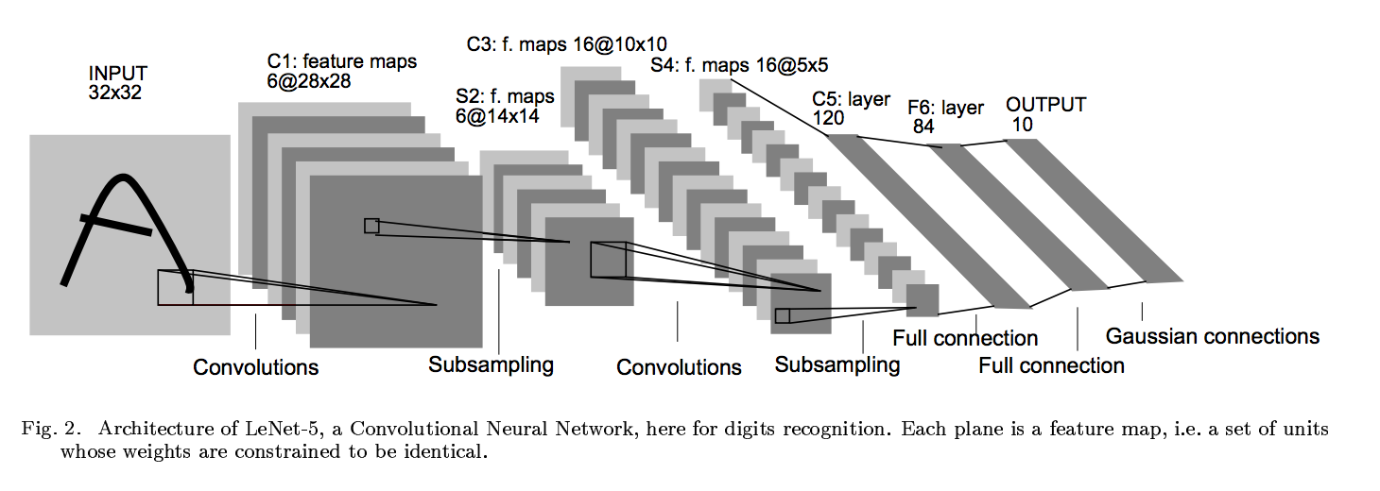
Convolutional networks

Slide 46
Convolutional networks
conv
subsample
conv
subsample
linear
filters
filters
weights

