Slide 2
General recipe
Logistic Regression!
Fix hypothesis class
Define loss function
Minimize average loss on the training set using SGD

Slide 3
Risk
Given:
Distribution over (x,y) pairs
A hypothesis from hypothesis class H
Loss function L
We are interested in Expected Risk:
Given training set S, and a particular hypothesis h, Empirical Risk:

Slide 4
Generalization
Training error
Generalization error

Slide 5
Controlling generalization error
How do we know we are overfitting?
Use a held-out “validation set”
To be an unbiased sample, must be completely unseen

Slide 6
Controlling generalization error
Variance of empirical risk inversely proportional to size of S
Choose very large S!
Larger the hypothesis class H, Higher the chance of hitting bad hypotheses with low training error and high generalization error
Choose small H!
For many models, can bound generalization error using some property of parameters
Regularize during optimization!
Eg. L2 regularization

Slide 7
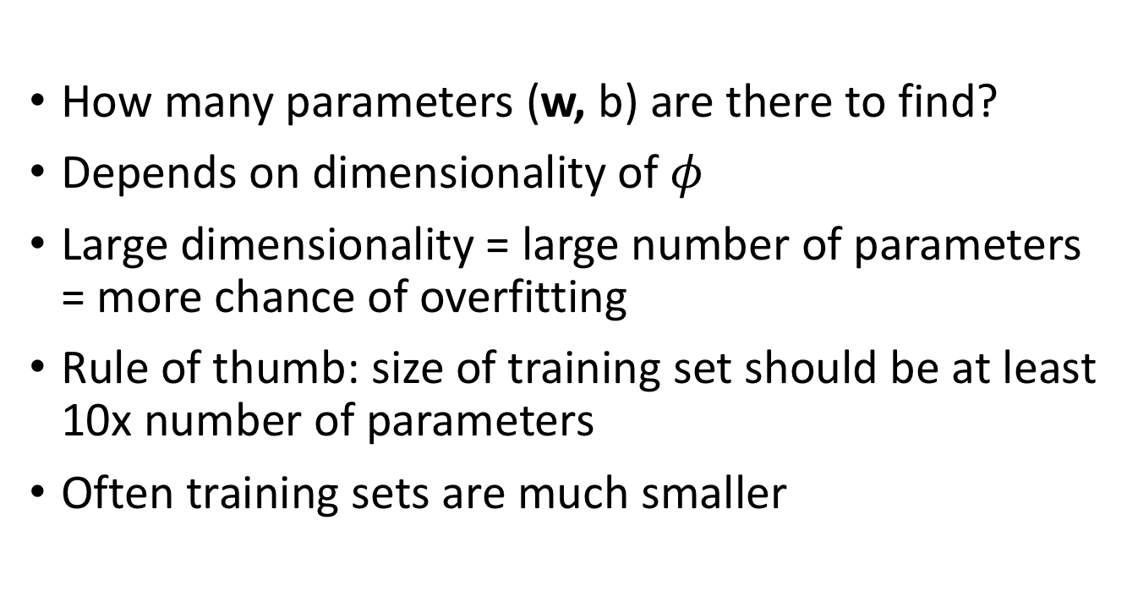
Controlling the size of the hypothesis class
How many parameters (w, b) are there to find?
Depends on dimensionality of $φ$
Large dimensionality = large number of parameters = more chance of overfitting
Rule of thumb: size of training set should be at least 10x number of parameters
Often training sets are much smaller

Slide 8
Regularization
Old objective
New objective
Why does this help?

Slide 9
Regularization
Ensures classifier does not weigh any one feature too highly
Makes sure classifier scores vary slowly when image changes
Prevents “crazy hypotheses” that are unlikely

Slide 10
Generalization error and priors
Regularization can be thought of as introducing prior knowledge into the model
L2-regularization: model output varies slowly as image changes
Biases the training to consider some hypotheses more than others
What if bias is wrong?

Slide 11
Bias and variance
Two things characterize a learning algorithm
Variance
How sensitive is the algorithm to the training set?
High variance = learnt model varies a lot depending on training set
High variance = overfitting, i.e., high generalization error
Bias
How much prior knowledge has been put in?
If prior knowledge is wrong, model learnt will not be able to achieve low loss (favors bad hypotheses in general)
High bias = underfitting, i.e., high training error

Slide 12
Bias and variance
Test error
Training error
High variance = overfitting
High bias = underfitting
Decreasing regularization →

Slide 13
Putting it all together
Want model with least expected risk = expected loss
But expected risk hard to evaluate
Empirical Risk Minimization: minimize empirical risk in training set
Might end up picking special case: overfitting
Avoid overfitting by:
Constructing large training sets
Reducing size of model class
Regularization

Slide 14
Putting it all together
Collect training set and validation set
Pick hypothesis class
Pick loss function
Minimize empirical risk (+ regularization)
Measure performance on held-out validation set
Profit!

Slide 15
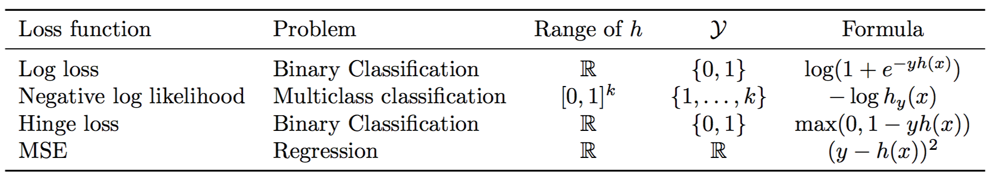
Loss functions and hypothesis classes

Slide 16

Back to images
What should $φ$ be?
Simplest solution: string 2D image intensity values into vector

Slide 17
Linear classifiers on pixels are bad
Solution 1: Better feature vectors
Solution 2: Non-linear classifiers

Slide 18
Better feature vectors
These must have different feature vectors: discriminability
These must have similar feature vectors: invariance

Slide 19
SIFT
Match pattern of edges
Edge orientation – clue to shape
Be resilient to small deformations
Deformations might move pixels around, but slightly
Deformations might change edge orientations, but slightly

Slide 20
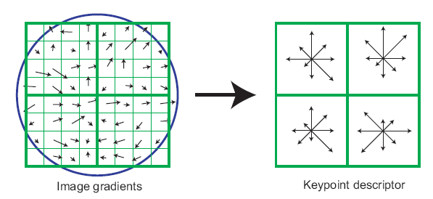
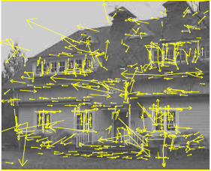
The SIFT descriptor
SIFT – Lowe IJCV 2004
Notes:
Do scale-space invariant feature detection using DoG.

Slide 21
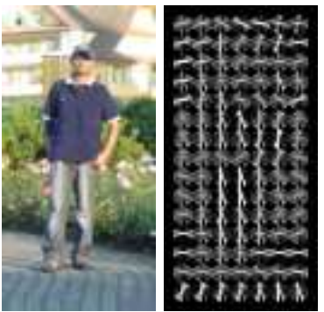
Same but different: HOG
Histogram of oriented gradients
Same as SIFT but without orientation normalization. Why?

Slide 22
Invariance to large deformations

Slide 23
Invariance to large deformations
Large deformations can cause objects / object parts to move a lot (much more than single grid cell)
Yet, object parts themselves have precise appearance
Idea: want to represent the image as a “bag of object parts”

Slide 24
Bags of words
Last night I dreamt I went to Manderley again. It seemed to me I stood by the iron gate leading to the drive, and for a while I could not enter, for the way was barred to me. There was a padlock and a chain upon the gate. I called in my dream to the lodge-keeper, and had no answer, and peering closer through the rusted spokes of the gate I saw that the lodge was uninhabited….
dream
night
drive
locked
gate
lodge
uninhabited

Slide 25
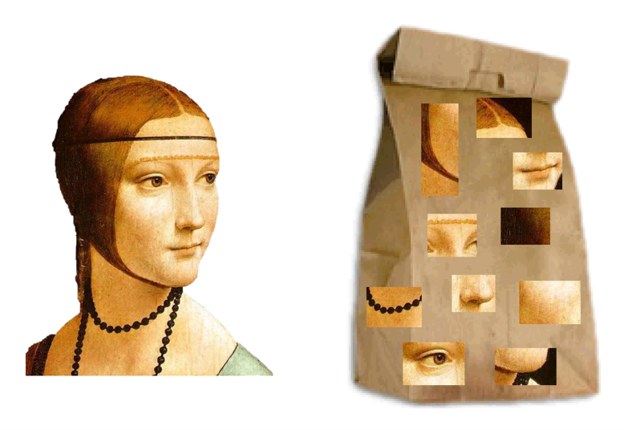
Bags of visual words

Slide 26
What should be visual words?
A word is a sequence of letters that commonly occurs
cthn is not a word, cotton is
Typically such a sequence of letters means something
Visual words are image patches that frequently occur
How do we get these visual words?

Slide 27
What should be visual words?
“Image patches that occur frequently”
..but obviously under small variations of color and deformations
Each occurrence of image patch is slightly different

Slide 28
What should be visual words?
Consider representing each image patch with SIFT descriptors
Consider plotting them out in feature space

Slide 29
What should be visual words?
Consider plotting SIFT feature vectors and clustering them using k-means
Each k-means center is a visual word

Slide 30
Identifying the words in an image
Given a new patch, we can assign it to the closest center

Slide 31
Identifying the words in an image
Given an image, take every patch and assign it to the closest k-means center
Each k-means center is a “word”
34
14
23
23

Slide 32
Identifying the words in an image
Given an image, take every patch and assign it to the closest k-means center
Each k-means center is a “word”
34 | 14 | 23 | 23 | 34
34 | 19 | 7 | 8 | 34
34 | 56 | 7 | 24 | 56
45 | 13 | 98 | 45 | 38
7 | 7 | 34 | 77 | 29

Slide 33
Encoding images as bag of words
Densely extract image patches from image
Compute SIFT vector for each patch
Assign each patch to a visual word
Compute histogram of occurrence

Slide 34
Too much invariance?
Object parts appear in somewhat fixed relationships

Slide 35
Idea: Spatial pyramids
Divide the image into four parts
Compute separate histogram in each part
Concatenate into a single feature vector

Slide 36
A pipeline for recognition
Compute image gradients
Compute SIFT descriptors
Assign to k-means centers
Linear classifier
Compute histogram
Horse

Slide 37
Linear classifiers on pixels are bad
Solution 1: Better feature vectors
Solution 2: Non-linear classifiers

Slide 38
Non-linear classifiers
Suppose we have a feature vector for every image

Slide 39
Non-linear classifiers
Suppose we have a feature vector for every image
Linear classifier

Slide 40
Non-linear classifiers
Suppose we have a feature vector for every image
Linear classifier
Nearest neighbor: assign each point the label of the nearest neighbor

Slide 41
Non-linear classifiers
Suppose we have a feature vector for every image
Linear classifier
Nearest neighbor: assign each point the label of the nearest neighbor
Decision tree: series of if-then-else statements on different features

Slide 42
Non-linear classifiers
Suppose we have a feature vector for every image
Linear classifier
Nearest neighbor: assign each point the label of the nearest neighbor
Decision tree: series of if-then-else statements on different features
Neural networks

