Slide 1
Recognition - III

Slide 2
General recipe
Logistic Regression!
Fix hypothesis class
Define loss function
Minimize total loss on the training set
Equivalent to minimizing the average loss

Slide 3
Machine learning is optimization

Slide 4
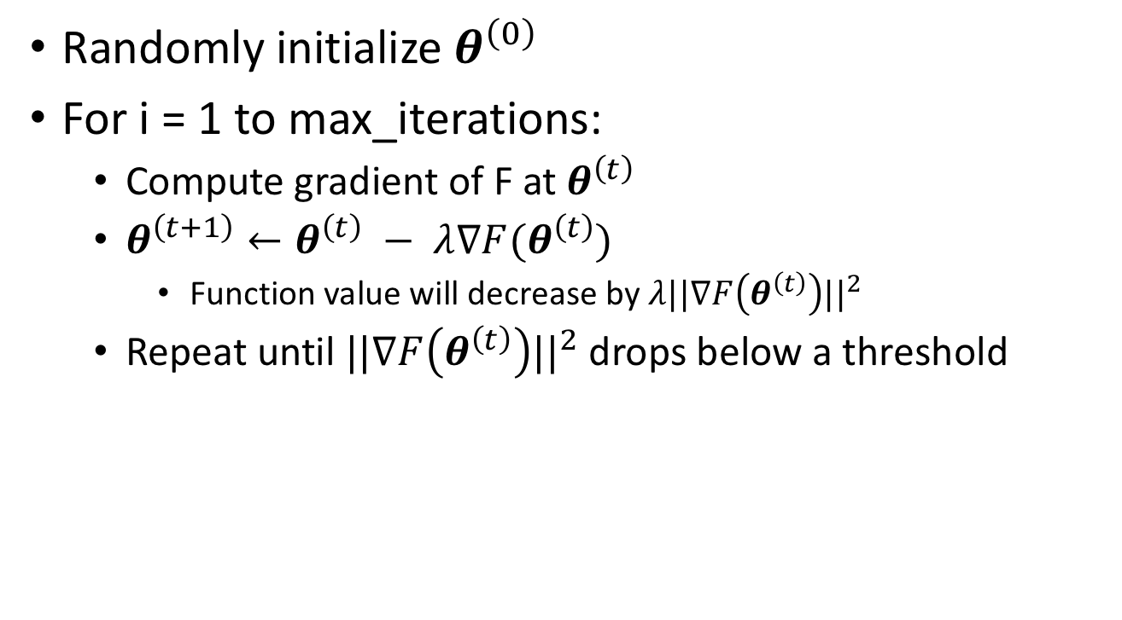
Optimization using gradient descent
Randomly initialize $θ^{\left(0\right)}$
For i = 1 to max_iterations:
  Compute gradient of F at $θ^{\left(t\right)}$
  $θ^{\left(t+1\right)}←θ^{\left(t\right)} − λ∇F(θ^{\left(t\right)})$
    Function value will decrease by $λ||∇F\left(θ^{\left(t\right)}\right)||^{2}$
  Repeat until $||∇F\left(θ^{\left(t\right)}\right)||^{2}$ drops below a threshold

Slide 5
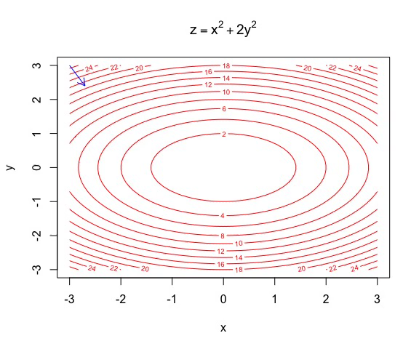
Gradient descent
https://yihui.name/animation/example/grad-desc/

Slide 6
Gradient descent - convergence
Every step leads to a reduction in the function value
If function is bounded below, we will eventually stop
But will we stop at the right “global minimum”?
  Not necessarily: local optimum!
Local min
Global min

Slide 7
Gradient descent in machine learning
Computing the gradient requires a loop over all training examples
Very expensive for large datasets

Slide 8
Stochastic gradient descent
Randomly sample small subset of examples
Compute gradient on small subset
  Unbiased estimate of true gradient
Take step along estimated gradient

Slide 9
General recipe
Logistic Regression!
Fix hypothesis class
Define loss function
Minimize average loss on the training set using SGD

Slide 10
General recipe
Fix hypothesis class
Define loss function
Minimize average loss on the training set using SGD
Why should this work?

Slide 11
Why should this work?
Let us look at the objective more carefully
We are minimizing average loss on the training set
Is this what we actually care about?

Slide 12
Risk
Given:
  Distribution over (x,y) pairs
  A hypothesis from hypothesis class H
  Loss function L
We are interested in Expected Risk:
Given training set S, and a particular hypothesis h, Empirical Risk:

Slide 13
Risk
Left: true quantity of interest, right: estimate
How good is this estimate?
If h is randomly chosen, actually a pretty good estimate!
  In statistics-speak, it is an unbiased estimator : correct in expectation

Slide 14
Risk
Empirical risk unbiased estimate of expected risk
Want to minimize expected risk
Idea: Minimize empirical risk instead
This is the Empirical Risk Minimization Principle

Slide 15
Overfitting
For randomly chosen h, empirical risk (training error) good estimate of expected risk
But we are choosing h by minimizing training error
Empirical risk of chosen hypothesis no longer unbiased estimate:
  We chose hypothesis based on S
  Might have chosen h for which S is a special case
Overfitting:
  Minimize training error, but generalization error increases

Slide 16
Overfitting = fitting the noise
Minimizer of empirical risk
Minimizer of expected risk
True distribution
Sampled training set

Slide 17
Generalization
Training error
Generalization error

Slide 18
Controlling generalization error
How do we know we are overfitting?
  Use a held-out “validation set”
  To be an unbiased sample, must be completely unseen

Slide 19
Controlling generalization error
Variance of empirical risk inversely proportional to size of S
  Choose very large S!
Larger the hypothesis class H, Higher the chance of hitting bad hypotheses with low training error and high generalization error
  Choose small H!
For many models, can bound generalization error using some property of parameters
  Regularize during optimization!
  Eg. L2 regularization

Slide 20
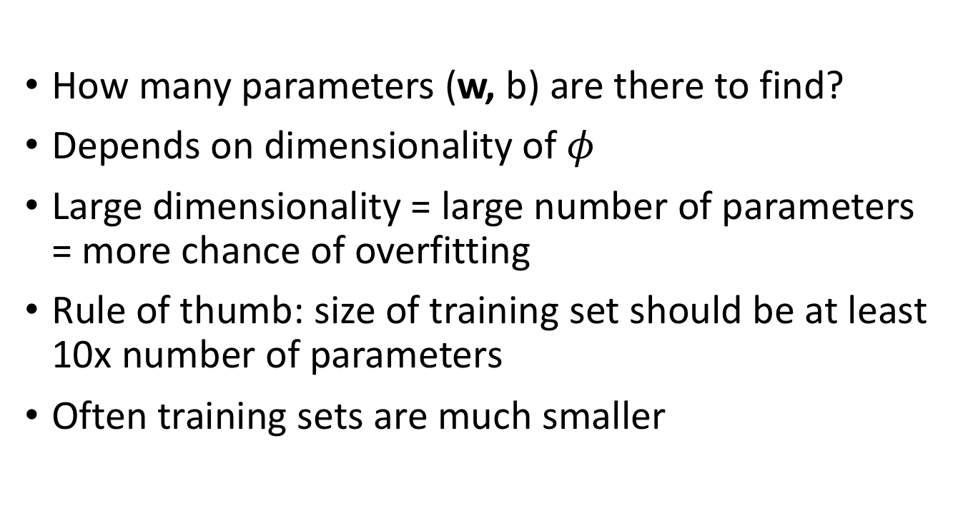
Controlling the size of the hypothesis class
How many parameters (w, b) are there to find?
Depends on dimensionality of $φ$
Large dimensionality = large number of parameters = more chance of overfitting
Rule of thumb: size of training set should be at least 10x number of parameters
Often training sets are much smaller

Slide 21
Regularization
Old objective
New objective
Why does this help?

Slide 22
Regularization
Ensures classifier does not weigh any one feature too highly
Makes sure classifier scores vary slowly when image changes
Prevents “crazy hypotheses” that are unlikely

Slide 23
Generalization error and priors
Regularization can be thought of as introducing prior knowledge into the model
  L2-regularization: model output varies slowly as image changes
  Biases the training to consider some hypotheses more than others
What if bias is wrong?

Slide 24
Bias and variance
Two things characterize a learning algorithm
Variance
  How sensitive is the algorithm to the training set?
  High variance = learnt model varies a lot depending on training set
  High variance = overfitting, i.e., high generalization error
Bias
  How much prior knowledge has been put in?
  If prior knowledge is wrong, model learnt will not be able to achieve low loss (favors bad hypotheses in general)
  High bias = underfitting, i.e., high training error

Slide 25
Bias and variance
Test error
Training error
High variance = overfitting
High bias = underfitting
Decreasing regularization →

Slide 26
Putting it all together
Want model with least expected risk = expected loss
But expected risk hard to evaluate
Empirical Risk Minimization: minimize empirical risk in training set
Might end up picking special case: overfitting
Avoid overfitting by:
  Constructing large training sets
  Reducing size of model class
  Regularization

Slide 27
Putting it all together
Collect training set and validation set
Pick hypothesis class
Pick loss function
Minimize empirical risk (+ regularization)
Measure performance on held-out validation set
Profit!

Slide 28
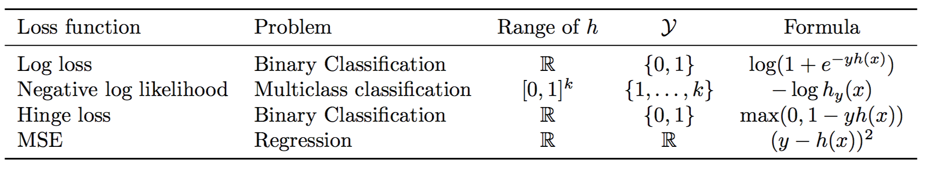
Loss functions and hypothesis classes

Slide 29

Back to images
What should $φ$ be?
Simplest solution: string 2D image intensity values into vector

Slide 30
Linear classifiers on pixels are bad
Solution 1: Better feature vectors
Solution 2: Non-linear classifiers

Slide 31
Better feature vectors
These must have different feature vectors: discriminability
These must have similar feature vectors: invariance

Slide 32
SIFT
Match pattern of edges
  Edge orientation – clue to shape
Be resilient to small deformations
  Deformations might move pixels around, but slightly
  Deformations might change edge orientations, but slightly

Slide 33
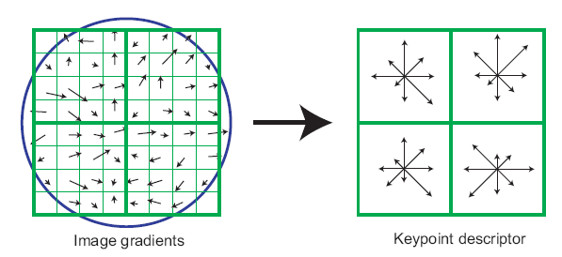
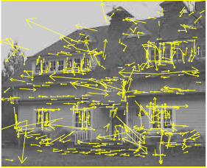
The SIFT descriptor
SIFT – Lowe IJCV 2004
Notes:
Do scale-space invariant feature detection using DoG.

Slide 34
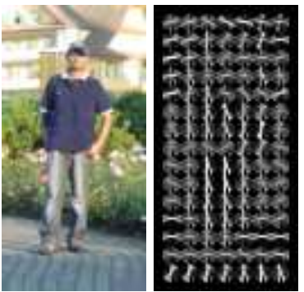
Same but different: HOG
Histogram of oriented gradients
Same as SIFT but without orientation normalization. Why?

Slide 35
Invariance to large deformations

Slide 36
Invariance to large deformations
Large deformations can cause objects / object parts to move a lot (much more than single grid cell)
Yet, object parts themselves have precise appearance
Idea: want to represent the image as a “bag of object parts”

Slide 37
Bags of words
Last night I dreamt I went to Manderley again. It seemed to me I stood by the iron gate leading to the drive, and for a while I could not enter, for the way was barred to me. There was a padlock and a chain upon the gate. I called in my dream to the lodge-keeper, and had no answer, and peering closer through the rusted spokes of the gate I saw that the lodge was uninhabited….
dream
night
drive
locked
gate
lodge
uninhabited

Slide 38
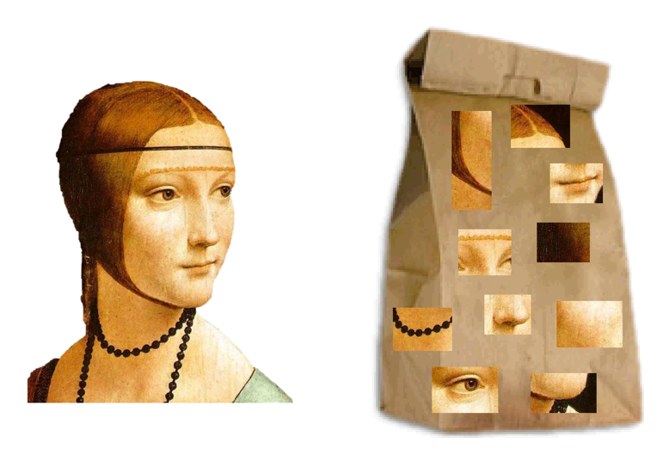
Bags of visual words

Slide 39
What should be visual words?
A word is a sequence of letters that commonly occurs
  cthn is not a word, cotton is
Typically such a sequence of letters means something
Visual words are image patches that frequently occur
How do we get these visual words?

Slide 40
What should be visual words?
“Image patches that occur frequently”
..but obviously under small variations of color and deformations
Each occurrence of image patch is slightly different

Slide 41
What should be visual words?
Consider representing each image patch with SIFT descriptors
Consider plotting them out in feature space

Slide 42
What should be visual words?
Consider plotting SIFT feature vectors and clustering them using k-means

Slide 43
What should be visual words?
Given a new patch, we can assign each patch to the closest center

Slide 44
Identifying the words in an image
Given a new patch, we can assign each patch to the closest center

Slide 45
Identifying the words in an image
Given an image, take every patch and assign it to the closest k-means center
  Each k-means center is a “word”
34
14
23
23

Slide 46
Identifying the words in an image
Given an image, take every patch and assign it to the closest k-means center
  Each k-means center is a “word”
34 | 14 | 23 | 23 | 34
34 | 19 | 7 | 8 | 34
34 | 56 | 7 | 24 | 56
45 | 13 | 98 | 45 | 38
7 | 7 | 34 | 77 | 29

Slide 47
Encoding images as bag of words
Densely extract image patches from image
Compute SIFT vector for each patch
Assign each patch to a visual word
Compute histogram of occurrence

Slide 48
Too much invariance?
Object parts appear in somewhat fixed relationships

Slide 49
Idea: Spatial pyramids
Divide the image into four parts
Compute separate histogram in each part
Concatenate into a single feature vector

Slide 50
Linear classifiers on pixels are bad
Solution 1: Better feature vectors
Solution 2: Non-linear classifiers

Slide 51
Non-linear classifiers
Suppose we have a feature vector for every image

Slide 52
Non-linear classifiers
Suppose we have a feature vector for every image
  Linear classifier

Slide 53
Non-linear classifiers
Suppose we have a feature vector for every image
  Linear classifier
  Nearest neighbor: assign each point the label of the nearest neighbor

Slide 54
Non-linear classifiers
Suppose we have a feature vector for every image
  Linear classifier
  Nearest neighbor: assign each point the label of the nearest neighbor
  Decision tree: series of if-then-else statements on different features

Slide 55
Non-linear classifiers
Suppose we have a feature vector for every image
  Linear classifier
  Nearest neighbor: assign each point the label of the nearest neighbor
  Decision tree: series of if-then-else statements on different features
  Neural networks

