Slide 1
Photometric stereo

Slide 2
Multiple pixels: matrix form
#pixels
3
#pixels
I
L^{T}
G
3
=
#lights
#lights

Slide 3
Unknown Lighting
What we’ve seen so far: [Woodham 1980]
Next up: Unknown light directions [Hayakawa 1994]
3

Slide 4
Unknown Lighting
Surface normals
Light directions
Diffuse albedo
Light intensity
4

Slide 5
Unknown Lighting
Surface normals, scaled by albedo
Light directions, scaled by intensity
5

Slide 6
Unknown Lighting
p = # pixels
G
n = # images
I
=
L^{T}
6

Slide 7
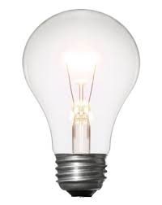
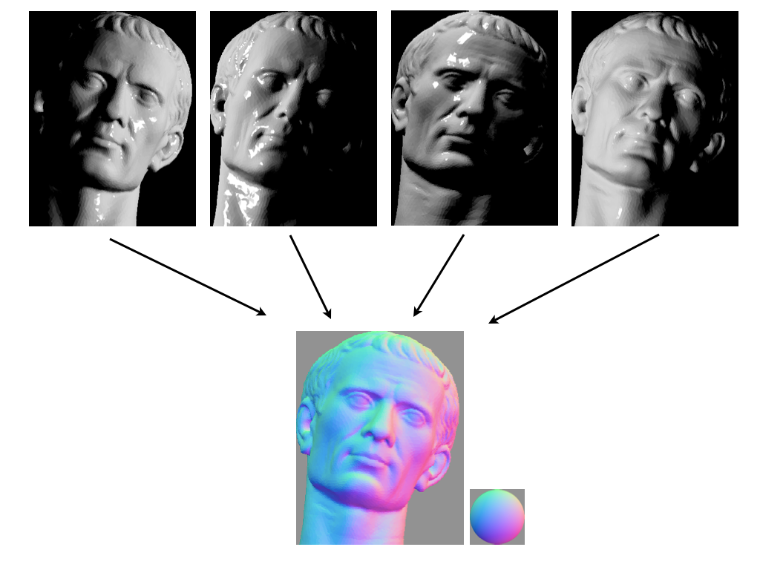
Unknown Lighting
Measurements
(one image per row)
Light directions
(scaled by intensity)
Surface normals
(scaled by albedo)
*
=
G
I
L^{T}
Both L and G are now unknown!
This is a matrix factorization problem.
7

Slide 8


Unknown Lighting
*
=
G
(3 x p)
I
(n x p)
L
(n x 3)
There’s hope: We know that I is rank 3

Slide 9
Unknown Lighting
Use the SVD to decompose I:
V
I
=
U
SVD gives the best rank-3 approximation of a matrix.

Slide 10
Unknown Lighting
Use the SVD to decompose I:
V
I
=
U
SVD gives the best rank-3 approximation of a matrix.
What do we do with $Σ$?

Slide 11

Unknown Lighting
Use the SVD to decompose I:
V
I
=
U
Can we just do that?

Slide 12

Unknown Lighting
Use the SVD to decompose I:
V
I
=
U
…almost.
Can we just do that?
The decomposition is unique up to an invertible 3x3 A.

Slide 13

Unknown Lighting
Use the SVD to decompose I:
V
I
=
U
…almost.
$$L=U\sqrt{Σ}A, G=A^{−1}\sqrt{Σ}V$$
Can we just do that?
The decomposition is unique up to an invertible 3x3 A.

Slide 14
Unknown Lighting
Use the SVD to decompose I:
V
I
=
U
$$L=U\sqrt{Σ}A, G=A^{−1}\sqrt{Σ}V$$
You can find A if you know
6 points with the same reflectance, or
6 lights with the same intensity.

Slide 15
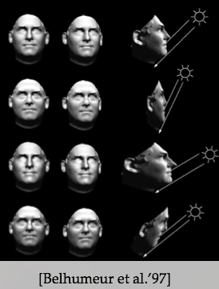
Unknown Lighting: Ambiguities
Multiple combinations of lighting and geometry can produce the same sets of images.
Add assumptions or prior knowledge about geometry or lighting, etc. to limit the ambiguity.

Slide 16
Recognition

Slide 17
Image classification
Given an image, produce a label
Label can be:
0/1 or yes/no: Binary classification
one-of-k: Multiclass classification
0/1 for each of k concepts: Multilabel classification

Slide 18
Image classification - Binary classification
Is this a dog? Yes

Slide 19
Image classification - Multiclass classification
Which of these is it: dog, cat or zebra?
Dog

Slide 20
Image classification - Multilabel classification
Is this a dog? Yes
Is this furry? Yes
Is this sitting down? Yes

Slide 21
A history of classification : MNIST
2D
10 classes
6000 examples per class
1990’s

Slide 22

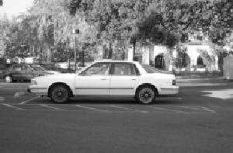
A history of classification : Caltech 101
101 classes
10 classes
30 examples per class
Strong category-specific biases
Clean images
MNIST
1990’s
2004

Slide 23
A history of classification: PASCAL VOC
20 classes
~500 examples per class
Clutter, occlusion, natural scenes
MNIST
Caltech 101
1990’s
2004
2007-2012

Slide 24
A history of classification: ImageNet
1000 classes
~1000 examples per class
Mix of cluttered and clean images
MNIST
Caltech 101
PASCAL VOC
1990’s
2004
2007-2013
2013-2017

Slide 25
Why is recognition hard?
Pose variation

Slide 26
Why is recognition hard?
Lighting variation

Slide 27
Why is recognition hard?
Scale variation

Slide 28
Why is recognition hard?
Clutter and occlusion

Slide 29
Why is recognition hard?
Intrinsic intra-class variation

Slide 30
Why is recognition hard?
Inter-class similarity

Slide 31
The language of recognition
Boundaries of classes are often fuzzy
“A dog is an animal with four legs, a tail and a snout”
Really?

Slide 32
The language of recognition
“… Practically anything can happen in an image and furthermore practically everything did” - Marr
Much better to talk in terms of probabilities
Joint distribution of images and labels : P(x,y)
Conditional distribution of labels given image : P(y|x)

Slide 33
Learning
We are interested in the conditional distribution
Key idea: teach computer visual concepts by providing examples
Training Set

Slide 34
Example
Binary classifier “Dog” or ”not Dog”
Labels: {0, 1}
Training set
{(
, 1),
(
, 1),
, 0) , … }
(

Slide 35
Choosing a model class
Will try and find P(y = 1 | x)
P(y=0 | x) = 1 - P(y=1 | x)
Need to find
But: enormous number of possible mappings

Slide 36
Choosing a model class
Assume h is a linear classifier in feature space
Feature space?
Linear classifier?

Slide 37
Feature space: representing images as vectors
Represent an image as a vector in
Simple way: step 1: convert image to gray-scale and resize to fixed size

Slide 38

Feature space: representing images as vectors
Step 2: Flatten 2D array into 1D vector

Slide 39
Feature space: representing images as vectors
Can represent this as a function that takes an image and converts into a vector
(
) =

Slide 40
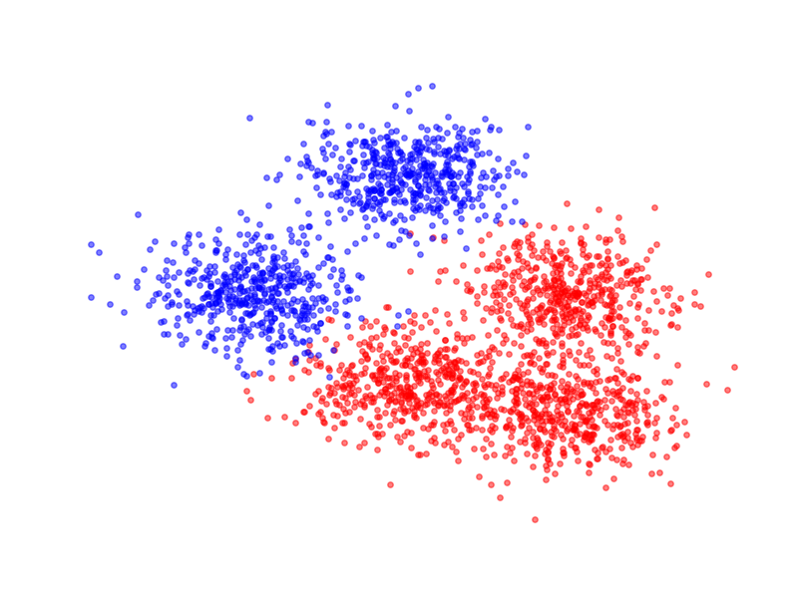

Linear classifiers
Given an image, can use $φ$ to get a vector and plot it as a point in high dimensional space

Slide 41
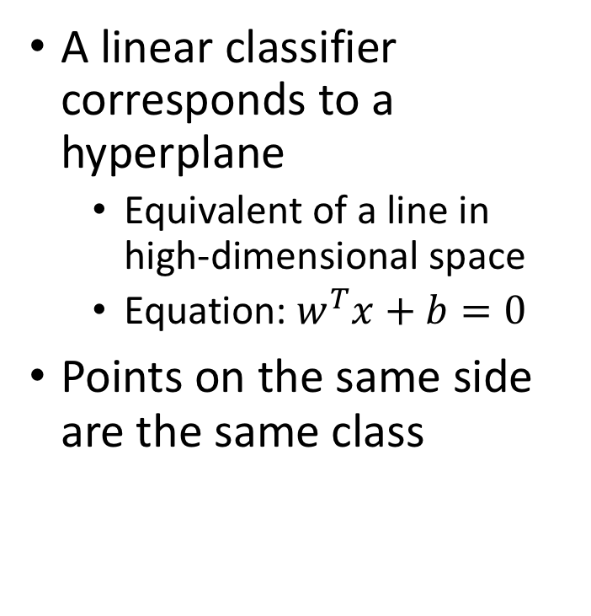
Linear classifiers
A linear classifier corresponds to a hyperplane
Equivalent of a line in high-dimensional space
Equation: $w^{T}x+b=0$
Points on the same side are the same class

Slide 42
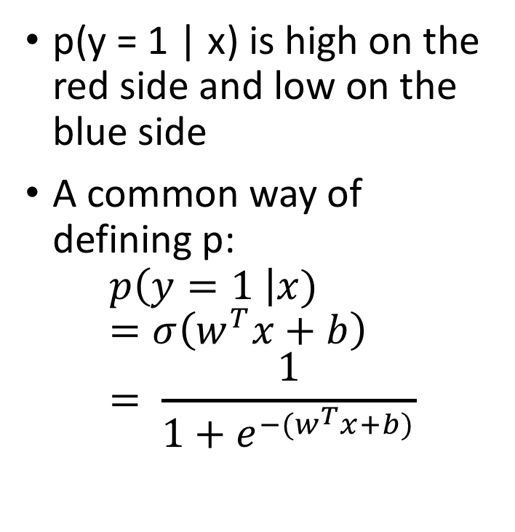
Linear classifiers
p(y = 1 | x) is high on the red side and low on the blue side
A common way of defining p:
$$p\left(y=1 \right|x)=σ\left(w^{T}x+b\right) \\ = \frac{1}{1+e^{−(w^{T}x+b)}}$$
sigmoid function

Slide 43
Linear classifiers in feature space

Slide 44
Linear classifiers in feature space
Family of functions depending on w and b
Each function is called a hypothesis
Family is called a hypothesis class
Hypotheses indexed by w and b
Need to find the best hypothesis = need to find best w and b
w and b are called parameters

Slide 45

Training: Choosing the best hypothesis
Use training set to find best-fitting hypothesis
$$S=\{\left(x_{i},y_{i}\right):i=1, …, n\}$$
Question: how do we define fit?

Slide 46
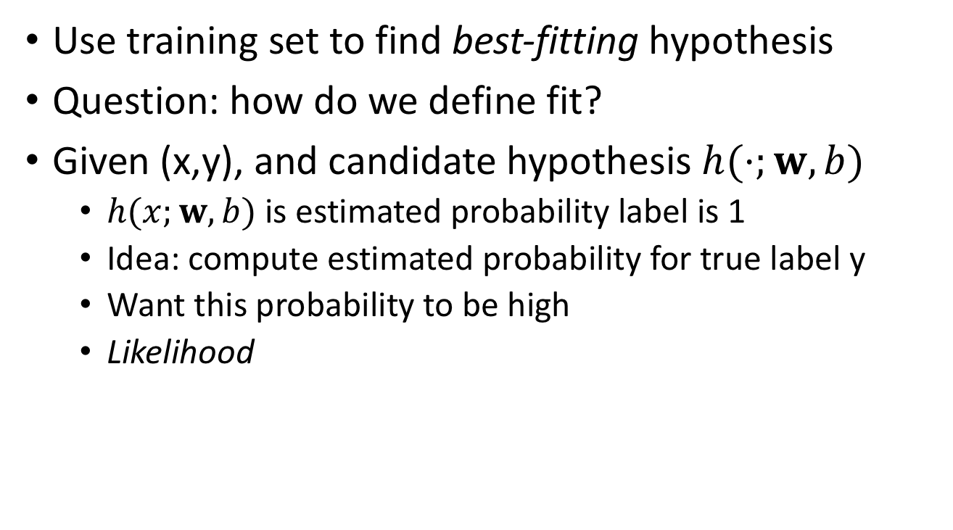
Training: Choosing the best hypothesis
Use training set to find best-fitting hypothesis
Question: how do we define fit?
Given (x,y), and candidate hypothesis $h(⋅;w,b)$
$h(x;w,b)$ is estimated probability label is 1
Idea: compute estimated probability for true label y
Want this probability to be high
Likelihood

Slide 47
An alternate expression for the hypothesis

Slide 48
An alternate expression for the hypothesis

Slide 49
Training: Choosing the best hypothesis
Likelihood of a single data point
Fit = total likelihood of entire training dataset

Slide 50
Training: Choosing the best hypothesis
Use log likelihood
Pick the hypothesis that maximizes log likelihood
Each hypothesis corresponds to a setting of w and b
Maximization problem

Slide 51
Training: Choosing the best hypothesis
Maximizing log likelihood = Minimizing negative log likelihood

Slide 52
Training: Choosing the best hypothesis
Negative log likelihood is a loss function
Training = minimizing total loss on a training set

Slide 53
General recipe
Fix hypothesis class
Define loss function
Minimize total loss on the training set
Why should this work?
How do we do the minimization in practice

