Slide 1
Photometric stereo

Slide 2
Multiple Images: Photometric Stereo
N
L₃
L₂
L₁
V

Slide 3
Photometric stereo

Slide 4
Multiple pixels: matrix form
#pixels
3
#pixels
I
L^{T}
G
3
=
#lights
#lights

Slide 5
Normal equations
Take derivative with respect to G and set to 0

Slide 6
Estimating depth from normals
So we got surface normals, can we get depth?
Yes, given boundary conditions
Normals provide information about the derivative

Slide 7
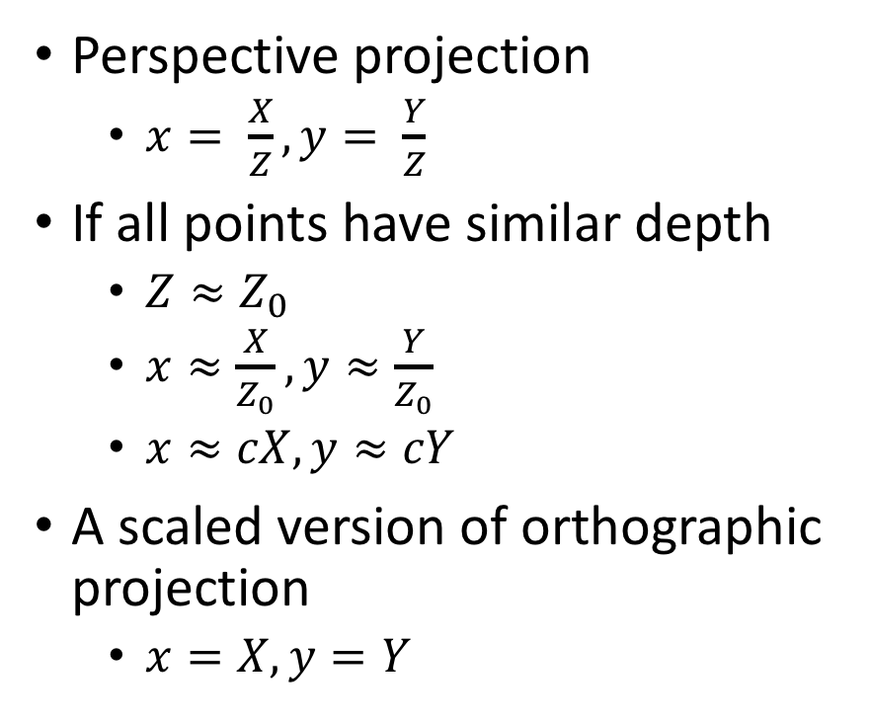
Brief detour: Orthographic projection
Perspective projection
  $x= \frac{X}{Z}, y= \frac{Y}{Z}$
If all points have similar depth
  $Z≈Z_{0}$
  $x≈\frac{X}{Z_{0}}, y≈\frac{Y}{Z_{0}}$
  $x≈cX, y≈cY$
A scaled version of orthographic projection
  $x=X, y=Y$
Perspective
Scaled orthographic

Slide 8



Depth Map from Normal Map
We now have a surface normal, but how do we get depth?
Assume a smooth surface
V₂
V₁
N
Get a similar equation for V₂
  Each normal gives us two linear constraints on z
  compute z values by solving a matrix equation
8

Slide 9
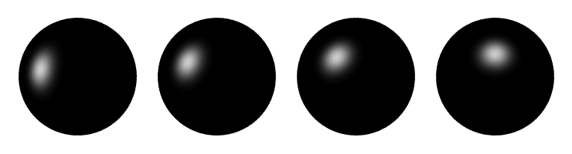
Determining Light Directions
Trick: Place a mirror ball in the scene.
The location of the highlight is determined by the light source direction.
9

Slide 10
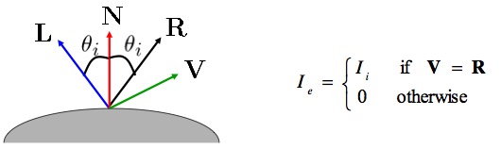
Determining Light Directions
For a perfect mirror, the light is reflected across N:
10

Slide 11

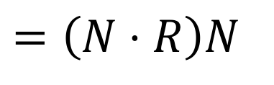

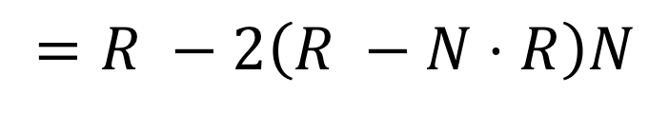
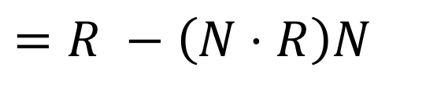
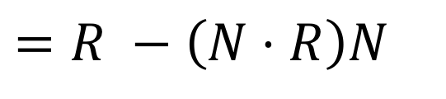
Determining Light Directions
N
$$=\left(N⋅R\right)N$$
L
||
||
R
$$=R −\left(N⋅R\right)N$$
$$=R −\left(N⋅R\right)N$$
= - 2
$$=R −2\left(R −N⋅R\right)N$$
$$=2\left(N⋅R\right)N −R$$
So the light source direction
is given by:
11

Slide 12


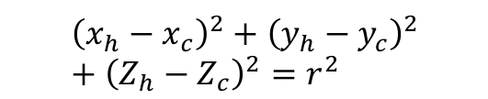




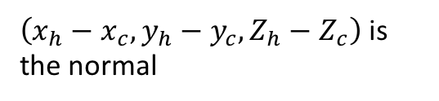
Determining Light Directions
Assume orthographic projection
Viewing direction R = [0,0,-1]
Normal?
$Z_{h}$ and $Z_{c}$ are unknown, but:
$${\left(x_{h}−x_{c}\right)}^{2}+{\left(y_{h}−y_{c}\right)}^{2}+{\left(Z_{h}−Z_{c}\right)}^{2}=r^{2}$$
$$(x_{h},y_{h}, Z_{h})$$
$$(x_{h},y_{h})$$
$\left(Z_{h}−Z_{c}\right)$ can be computed
$$(x_{c},y_{c}, Z_{c})$$
$\left(x_{h}−x_{c}, y_{h}−y_{c}, Z_{h}−Z_{c}\right)$ is the normal
$$(x_{c},y_{c})$$
Z=1

Slide 13
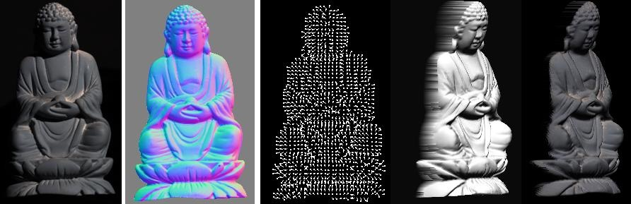
Photometric Stereo
What results can you get?
Input
(1 of 12)
Normals (RGB colormap)
Normals (vectors)
Shaded 3D
rendering
Textured 3D
rendering

Slide 14
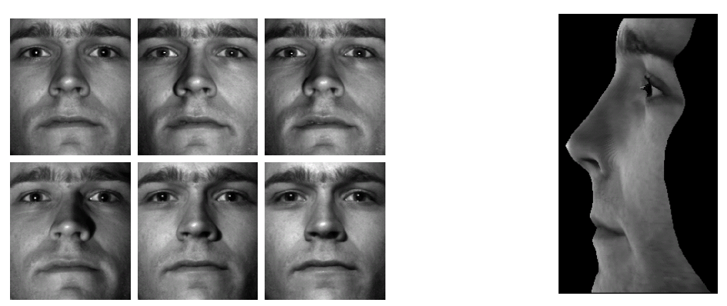
Results
from Athos Georghiades
14

Slide 15
Results
Input
(1 of 12)
Normals (RGB colormap)
Normals (vectors)
Shaded 3D
rendering
Textured 3D
rendering

Slide 16
Photometric stereo
How many lights / images do you need?
Are there any constraints on where to put the lights?

Slide 17
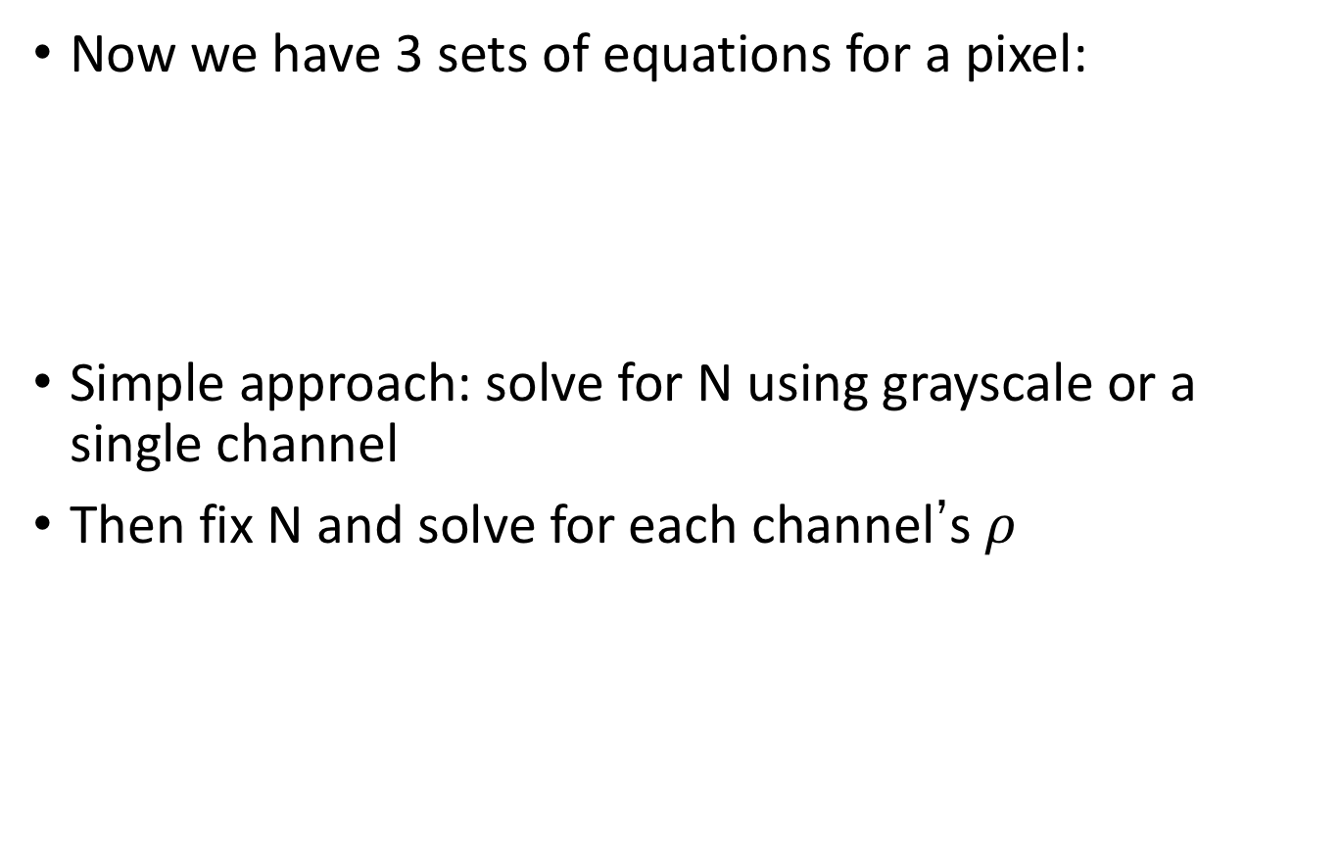
Color Images
Now we have 3 sets of equations for a pixel:
Simple approach: solve for N using grayscale or a single channel
Then fix N and solve for each channel’s $ρ$
Red values from all images
Green values for all pixels
Blue values from all images

Slide 18

Color Images
Then fix N and solve for each channel’s $ρ$ :
Want to minimize $Q(ρ)$
  Take derivative and set to 0

Slide 19
Question
How many color images do you need?
How many color images do you need if the object was grayscale?

Slide 20
Questions?

Slide 21
Unknown Lighting
What we’ve seen so far: [Woodham 1980]
Next up: Unknown light directions [Hayakawa 1994]
21

Slide 22
Unknown Lighting
Surface normals
Light directions
Diffuse albedo
Light intensity
22

Slide 23
Unknown Lighting
Surface normals, scaled by albedo
Light directions, scaled by intensity
23

Slide 24
Unknown Lighting
p = # pixels
G
n = # images
I
=
L^{T}
24

Slide 25
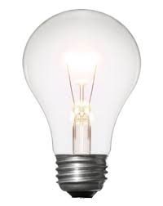
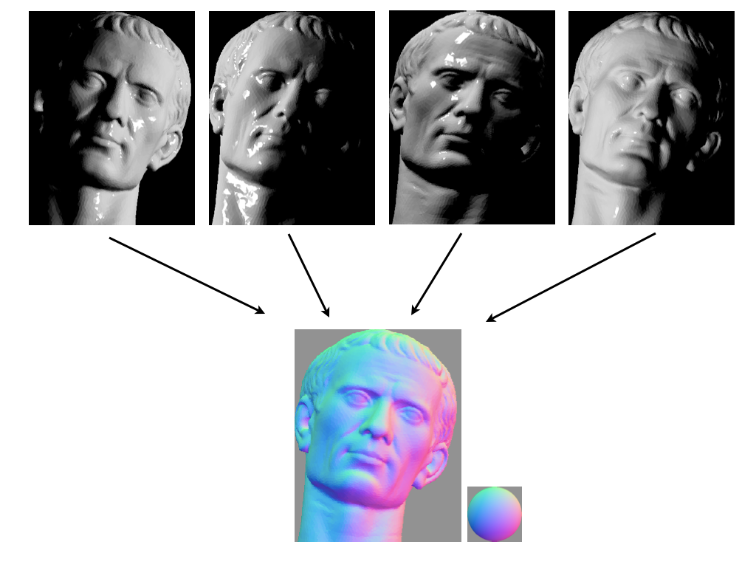
Unknown Lighting
Measurements
(one image per row)
Light directions
(scaled by intensity)
Surface normals
(scaled by albedo)
*
=
G
I
L^{T}
Both L and G are now unknown!
This is a matrix factorization problem.
25

Slide 26


Unknown Lighting
*
=
G
(3 x p)
I
(n x p)
L
(n x 3)
There’s hope: We know that I is rank 3

Slide 27
Unknown Lighting
Use the SVD to decompose I:
V
I
=
U
SVD gives the best rank-3 approximation of a matrix.

Slide 28
Unknown Lighting
Use the SVD to decompose I:
V
I
=
U
SVD gives the best rank-3 approximation of a matrix.
What do we do with $Σ$?

Slide 29

Unknown Lighting
Use the SVD to decompose I:
V
I
=
U
Can we just do that?

Slide 30

Unknown Lighting
Use the SVD to decompose I:
V
I
=
U
…almost.
Can we just do that?
The decomposition is unique up to an invertible 3x3 A.

Slide 31

Unknown Lighting
Use the SVD to decompose I:
V
I
=
U
…almost.
$$L=U\sqrt{Σ}A, G=A^{−1}\sqrt{Σ}V$$
Can we just do that?
The decomposition is unique up to an invertible 3x3 A.

Slide 32
Unknown Lighting
Use the SVD to decompose I:
V
I
=
U
$$L=U\sqrt{Σ}A, G=A^{−1}\sqrt{Σ}V$$
You can find A if you know
6 points with the same reflectance, or
6 lights with the same intensity.

Slide 33
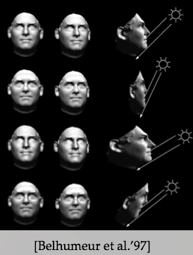
Unknown Lighting: Ambiguities
Multiple combinations of lighting and geometry can produce the same sets of images.
Add assumptions or prior knowledge about geometry or lighting, etc. to limit the ambiguity.

Slide 34
Photometric stereo
How do we deal with non-lambertian surfaces?
How do we make sure we know the lighting directions?
How can we effectively use color?

Slide 35
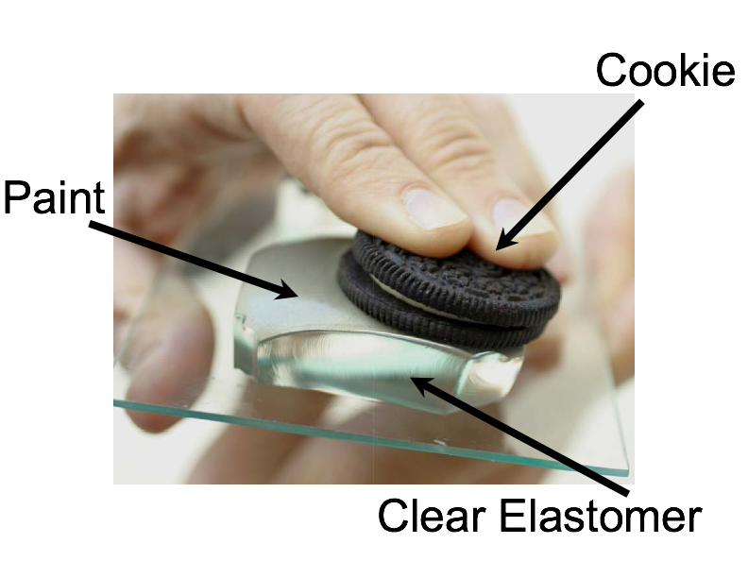
Johnson and Adelson, 2009

Slide 36
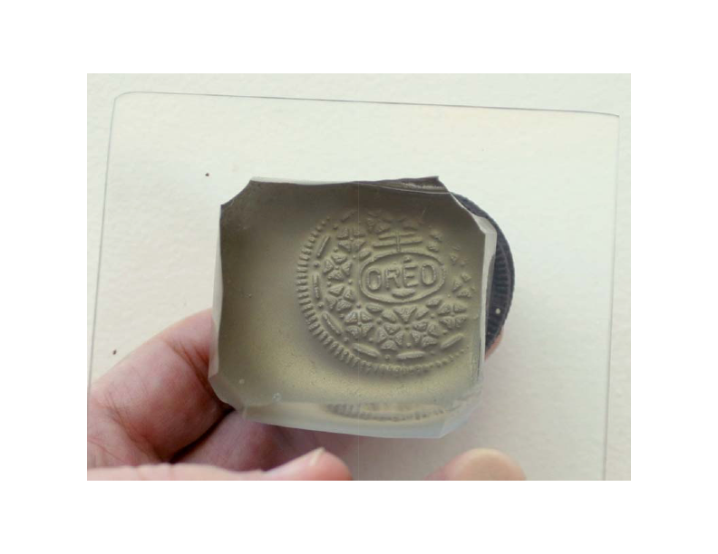

Slide 37
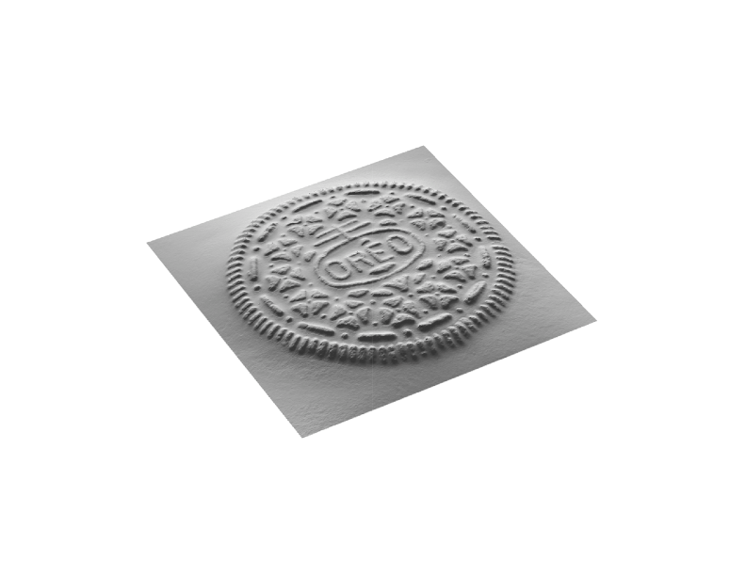

Slide 38
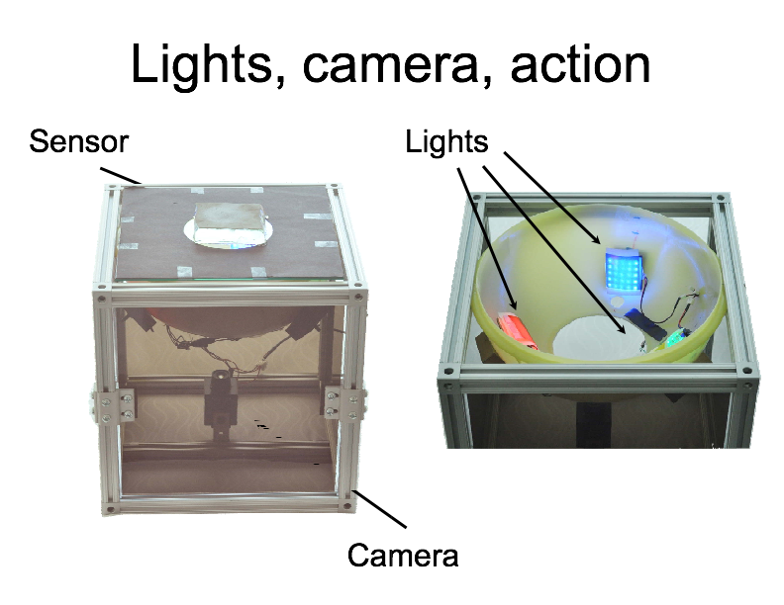

Slide 39
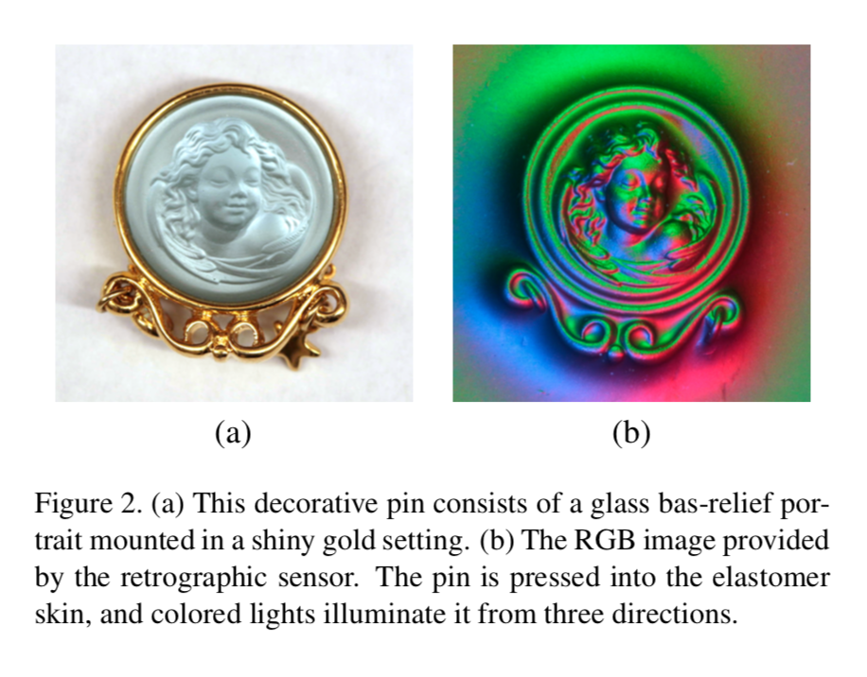

Slide 40
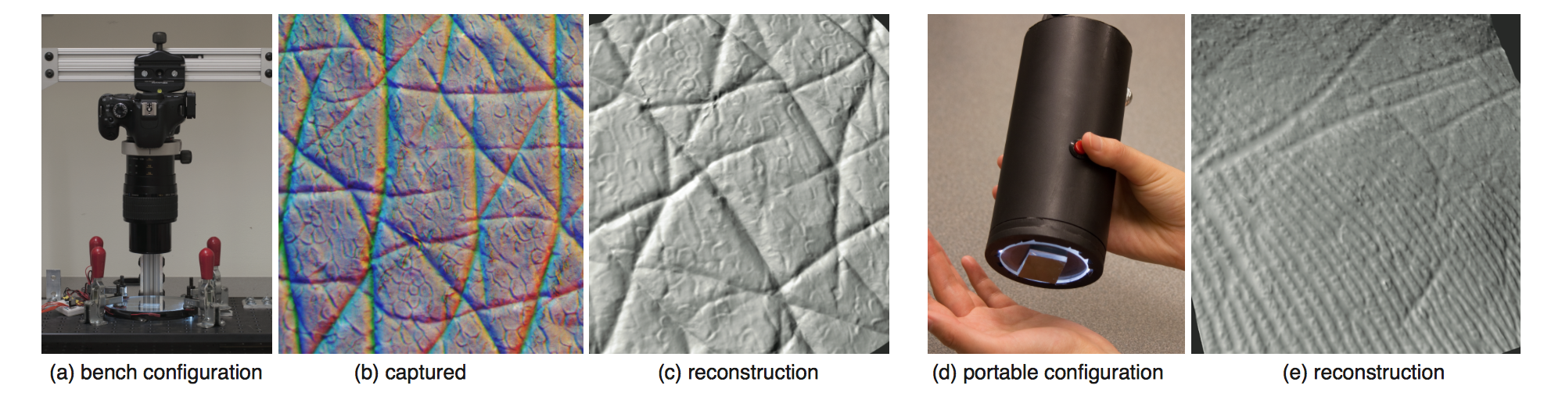
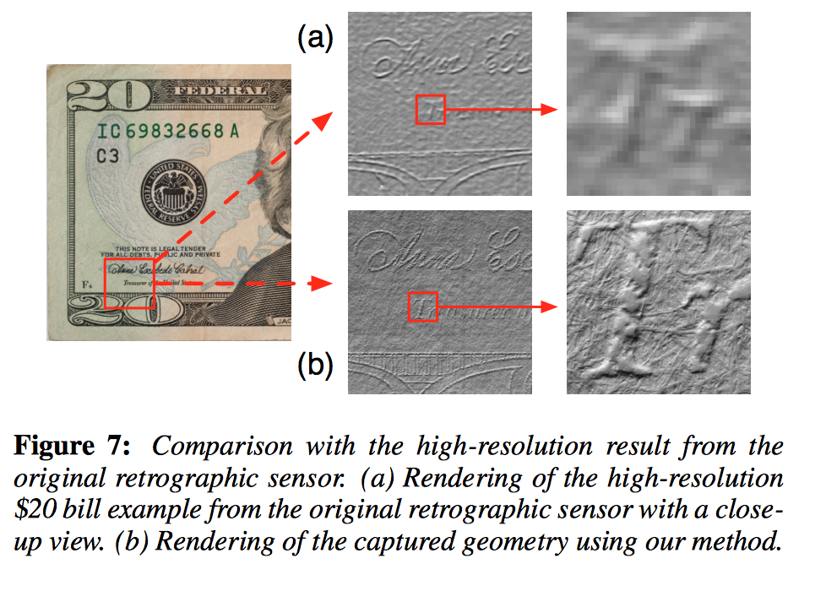

Slide 41
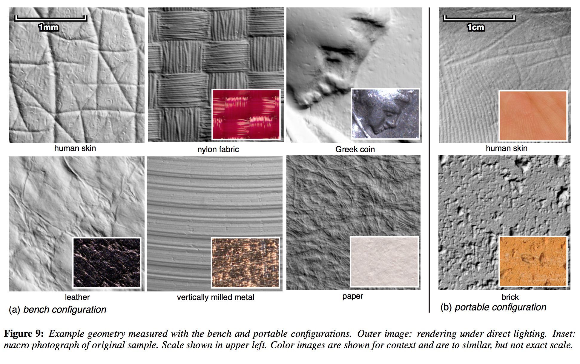

Slide 42
Summary of reconstruction
Given multiple cameras, correspondence, cameras
  Triangulation
  Set up linear equations of the form Ax = 0
  Correspondence must satisfy epipolar constraint
Stereo is easy for rectified stereo cameras
  Only disparities along a row
  Disparity direct measure of depth
Photometric stereo: use different light sources
  Gives you normals and albedo

