Slide 1
Epipolar geometry continued

Slide 2
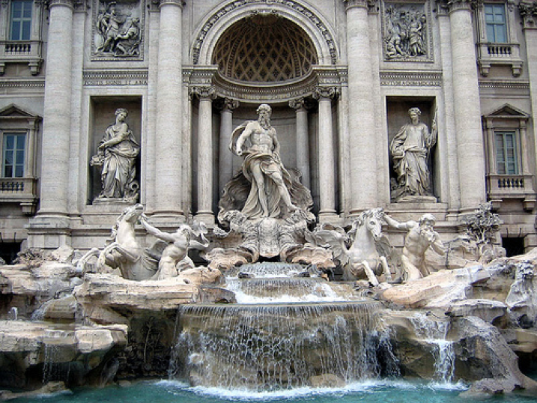
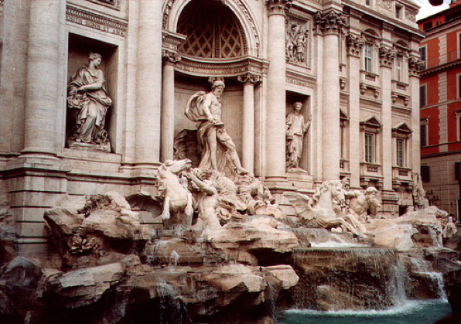
Epipolar lines

Slide 3
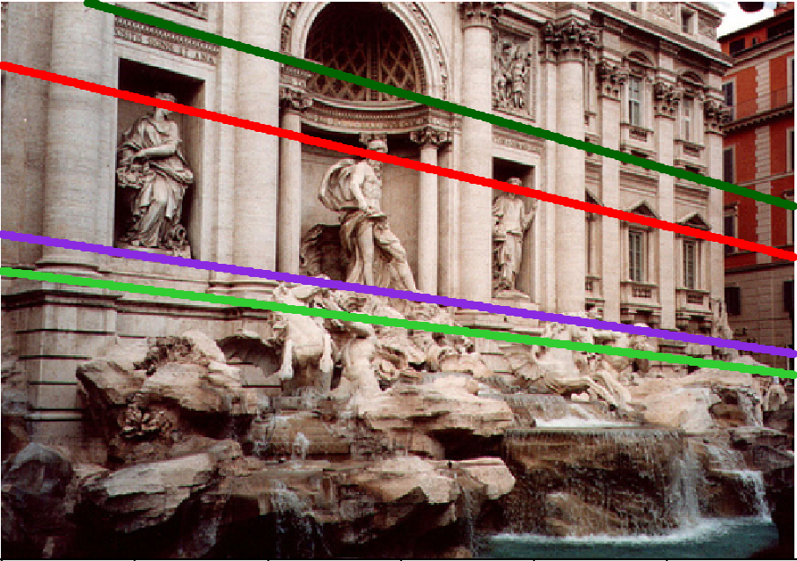
Epipolar lines

Slide 4
Epipolar lines
Epipole

Slide 5
Nomenclature
X
l/
right epipolar line
left epipolar line
x
/
x
e
e
/
C
C
/
The epipolar line l/ is the image of the ray through x
The epipole e is the point of intersection of the line joining the camera centres with the image plane
this line is the baseline for a stereo rig, and
the translation vector for a moving camera
The epipole is the image of the centre of the other camera: e = PC/ , e/ = P/C

Slide 6
Epipolar geometry - the math
Assume intrinsic parameters K are identity
Assume world coordinate system is centered at 1st camera pinhole with Z along viewing direction

Slide 7
Epipolar geometry - the math
Assume intrinsic parameters K are identity
Assume world coordinate system is centered at 1st camera pinhole with Z along viewing direction

Slide 8
Epipolar geometry - the math
Assume intrinsic parameters K are identity
Assume world coordinate system is centered at 1st camera pinhole with Z along viewing direction

Slide 9
Epipolar geometry - the math
Assume intrinsic parameters K are identity
Assume world coordinate system is centered at 1st camera pinhole with Z along viewing direction

Slide 10
Epipolar geometry - the math
Assume intrinsic parameters K are identity
Assume world coordinate system is centered at 1st camera pinhole with Z along viewing direction

Slide 11
Epipolar geometry - the math
0
0

Slide 12
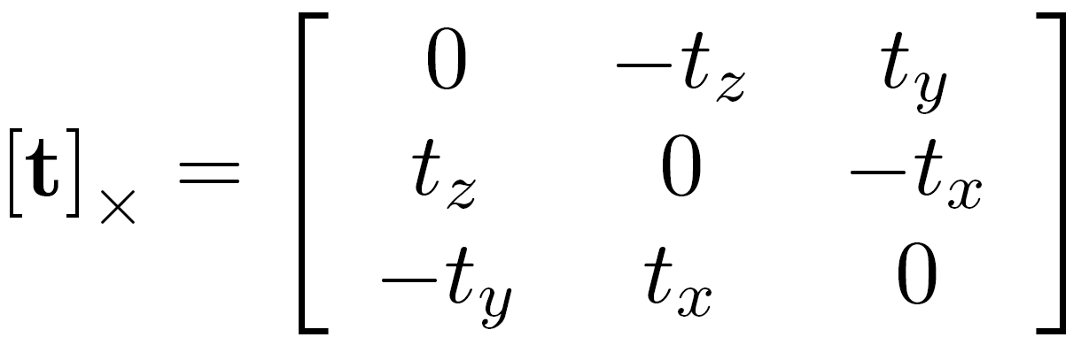
Epipolar geometry - the math
Can we write this as matrix vector operations?
Cross product can be written as a matrix

Slide 13
Epipolar geometry - the math
Can we write this as matrix vector operations?
Dot product can be written as a vector-vector times

Slide 14
Epipolar geometry - the math
Can we write this as matrix vector operations?
Dot product can be written as a vector-vector times

Slide 15
Epipolar geometry - the math

Slide 16
Epipolar geometry - the math
Homogenous coordinates of point in image 2
Homogenous coordinates of point in image 1
Essential matrix

Slide 17
Epipolar constraint and epipolar lines
Consider a known, fixed pixel in the first image
What constraint does this place on the corresponding pixel?
where
What kind of equation is this?

Slide 18
Epipolar constraint and epipolar lines
Consider a known, fixed pixel in the first image
where
Line!

Slide 19
Epipolar constraint: putting it all together
If p is a pixel in first image and q is the corresponding pixel in the second image, then: q^{T}Ep = 0
E = [t]_{X}R
For fixed p, q must satisfy: q^{T}l = 0, where l = Ep
For fixed q, p must satisfy: l^{T}p = 0 where l^{T} = q^{T}E, or l = E^{t}q
These are epipolar lines!
Epipolar line in 2nd image
Epipolar line in 1st image

Slide 20
Essential matrix and epipoles
E = [t]_{X}R
Ep is an epipolar line in 2nd image
All epipolar lines in second image pass through c₂
c₂ is epipole in 2nd image

Slide 21
Essential matrix and epipoles
E = [t]_{X}R
E^{T}q is an epipolar line in 1st image
All epipolar lines in first image pass through c₁
c₁ is the epipole in 1st image

Slide 22
Essential matrix
Assume intrinsic parameters (K) are identity
For corresponding pixels p and q
q^{T}Ep = 0
E = [t]_{X} R
Given pixel p in first image Ep is corresponding epipolar line in the second image
Given pixel q in second image, E^{T}q is corresponding epipolar line in first image

Slide 23
Epipolar geometry - the math
We assumed that intrinsic parameters K are identity
What if they are not?

Slide 24
Fundamental matrix

Slide 25
Fundamental matrix

Slide 26
Fundamental matrix

Slide 27
Fundamental matrix

Slide 28
Fundamental matrix
Fundamental matrix

Slide 29
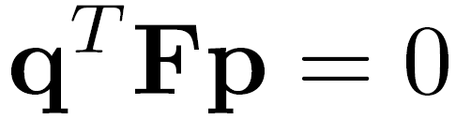

Fundamental matrix result

Slide 30


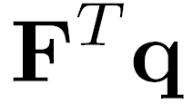




Properties of the Fundamental Matrix
is the epipolar line associated with
is the epipolar line associated with
T
0
Notes:
5 parameters

Slide 31
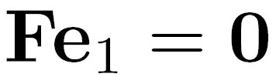
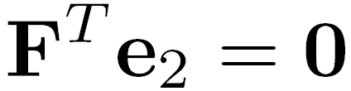
Properties of the Fundamental Matrix
is the epipolar line associated with
is the epipolar line associated with
and
All epipolar lines contain epipole
T
0
Notes:
5 parameters

Slide 32

Properties of the Fundamental Matrix
is the epipolar line associated with
is the epipolar line associated with
and
is rank 2
T
0
Notes:
Prove that F is rank 2. F

Slide 33
Why is F rank 2?
F is a 3 x 3 matrix
But there is a vector c₁ and c₂ such that Fc₁ = 0 and F^{T}c₂ = 0

Slide 34
Fundamental matrix song

Slide 35


Estimating F
If we don’t know K₁, K₂, R, or t, can we estimate F for two images?
Yes, given enough correspondences

Slide 36
Estimating F – 8-point algorithm
The fundamental matrix F is defined by
for any pair of matches x and x’ in two images.
Let x=(u,v,1)^{T} and x’=(u’,v’,1)^{T},
each match gives a linear equation

Slide 37
8-point algorithm
In reality, instead of solving , we seek f to minimize , least eigenvector of .

Slide 38
8-point algorithm – Problem?
F should have rank 2
To enforce that F is of rank 2, F is replaced by F’ that minimizes subject to the rank constraint.
This is achieved by SVD. Let , where
, let
then is the solution.
Notes:
The problem is that the resulting often is ill-conditioned. In theory, should have one singular value equal to zero and the rest are non-zero. In practice, however, some of the non-zero singular values can become small relative to the larger ones. If more than eight corresponding points are used to construct , where the coordinates are only approximately correct, there may not be a well-defined singular value which can be identified as approximately zero. Consequently, the solution of the homogeneous linear system of equations may not be sufficiently accurate to be useful.

Slide 39
Recovering camera parameters from F / E
Can we recover R and t between the cameras from F?
No: K₁ and K₂ are in principle arbitrary matrices
What if we knew K₁ and K₂ to be identity?

Slide 40
Recovering camera parameters from E
t is a solution to E^{T}x = 0
Can’t distinguish between t and ct for constant scalar c
How do we recover R?

Slide 41
Recovering camera parameters from E
We know E and t
Consider taking SVD of E and [t]_{X}

Slide 42
Recovering camera parameters from E
t is a solution to E^{T}x = 0
Can’t distinguish between t and ct for constant scalar c

Slide 43
8-point algorithm
Pros: it is linear, easy to implement and fast
Cons: susceptible to noise
Degenerate: if points are on same plane
Normalized 8-point algorithm: Hartley
Position origin at centroid of image points
Rescale coordinates so that center to farthest point is sqrt (2)

Slide 44
Other approaches to obtaining 3D structure

Slide 45

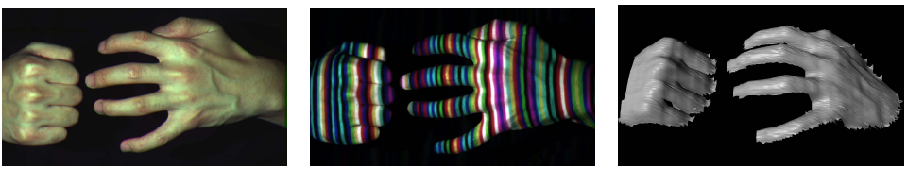
Active stereo with structured light
Project “structured” light patterns onto the object
simplifies the correspondence problem
Allows us to use only one camera
camera
projector
L. Zhang, B. Curless, and S. M. Seitz. Rapid Shape Acquisition Using Color Structured Light and Multi-pass Dynamic Programming. 3DPVT 2002

Slide 46
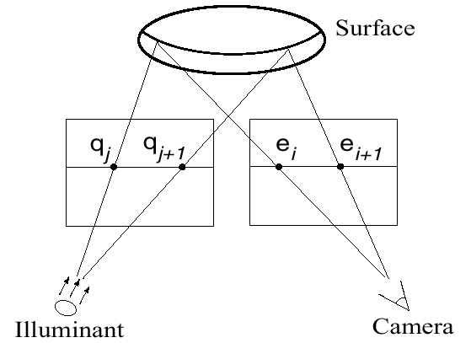
Active stereo with structured light
L. Zhang, B. Curless, and S. M. Seitz. Rapid Shape Acquisition Using Color Structured Light and Multi-pass Dynamic Programming. 3DPVT 2002

Slide 47
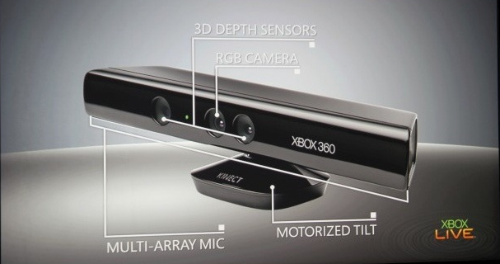
Microsoft Kinect

